Slide 1
ATF2 post-IP Diamond Sensor Status
Philip Bambade
Laboratoire de l’Accélérateur Linéaire
Université Paris 11, Orsay, France
on behalf of: Frédéric Bogard, Patrick Cornebise, Angeles Faus-
Golfe, Nuria Fuster-Martinez¹, Hayg Guler, Viacheslav
Kubytskyi, Shan Liu², Renjun Yang
¹ IFIC, Valencia
² PhD completed July 2015, now at DESY/XFEL
19th ATF2 project meeting LAL-Orsay 13-15 January 2016

Slide 2
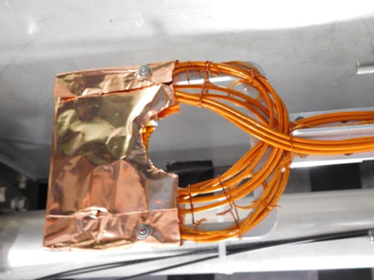
Horizontal and vertical diamond scanners 1.5 m after BDUMP magnet. Installed + commissioned in Nov-Dec 2014 and May-June 2015, respectively.

Slide 3
In vacuum diamond sensor scanner for beam halo measurements in the beam line at the KEK Accelerator Test Facility, by S. Liu et al.: arXiv:1512.08024
➔ submitted to NIMA (December 2015)

Slide 4
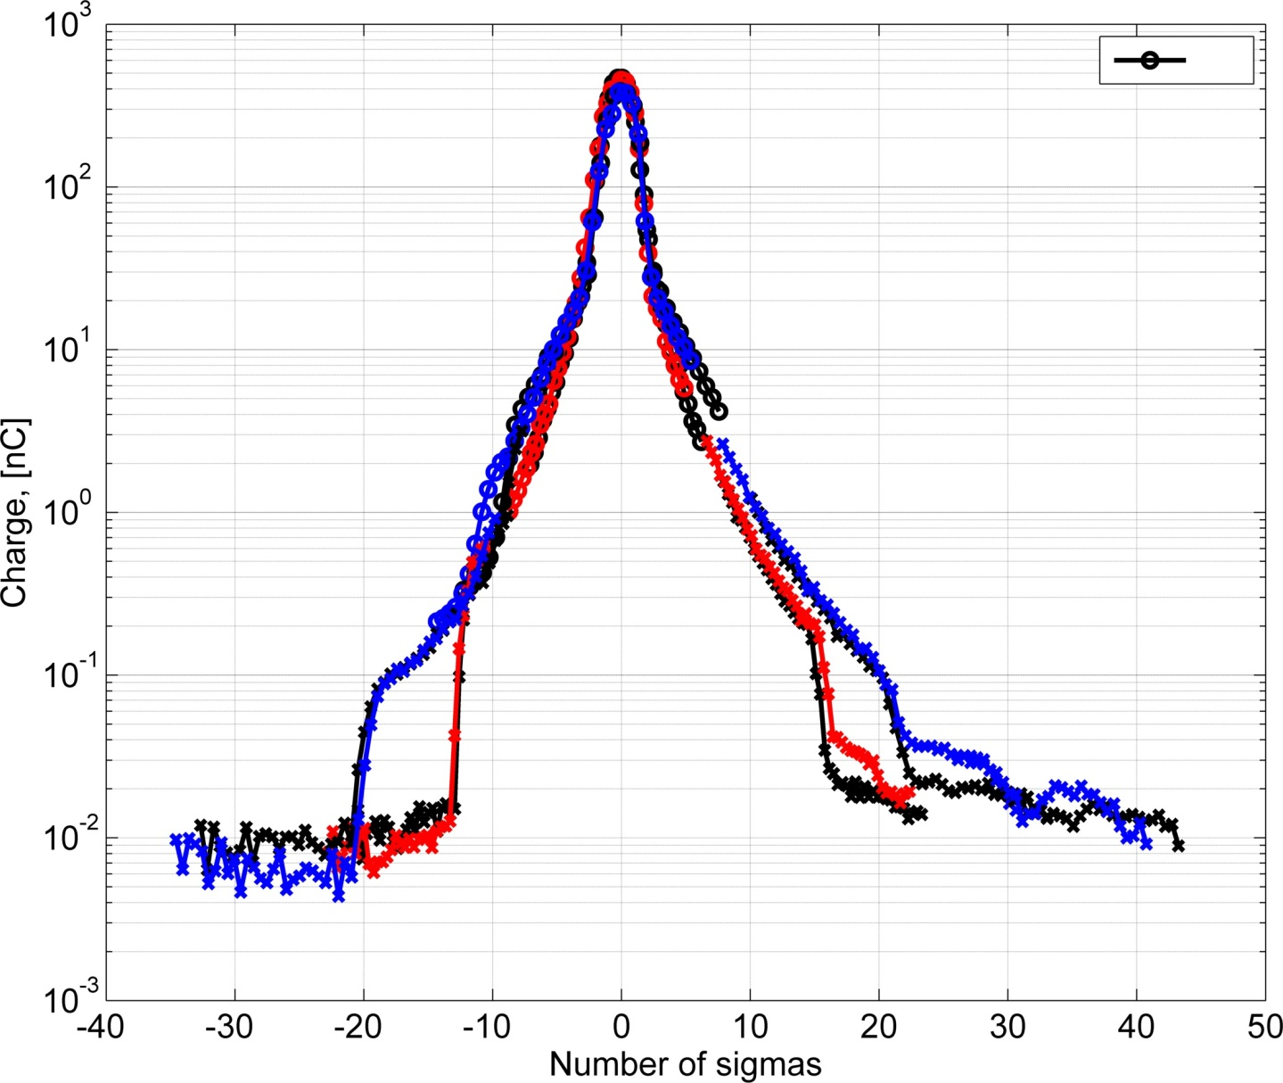
Vertical Beam halo scan. N ≈ 8e9
Red: 10x1 optics, σ= 1.46 mm
Blue: 10x4 optics, σ=0.98 mm
Determined the cut by the BDUMP aperture.

Slide 5
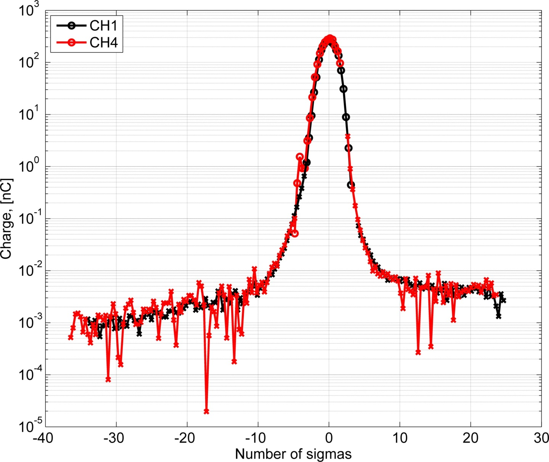
Horizontal scan. N = 2e9; Vacuum =7.87e-7
Beam core scan, beam steering, vertical alignment.
Complete scan of beam core and beam halo:
Sigmas from channels 1-4 → 1.4396 1.3652 1.3614 1.4057 mm

Slide 6
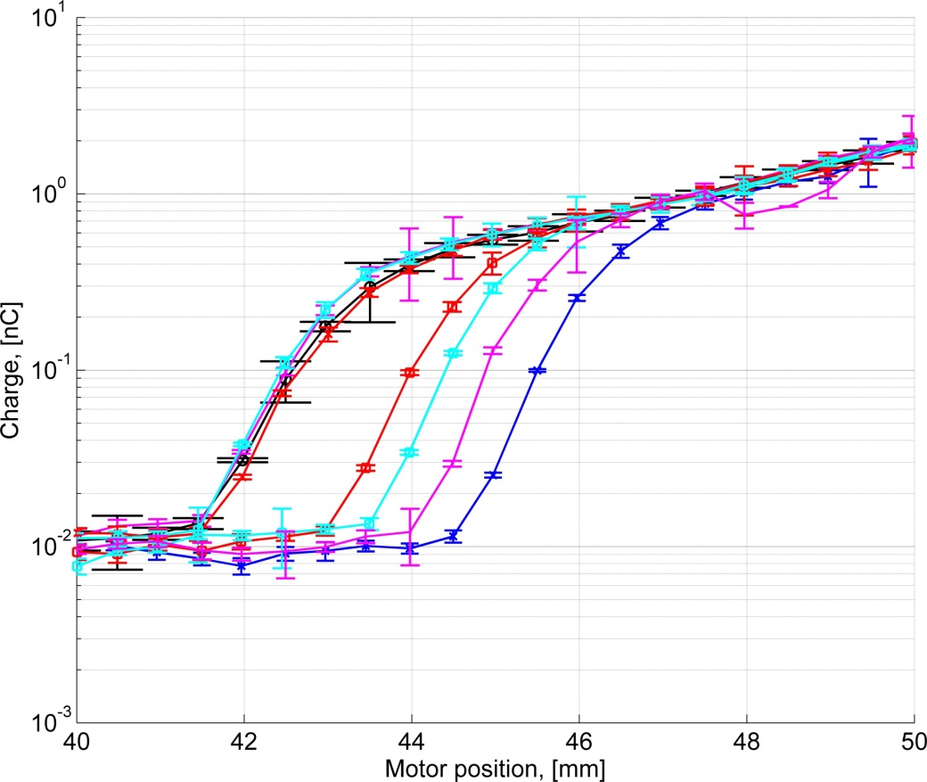
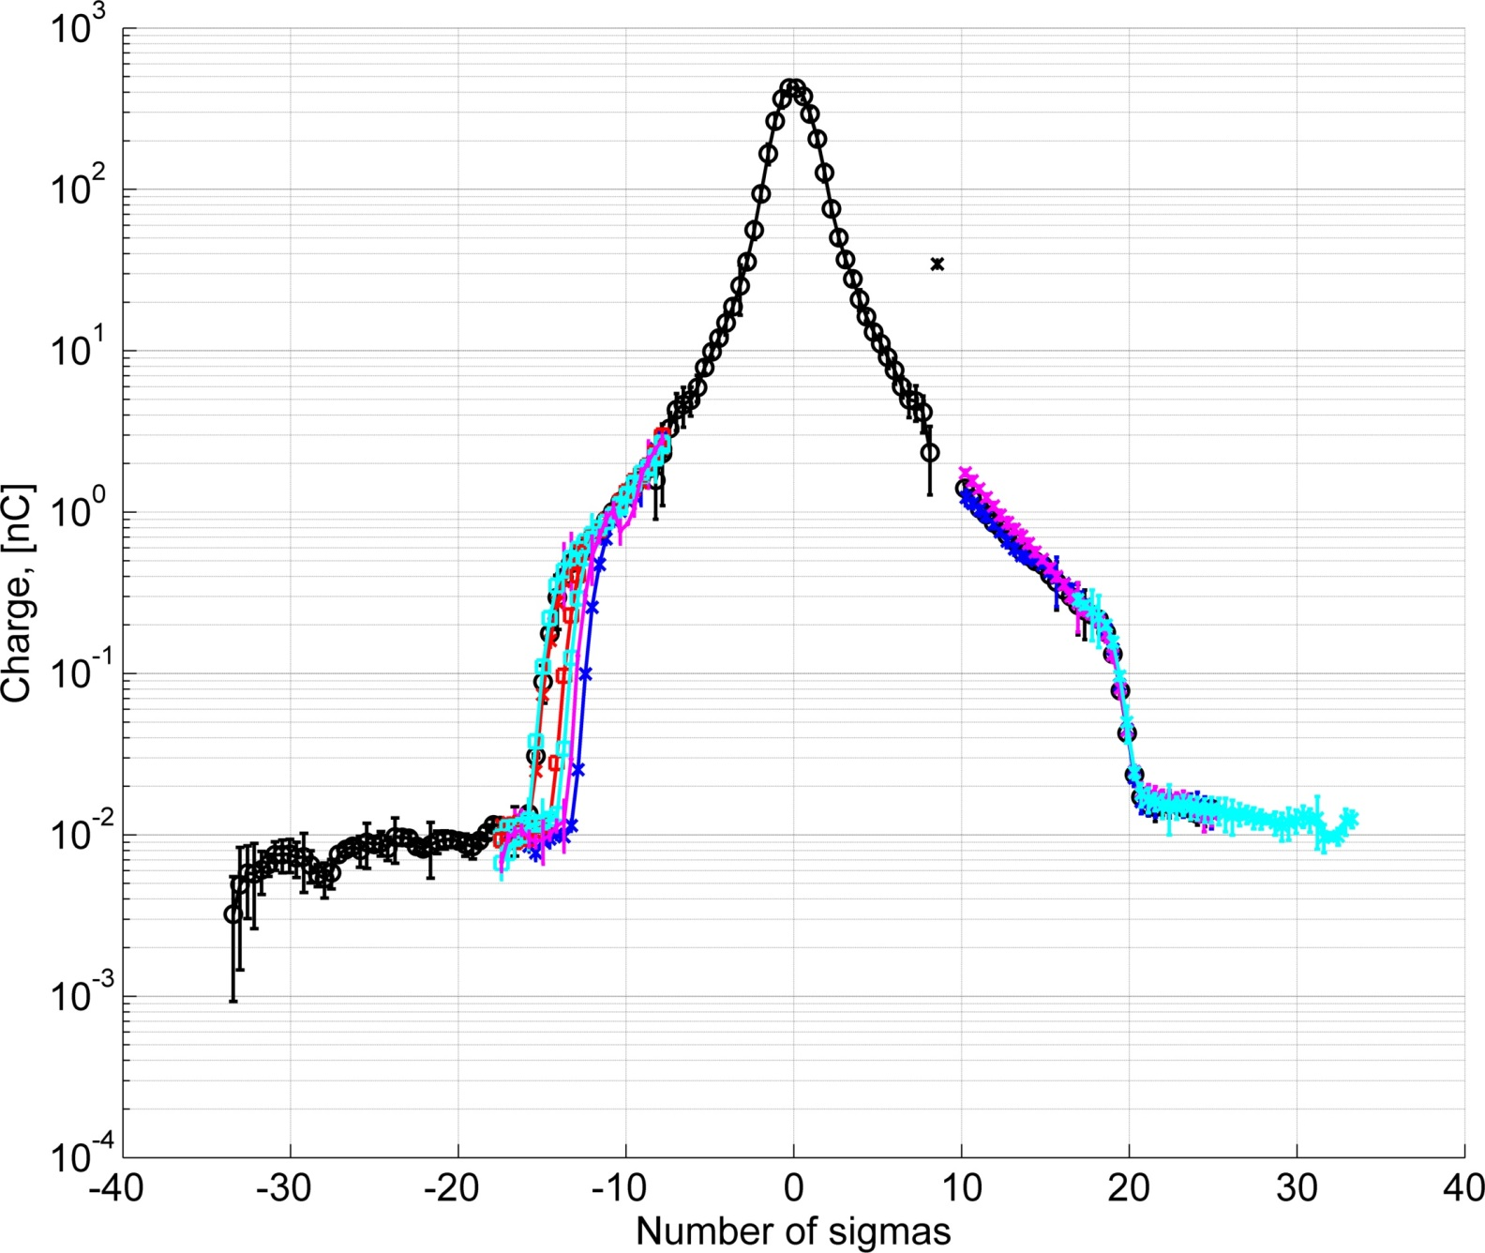
Investigated role of “collimator” on the beam halo cut. 0.1mm of collimator displacement→ 0.5mm halo cut position.
Limited range of “collimator” positions → observed effect only on the left side of halo (top side).
Role of “collimator”
(tapered beam pipe)
Cut from BDUMP aperture
zoom
Cuts from collimator

Slide 7
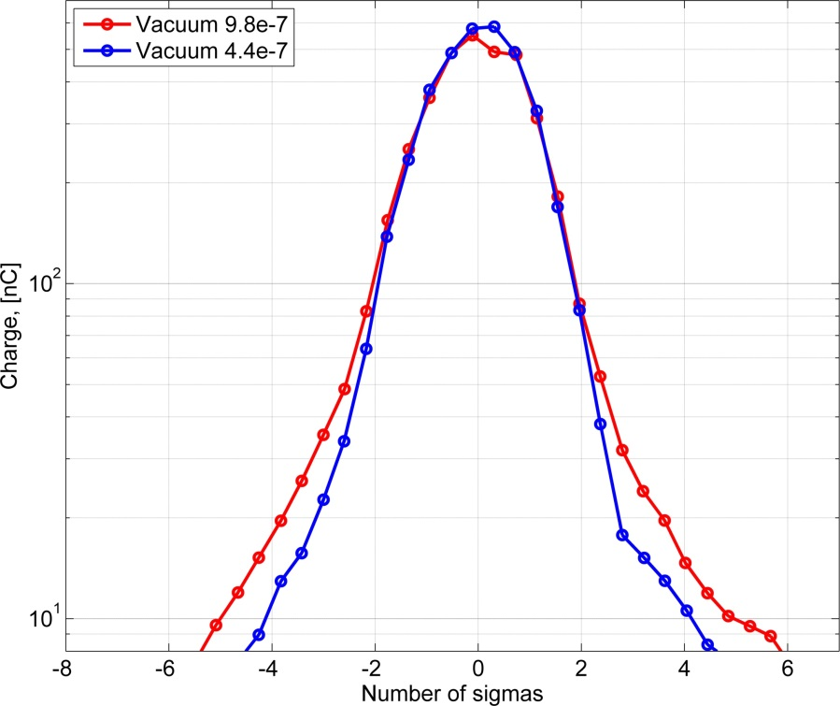
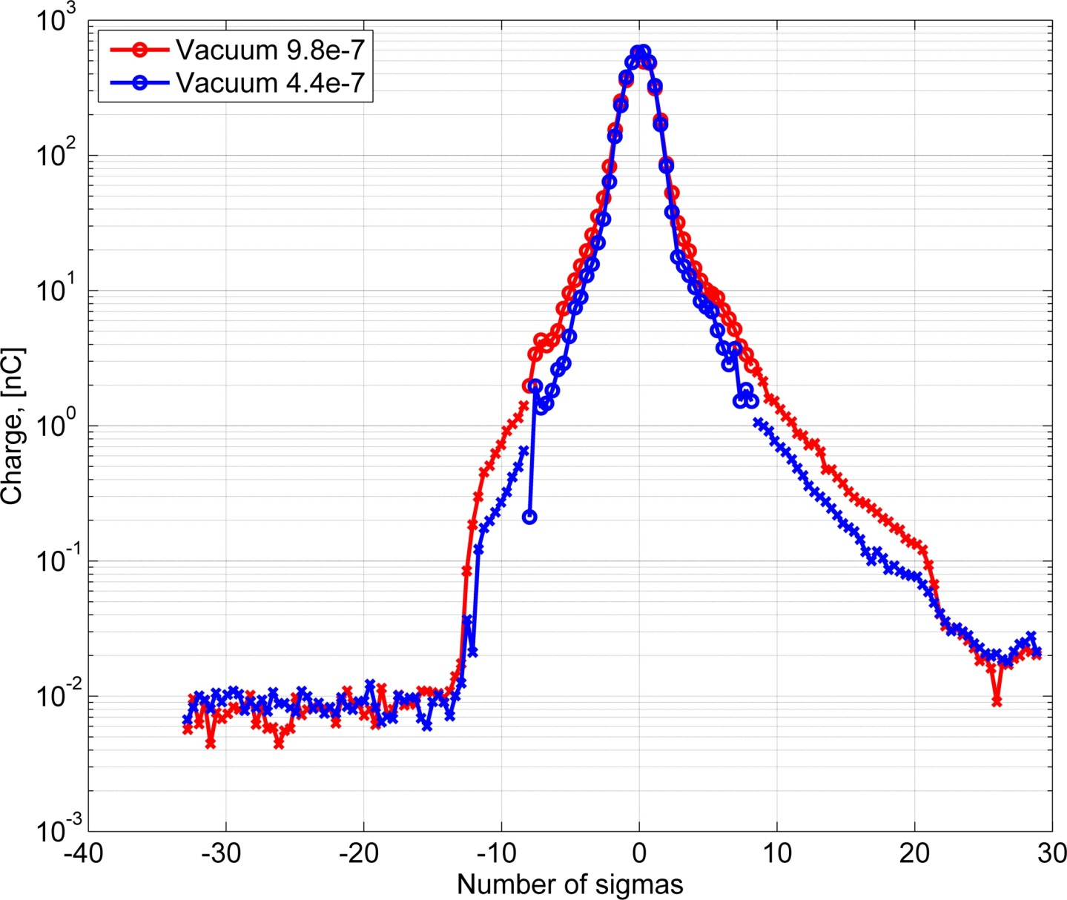
Vacuum level
Vertical scan. N ≈ 8e9 (for better detection of halo)
First complete scan of beam core and beam halo (red).
Turned on ion pumps, vacuum level recovered quickly (5~10mins) to 4.4e-7.
Second complete scan of beam core and beam halo (blue).
Zoom of the beam core
Rough estimation:
Vacuum changed≈2 times
and Halo changed ≈2 times
Sigma CH1-CH4: 1.1989 1.0916 1.0924 1.2087 mm

Slide 8
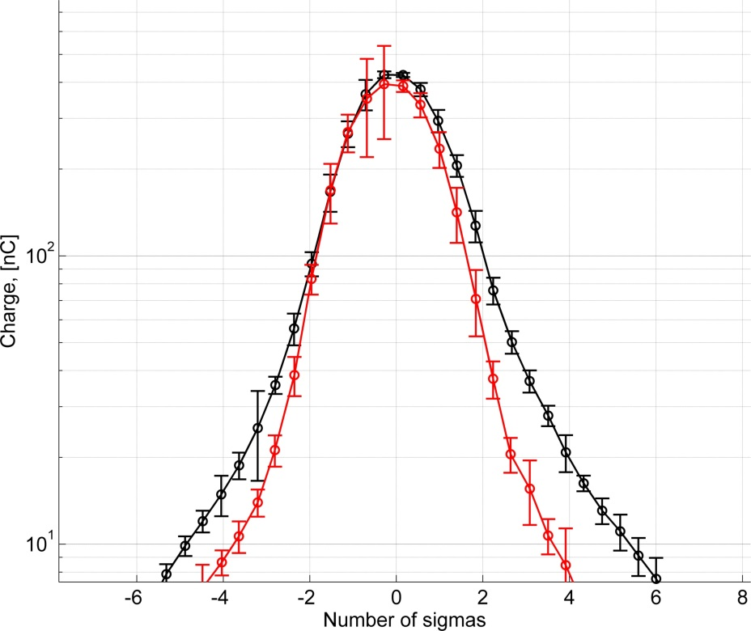
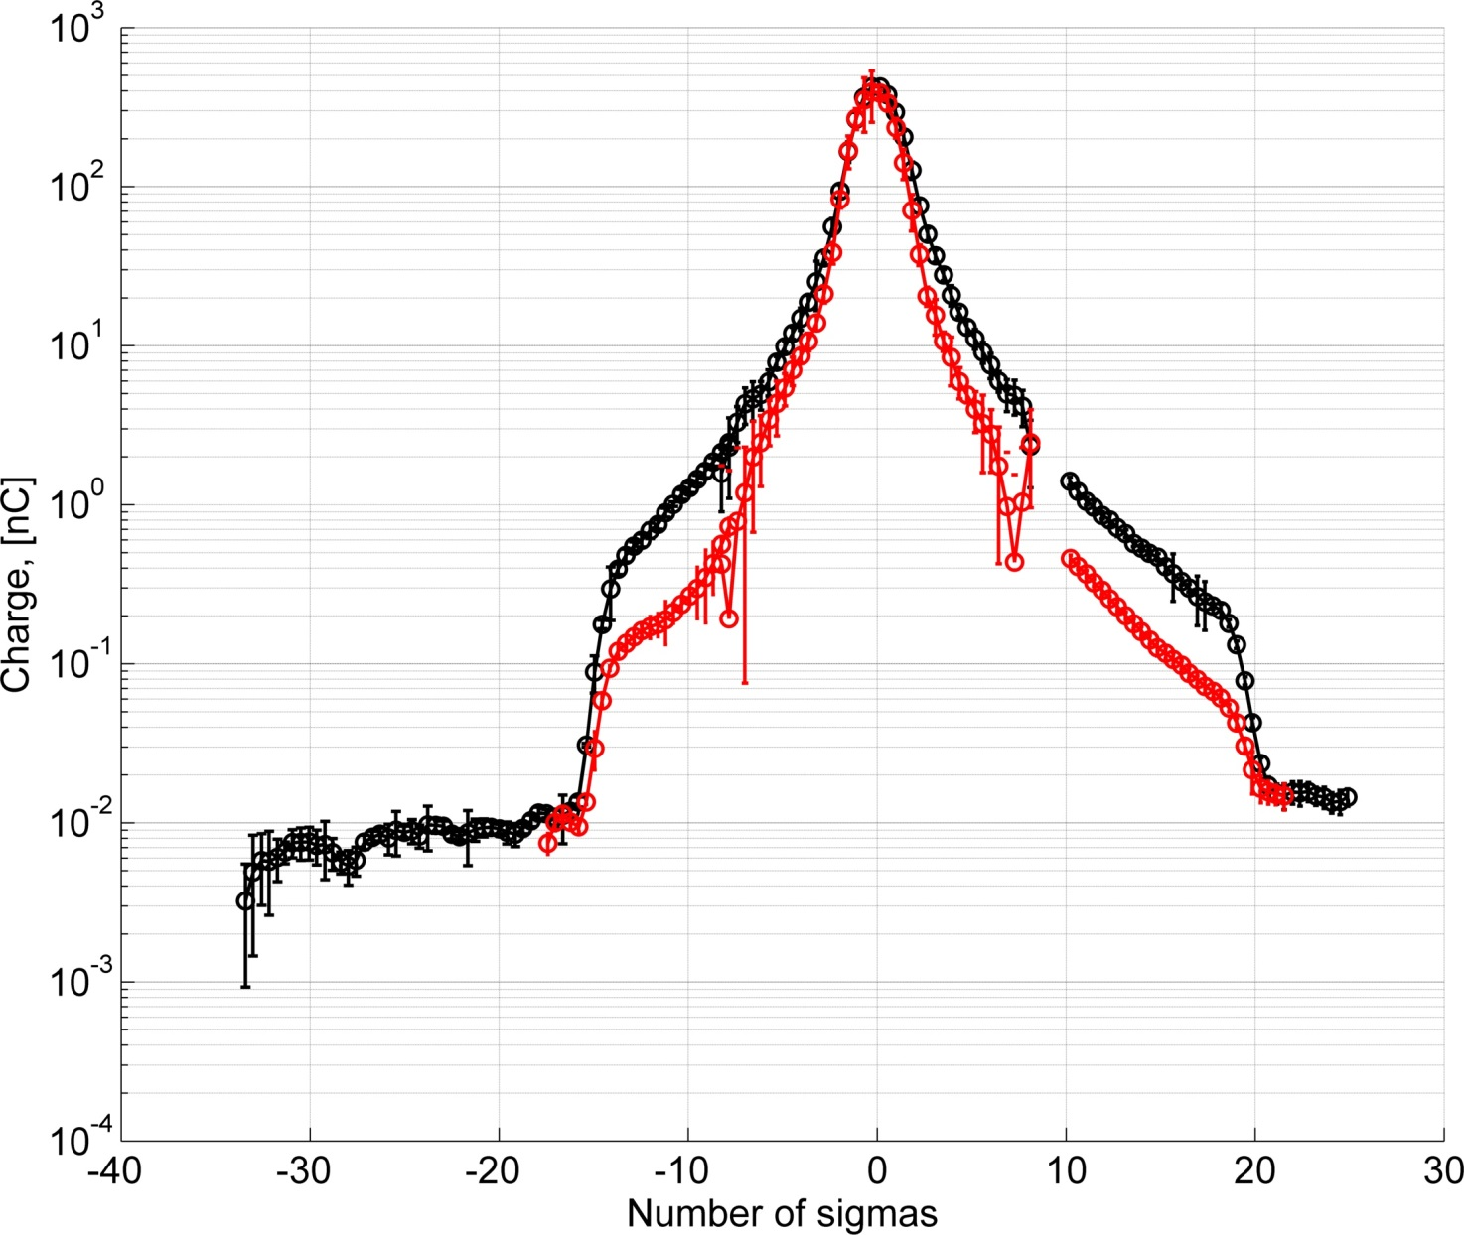
Vacuum level
→ Beam gas Coulomb scattering
Zoom of the beam core
Red 4.84e-7 Pa
Black 13.5e-7 Pa
SigmaCH1-4: 1.19 1.09 1.09 1.24

Slide 9
Prediction of transverse halo from Coulomb scattering in DR
Analytical Estimate of ATF Beam Halo Distribution, by D. Wang et al.: Chinese Physics C 2014 Vol. 38(12): 127003

Slide 10
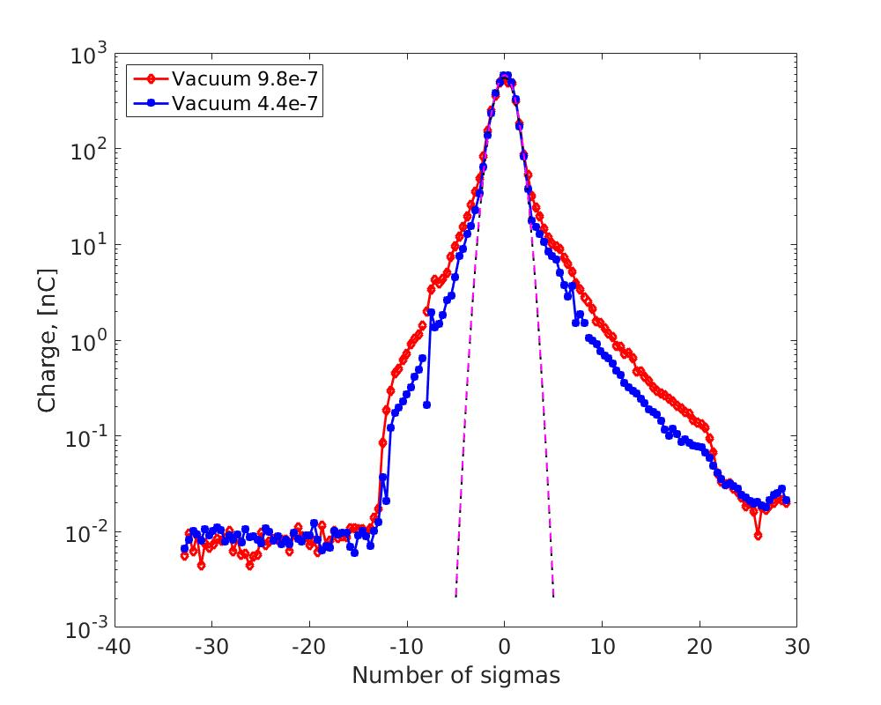
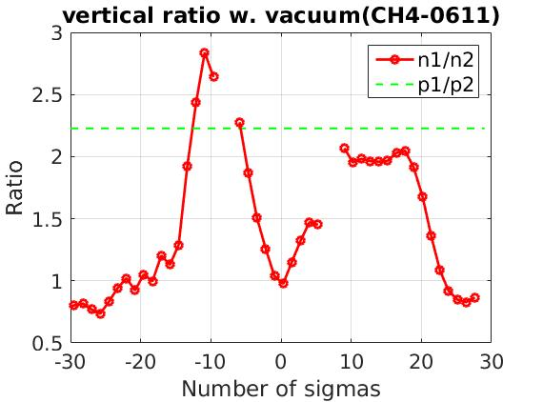
Vacuum level @ Damping ring
Top side → collected charge ratio exceeds vacuum pressure ratio
Bottom side → collected charge ratio fluctuates around the ratio of vacuum pressures

Slide 11
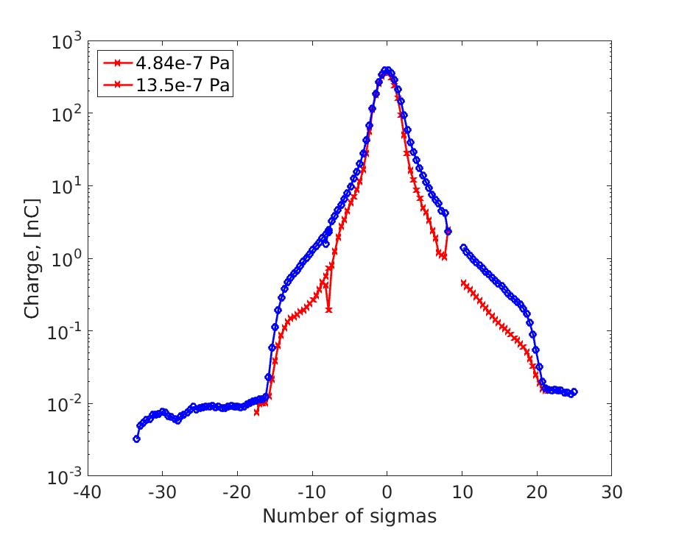
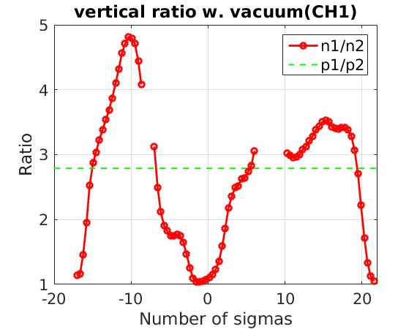
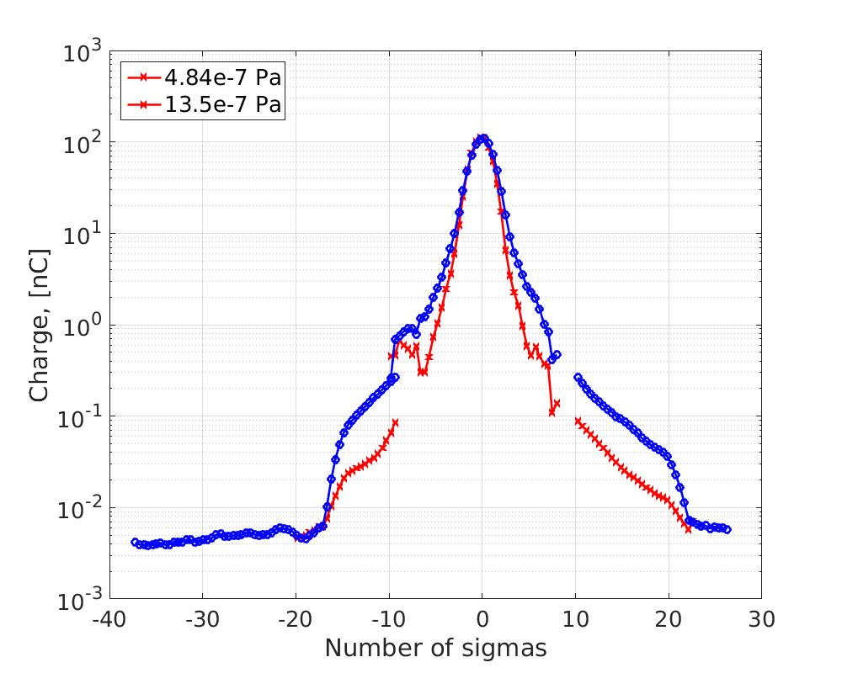
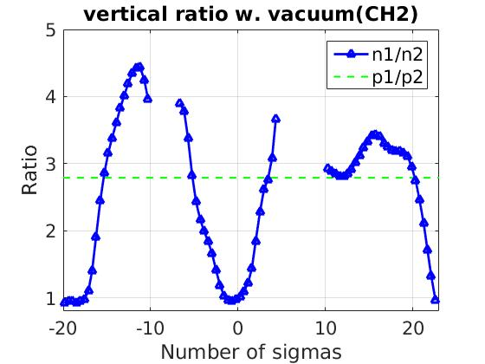
Vacuum level

Slide 12
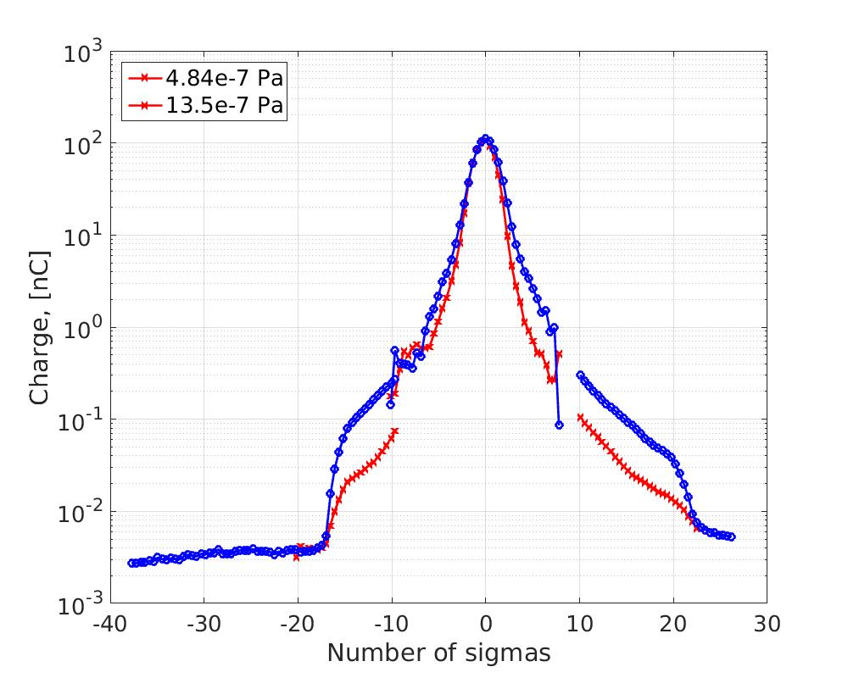
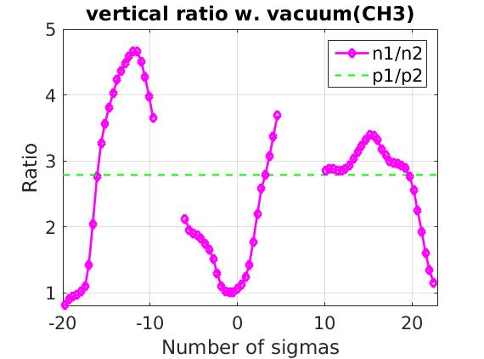
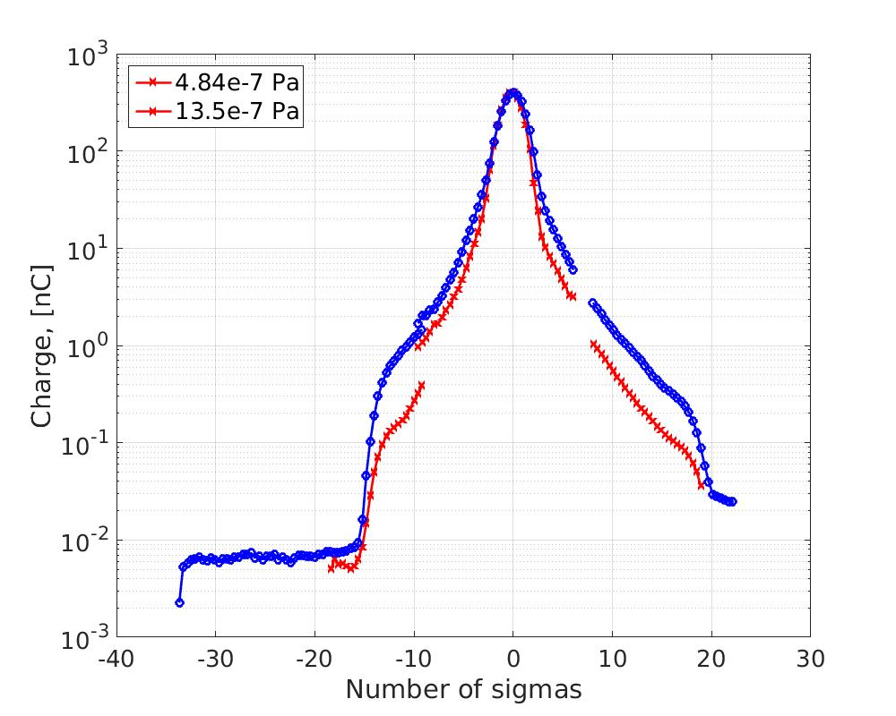
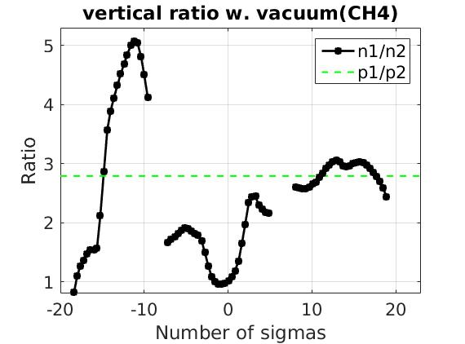

Slide 13

Diamond Sensor itself has very large dynamic range:
1 e- with amplifier, 10² → 10⁹ without amplifier / with attenuator
Signal magnitude ∼ proportional to number of incident particles and bias voltage
Data acquisition limitations are due to the oscilloscope dynamic range
Initialization step + Beam core
Beam Halo measurements
First Beam core scan @-400 V with 30dB attenuators. Find the beam position.
Beam steering (horiz/vert) to maximize signal on given channel.
Beam core scan @-400 V with 30dB attenuators. Fitting each channel to obtain sigma and position.
Move DS far from beam core. Remove attenuators.
5. Scan left beam halo @-400 V;
BEAM OFF; move to the right; BEAM ON;
Scan right beam halo @-400 V
In case of change of beam parameters → full procedure is repeated

Slide 14
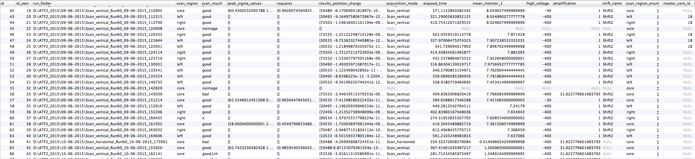
Difficulties:
Data need to be combined “left/core/right”;
The same core is a “parent” for several left/right scans.
Core fitting parameters must be known by “child” left/right;
etc...
Our approach is to use MySQL database for data processing.
More difficult at the beginning, but after implementation allows to keep well structured data; simplifies analysis; searches; comparisons etc…

Slide 15
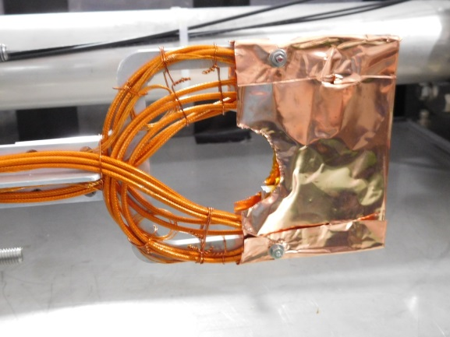
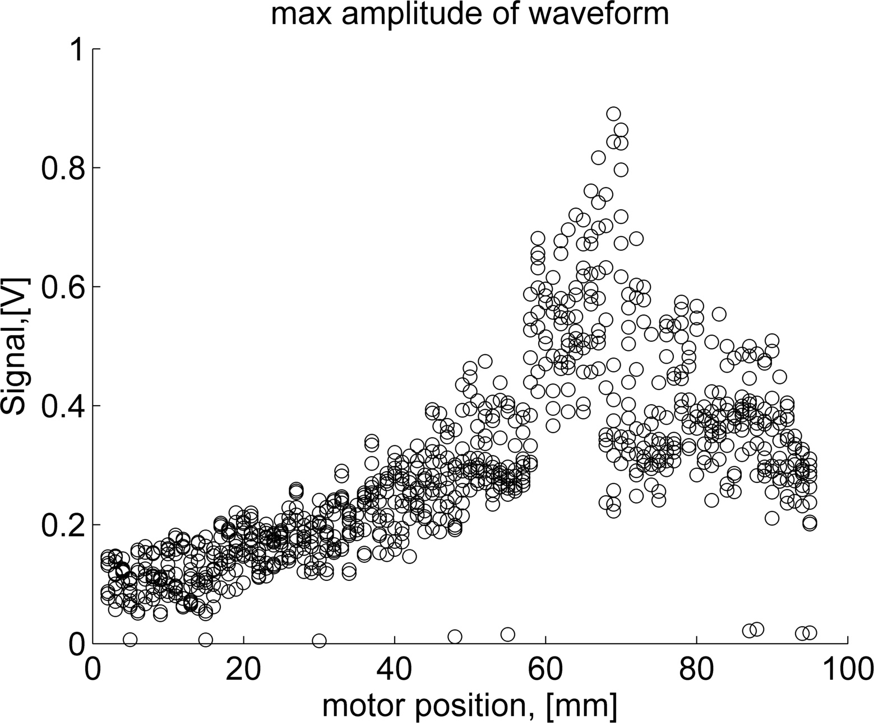
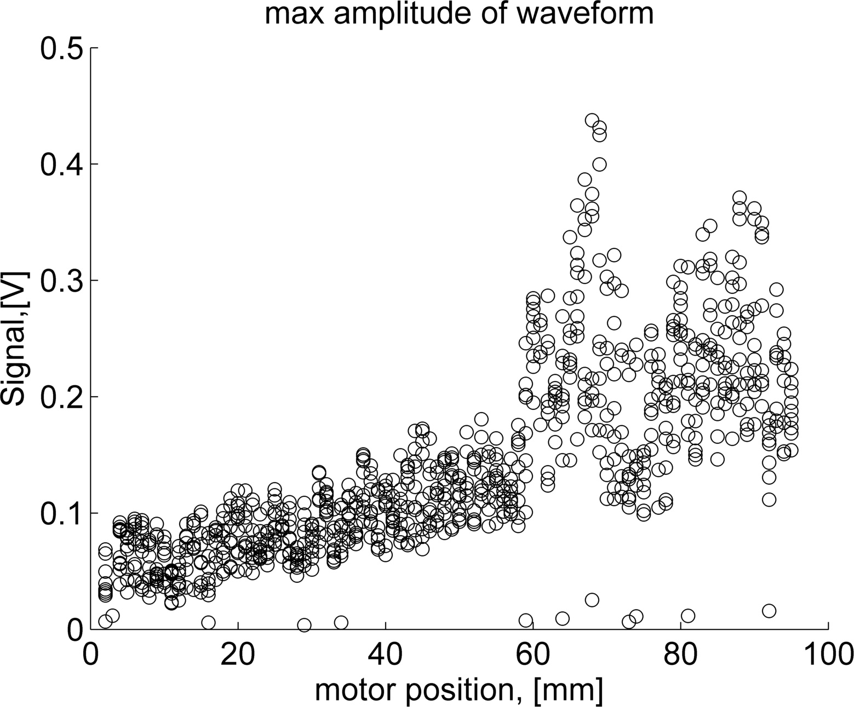
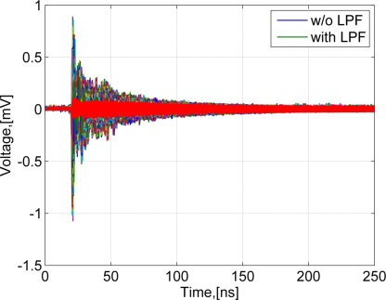
Pickup questions.
Vertical DS.
Averaged waveforms in the file:
pickup_Scan_vertical_Run60_26-05-2015_172033.pdf
Shielding closed
Shielding open
Test 1. Ne=4.4e9
Test 2. Ne=1.8e9
BEAM
BEAM

Slide 16
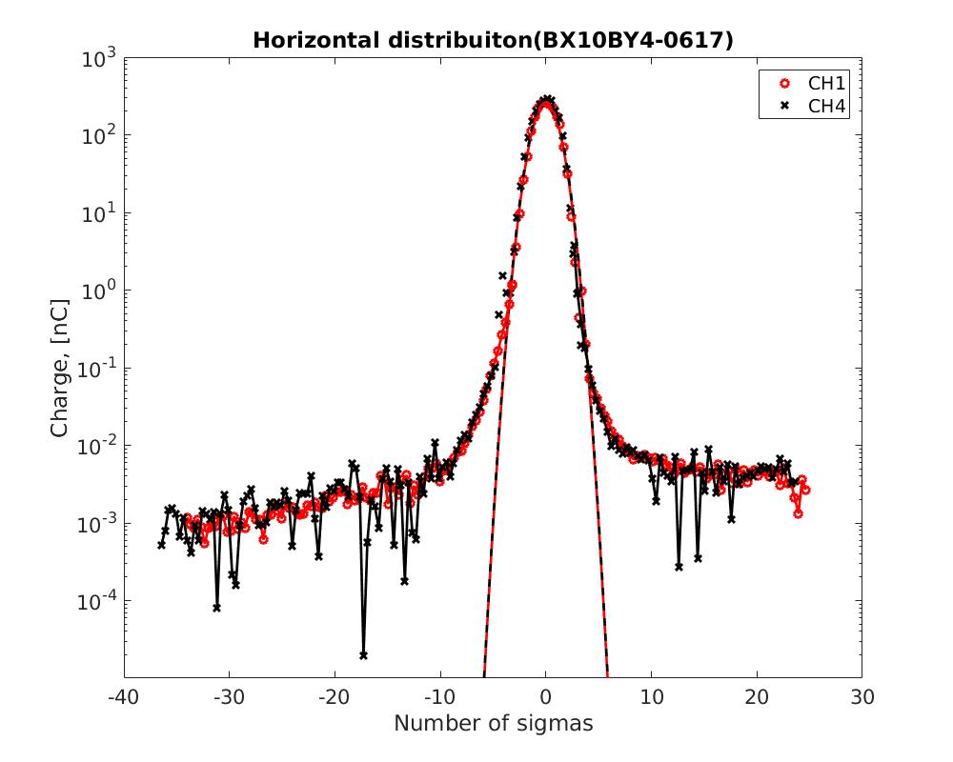
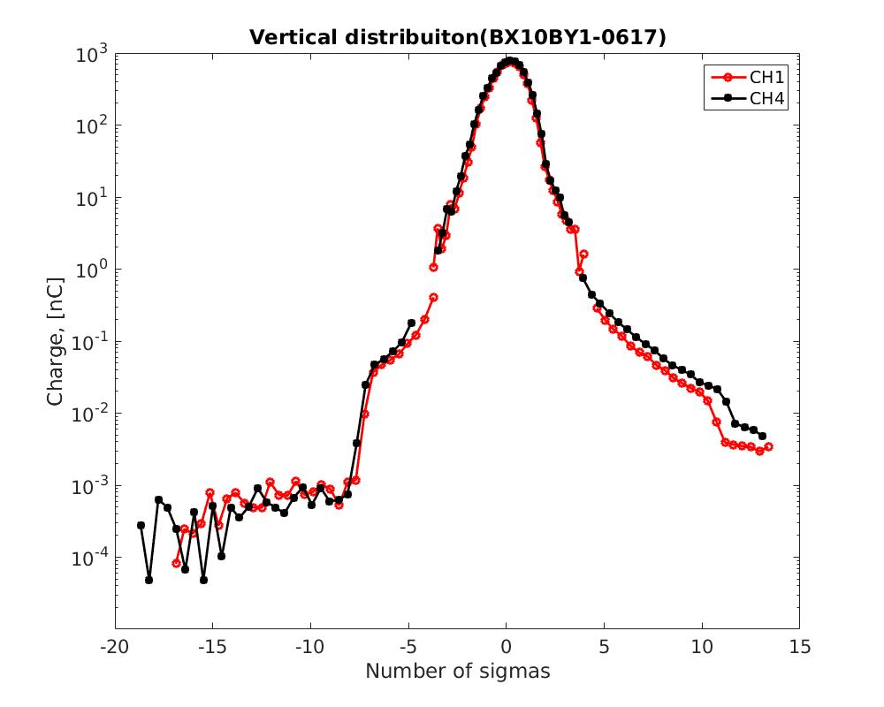
Pickup level
For horizontal and vertical (BX10BY1) pickup levels on the left are ~1e-3 nC → 300 electrons
Other vertical measurements have a ~1e-2 nC
pickup level (3000 electrons) → different conditions ?

Slide 17
Present state and open questions
Vertical and horizontal Diamond Sensor with 4 strips. Currently, data taking needs trained operator
Diamond Sensor readout scheme is optimized for beam halo. Beam core measurements affected by a long charge collection time, which eventually leads to saturation effects (for more than 10⁶ ot 10⁷ e-)
At present, electromagnetic pickup does not allow to extend dynamic range to lower than few thousand electrons, however the Diamond Sensor itself can measure down to ∼ 100 electrons without amplifier
Future plans
Investigation of collimation… (Nuria Fuster-Martinez et al.)
More detailed study of beam halo, mitigation of EM pickup… (Renjun Yang et al.)
Fully automatic scan. Variable attenuators or another solution?
More complete integration with EPICS ? Operation by other ATF members for beam core measurements?
New HV power supplies
Make few runs with new high resolution oscilloscope
Reinstall exactly the same setup for study and beam diagnostics at PHIL

Slide 18
Extra slides

Slide 19
PCB and layout of electronic circuit

Slide 20
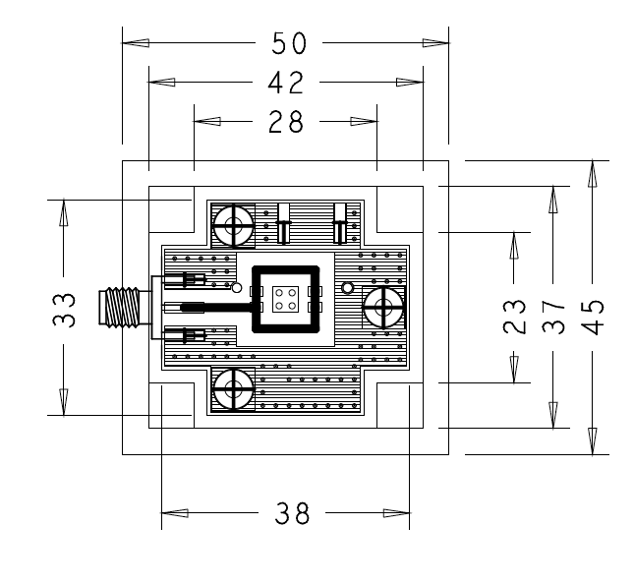
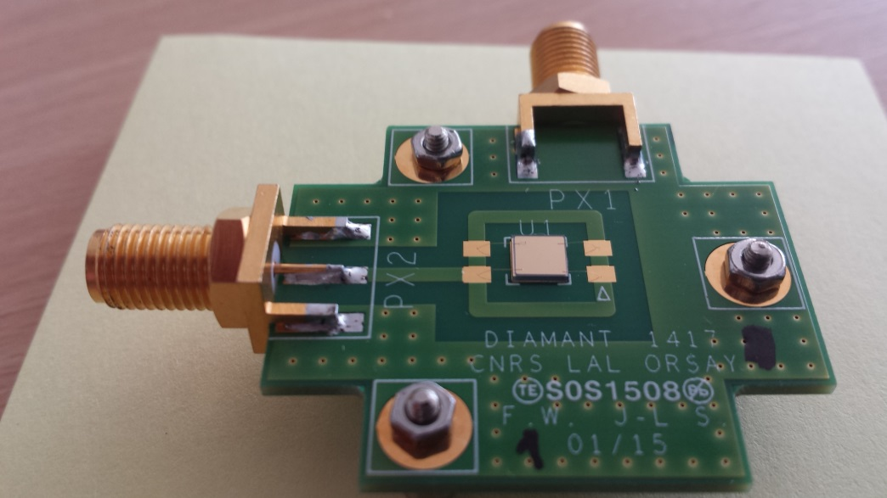
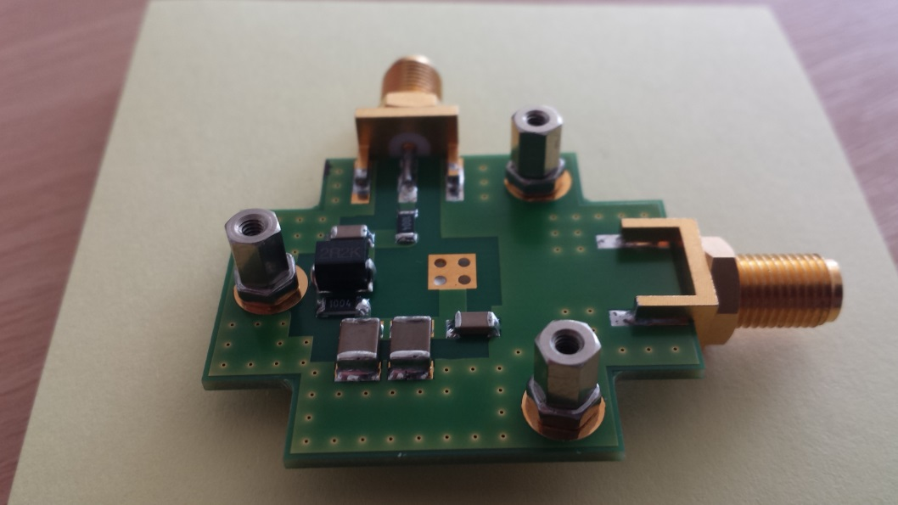
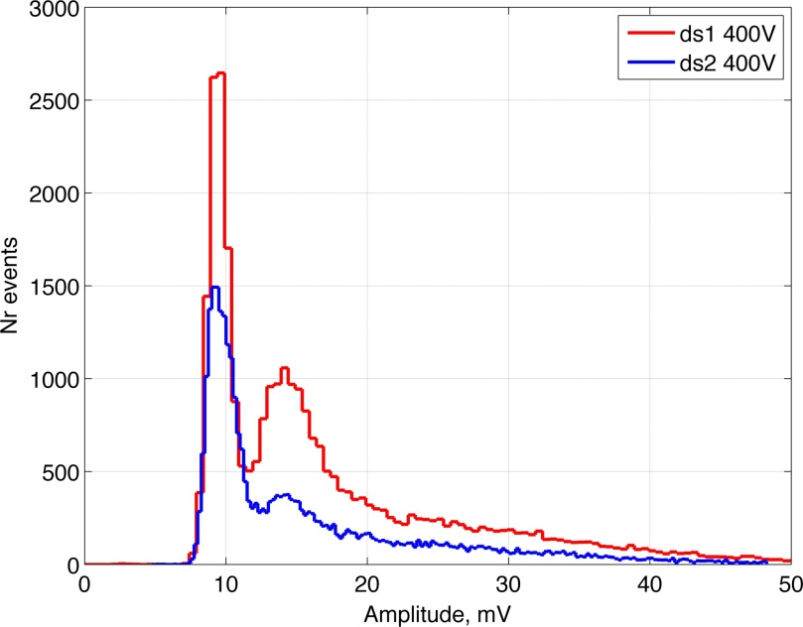
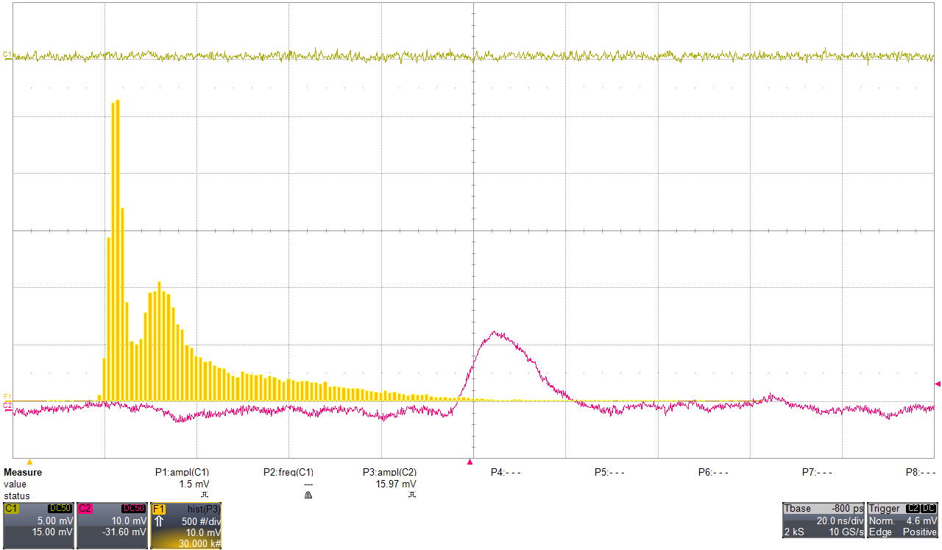
Diamond sensor prepared at LAL
500μm sCVD diamond from E6 with Ti/Pt/Au metallization from GSI
Front side
HV
Back side
HV
Signal
Signal
noise
Signal with fast charge amplifier
Signal ⁹⁰Sr

Slide 21
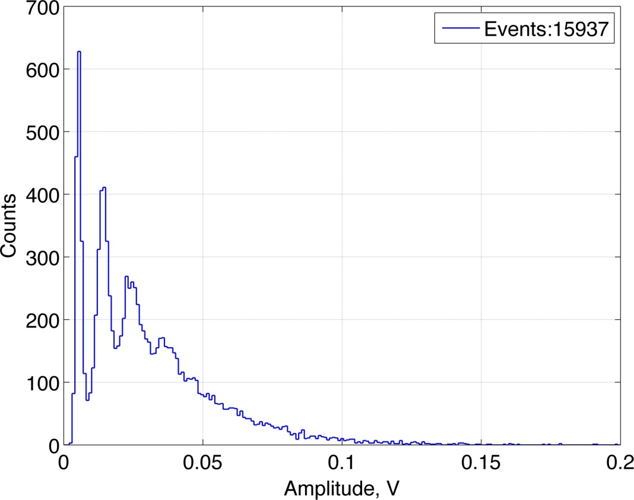
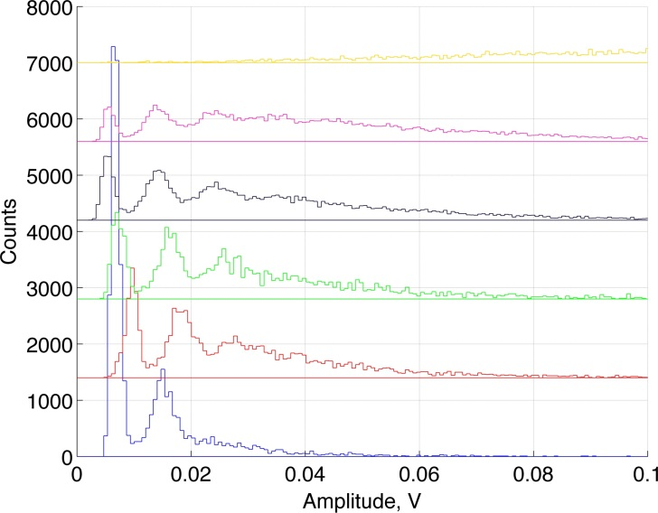
Diamond sensor → single electron control in LEETECH (LAL-Orsay)
0
1
2
3
10⁹ 3.5 MeV e-/bunch
← different collimator settings

