Slide 1



ODR/OTR emittance station at ATF2 (KEK)
M. Bergamaschi^{1,2}, E. Bravin², P. Karataev¹,
R. Kieffer², K. Kruchinin¹, T. Lefevre², S. Mazzoni²
John Adams Institute at Royal Holloway, Egham UK
CERN European Organisation for Nuclear Research, Geneva, Switzerland

Slide 2
Overview
Motivations and Goals:
Develop, install and test a combined Optical Transition Radiation (OTR) and Optical Diffraction Radiation (ODR) emittance station at ATF2 at High Energy Accelerator Research Organisation (KEK)
To optimize sensitivity to micron and sub-micron beam sizes, we plan to observe ODR/OTR in the visible and near-UV wavelength range, down to approximately 180 nm.

Slide 3
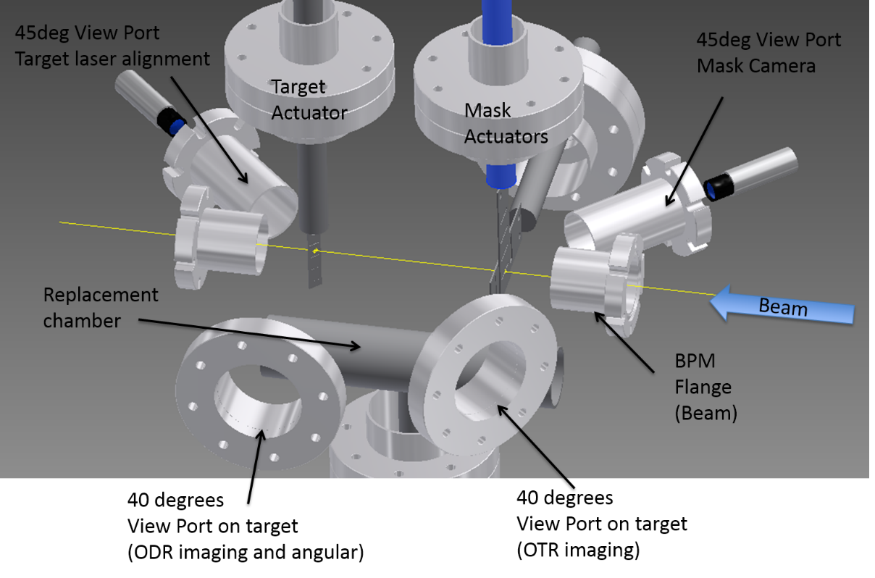
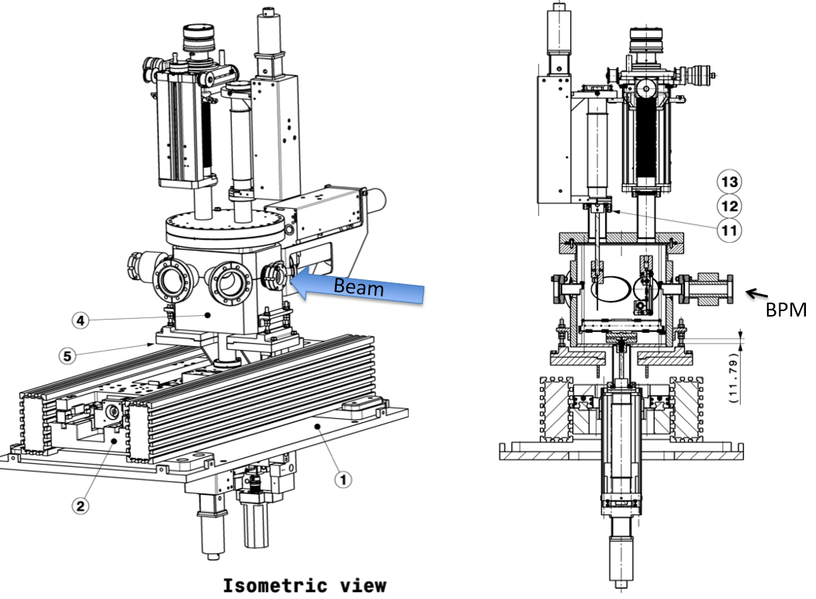
Experimental design

Slide 4
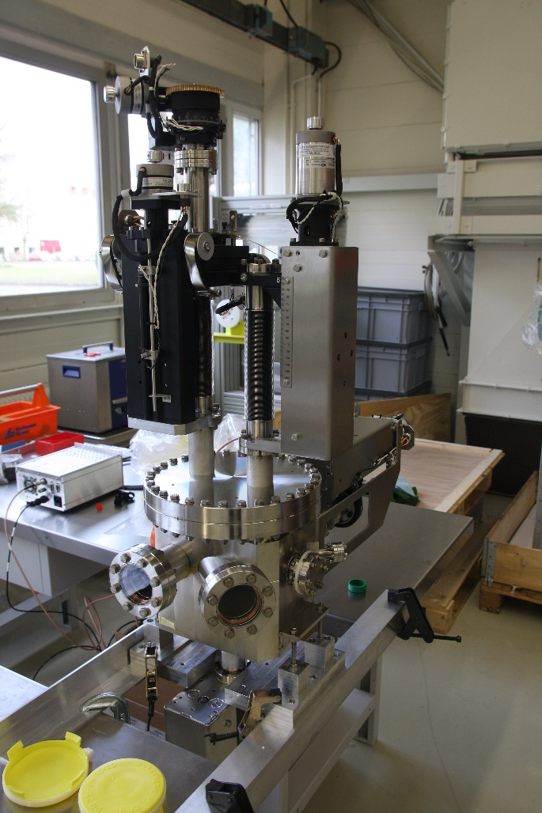
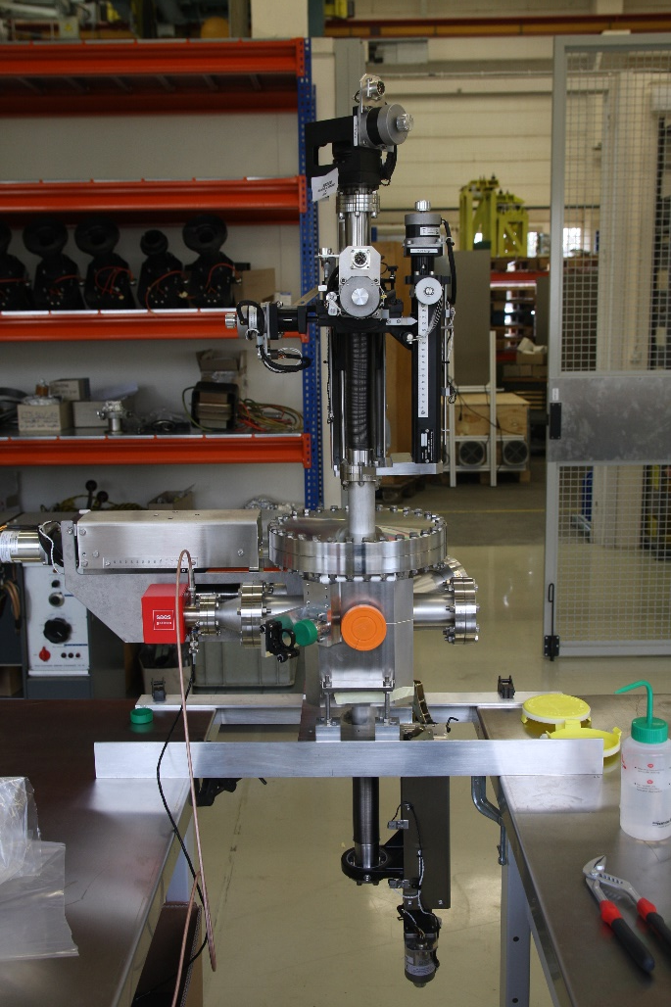
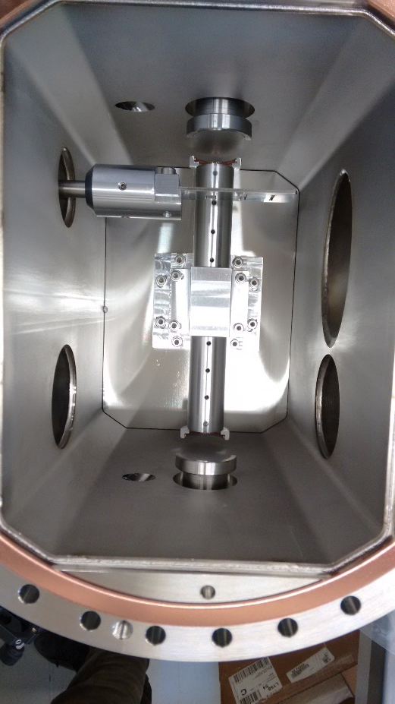
Project status
Tank production

Slide 5
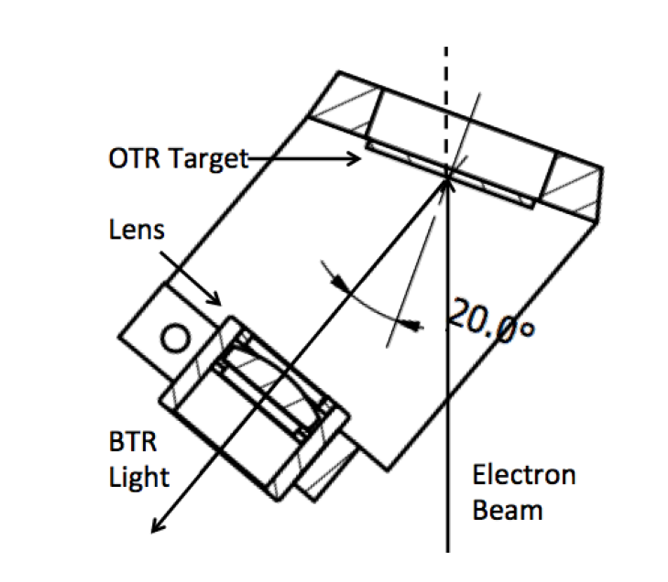
Project status
Target and mask produced from a Silicon wafer at EPFL (Lausanne)
Target holder
Planarity between two slit sides is about 10 nm < λ/10

Slide 6
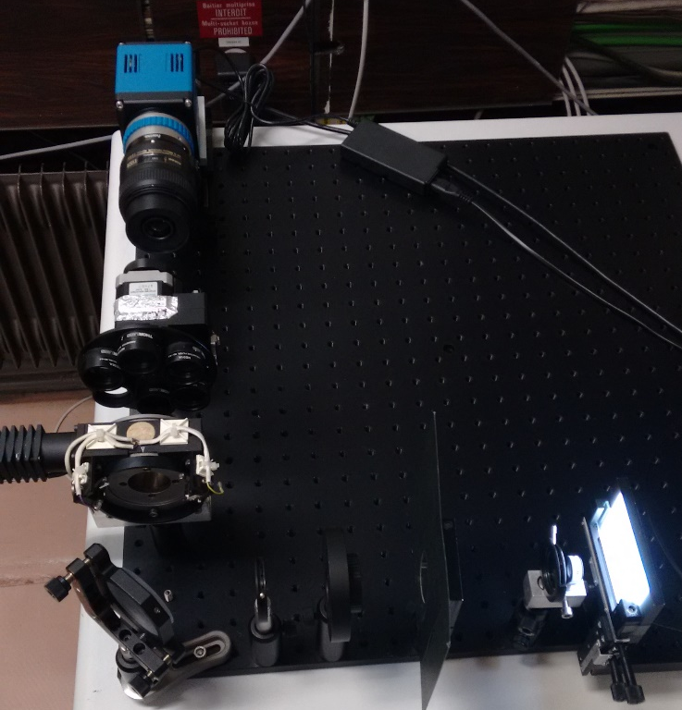
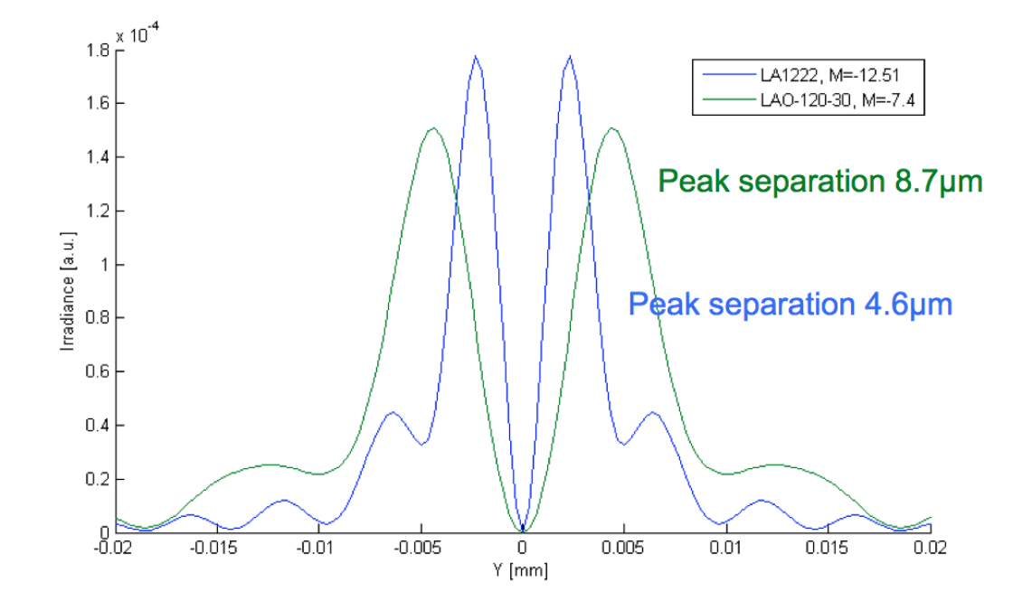
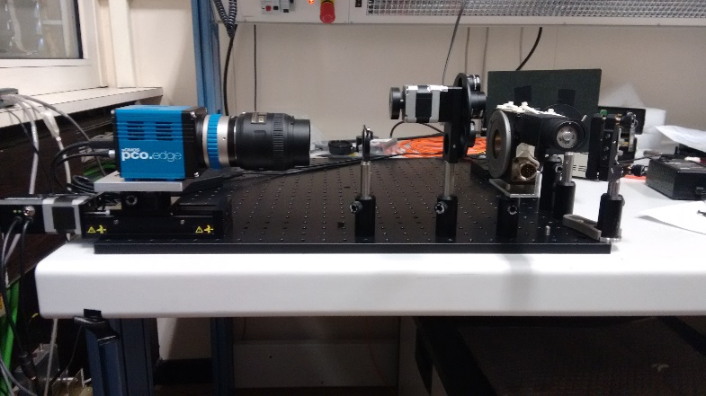
OTR optical line
Zemax simulation of the expected OTR PSF for a selection of commercial lenses
OTR optical line tests
sCMOS Camera on linear stage
Camera lens
Filter wheel
Polariser rotational stage
Folding mirror
First Lens

Slide 7
ODR optical line
Far-field (angular) configuration
Light from viewport
Mirror
Mirror
Lens f = 100
Mirror
Mirror
On an horizontal translational stage
Filter wheel
Lens f = 500
Polarizer
Intensified camera
Mirror
Mirror

Slide 8
ODR optical line
Imaging configuration
Light from viewport
Mirror
Mirror
Lens f = 100
Mirror
Mirror
On an horizontal translational stage
Filter wheel
Lens f = 500
Polarizer
Intensified camera
Mirror
Mirror

Slide 9
Summary
Status of the project:
ODR and OTR optical lines already designed for the visible range
All component except of cameras shipped to KEK and already arrived
System planned to be installed at ATF2 during shutdown week of February 2016 (08/02/2016-14/02/2016)
We plan to be at ATF2 with both cameras on 03/02/2016 to set-up the installation
First experimental measurements planned the week after installation
Scheduled beam time?
Future improvement:
After first measurements in the visible wavelength range, upgrade the optical line for UV wavelength range

Slide 10
Thank you for your attention!

Slide 12
