Slide 1


ATF hardware status
    - Orbit Stabilization
T.Naito(KEK)
ATF2 Project meeting 2016.1.13
Laboratoire de l'Accélérateur Linéaire (LAL)
Orbit oscillation due to the Cooling water temperature change
Orbit drift in FF due to the DR air-conditioner
Extraction kicker trouble(2015.11~2015.12)
Proposal for the pulse stabilization of the extraction kicker

Slide 2
ATF hardware status
    - Orbit Stabilization
T.Naito(KEK)
ATF2 Project meeting 2016.1.13
Laboratoire de l'Accélérateur Linéaire (LAL)
Orbit oscillation due to the Cooling water temperature change
Orbit drift in FF due to the DR air-conditioner
Extraction kicker trouble(2015.11~2015.12)
Proposal for the pulse stabilization of the extraction kicker

Slide 3
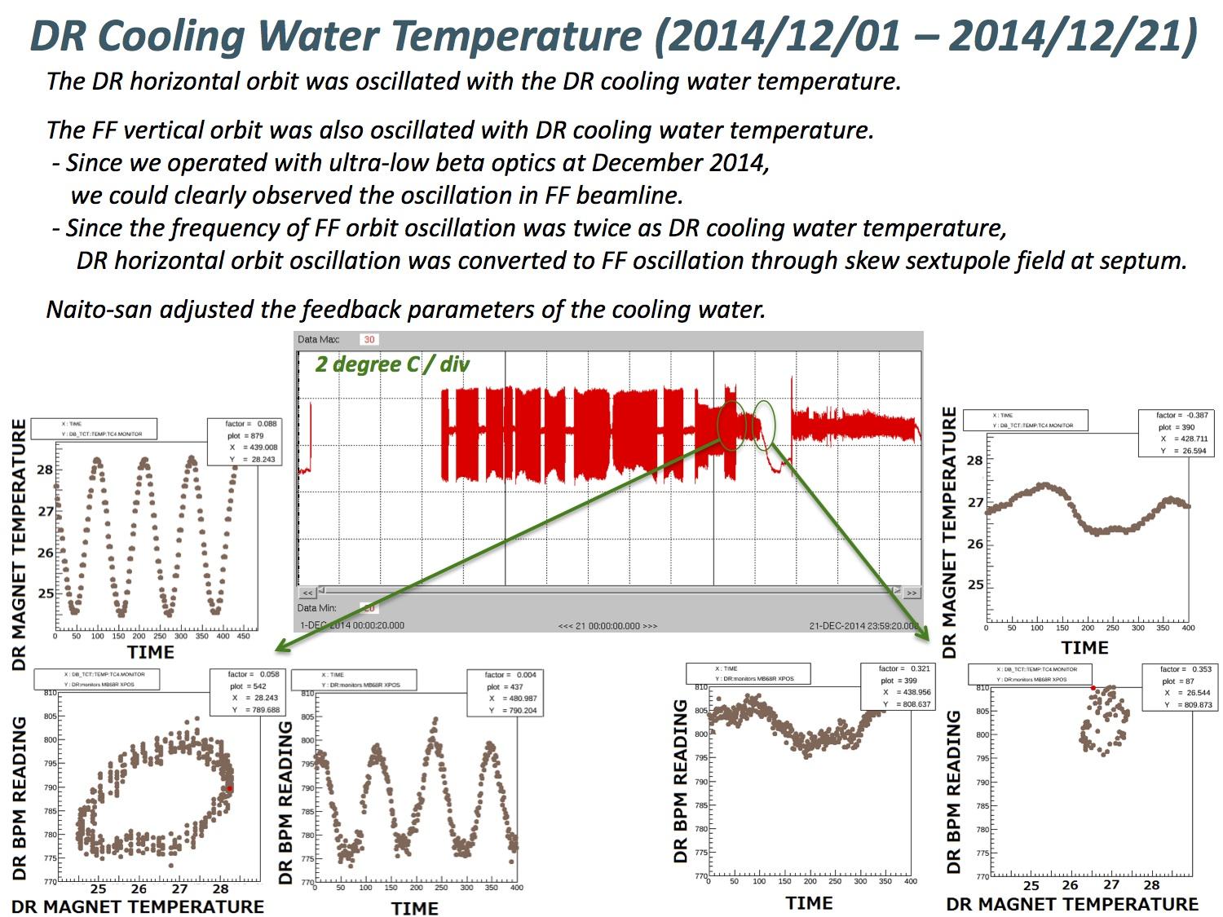
DR Mag Cooling water temp(~2014)
T. Okugi
2015 Proj. Mtg
MB68R
X-pos

Slide 4
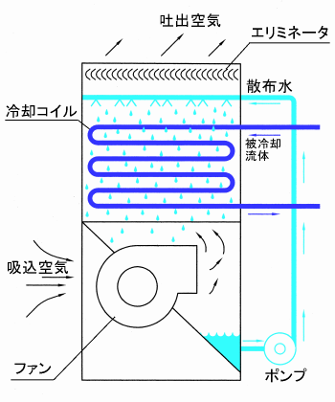
Cooling water system(1)
Cooling tower is generally used to make the cooled water. The evaporation of the sprinkling water cools down the heated water in the accelerator. One feature of the cooling tower is that it uses very less electricity compared to an electric chiller system. However, the cooling power is strongly dependent on the environment temperature and the humidity.
Cooling coil
Sprinkling water
heated water
air
Cooled water
Fan
Pump
Cooling tower

Slide 5
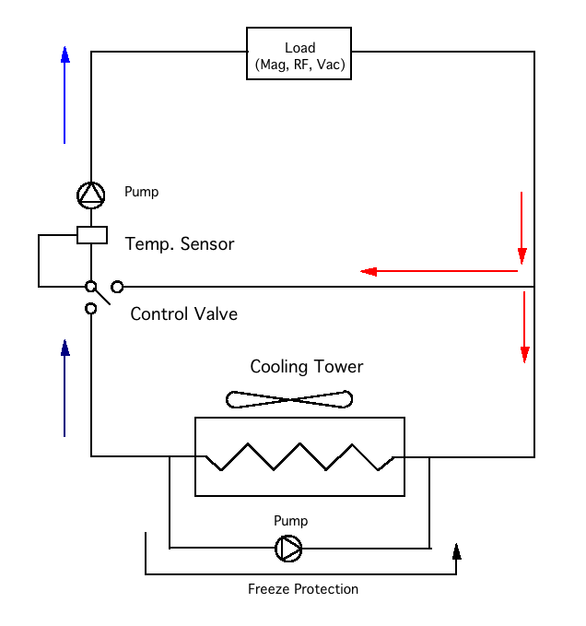
Cooling water system(2)
Control system of the cooling tower –
Two stage control is used,
ON/OFF control
Sprinkler on/off, Fan on/off
2) Analogue control
Three-way valve
The water temperature is kept in the range of 2 or 3 degreesC by on/off control of the sprinkler and the fan. The temperature range is increased at the winter season for the strong cooling power.
The three-way valve stabilizes the water temperature by mixing the heated water and the cooled water.

Slide 6
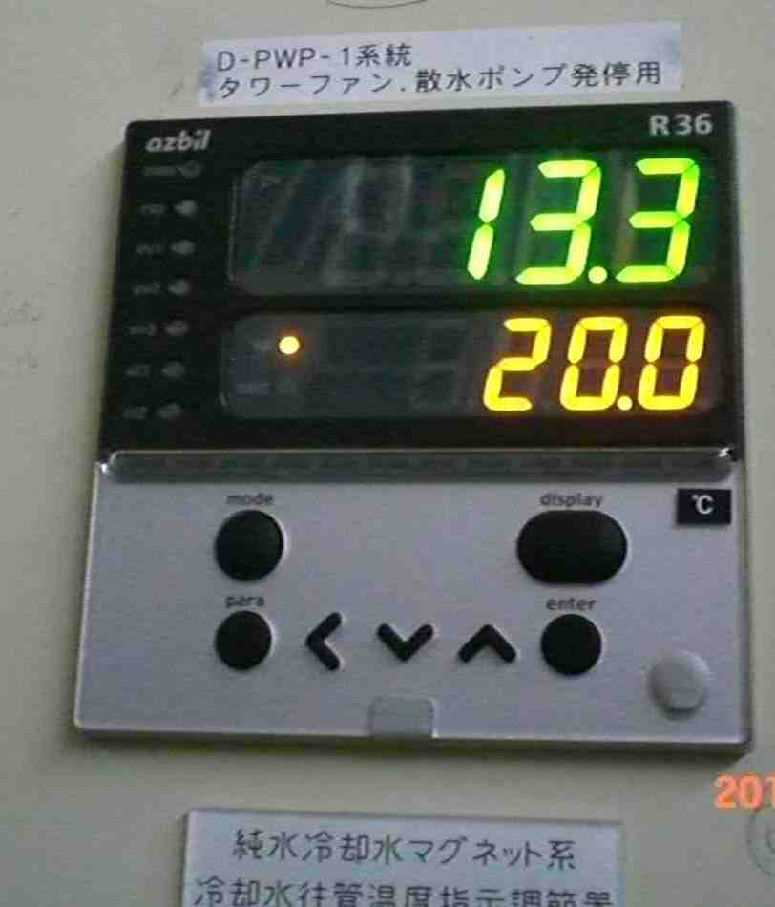
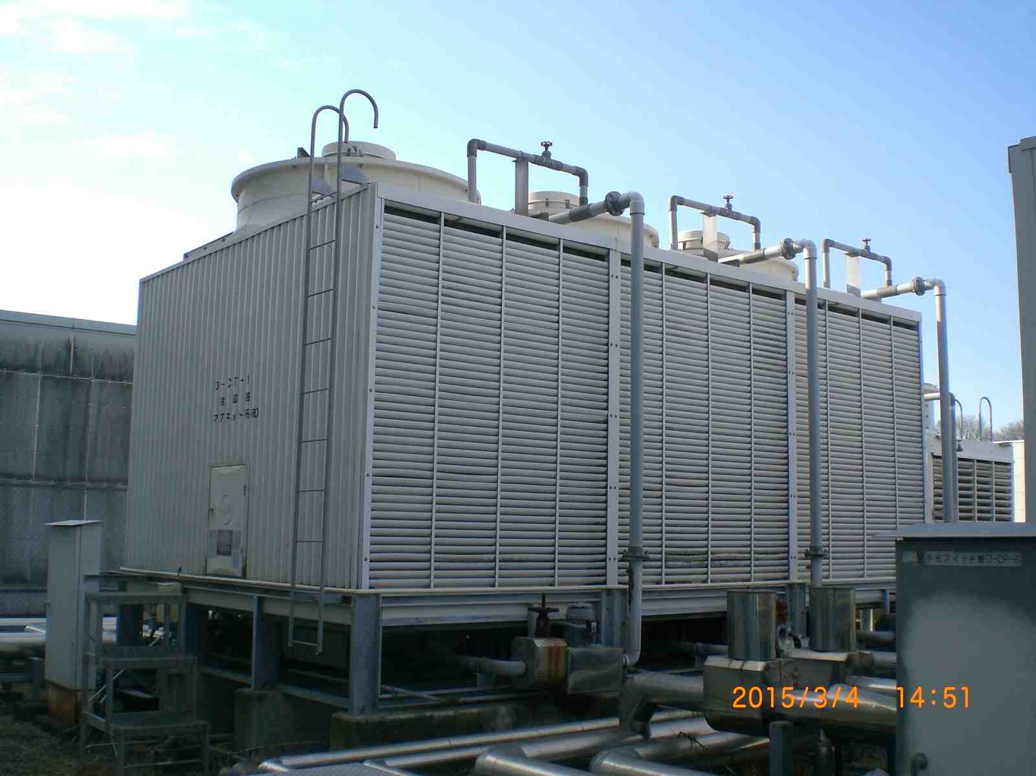
Cooling water system(3)
Control panel
Cooling tower
water flow Number of cooling tower Electric Power
Magnet 1300L/m 3 15kW
Magnet(aux.) 300L/m 1 5kW
RF(klystron) 1000L/m 2 10kW
Vacuum 120L/m 1 5kW

Slide 7
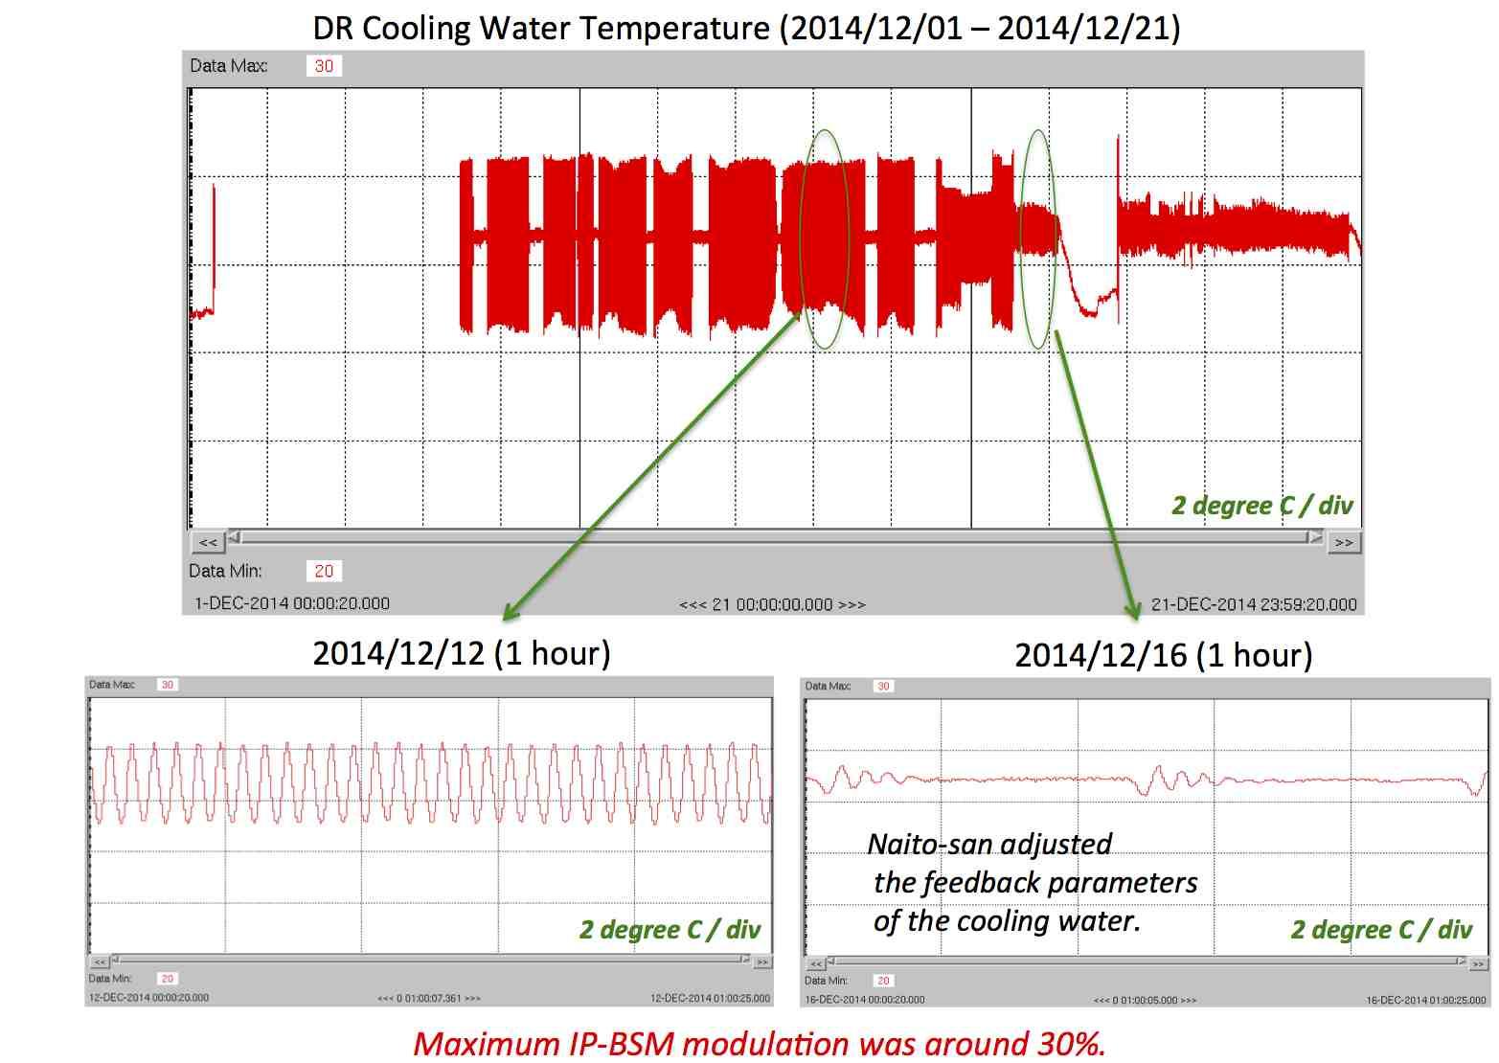
Cooling water system(4)
Before adjust the control parameters
After adjust the control parameters
The temperature stability depends on the control parameters(PID control) and on/OFF interval. The temperature fluctuation is about 1 degreesC even after adjust the PID parameters, which comes from the on/off control of the sprinkler and the fan.

Slide 8
Cooling water system(5)
Control procedure to make stable temperature
Independent on/off control of the sprinkler and the fan makes small temperature change of the cooled water.
  Mag 1 step -> 6 step, RF 1 step -> 4 step, Vac 1 step -> 2 step
Some of the sprinklers are kept on during the two-weeks of operation, which aims to reduce(or stop) the repetition rate of the on/off control.
Expand the control range of the three-way valve - the control range is set at 0~100%. The previous setting was limited to 0~70%, even if all of the accelerator power supplies are turned on. 30% of the water flow is needed to avoid water freeze problem during the winter shutdown. We installed an on/off switch of the control range limiter. The limiter is turned off during the accelerator operation.

Slide 9
Cooling tower On/OFF Control image(1)
Previous control
Upper threshold
sprinkler1
sprinkler2
sprinkler3
Lower threshold
Each cooling tower turns on/off at same temperature.
Present control
Upper threshold1
sprinkler1
Lower threshold1
Upper threshold2
Lower threshold2
sprinkler2
Upper threshold3
Lower threshold3
sprinkler3
Each cooling tower turns on/off at different temperature.

Slide 10
Cooling tower On/OFF Control image(2)
The threshold level of the temperature turn on/off control is set very wide. In this case, the temperature changes very slowly according to the environment temperature. Consequently, the periodic temperature change can be avoided.
Upper threshold1
sprinkler1
Upper threshold2
Lower threshold1
Upper threshold3
sprinkler2
Lower threshold2
sprinkler3
Lower threshold3

Slide 11
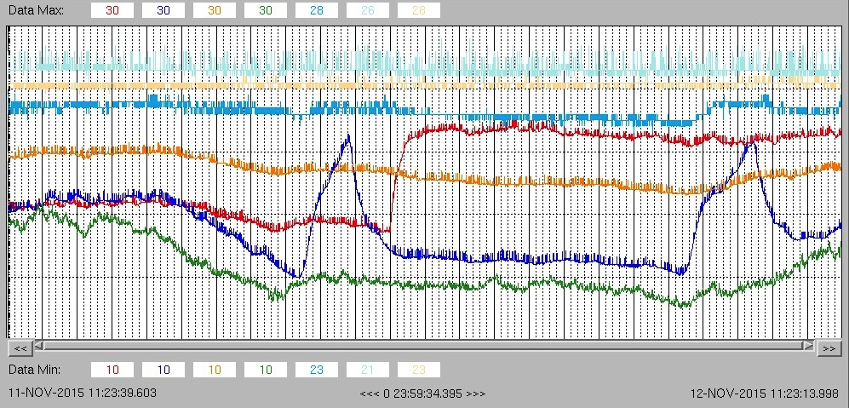
Cooling water system(6)
RF
１℃
MAG
VAC
4℃
RF
CoolingTower
VAC
CoolingTower
MAG
CoolingTower
Out side
Temp
Temp stability MAG: 0.1degC, RF: 0.2degC, VAC: 0.5degC
  The temperature change of the VAC came from the low heat power. So, the BT magnet uses VAC cooling water to increase the heat power.(~Jan 2016)

Slide 12
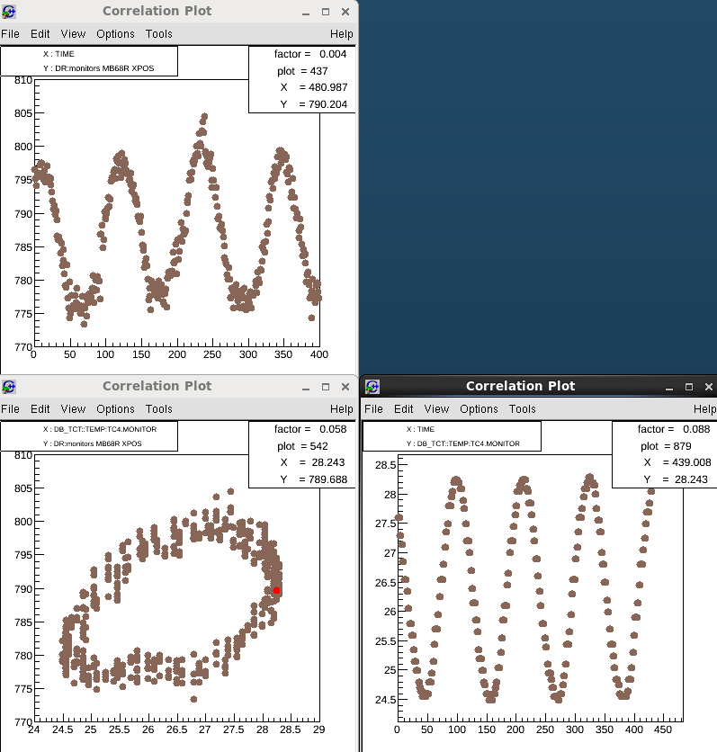
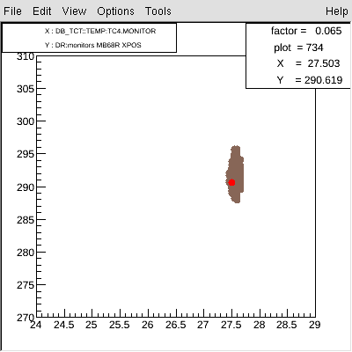
Cooling water system(7)
MB68R X-pos
Mag Cooling water temp
Orbit oscillation disappeared.

Slide 13
ATF hardware status
    - Orbit Stabilization
T.Naito(KEK)
ATF2 Project meeting 2016.1.13
Laboratoire de l'Accélérateur Linéaire (LAL)
Orbit oscillation due to the Cooling water temperature change
Orbit drift in FF due to the DR air-conditioner
Extraction kicker trouble(2015.11~2015.12)
Proposal for the pulse stabilization of the extraction kicker

Slide 14
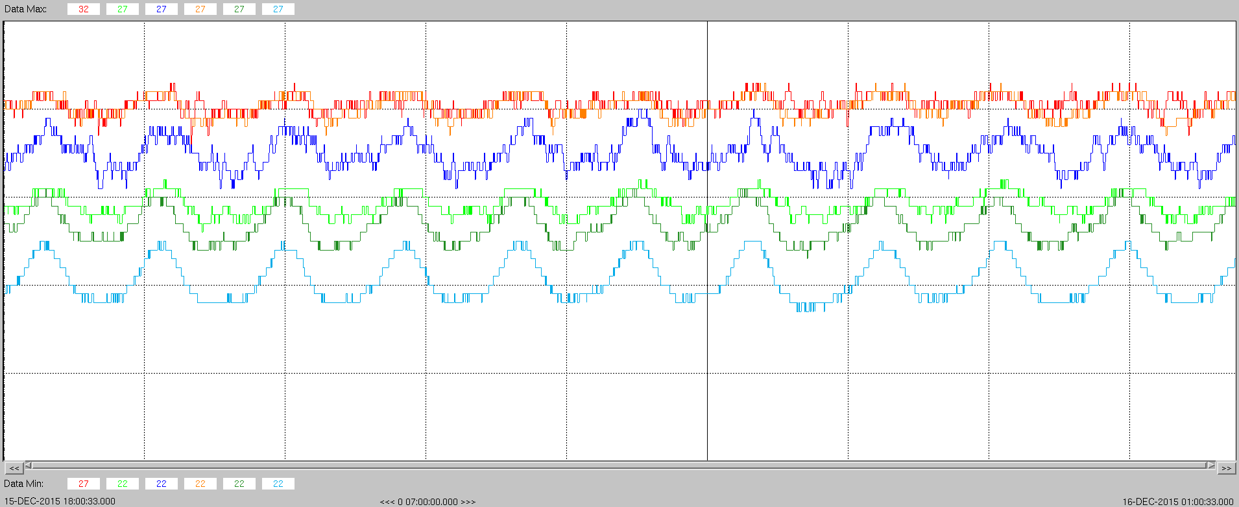
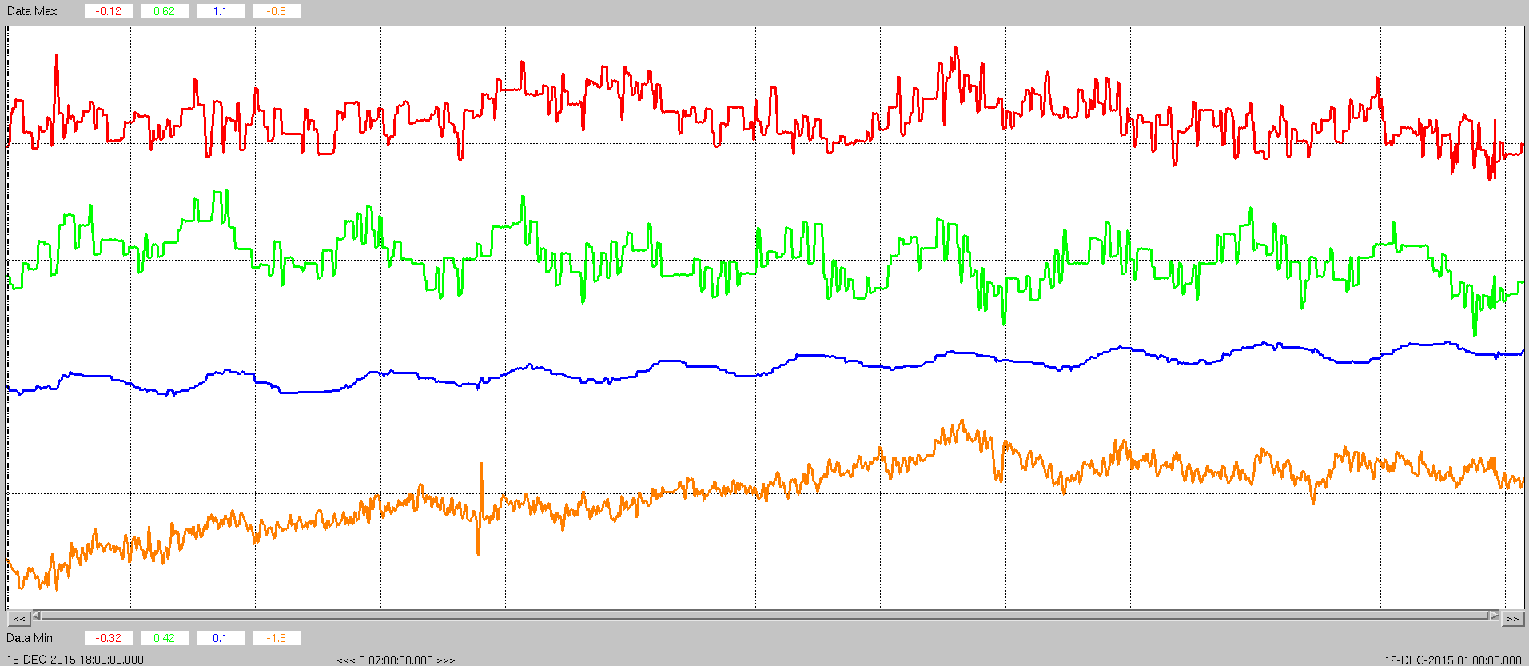
Orbit drift with the DR room temp(1)
Air Temperature: 12/15 18:00 – 12/16 01:00
DR tunnel Temp(1), (2), (3), (4), (5)
  Temp change < 1degC
40 minutes
Feedback Kicker Amplitude : 12/15 18:00 – 12/16 01:00
Horizontal ZH4X, ZH5X
Vertical ZVFB1X, ZVFB2X
The strength of the orbit feedback correlated with the DR temp.

Slide 15
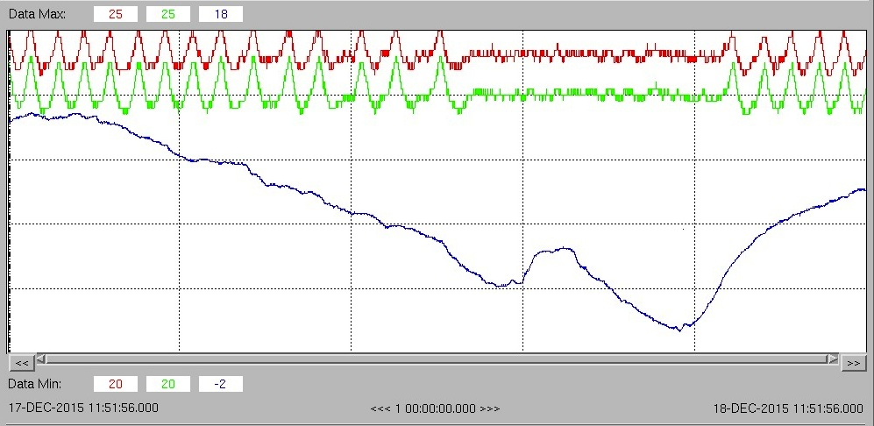
Orbit drift with the DR room temp(2)
Air Temperature: 12/17 12:00 – 12/18 12:00
(1)
(2)
DR tunnel Temp(1), (2),
Outside Temp (3)
1degC
(3)
4degC
The interval of turned ON/OFF of the chiller was changed by the outside temp.
  -> reducing the interval and Increasing the PID parameters will be done to stabilize the air temperature. (~Jan.2016)

Slide 16
ATF hardware status
    - Orbit Stabilization
T.Naito(KEK)
ATF2 Project meeting 2016.1.13
Laboratoire de l'Accélérateur Linéaire (LAL)
Orbit oscillation due to the Cooling water temperature change
Orbit drift in FF due to the DR air-conditioner
Extraction kicker trouble(2015.11~2015.12)
Proposal for the pulse stabilization of the extraction kicker

Slide 17
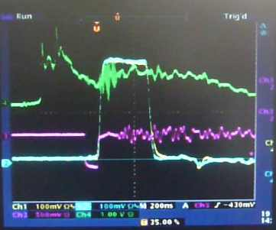
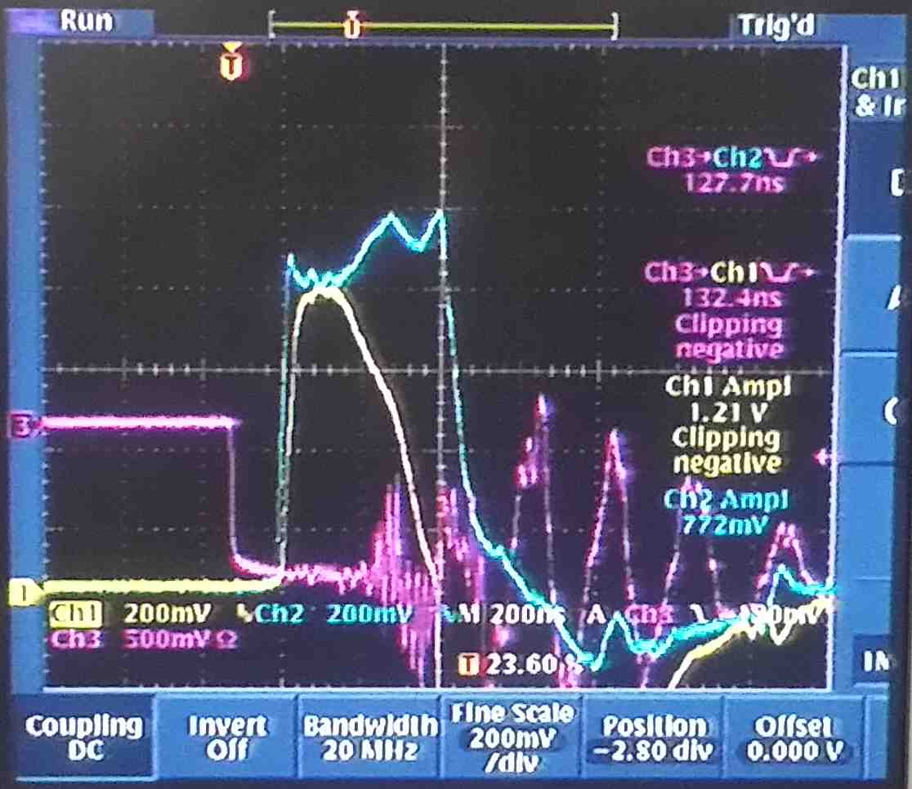
ATF extraction kicker trouble (2015/11/16~2015/12/01)
2015/11/16 - Suddenly, the ATF beam could not be extracted to the extraction line. The kicker waveform changed from Fig.1 to Fig.2. In the figures, the ch1(yellow) shows the thyratron1 current and ch2(blue) shows the thyratron2 current. It seemed thyratron1 has some serious damage.
2015/11/17 - The thyratron1 was changed to other one. Unfortunately, we have no new spare, so we replaced to an old thyratron. The thyratron was used several years, which was working but the output pulse timing was unstable.
Fig.1
Fig.2

Slide 18
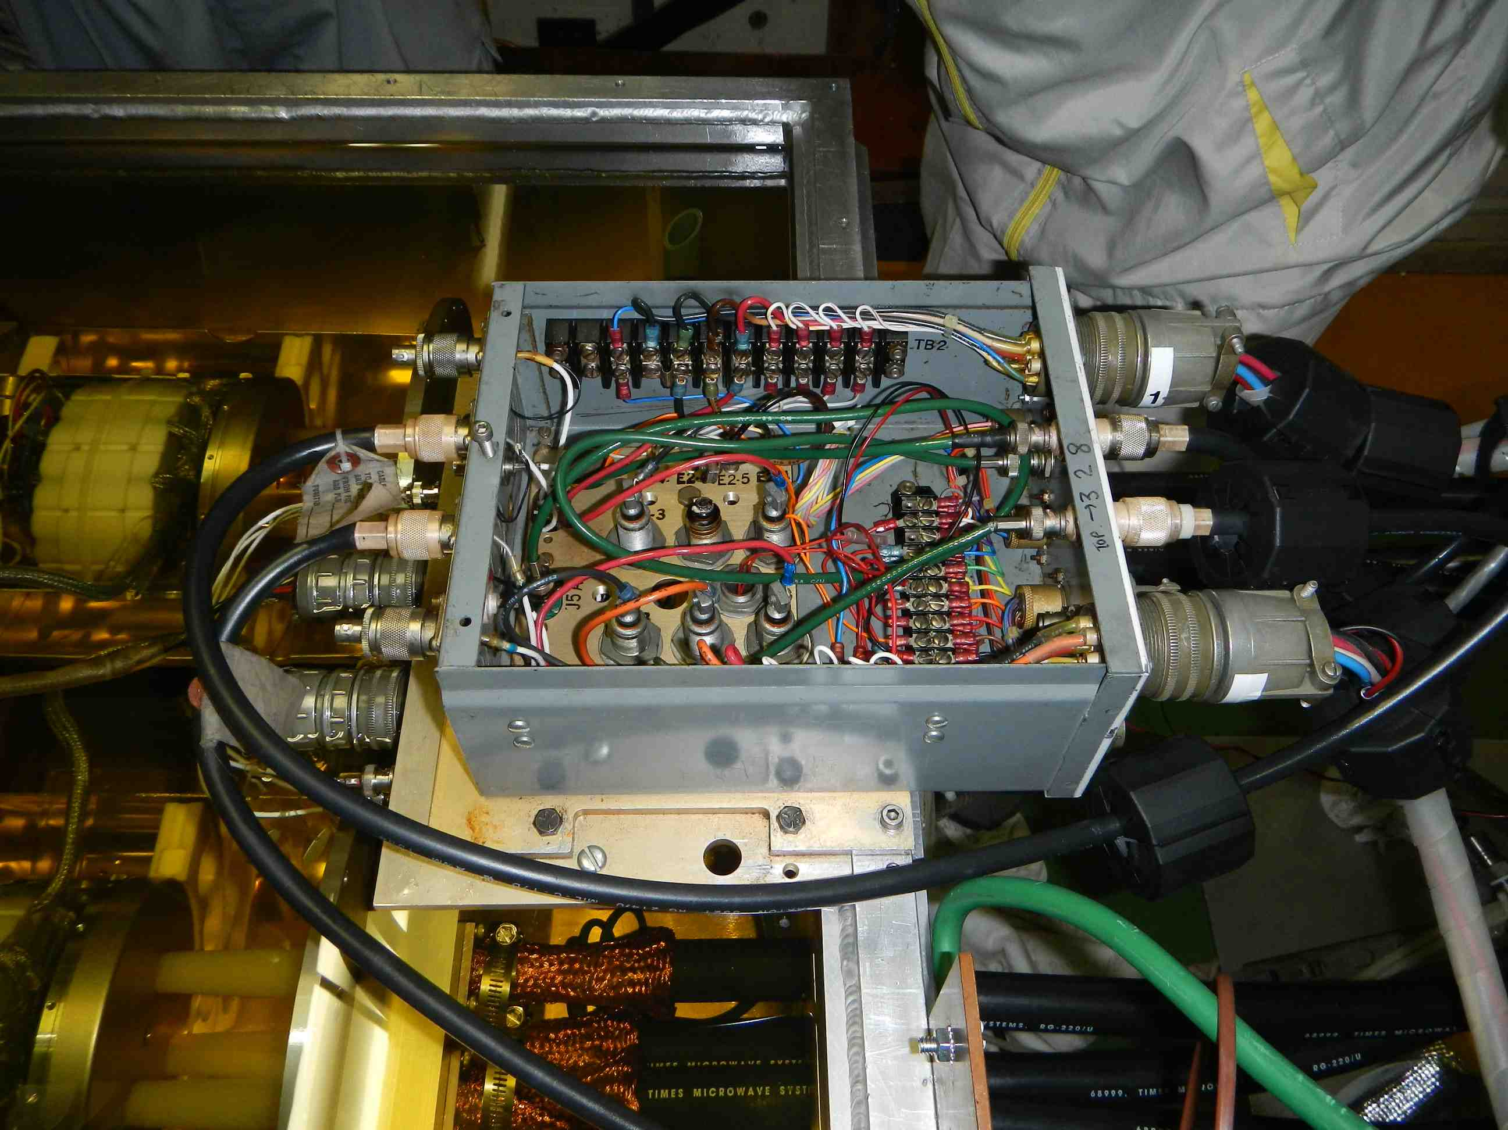
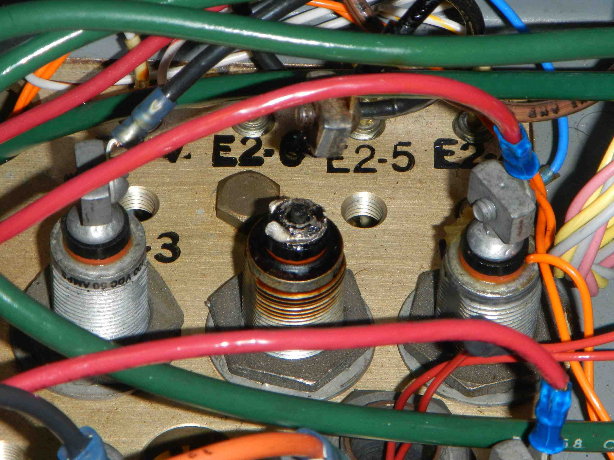
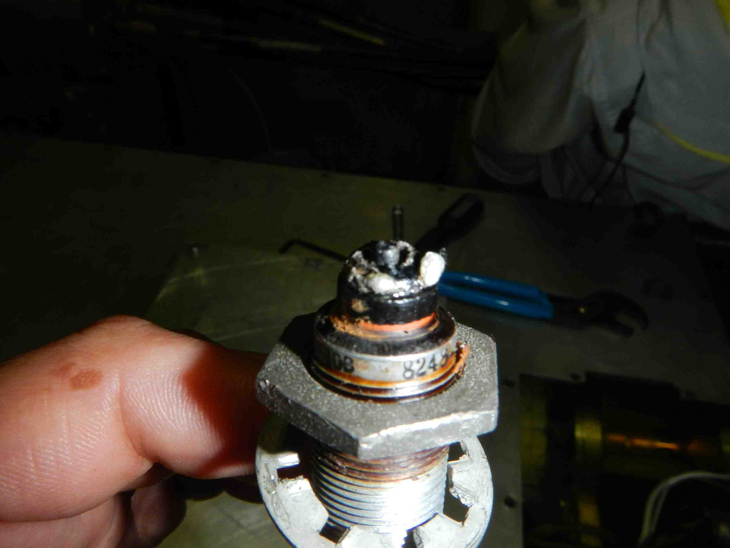
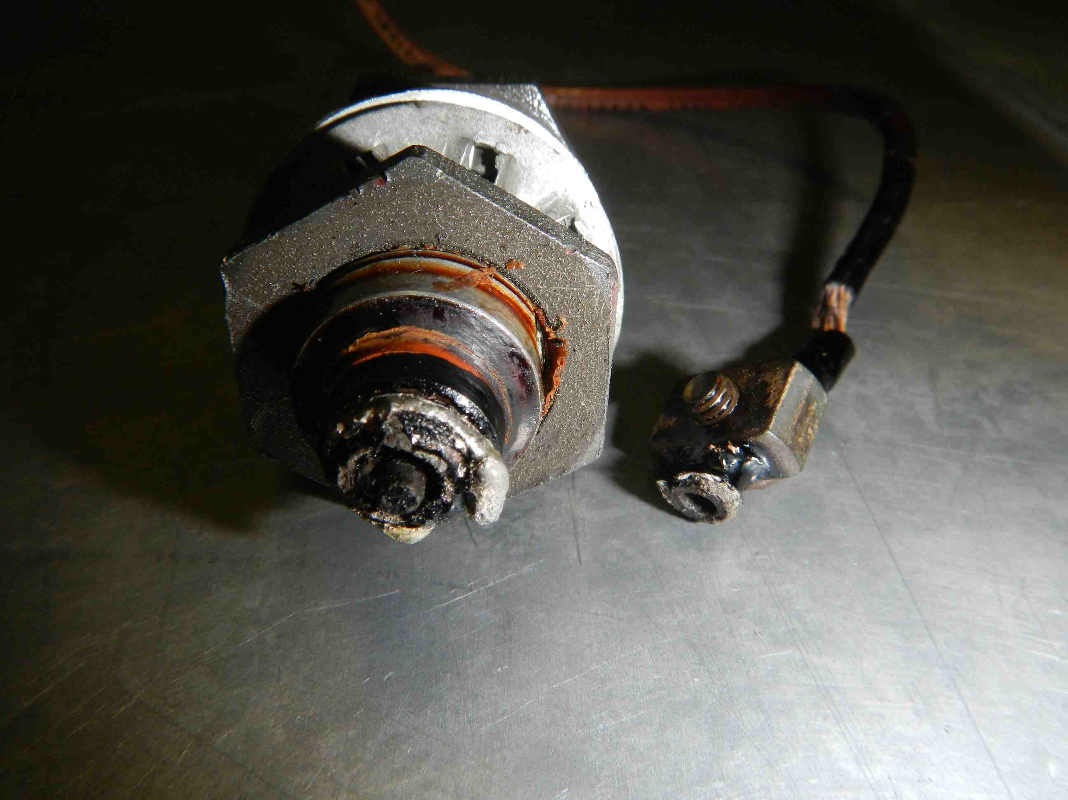
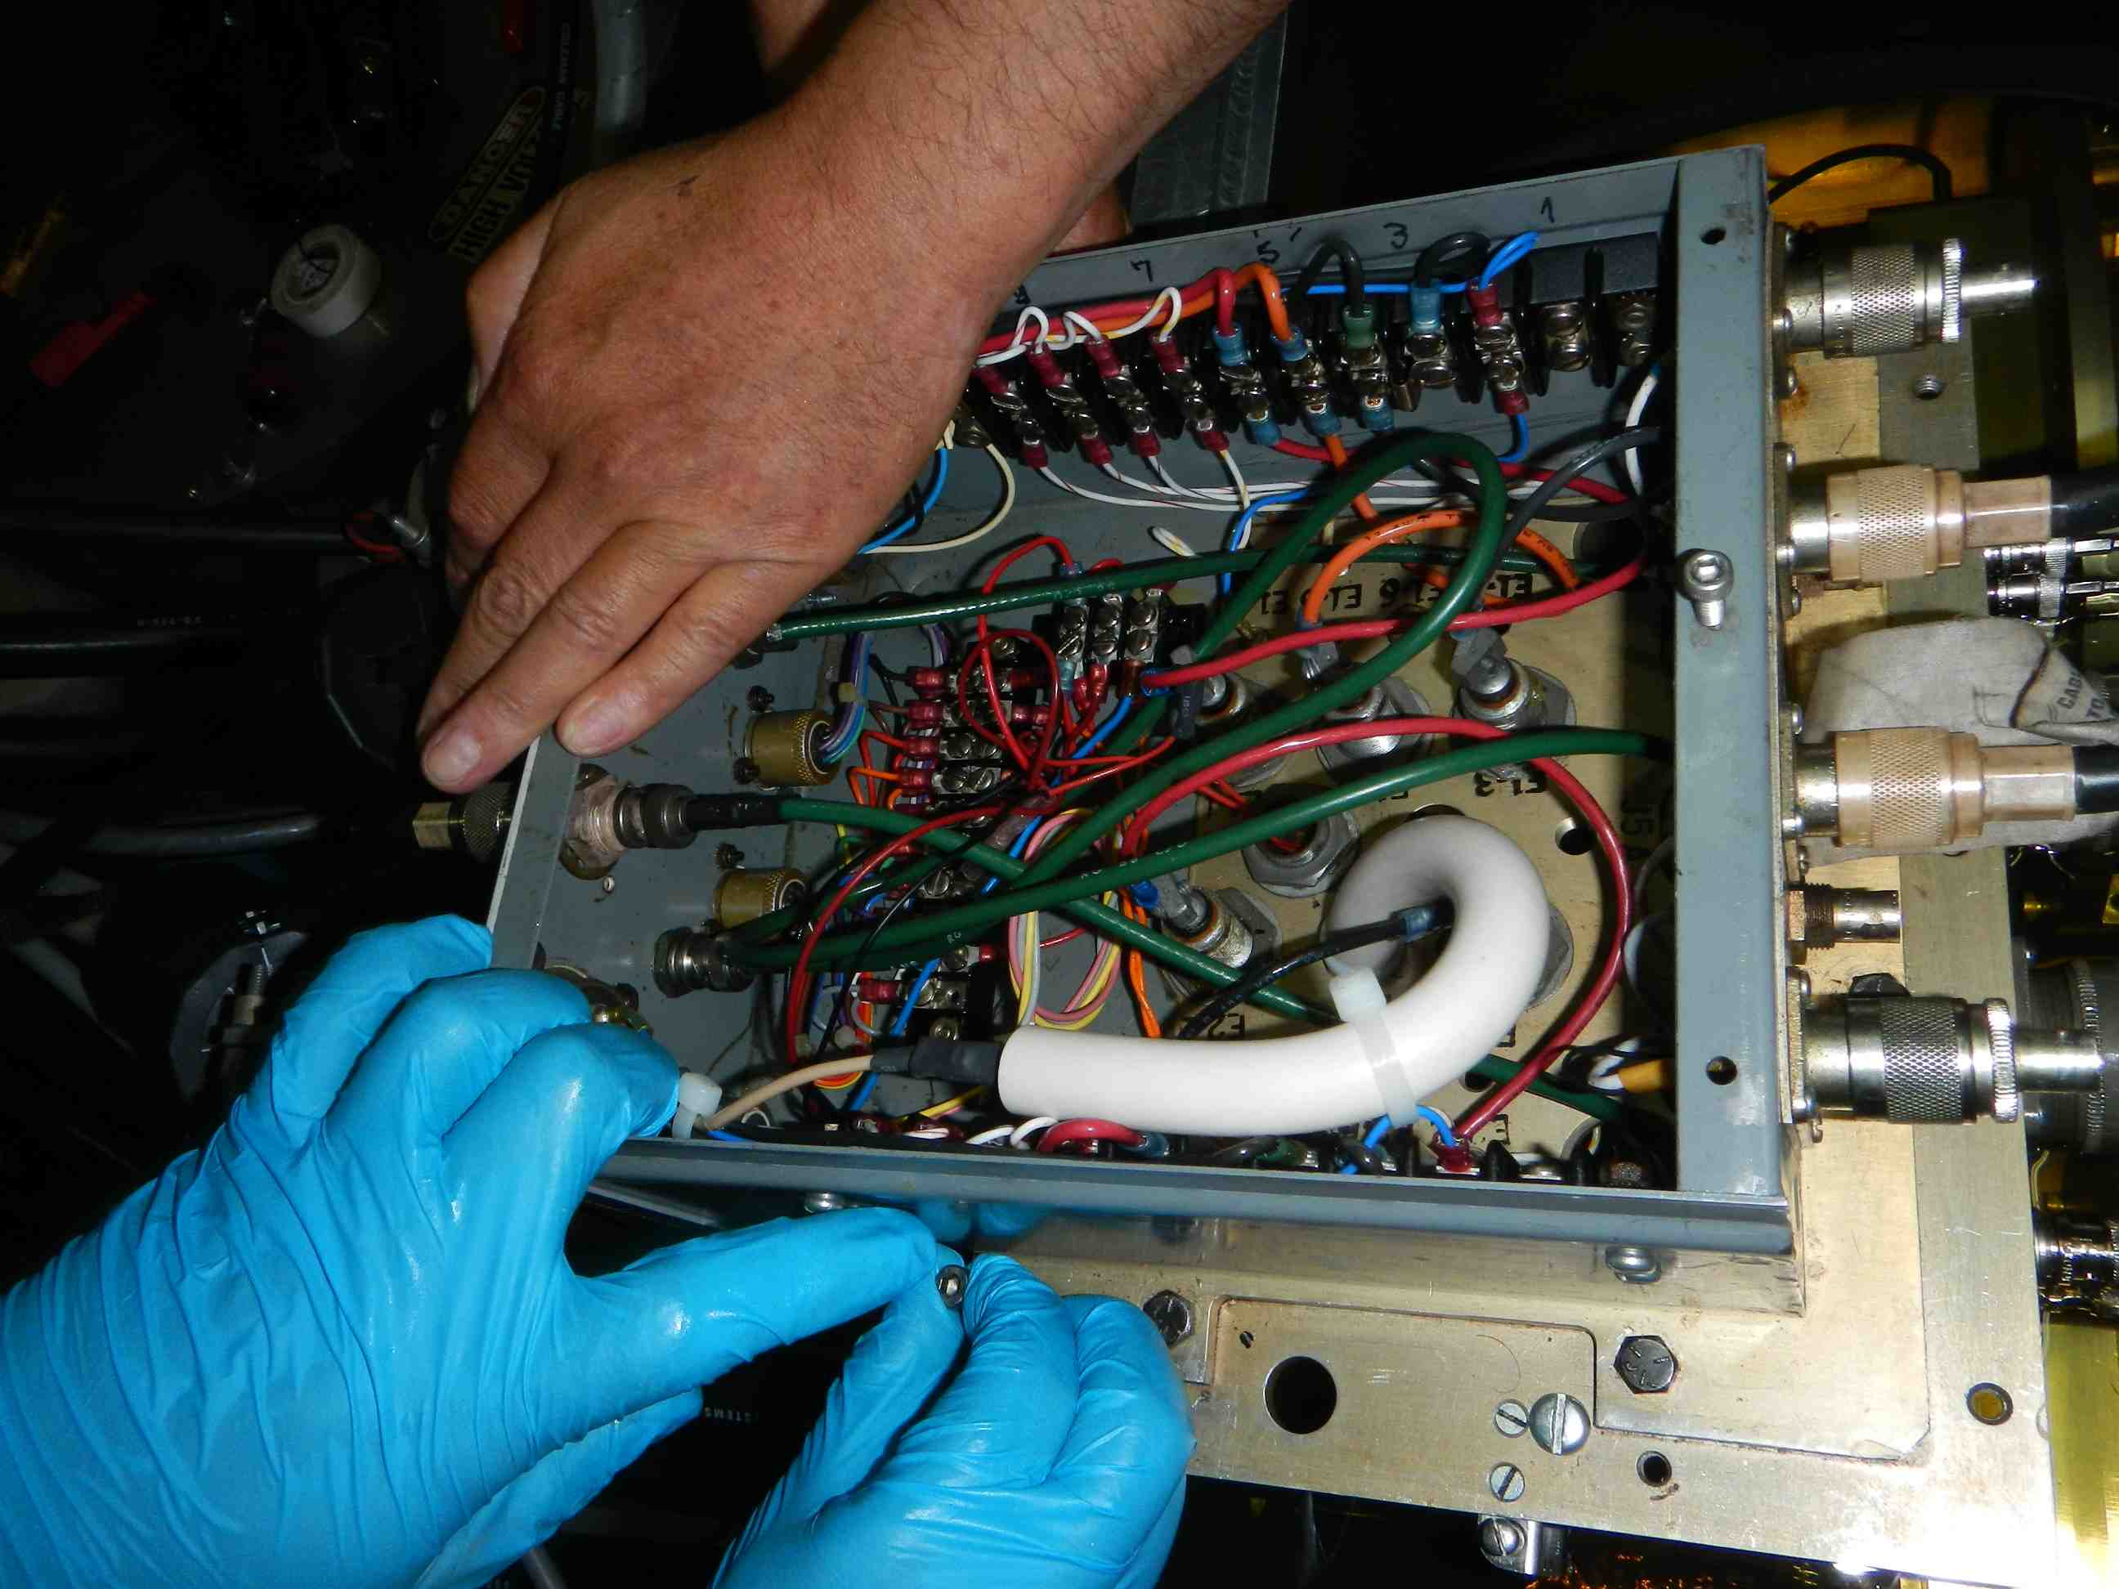
ATF extraction kicker trouble (2015/11/16~2015/12/01)
2015/11/30 - The kicker suddenly stopped after 12hours from the start up in the week.
2015/12/01 - Finally, we found the melted feed through of the thyratron heater, which is replaced to an HV cable. We lost 7 shifts because the trouble.
Melted feed through

Slide 19
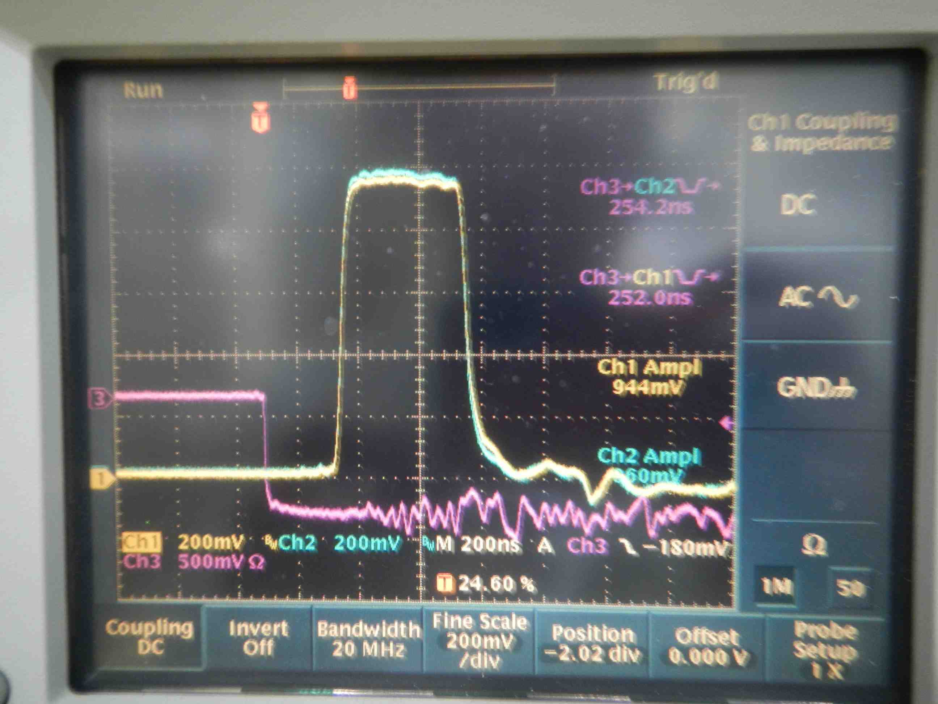
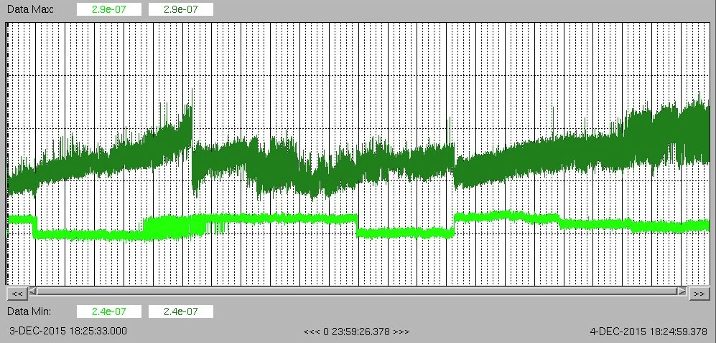
Timing jitter of the extraction kicker
This graph shows the timing jitter of the tyratron pulse.
The vertical axis is the delay time from trigger to the output pulse and the horizontal axis is the time trend in one day.
Thyratron 1
Thyratron 2
10ns
Thyratron 1
Thyratron 2

Slide 20
ATF hardware status
    - Orbit Stabilization
T.Naito(KEK)
ATF2 Project meeting 2016.1.13
Laboratoire de l'Accélérateur Linéaire (LAL)
Orbit oscillation due to the Cooling water temperature change
Orbit drift in FF due to the DR air-conditioner
Extraction kicker trouble(2015.11~2015.12)
Proposal for the pulse stabilization of the extraction kicker
  “In the future support from SLAC will be limited because we will not have a running systems to use.” - John W. Krzaszczak(SLAC)

Slide 21
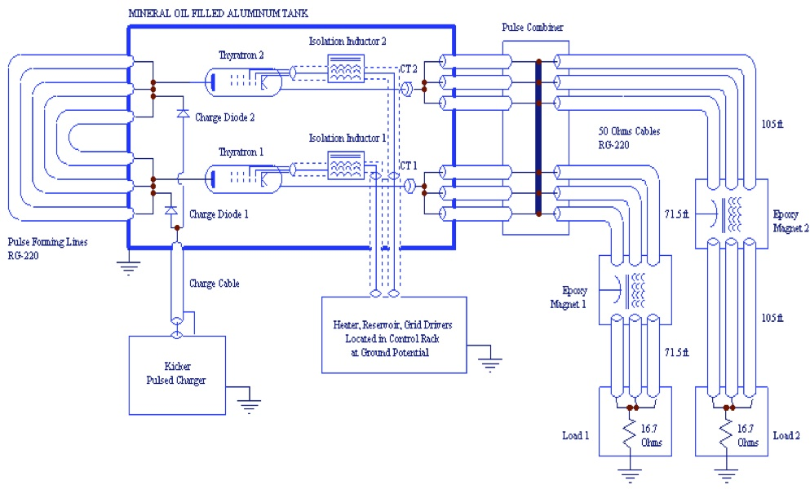
Present layout of ATF extraction kicker
2nd kicker magnet was skipped(2013).
PulseWidth=
300ns
Impedance
50/3 ohm
=16.7 ohm
The 2nd kicker magnet was skipped since 2013. However, the pulse power supply(PPS) produces two pulses and one pulse go to the dummy load directly. This proposal is to modify the PPS from a double pulse to a single pulse.
The benefit of the modification is
To reduce the thyratron current(stable operation, reduce the noise, etc.),
To reduce the pulse width fluctuation,
To extend the life of the devices .

Slide 22
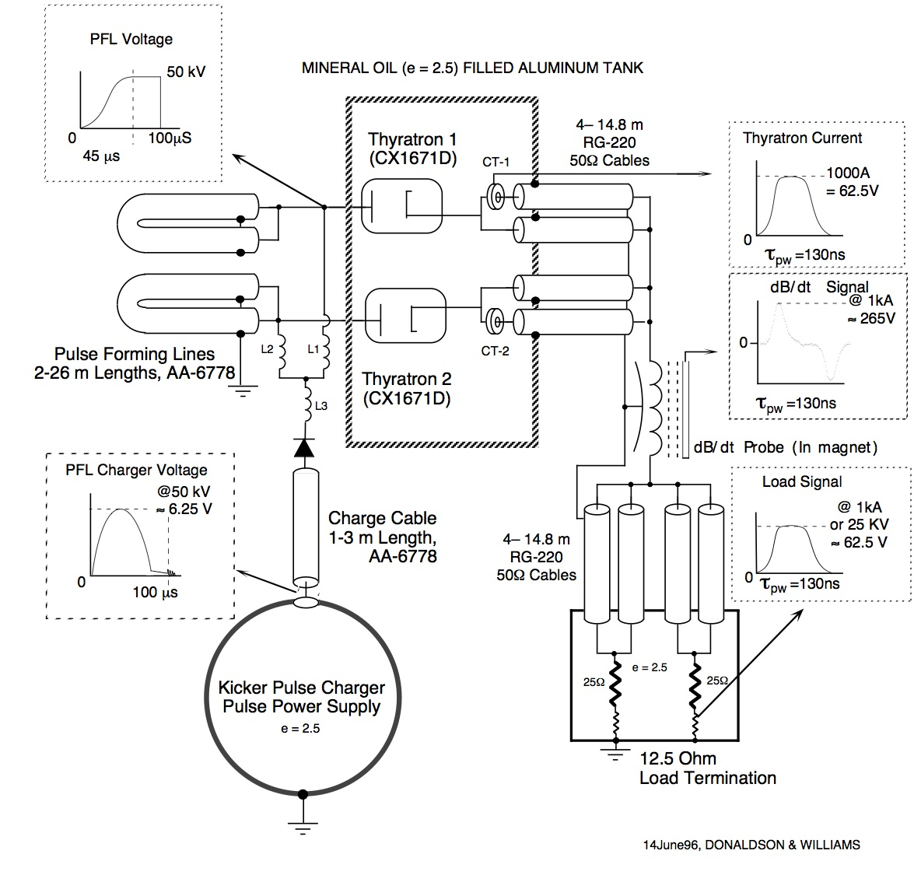
Layout of the ATF Injection kicker
Pulse Width=
130ns
Impedance
50/4 ohm
=12.5 ohm
The modification is aiming to the same configuration as the injection kicker.

Slide 23
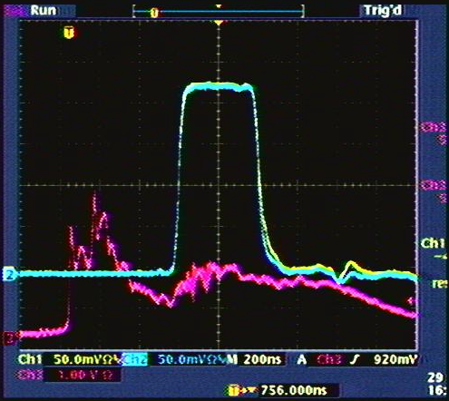
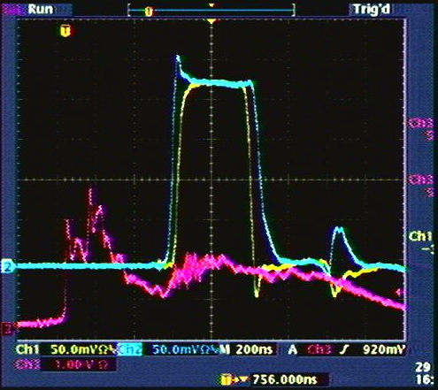
Pulse width change
On timing
Off timing
The difference of the Pulse timing affects not only changing the timing but also changing the pulse width, which come from the circuit configuration. The injection kicker doesn’t change the pulse width.

Slide 24
Proposed layout of ATF extraction kicker
Same cable
length
Load Impedance
=12.5 ohm
Same configuration as the injection kicker can be made by changing the cable connection. The modification work needs about one week and the modification can be back to a double pulse configuration, if needed.

Slide 25
Summary
The orbit oscillation in the DR due to the Cooling water temperature change was fixed by stabilizing the temperature.
The orbit drift in FF was due to the temperature change of the DR air-conditioner. This temperature change also should be minimized.
The Extraction kicker trouble(2015.11~2015.12) was fixed by replacing the thyratron heater feed through.
The extraction kicker PS modification was proposed to minimized the orbit jitter and to improve the maintenance.

