Slide 1
CR11
Rearrangement of
Undulator Positron Source
Wei Gai (ANL)
Masao Kuriki (Hiroshima)
Toshiyuki Okugi (KEK)
8-Dec-2015
CMB Meeting

Slide 2
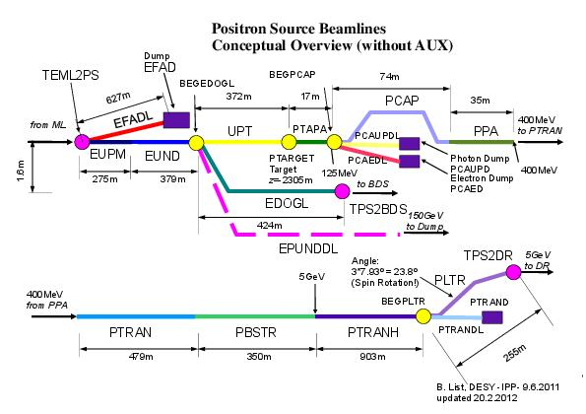
The Points
Rearrange Undulator Positron Source for
  Higher flexibility
  Better performance
Relocate PBSTR to upstream to shorten PTRAN.
Relocate ECS (Energy Compressor Section) to upstream.
Relocate Path Length Adjuster to downstream of ECS.

Slide 3
Rationale
A long transport line (PTRAN 470m) between PPA (Positron Pre Accelerator) and PBSTR (Positron BooSTeR) at 500 MeV can be omitted by moving PBSTR to upstream.
ECS is moved to downstream of PBSTR.
Path Length Adjuster is moved to downstream of ECS.
By relocating them, a) PTRAN (500 MeV) is omitted, b) PTRANH (5 GeV) is increased, but the energy spread there is decreased to 0.75% which suppresses chromatic effects.
In the current configuration, PLA (chicanes) is followed by ECS (chicanes + RF). In this case, momentum compaction by PLA and ECS has to be matched to RF. PLA and ECS is fully coupled.
Changing the order of ECS and PLA, ECS and PLA can be decoupled. The operation is simplified.
An additional cryomodule for PBSTR for operational margin.

Slide 4
Relocation of PBSTR
By relocating PBSTR to upstream, we can reserve a less busy area for higher flexibility.
Integrate ECS and PLA for better performance.
ECS
∂
∂
∂
400 MeV Transport (PTRAN)
Path Length Adjuster
Undulator
PPA
PBSTR
5 GeV Transport (PTRANH)
Undulator Source
∂
∂
~ 1.1 km
∂
Undulator
PPA
PBSTR
ECS PLA
PTRANH
Undulator Source

Slide 5
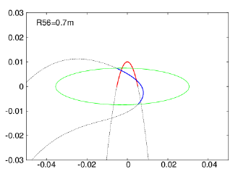
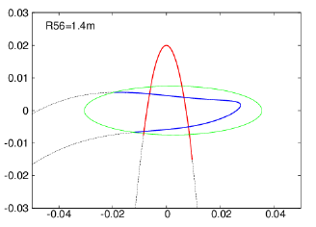
R₅₆ of ECS
1.4 m R₅₆ of ECS gives a better phase space matching to DR acceptance comparing to 0.7 m (TDR).

Slide 6
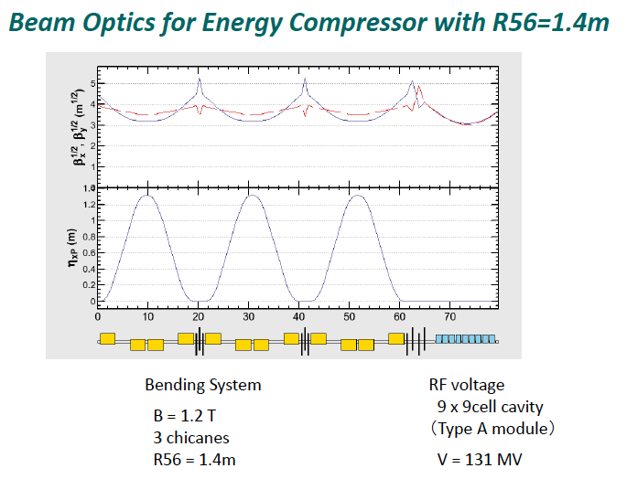

Slide 7
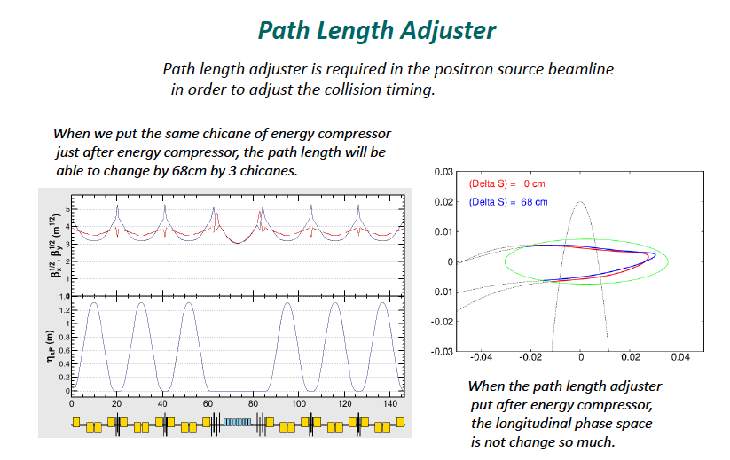

Slide 8
Cost Estimate
Cost impact by the CFS modification can be estimated once CFS group fix the design.
Number of components is increased:
  An additional cryomodule of PBSTR for operational margin.
Number of components is decreased:
  Quads because the beam energy is increased to 5 GeV.
Cost impact on the components is summarized as ……

Slide 9
Summary
Rearrangement on Undulator positron source is proposed.
  Relocate PBSTR.
  Relocate and change order of PLA and ECS for more simple operation.
  Better matching by 1.4m R56.
  Additional cryomodule of PBSTR for margin

