Slide 1
STATUS OF CHANGE REQUEST 013, CHANGE IN LINAC SHIELD WALL AND TUNNEL CROSS-SECTION
Request document in final preparation
No significant changes to Technical Presentations in LCWS 2015 in Nov
Final discussion of CFS impact in last hour!

Slide 2
Abstract:- The present CFS design of the linac tunnel cross-section, optimized for the Kitakami site, is a ‘Komoboku’ shape divided into three sections by a shield wall. These are the beam tunnel containing the accelerating cavities and the high power beams, (3.8 m wide), the concrete shield wall, (3.5m thick), and the service tunnel, (3.7m wide). This allows access to the service tunnel by technical personnel under all beam operation scenarios including worst case accident conditions of loss of multi-megawatts of beam power in the linac tunnel.
It is proposed to limit access to the service tunnel to when there is NO accelerated beam in the linac but all equipment in the tunnels can be in operation. The shield wall is reduced in thickness to 1.5 meters which is thick enough to shield personnel from the radiation from dark current produced by the powered cavities. The dark current levels and distribution along with the produced gamma and neutron fluxes in the beam and service tunnels have been simulated extensively and confirm that a 1.5 meter wall is still a conservative shield. The impact on operation and beam time availability of the more restrictive access conditions into the service tunnel has also been studied and found to be comparable to that assumed in the TDR.
Both the shield wall and the Kamaboku tunnel width are reduced by 2 meters along the 22 km of linac length, which is a considerable savings in construction cost and schedule.

Slide 3
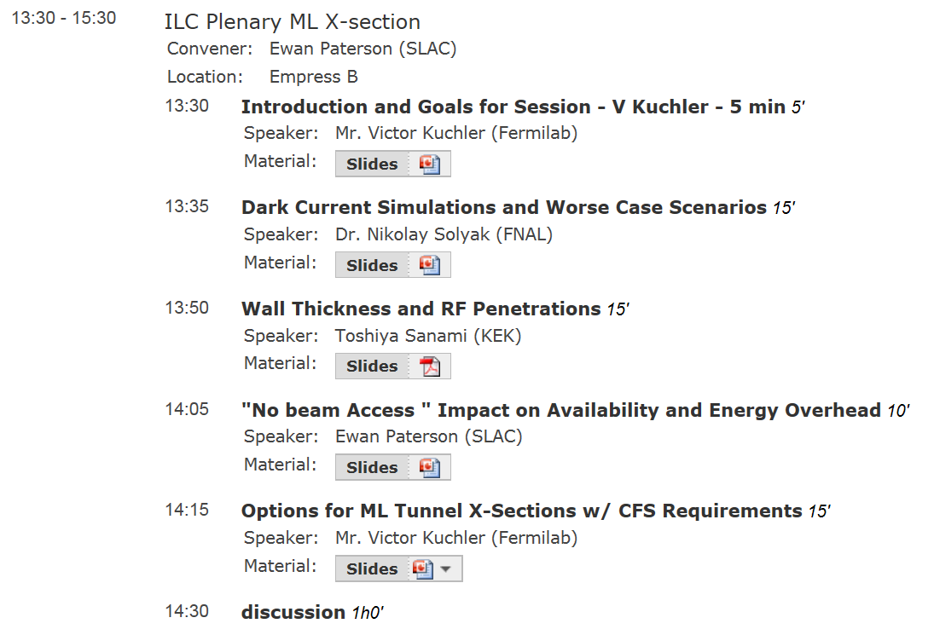
Technical References

Slide 4
UPDATE in last hour!
Safety cross-over passage should NOT be opposite a quadrupole. Away from a quad the radiation is more than one order of magnitude lower and passage should be simpler. Place passage approximately between cryomodules of TYPE A (no quad) in ABAABA system and spaced as required by codes.
Can overall tunnel be 9 meters?
Cost saving with 3.5 -> 1.5 meter wall?
Cost saving of tunnel 11 -> 9? Meters?

