Slide 1
Analysis Test Beam
Pixel TPC z deformations
Peter Kluit, Michael Lupberger, Jan Timmermans
LC TPC-pixel meeting 28 January 2016

Slide 2
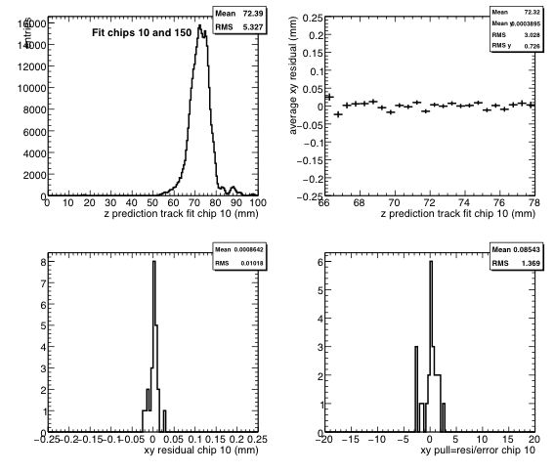
Chip 10 z deformations
Z beam profile on chip 10
Residual flat
Left bottom residuals xy of right top distribution
Left right the pulls = residual/error
Reason for flatness is that the chip 10 is reference for alignment

Slide 3
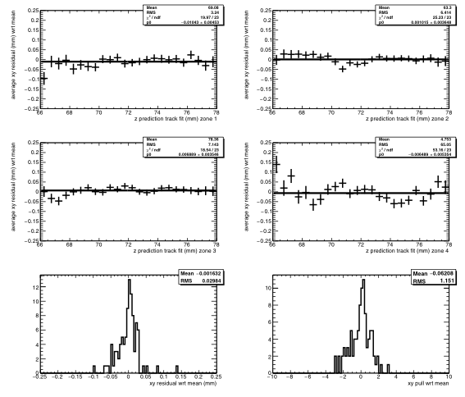
Chip 10 z residual deformations
Spit chip 10 in four zones in y pixels:
0-64, 64-128, 128-192,192-256
Residuals have structure
Left bottom gives the residuals of the 4 zones
Right pulls
Residuals have 30 micron rms and pull 1.2. So add sys error of 15 microns

Slide 4
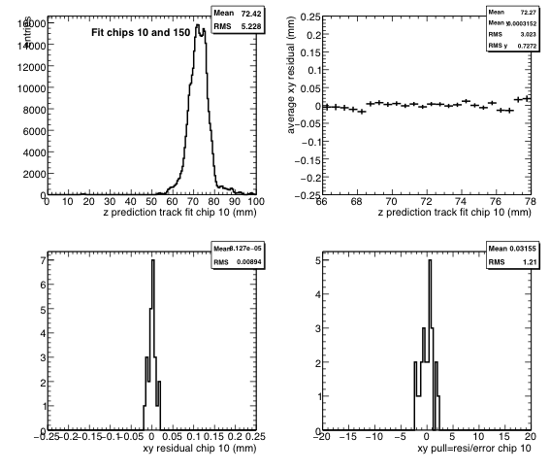
Chip 10 z deformations if all z hits used in fit

Slide 5
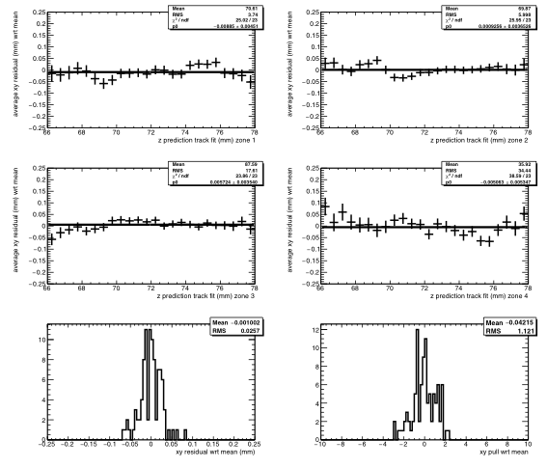
Chip 10 z residual deformations if all z hits used in fit
Same observation of additional syst of 15 microns if one studies the zones

Slide 6
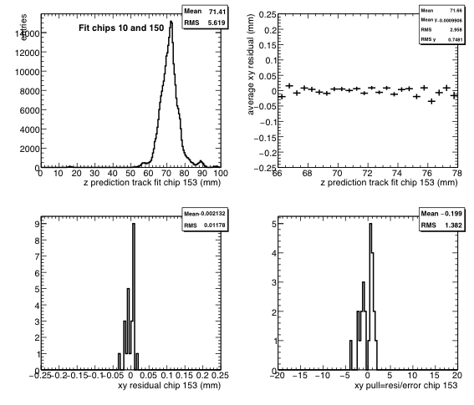
Chip 153 z deformations if all z hits used in fit
Also chip 153 is a reference chip for alignment that gives a flat distribution

Slide 7
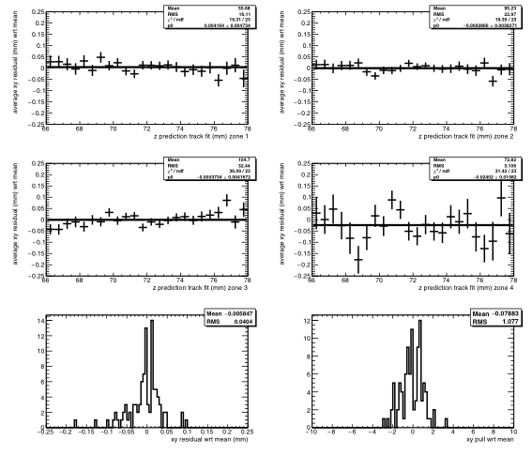
Chip 153 z residual deformations if all z hits used in fit
Similar conclusion as for chip 10. There is additional syst of about 15 microns in the zones

Slide 8
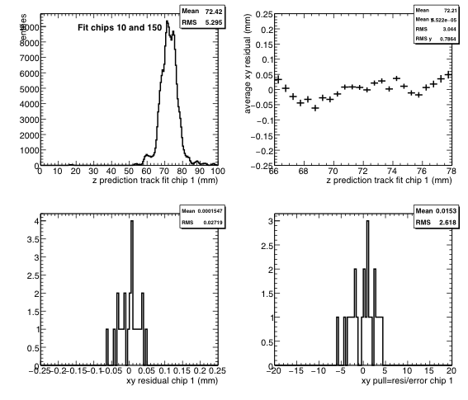
Chip 1 z deformations if all z hits used in fit
Chip 1 is NOT used as a reference.
Observe a structure in the residuals of 27 microns. The pull is 2.6. So beyond stats.
So 25 microns syst

Slide 9
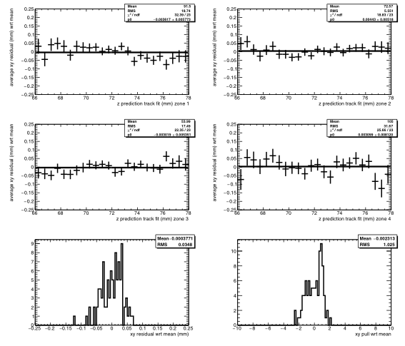
Chip 1 residual z deformations if all z hits used in fit
The common shifts shown in previous slide are subtracted
Same conclusion as for chip 10 and 153 of additional sys of 15 microns

Slide 10
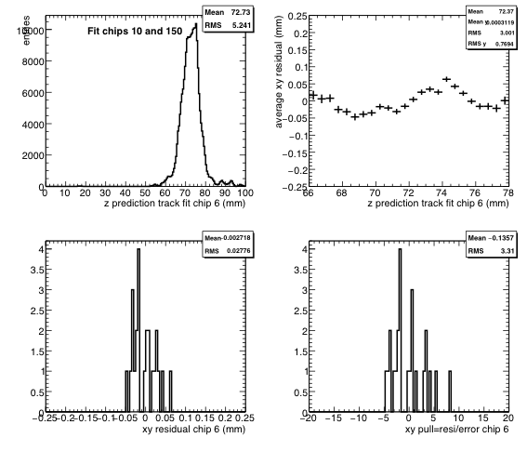
Chip 6 z deformations if all z hits used in fit
Chip 6 has additional syst of 25 microns

Slide 11
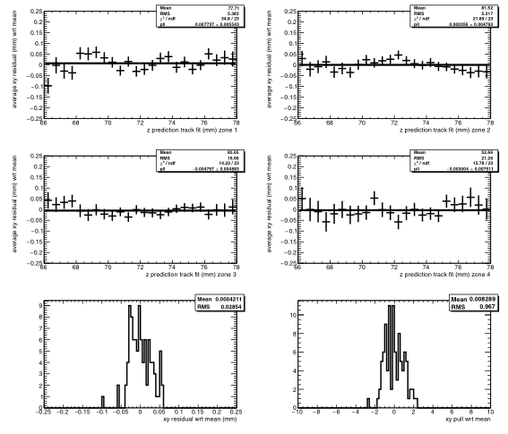
Chip 6 residual z deformations if all z hits used in fit

Slide 12
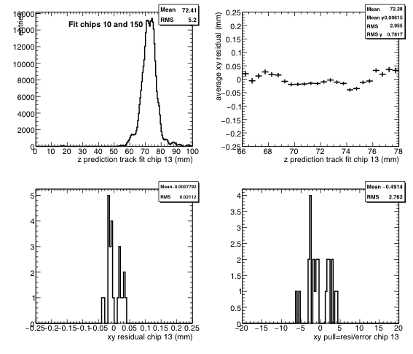
Chip 13 z deformations if all z hits used in fit
Chip 13 has
syst of 20 microns

Slide 13
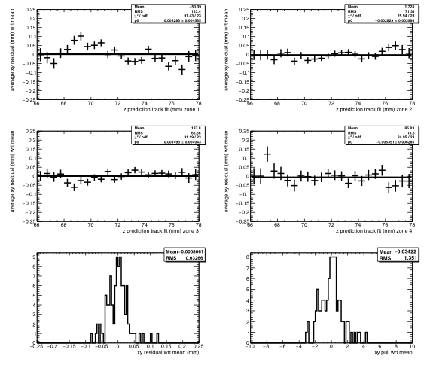
Chip 13 residual z deformations if all z hits used in fit

Slide 14
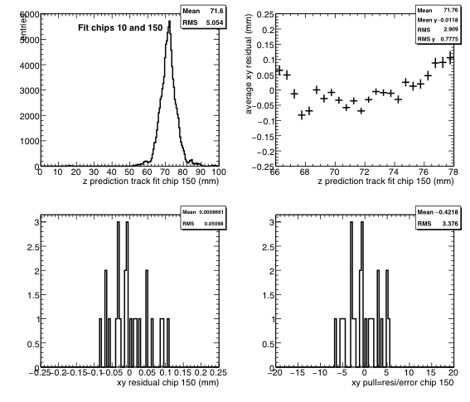
Chip 150 z deformations if all z hits used in fit
Chip 150
Additional syst 70 microns
Quite bad

Slide 15
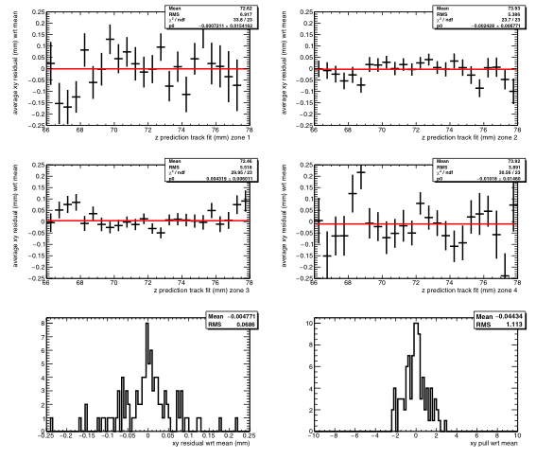
Chip 150 residual z deformations if all z hits used in fit

Slide 16
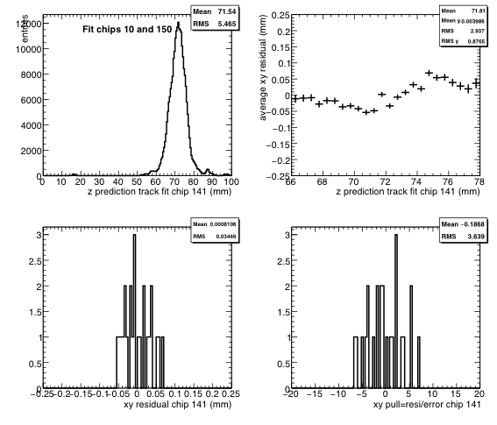
Chip 141 z deformations if all z hits used in fit
Chip 141
additional sys
35 microns

Slide 17
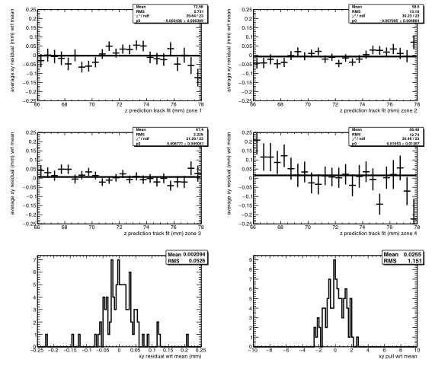
Chip 141 residual z deformations if all z hits used in fit

Slide 18
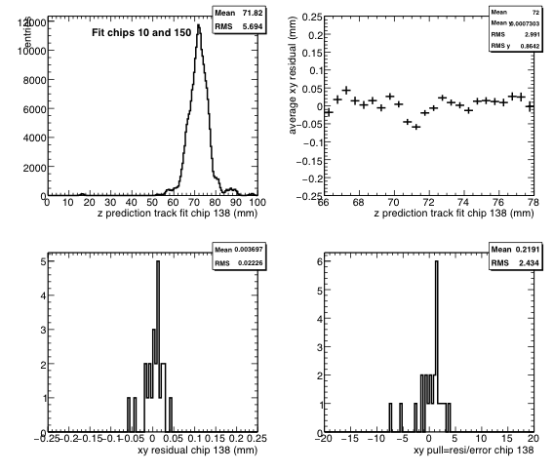
Chip 138 z deformations if all z hits used in fit
Chip 138 additional syst 22 microns

Slide 19
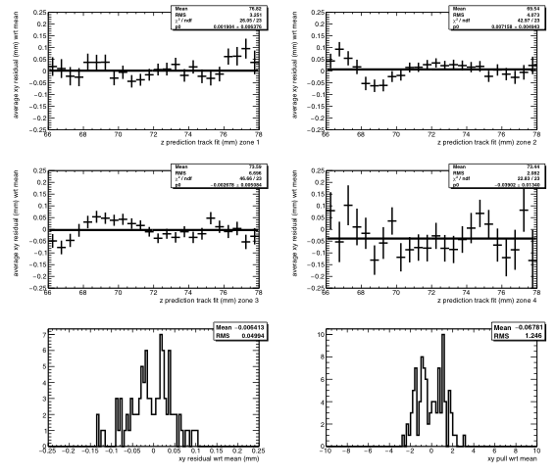
Chip 138 residual z deformations if all z hits used in fit

Slide 20
Overview all chips
chip rms pull rms syst
systematics
chips 10 and 153
6 microns
All others
19 to 40 microns
Trend chips 90 to 153 worse than others
1 0.0271938 2.61763 0.023225
6 0.0311058 3.60138 0.0287075
10 0.0109067 1.53113 0.00625438
13 0.0247628 3.1621 0.0222863
17 0.0278677 3.43124 0.0255007
22 0.0267972 3.08028 0.0239729
26 0.0259569 2.68479 0.0223558
29 0.0262465 2.43372 0.0218152
66 0.0257813 2.26379 0.0207505
69 0.0257808 1.93203 0.0188741
82 0.0235697 2.51261 0.0198363
85 0.0275432 2.8435 0.0241367
90 0.03673 3.31217 0.033382
93 0.0267364 2.74584 0.0231903
134 0.0418711 3.44197 0.0383368
138 0.0261769 2.87476 0.0230094
141 0.0334069 3.46663 0.0306271
150 0.0444011 3.06263 0.0396674
153 0.0115297 1.38851 0.00554944

