Slide 1

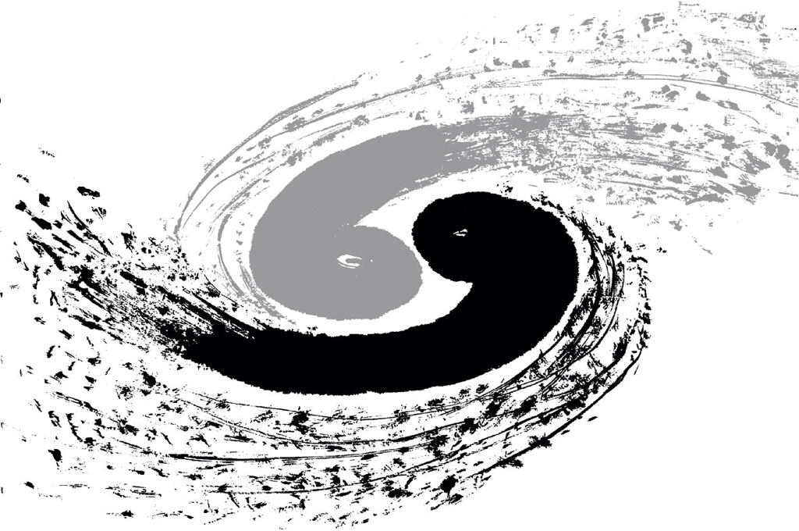

Charged PID in Arbor
23/02/2016
Dan YU

Slide 2
Introduction
Use of very high granularity
  (SiW-ECAL+SDHCAL) + ARBOR
  new means of Particle ID
PID on final charged PFO’s — This talk
internally to improve Energy scale (~SW compensation) and Track-Cluster matching

Slide 3
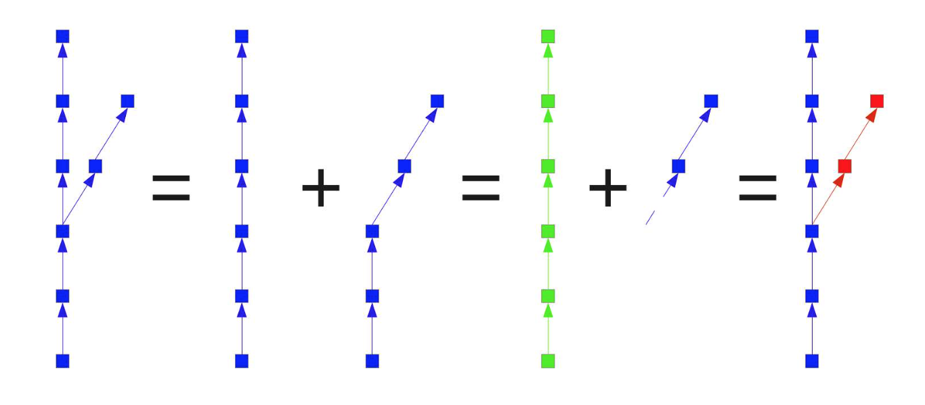
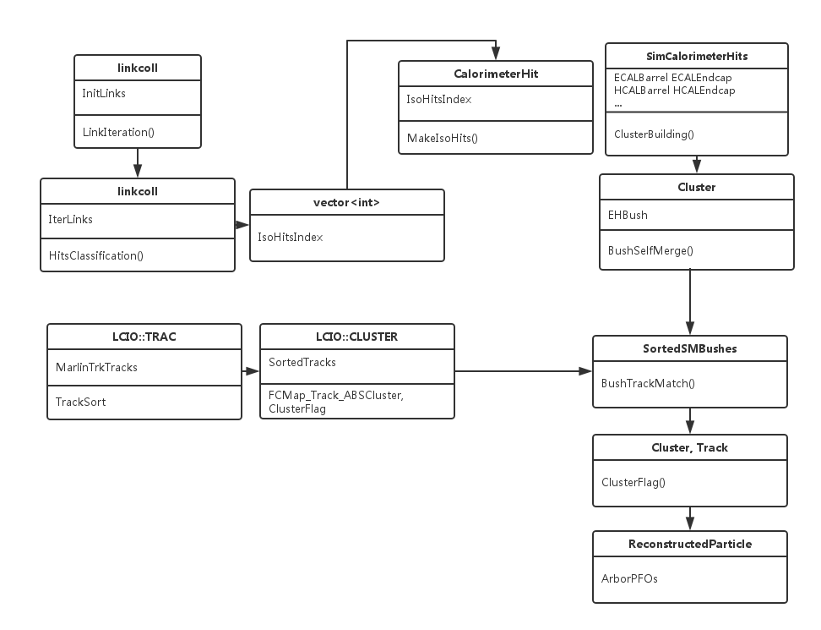
Arbor
Motivation: spatial configuration
Steps:
  Build connectors
  Clean connectors
  Iteration
Under development

Slide 4
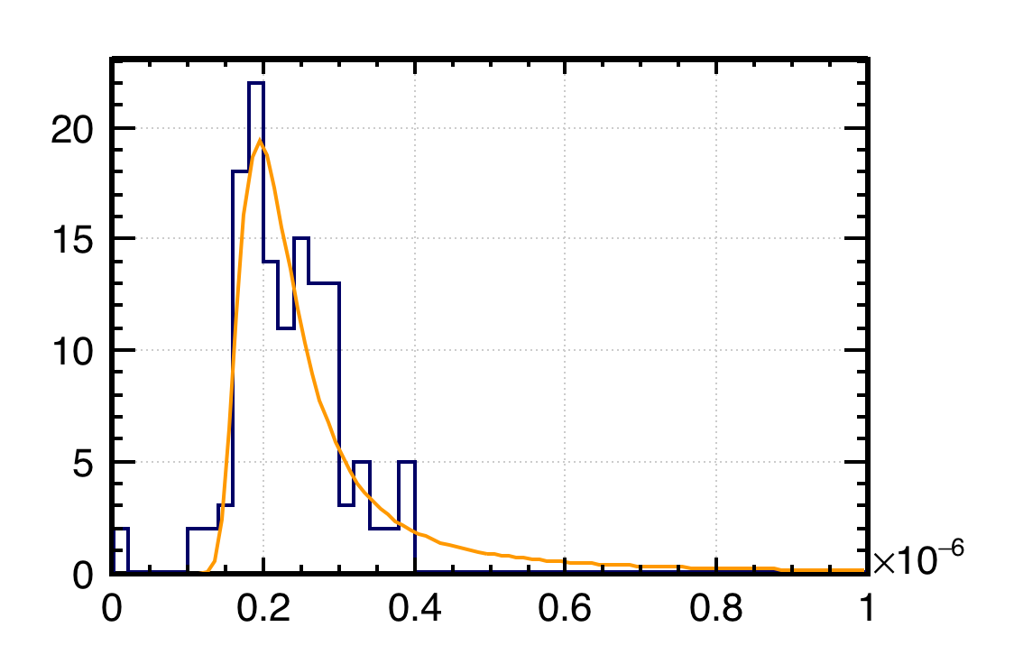
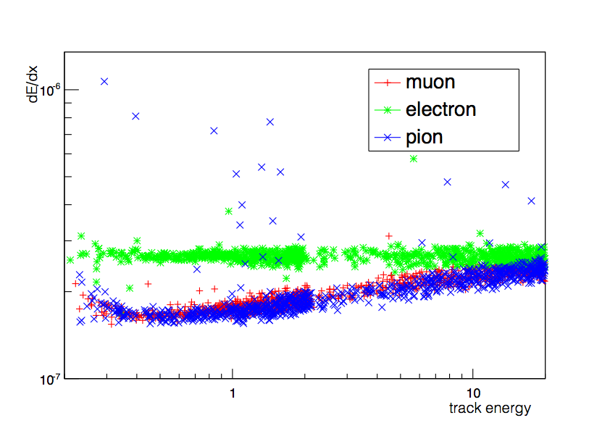
PID Variables: tracks
dE/dx: For a track in TPC, the distribution of energy loss per unit of depth follows the Landau distribution.
The dE/dx of a track used here is actually the average of this value but after vetoing tails at the two edges of Landau distribution [10%–70%]
energy loss per unit of depth of a 10 MeV pion track including missing hits [bef. cut]

Slide 5
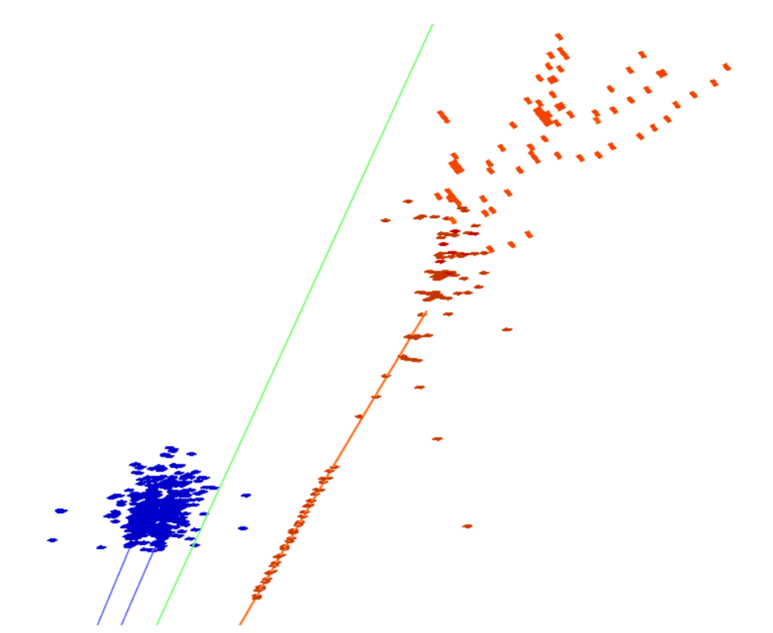
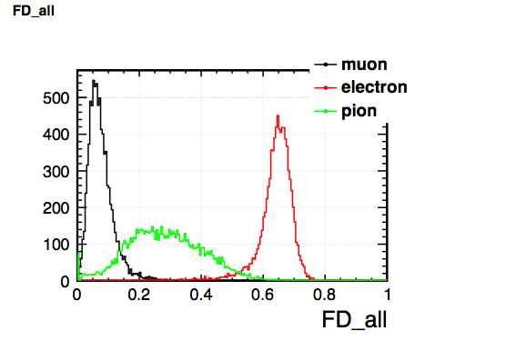
PID Variables: Fractal Dim.
reveals detailed information of the spatial configuration of the shower
  α: scale at which the shower is analysed
  (by grouping hits)
  Nα: the number of hits at scale α
  Rα,β =Nβ/Nα: ratio of the number of hits at different scales
  FDβ = ⟨log(Rα,β)/log(α)⟩β–20 + 1 (or FD-1)
    here：FD1mm
Used: FD_ECAL, FD_HCAL, FD_all
10GeV events

Slide 6
PID Variables: Other Calo
Energy Distribution:
  the proportion of energy deposit in ECAL: EcalEn
  energy deposit in the first 10 layers in ECAL: EEClu_L10
  energy deposit in a cylinder around the incident direction
  within a radius of 1 RM and 1.5 RM : EEClu_r, EEClu_R
Spatial Hits Information:
  number of layers hit by the shower: ECALHit, HCALHit
  number of hits in the first 10 layers of ECAL: NH_ECALF10
  the maximum distance between a hit and the helix: MaxDisHel
  the maximum and average distance between a hit and axis of the shower
  (defined by the 1st hit and the COG): maxDisHtoL, avDisHtoL
  the depth of COG, the depth of shower defined as the depth between the
  outer most hit and inner most hit, and the depth of inner most hit: graDepth, CluDepth, MinDepth

Slide 7
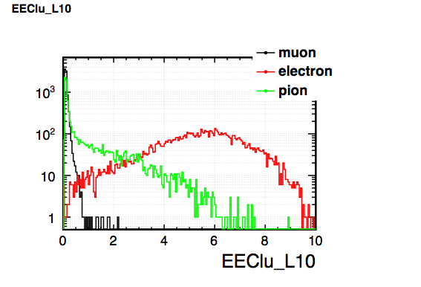
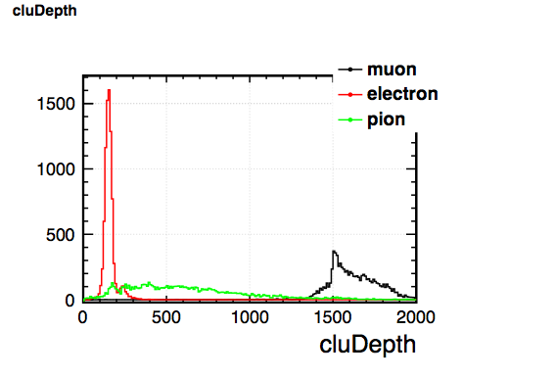
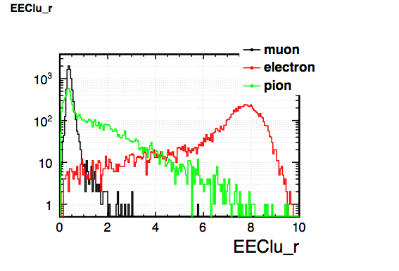
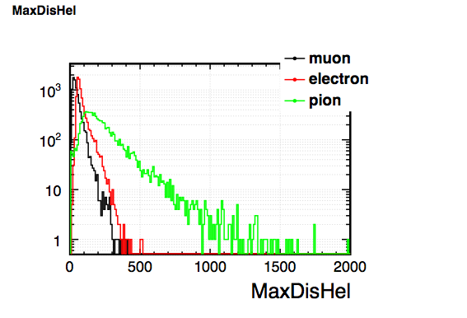
Variables Plots (10GeV Events)

Slide 8
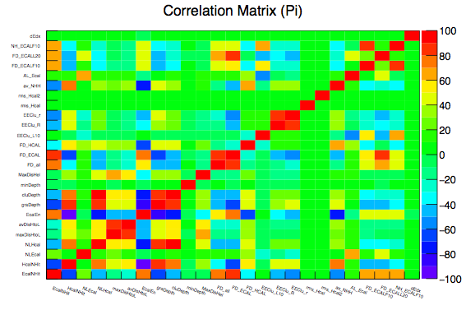
TMVA Correlation Matrix
10GeV Pion
(root-6.04)

Slide 9
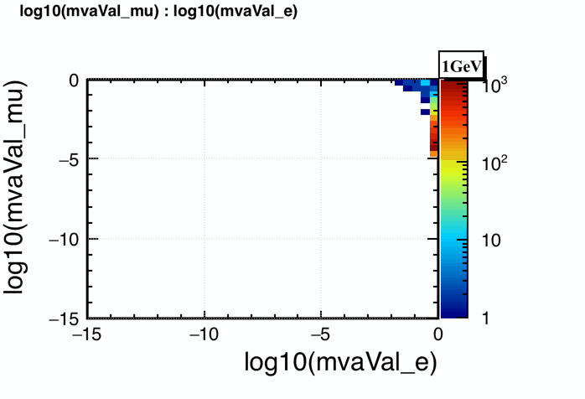
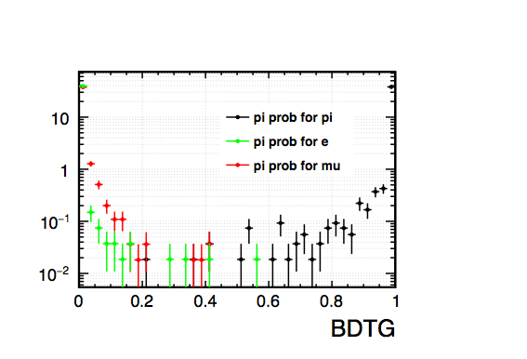
TMVA BDTG
Samples: (e, mu, pi) x (1, 2, 3, 5, 7, 10, 20, 30, 40, 50, 70 GeV ) x (10000 events)
Method: TMVA BDTG selected as “best” (vs likelihood, etc.)
Catalog：TMVA Value for e, mu, pi (Multiclass)
Classification : • mvaVal_*>0.5 and the other two mvaVal < 0.5
• otherwise “undefined pid”
BDTG Value mvaVal_pi
for 10GeV pi, e, mu

Slide 10
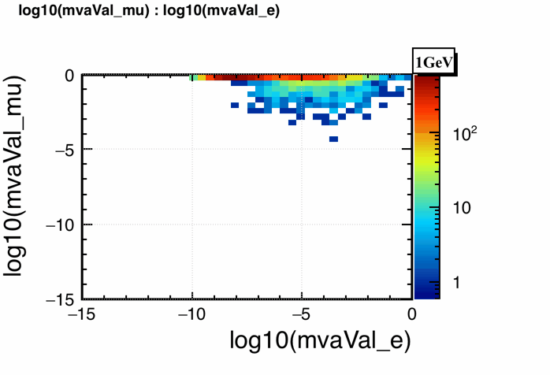
TMVA BDTG
Samples: (e, mu, pi) x (1, 2, 3, 5, 7, 10, 20, 30, 40, 50, 70 GeV ) x (10000 events)
Method: TMVA BDTG selected as “best” (vs likelihood, etc.)
Catalog：TMVA Value for e, mu, pi (Multiclass)
Classification : • mvaVal_*>0.5 and the other two mvaVal < 0.5
• otherwise “undefined pid”
BDTG Value mvaVal_pi
for 10GeV pi, e, mu

Slide 11
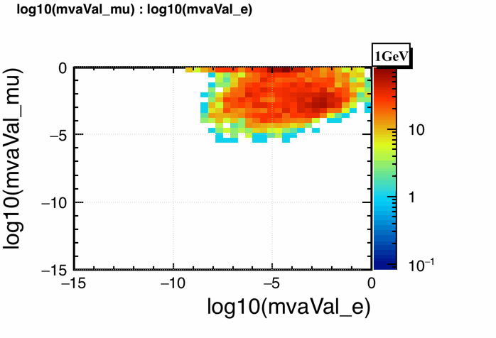
TMVA BDTG
Samples: (e, mu, pi) x (1, 2, 3, 5, 7, 10, 20, 30, 40, 50, 70 GeV ) x (10000 events)
Method: TMVA BDTG selected as “best” (vs likelihood, etc.)
Catalog：TMVA Value for e, mu, pi (Multiclass)
Classification : • mvaVal_*>0.5 and the other two mvaVal < 0.5
• otherwise “undefined pid”
BDTG Value mvaVal_pi
for 10GeV pi, e, mu

Slide 12
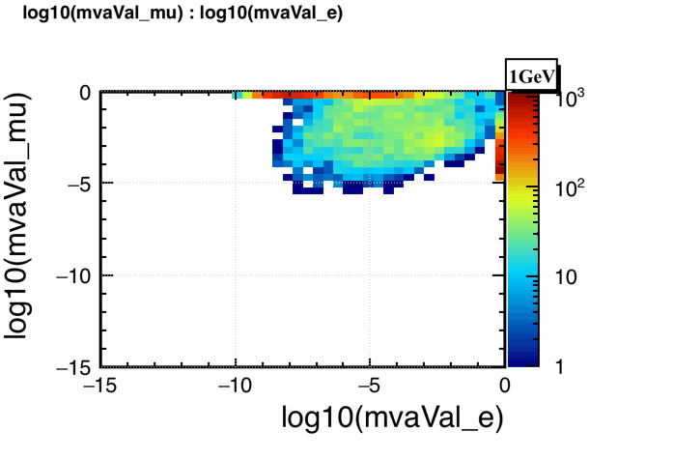
TMVA BDTG
Samples: (e, mu, pi) x (1, 2, 3, 5, 7, 10, 20, 30, 40, 50, 70 GeV ) x (10000 events)
Method: TMVA BDTG selected as “best” (vs likelihood, etc.)
Catalog：TMVA Value for e, mu, pi (Multiclass)
Classification : • mvaVal_*>0.5 and the other two mvaVal < 0.5
• otherwise “undefined pid”
BDTG Value mvaVal_pi
for 10GeV pi, e, mu

Slide 13
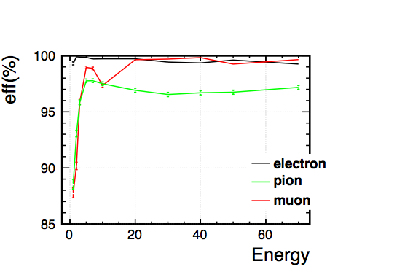
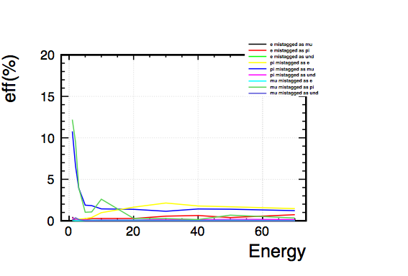
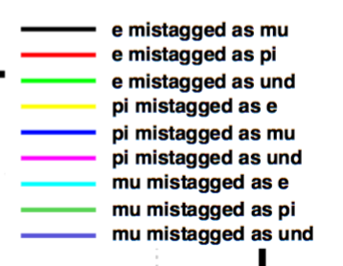
Efficiency & Mis-tagging
PID efficiency for e, mu, pi
PID mis-tagging probability for e, mu, pi
Efficiency ≥ 99% for e,
≥99% for µ @ E≥20 GeV (to be X-checked @ 10 GeV, dE/dx effect ?)
~97% for π @ E≥ 5 GeV
Purity ≥ 97% @E≥5 GeV (excl. µ @10 GeV)

Slide 14
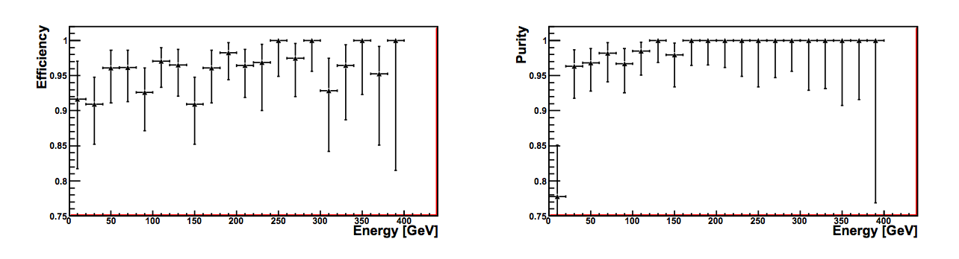
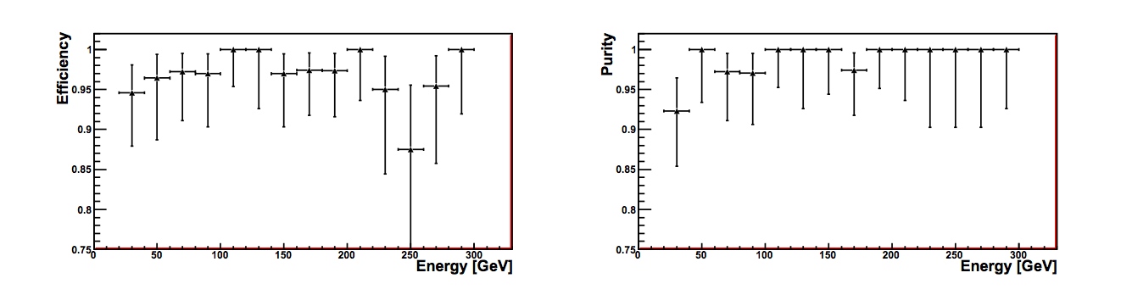
Comparison
(Model: CLIC_ILD_CDR)
CLIC ILD particle-ID efficiency for electrons(upper)/pions(lower)
as a function of the MC-Particle energy (From LCD-Note-2011-005)

Slide 15
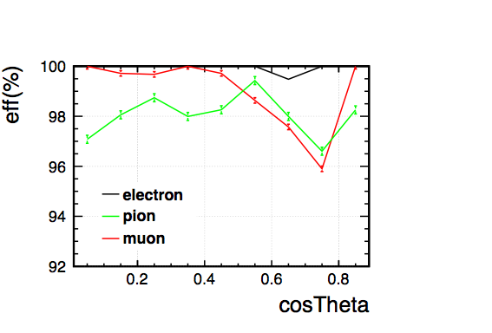
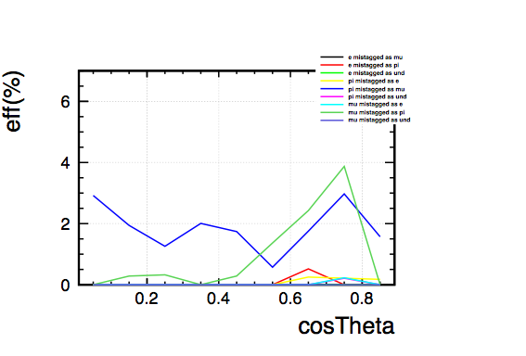
Angular Dependence
PID efficiency for 5GeV e, mu, pi on function of cosTheta
PID mistagging probability for 5GeV e, mu, pi
pion and muon confusion at the gap between barrel and endcap
not much influence on electrons

Slide 16
Conclusion
Done:
  Tracker information (dE/dx) combined with calorimeter for PID
  (esp useful below 5 GeV)
  Fractal Dimension applied to describe shape of shower
  PID efficiency improved with Arbor PFA: about 97% for pions higher than 3GeV
To do:
  Angular dependence studied: barrel/endcap OK separately
    check PFA at gap
    points at 8.5 GeV, 12.5, 15 GeV…
  Applications: ex. Tau decay final states

Slide 17
Thank You!

