Slide 1

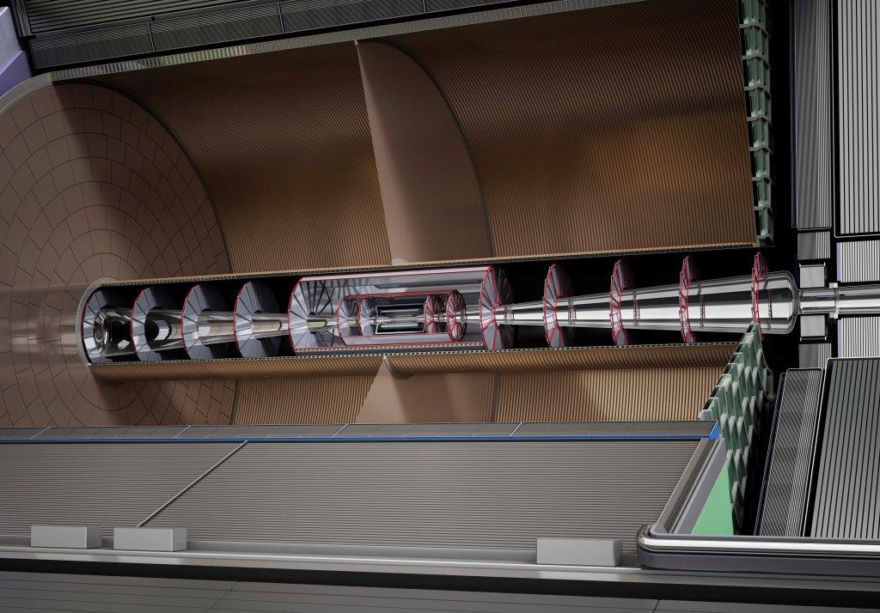
Why do we want a TPC?
ILD software and optimization meeting, Feb. 22-26, 2016, DESY
P. Colas, CEA Saclay
Why not a Si tracker?

Slide 2
Material budget
A TPC has the least matter along the tracks and before the calorimeters: 1.3% X° in the barrel region and 0.25 X° in the endcaps.
In silicon detectors it is difficult to have sensors thinner than 200 µm. This makes that after 5 layers a 10 GeV track is scattered by more than the (2-7 µm) resolution of the device.

Slide 3
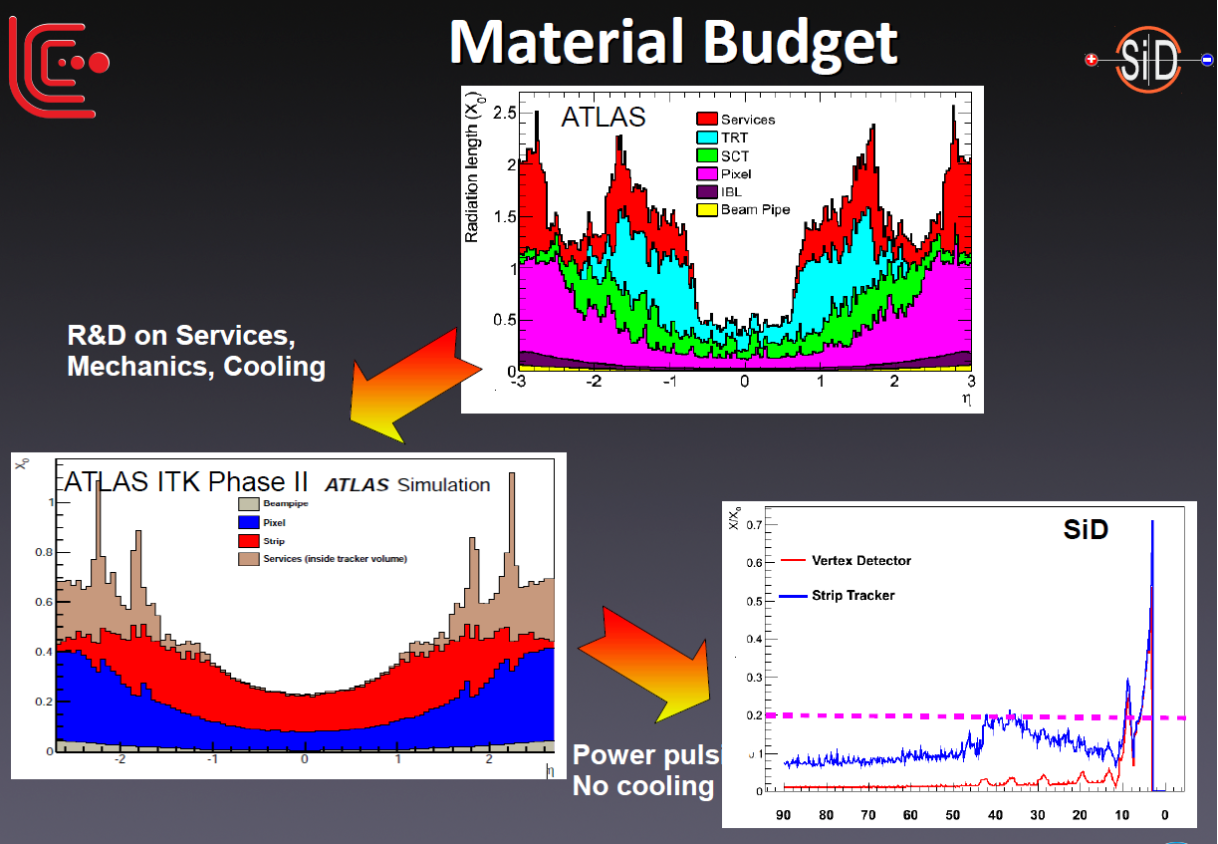
M. Stanitzki, IAS conf in HK, Jan. 2016
Material budget in Si trackers : cooling, readout

Slide 4
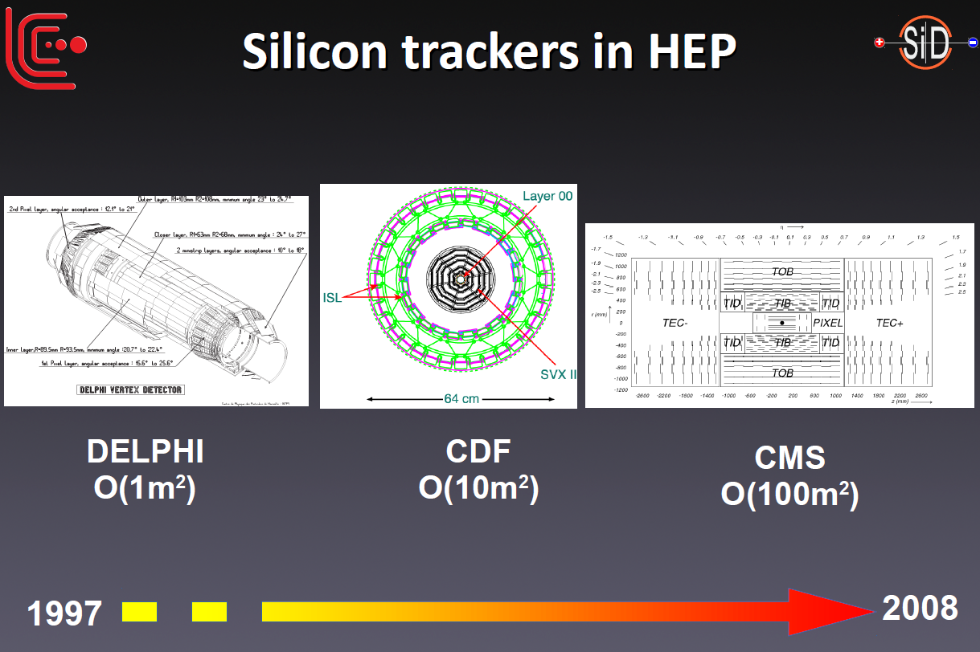
Cost
Surfaces tend to increase but Silicon cost does not decrease. TPC: 36 MILCU total
SiD
2030
M. Stanitzki, HK IAS conf, Jan.2016

Slide 5
Pattern recognition
Continuous tracking provides an opportunity to find V0s, kinks, and tracks not pointing to the interaction point.
This can improve jet resolution from PFA and be sensitive to new physics.
A quantitative assessment of these effects is still needed.

Slide 6
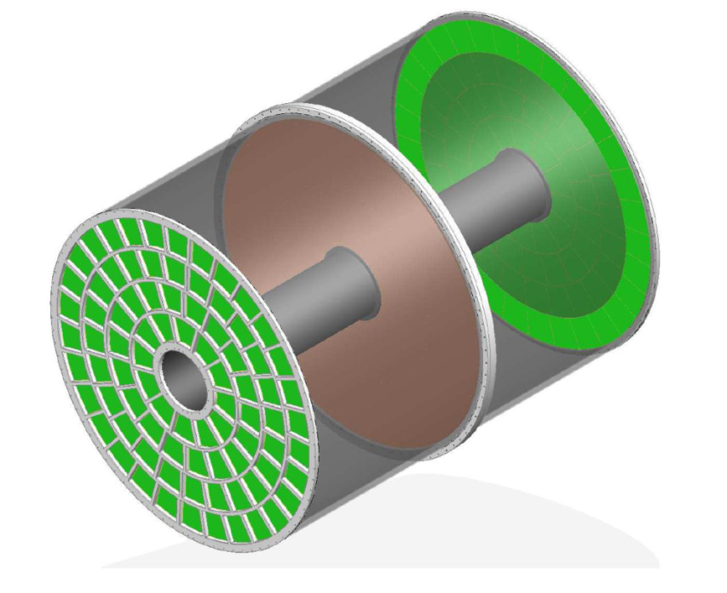
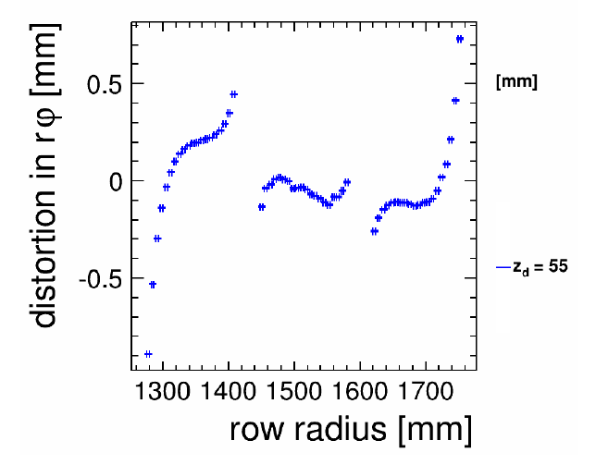
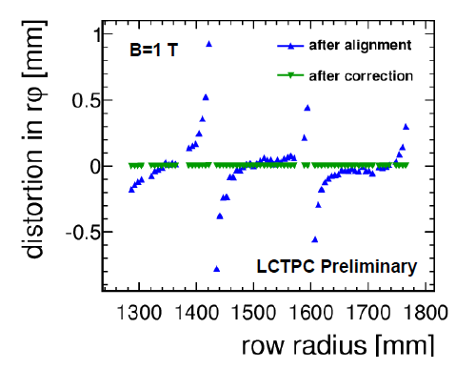
Tracking issues
Small number of modules (168 in this 4-wheel example), with 3 relevant alignment parameters each.
CMS silicon tracker has 200,000 sensors.
In a TPC, tracking has to face distortions problems.
Corrections and mitigation of distortions are being studied
MM
GEM

Slide 7
Example of a 3-wheel design

Slide 8
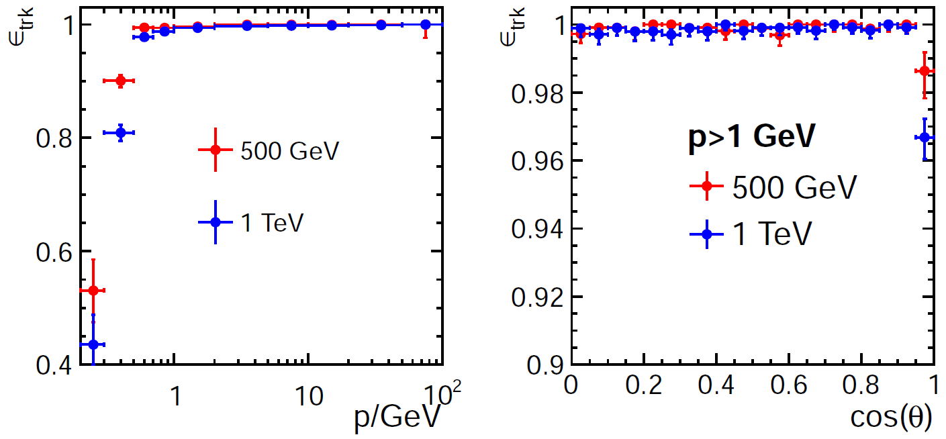
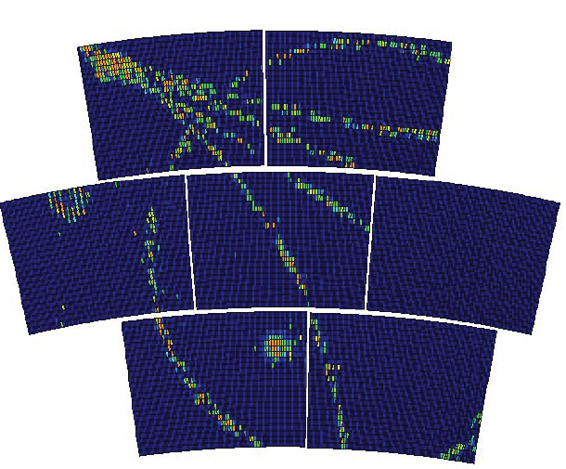
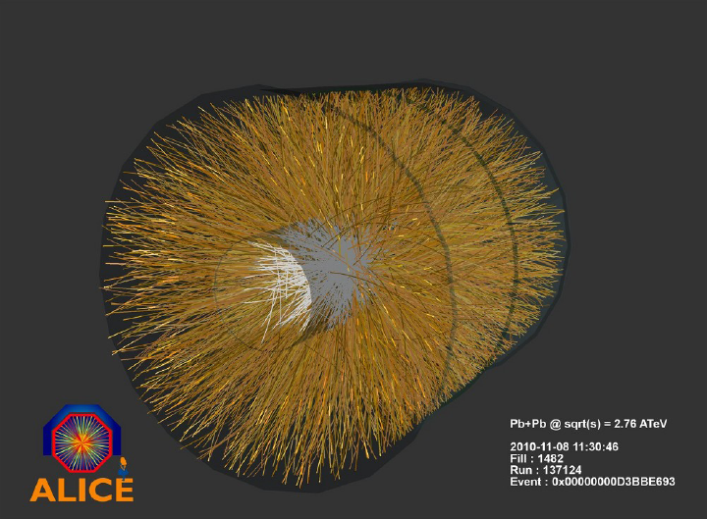
Large number of track points
High granularity (~10⁹ voxels)
Truly 3D points
facilitates track finding
and background rejection
DBD
DBD

Slide 9
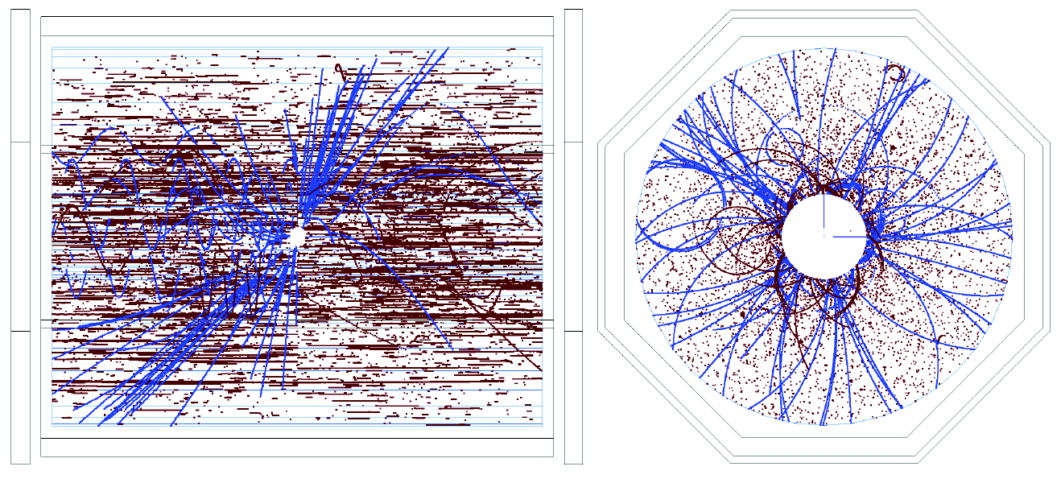
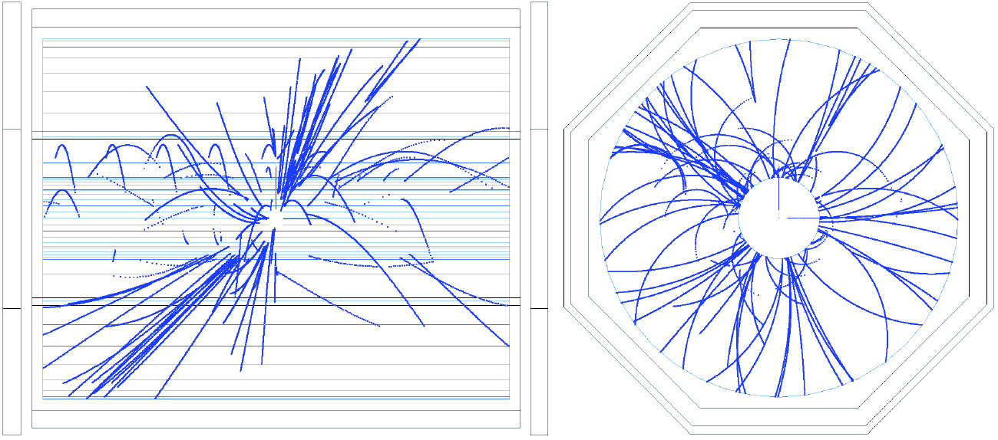
The TPC integrates over 150 bunch
crossings. Also the machine back-
ground is integrated. To verify that
tracking still works in these conditions,
tt → 6 jets events with all backgrounds
were simulated.
The microcurlers from low-energy γ
conversions could easily be removed.
Background
blue → physics
red → machine background
Microcurlers removed
Reconstructed TPC tracks.

Slide 10
Global tracking issues
In the presence of beam background, despite an excellent (2 to 7 micron) resolution, track reconstruction in a silicon detector suffers from a huge combinatorics including overwhelming fake hits.
A seed might be needed and the TPC tracks might give this (out -> in reconstruction scheme)

Slide 11
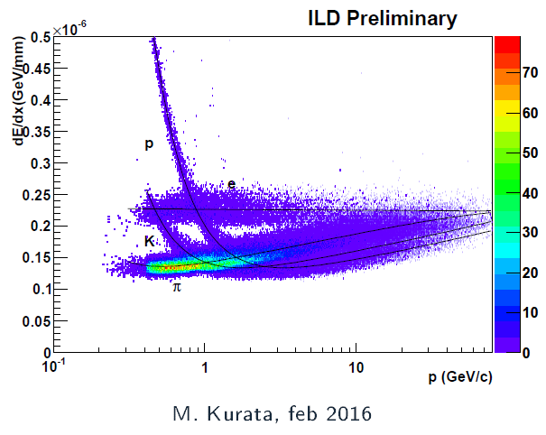
dE/dx
Within a TPC, it is expected to have a 2-3 sigma discrimination between K and π .
However a detailed understanding of GEM or Micromegas energy resolution would be needed to certify this.
A pixel TPC would be unbeatable for this, as it has a cluster-counting capability.

Slide 12
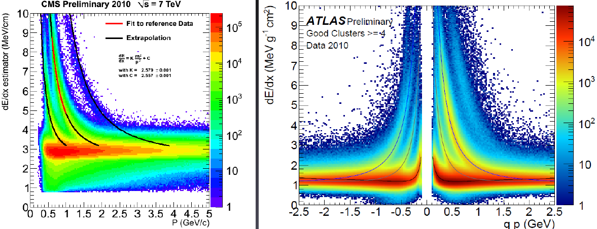
dE/dx
Silicon is far from having such a capability

Slide 13
Conclusion
Apart from usual advantages (minimum matter budget and cost for a 3D continuous tracking with dE/dx capability and basically no aging, a TPC might be the only way to seed a tracking for the silicon part in a harsh environment.
Despite all the (well mastered) inconveniences – slow drift, diffusion, gas purity, distortions– the advantages make this choice robust.

Slide 14
