Slide 1
ATF Report
December trip week 2 summary and results
Neven Blaskovic Kraljevic, Talitha Bromwich, Rebecca Ramjiawan

Slide 2
Introduction
Progress towards synchronising FONT data and IP data.
Upstream stripline BPM set-up (including MFB1FF).
IPBPM setup.
Waveforms at different charges to observe changes in static signal.
Upstream feedback in 2 bunch mode.

Slide 3
Synchronising FONT data with IP data
ATF DAQ
EPICs
FONT DAQ
(on FONT laptop)
Synchronisation signal
generated by FONT5a board
Signal readback into FONT DAQ
Signal to IP and out via SIS digitsier
SIS digitiser
Signal readback
IP
Synchronisation signal
FONT5a board

Slide 4
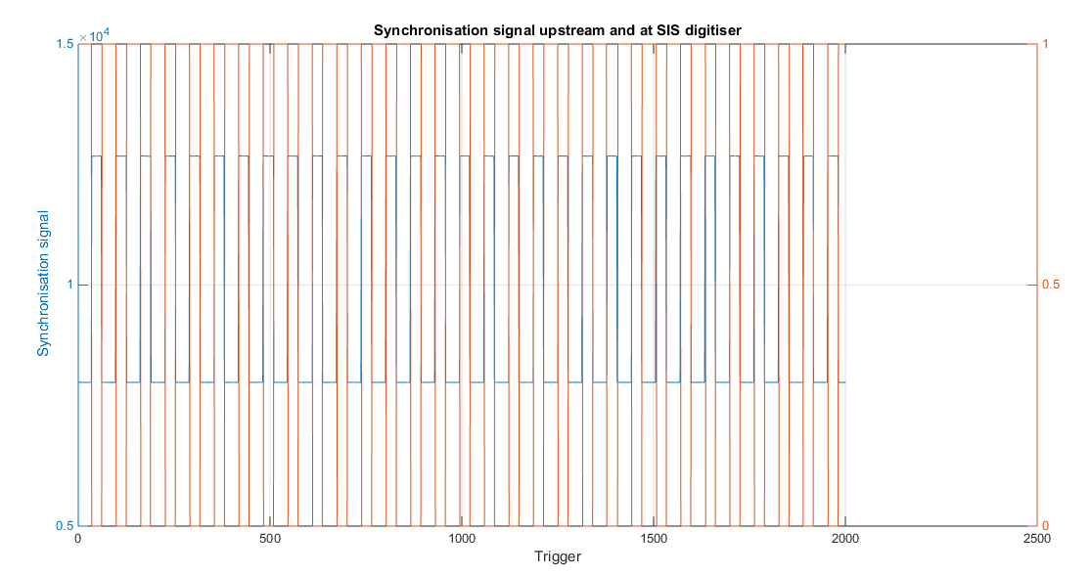
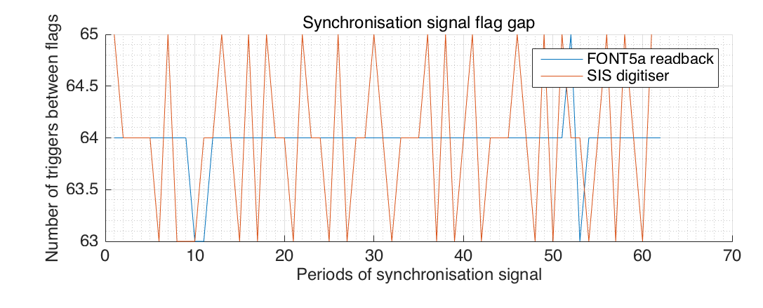
Synchronisation progress so far …
Data synchronisation to within 1 trigger between SIS signal and FONT5 board readback.
Tried delaying data publication from FONT DAQ to EPICs so that FONT data always lags IP data by 1 trigger.
50ms delay enabled most stable performance, but still too much random variation.
Synchronisation not fully understood in firmware. More tests to be performed in Oxford.

Slide 5
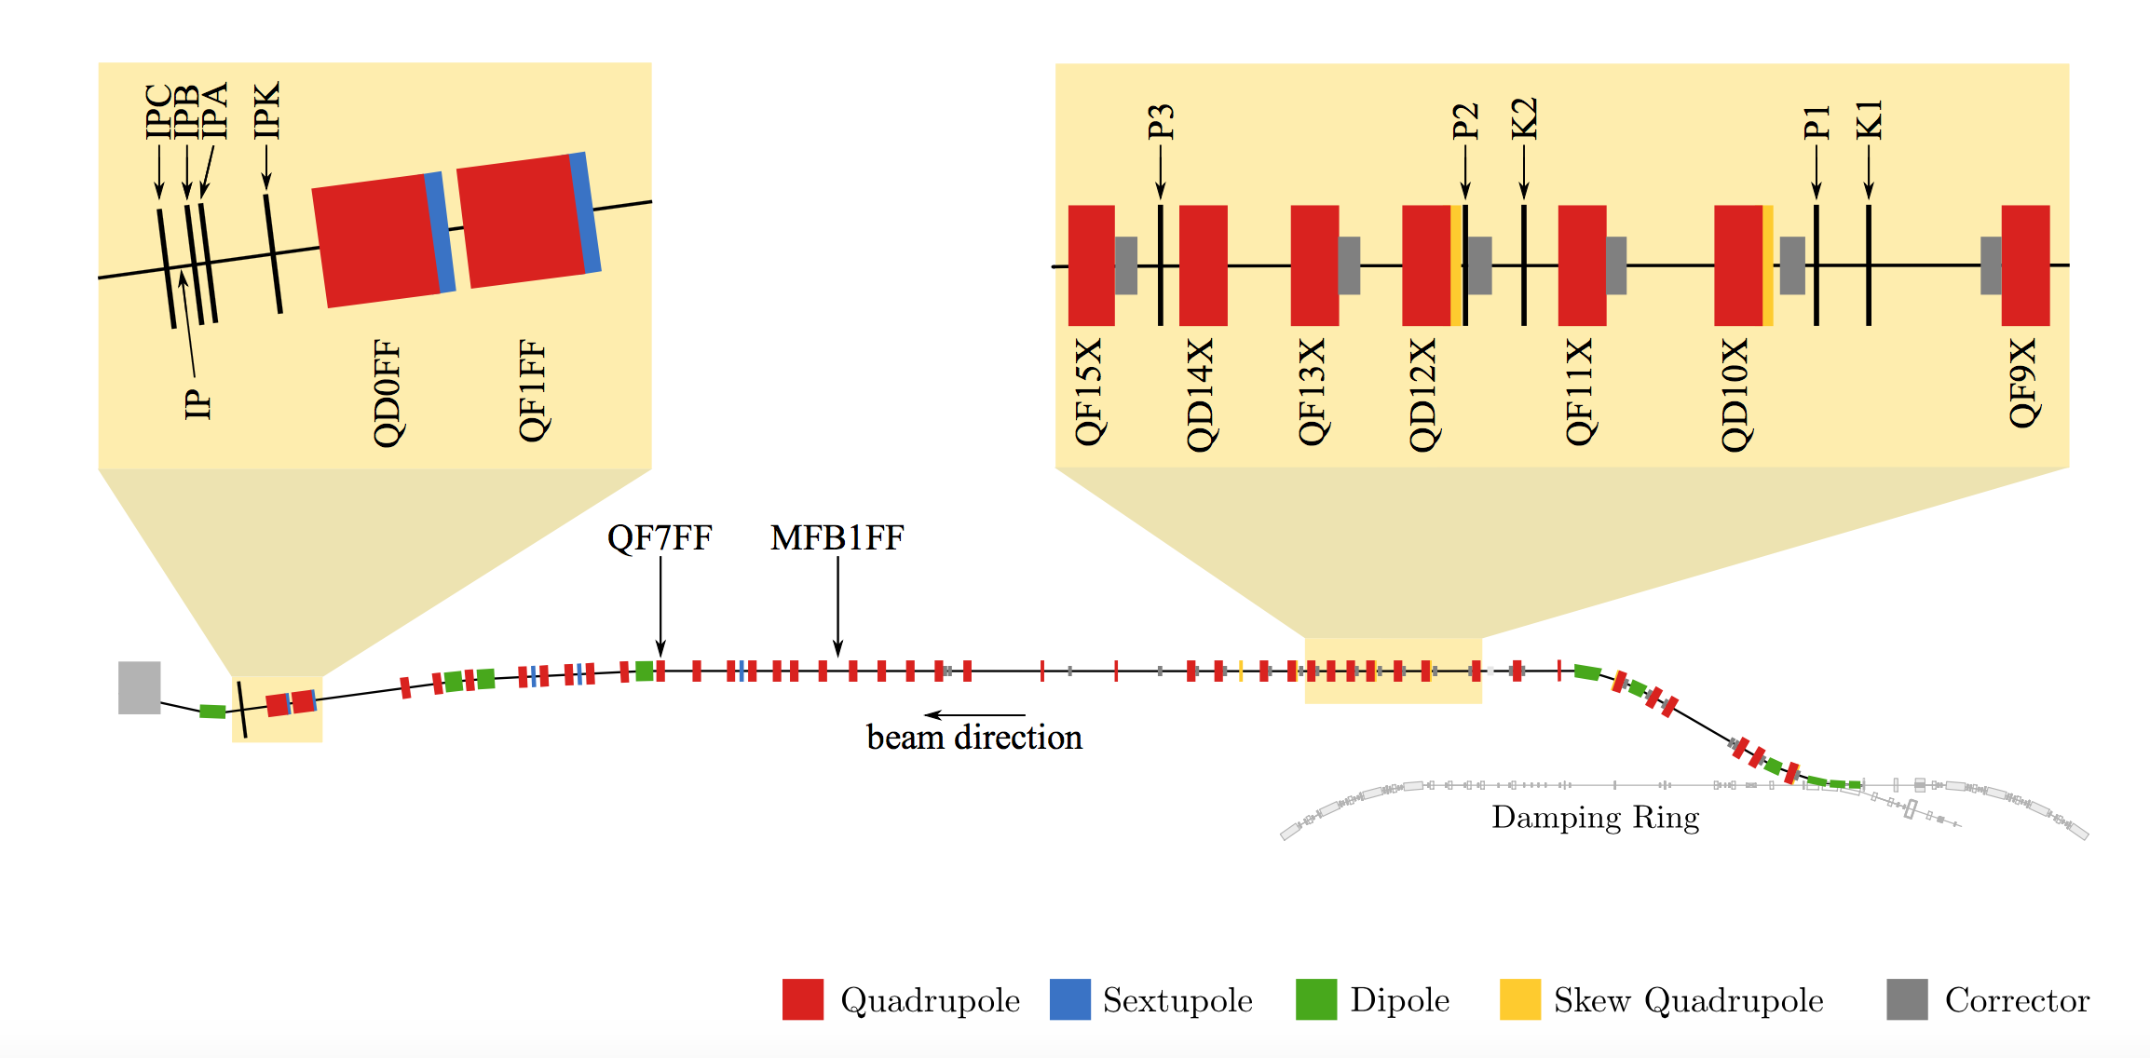
2-bunch upstream feedback with position and jitter measurement at IP
Perform upstream feedback using P2 and P3 and new FONT5a board. With and without introducing more jitter.
Measure correction upstream at P2 and P3, at witness stripline BPM MFB1FF, and then using cavity BPMs IPB and IPC either side of the IP.
Not yet synchronised between upstream FONT and IP, so
interleaved feedback will have to wait for future experiments.
Diagram of ATF beamline:
G.White et al Phys. Rev. Lett. 112 (2014) 034802

Slide 6
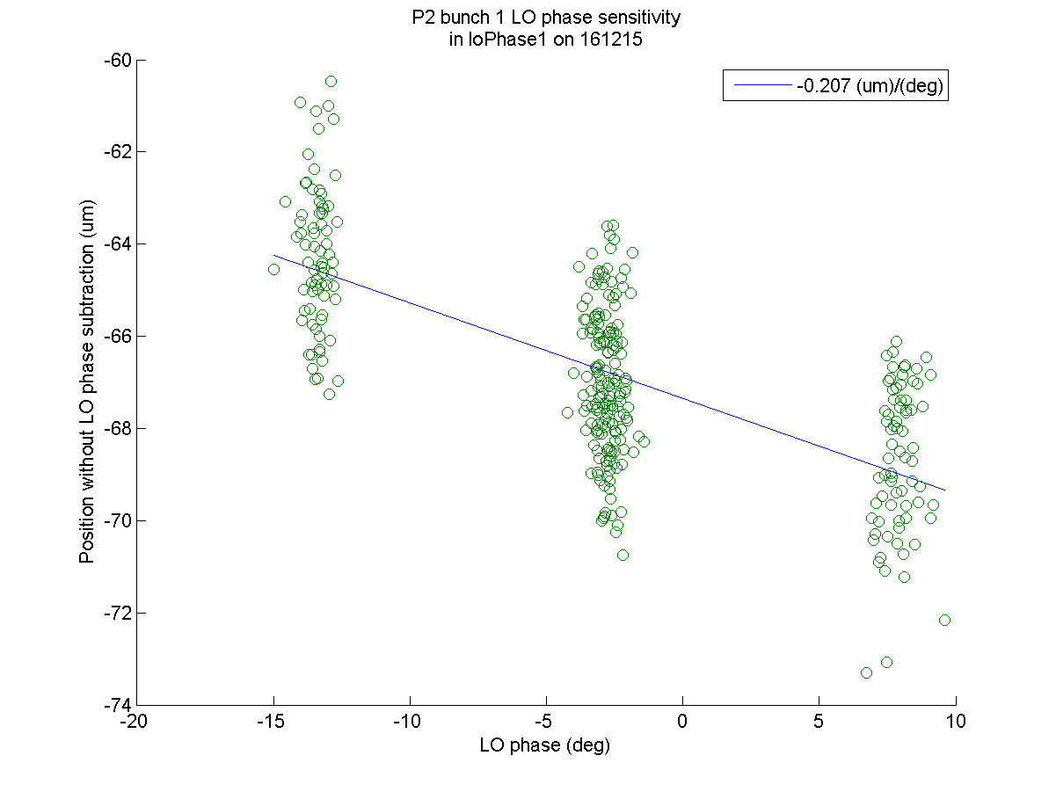
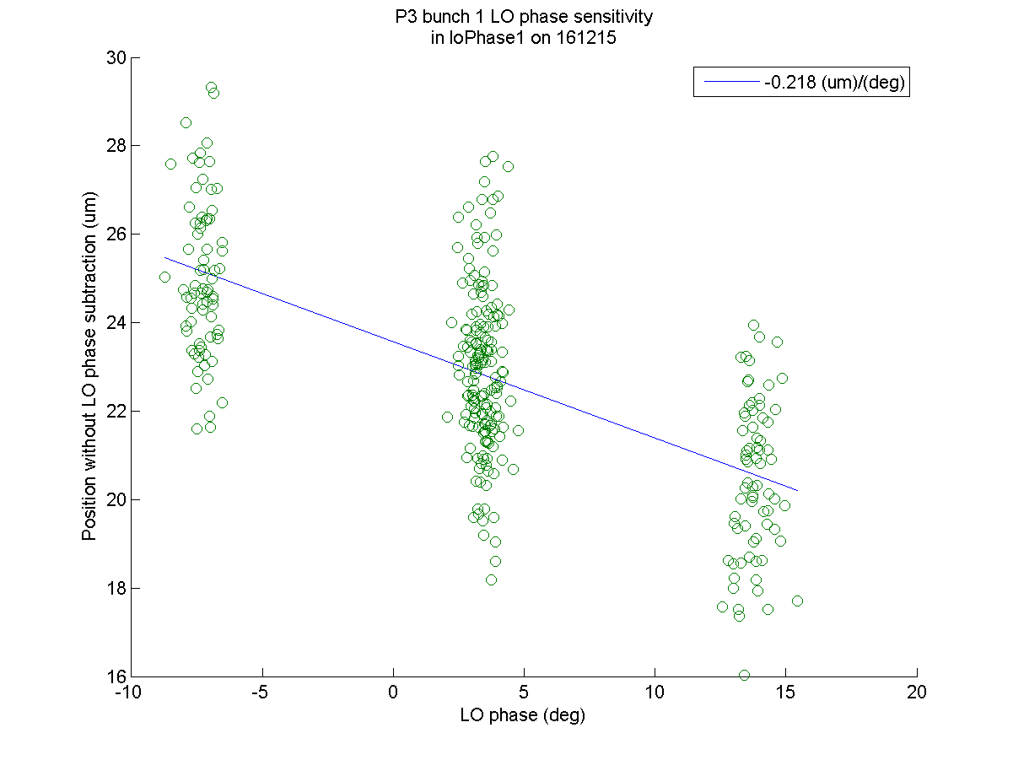
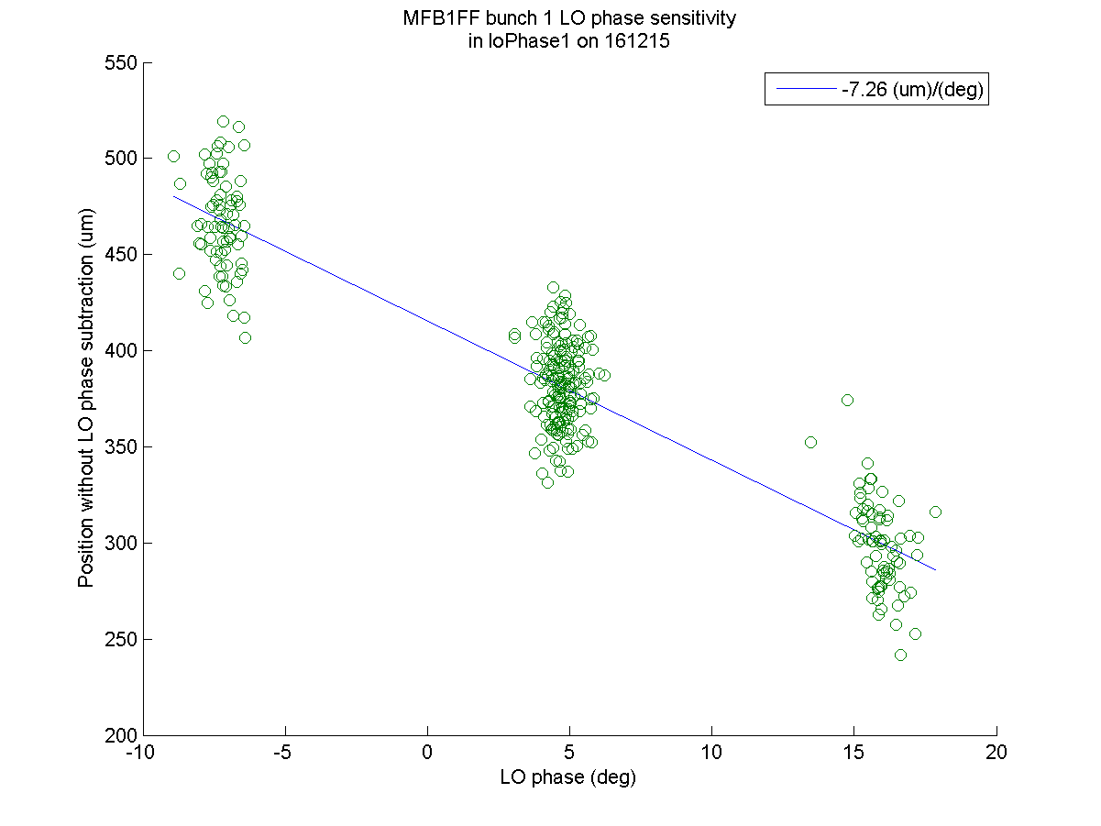
FONT stripline BPM performance checks
Instrumented stripline BPM MFB1FF between upstream and IP.
Performed stripline calibrations and position sensitivity on LO phase at P2, P3 and MFB1FF.
  Results consistent with those obtained previously.

Slide 7
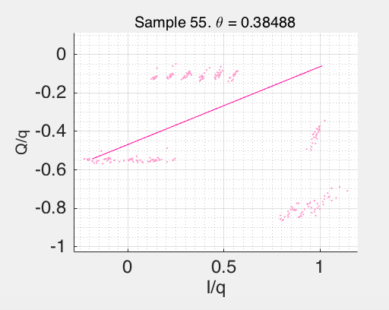
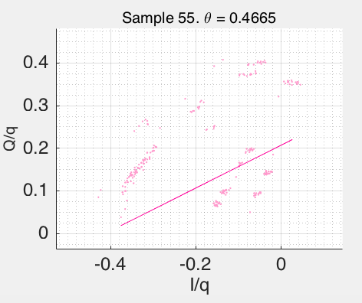
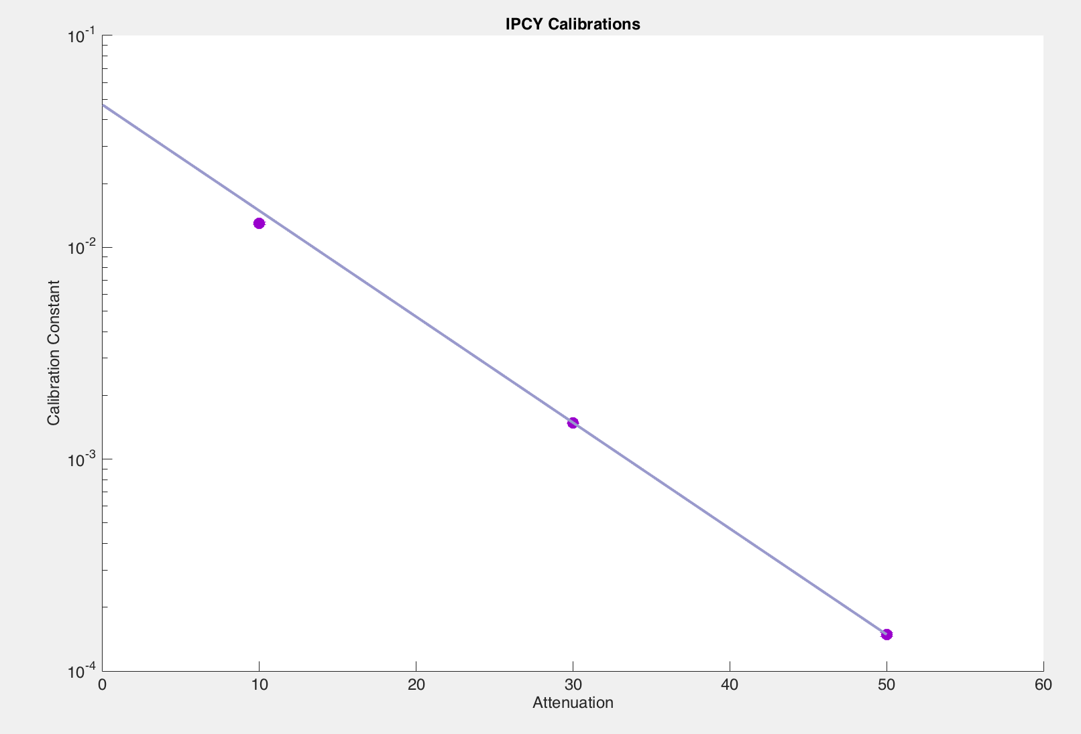
IP cavity BPM IPB and IPC calibrations
Observed discontinuities in both BPMs at 10dB, both in the moved and non-moved BPM, as in June.
Proceeded to calibrate at higher attenuation. Attenuation scaled to 10dB when discontinuity excluded.
IPBPM LabVIEW application froze twice during calibrations – restarted as outlined by Oscar.
IPByCal4_10dB_ipbpm_151216
IPCyCal2_10dB_ipbpm_151216

Slide 8
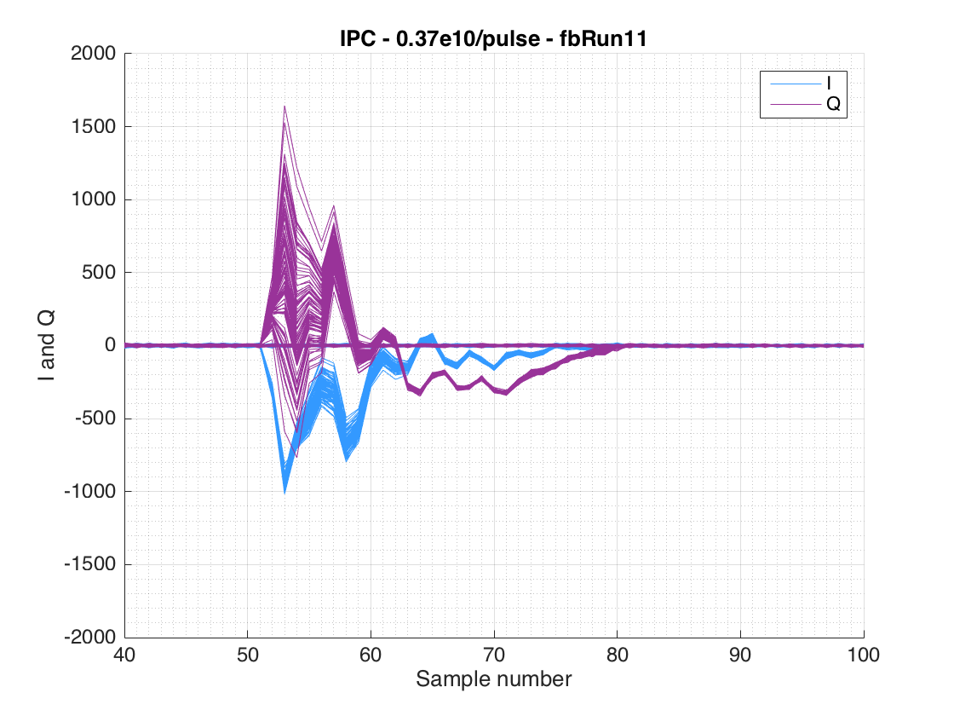
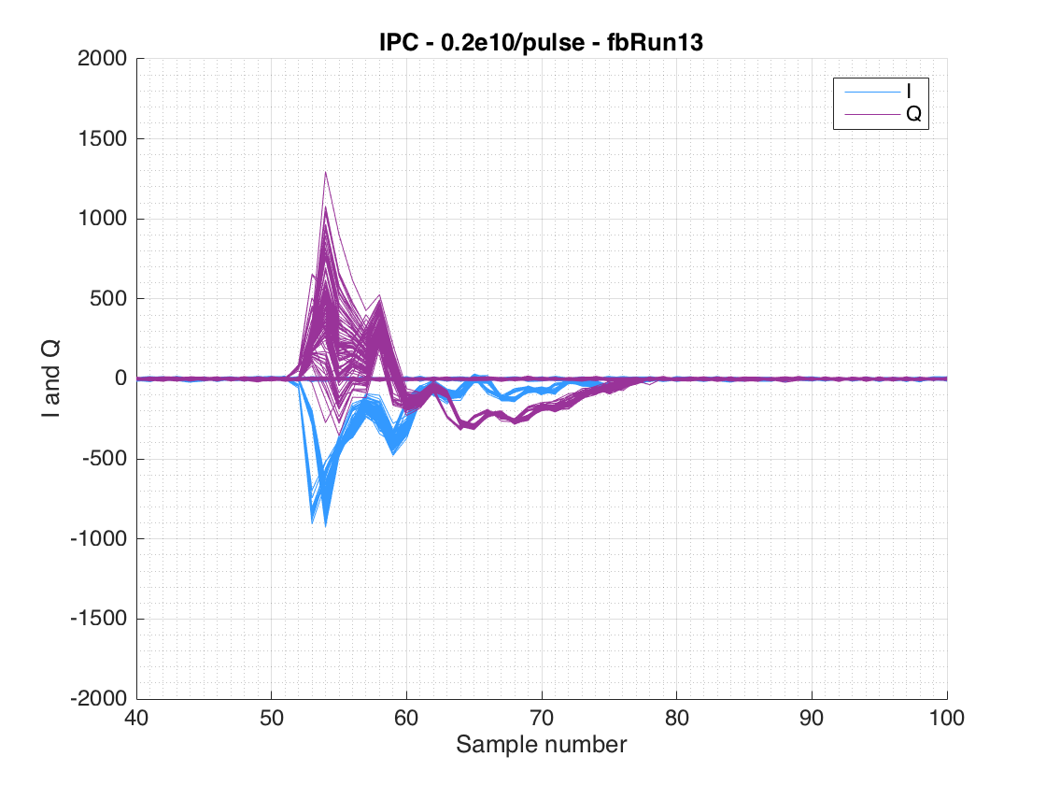
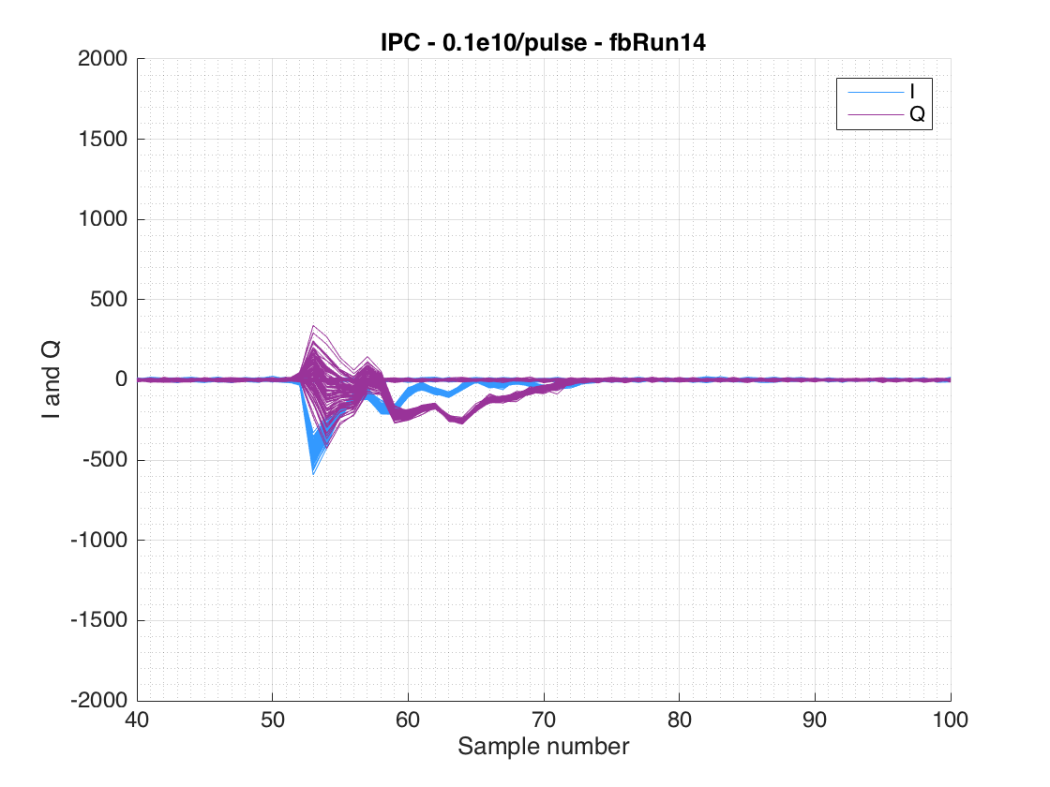
Static waveform in IP cavity BPMs
  Gathered waveforms at different charges to observe changes in the amplitude of the unwanted static waveform.

Slide 9
Upstream feedback in 2-bunch mode
  Second bunch tuned by Kano-san and Okugi-san.
  Measured at stripline BPMs P2, P3 and MFB1FF, and IP BPMs IPB and IPC. Beam jitter upstream stabilised from 1.5um to 0.6um at P2 and P3.
  No apparent correction at MFB1FF in absence of additional jitter source. Jitter stabilised to 20um in presence of additional jitter.
  Ran feedback with introduced jitter source at different amplitudes.

Slide 10
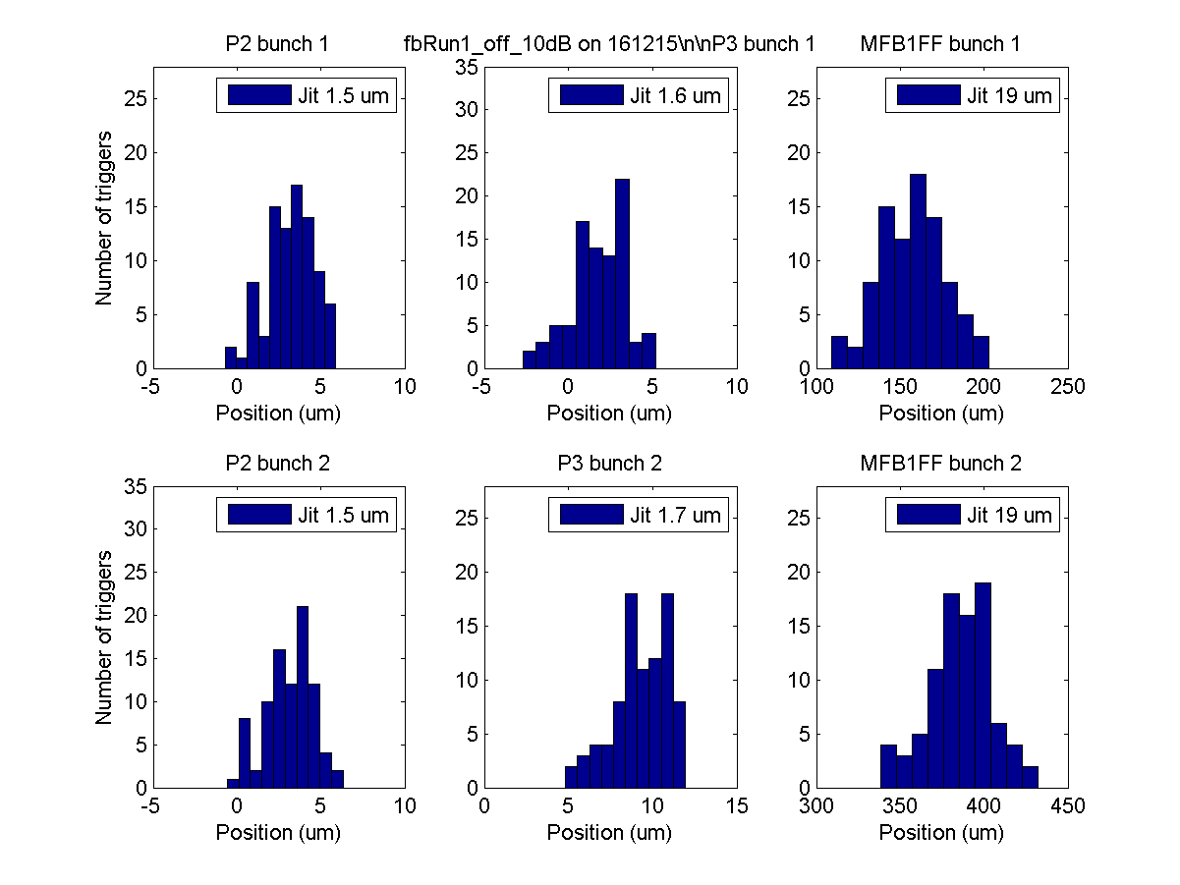
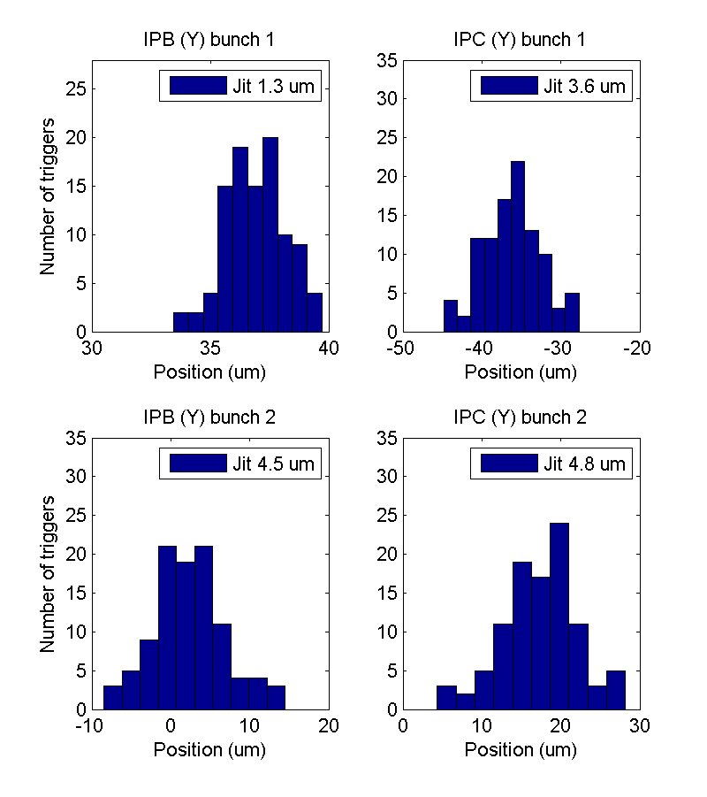
Bunch-to-bunch correlation – Feedback off
P2
P3
MFB1FF
IPB
IPC

Slide 11
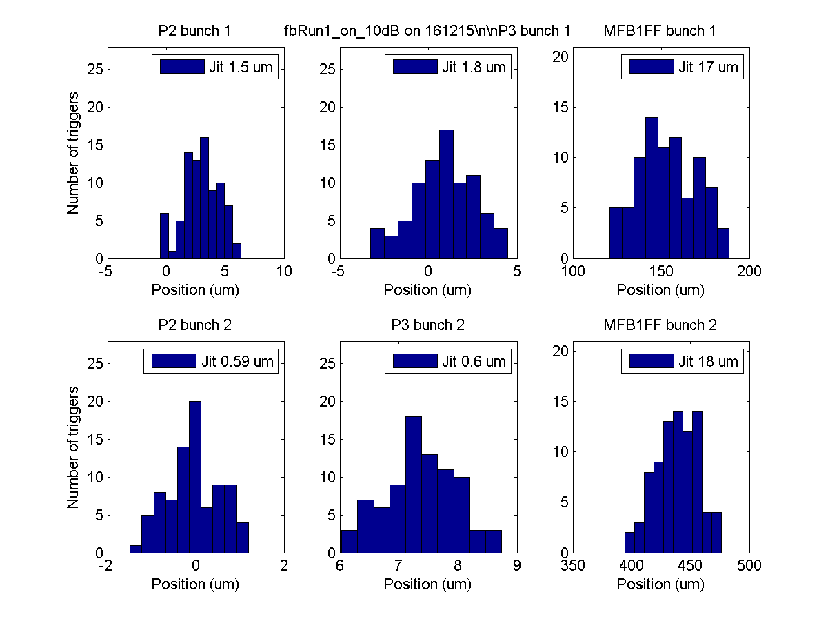
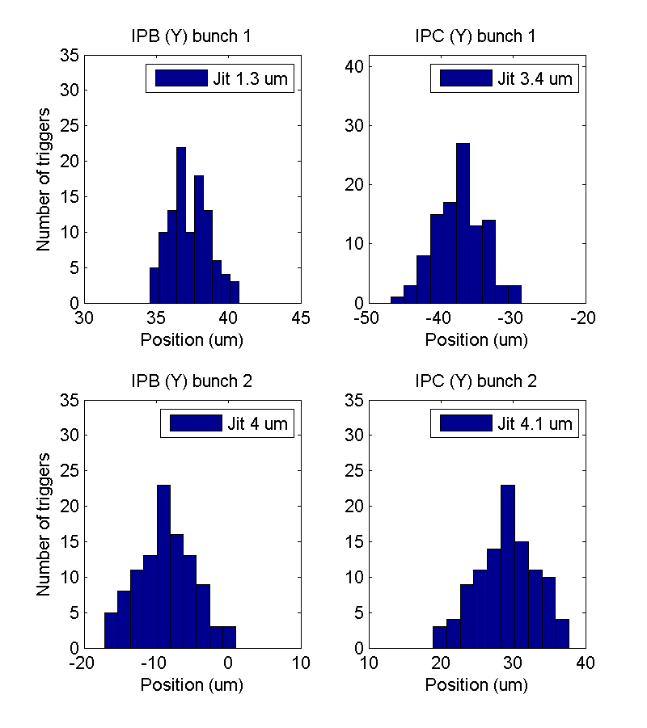
Bunch-to-bunch correlation – Feedback on
P2
P3
MFB1FF
IPB
IPC

Slide 12
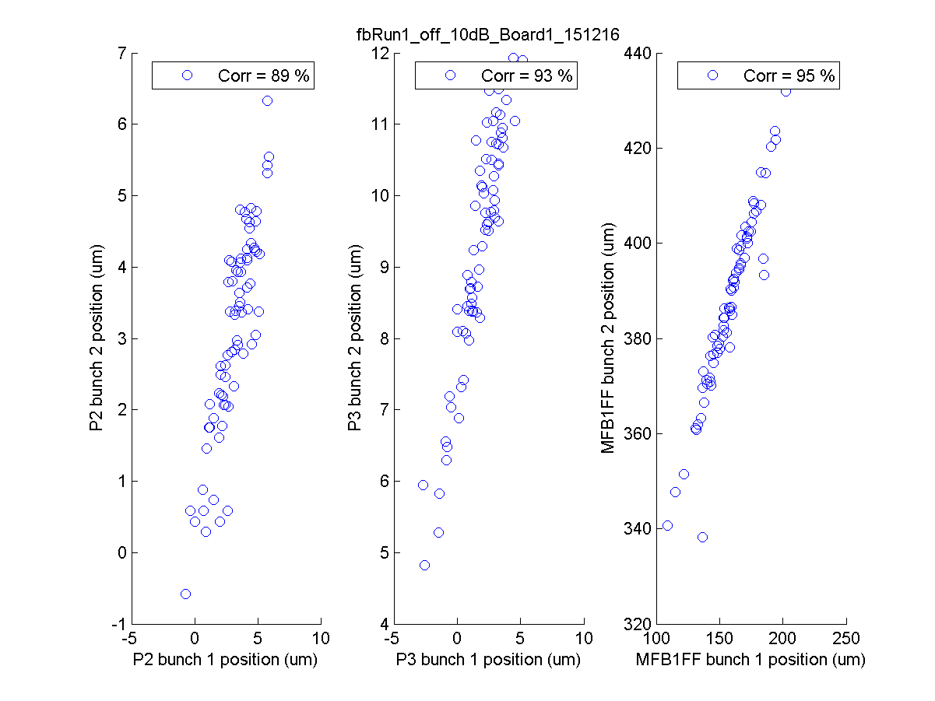
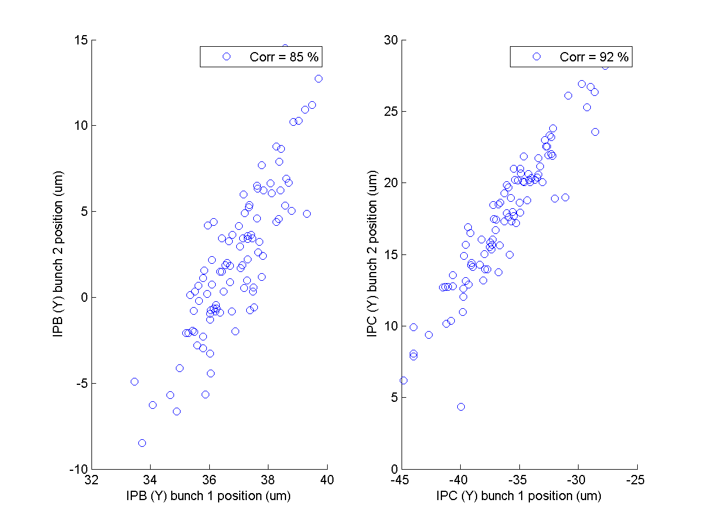
Bunch-to-bunch correlation – Feedback off
P2
P3
MFB1FF
IPB
IPC

Slide 13
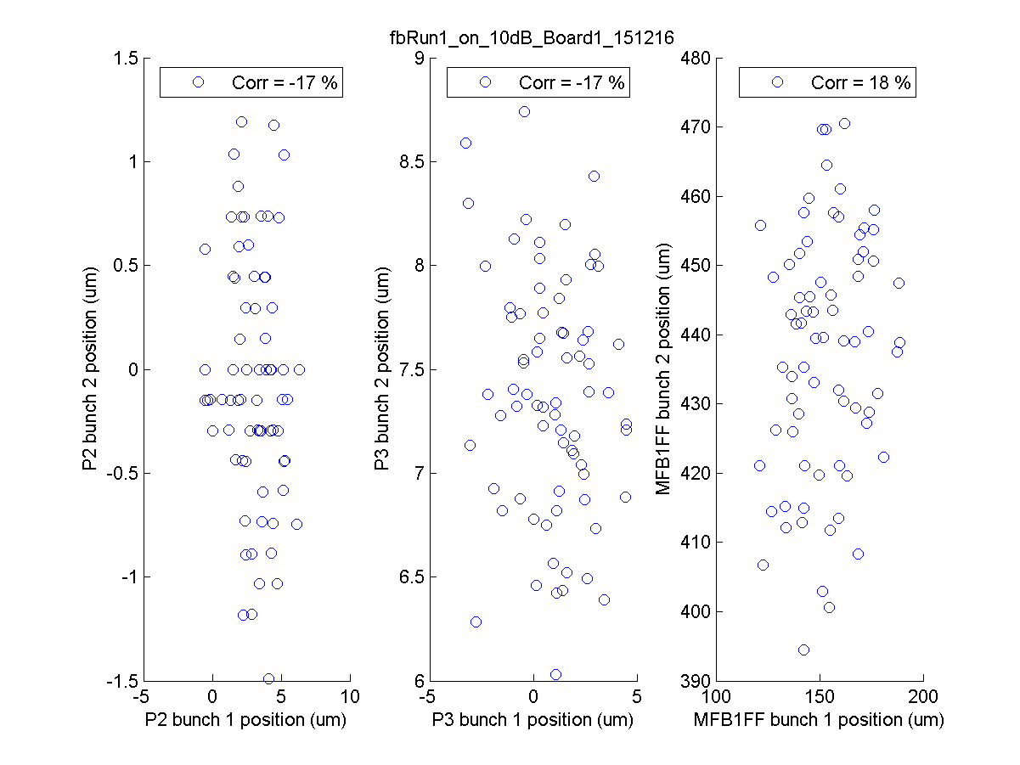
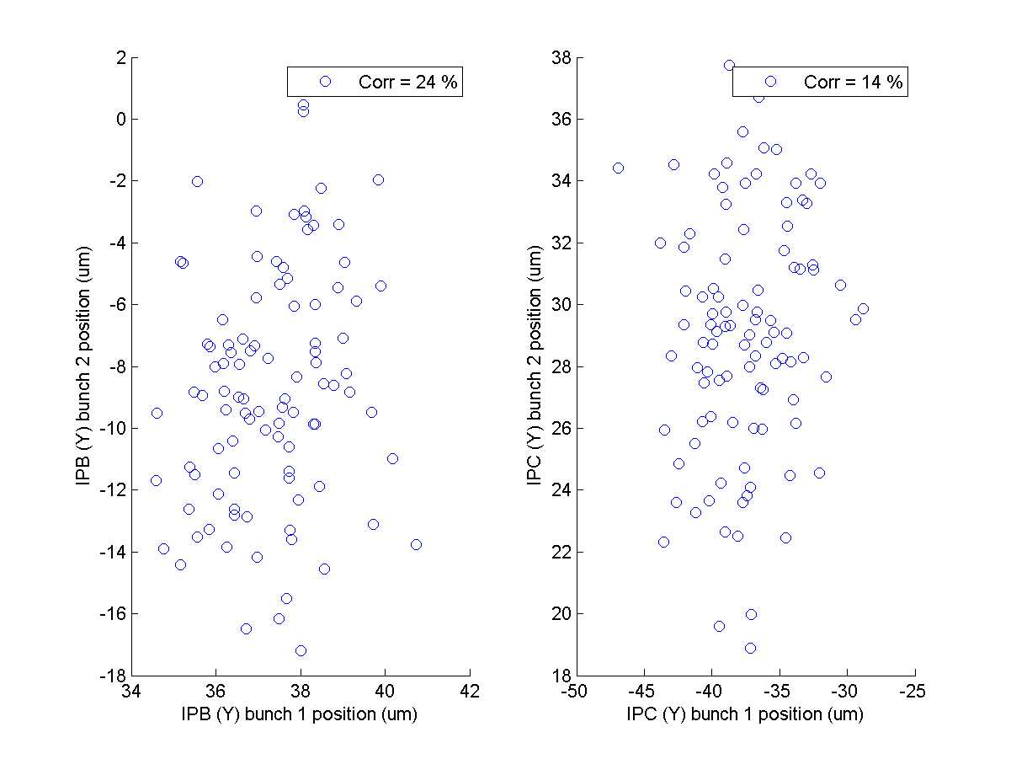
Bunch-to-bunch correlation – Feedback on
P2
P3
MFB1FF
IPB
IPC

Slide 14
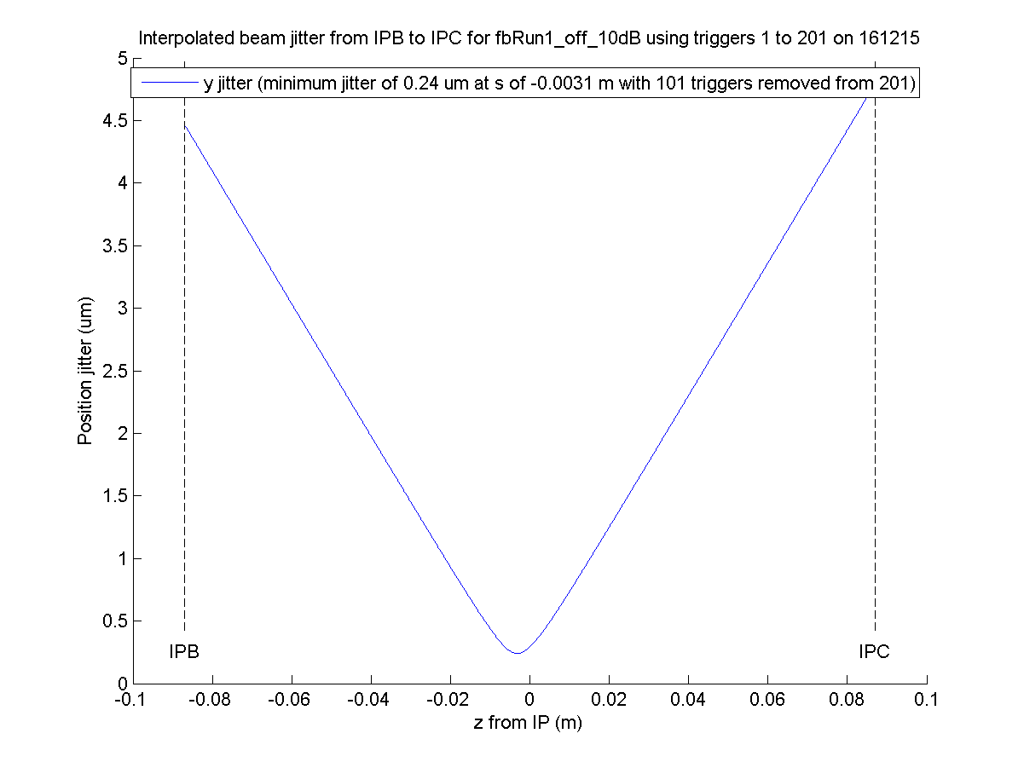
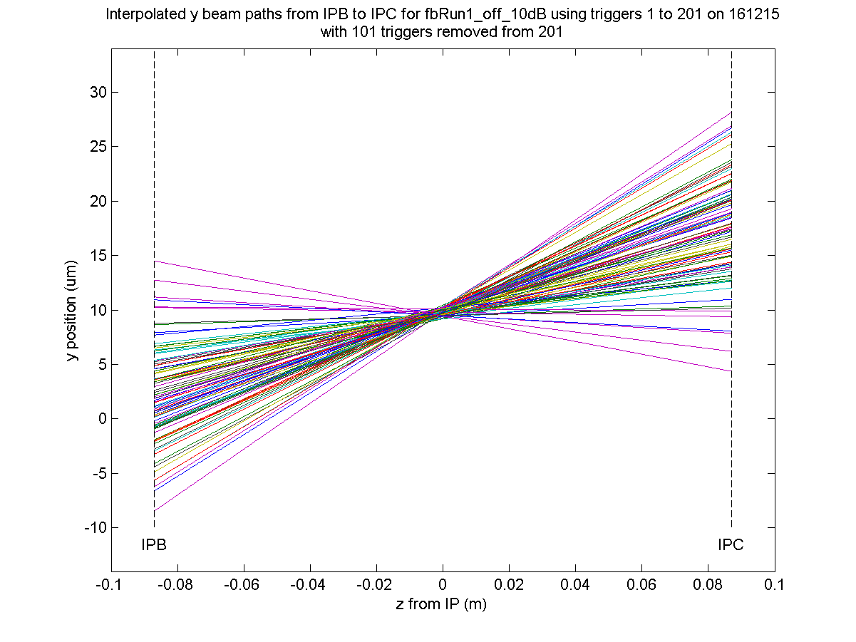
Interpolated jitter at waist – feedback off

Slide 15
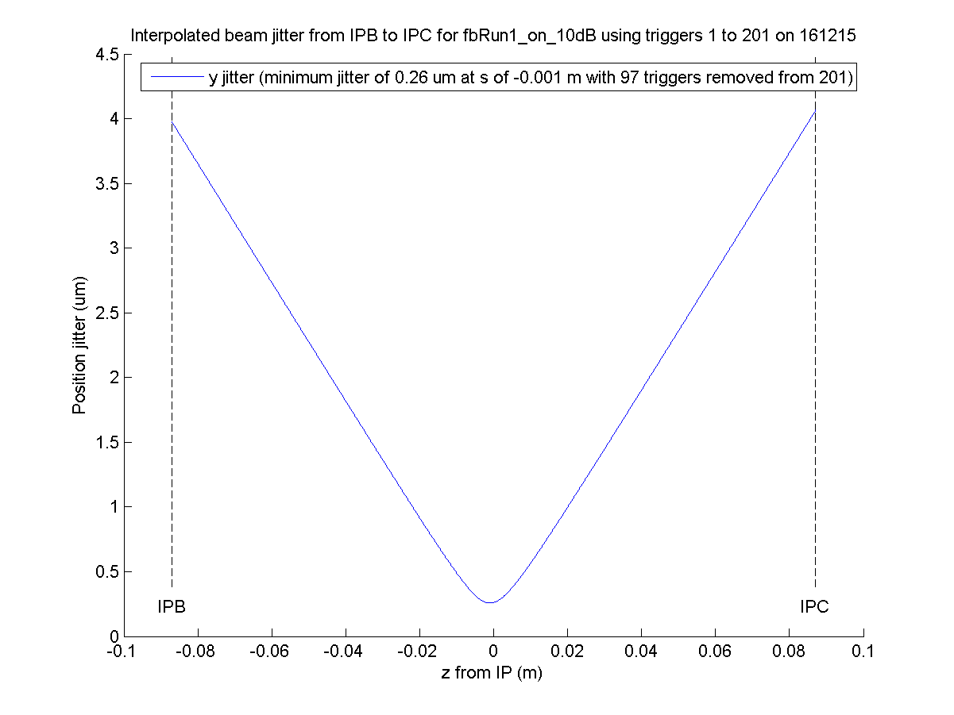
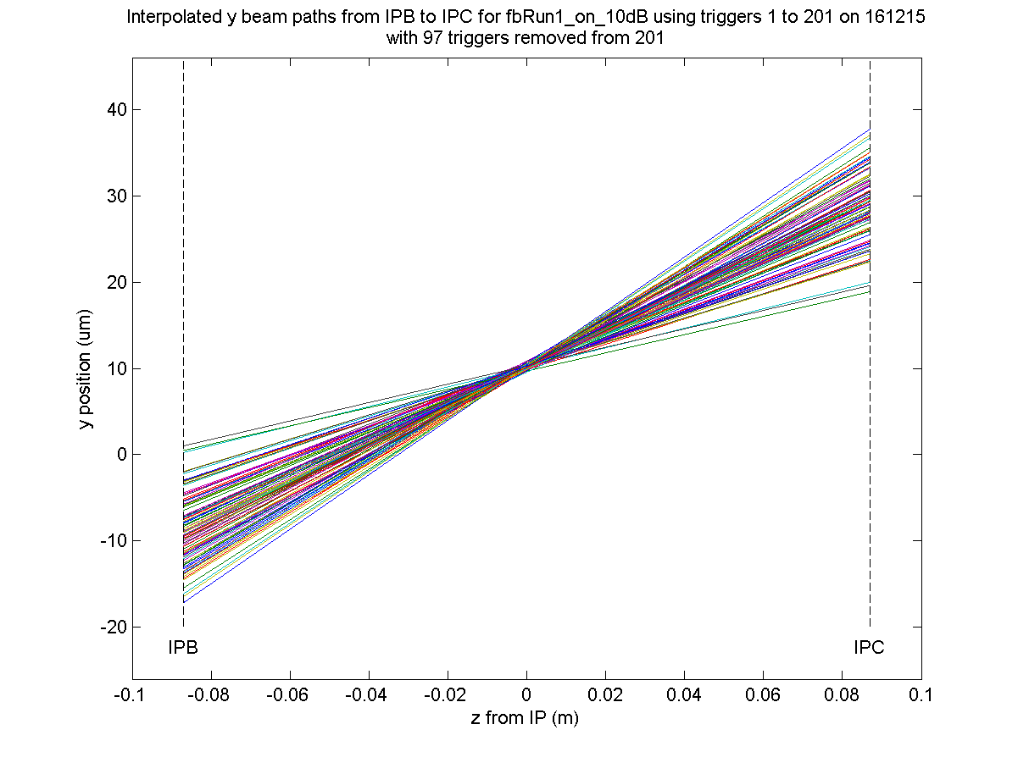
Interpolated jitter at waist – feedback on

Slide 16
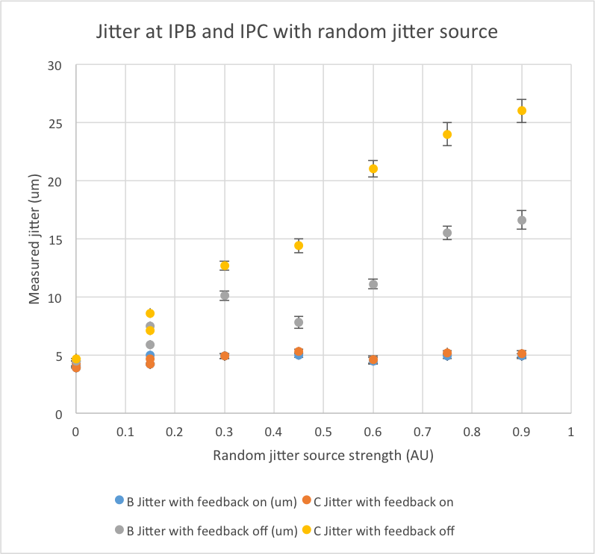
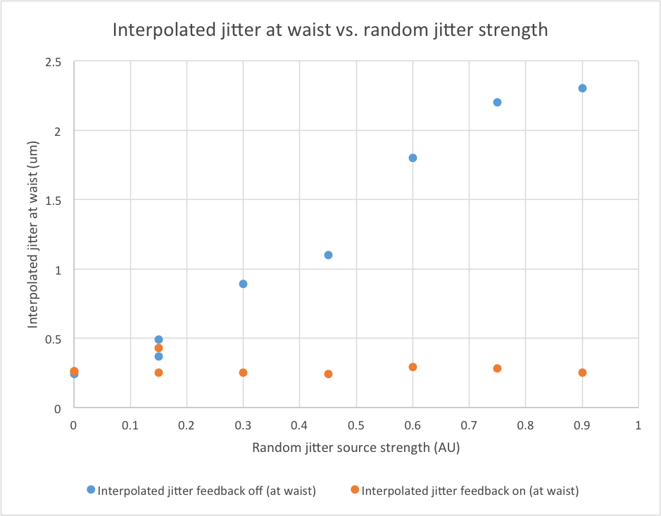
Introducing random jitter source

Slide 17
Summary
Progress towards synchronising FONT data and IP data.
  Look at synchronisation signal in Oxford
Stripline BPM calibrations and position sensitivity on LO phase performed at P2, P3 and MFB1FF.
  Consistent with previous experiments.
Calibrated IPB and IPC.
  Discontinuities observed.
Waveforms at different charges taken to observe changes in static signal.
  A dependence is observed – to be analysed.
Upstream feedback in 2 bunch mode.
  Beam stabilised from 1.5um to 600nm at P2 and P3. But no correction observed at MFB1FF or IP in the absence of additional jitter source.
  Beam jitter sabilised to same level for a range of additional jitter source strengths.

