Slide 1
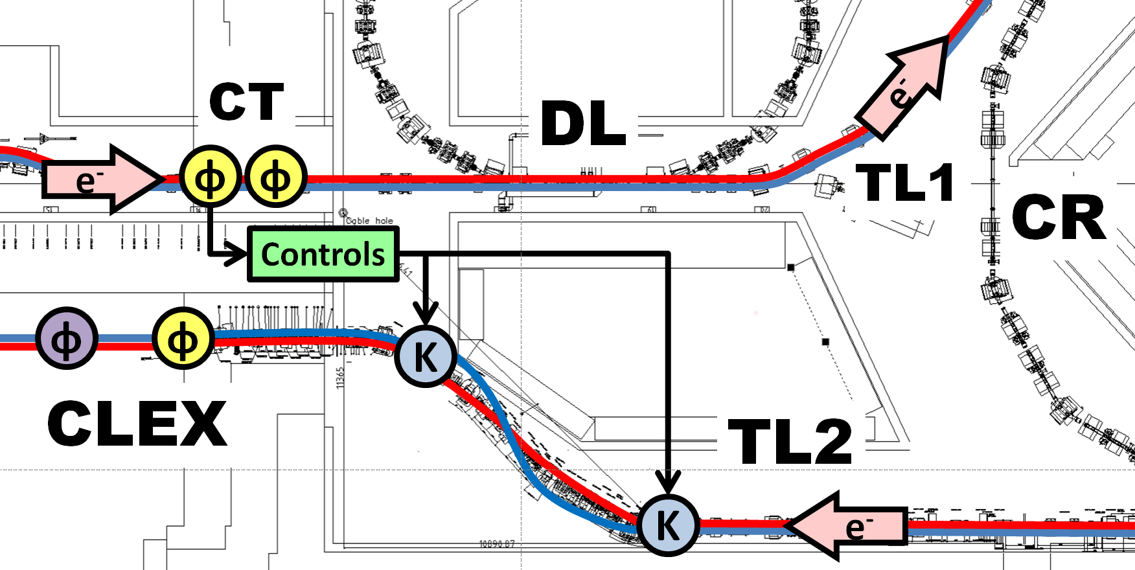
Phase Feedforward in 2015 & Plans for 2016
Jack Roberts

Slide 2
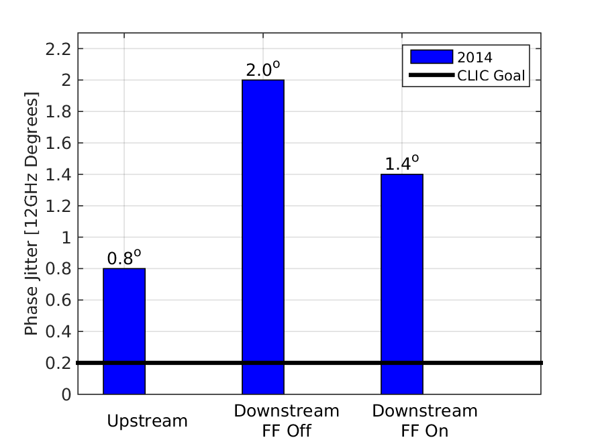
Status 2014
First feedforward tests in December 2014: hardware installations, timings setup etc.
Demonstrated ~30% reduction in downstream phase jitter from 2 degrees to 1.4 degrees.

Slide 3
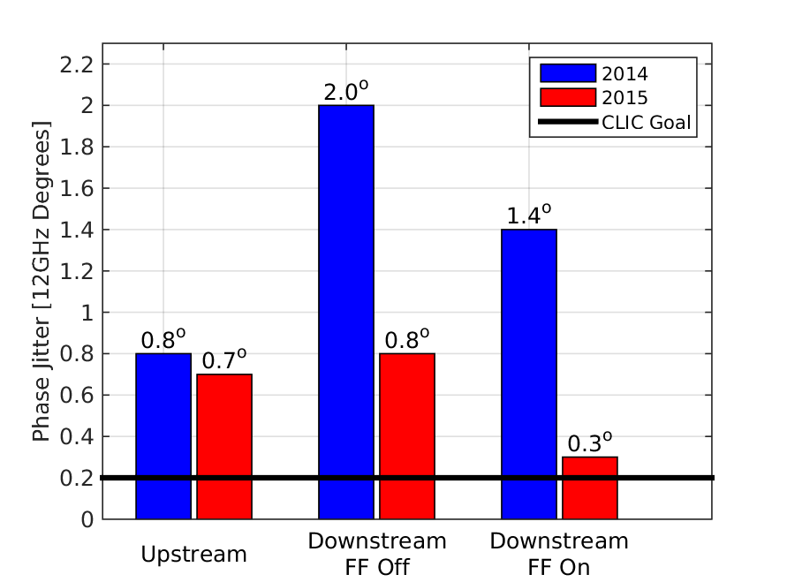
Status 2015
2.5x lower uncorrected downstream phase jitter (2 degrees -> 0.8 degrees).
5x lower corrected downstream phase jitter (1.4 degrees -> below 0.3 degrees).

Slide 4
Issues Limiting 2014 Performance
Phase propagation:
  Low correlation (~50%) and large jitter increase between the upstream (FF input) and downstream phase.
Phase monitor performance:
  Poor resolution: Up to 0.8 degrees instead of expected <0.2 degrees.
Correction range
  Regularly saturating amplifier (±3 degrees range) with 2 degrees phase jitter downstream.
All have been addressed and improved during 2015.

Slide 5
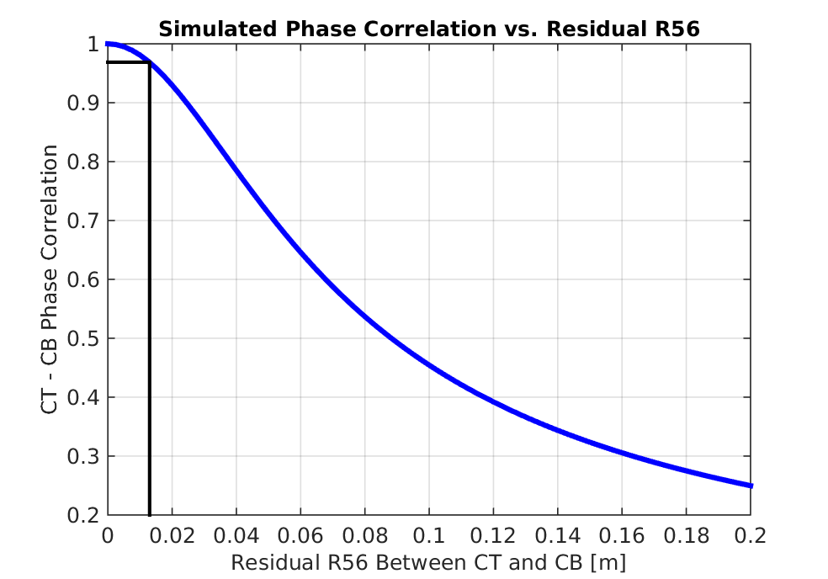
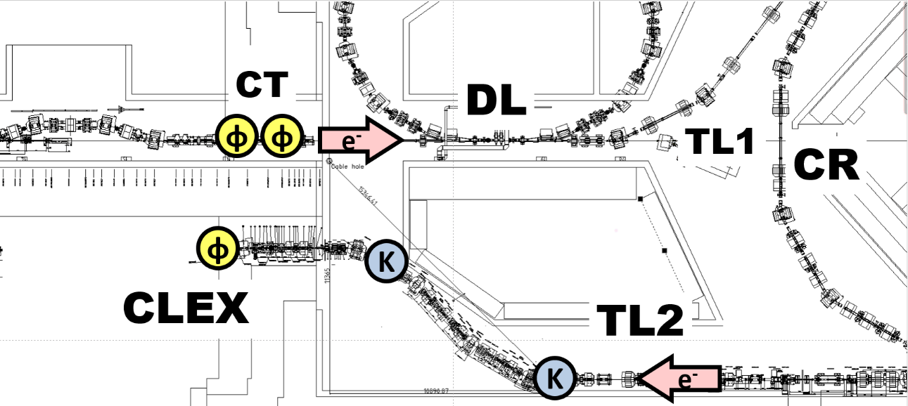
Phase Propagation
R56 = 0 m
R56 = -0.2 m
Non-zero R56 between the upstream and downstream phase monitors causes additional uncorrelated phase jitter downstream (via energy jitter).
To achieve 0.2 degrees stability at CTF, R56 must be controlled at the 1 cm level.
Compensate for negative R56 in TL2 with positive R56 in TL1.

Slide 6
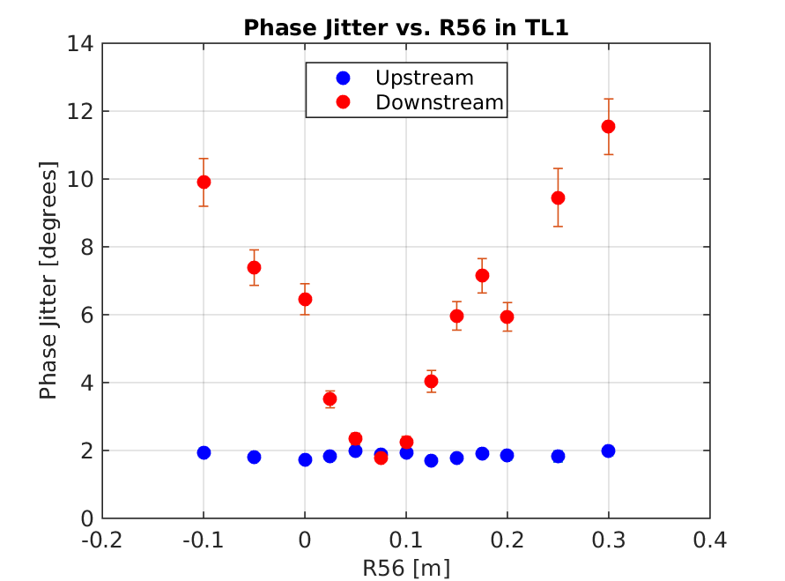
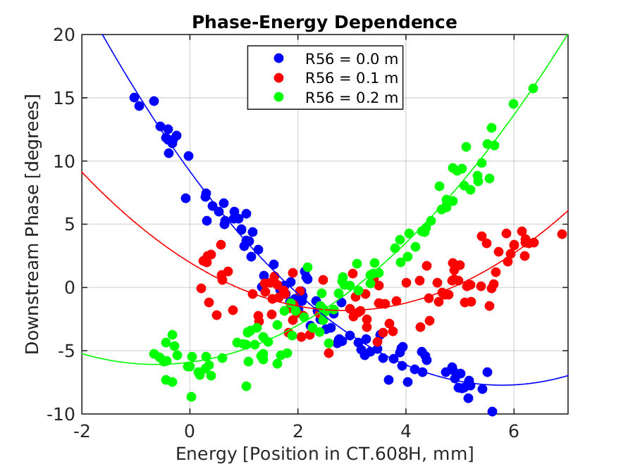
Phase Propagation
Beam energy varied ±1%
By varying R56 in TL1 we reduce the downstream phase jitter to the same level as the upstream phase jitter.
Higher order energy dependencies clearly visible: mitigated by flattening energy variations along the pulse.
Achieved 95% correlation, but extremely sensitive to small changes in injector.

Slide 7
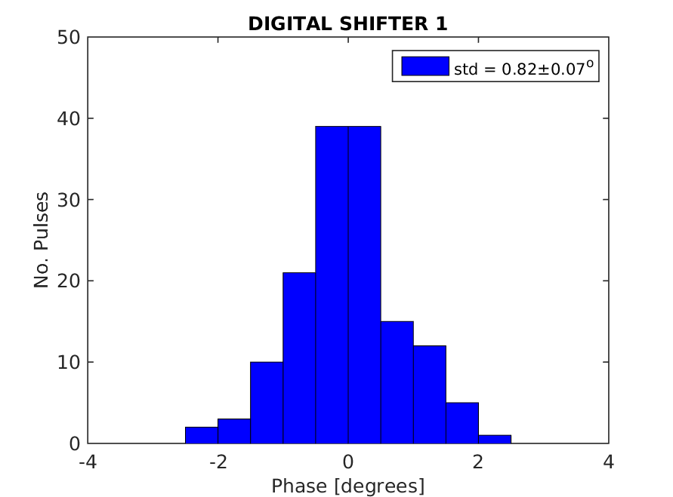
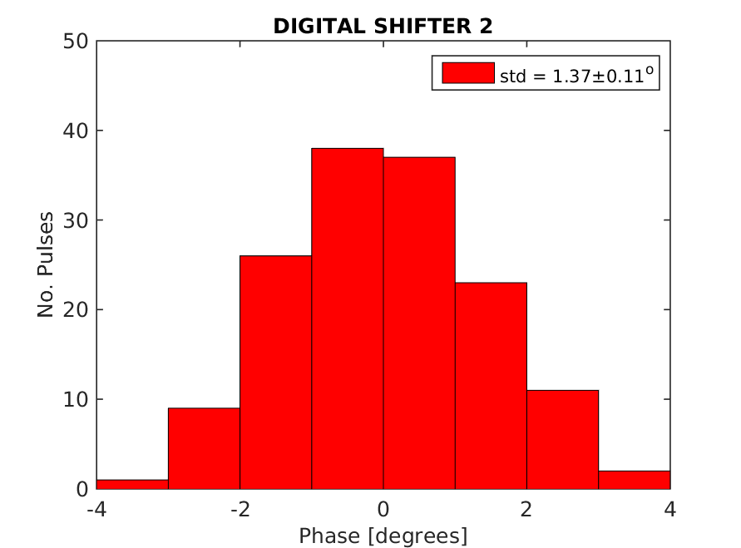
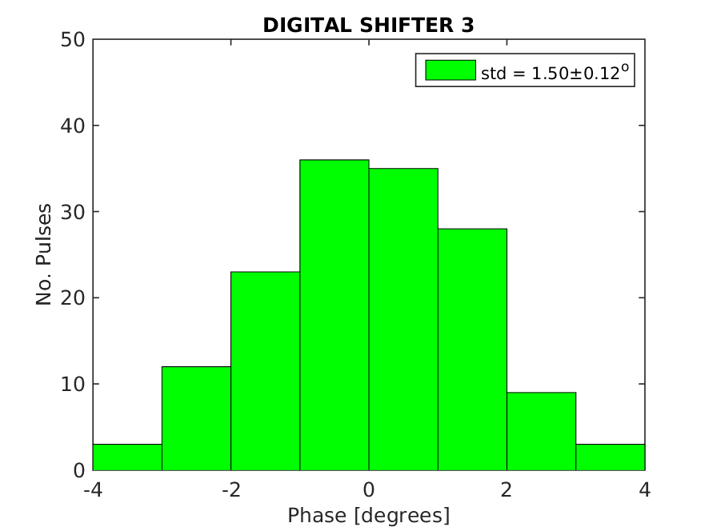
Phase Monitor Performance
3 purpose built phase monitors (from INFN Frascati): 2 upstream, 1 downstream.
Only achieved ~0.7 degrees resolution in late 2014/early 2015.
  Limits best possible corrected phase stability to 1 degree.
Identified source of problem to be noise originating from the digital phase shifters used in the electronics:
  With the same monitor connected to different sets of electronics, jitter varied by a factor 2.

Slide 8
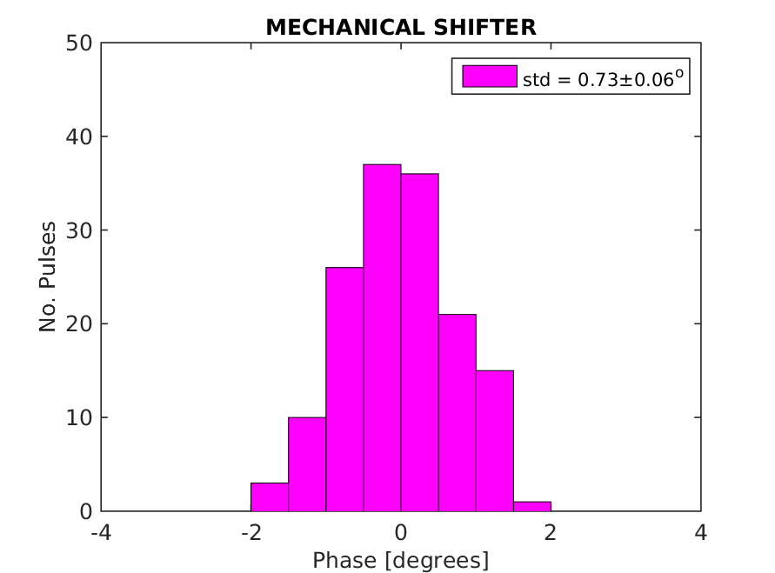
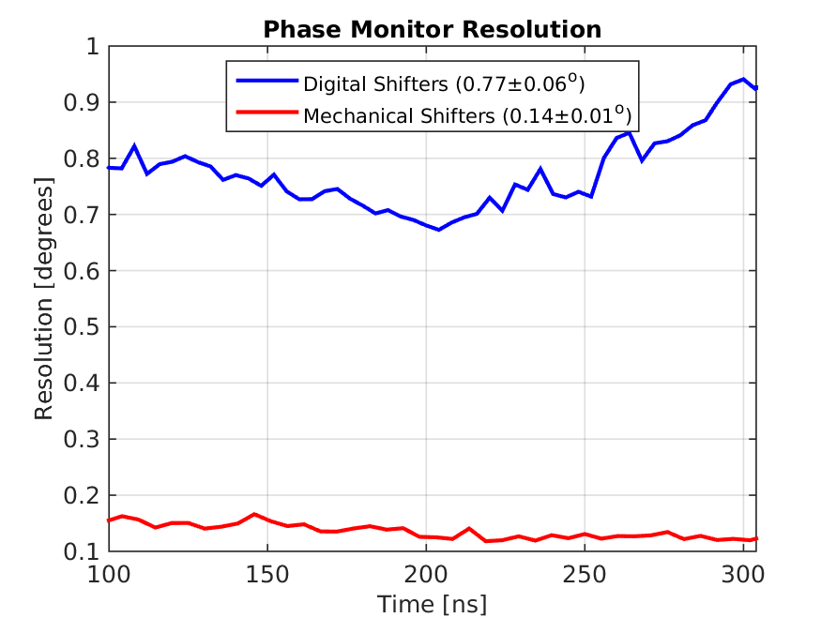
Phase Monitor Performance
Changed all the digital shifters to new mechanical phase shifters.
Upstream phase jitter (beam jitter, not noise floor) consistently ~0.75 degrees for each set of electronics.
Resolution between two upstream monitors 0.14 degrees across the pulse.
0.14 degrees resolution or below required to be able to achieve 0.2 degrees stability.

Slide 9
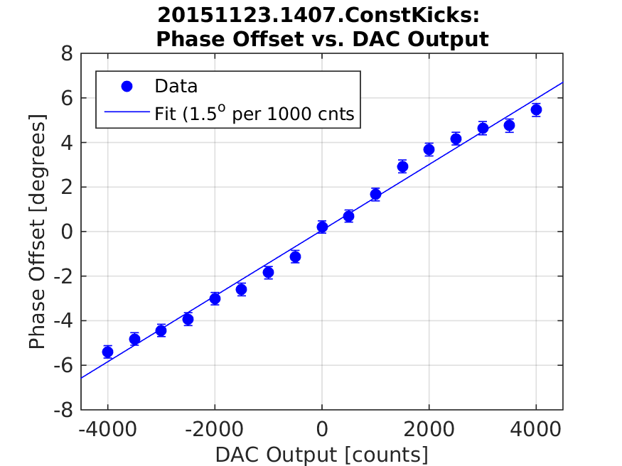
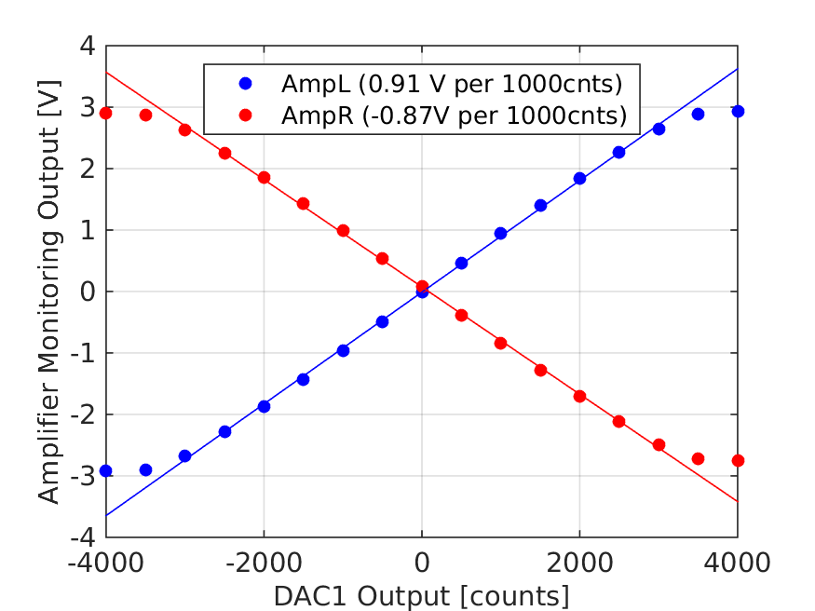
New Amplifier
Nov 2014-Oct 2015: 345 V for ±3 degrees range.
Nov 2015: 690 V for ±6 degrees range.

Slide 10
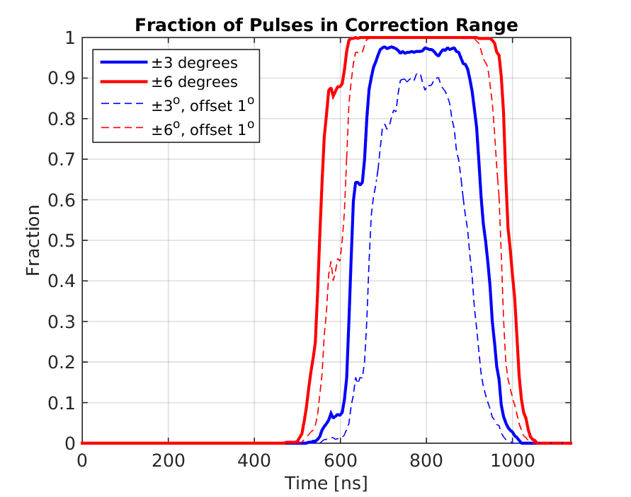
New Amplifier: Effect on Correction
In nominal conditions ~350ns of pulse can now be optimally corrected (relevant pulse length for CLIC 240ns) .

Slide 11
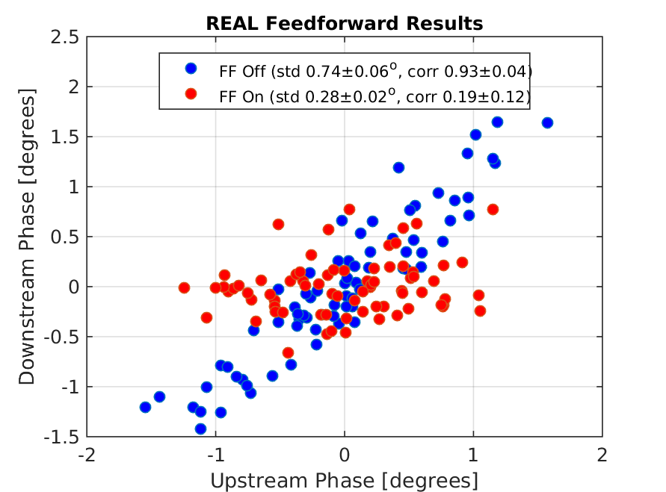
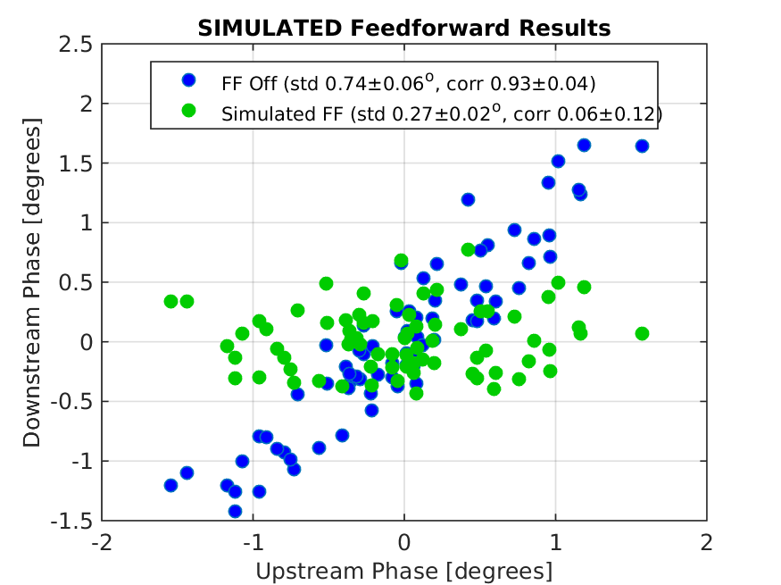
Phase Feedforward: Current Jitter Record
Interleaved data: Even pulses have FF on and odd pulses have no correction applied.
0.74 degrees phase jitter reduced to 0.28 degrees.
Simulated best possible (unlimited) FF correction given beam conditions 0.27 degrees.

Slide 12
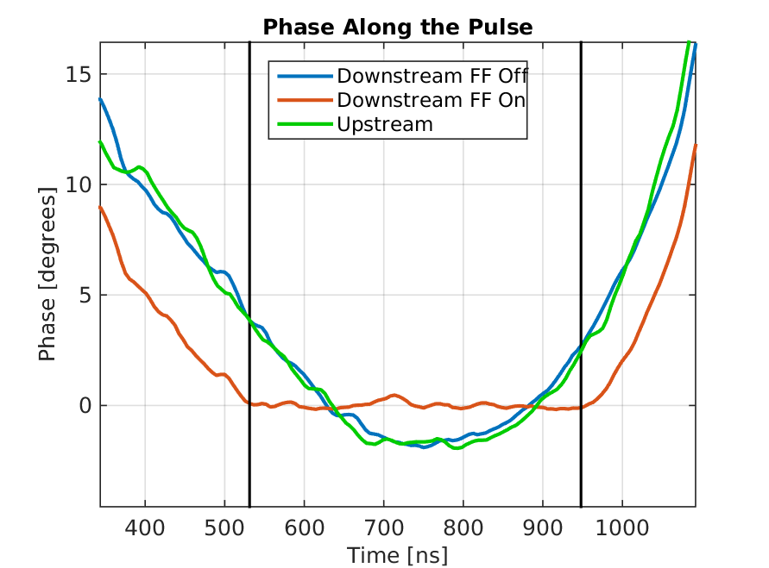
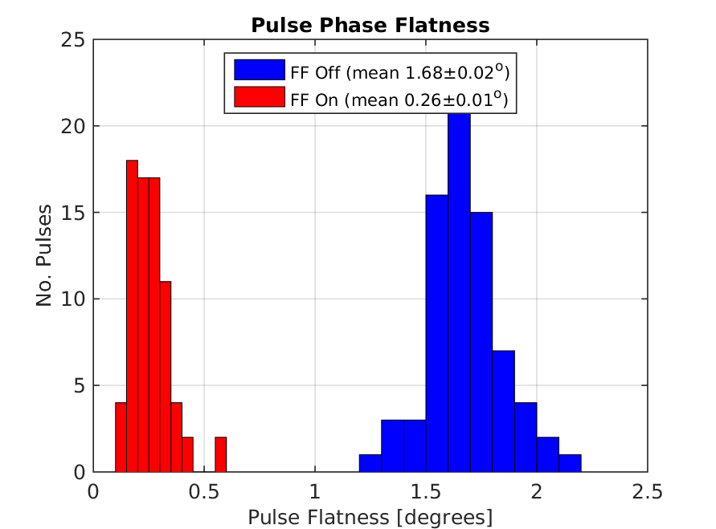
Phase Feedforward: Current Jitter Record
Amplifier Saturated
Amplifier Saturated
High bandwidth (~30 MHz) correction: Correct variations along the pulse not only jitter on the mean.
Phase variation along the pulse (between black lines) reduced from 1.68 to 0.26 degrees (mean deviation of samples along pulse).

Slide 13
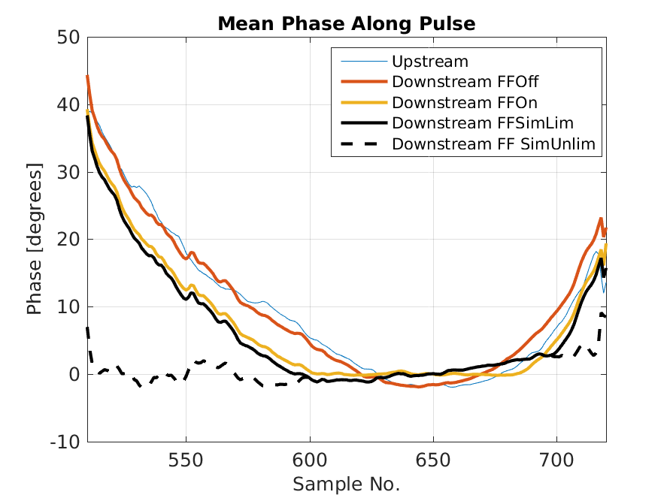
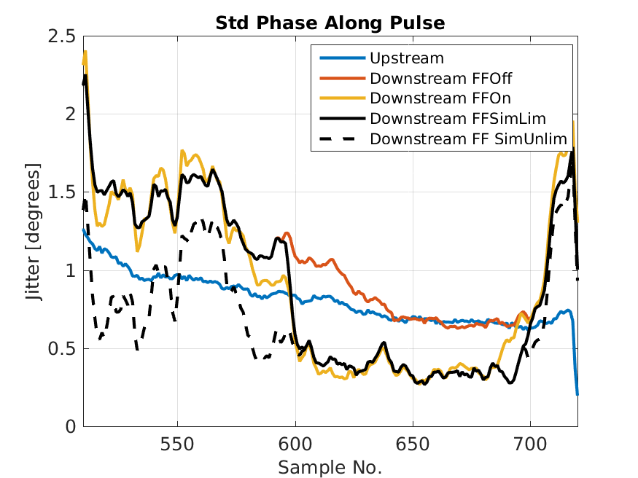
Simulations Along Pulse: Phase Jitter Record

Slide 14
Remaining Points for 2016

Slide 15
Remaining Points for 2016
Phase Feedforward:
  Remaining stability goals.
  Different operational setups to try.
Phase propagation
  Optics.
  Drifts.
  Other sources.
Phase monitor performance:
  Resolution.
  Other issues (e.g. Diodes).
Consequences for CLIC.

Slide 16
Phase Feedforward
Further reduce phase jitter.
New correction setups.
Operational changes.

Slide 17
0.2 Degrees Stability / Factor 10 Reduction
To achieve 0.2 degrees jitter:
  Need 97% correlation.
Amplify phase jitter to 2 degrees – maybe using Frascati chicane with 0<R56<0.45.
  Need 99.5% correlation for factor 10 reduction.
    Did achieve this correlation with natural Frascati chicane (R56 = 0.45m), but with >5 degrees phase jitter.
Majority of the improvement will have to come from phase propagation.

Slide 18
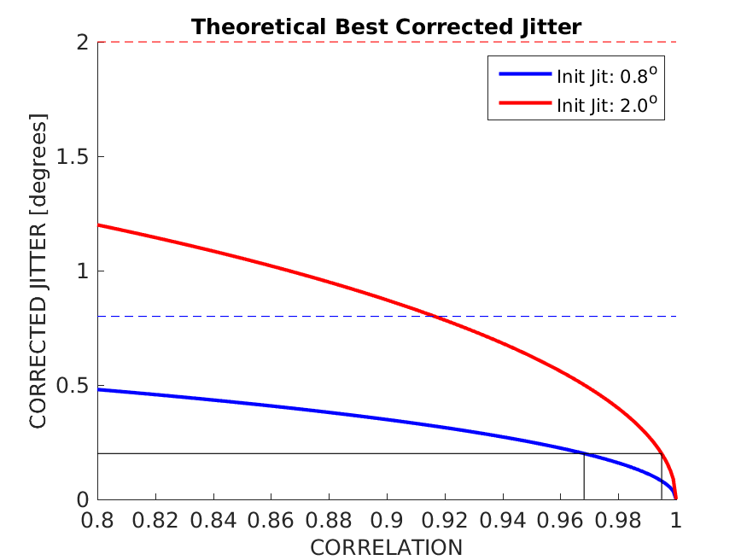
Theoretical Corrected Phase Jitter vs. Correlation

Slide 19
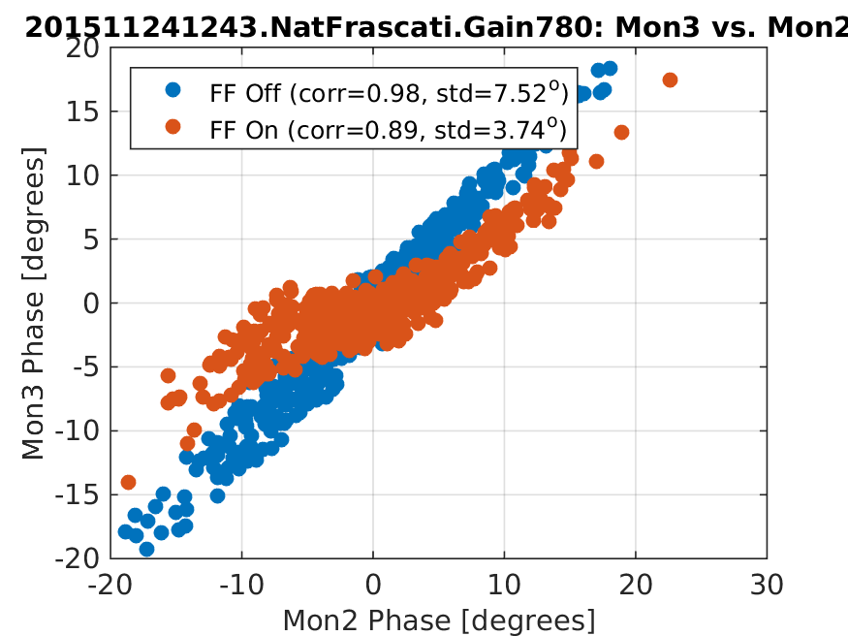
Feedforward with Natural Frascati Chicane (R56 = 0.45m)

Slide 20
Combined Beam
Possibly interesting as a different scheme for CLIC if a good demonstration can be achieved at CTF.
E.g. factor 8 beam at CTF:
  Upstream: 1.5 GHz, 1.1 μs beam with 8 x 180º phase switches.
  Downstream: 12 GHz, 140 ns beam.
  FF Algorithm: Correct using average of each 140 ns upstream sub-train.
Needs: Combiner module added to firmware, study of combined beam phase propagation.

Slide 21
Removal of Slow Phase Drifts
Goal: Keep phase in correction range for longer.
  Combination of phase feedforward and slow feedback.
    Slowly update channel offset in DAQ to keep correction centred around zero. Remove resulting drift in mean with slow correction.
      Probably would only have a positive effect for very long datasets.
Linked to phase propagation – slow drifts cause loss of correlation.
  If all phase drifts lead to loss of correlation, trying to remove them after the linac will not improve feedforward performance.

Slide 22
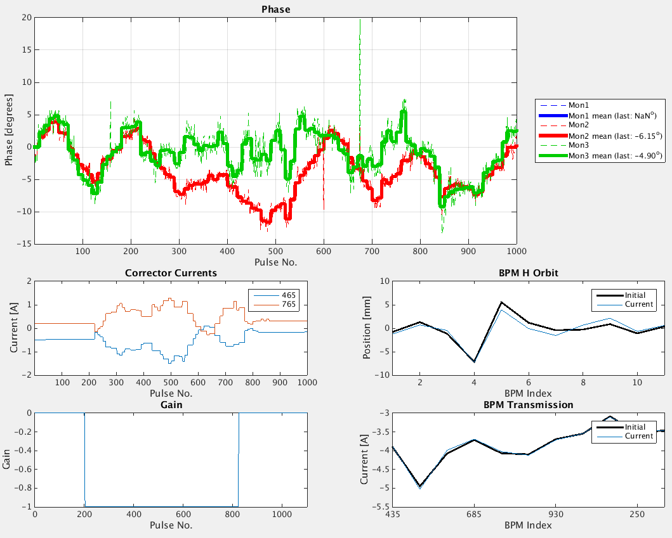
Example Slow Correction Results

Slide 23
With Additional Inputs
May be possible to remove some remaining sources of phase jitter using additional inputs in to the correction algorithm/signal processing, e.g.
  Energy (via BPM signal)
  Position (via Phase Monitor difference signals)

Slide 24
Corrections for Amplifier in Firmware
As corrected phase jitter is reduced further may start to be sensitive to small effects from the amplifier that can be taken in to account in firmware:
  Droop correction.
    IIR filters are present but cause overflow in correction output with current firmware.
  Slew rate correction.

Slide 25
Acquisition
Would still be beneficial to be able to acquire FONT ADCs over the CERN control system along with other signals.
  Adding shared variables to DAQ.
  Developing FESA class for control system.

Slide 26
Phase Propagation
Drifts in injector leading to loss of phase correlation.
Energy dependence – including higher orders.
Other sources of phase jitter.

Slide 27
Sensitivity to Drifts in Injector
Have been able to achieve >90% (up to 95%) correlations but only for short periods of time without further interventions (~hour time scale).
Need to identify the cause for the loss in correlation. Suspect energy drifts resulting from changes in klystrons after trips etc.
  Higher order energy dependencies means optimal R56 point drifts with energy -> energy drifts reintroduce energy component in downstream phase.
  Might be that size of drifts we are sensitive to are smaller than injector feedbacks can hope to correct.
  Or may not be coming directly from energy.

Slide 28
Higher Order Energy Dependencies
Attempt to match optics with smaller second order R56 (T566).
  Chances of the matched optics working as expected in the machine probably slim.
Smooth energy variations along the pulse.
  Best feedforward result came after Davide used one of his feedbacks to change the waveform of one klystron to smooth the upstream phase.

Slide 29
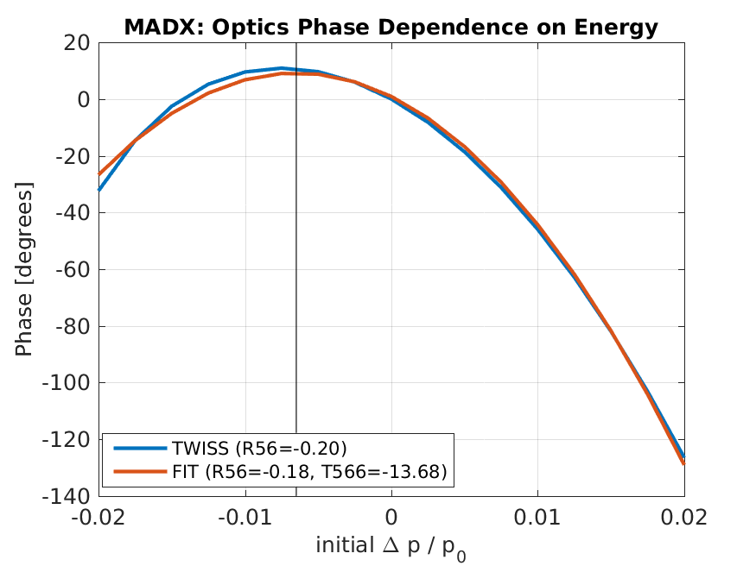
Phase vs. Energy Offset According to MADX

Slide 30
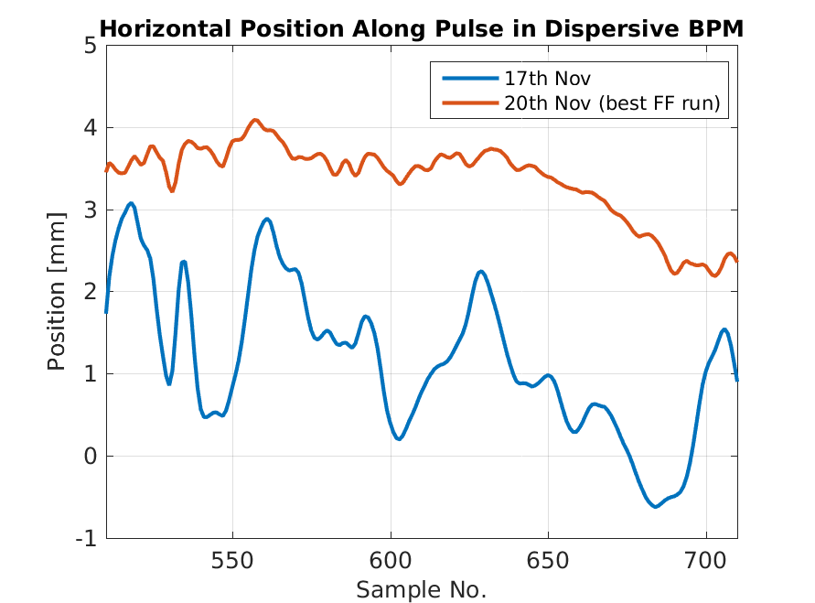
Energy Variation Along Pulse

Slide 31
Other Sources of Phase Jitter
May be sources of uncorrelated phase jitter not linked to energy/changes in injector.
Most likely candidates would be jitter on power supplies, e.g.
  Combiner ring septum
  Dipoles

Slide 32
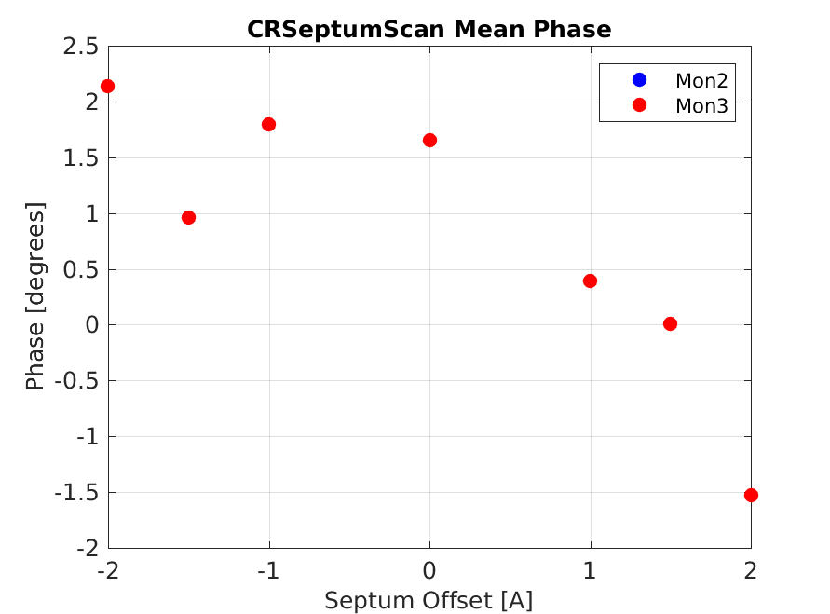
Downstream Phase vs. CR Septum Current

Slide 33
Phase Monitor Performance
  Resolution on FONT5a board Re-emergence of 0.35 degrees resolution.
  Diode performance.
  Cross-talk between channels.
  Dependence on position.
  Baseline noise.

Slide 34
Resolution
Spent Wednesday last week taking a vast array of measurements to try to understand worse resolution on FONT5a board (>0.35 degrees compared to <0.15 degrees).
  357MHz (generator) and 192MHz (same as used by SiS) clock frequency, with/without the signals split to SiS, on the FONT5a and the old FONT5 board.
  Eventually in the analysis I realised the resolution on the SiS is now 0.35 degrees as well, no longer the 0.15…
    No setup changes since the best 0.13 degrees result. Maybe a loose connection/similar that developed.
    Ideally/hopefully only something that changed on Mon2 – wouldn’t effect correction. Otherwise 0.28 degrees corrected jitter shouldn’t be possible.

Slide 35
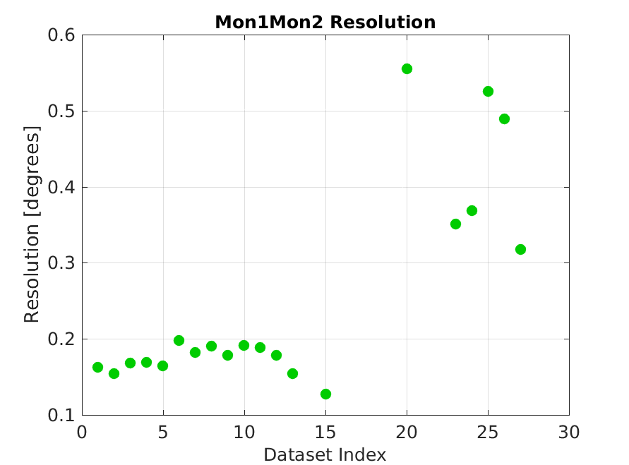
Resolution History
Amplifier
not connected
Mon1 connected
To FONT for FF.
All new shifters
Installed.
Attenuation on
Input removed.

Slide 36
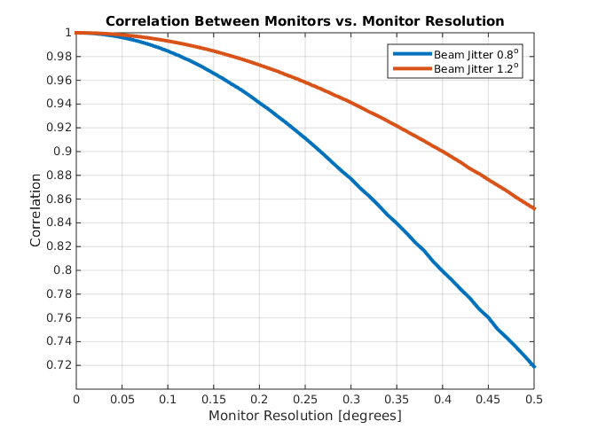
Resolution: Significance for Correction

Slide 37
Diode Performance
Diodes saturate earlier than the Mixers.
  Attenuating inputs to avoid saturation of diodes results in worse resolution (using Mixer only).
Cross-talk (Diode on Mixer and Mixer on Diode) should be taken in to account in order to use the diodes.
Diode outputs should be amplified to increase signal/noise on SiS.
  New amplifiers built but all had issues.
Reflection on Mon3 Diode.

Slide 38
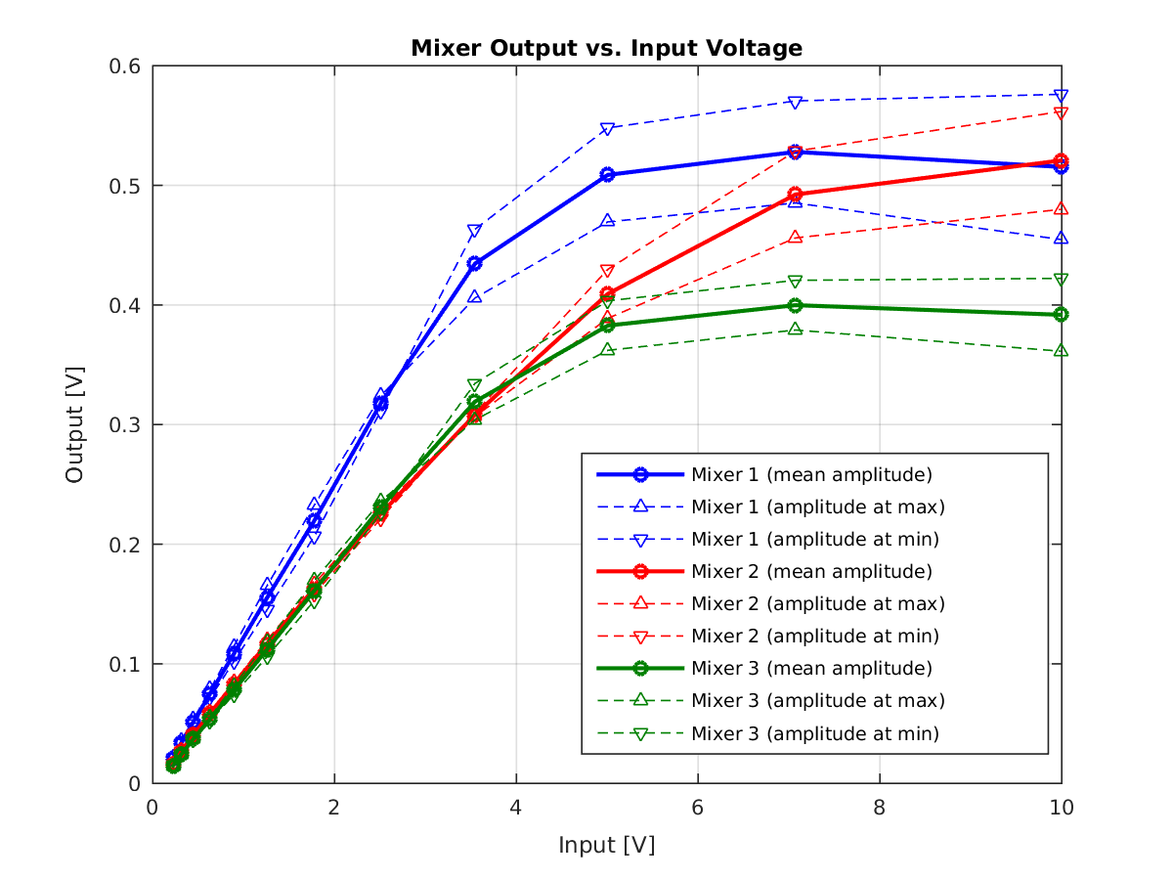
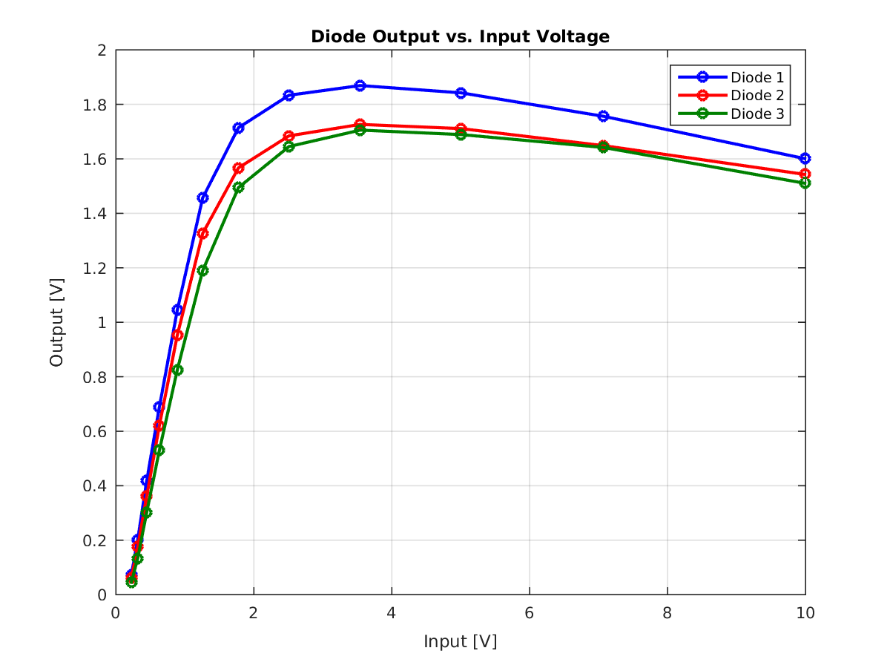
Mixer, Diode vs. Input Voltage

Slide 39
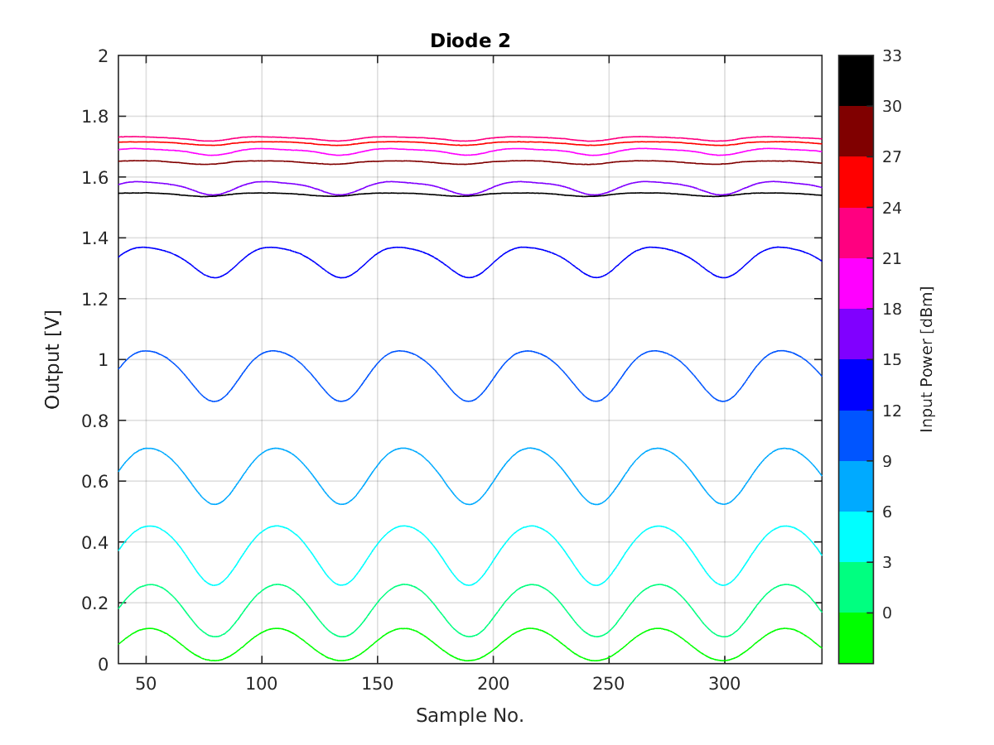
Cross-Talk on Diode

Slide 40
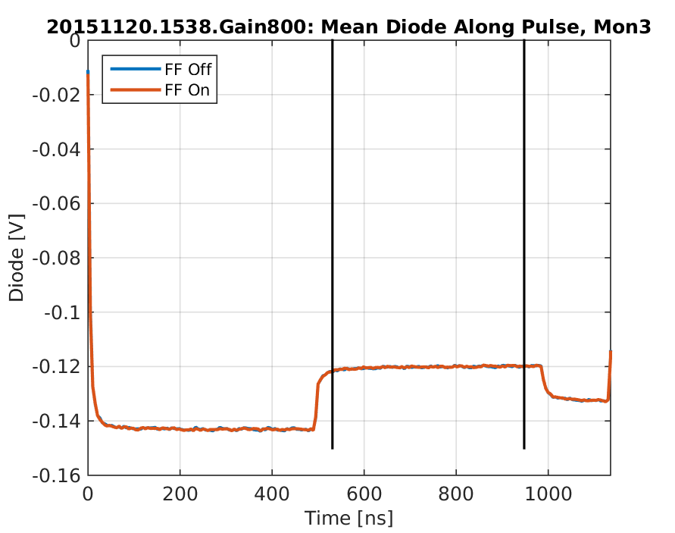
Reflection on Mon3 Diode

Slide 41
Dependence on Position
Measured clear dependence of Mon1 and Mon2 phase measurement (Mixer only) on position.
  Comes mostly from variations in input power*.
  Should be able to reduce effect by using diodes?
  Include phase monitor position measurements in phase reconstruction?
Needs to be measured for Mon3 as well.
* Changing correctors during position scan changes path length between corrector and phase monitor. Back of envelope calculation gives only 0.1 degrees effect.

Slide 42
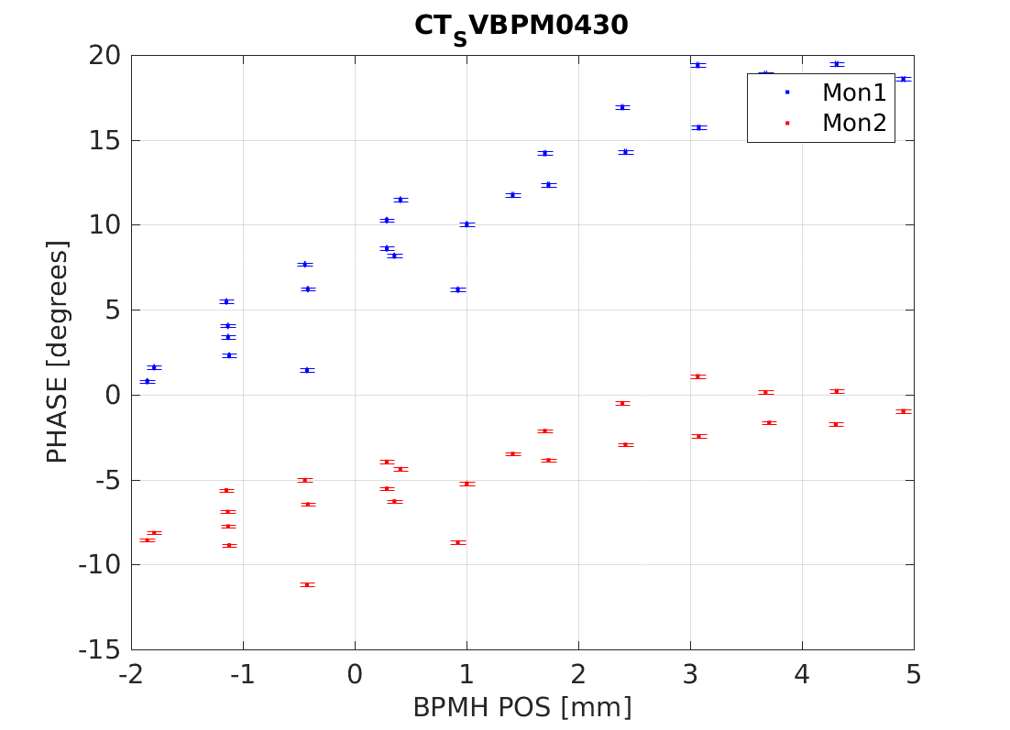
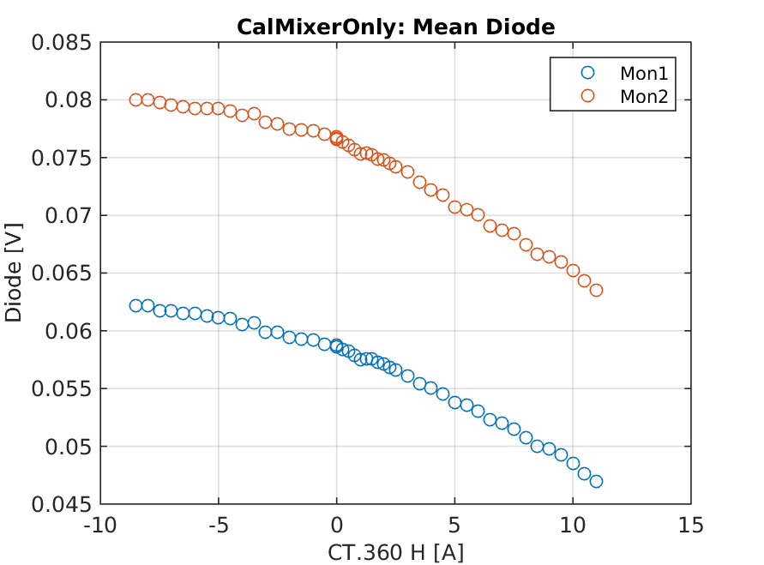
Example Preliminary Position Scan Results

Slide 43
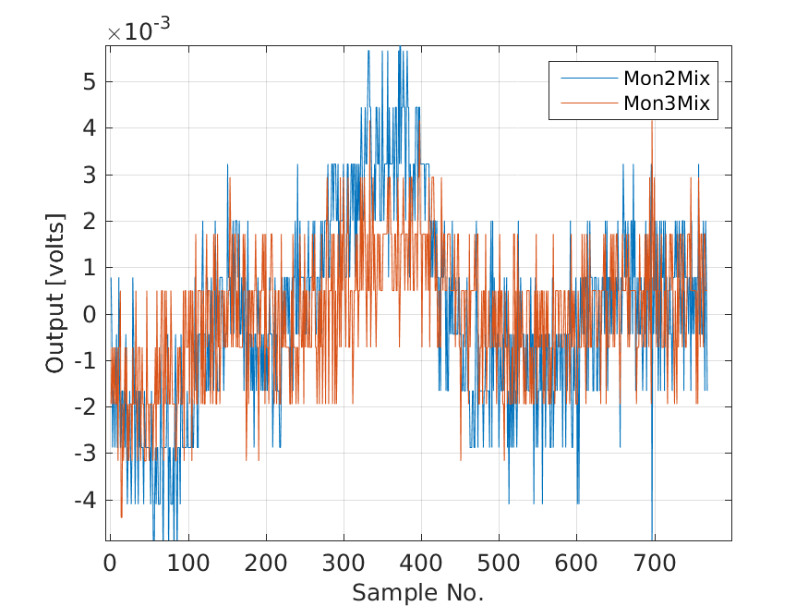
Baseline Noise
Shapes in baseline noise from all monitors that may have an effect on performance. Scale as seen here probably insignificant.

Slide 44
Consequences for CLIC
  Optics
  Hardware requirements
  Different schemes (e.g. combined beam, 2 kickers instead of 4 etc.)

Slide 45
Summary
Achieved 0.28 degrees phase stability at CTF, getting very close to the CLIC goal of 0.2 degrees.
Result thanks to:
  Increasing upstream-downstream phase correlation from 50% to 95% via a campaign of R56 and energy optimisation, plus much improved stability at CTF.
  Changes to phase monitor electronics improved resolution from 0.75 to below 0.15 degrees.
  New amplifier to double the correction range.
Remaining points:
  Increase reproducibility/longevity of 95% correlation.
  Phase monitor performance – especially why is resolution now worse?
  To achieve 0.2 degrees stability: >97% correlation required.
  Demonstrate factor 10 jitter reduction: 99.5% correlation with upstream jitter amplified to >2 degrees

Slide 46

Merry Christmas!

