Slide 1
Status in Japan
Akira Yamamoto
Report for the TB meeting,
5 January, 2016

Slide 2
SRF Progress in ‘15, and Prospect in ‘16
STF: CM1+CM2a Gradient Performance
  G-average = 30. 3 MV/m
  CM1-upstream : 39, 37, 35, 36 MV/m
    not degraded
  CM1-downstream: 26, 16, 26, 32 MV/m
    Clearly degraded
  CM2a: 18, 34, 33, 32 MV/m
    partly degraded
New Input-coupler (Tesla compatible) to be tested soon
RF wave-guides delivered and to be assembled
  8-cavity string to be connected to Klystron
  8-cavity string RF test to be realized in May through July

Slide 3
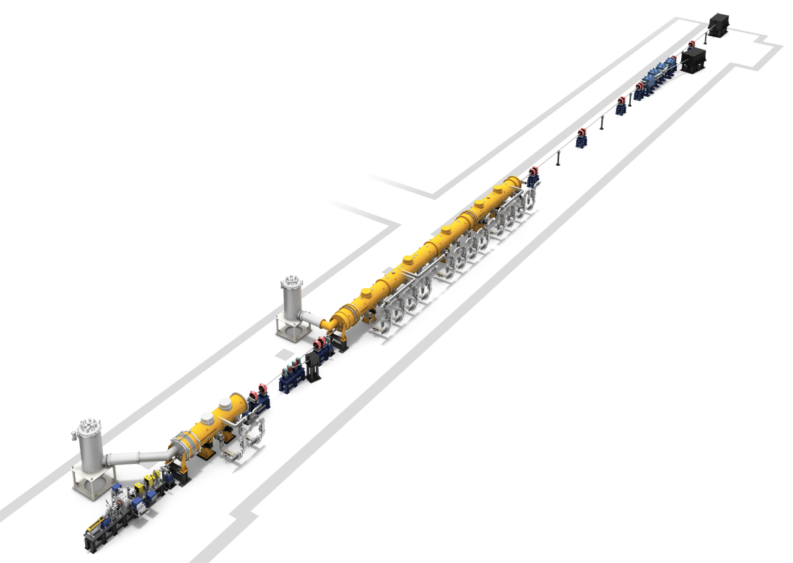
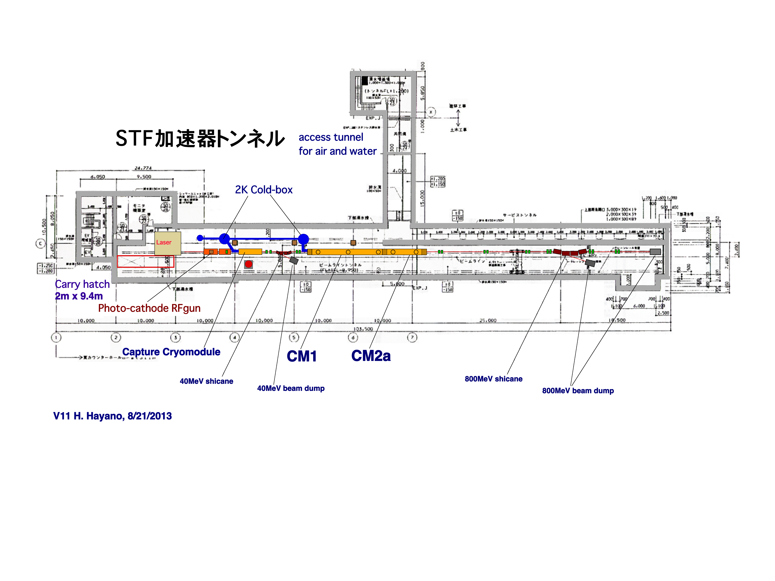
CM Test and Beam Acceleration
Design
Beam Energy：418MeV (40MeV + 31.5MeVx12cavities)
Beam Charge： 2.15nC/bunch, 2437bunch, 0.9ms, 5Hz
Beam current: 5.8mA in train
Bunch train: 369ns spacing
ILC-TDR、2E10/bunch, 1312bunch/train
554ns spacing, 0.72ms train length
5.8mA peak current

Slide 4
2016年時のSTF加速器の計画
CM1とCM2aが連結設置。 ビームラインは将来のクライオモジュール追加を想定
してマグネットやビームダンプを後方に配置する。
CM2b,CM3a,CM3bの予定の場所にはQマグネットダブレットを３組配置するが、
CMを組み込むときには順時外していく。
上流に40MeVダンプ１台、下流に800MeVダンプ２台（１台はエネルギー
アナライザー後のダンプ）

Slide 5
Cryogenics Layout Study
CR-008 ready to be submitted to the CMB
  Main compressor and He storage on surface
New Actions:
  4K cold-box location to be further studied
    An industrial study contracted with Taiyo-Nissan (Linde) for cold-box optimization study and thermal balance. A clear view expected by the next LCWS-Spain
    A technical study contracted also with J-Power, for CFS cost difference.

Slide 6
CFS Progress
ILC TOT program delivered to KEK
  Study for access-hall direction and and access tunnel approach to surface being started
  A special action needed to establish a consensus
    ML orientation (CM and RF utility sides)
    Access hall direction,
      Still some confusion existing
  A mini-workshop in March, to boost layout/access study by using TOT
    An small/additional contract made with ARUP.

Slide 7
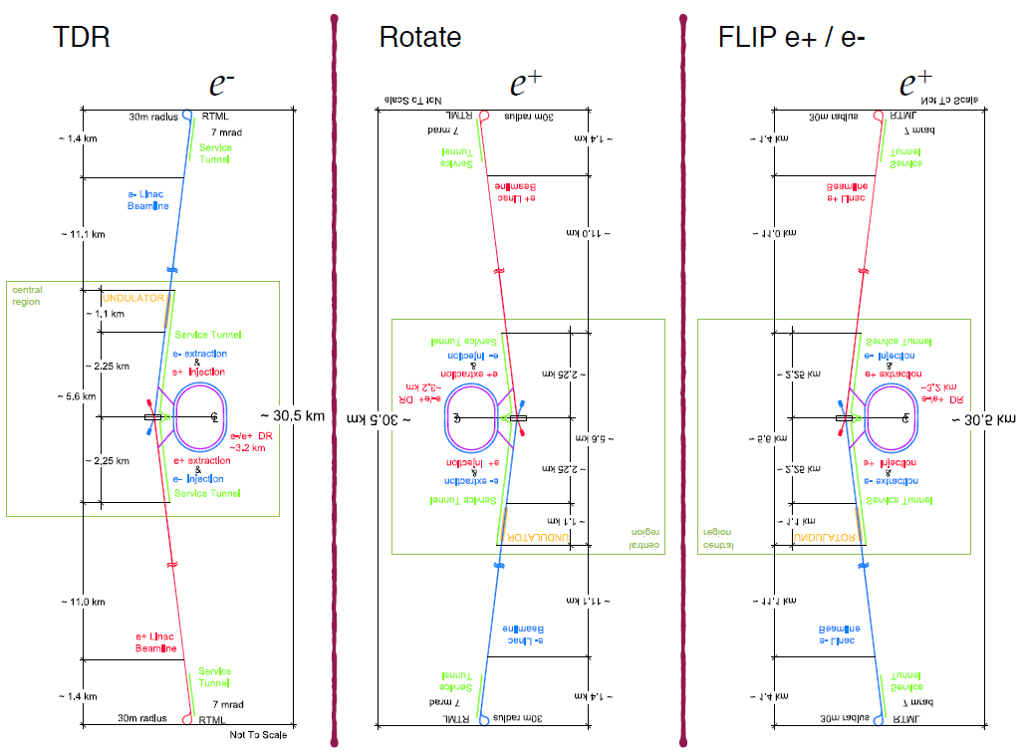
ILC Accelerator Layout
Some confusion and alternate options

Slide 8
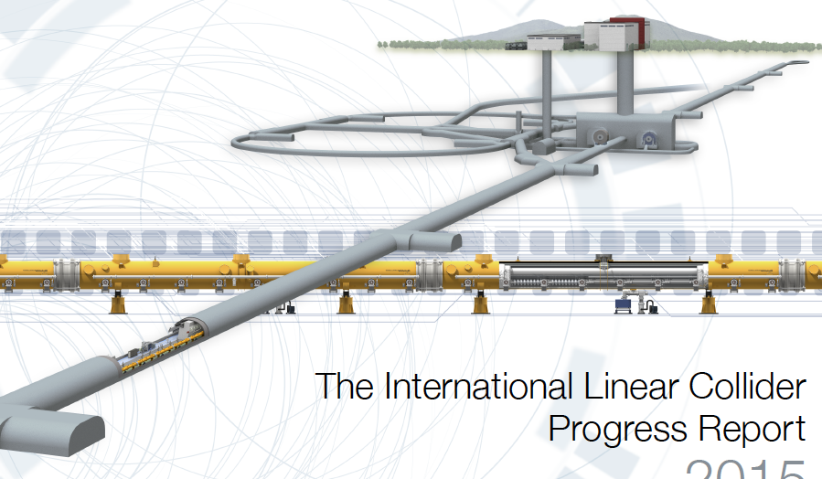
Tunnel Access Consideration
Good for maintenance
Good for installation

Slide 9
Access Hall & Connection Hall
Comparison TDR and Revised design
TDR Design
Total length 180m
For portal
Connection Hall
Service gallery
Shield wall
Beam gallery
Alternative Design
Total length 91m
For portal
Connection Hall
Service gallery
Shield wall
Beam gallery

Slide 10
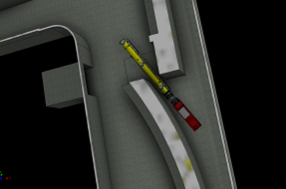
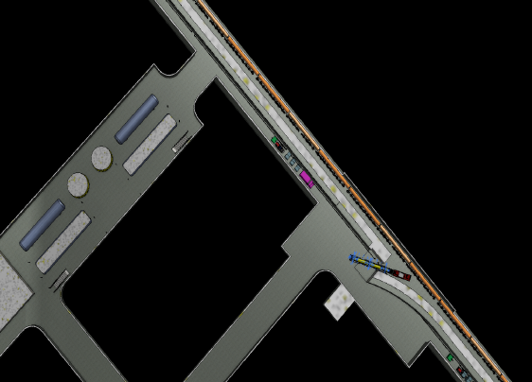
B案： 専用搬送車進入方式
遮蔽ゲート
アクセストンネル
特徴
特殊車両による搬入、設置
供用時；電動ゲートにより遮蔽
課題
RFトンネル部の設備供給ラインの切回し？
遮蔽ゲートの収納

Slide 11
CRWG
Led by Kaoru
Meeting, today, in parallel

Slide 12
Activities with MEXT
Human Resource Working Group
  1st meeting in November, 18
  2nd meeting in December, 21
  3rd meeting in February, 15
  4 ~ 6 in Spring, 2016
Commissioned Survey
  To be reported to MEXT by NRI, February 1.

Slide 13
KEK ILC Action Plan
Working Group Report completed
  Reported to MEXT
  To be formally announced at KEK, by DG, this week.
  To be open on the KEK URL, as a topic, tomorrow.

