Slide 1


Progress towards nanometre level beam stabilisation
Neven Blaskovic, Talitha Bromwich, Philip Burrows,
Glenn Christian, Colin Perry, Rebecca Ramjiawan
John Adams Institute, Oxford University

Slide 2
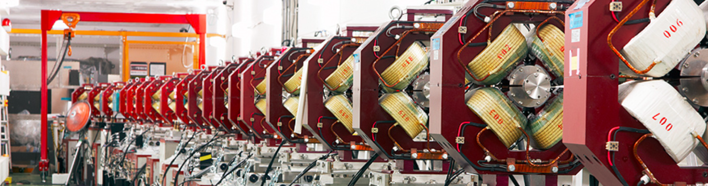
Outline
Introduction to our work at ATF
Set-up and components
Stripline and cavity BPM performance
Intra-train feedback results
Neven Blaskovic 2

Slide 3
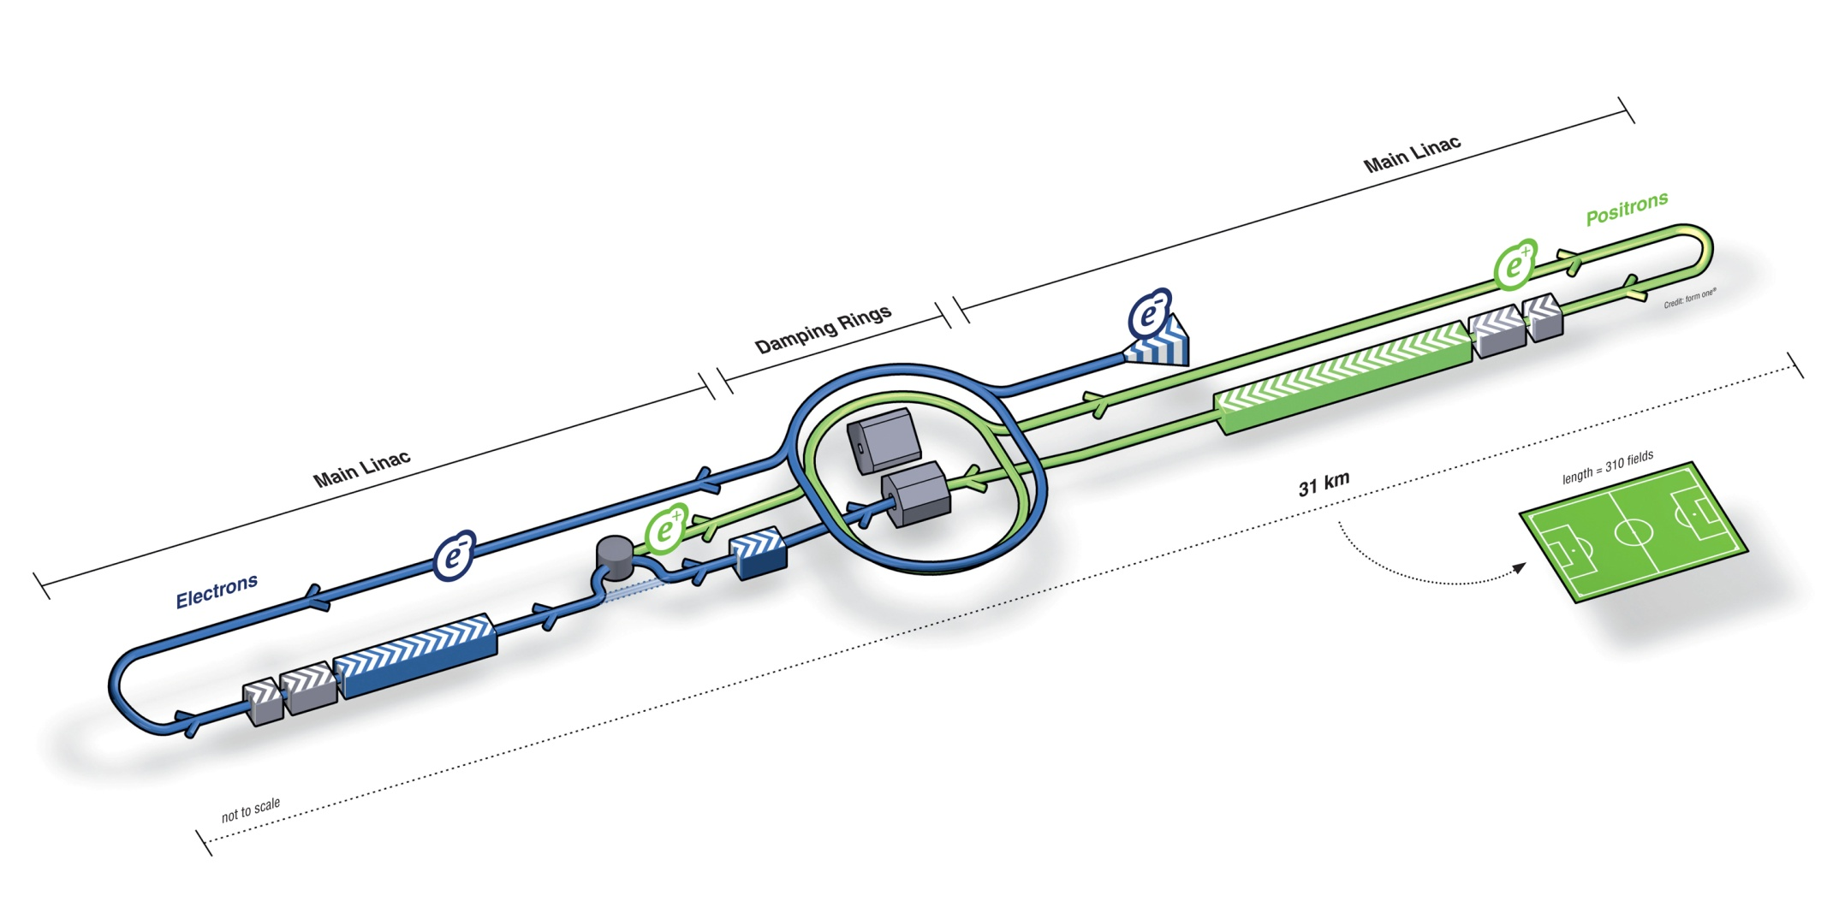
Introduction
International Linear Collider (ILC)
The next large particle accelerator will most likely be a linear electron-positron collider
A proposed design is the International Linear Collider (ILC):
Neven Blaskovic 3

Slide 4
Introduction
Feedback on Nanosecond Timescales (FONT)
Linear colliders are single-pass machines
Successful collision of bunches is critical
A fast feedback system is required, e.g. FONT:
Neven Blaskovic 4

Slide 5
Introduction
Accelerator Test Facility (ATF), Japan
We test the FONT feedback system at ATF, the Accelerator Test Facility for the future ILC:
Extraction line
Damping ring
Linear accelerator
90 m
Neven Blaskovic 5

Slide 6
Introduction
Feedback at the Accelerator Test Facility
ATF provides pairs of bunches travelling in the extraction line with ~200 ns bunch separation
We measure the position of the first bunch in order to correct the path of the second bunch
Extraction line
Neven Blaskovic 6

Slide 7
Introduction
Feedback at the Accelerator Test Facility
IPC
IPB
IPA
IPK
M
P3
P2
K2
K1
Key
P2
P3
M
Stripline BPMs
IPA
IPB
IPC
Cavity BPMs
Processor
Processor
Processor
Amplifier
Processor
Processor
Processor
Amplifier
Amplifier
Processor
Down mixer
Board
Digital board
Amplifier
Kicker amplifier
Board
Board
K1
K2
IPK
Stripline kickers
Neven Blaskovic 7

Slide 8
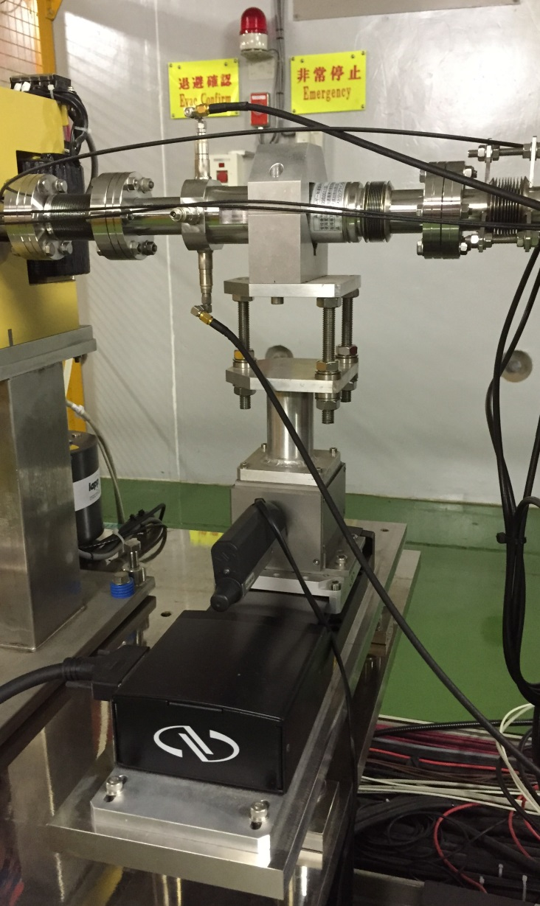
Results
Upstream Feedback
IPC
IPB
IPA
IPK
M
P3
P2
K2
K1
Processor
Processor
Processor
Amplifier
Processor
Processor
Processor
Amplifier
Amplifier
Board
Board
Neven Blaskovic 8

Slide 9
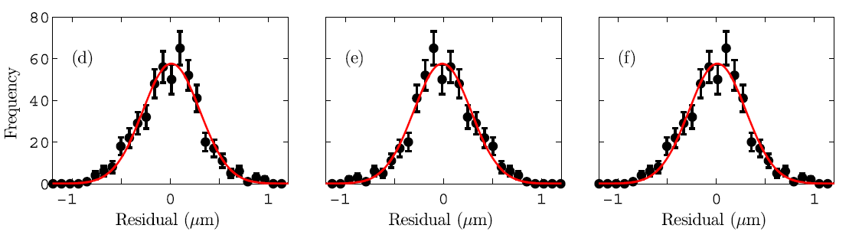
Results – Upstream Feedback
Stripline BPM resolution
Stripline BPM resolution: 291 ± 10 nm
Published in PRSTAB 18, 032803 (2015)
Neven Blaskovic 9

Slide 10
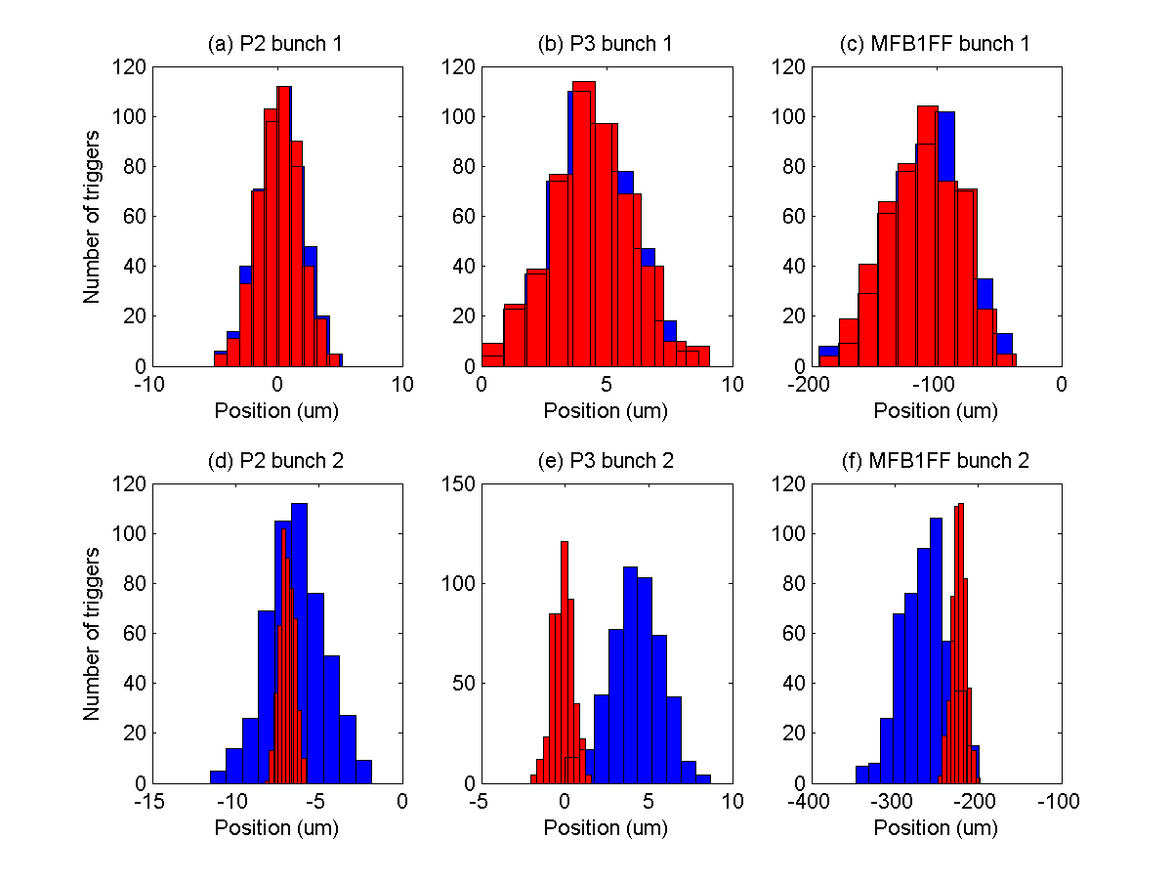
Results – Upstream Feedback
Position stabilisation upstream
Neven Blaskovic 10

Slide 11
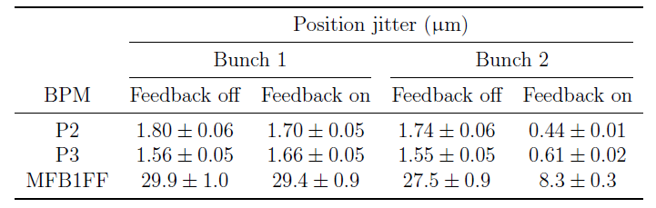
Results – Upstream Feedback
Position stabilisation upstream
Factor ~3 improvement
Neven Blaskovic 11

Slide 12
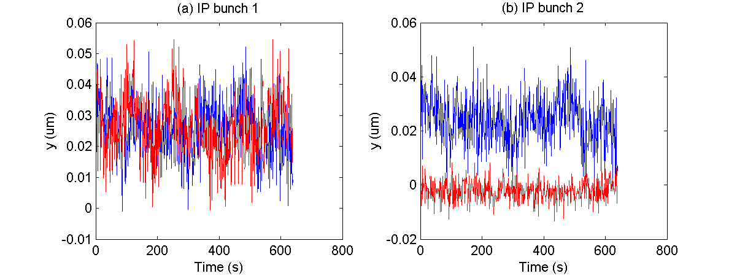
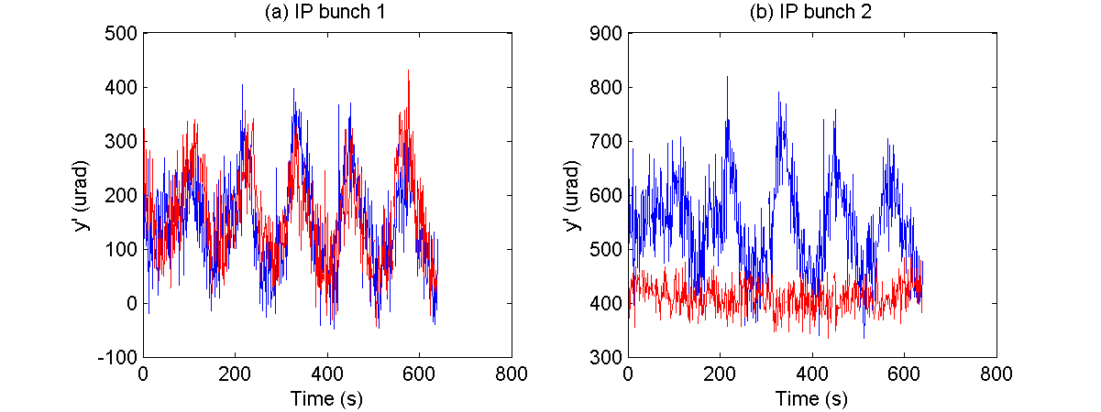
Results – Upstream Feedback
Position stabilisation propagated to the IP
y position
y’
angle
Neven Blaskovic 12

Slide 13
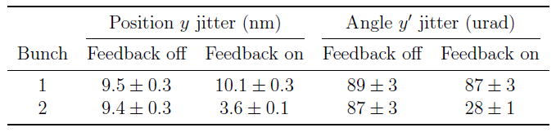
Results – Upstream Feedback
Position stabilisation propagated to the IP
Propagating results to IP suggests beam stabilisation to a few nm – challenge is to measure this!
Neven Blaskovic 13

Slide 14
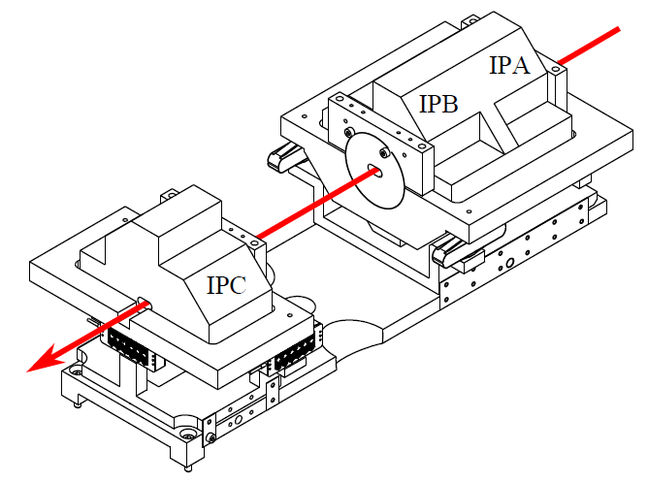
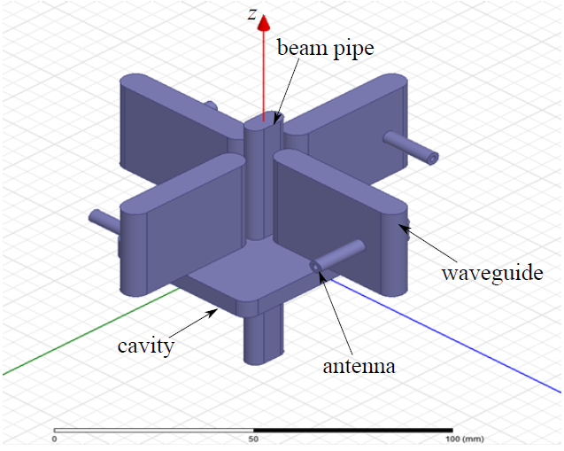
Results
IP Feedback
IPC
IPB
IPA
IPK
M
P3
P2
K2
K1
Processor
Processor
Processor
Amplifier
Processor
Processor
Processor
Amplifier
Amplifier
Board
Board
Neven Blaskovic 14

Slide 15
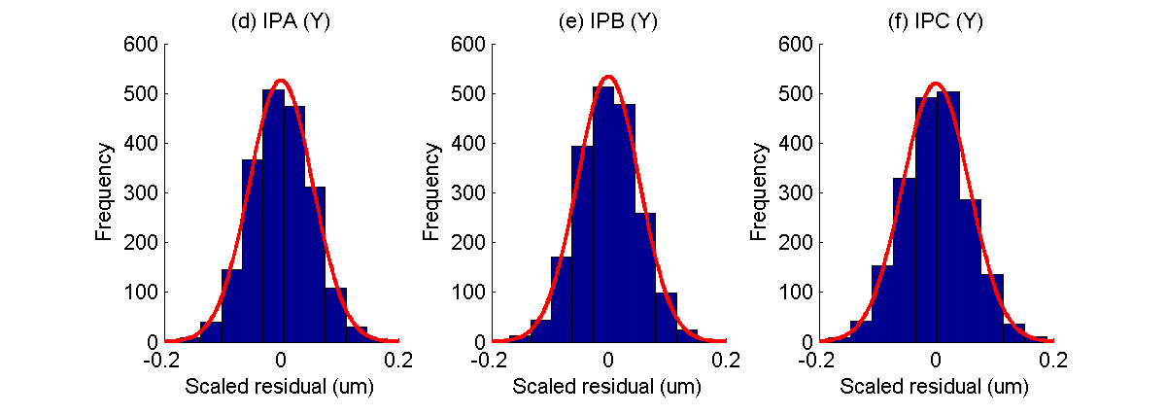
Results – IP Feedback
IP BPM resolution
IP BPM resolution: ~50 nm
Neven Blaskovic 15

Slide 16
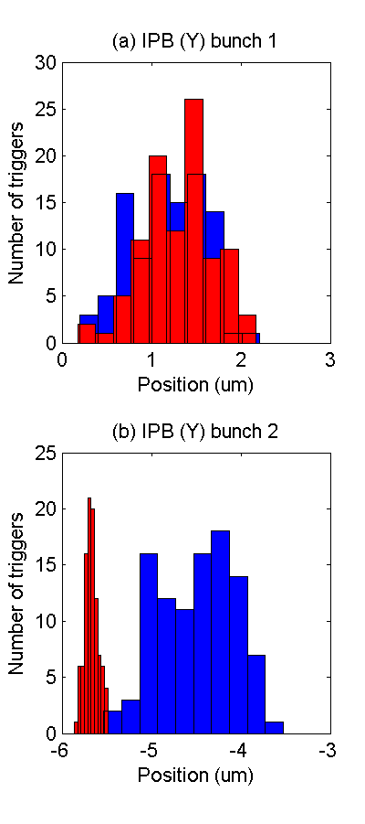
Results – IP Feedback
Position stabilisation in the IP region
Neven Blaskovic 16

Slide 17
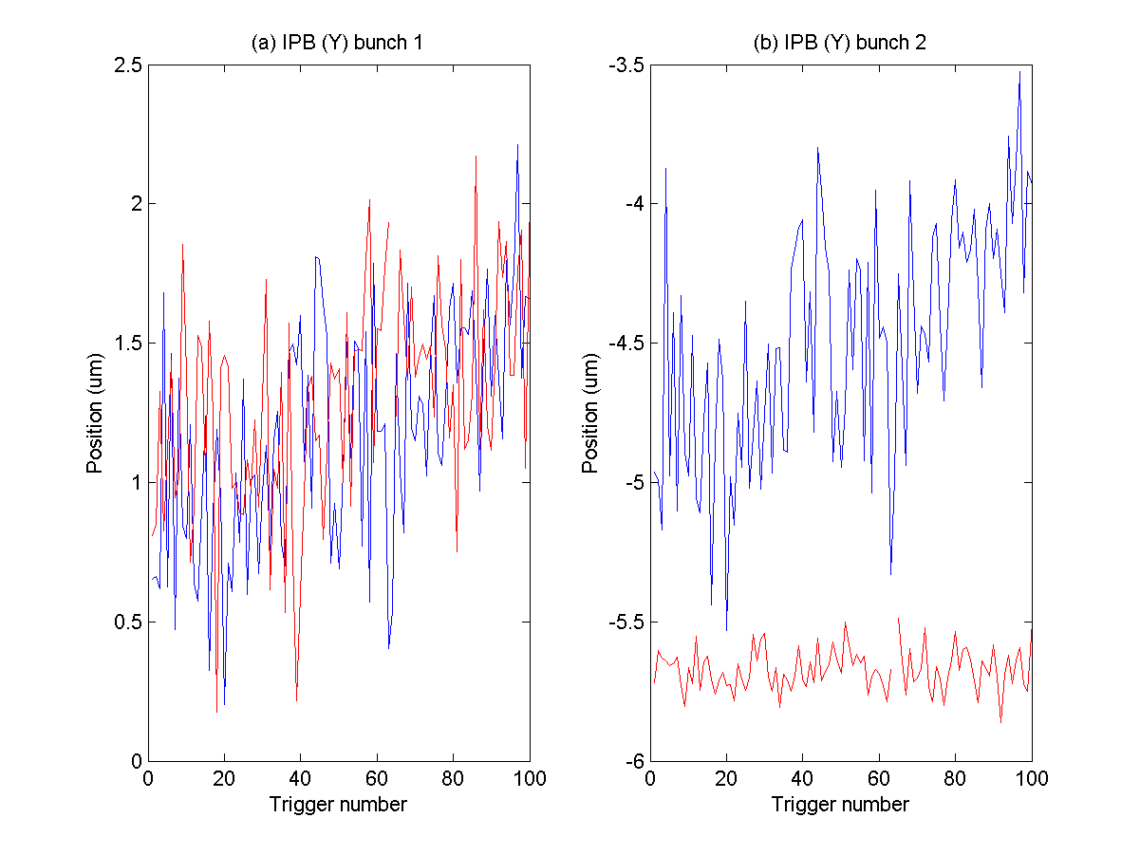
Results – IP Feedback
Position stabilisation in the IP region
Neven Blaskovic 17

Slide 18
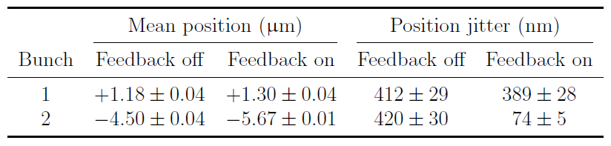
Results – IP Feedback
Position stabilisation in the IP region
stabilised
to ~75 nm
Neven Blaskovic 18

Slide 19
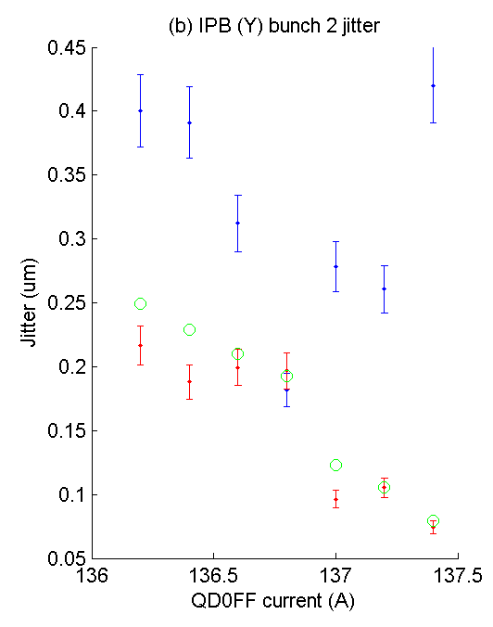
Results – IP Feedback
Position stabilisation in the IP region
Feedback off
Feedback on
Prediction
Performance with feedback on matches prediction (assuming a perfect feedback system)
for a range of incoming beam conditions
Neven Blaskovic 19

Slide 20
Conclusions
Upstream feedback: 2 BPMs to drive 2 kickers
  Stripline BPM resolution: ~300 nm
  Local beam stabilisation: ~500 nm
  Potential for nm-level beam stabilisation at the IP
IP feedback: 1 BPM to drive 1 kicker
  IP BPM resolution: ~50 nm
  Local beam stabilisation: ~75 nm
  Work ongoing to improve IP BPM resolution
Neven Blaskovic 20

Slide 21
Thank you for your interest and support!
Neven Blaskovic 21

