Slide 1
CRWG
(Central Region Working Group) Report
K. Yokoya
2016-0121, ADI

Slide 2
Meetings
There have been 3 meetings since the last ADI
Dec.12
  My report on the mission of the group, short list of what to do
Jan.5
  Central Region Review by Ewan
  “Design Integration and Change Management” by Benno
Jan.19
  Review of Lattice 2015b by Benno
  “Issues to be solved” by KY, but time was up
Next Feb.2
May sounds a lot of progress……

Slide 3
Still wondering what to do
First, must understand
  where is what in TDR and 2015b
  Roles of the systems: MPS, tune-up dump, emergency dump
Lack of detailed specifications in TDR
  10Hz operation
  Auxiliary positron source
Many factors for deciding the tunnel structure
  Shield of positron target
  Remote handling system
  Access rules
  Muon wall
  Installation path

Slide 4
Need to assign works to individual groups/areas through CRWG members
  Sources: Kuriki
  BDS: Glen, Okugi
  CFS: Miyahara, Sanuki
The rest of this file is the slides which were to be presented in the meeting on Jan.19

Slide 5
Issues to be Solved
Kaoru Yokoya
CRWG Meeting, Jan.19, 2016

Slide 6
Tune-up dumps
Location
  E+ side : after e+ linac
  E- side : after dogleg downstream of undulator
Consisting of
  Monitor
  Fast kicker after skew correction, emittance diagnostics, and polarimeter
  Beamline to the dump
  Fast sweeper
  dump
Role
  Beam dump for linac commissioning when detector is not ready
    Up to full intensity
  Emergency beam dump
Power capability
  Same as the primary (full) dump, i.e., 14MW
Beamline to the dump
  Energy band width 10%? (plus 1%, minus 10%?)

Slide 8
Emergency Dump
Questions
  Erroneous bunches go through undulator and dogleg?
  How large is the energy band width of dogleg?
There used to be an emergency dump just before undulator (in my memory) for avoiding erroneous beam to hit the undulator. Has it been removed? No, TDR shows a dump.
  When we moved the undulator to linac end, it was claimed another MPS would be needed if the undulator is in the middle of linac.
  TDR shows a beamline EFADL. This should be below the undulator line (same side as the dogleg)
  Emergency kicker
    Response time ~300ns ?
    Flat-top ~200μs ? (remaining pulse up to 1ms is stopped at DR exit)
TDR mentions about “pilot bunch” as an option
  Single, weak bunch
  10μs (long enough to excite protection system, short enough compared with linac fill time) ahead of the main pulse

Slide 9
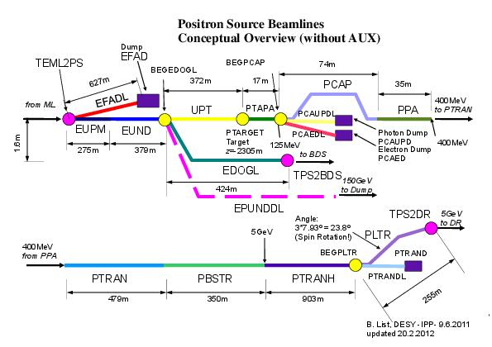

Slide 10
Primary Dump
Is there an accepted design of the dump hall?
  EDMS D00000001089925,B,1,1
  done by B. smith from CCLRC ( Rutherford labs)
Somebody has to check the entire dump system
Not a job of CRWG except
  The size of the dump hall
  Emergency signal
  Access to surface??

Slide 12
Positron Target Region
Target must be shielded
  1 meter concrete (A.Ushakov) ?
    Perhaps, heavy concrete is better for saving space
  Keep the corridor in the beam tunnel for installation of cryomodules for 5GeV SC linac
  Air and water?
Access principle
  When the main beam is on, no access allowed to beam tunnel and service tunnel
  What about the case when only axiliary source is on (only to DR, not to main linac)? Intensity is 1/100 or 1/(100*1312). (drive electron intensity is ~10x)
  When beam is off, access is allowed to the beam tunnel, too. (1 hour after beam-off?)

Slide 14
Model used by Andriy Ushakov, LCWS2015

Slide 16
Remote Handling of Positron Target
Missing detailed design → to be by positron team
How big a space in the tunnel needed?
How often is the replacement?
How many used targets can be stored?
Eventually, the used targets should be moved to the surface, after cooling of radiation to some level.
  Transport path must be decided and prepared
  How big is one target with container?
    Container can be lead-covered (only gamma ray is the issue)
  The design for TDR vol.3-I says the part to be replaced is 1400×1140×1650mm, 5 tons
  But it’s not clear which parts to be replaced
    Target itself, flux concentrator,
    NC cavity (cavities), solenoid

Slide 17
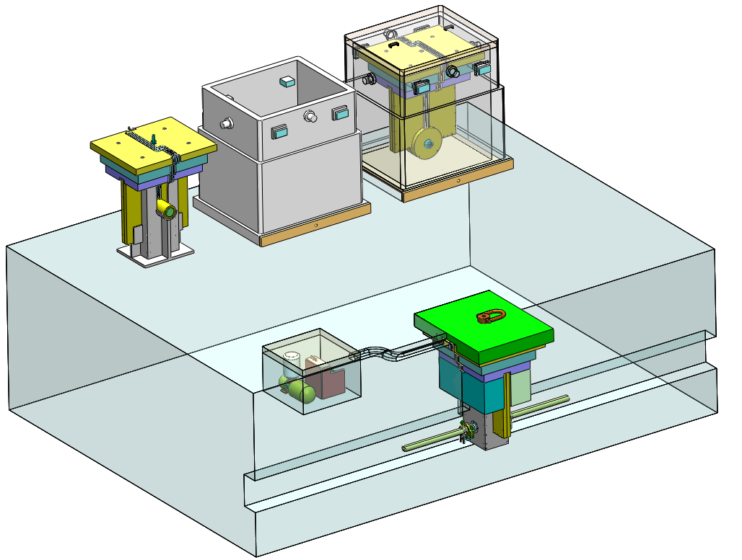
1. General Layout
Used Target
& Container
Target Handling Container
Base
New Target
Utilities:
Water pump
Vacuum Pump
etc.
Target Station

Slide 18
10Hz Operation
Should it be included at the project start?
  Top-level decision needed, but, perhaps, NO
  Presumably, the possibility of 10Hz operation should not be completely excluded → then, in the followings, only the space to be reserved is the issue
The waste electron beam (after creating positron)
  Beam dump must be specified
    6.3MW (5Hz, 150GeV, 3.2nC, 2625 bunches)
    → use the tune-up dump
  The beamline EPUNDDL, leading the waste electron (150GeV) to a beam dump, must be designed
    BDS or sources → BDS
    No problem of emittance increase
    → much shorter than the dogleg, can be lifted up to ceiling
  Even when 10Hz operation is not included at the project start, the tunnel space for the beamline must be reserved
Pulsed magnet (5Hz, vertical bend) must be inserted (to lead both 150GeV and E_{CM}/2 beams to the center of undulator) just upstream of the undulator
  Is the space (longitudinal length) reserved?
  Also another pulsed magnet after undulator to separate EDOGL and EPUNDDL
What else for CRWG?

Slide 19
Auxiliary Positron Source
TDR
  S-band normal-conducting, 500MeV linac
  Share the target (and its downstream) with the undulator source
  Positron intensity ~1% (single bunch)
    Does this mean the pulse charge is 1/(1312*100) of the nominal beam?
  Length < 40m
Role
  Commissioning of positron DR (electron linac not ready yet)
    Or keep alive of e+DR during shut down of electron linac
  Detector calibration at Z0?
    This makes sense only when 10Hz mode is not available
    But luminosity is too low even for calibration?
What do we need now?

Slide 21
Muon Wall
Don’t want to think of as CRWG issue
Basically BDS issue
Can be CRWG issue, if (as Okugi san suggested) a larger tunnel with fixed muon-wall size causes more muon background to the detector
Let’s wait for now for the conclusion of BDS team

Slide 22
Special Caverns
Is there any caverns that requires special access
  Laser hut
    Polarization monitor

