Slide 1


Future Circular Collider Design Study
PS
LHC
FCC
SPS
http://cern.ch/fcc
Fabiola Gianotti (CERN), FALC meeting, KEK, 24-2-2016

Slide 2
Motivation
European Strategy for Particle Physics 2013:
  “…to propose an ambitious post-LHC accelerator project….., CERN should undertake design studies for accelerator projects in a global context,…with emphasis on proton-proton and electron-positron high-energy frontier machines….coupled to a vigorous accelerator R&D programme, including high-field magnets and
  high-gradient accelerating structures,….”
CLIC studies already in
place since some time
US P5 recommendation 2014:
  ”….A very high-energy proton-proton collider is the most powerful tool for direct discovery of new particles and interactions under any scenario of physics results that can be acquired in the P5 time window….”
ICFA statement 2014:
  ”…. ICFA supports studies of energy frontier circular colliders and encourages global coordination.….”

Slide 3
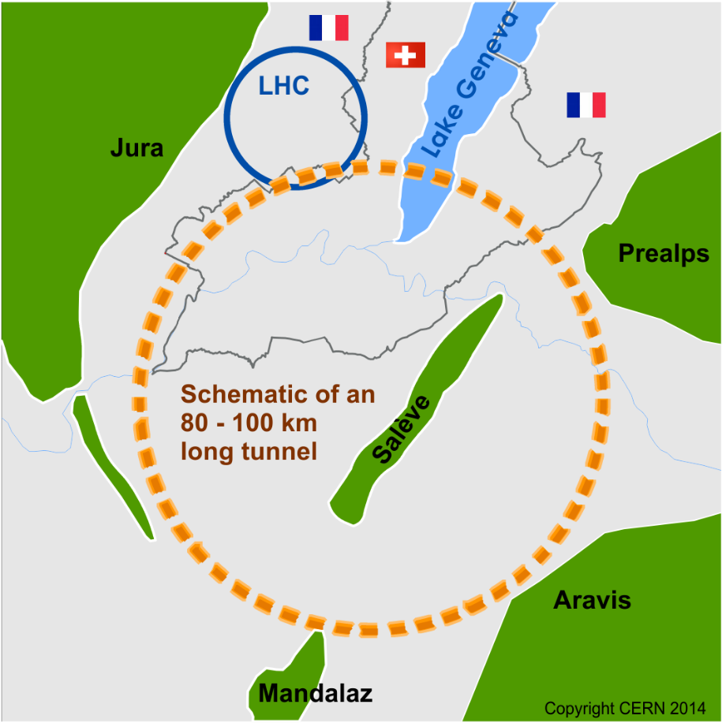
Goal: CDR (including cost estimate) by end 2018
(in time for next European Strategy)
International conceptual design study:
pp collider (FCC-hh): ultimate goal
→ defines infrastructure requirements;
~ 100 km ring; 16 T magnets
√s ~ 100 TeV, L~2x10³⁵; 4 IP, ~20 ab⁻¹/expt
e⁺e⁻ collider (FCC-ee): possible first step
√s = 90-350 GeV, L~70-1.3 x 10³⁴; 2 IP
pe collider (FCC-he): option
√s ~ 3.5 TeV, L~10³⁴
Also part of the study: HE-LHC: ~16 T dipoles in LHC tunnel → √s ~ 30 TeV
Strong physics case if new physics from LHC/HL-LHC
Powerful demonstration of the FCC-hh magnet technology

Slide 4
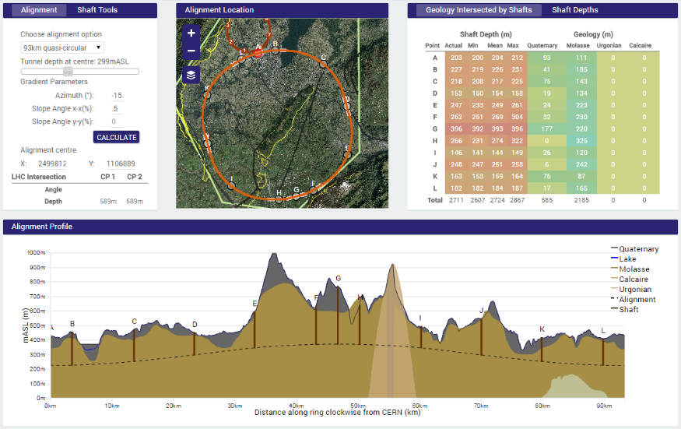
Progress on site investigations
Although machine studies are site-neutral, FCC at CERN would benefit from existing laboratory infrastructure and accelerator complex
90-100 km ring fits geology

Slide 5
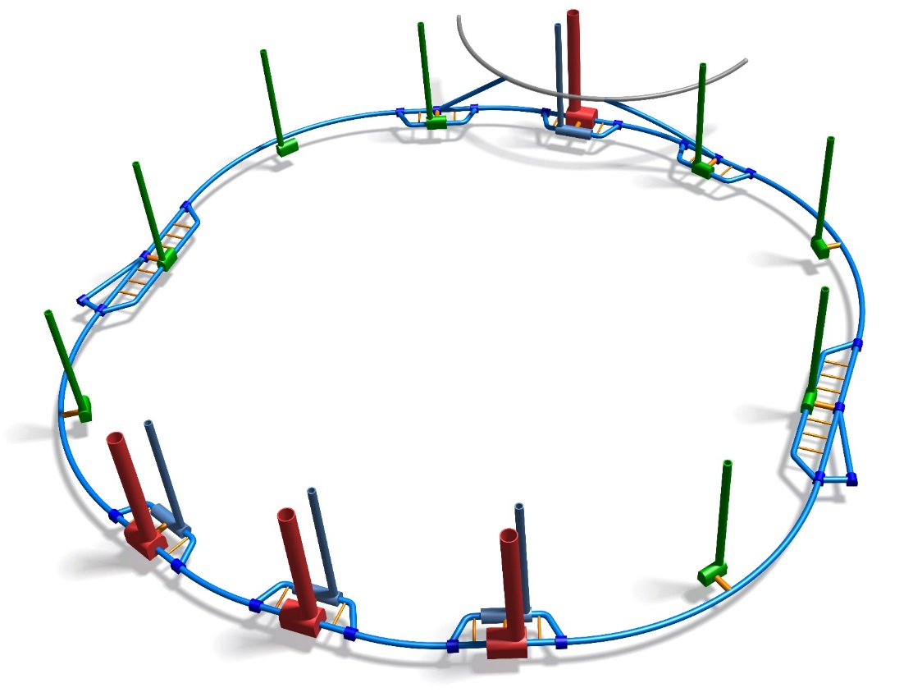
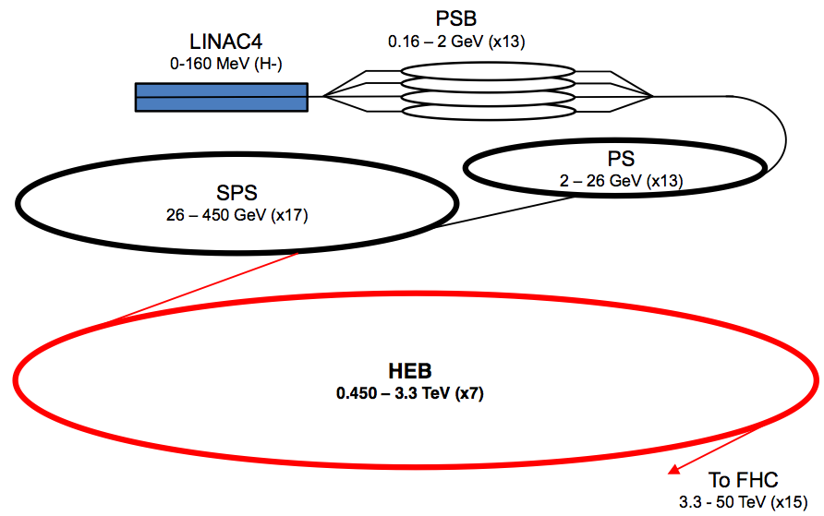
Infrastructure and injectors
FCC 3D tunnel model
Using existing CERN accelerator complex
for the injectors:
baseline for High-Energy Booster is
“refurbished” LHC (for 30’ FCC filling time
need to increase ramp-up rate from
10 A/s to 50 A/s → new power converters)

Slide 6
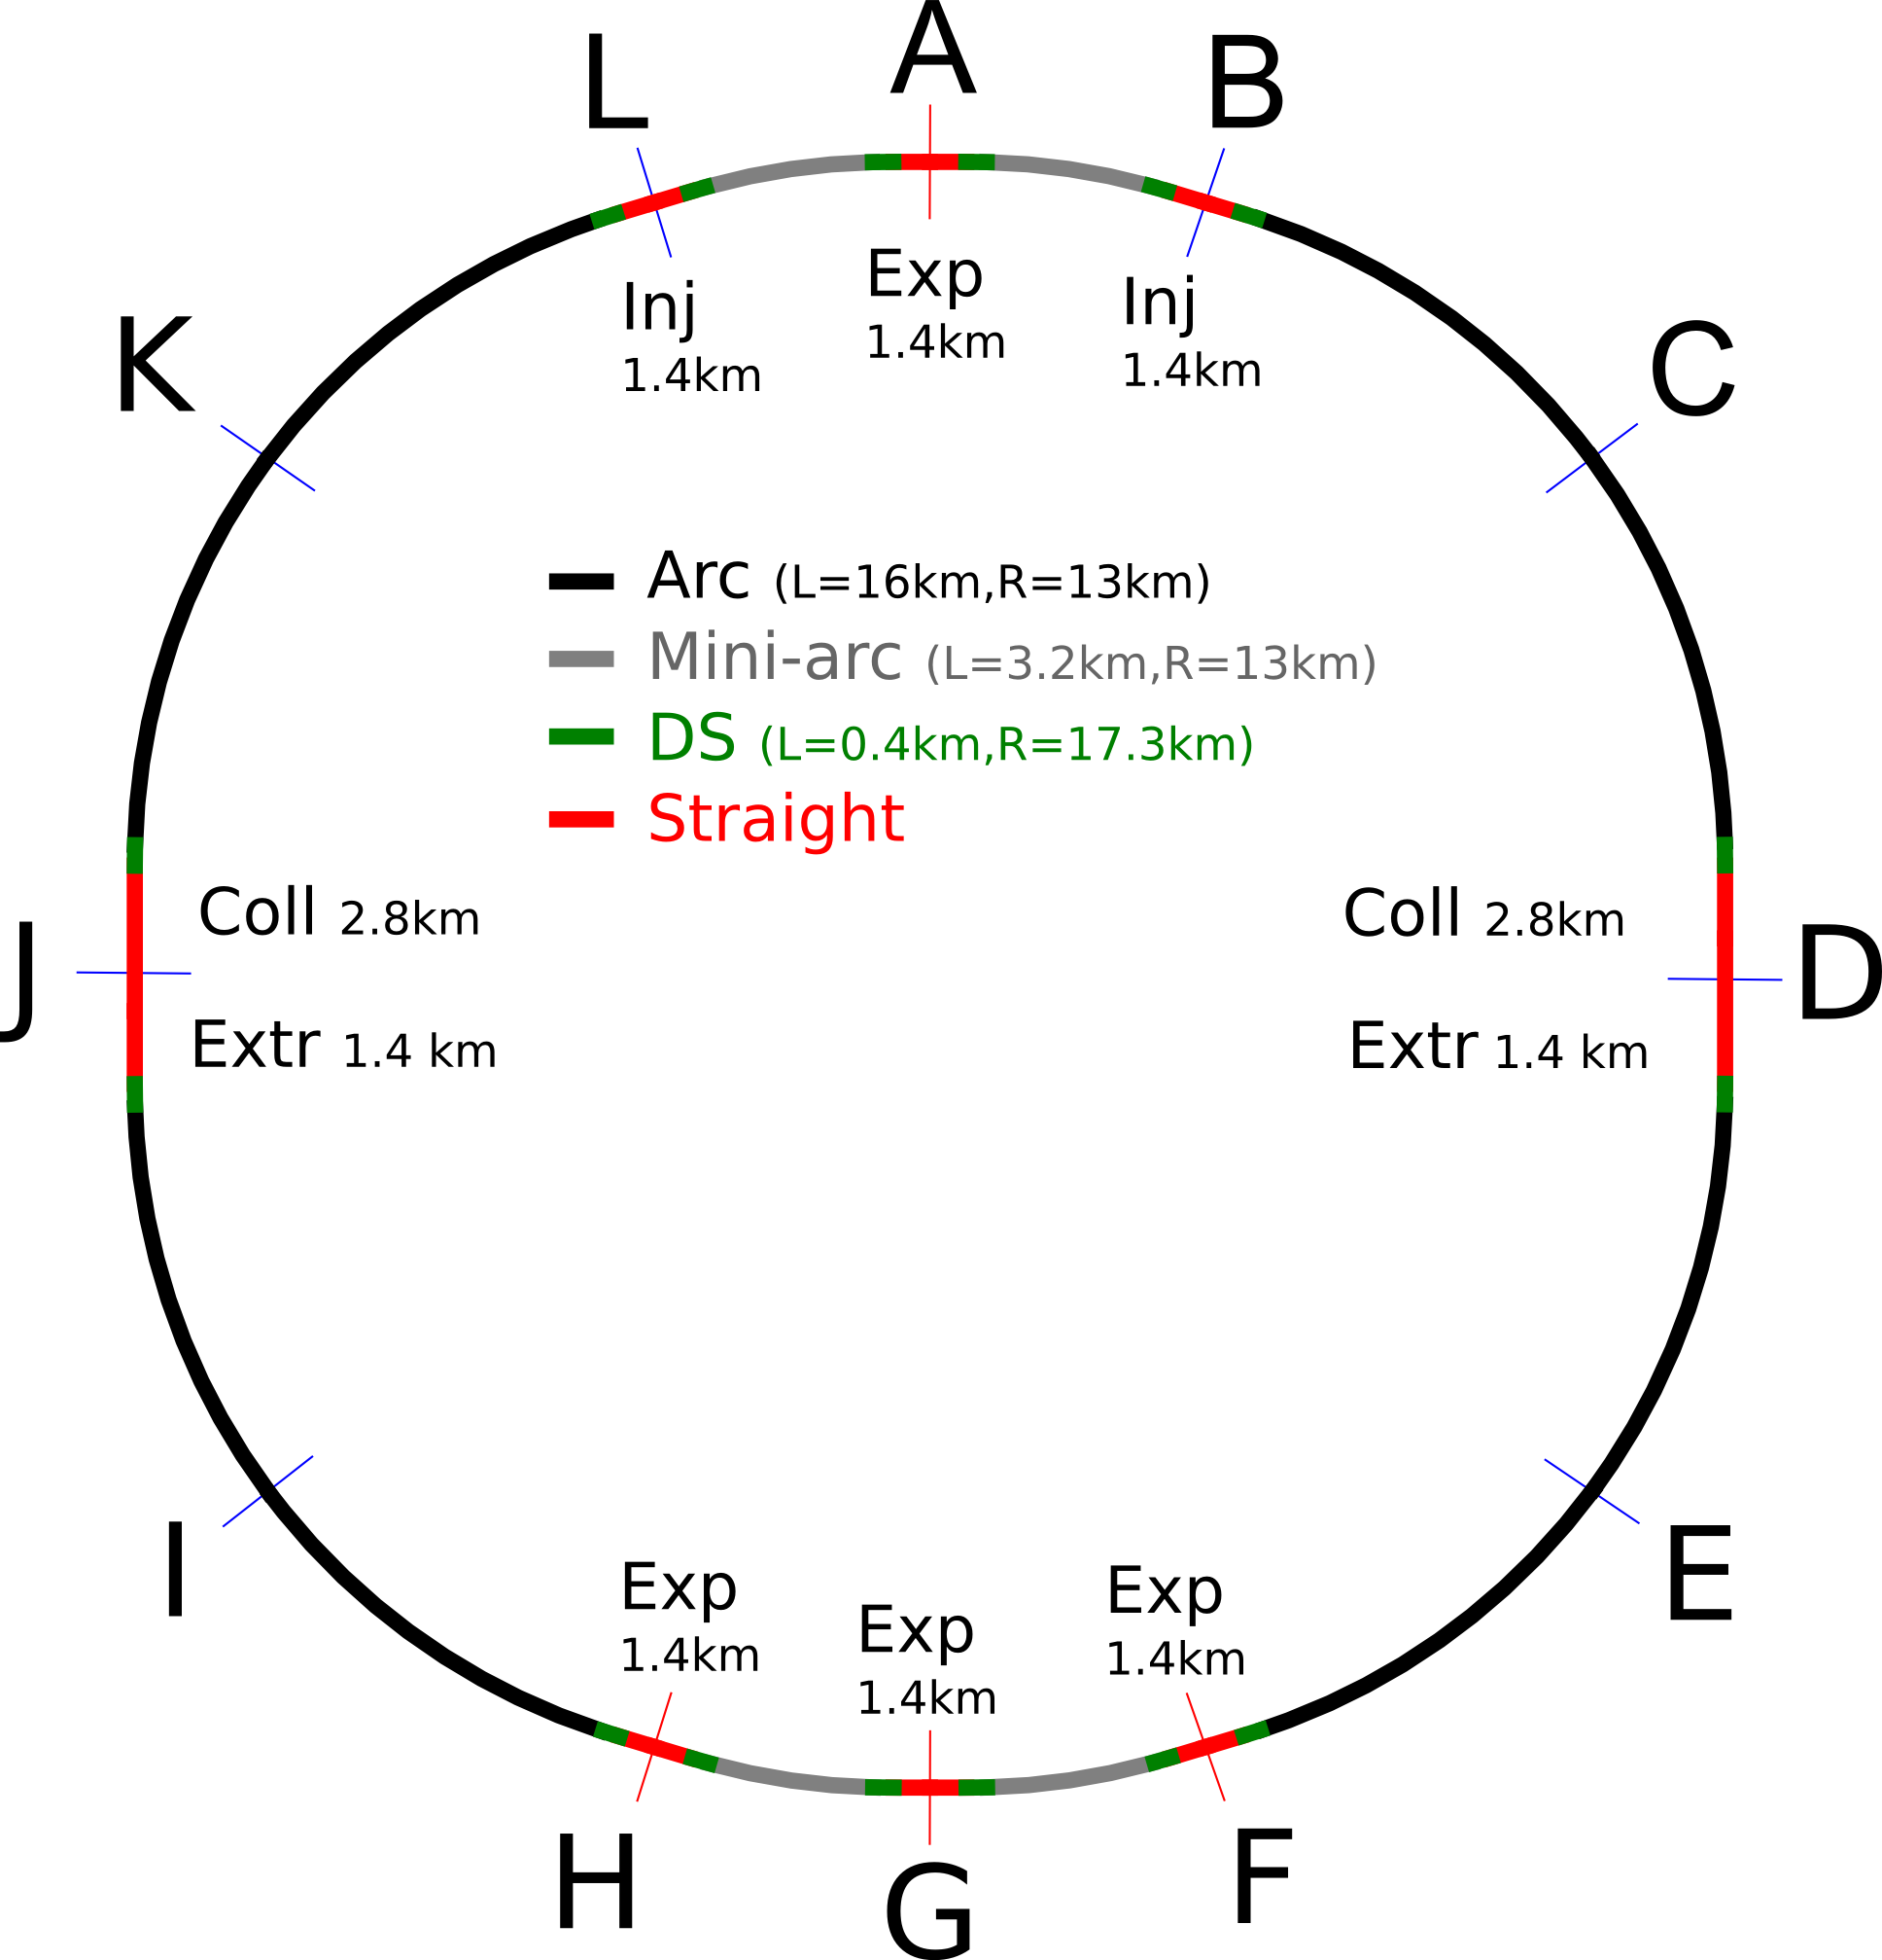
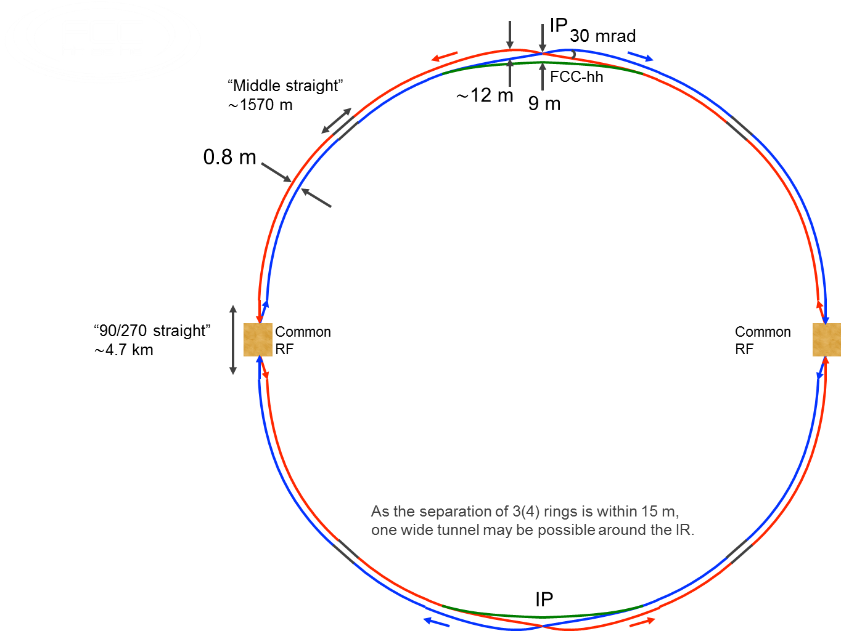
FCC-hh and FCC-ee consistent machine layouts
FCC-hh
FCC-ee 1, FCC-ee 2, FCC-ee booster
(FCC-hh footprint)
K. Oide
9 m off-centred IPs
wrt. hh IPs
Closed optics solutions for full ring for both machines available

Slide 7
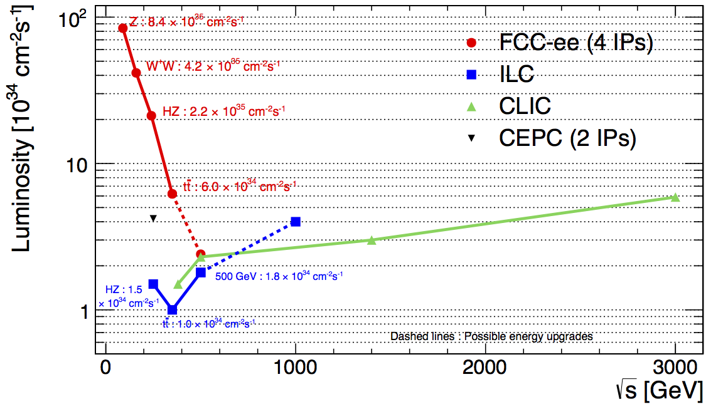
FCC-ee overview
√s (GeV) Main physics goals
90 Z-pole precision EW measurements beyond LEP, SLC
160 WW precision physics (mass at threshold)
250 H precision physics (HZ)
~350 H (HZ, Hνν) and top (mass, couplings) precision physics

Slide 8
Lepton collider parameters
parameter | FCC-ee |  |  | CepC | LEP2
energy/beam [GeV] | 45 | 120 | 175 | 120 | 105
bunches/beam | 90000 | 770 | 78 | 50 | 4
beam current [mA] | 1450 | 30 | 6.6 | 16.6 | 3
luminosity/IP x 10³⁴ cm⁻²s⁻¹ | 70 | 5 | 1.3 | 2.0 | 0.0012
energy loss/turn [GeV] | 0.03 | 1.67 | 7.55 | 3.1 | 3.34
synchrotron power [MW] | 100 |  |  | 103 | 22
RF voltage [GV] | 0.08 | 3.0 | 10 | 6.9 | 3.5
FCC-ee: 2 separate beam pipes
CepC baseline: single beam pipe → number of bunches per beam limited to 50
New baseline 2016: 2 IP with crab waist scheme

Slide 9
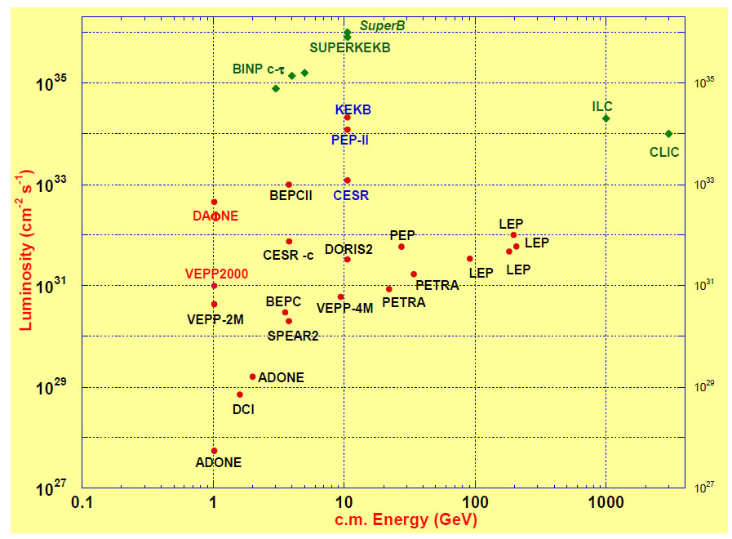
Main challenges: SCRF system, beam dynamics, …
Achieve extremely high luminosities at high energy → build on experience from
previous colliders
FCC-ee
LEP:
SR effects
KEKB & PEP-II:
high beam
currents
top-up injection
DAFNE: crab waist
S-KEKB: low β_{y}*
KEKB: e⁺ source
HERA, LEP, RHIC:
spin gymnastics
DAΦNE
VEPP2000
Barry Barish
13 January 2011

Slide 10
Hadron collider parameters
Parameter | FCC-hh |  | SppC | LHC | HL LHC
collision energy cms [TeV] | 100 |  | 71.2 | 14
dipole field [T] | 16 |  | 20 | 8.3
# IP | 2 main + 2 |  | 2 | 2 main + 2
bunch intensity [10¹¹] | 1 | 1 (0.2) | 2 | 1.1 |  | 2.2
bunch spacing [ns] | 25 | 25 (5) | 25 | 25 |  | 25
luminosity/Ip [10³⁴ cm⁻²s⁻¹] | 5 | ~25 | 12 | 1 |  | 5
events/bunch crossing | 170 | ~850 (170) | 400 | 27 |  | 135
stored energy/beam [GJ] | 8.4 |  | 6.6 | 0.36 |  | 0.7
E-loss/turn synchrotron radiation/beam | 5 MeV 3 MW |  | 2 MeV 5.8 MW | 7 keV 5.4 kW |  | 7 keV 9.5 kW
Phase 1 (baseline): peak L = 5 x 10³⁴ cm⁻²s⁻¹ (𝛽*=1.1 m)
→ ~250 fb⁻¹/year
Phase 2 (ultimate): peak L= 2.5 x 10³⁵ cm⁻²s⁻¹ (𝛽*=0.3 m)
→ ~1000 fb⁻¹/year
Integrated luminosities assume
~ 15% of the year in stable beams
(~0.5 x 10⁷ s) as LHC in 2012 → realistic
Total of ~ 20000 fb⁻¹ per experiment for ~ 25 years of operation

Slide 11
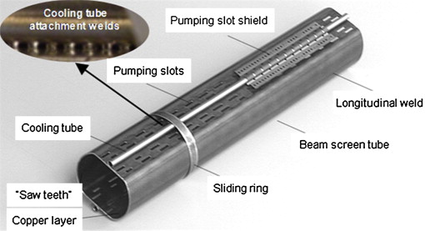
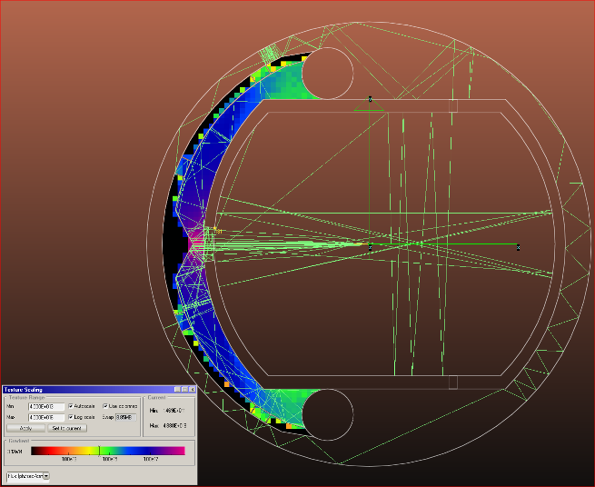
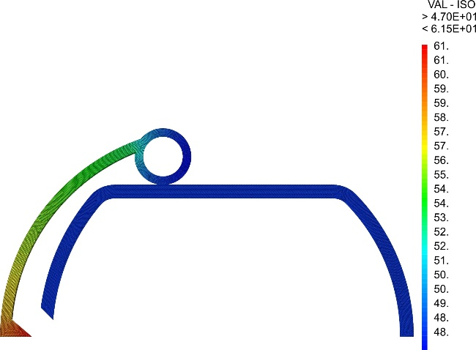
Synchrotron radiation - beam screen
High synchrotron radiation load of protons @ 50 TeV:
~30 W/m/beam (@16 T)
5 MW total in arcs (LHC <0.2W/m)
New type of ante-chamber
absorption of synchrotron radiation
avoids photo-electrons, helps vacuum
LHC beam screen
Photon distribution
Heat transport
Beam screen temperature of 16 K would require 300 MW for cooling; 50 K requires 100 MW, current baseline for 1.9 K magnets

Slide 12
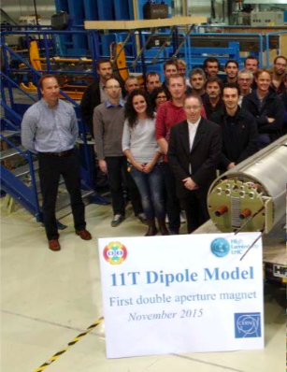
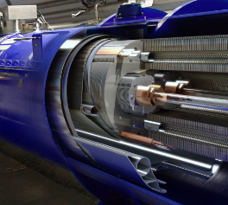
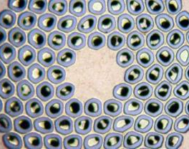
Key technology R&D: high-field magnets
“Natural” continuation of LHC and HL-LHC programmes
Step-wise approach → each step deployed and operated
in a (big) accelerator:
LHC: 8.3 T → push to ultimate field of 9 T ?
HL-LHC:
-- 11 T dipoles in dispersion suppression collimators
-- 12-13 T peak field low-𝛽 quadrupoles ATLAS and CMS IR’s
December 2015: Nb₃Sn short (1.8 m) two-in-one
coil reached 11.3 T (> nominal !) without quenches
Conductor RD
Increase critical current
density (x 2)
High quantities at
required quality
Material processing
Reduce cost
Magnet design
Develop 16T short models
Field quality and needed
aperture (40 mm)
Optimum coil geometry
Manufacturing aspects
Cost optimisation
16 T
Nb₃Sn
End 2018: 16 T, 50 mm gap ~ 1m demonstrator

Slide 13
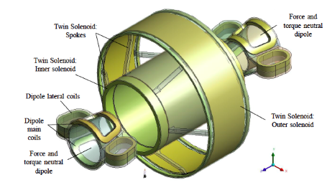
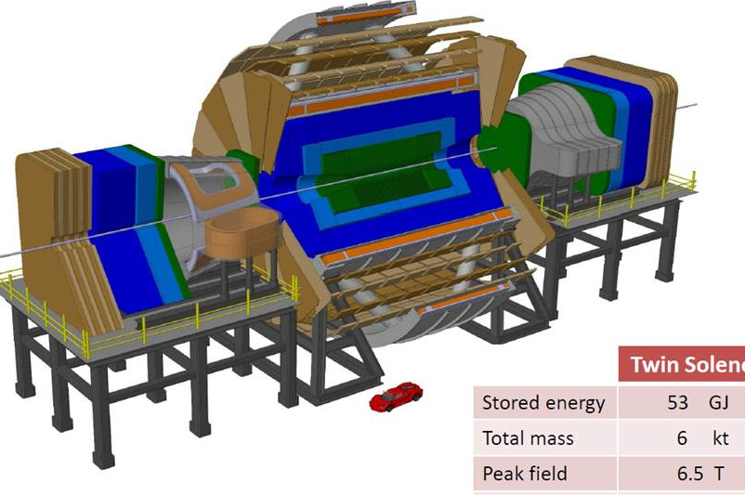
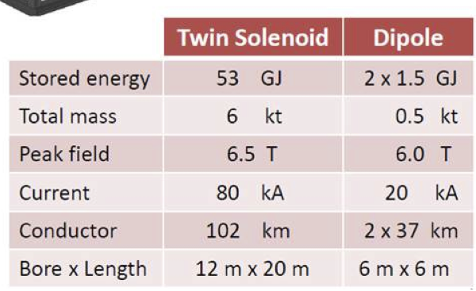
Detector concepts for 100 TeV pp colliders
Driving requirements:
BL² ~10 x ATLAS/CMS for 10% muon momentum resolution
at 10-20 TeV
→ large-bore, high-field solenoid
→ return flux captured by twin solenoid (otherwise > 5000 m³ Fe in return joke)
Coverage with tracking and precise calorimetry up to |𝜂|~5: light physics (e.g. H) is produced flat in rapidity at 100 TeV
→ forward dipole à la LHCb: B~10 Tm
Size x2 CMS,
stored energy x 20
And: fast, granular calorimeters (pile-up, boosted jets), high-resolution Si sensors for tracking, etc.
→ R&D for FCC detectors is natural continuation of R&D for LHC Phase II upgrades.
Note: integrated dose > 20 x Phase II and pileup up to ~ 800 events/crossing

Slide 14
Preliminary schedule
1980
1985
1990
1995
2000
2005
2010
2015
2020
2025
2030
2035
Constr.
Physics
LEP
Design
Proto
Construction
Physics
LHC
Design
Construction
Physics
HL-LHC
20 years
Technically, construction of tunnel
and magnets could start ≥ 2025
FCC
Design
Proto
Construction
Physics
CDR by end 2018 for next ES update

Slide 15
Physics reach in a nutshell
FCC-hh: 100 TeV
explore directly the 10-50 TeV E-scale
provide conclusive exploration of the EWSB dynamics
say the final word about heavy WIMP dark matter
etc.
FCC-ee: 90-350 GeV
measure Higgs couplings to O(0.1%), except ttH and HH and rare decays
indirect sensitivity to E-scale up to O(100 TeV) by improving by ~20-200 times the precision of EW parameters measurements, ΔM_{W} < 1 MeV, Δm_{top} ~ 10 MeV
etc.
The two machines are complementary and synergetic, e.g. from measurement
of ttH/ttZ ratio, and using ttZ coupling and H branching ratio from FCC-ee, the FCC-hh can measure ttH to ~ 1%

Slide 16




























FCC International Collaboration
72 institutes + CERN (host institute)
26 countries + European Commission
Status: 1 February 2016
Based on Memorandum of Understanding (MoU’s)

Slide 17
The 72 Collaboration Members (+ CERN) as of 1st February 2016
ALBA/CELLS, Spain
Ankara U., Turkey
U Belgrade, Serbia
U Bern, Switzerland
BINP, Russia
CASE (SUNY/BNL), USA
CBPF, Brazil
CEA Grenoble, France
CEA Saclay, France
CIEMAT, Spain
Cinvestav, Mexico
CNRS, France
CNR-SPIN, Italy
Cockcroft Institute, UK
U Colima, Mexico
UCPH Copenhagen, Denmark
CSIC/IFIC, Spain
TU Darmstadt, Germany
TU Delft, Netherlands
DESY, Germany
DOE, Washington, USA
TU Dresden, Germany
Duke U, USA
EPFL, Switzerland
KIT Karlsruhe, Germany
KU, Seoul, Korea
Korea U Sejong, Korea
U. Liverpool, UK
MAX IV, Lund, Sweden
MEPhI, Russia
UNIMI, Milan, Italy
MIT, USA
Northern Illinois U, USA
NC PHEP Minsk, Belarus
U Oxford, UK
PSI, Switzerland
U. Rostock, Germany
RTU, Riga, Latvia
UC Santa Barbara, USA
Sapienza/Roma, Italy
U Siegen, Germany
U Silesia, Poland
TU Tampere, Finland
TOBB, Turkey
U Twente, Netherlands
TU Vienna, Austria
Wigner RCP, Budapest, Hungary
Wroclaw UT, Poland
UT Enschede, Netherlands
U Geneva, Switzerland
Goethe U Frankfurt, Germany
GSI, Germany
GWNU, Korea
U. Guanajuato, Mexico
Hellenic Open U, Greece
HEPHY, Austria
U Houston, USA
IIT Kanpur, India
IFJ PAN Krakow, Poland
INFN, Italy
INP Minsk, Belarus
U Iowa, USA
IPM, Iran
UC Irvine, USA
Istanbul Aydin U., Turkey
JAI, UK
JINR Dubna, Russia
FZ Jülich, Germany
KAIST, Korea
KEK, Japan
KIAS, Korea
King’s College London, UK

Slide 18
FCC organisation structure
Governance Structure
CERN DG
Collaboration Board
Steering Committee
Advisory Committee
Executive Structure
Study
Coordination Group
Hadron Collider Physics Experiments
Lepton Collider
Physics Experiments
e-p
Physics Experiments Machines
Hadron
Collider
Lepton Collider
Hadron and Lepton
Injectors
High-Energy
LHC
Accelerator
R&D
Technologies
Infra-structures
Operation
Costing Planning

Slide 19
FCC organisation structure
Governance Structure
CERN DG
Collaboration Board
Steering Committee
Advisory Committee
Chair: L. Rivkin
1 representative per institute
Identifies/reviews resource needs
Appoints SC members
Executive Structure
Study
Coordination Group
Hadron Collider Physics Experiments
Lepton Collider
Physics Experiments
e-p
Physics Experiments Machines
Hadron
Collider
Lepton Collider
Hadron and Lepton
Injectors
High-Energy
LHC
Accelerator
R&D
Technologies
Infra-structures
Operation
Costing Planning

Slide 20
FCC organisation structure
Governance Structure
CERN DG
Collaboration Board
Steering Committee
Advisory Committee
Chair: ECFA representative
Members: 1-2 representatives per region, CB Chair,
CERN Directors for Accelerators and for Research
Supervises project execution, ensures implementation
of CB decisions
Reports to CB and CERN DG
Executive Structure
Study
Coordination Group
Hadron Collider Physics Experiments
Lepton Collider
Physics Experiments
e-p
Physics Experiments Machines
Hadron
Collider
Lepton Collider
Hadron and Lepton
Injectors
High-Energy
LHC
Accelerator
R&D
Technologies
Infra-structures
Operation
Costing Planning

Slide 21
FCC organisation structure
Governance Structure
CERN DG
Collaboration Board
Steering Committee
Advisory Committee
External experts (up to 12) proposed by SC, appointed by CB
Reviews scientific and technical progress, assists SC in
major technical decision.
Will be put in place in the course of 2016
Executive Structure
Study
Coordination Group
Hadron Collider Physics Experiments
Lepton Collider
Physics Experiments
e-p
Physics Experiments Machines
Hadron
Collider
Lepton Collider
Hadron and Lepton
Injectors
High-Energy
LHC
Accelerator
R&D
Technologies
Infra-structures
Operation
Costing Planning

Slide 22
EuroCirCol: EU grant from Horizon 2020 programme
EC contributes with 3 M€ (150 k€ to CERN/admin, rest to partner institutes) to main aspects
of hadron collider design: arc & IR optics, 16 T magnets, cryogenic beam vacuum system
Work supported by the European Commission under the HORIZON 2020 project EuroCirCol, grant agreement 654305
CERN | IGO
TUT | Finland
CEA | France
CNRS | France
KIT | Germany
TUD | Germany
INFN | Italy
UT | Netherlands
ALBA | Spain
CIEMAT | Spain
STFC | United Kingdom
UNILIV | United Kingdom
UOXF | United Kingdom
KEK | Japan
EPFL | Switzerland
UNIGE | Switzerland
NHFML-FSU | USA
BNL | USA
FNAL | USA
LBNL | USA
Japan
KEK
Finland
TUT
United Kingdom
STFC, UNILIV, UOXF
Netherlands
UT
Germany
KIT, TUD
France
CEA, CNRS
CERN
Switzerland
EPFL, UNIGE
Italy
INFN
Spain
ALBA, CIEMAT
Consortium Beneficiaries, signing the Grant Agreement

Slide 23
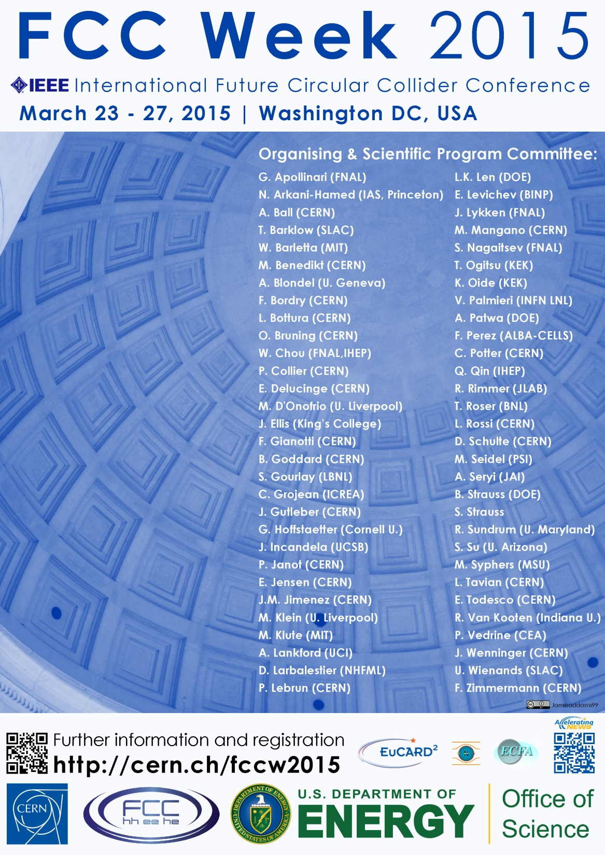

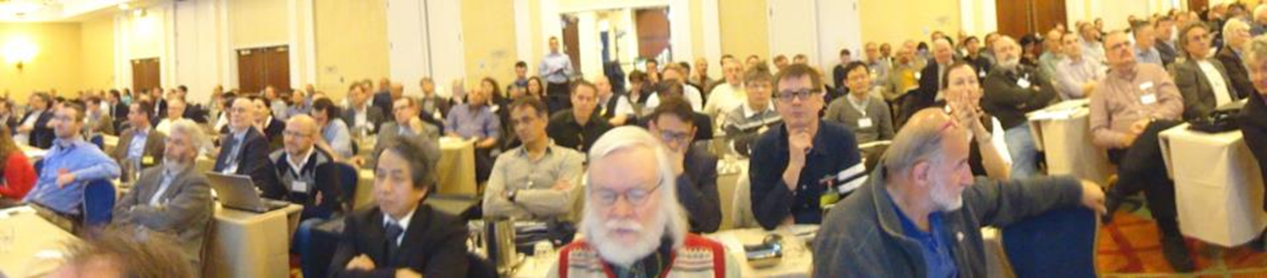
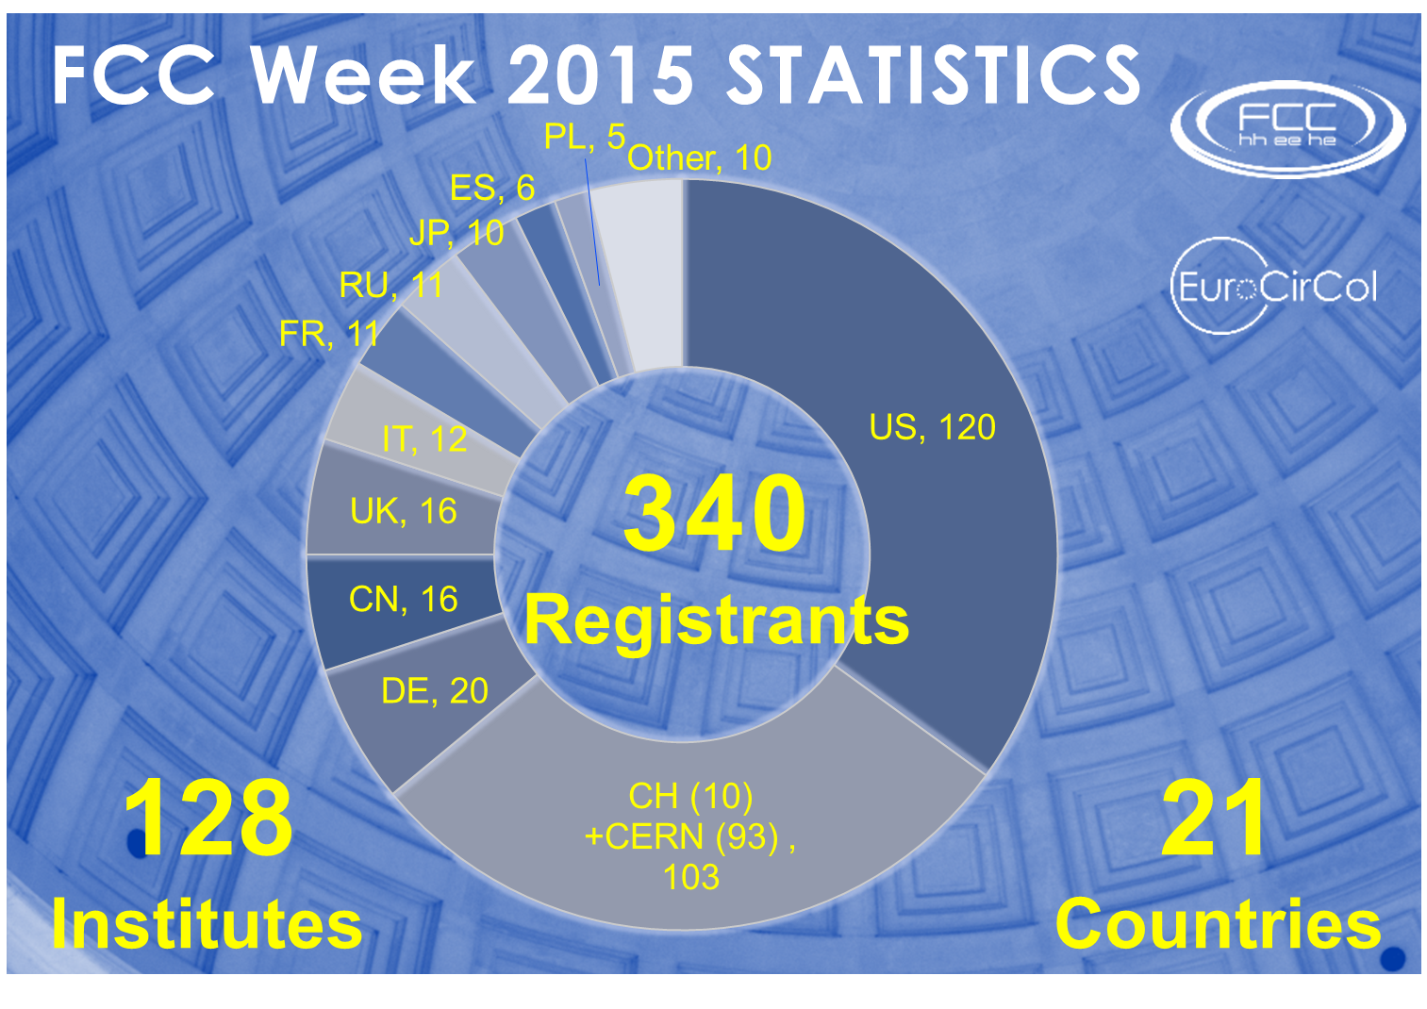
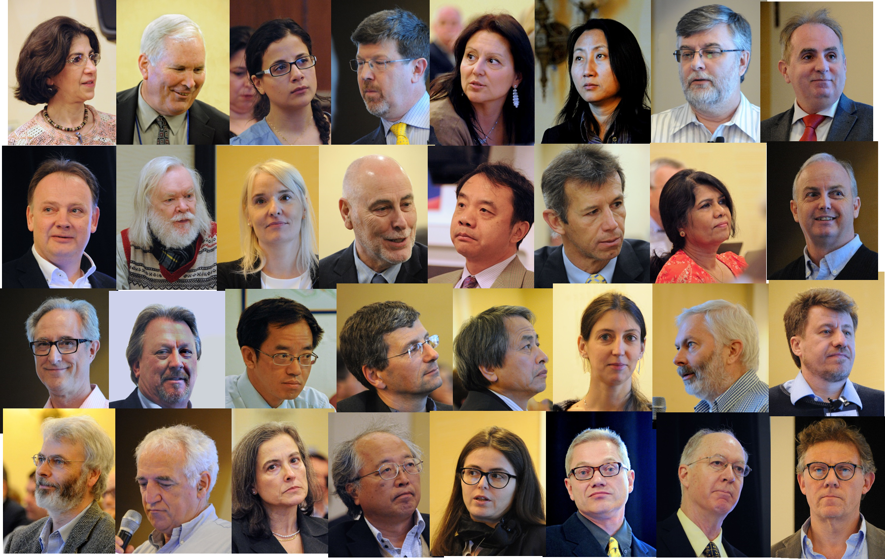
First FCC Week
Conference
Washington DC
23-27 March 2015
http://cern.ch/fccw2015
“head shots” from Bob Palmer (BNL)

Slide 24
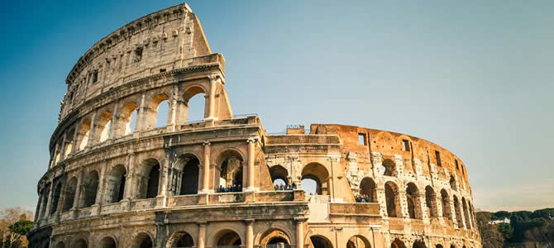







FCC Week 2016
Rome, 11-15 April 2016
http://cern.ch/fccw2016

Slide 25
LHC history
EXTRAS

Slide 26
FCC main achievements 2015
Geological studies (tunnel optimization tool, 80-100 km preferred, implementation compatible with LHC as injector)
Determination of FCC-hh luminosity goals based on physics arguments; assessment of requirements for integrated luminosity
FCC-hh machine design & staged operation scenario consistent with physics goals
Consistent layouts of hadron and lepton colliders with complete ring optics solutions
Improved performance of lepton collider (crab waist IR optic, dynamic aperture, SR)
Five intermediate accelerator & infrastructure reviews with external experts
Start of CERN 16 Tesla magnet R&D programme (conductor & prototypes)
Detailed engineering of detector twin solenoid + double dipole SC magnet system
Definition of a baseline detector geometry
Detailed tracker layout based on LHC Phase II technology, HCAL granularity studies
Definition of benchmark physics channels for detector performance studies
Establishment of an efficient team for FCC software development; parametrized simulation (DELPHES) and fast simulation within the FCC software framework
Launched FCC-ee physics working groups, catalogue of BSM physics sensitivities
Funding of core R&D for FCC-hh by EC HORIZON2020 EuroCirCol project
Growing global collaboration (now 70 institutes from 26 countries)
Annual collaboration meeting in Washington DC (340 participants, 128 institutes)

Slide 27
FCC major goals for 2016
Annual collaboration meeting in Rome,11-15 April 2016
Report on “Physics at 100 TeV”, defining physics opportunities in the areas of
SM, Higgs, BSM, Heavy Ions, injectors → available by Rome FCC week
Physics studies of benchmark channels for baseline detector parameters
Detailed calorimeter studies ECAL, HCAL (High Granularity Calorimetry)
Refinement of baseline detector layout, overall engineering aspects, cavern layout
investigation of alternative detector concepts
Iterate, review and and freeze baseline lattice, optics and machine parameters for hadron and lepton colliders
IR integration for both colliders
Establish technical infrastructure target performance parameters
Develop technical infrastructure baselines: EL distribution, CV, cryogenics
Define surface points and tunnel layouts, cross section and integration aspects
Establish safety, access, transport requirements and concepts
Preparation of cost modelling and scheduling tools
Launch of socio-economic impact assessment
Worldwide promotion of Nb₃Sn & high-field magnets programmes
Continue and expand FCC technology R&D and prototyping activities
Submission of EC Marie-Curie training network proposal

Slide 28
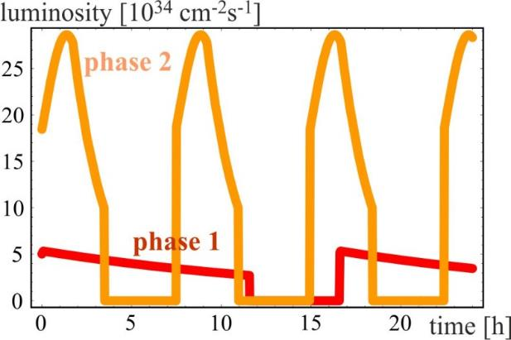
FCC-hh: Key milestones physics studies
2015:
Assessment of the requirements for integrated luminosity
First definition of benchmarks for detector performance, exploration of detector concepts, development of detector simulation software
Workshops (in coordination with FCC-hh) :
  Future of HEP (Hong Kong, January)
  Physics frontier with Circular Colliders (Aspen, January)
  BSM & Higgs @ 100 TeV (CERN, March)
  EW Baryogenesis probes at FCC (Amherst, Sept)
  Ions at the FCC (CERN, September)
  QCD & SM @ 100 TeV (CERN, October)
  Dark Matter @ 100 TeV (FNAL, Dec)
2016:
Report on “Physics at 100 TeV”. Define physics opportunities in the areas of SM, Higgs, BSM, Heavy Ions, injectors => available by Rome FCC week
Start integration of physics studies and detector simulation
Continue Workshop and WG activities
radiation damping: τ~1 h
Machine design consistent with preliminary physics goal: ~20 ab⁻¹ total

Slide 29
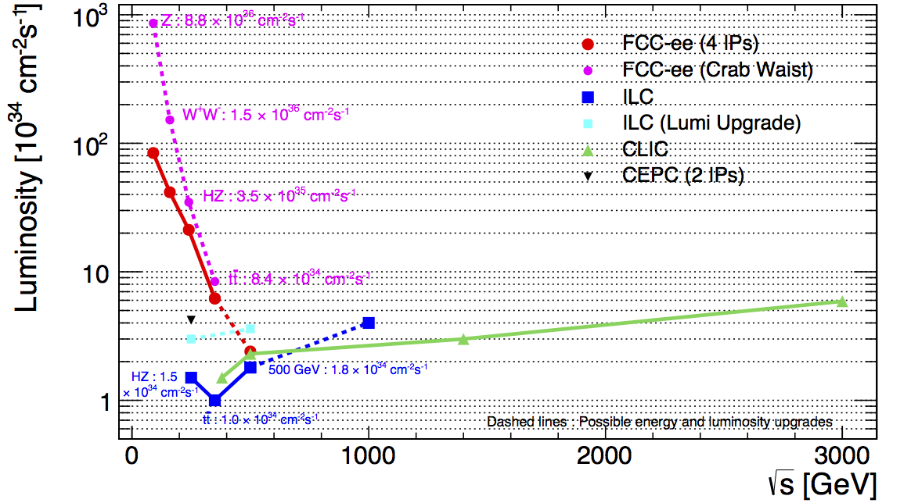
FCC-ee with crab waist scheme
ILC upgrade: 1312→ 2625 bunches per pulse

Slide 30
FCC-hh luminosity phases
phase 1: β*=1.1 m, ΔQ_{tot}=0.01, t_{ta}=5 h, 250 fb⁻¹ / year
phase 2: β*=0.3 m, ΔQ_{tot}=0.03, t_{ta}=4 h, 1 ab⁻¹ / year
radiation damping: τ~1 h
PRST-AB 18, 101002 (2015)
  for both phases:
  beam current 0.5 A
  total synchrotron radiation power ~5 MW.
consistent with
physics goal:
20 ab⁻¹ in total

Slide 31
Cryo power for cooling of SR heat
contributions: beam screen (BS) & cold bore (BS heat radiation)
Overall optimisation of cryo-power, vacuum and impedance
Termperature ranges: <20, 40K-60K, 100K-120K
Ph. Lebrun
L. Tavian
V. Baglin
300MW
200MW
100MW
Multi-bunch instability growth time: 25 turns 9 turns (ΔQ=0.5)

Slide 32
CERN – FCC 16T program launched
Main Milestones of the FCC Magnets Technologies
Milestone | Description | 15 | 2016 |  | 2017 |  | 2018 |  | 2019 |  | 2020 |  | 21
M0 | High J_{c} wire development with industry
M1 | Supporting wound conductor test program
M2 | Design & manufacture 16T ERMC with existing wire
M3 | Design & manufacture 16 T RMM with existing wire
M4 | Design & manufacture 16T demonstrator magnet
M5 | Procurement 70 km of enhanced high J_{c} wire
M6 | EuroCirCol design 16T accelerator quality model
 | Manufacture and test of the 16 T EuroCirCol model
ERMC (16 T mid-plane field) RMM (16 T in 50 mm cavity) Demonstrator (16 T, 50 mm gap) mid 2017 end 2017 end 2018

Slide 33
The two main goals
Higgs boson measurements beyond HL-LHC (and any e⁺e⁻ collider)
exploration of energy frontier
are quite different in terms of machine and detector requirements
Exploration of E-frontier →look for heavy objects up to m ~30-50 TeV, including
high-mass V_{L}V_{L} scattering:
requires as much integrated luminosity as possible (cross-section goes like 1/s)
→ may require operating at higher pile-up than HL-LHC (~140 events/x-ing)
events are mainly central→ “ATLAS/CMS-like” geometry is ok
main experimental challenges: good muon momentum resolution up to ~ 50 TeV; size of
detector to contain up to ~ 50 TeV showers; forward jet tagging; pile-up
Precise measurements of Higgs boson:
would benefit from moderate pile-up
light object → production becomes flatter in rapidity with increasing √s
main experimental challenges: larger acceptance for precision physics than ATLAS/CMS
→ tracking/B-field and good EM granularity down to |η|~4-5; forward jet tagging; pile-up

Slide 34
Coupling LHC CepC FCC-ee ILC CLIC FCC-hh
√s (TeV)→ 14 0.24 0.24 +0.35 0.25+0.5 0.38+1.4+3 100
L (fb⁻¹) → 3000(1 expt) 5000 13000 6000 4000 40000
K_{W} 2-5 1.2 0.19 0.4 0.9
K_{Z} 2-4 0.26 0.15 0.3 0.8
K_{g} 3-5 1.5 0.8 1.0 1.2
K_{γ} 2-5 4.7 1.5 3.4 3.2 < 1
K_{μ} ~8 8.6 6.2 9.2 5.6 ~ 2
K_{c} -- 1.7 0.7 1.2 1.1
K_{τ} 2-5 1.4 0.5 0.9 1.5
K_{b} 4-7 1.3 0.4 0.7 0.9
K_{Zγ} 10-12 n.a. n.a. n.a. n.a.
Γ_{h} n.a. 2.8 1% 1.8 3.4
BR_{invis} <10 <0.28 <0.19% <0.29 <1%
K_{t} 7-10 -- 13% ind. tt scan 6.3 <4 ~ 1 ?
K_{HH} ? 35% from K_{Z} 20% from K_{Z} 27 11 5-10
model-dep model-dep
Units
are %
Few preliminary
estimates available
SppC : similar reach
from K_{γ}/K_{Z}, using
K_{Z} from FCC-ee
rare decays → pp
competitive/better
from ttH/ttZ,
using ttZ and H
BR from FCC-ee
LHC: ~20% today → ~ 10% by 2023 (14 TeV, 300 fb⁻¹) → ~ 5% HL-LHC
HL-LHC: -- first direct observation of couplings to 2nd generation (H→ μμ)
-- model-independent ratios of couplings to 2-5%
Best precision (few 0.1%) at FCC-ee (luminosity !), except for heavy states (ttH and HH) where high energy needed → linear colliders, high-E pp colliders
Complementarity/synergies between ee and pp
Theory uncertainties (presently few percent e.g. on BR) need to be improved to
match expected superb experimental precision

Slide 35
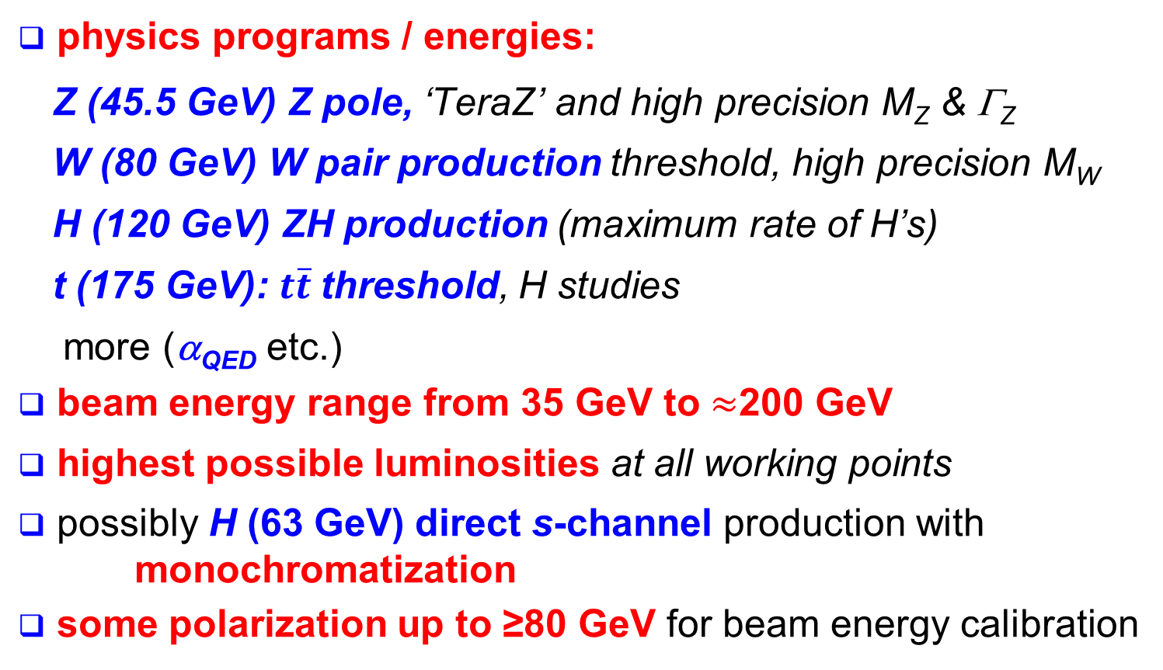
FCC–ee physics requirements
physics programs / energies:
  Z (45.5 GeV) Z pole, ‘TeraZ’ and high precision M_{Z} & Γ_{Z}
  W (80 GeV) W pair production threshold, high precision M_{W}
  H (120 GeV) ZH production (maximum rate of H’s)
  t (175 GeV): $t\overline{t}$threshold, H studies
  more (α_{QED} etc.)
beam energy range from 35 GeV to $≈$200 GeV
highest possible luminosities at all working points
possibly H (63 GeV) direct s-channel production with monochromatization
some polarization up to ≥80 GeV for beam energy calibration

Slide 36
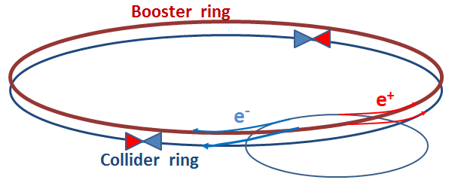
CepC FCC-ee
Ring (km) 53.6 100
√s (GeV) 240 240 350 90
E loss per turn (GeV) 3 1.7 7.5 0.03
Total RF voltage (GV) 6.9 5.5 11 2.5
Beam current (mA) 16.6 30 6.6 1450
N. of bunches 50 (one ring!) 1360 98 16700
L (10³⁴ cm⁻² s⁻¹)/IP 1.8 6 1.8 28
e±/bunch (10¹¹) 3.7 0.46 1.4 1.8
σ_{y}/σ_{x} at IP (μm) 0.16/74 0.045/22 0.045/45 0.25/121
Interaction Points 2 4 4 4
Lumi lifetime (min) 60 21 15 213
SR power/beam 50 MW 50 MW
Main challenges:
FCC ring size
Synchrotron radiation → 100 MW RF system
with high efficiency
Beam polarization for beam energy calibration at Z-pole and
WW threshold to <100 keV to measure m_{Z}, m_{W} to < MeV at FCC-ee
Machine design with large energy acceptance over full √s span
Note: Super-KEKB is an excellent “prototype”, with more stringent requirements on
positron rate, momentum acceptance, lifetime, β_{y}*

Slide 37
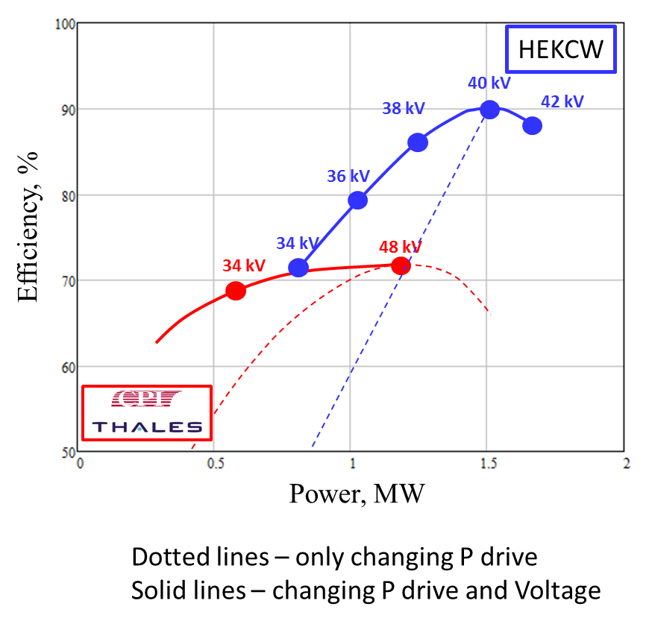
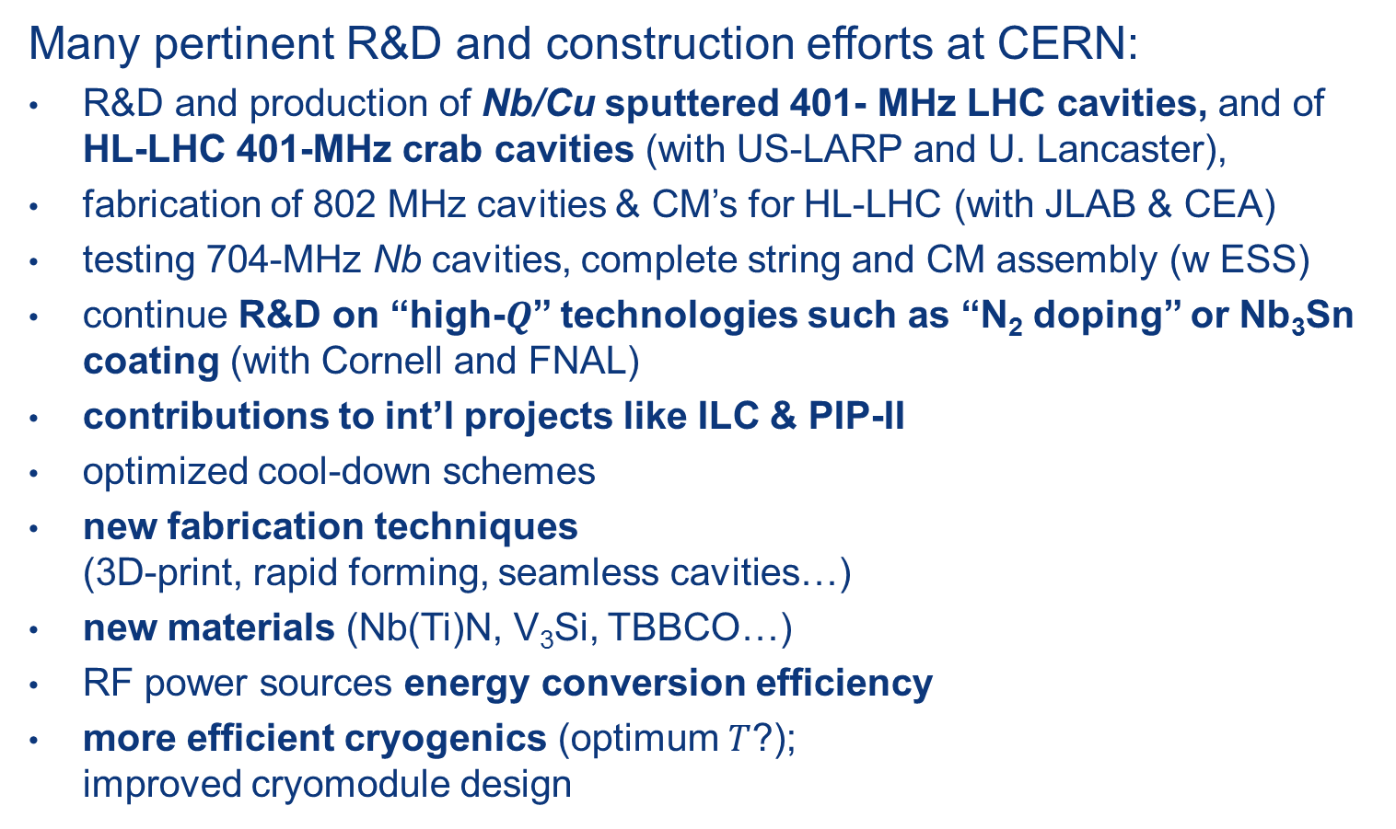
SC RF R&D towards FCC
Many pertinent R&D and construction efforts at CERN:
R&D and production of Nb/Cu sputtered 401- MHz LHC cavities, and of HL-LHC 401-MHz crab cavities (with US-LARP and U. Lancaster),
fabrication of 802 MHz cavities & CM’s for HL-LHC (with JLAB & CEA)
testing 704-MHz Nb cavities, complete string and CM assembly (w ESS)
continue R&D on “high-$Q$” technologies such as “N₂ doping” or Nb₃Sn coating (with Cornell and FNAL)
contributions to int’l projects like ILC & PIP-II
optimized cool-down schemes
new fabrication techniques (3D-print, rapid forming, seamless cavities…)
new materials (Nb(Ti)N, V₃Si, TBBCO…)
RF power sources energy conversion efficiency
more efficient cryogenics (optimum $T$?); improved cryomodule design
I. Syratchev

