Slide 1
LCC report to FALC
L. Evans, Tsukuba 24th February 2016

Slide 2
LCC Mandate
The mandate of the LCC is to support the global design effort to enable the possible realization of a timely electron-positron collider and its detectors based on ILC technology, to support the CLIC technology development for a potential future higher energy machine and to coordinate both efforts in order to exploit synergies between them.

Slide 3
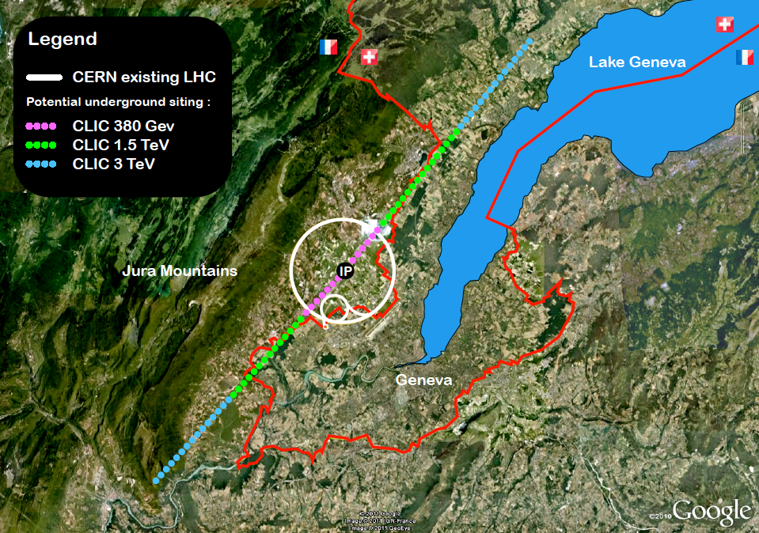
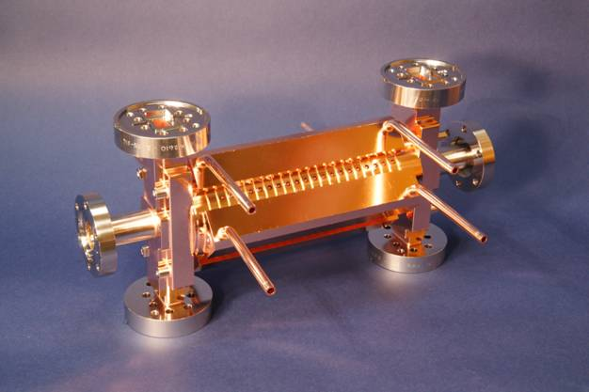
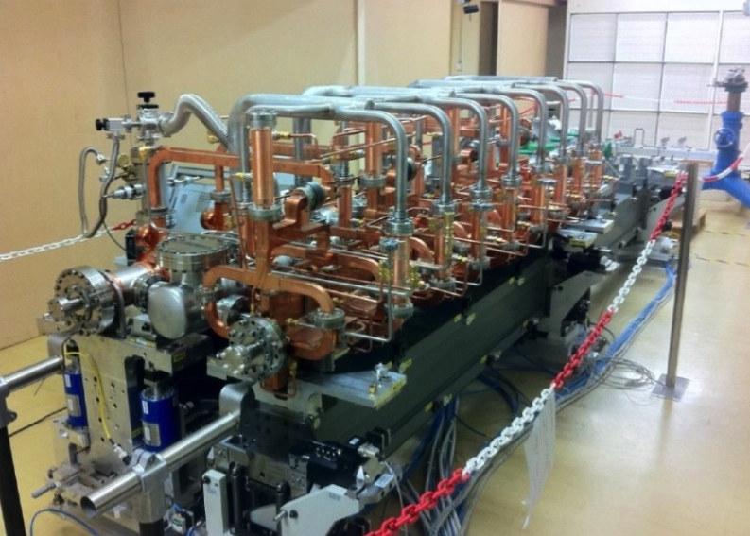
The CLIC project
2012 CLIC CDR submitted, input to the European Strategy process.
The CERN LC activities now address:
High Gradient acceleration, machine studies for high energy frontier e+e- (CLIC)
European ILC effort
General accelerator and detector R&D
Main actvitiy: CLIC 2013-19 Development Phase
Develop a Project Plan for a staged implementation in agreement with LHC findings; further technical developments with industry, performance/optimisation studies for accelerator parts and systems, as well as for detectors.
Key features:
High gradient (energy/length)
Small beams (luminosity)
Repetition rates and bunch spacing (experimental conditions)
Accelerator collaboration with ~50 institutes
Detector collaboration operative with ~25 institutes
Notes:
Mention collaborative agreement (~60-70) and 80 students covering 2014-2018 when talking about collaboration
Often linked to local project where “CLIC or LC technologies” exist or are essential for their future plans

Slide 4
Activity groups |  | CDR status/concerns (around 2012-13) | Main on-going activities – achieved or in progress (aiming for next ESU 2018-19)
Parameters and Design, Implementation |  | Not optimized except at 3 TeV and not adjusted for Higgs discovery, not optimized cost, first power/energy estimates, limited industrial costing | Design and Parameters cost and power optimized at all stages (380 GeV, 1.5 and 3 TeV) – to be adapted to LHC results as needed, including klystron option for first stage. Power reduction studies (magnets, klystrons, design, overheads) Industrial quotes/experience for main items Schedule/layout near CERN, plans for preparation phase 2019-2025
X-band technology |  | Single elements demonstrated – limited by test-capacity, commercial klystron just becoming available in 2012-13 opening for test-facilities, FEL linac use, klystron driven modules | Three new test-stands at CERN with commercial RF Units. Statistics for gradient and design optimization (x5), increased industrial capacity of complete structures Optimize structure choice and other X-band elements. Use in smaller machines at FEL linacs (new or upgrades) with commercial RF units. High efficiency RF studies (X-band as well as L-band)

Slide 5
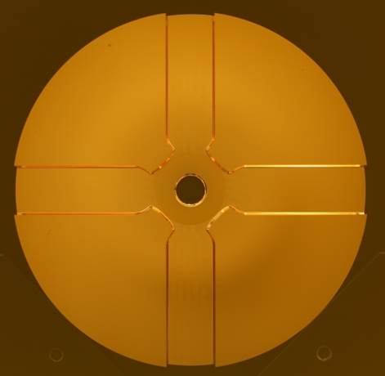
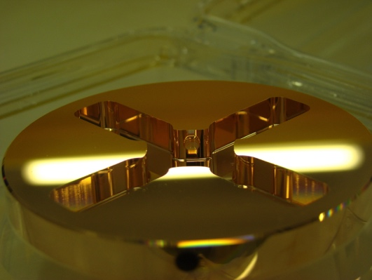

X-band structures and testing
X-band Technologies:
High gradient structures and high efficiency RF (structure prod. in green)
X-band High power Testing Facilities (x3 increase) (in red)
Use of X-band technologies for FELs
VDL
CERN
PSI
CIEMAT
SLAC
◉
KEK
◉
◉
◉
◉
Tsinghua
SINAP
◉
◉
◉
◉
◉
◉
8

Slide 6
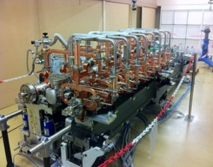
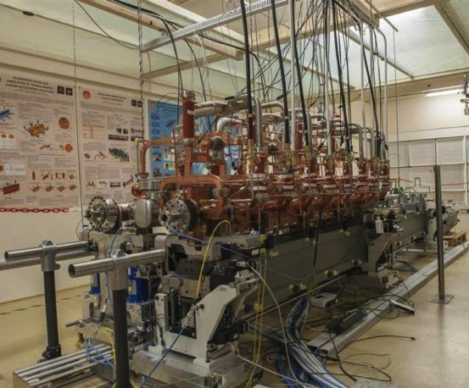
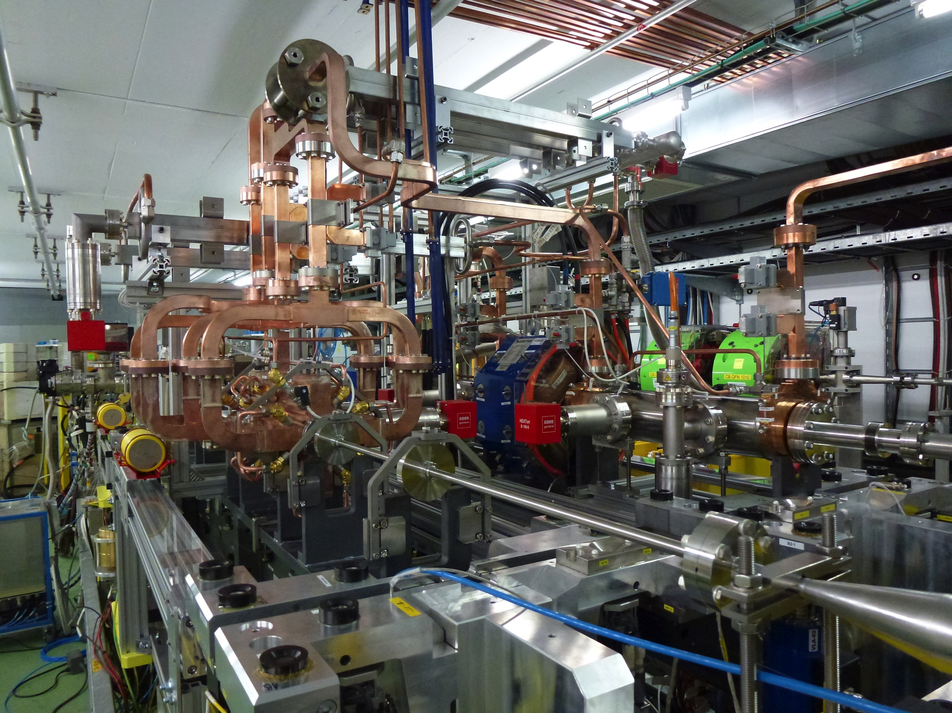
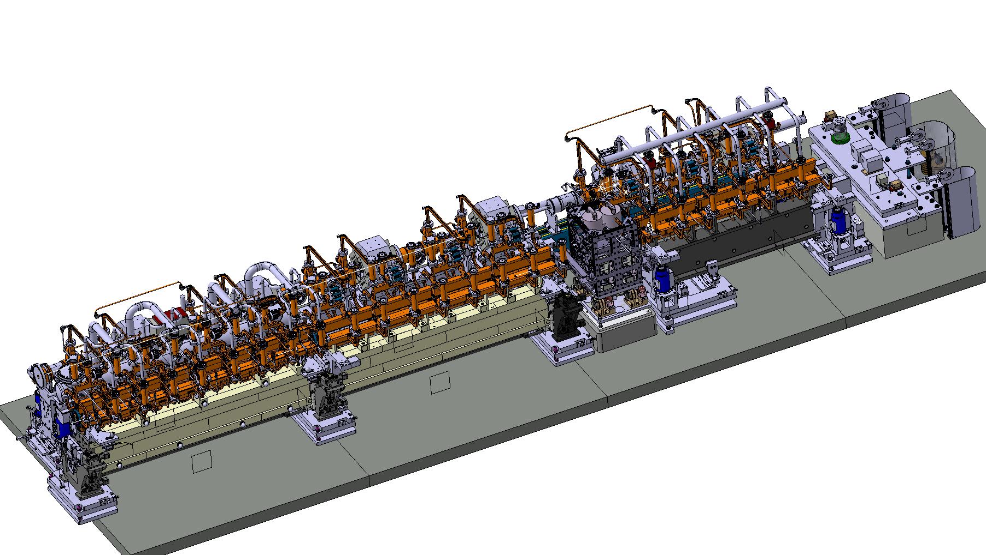
drive beam
CLIC module review June 22:
https://indico.cern.ch/event/393250/
Recently installed 2-beam acceleration module in CTF3
(according to latest CLIC design)
First 2-beam tests stand reached 145 MV/m (2012)
main beam

Slide 7
Main Linac Tolerances
Nanobeam studies in ATF and FACET
The CLIC coll. is very interested in a longer term programme at ATF2 - ongoing:
FFS performance, including building 2 octupoles for ATF2 (to study FFS tuning with octupoles – being built)
Stability, feedbacks, instrumentation
General support for ATF2 operation
Support UK and Spanish LC activities (contracts with 7 universities with 50/50 sharing) that are have a significant ATF component
Key elements for performance being addressed with specific developments or tests: alignment, stability, damping systems, wakefield monitors (CTF3 in progress), damping rings performances and elements -> wanted to complement by beam based alignment system performance verification (FACET)

Slide 9

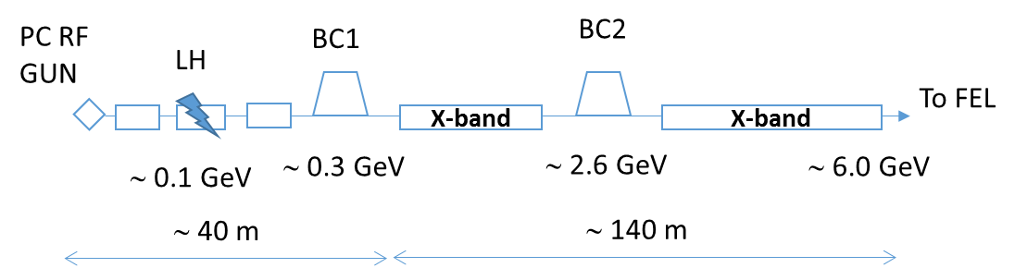
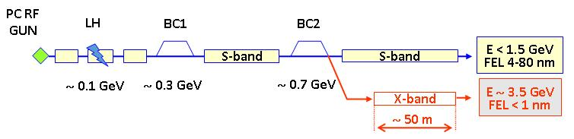
Xband facilities - FELs
X-band technology appears interesting for compact, relatively low cost FELs – new or extensions
  Logical step after S-band and C-band
  Example similar to SwissFEL: E=6 GeV, Ne=0.25 nC, s_{z}=8mm
Use of X-band in other projects will support industrialisation
  They will be klystron-based, additional synergy with klystron-based first energy stage
Started to collaborate on use of X-band in FELs
  Australian Light Source, Turkish Accelerator Centre, Elettra, SINAP, Cockcroft Institute, TU Athens, U. Oslo, Uppsala University, CERN
Share common work between partners
  Cost model and optimisation
  Beam dynamics, e.g. beam-based alignment
  Accelerator systems, e.g. alignment, instrumentation…
Define common standard solutions
  Common RF component design, -> industry standard
  High repetition rate klystrons (200->400 Hz now into test-stands)
Important collaboration for X-band technology

Slide 10
Novel RF developments
Work shared between researchers and industry at CERN, in the US, UK, France, Sweden, Russia … covering much wider than CLIC but seed funded from the CERN LC budget:
The increase in efficiency of RF power generation for the future large accelerators such as CLIC, ILC, ESS, FCC and others is considered a high priority issue.
The deeper understanding of the klystron physics, new ideas and massive application of the modern computation resources are the key ingredients to deign the klystron with RF power production efficiency at a level of 90% and above.

Slide 11
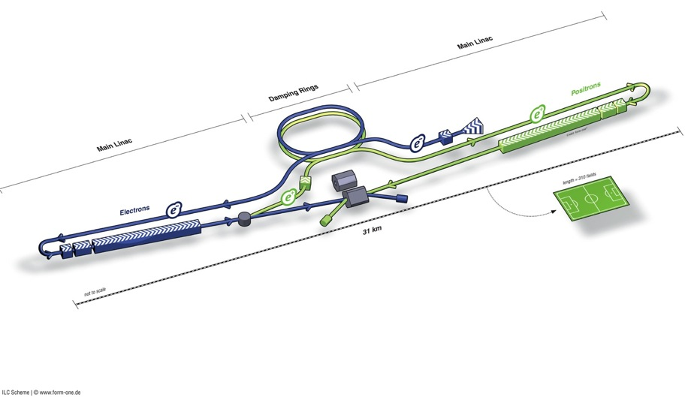
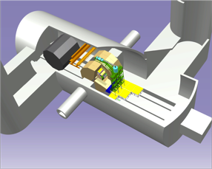
ILC Accelerator in TDR
Damping Rings
Polarised electron source
Ring to Main Linac (RTML)
(including
bunch compressors)
e+ Main Linac
e- Main Linac
Parameters | Value
C.M. Energy | 500 GeV
Peak luminosity | 1.8 x10³⁴ cm⁻²s⁻¹
Beam Rep. rate | 5 Hz
Pulse duration | 0.73 ms
Average current | 5.8 mA (in pulse)
FF beam size (y) | 5.9 nm
E gradient in SCRF acc. cavity | 31.5 MV/m +/-20% Q₀ = 1E10
E+ source
Demonstrated in TDR
Progress in 2014

Slide 12
Technical Highlights in 2015
SRF
    EXFEL: exceeded 90 % of 800 cavity production, and 60 % of 100 cryomodule assembly and test
    Fermilab-ASTA: reached the ILC specification gradient of ≥31.5 MV/m
    KEK-STF2: CM1+CM2a (12 cavity string) under cold test
    SLAC-LCLS: construction started in consortium with SLAC, Fermilab, and JLab
Nano-beam
    ATF2: reached 44 nm at the final focus, closing the primary goal of 37 nm, in 2014
      Corresponding to 7 nm at the ILC energy (250 GeV/beam) with the goal of 6 nm
Accelerator Design and Integration (ADI)
    LCC: processed Post-TDR design update with the Change Management
      Common L* for both detectors of ILD and SiD
      Vertical access at Detector Hall at IR points
      Extension of ML tunnel for optimizing e+e- collision timing and for redundancy of ML SRF cavity gradient integration
      Others
    LCC: is continuing efforts to seek for cost saving in balance to necessary increasing

Slide 13
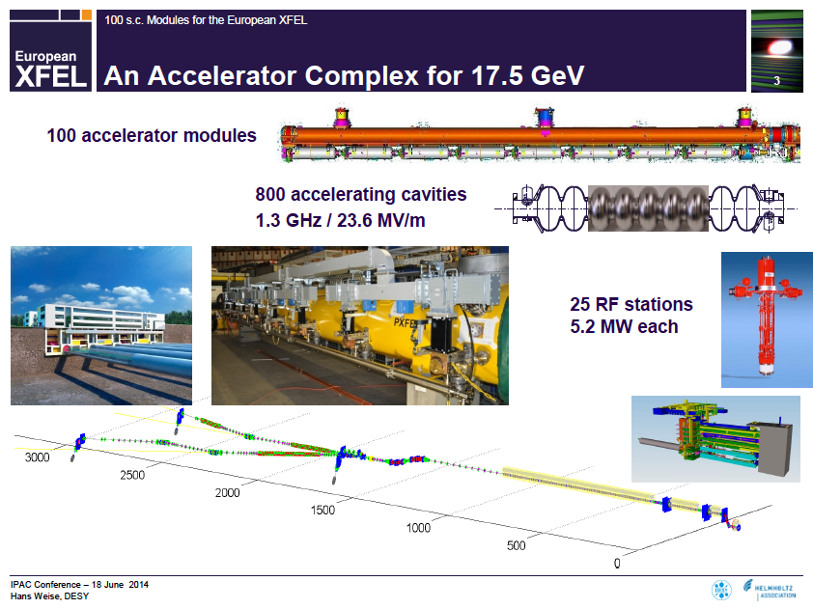
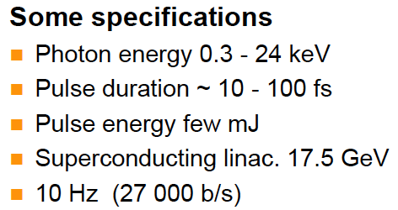
IPAC14: Courtesy: H. Weise
SC Linac (~ 1 km)
EXFEL: 1/20 Scale Project on going, Industrialization being verified !!
800 Cavities under production (at RI, Zanon) , and
assembled / Tested at CEA-Saclay, DESY

Slide 14
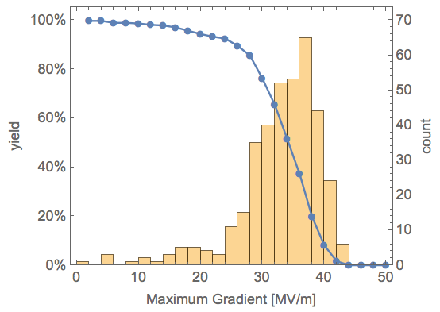
XFEL cavities treated with ILC recipe.

Slide 15
HiGrad cavity tests
There are 15 cavities out of the XFEL production available for special treatment.
Thanks to DESY, these cavities will be tested under special conditions to investigate the temperature dependence of their performance.
They can also be given further chemical treatment if deemed necessary.

Slide 16
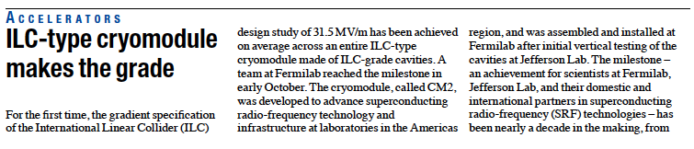

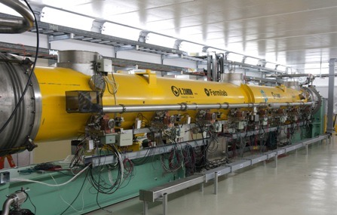
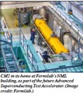
CM2 reached <31.5 MV/m > at Fermilab in 2014
Cavity | Gradient (MV/m)
1 | 31.9
2 | 30.8
3 | 31.8
4 | 31.7
5 | 31.5
6 | 31.3
7 | 31.6
8 | 31.4
Cryomodule test at Fermilab reached < 3.15 > MV/m, exceeding ILC specification

Slide 17
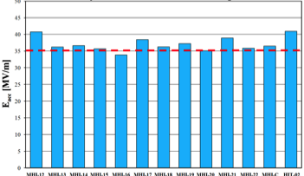
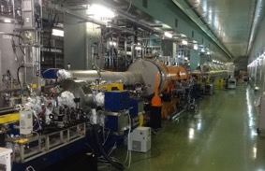
KEK-STF2 is to be a SRF Beam Accelerator Facility
Objective
High Gradient (31.5 MV/m)
＝＞Demonstration of full cryomodule
Pulse and CW operation (for effective R&D)
Better efficiency power sources
SRF electron gun
Training for next generation s
Plan:
Multiple Cryomodule for system study
In-house Cavity to be installed
in cooperation with industry
Wide range application including
Photon Science
Electron Gun
Full Cryomodules
Undulators (in future)
Detector
CM0
BC
SC RF-Gun
CM1
CM2a+2b
CM3a +3b,
Beam Dump
Cavity VT performing :
35 MV/m with the yield of > 90 %
Cryomodule Test in progress
First 4 cavity performing > 35 MV/m
2013-12-18

Slide 18
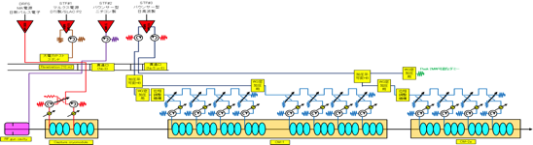

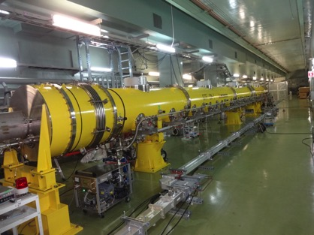
CM1 + CM2a RF Power Distrib. in Progress
The first full beam acceeleration test in 2016.
2015
A. Yamamoto, LCB-150226
ILC Acc. Status

Slide 19
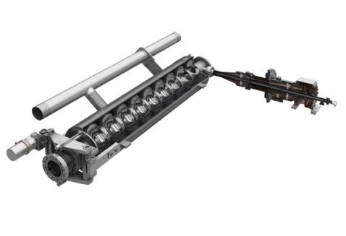
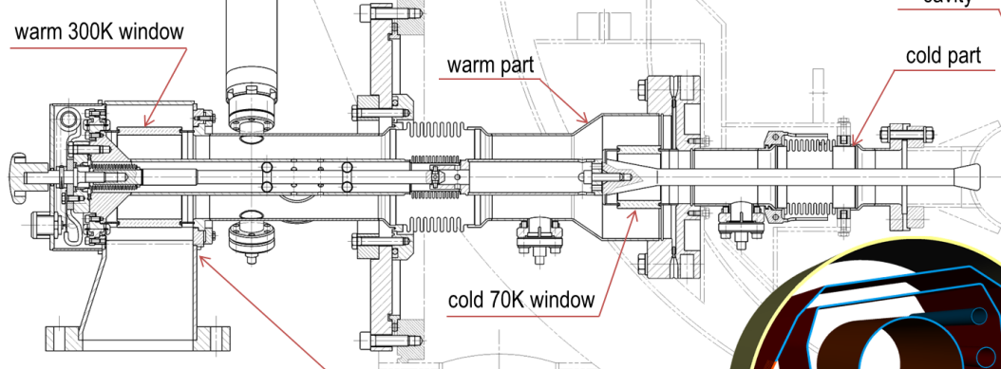
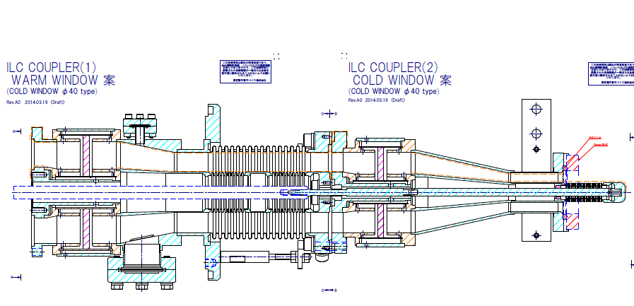
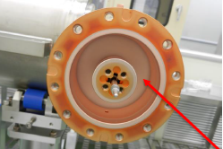
RF-Power Coupler Development w/ low-SEE coefficient ceramic window
Plug-compatible,
cold-interface
40 φ
 | STF-A | STF-B*
Cold end-flange | 40 mm | 40 mm
Ceramic window | A479 | AH100A
SEE coefficient | 11.2 | 4.6
Coating | yes | no
Conditioning time | 86 hrs | In progress
TTF-III/E-XFEL Coupler
w/ bellows
40 φ
w/o
bellows
New, KEK-STF Coupler
* CERN-KEK Cooperation

Slide 20
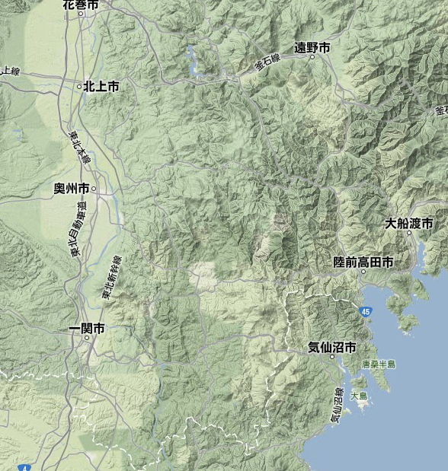
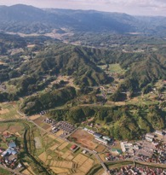
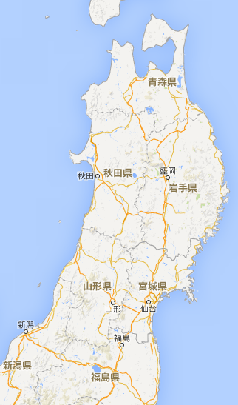
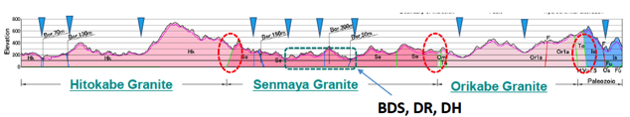
ILC Site Candidate Location in Japan: Kitakami
Preferred site selected by JHEP community,
Endorsed by LCC, in 2013
High-way
Oshu
Express-
Rail
Ofunato
Kesen-numa
Sendai
Ichinoseki
IP Region

Slide 21
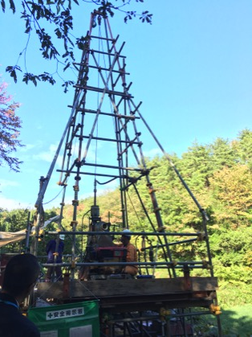
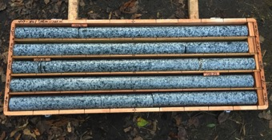
A new boring evaluation in progress for IP area
A new boring test in progress to verify the vertical access feasibility for detector hall at IP
IP Region

Slide 22
The future of LCC
Japan has made it clear that no decision on ILC will be made before 2017.
Is it necessary to keep a structure in place to hold together the International community until this decision is made?

