Slide 1
Plans for ILC Main Linac Studies in 2016
N. Solyak
TB meeting, Feb.9, 2016

Slide 2
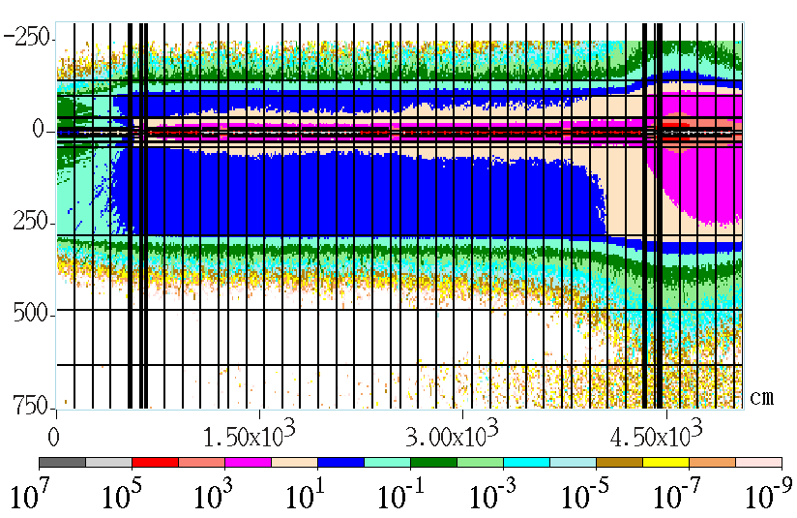
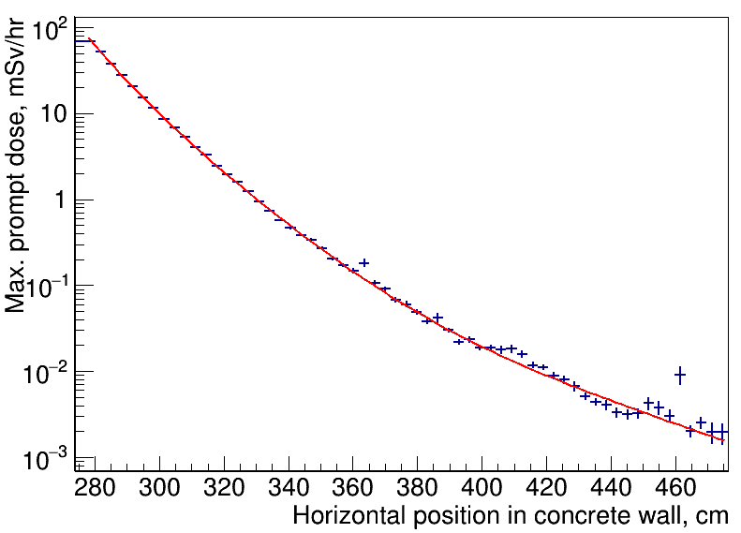
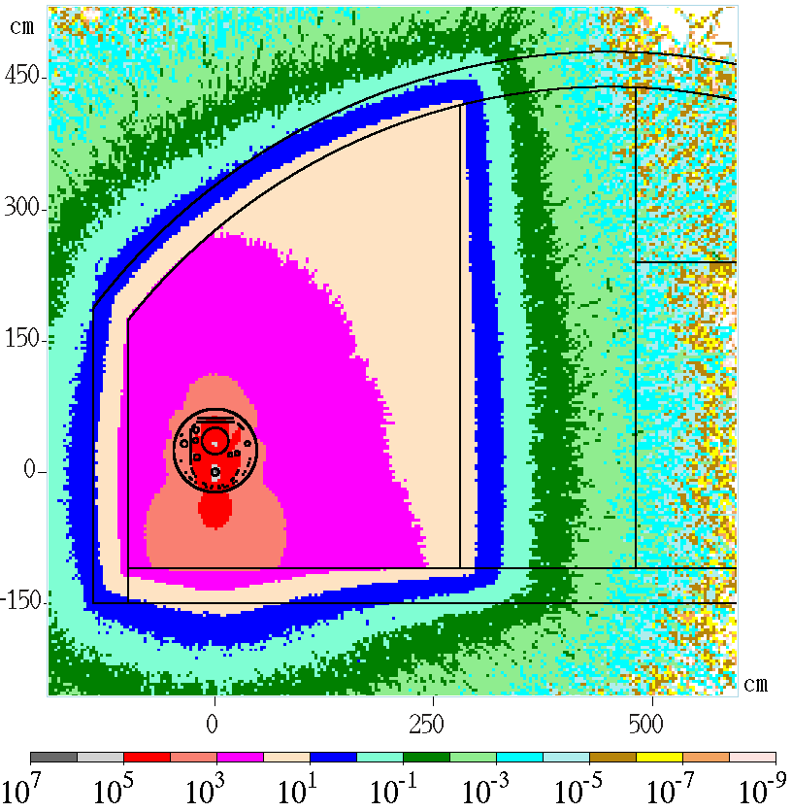

Radiation dose vs. concrete wall thickness
Magnets 250GeV, laser-straight linac
Fit for attenuation curve for prompt dose, mSv/hr
$$D\left(x\right)=e^{p0+p1\left(x−280\right)}+e^{p2+p3\left(x−320\right)}+e^{p4+p5\left(x−360\right)}$$
p0 = 3.42573e+00
p1 = -7.14516e-02
p2 =- 1.68580e+00
P3 = -1.27563e-01
P4 = -3.14138e+00
P5 = -2.89486e-02
25uSv/h (~1.2m)
1.5m

Slide 3
For low magnetic field in quadrupole trapped dark current particles can not be effectively kick-out to the walls. Some fraction will continue accelerate in next several CM’s before it will be lost. Equilibrium distribution of losses will be achieved after few RF units.
Worst scenario (C.Adolphsen) : all quads are OFF → more energy of accelerated DC beam before it will be lost.
- curvature steering corrector are OFF. Dark current will be lost after ~700m (15GeV) in the walls.
- nominal steering correctors will over kick dark current beam to wall after < 100m.
Effect of quad settings on radiation dose:

Slide 4
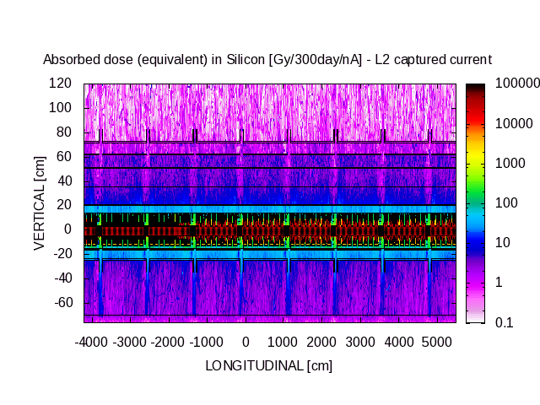

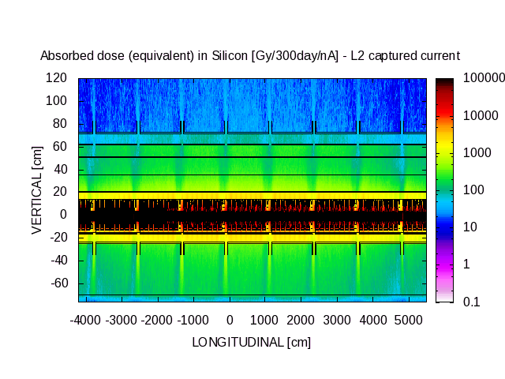
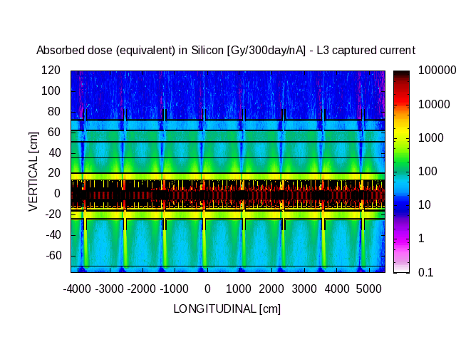
LCLS-II: Effect of quad settings on radiation dose
0 MeV
Vertical [cm]
700 MeV
[Gy/300d/nA]
Vertical [cm]
4000 MeV
Vertical [cm]
MSL - 2015
Longitudinal [cm]

Slide 5
LCLS-II: Effect of quad settings on radiation dose
0 MeV
Vertical [cm]
700 MeV
Settings at 700 MeV are the worst for radiation to the cryomodules as field emission is accelerated but ultimately is lost, depositing most energy
[Gy/300d/nA]
Vertical [cm]
4000 MeV
Vertical [cm]
MSL - 2015
Longitudinal [cm]

Slide 6
ILC Main Linac configuration
Bunch Compressor (5-15GeV) is located in straight-line tunnel
  BC1 – 3 CMs
  BC2 – 45 CM’s to accelerate from 5 to 15 GeV
Rest of Main Linac (15-250GeV) CM’s are installed in curved tunnel
Dark current can not propagate up to end of the linac and will be lost earlier in linac due to tunel curvature. Need simulations to see details

Slide 7
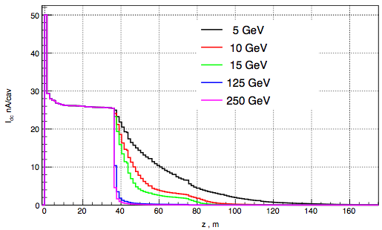
Dark current distribution from single cavity
~0.02 nA/m
Single cavity (just after focusing quad) emits 50 nA of dark current

Slide 8
Power loss distribution done for quad settings, corresponding energy range 5-250 GeV for laser- straight linac.
Previous Studies
Assumption: Each cavity in linac produces 50nA of dark current (at the cavity exit)
Start with 1st cavity after quad. In simulation we track all particle from each cavity through 8RF units (24 CMs, 208 cavities).
In all cases equilibrium was achieved
Power per cavity (~1.3m) of all lost particles are plotted.
Duty cycle = 1%; 1ms x 10Hz

Slide 9
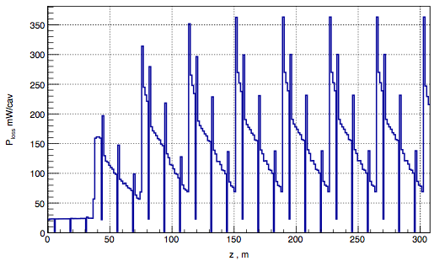
Power loss distribution: 5 GeV
1st cavity
quad
Losses equalize at 4th quad, peak losses are in cavity just after quad
- x2 increases max losses/cavity; x5 - integrated loses per RF-unit (vs. 1st RF unit);

Slide 10
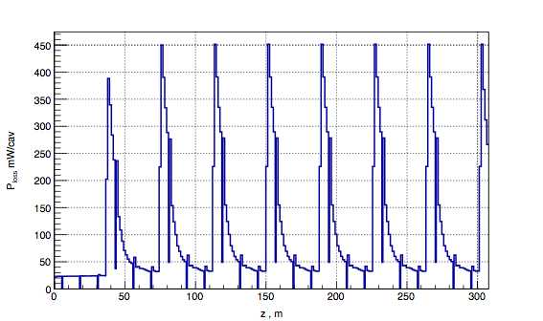
Power loss distribution: 15 GeV
quad
Losses equalize at 2nd quad, peak losses are in cavity just after quad

Slide 11
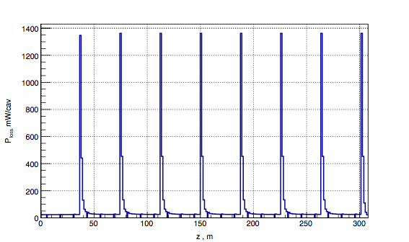
Power loss distribution: 125 GeV
quad
1st cavity
Losses equalize at 1st quad, peak losses are in quad

Slide 12
Summary of equilibrium losses
 | 5 GeV | 10 GeV | 15 GeV | 125 GeV | 250 GeV
Max in Quad, [W/quad] | 0.07 | 0.15 | 0.22 | 1.35 | 1.7
Max in Cavity, [W/cavity] | 0.36 | 0.36 | 0.45 | 0.45 | 0.2
Integrated over RF unit [W] | 4.1 | 3.5 | 3.2 | 2.67 | 2.57
Assumptions
Straight-line tunnel
DC=50nA/cav; 1% duty factor (1ms x 10Hz)
Expected energy losses in curved linac without quad focusing
Max. Cavity/quad < 4 W
Integrated in RF unit < 100 W
Curvature steering is off
Max. Cavity/quad < 1 W
Integrated in RF unit < 10 -20W
Curvature steering is ON

Slide 13
Plans to study worst scenarios of radiation from dark current
Simulate dark current losses in curved linac in case of no quad focusing (energy spectrum and locations) for 2 cases:
  No steering dipole to compensate earth curvature of tunnel
  Nominal settings for curvature steering
2. Simulate Radiation in tunnel for the worst case scenario of losses.

Slide 14
Task #2: Low emittance transport studies in ML for a new lattice 2015b
Last LET studies was done for linac w/o bunch compressor for 2007b lattice of for simplified uniform lattice.
TDR lattice was already modified → In 2015b lattice few modification:
  BC was moved to ML from RTML
  New CM segmentation
  Earth curvature and dispersion matching was re-done.
  New lattices for extraction lines
  Spare CM’s in BC2,
  Matching and collimation moved from BDS to ML
  10% cavity Gradient spread.
  Alignment models should be upgraded (LCLS-II)
  Diagnostics

Slide 15
Task #2: LET studies in ML (continue)
Run 2015b and check / fix inconsistencies
Check basic emittance performances with standard set of static errors and compare with old 2007b lattice
  Misalignment, Wakefield,
  3. Update misalignment model, add
  4. Dynamic errors:
  5. Start-to-end simulation (RTML+ML+BDS) -- ?
Program was discussed in LCWS15 at Whistler in Beam Dynamics working group
Will be discussed in LCWS2016 workshop

Slide 16
Further ML studies
Radiation from Dark Current
Based on preliminary results the conclusion (LCWS2015) was to reduced concrete wall thickness from 3.5m to 1.5- 2 m. Review recommendation: need more studies to prove that.
Next steps:
  Dark Current tracking studies for worst case scenarios:
    - No focusing (with and w/o earth curvature steering dipoles)
  MARS simulations for worst scenario losses (0, 5) GeV
    - Take into account penetrations in walls.
2015b Lattice evaluation and LET studies
* Scope of studies need to be finalized

