Slide 1
Recent Status of 40mm Input Coupler
Y. Yamamoto, A. Yamamoto, T. Matsumoto, E. Kako (KEK)
E. Montesino (CERN)
Kirk

Slide 2
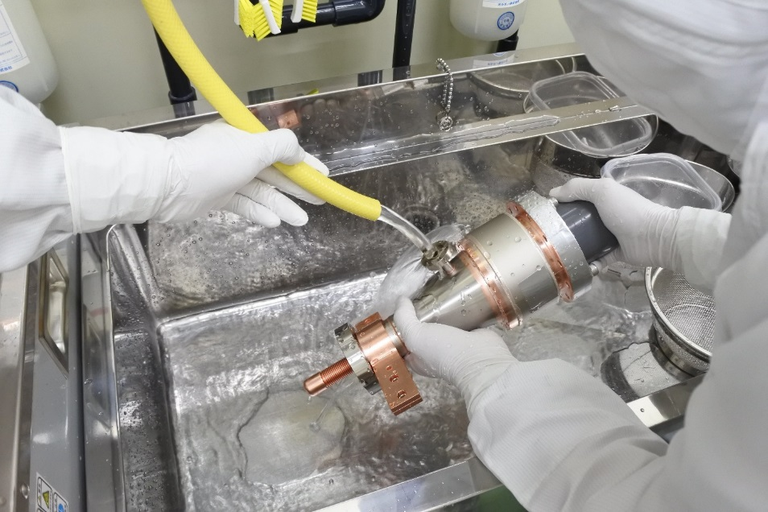
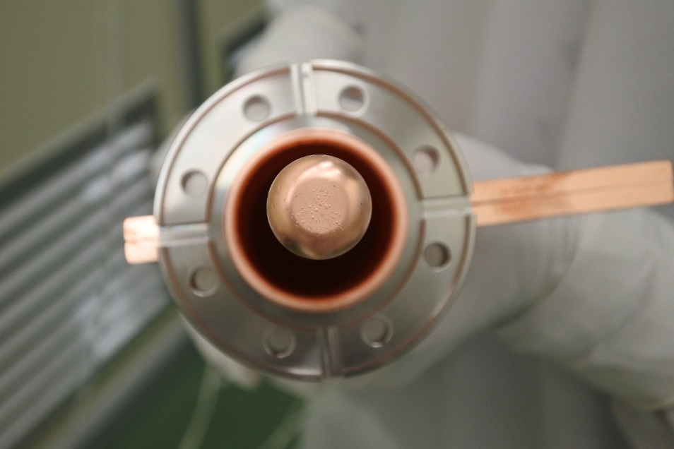
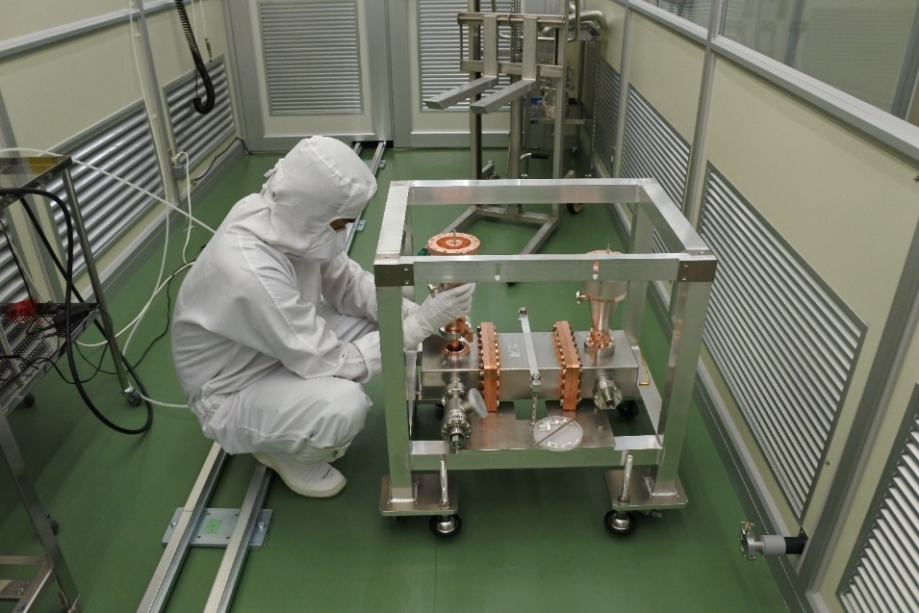
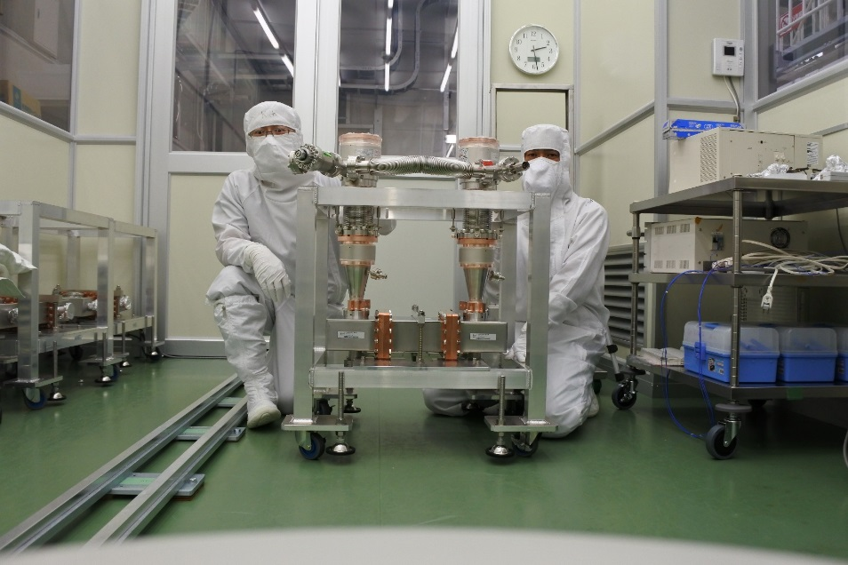
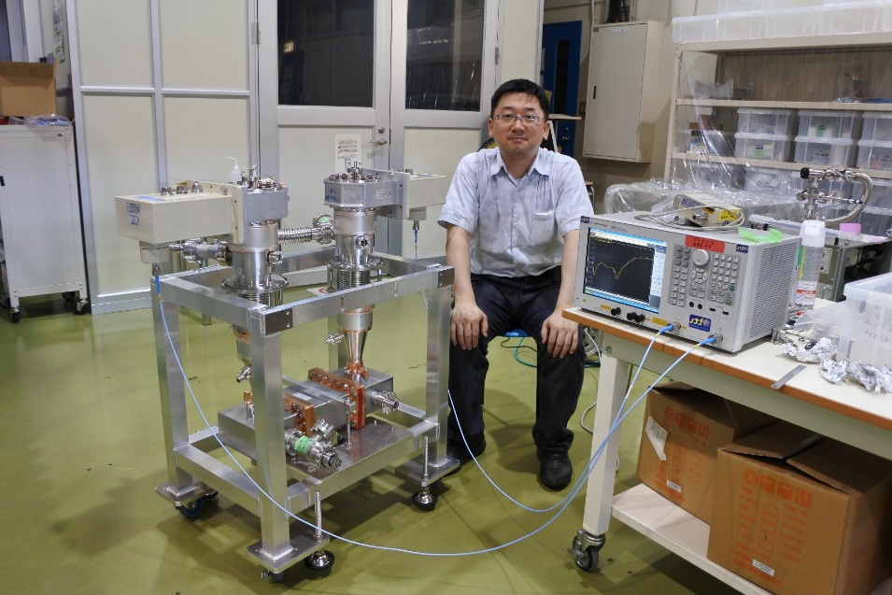
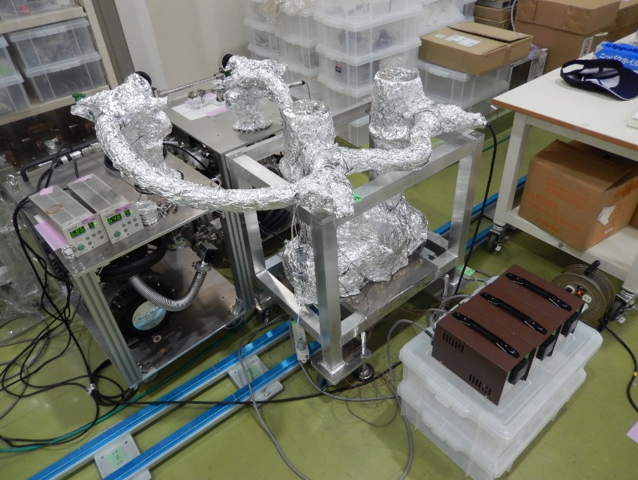
Cold part #1 has problematic copper plating.
But, as now, it’s not significant in high power test!
Ultra-pure water rinsing → assembly work in Class10 → Leak check → Low power test → Baking

Slide 3
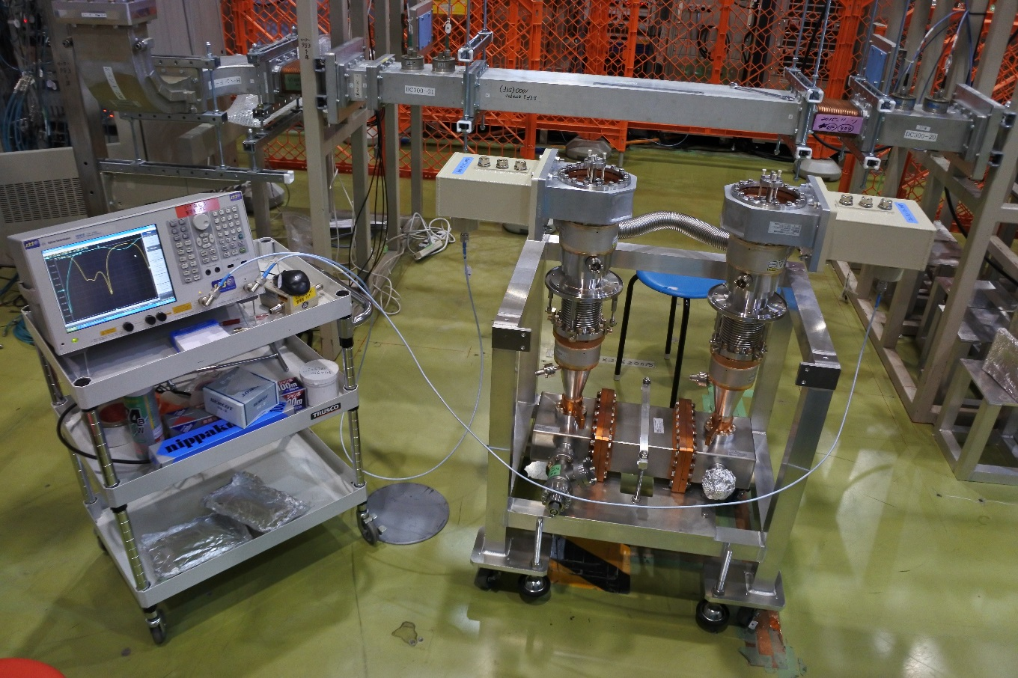
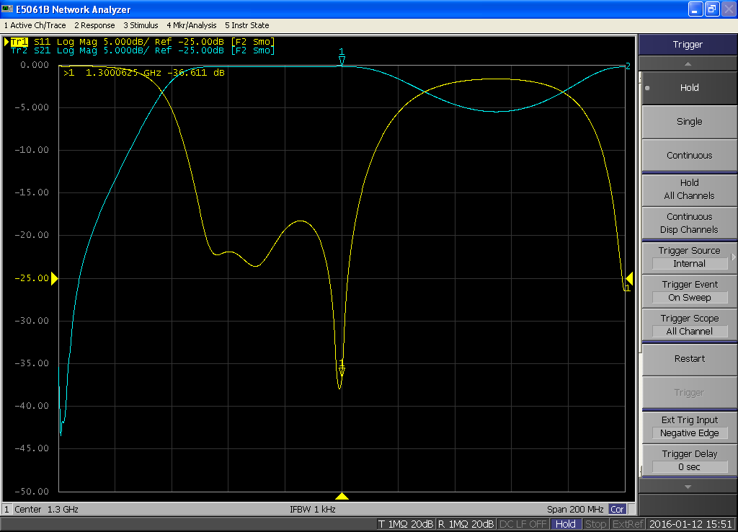
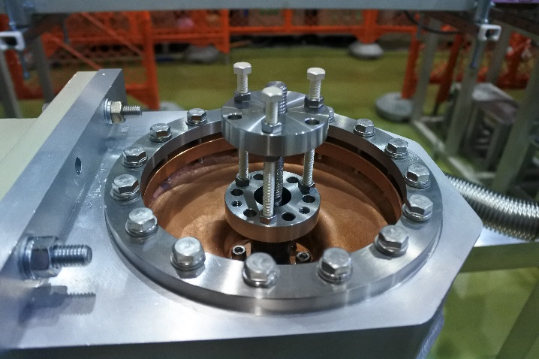
Final low power test at test bench before connecting to waveguide system
S₁₁=-36.6 dB, S₂₁=-0.13 dB
adjustable

Slide 4
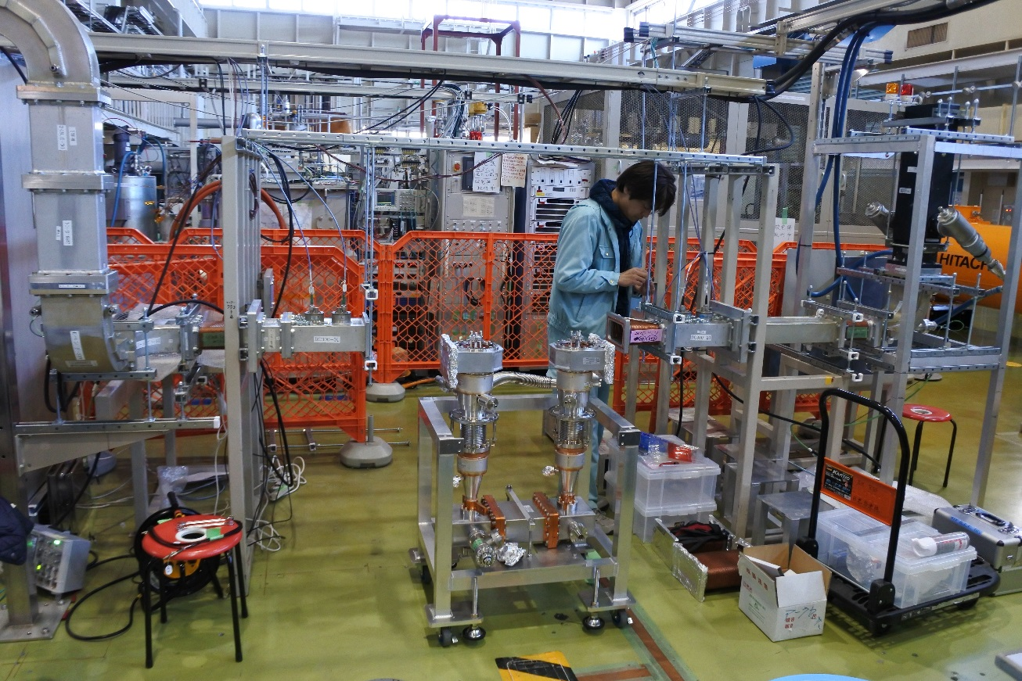
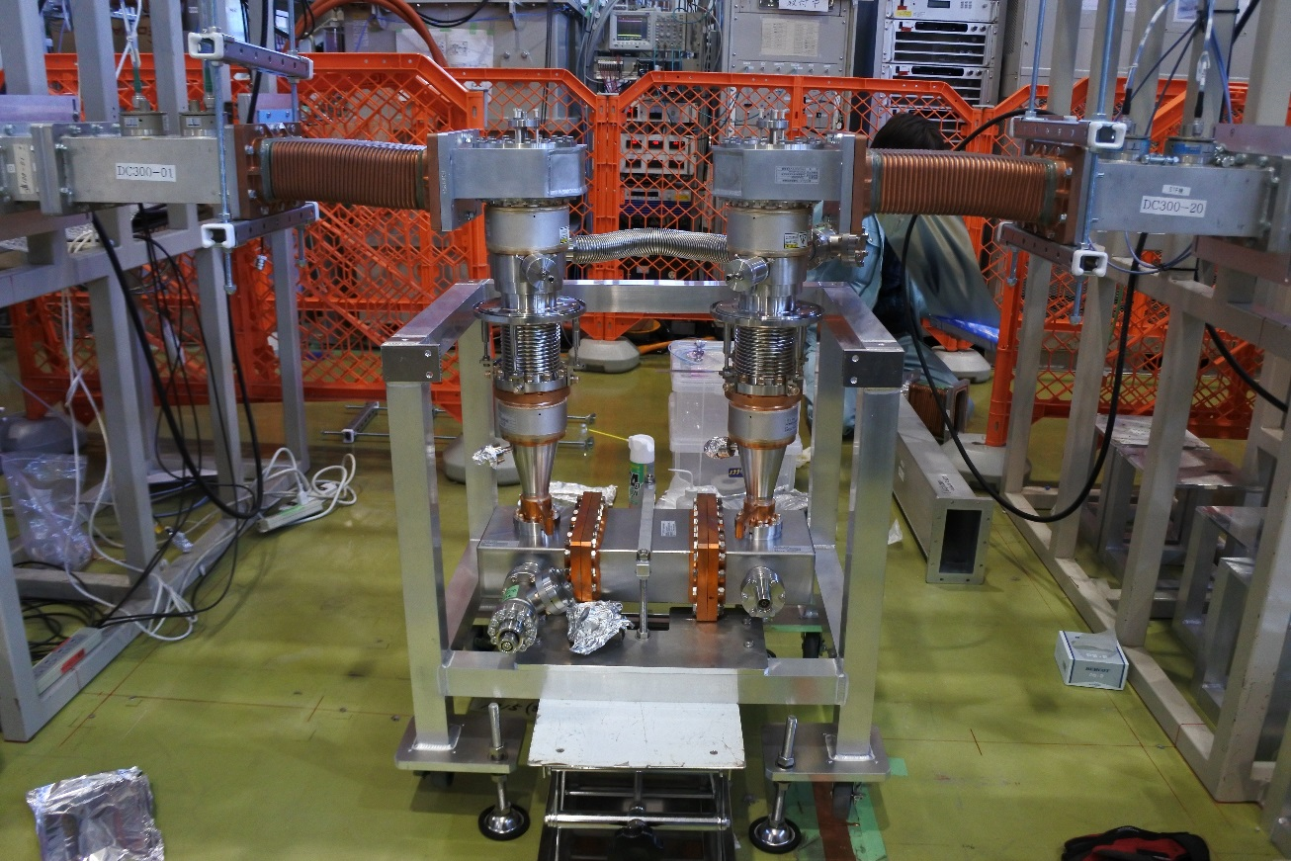
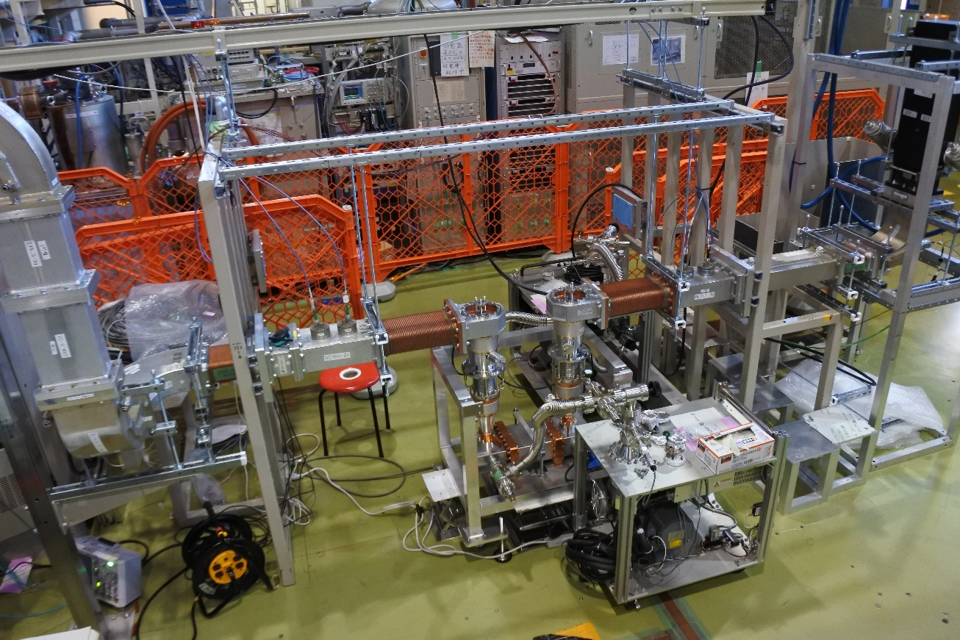
Connection to waveguide system
Pumping starts
(coupler has been under vacuum
after assembly work in clean room)

Slide 5
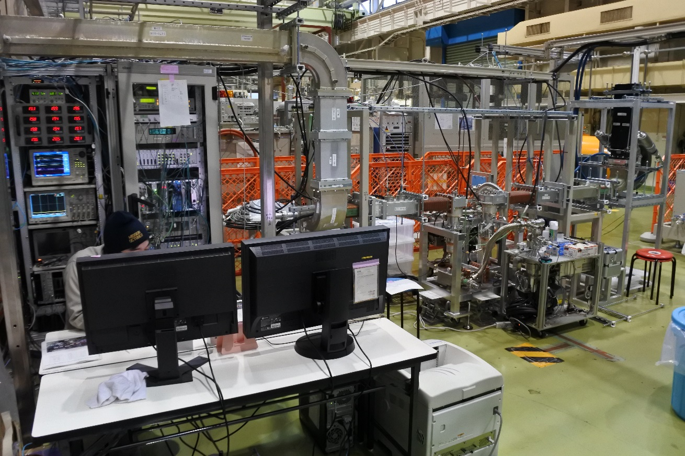
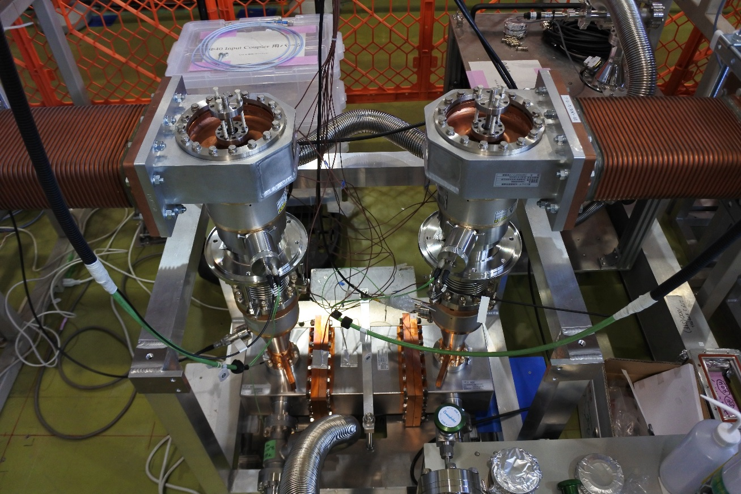
Arc sensor at warm window
e⁻ probe at cold window
Final setup for RF coupler conditioning
We are monitoring RF power, vacuum, temperature for coupler outside, arc sensor output and electron probe output.
Step of RF pulse width: 10μsec → 30μsec → 100μsec → 500μsec → 1500μsec → 1650μsec (TDR spec.)
Max. Power for each RF pulse width: 1200kW @< 500μsec
800kW @> 500μsec

Slide 6
List of Signals and I/L level
Signal name | I/L threshold
P_{for@up}, P_{back@up}, P_{for@down} | P_{for@up} < 1.3 MW, P_{back@up} < 10 kW
Cold / Warm Vacuum | 1 ~ 2 x 10⁻⁴ [Pa] (4 x 10⁻⁴ [Pa] @temporary)
Arc #1, #2 @waveguide | 2000/6500, 2000/7000
Arc Up, Arc Down | 2000/6090, 2000/6550
Electron peak-hold #1, #2
Electron charge #1, #2
Temperature #1 ~ #12
VSWR @up, down | < 1.4
Cooling water | < ?

Slide 7

Cooling water @Dummy Load
downstream
upstream
Warm Vac
P_{forward}
P_{backward}
Arc #2
Arc #1
P_{backward}
P_{forward}
Arc down
Arc up
e⁻ #2
(peak, Q)
e⁻ #1
(peak, Q)
Cold Vac

Slide 8
History of RF Conditioning @Test Bench
Date | Content | Result
12/Jan
15/Jan | Klystron #2 ON, RF ON, Power meter setting | 27.9 kW @10μsec/5Hz
18/Jan |  | 43.0 kW @10μsec/5Hz
19/Jan |  | 61.0 kW @10μsec/5Hz
20/Jan |  | 149 kW @10μsec/5Hz
21/Jan | Arc I/L ON | 207 kW @10μsec/5Hz
22/Jan |  | 312 kW @10μsec/5Hz
25/Jan |  | 500 kW @10μsec/5Hz
26/Jan |  | 861 kW @10μsec/5Hz
27/Jan | 10μsec/5Hz finished | 1200 kW (1hour keep) @10μsec/5Hz
28/Jan |  | 1211 kW (1hour keep) @30μsec/5Hz
29/Jan | 30μsec/5Hz finished | 1215 kW @100μsec/5Hz
1/Feb | 100μsec/5Hz finished | 1216 kW (1hour keep) @100μsec/5Hz, 604 kW @500μsec/5Hz
2/Feb | 500μsec/5Hz finished | 1200 kW (1hour keep) @500μsec/5Hz
3/Feb | Fan x 2 ON | 818 kW (1hour keep) @1500μsec/5Hz
4/Feb | Fan x 4 ON, 1500μsec/5Hz finished | 607 kW @1650μsec/5Hz
5/Feb |  | 708 kW (1hour keep) @1650μsec/5Hz

Slide 9
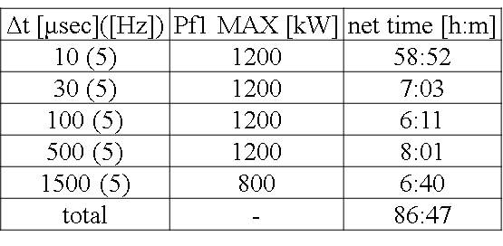
Preliminary
1650μsec/700kW (final goal)

Slide 10
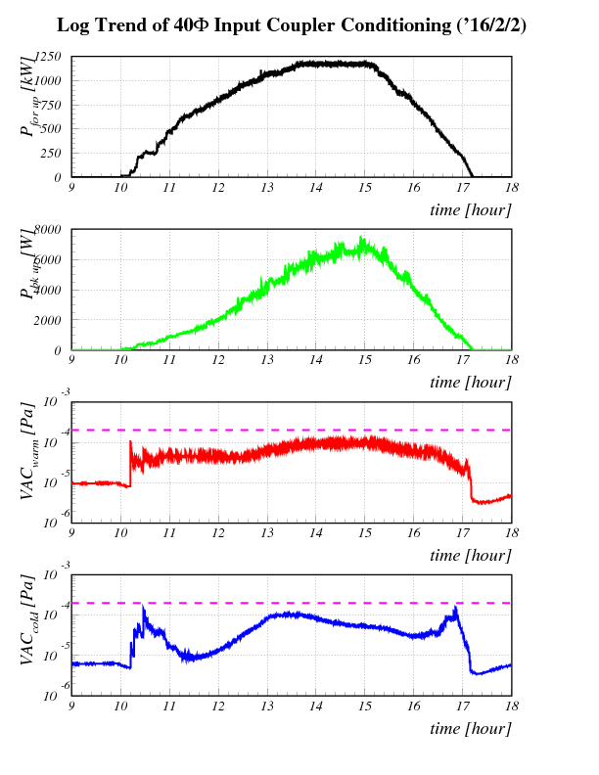
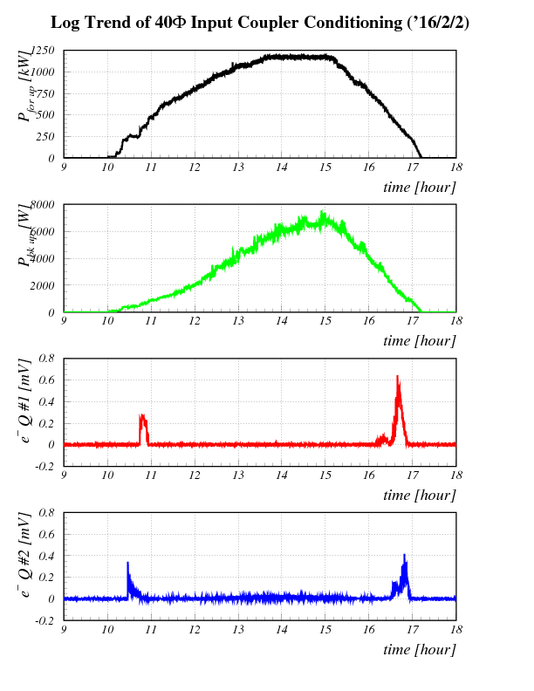
Trend Graph for Coupler Conditioning under 500μsec/5Hz
Preliminary
1200kW
1200kW
P_{forward}
P_{forward}
P_{backward}
P_{backward}
Interlock level
VAC_{warm}
Electron #1
Interlock level
VAC_{cold}
Electron #2

Slide 11
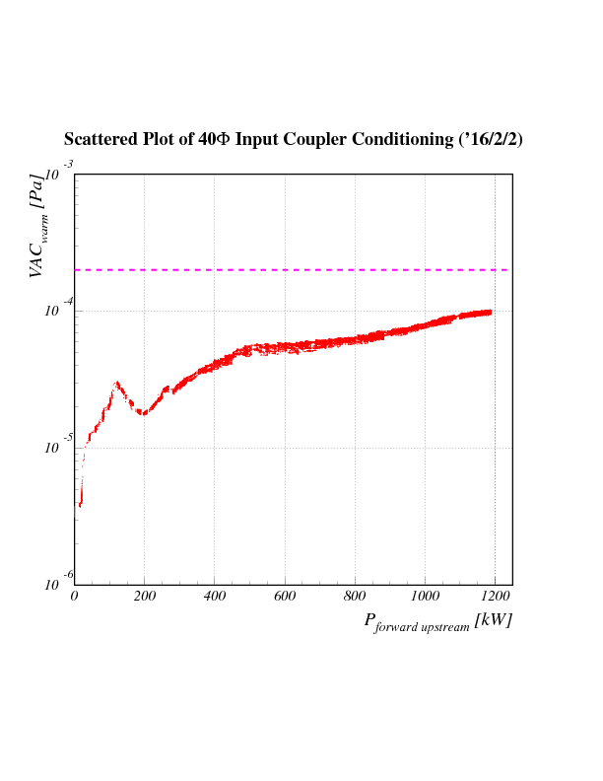
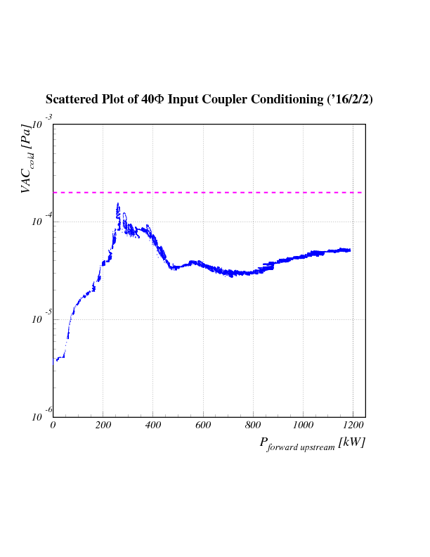
Scattered Plot for Coupler Conditioning under 500μsec/5Hz
Preliminary
Pulse width : 500[μsec]
Rep. rate : 5 [Hz]
Down data
Interlock level
Interlock level

Slide 12
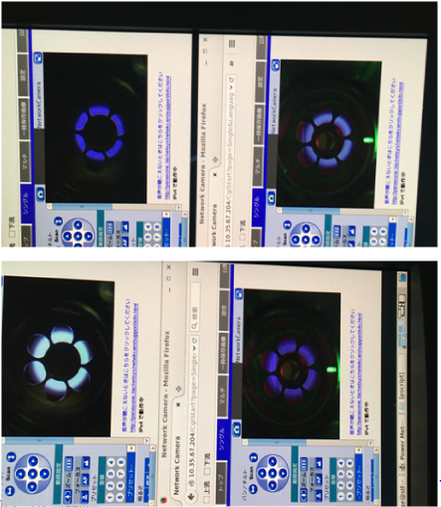
30 μsec / 5 Hz
1650 μsec / 5 Hz

Slide 13
Summary of STF-2 coupler conditioning at test bench
87:55
62:23
46:20
48:53
44:50
29:42

Slide 14
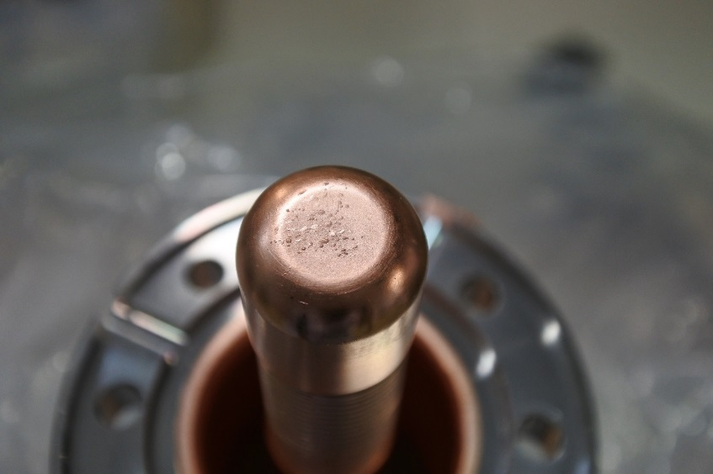
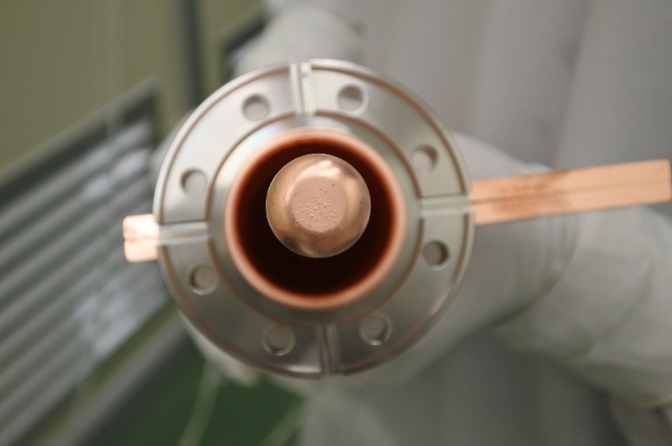
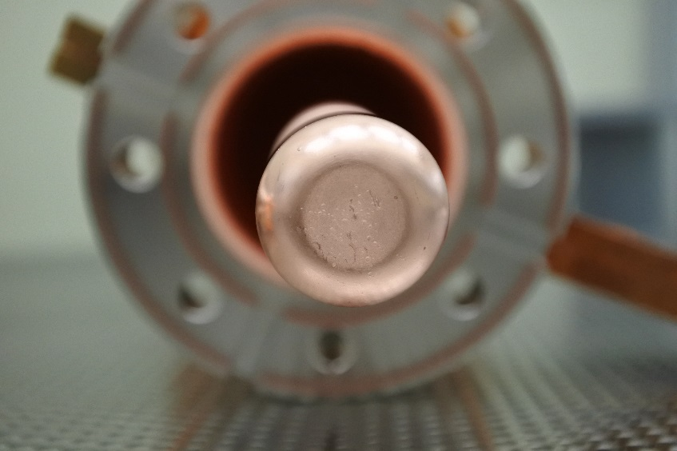
Incoming inspection
After rinsing
After RF conditioning (Today!)
These are not same photos!

Slide 15
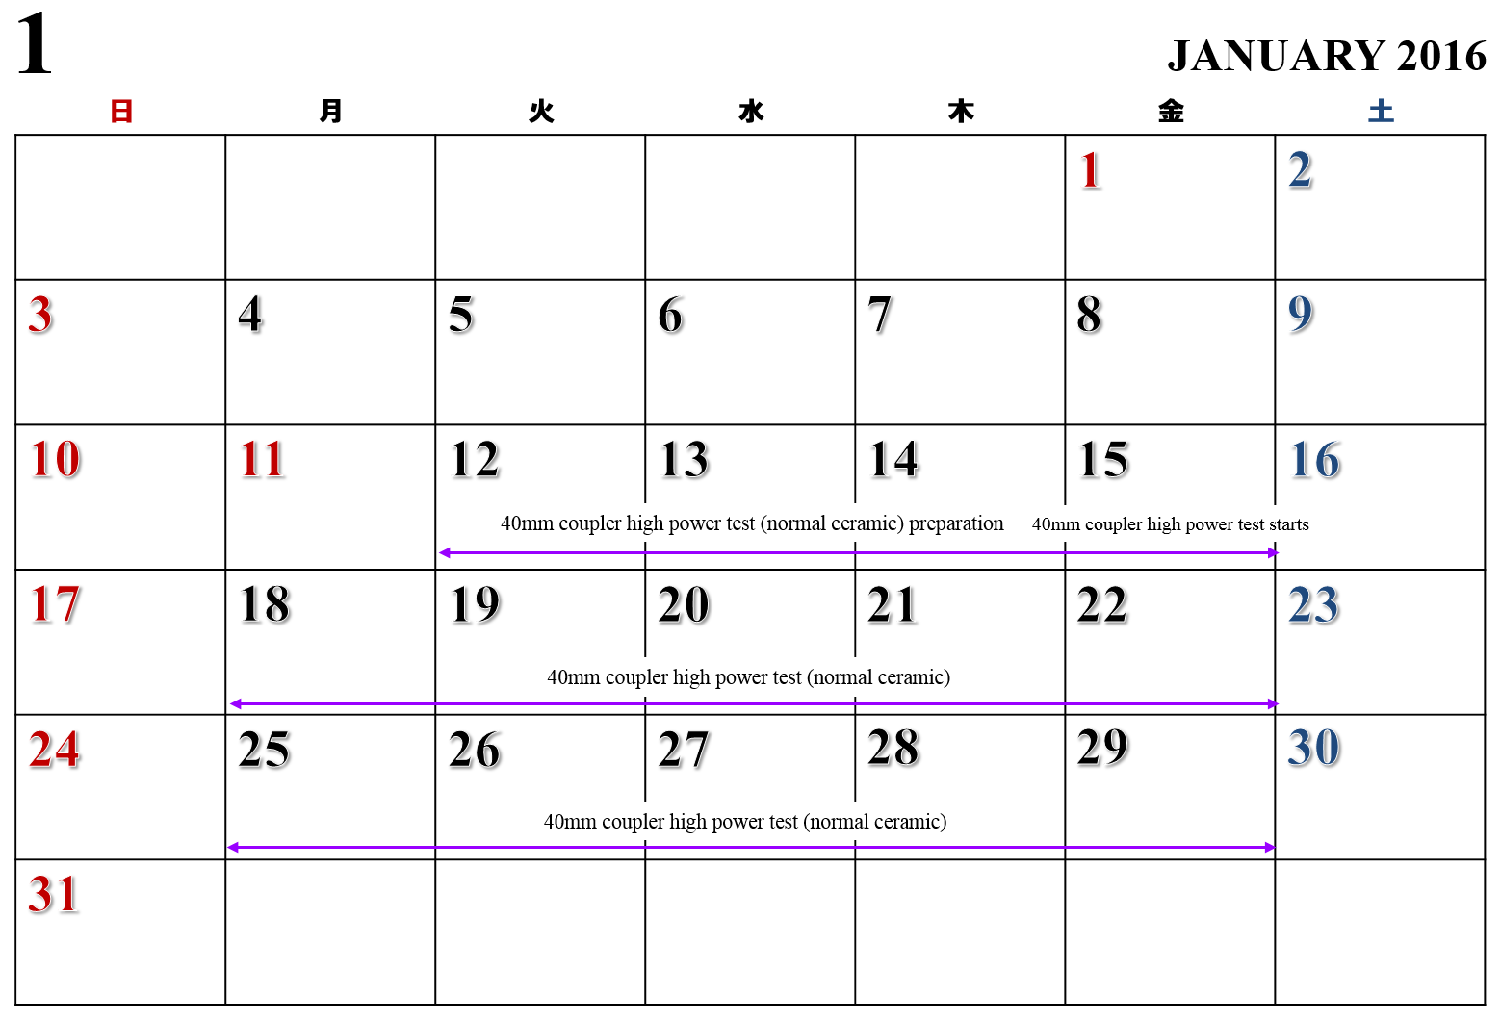

Slide 16
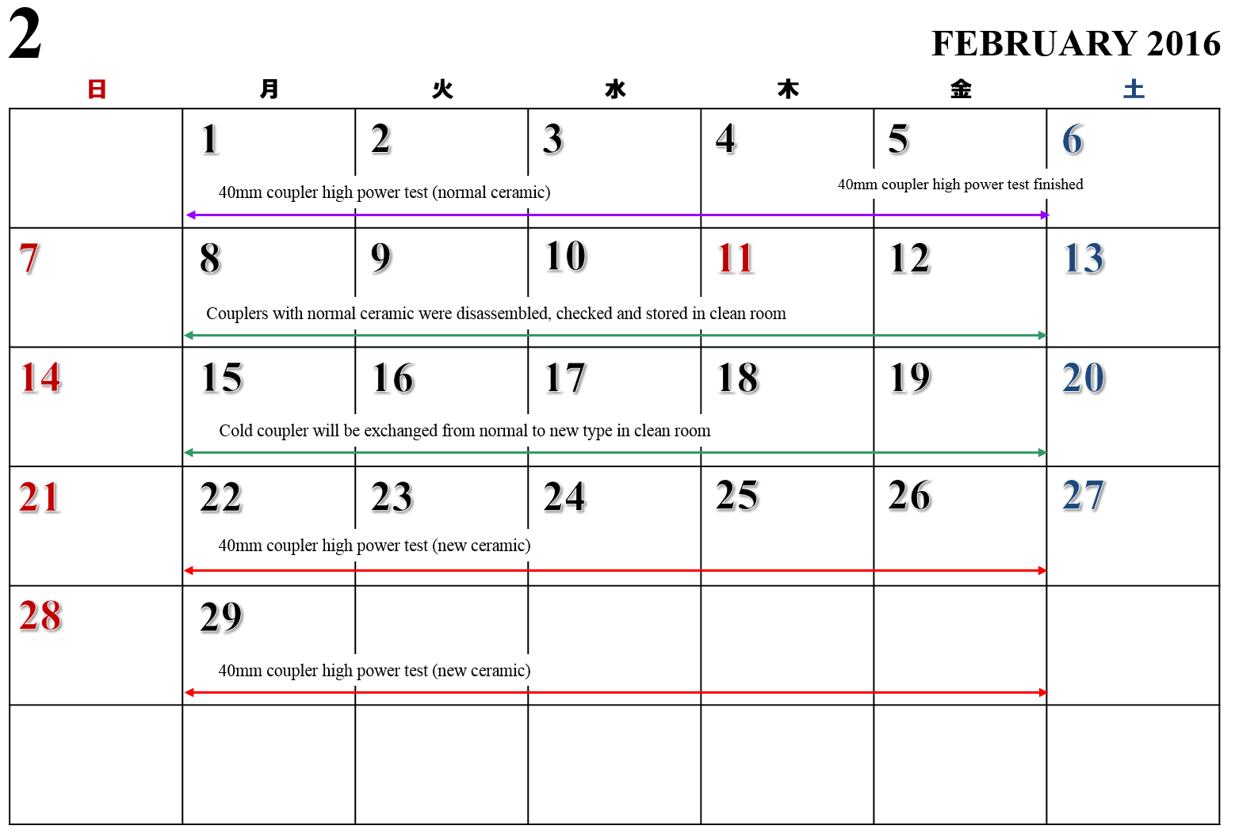

Slide 17
