Slide 1
Dark Current Studies update
(straight and curved linac without magnets)
N.Solyak. A.Sukhanov
Feb.25,2016

Slide 2
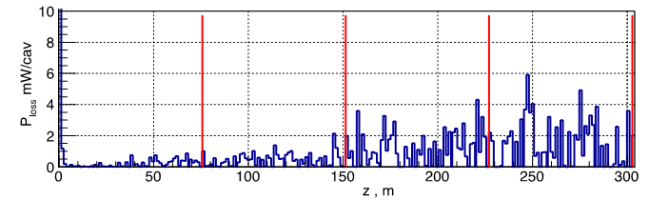
Straight section – no curvature, quads/correctors OFF
Losses of Dark current from one cavity along linac (50k particles)
Q#2
Q#4
Q#6
Q#8

Slide 3
Straight section – no curvature, quads at 0 gradient
(Spectrum and distribution of propagating dark current)
Quad 2
Quad 4
Quad 6
Quad 8

Slide 4
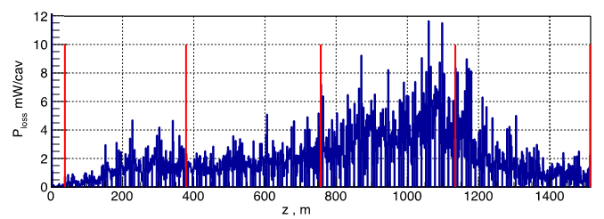
Curved section, quads/correctors at 0 gradient
Losses of Dark current from one cavity along linac (50k particles)
Quad 1
Quad 10
Quad 20
Quad 30
Quad 40

Slide 5
Curved section, quads/correctors at 0 gradient
(Spectrum and distribution of propagating dark current)
Quad 1
Quad 10
Quad 20
Quad 30
Quad 40

Slide 6
Next steps
Simulation of dark current losses in curved linac for 0 gradient in all quadrupole and :
  nominal settings of dipole correctors for perfectly aligned linac (to compensate earth curvature for the main beam)
  Settings of dipole correctors defined after steering of the curved linac for one seed of misalignments.
Define worst case scenario (highest local power losses) and run MARS to simulate radiation level in ML tunnel.

