Slide 1
SiD EMCal Progress
M. Breidenbach, D. Freytag, N. Graf, G. Haller, R. Herbst,
M. Oriunno, A. Tormada,K. Skarpaas,
SLAC National Accelerator Laboratory
J. Brau, R. Frey, C. Gallagher, D. Strom,
J. Barkeloo, A. Steinhebel (grad students),
U. Oregon, Eugene
C. Neher, M. Tripathi
UC Davis

Slide 2
Outline
Some context and history
Mechanical Progress
Beam test, simulation & major implications
Possible new sensor design
Multiplicity studies
KPiX modifications

Slide 3
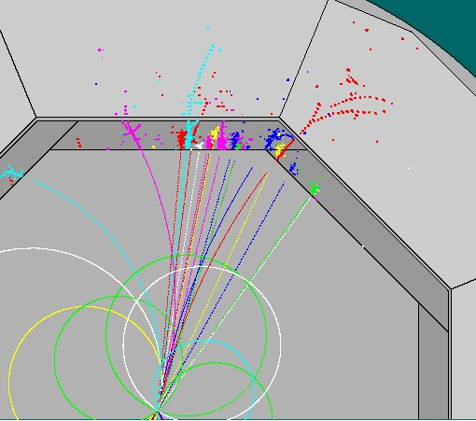
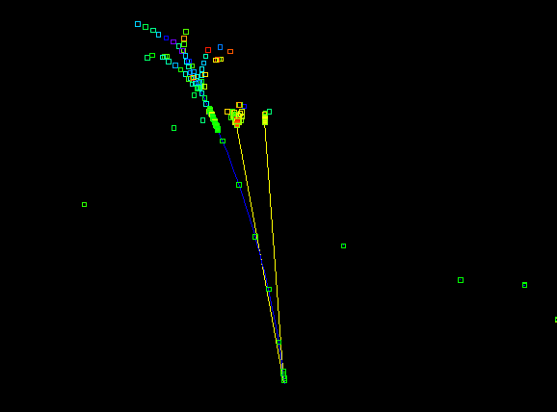
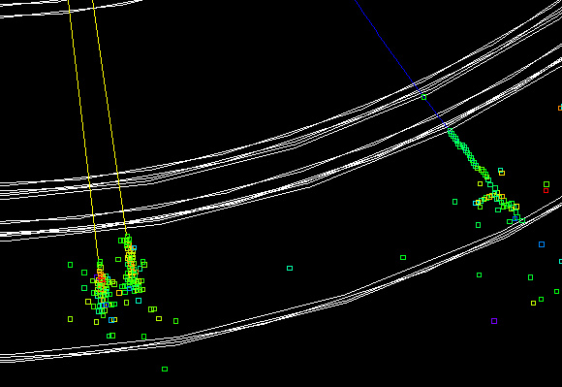
SiD “Imaging ECal”:
Motivated by ILC Physics
Guiding principles: Measure all final states and measure with precision
Multi-jet final states (t-chan, missing E, combinatorics)
  π° measurement should not limit jet resolution
  id and measure h° and h± showers
  track charged particles
Tau id and analysis
  Unique window on BSM
Photons
  Energy resolution, e.g. h→γγ
  Vertexing of photons ( σ_{b}∼1 cm ), e.g. for GMSB
Electron id
Bhabhas and Bhabha acollinearity
Hermiticity
⇒ Imaging (E)Calorimetry can do all this (“particle flow”)

Slide 4
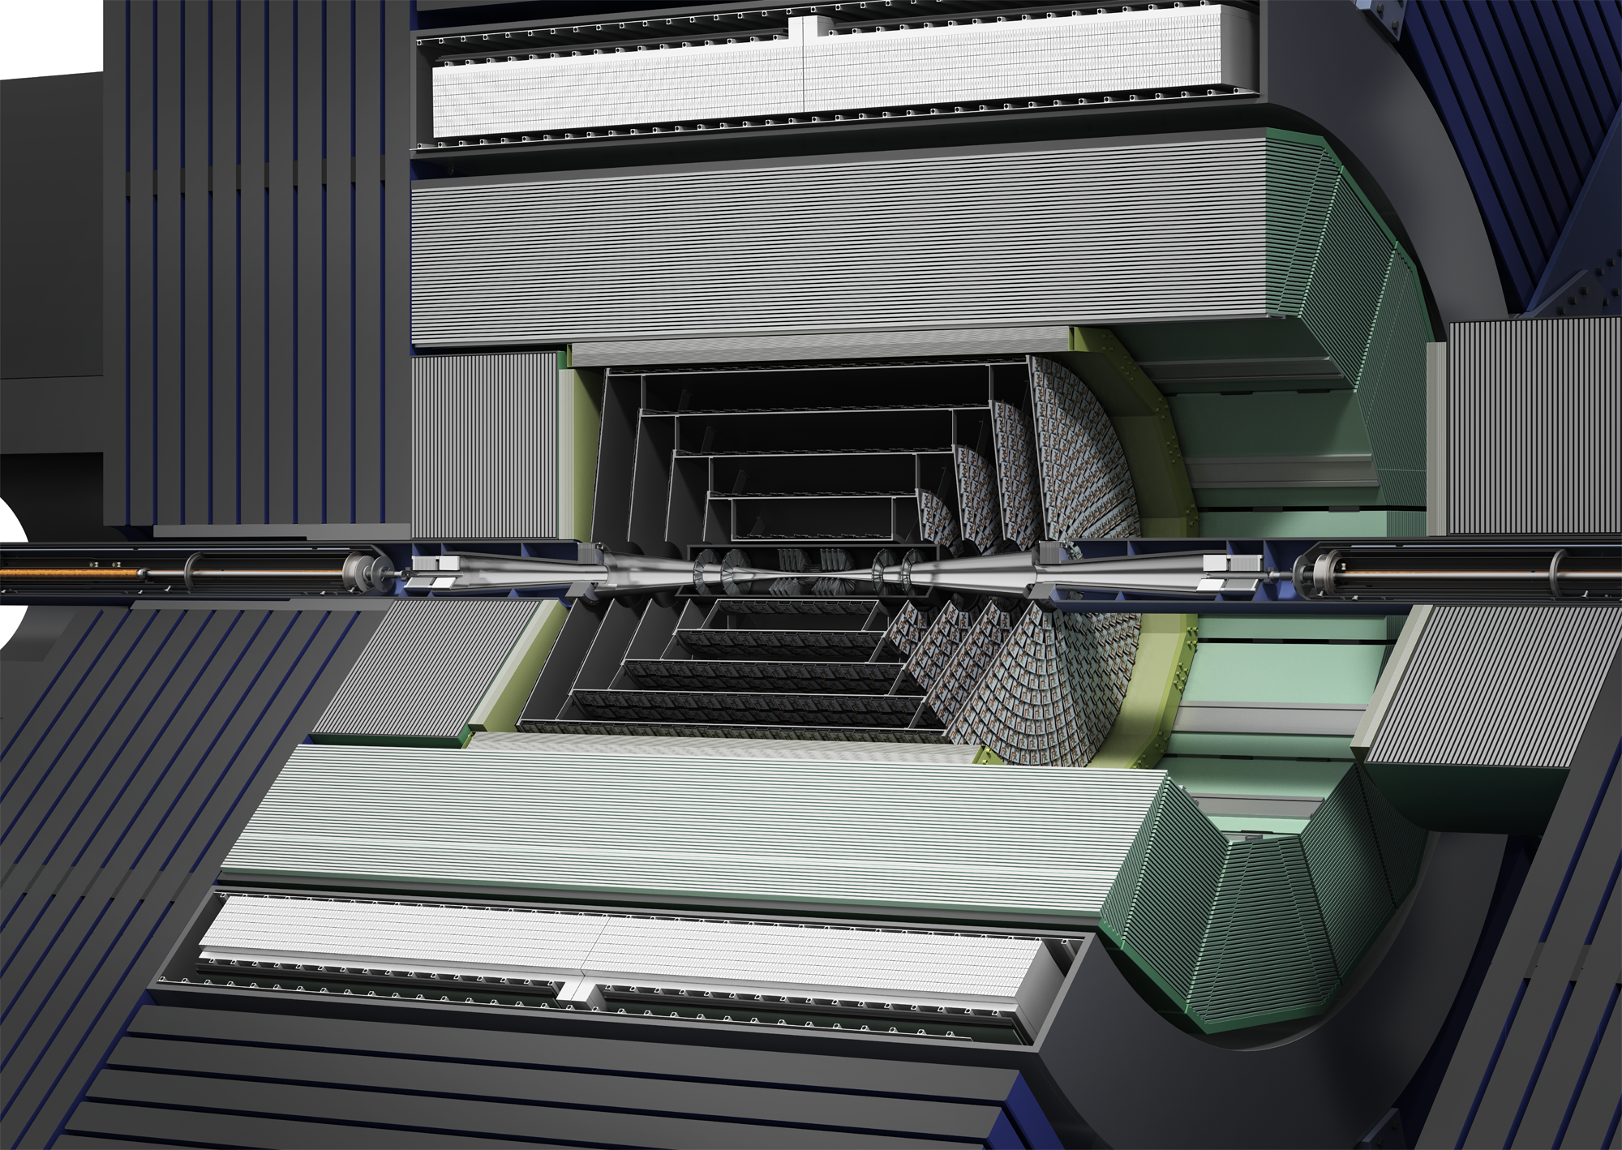
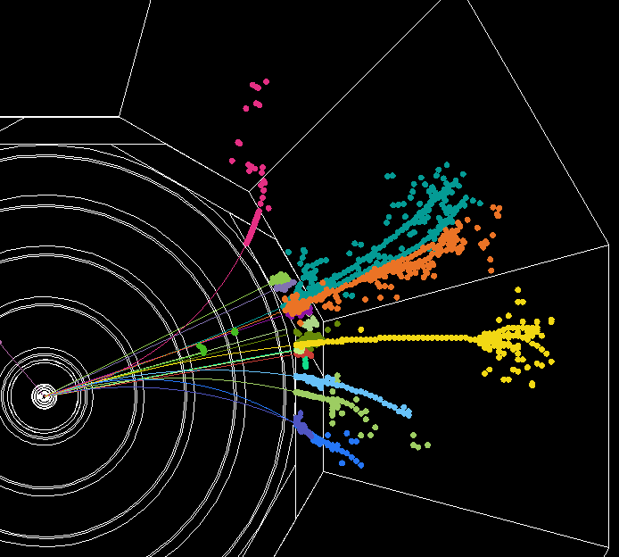
Particle Flow Calorimetry
SiD is designed for Particle Flow Calorimetry
Promises superb jet energy resolution
Tracker measures charged momentum
Calorimeters measure neutral energy after
excluding energy from charged tracks
Fine segmentation required!
Current invariant mass resolution <4%
Z’s to light quarks at ILC500.
EMCal is critical element
SiD has been developing a silicon-tungsten
calorimeter to achieve the highly granular
Ecal requirements of the PFA concept
EMCal
Tracker

Slide 5
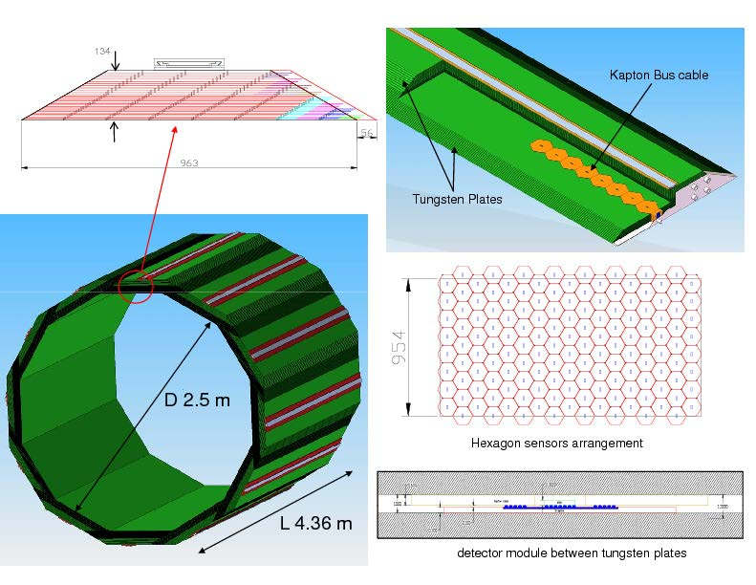
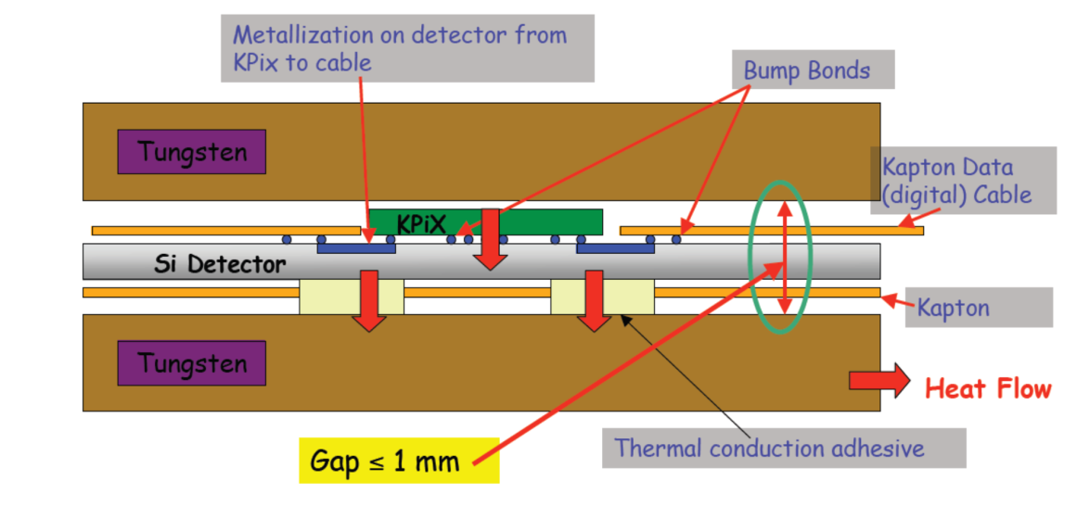
The SiD ECal Baseline
An imaging calorimeter: 30 layers tungsten interleaved with 30 layers pixellated silicon
DBD Baseline configuration:
transverse: 13 mm² pixels
longitudinal: (20 x 5/7 X₀) + (10 x 10/7 X₀) ⇒ 17%/sqrt(E)
1 mm readout gaps ⇒ 13 mm effective Moliere radius
Tungsten plates thermal bridge to edge cooling
(preconceptual design)

Slide 6
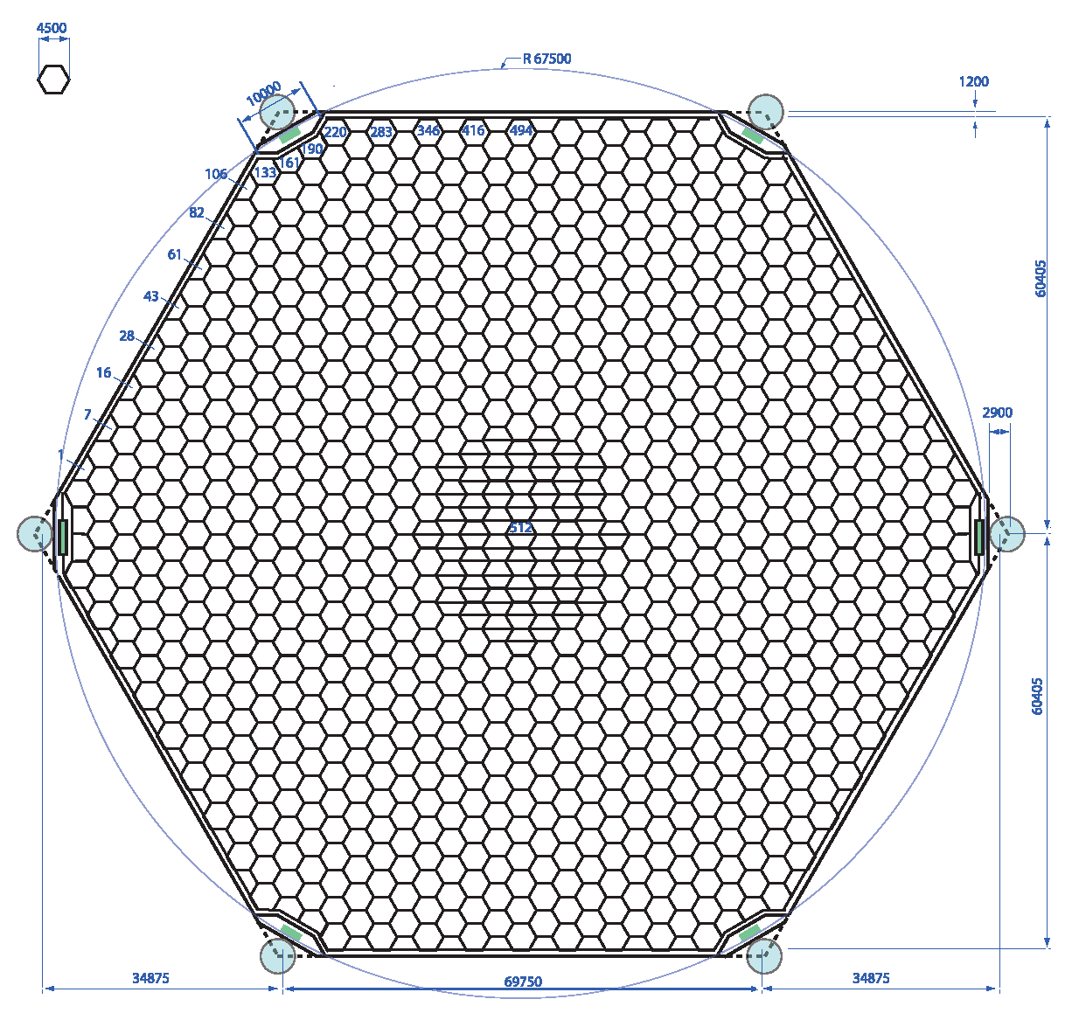
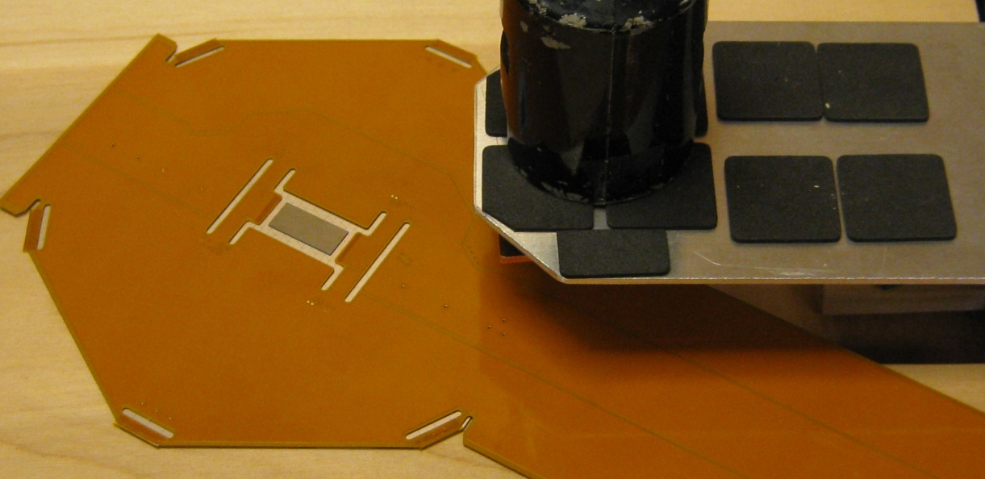
Si sensors
6 inch wafers
1024 13 mm² pixels
KPiX readout and cable are bump-bonded directly to sensor
KPiX ASIC & sample trace

Slide 7
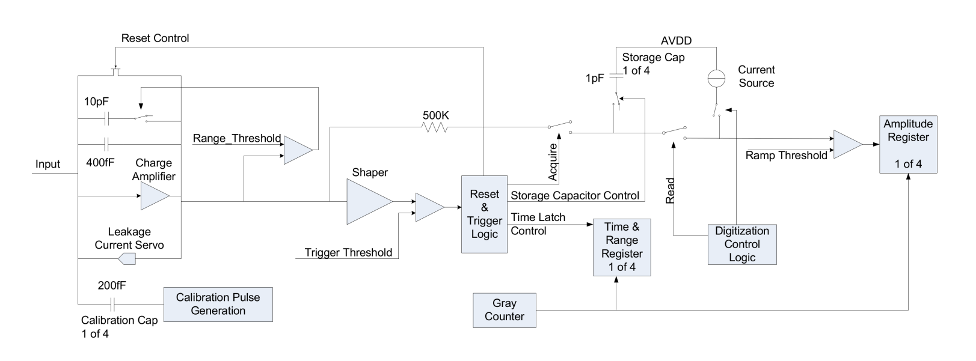
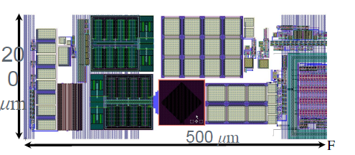
KPiX – System on a Chip
KPiX is a 1024 channel ASIC to bump bond to Si detectors, optimized for the ILC (1 ms trains, 5 Hz rate):
  Low noise dual range charge amplifier w/ 17 bit dynamic range.
  Power modulation w/ average power <20 μW/channel (ILC mode).
  Up to 4 measurements during ILC train; each measurement is amplitude and bunch number.
  Digitization and readout during the inter-train period.
  Internal calibration system
  Noise Floor: 0.15 fC (1000 e⁻ )
  Peak signal (Auto-ranging) 10 pC
  Trigger Threshold Selectable (0.1 – 10 fC)
One pixel,
200 x 500 μm²

Slide 8
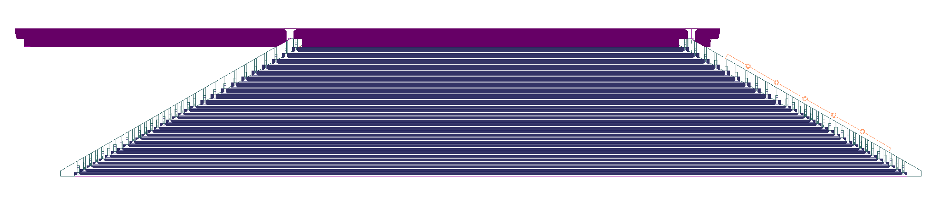
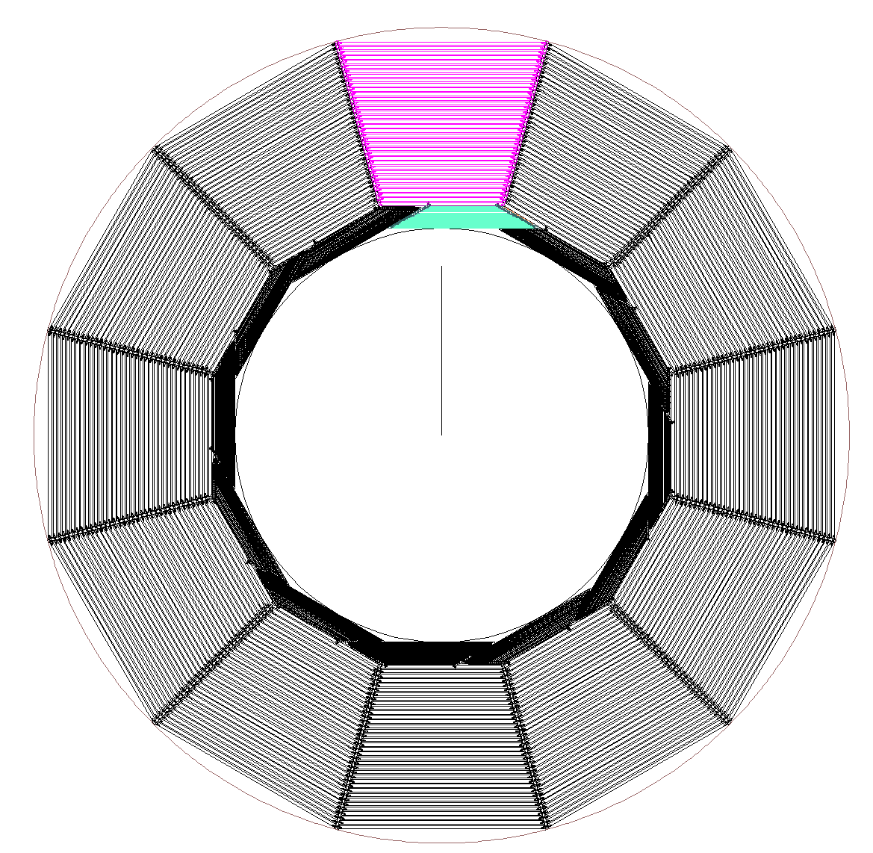
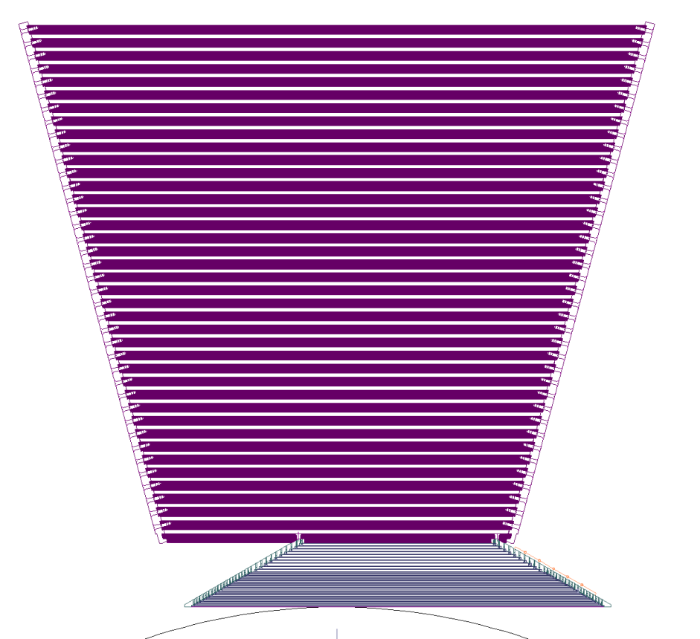
Mechanical Progress
ECAL module is built on first layer of HCal
HCAL module supports ECAL module
Note module overlap: No gaps; service cables at ends.

Slide 9
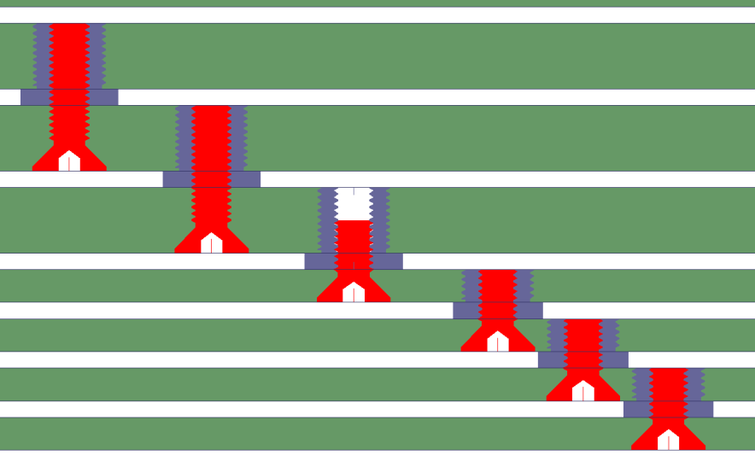
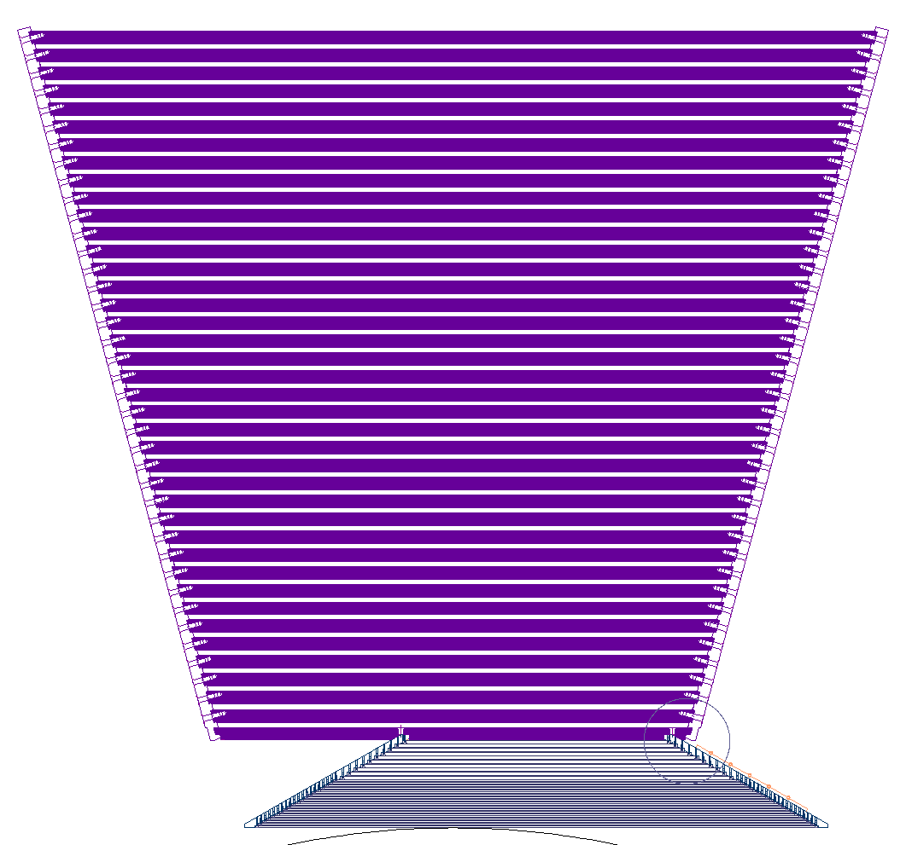
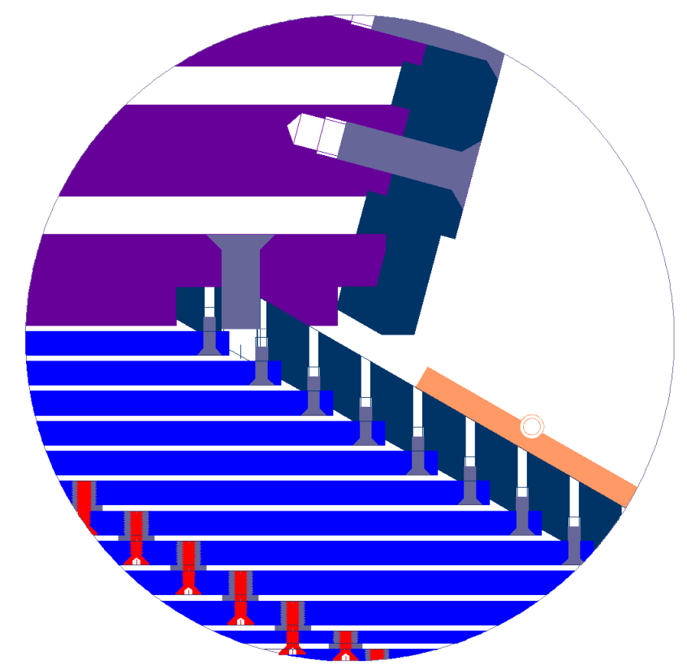
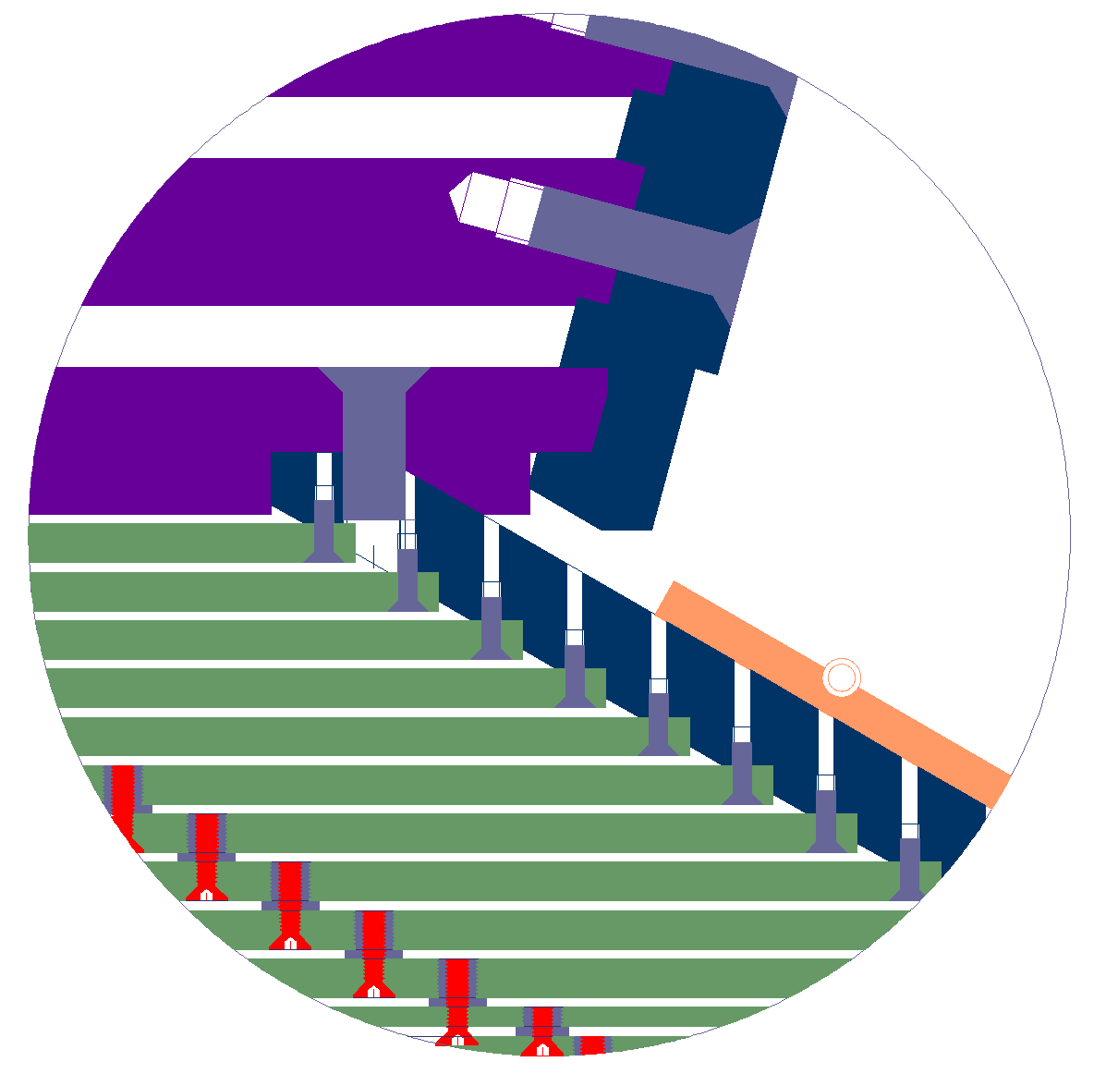
HCal plates supported by interlaced grooved straps
EmCal plates screwed to support plates tied to inner Hcal plate. Inner Hcal plate “belongs” to EMCal module.
Tungsten plates tied to each other with plausible screws and spacers

Slide 10
50 GeV – 1000 events
SiW Calorimeter Simulations
Studies by
Jason Barkeloo
& Amanda Steinhebel
building on earlier work of
Dylan Mead, Bill McCann,
Kyle Travis & Teddy Hay

Slide 11
500 GeV energy sum for central pixels vs. pixel radius
Approx.
SiD

Slide 12
Energy sum for central pixels vs. pixel radius (E=10, 50, 75, 100, 250, 500 GeV)
Approx.
SiD

Slide 13
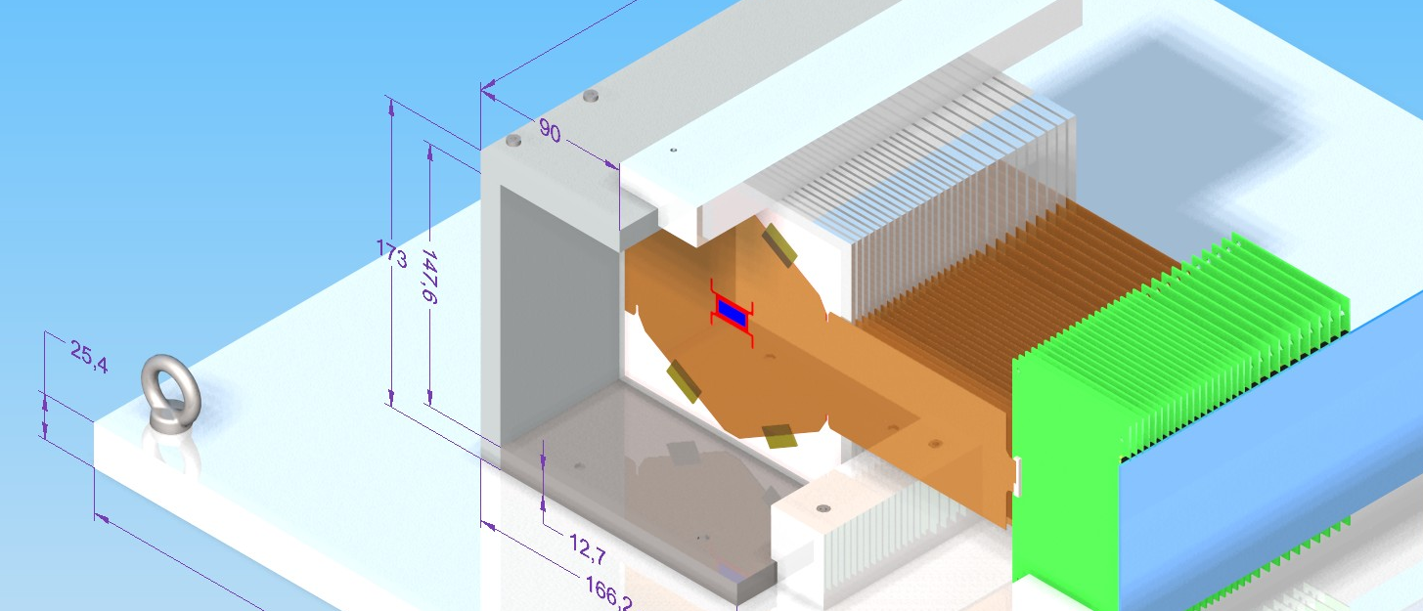
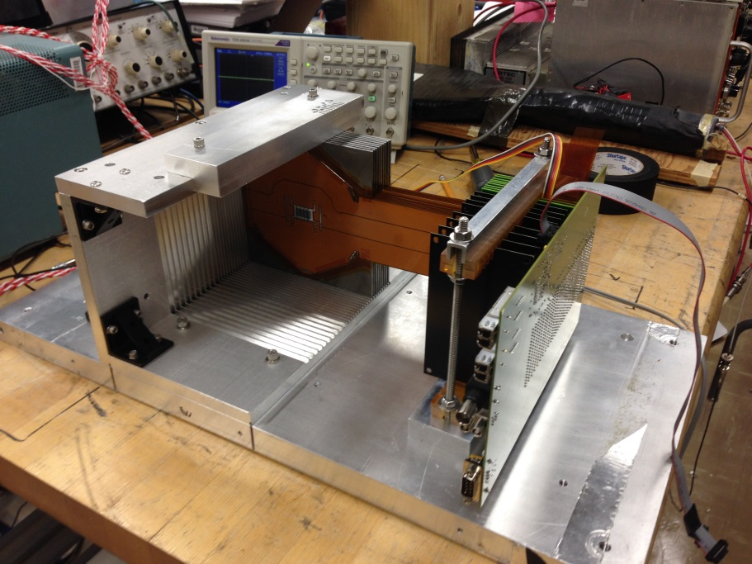
Initial test beam module for T-511 only 9 Si + 8 W layers (~ 6 X₀)
FUTURE
NOW
First system test EMCal sensors in SLAC End Station A beam at 12.1 GeV
Utilized (finally!) successfully bump bonded KPiX to sensor and sensor to cable.
Uncovered issues related to many pixels triggered simultaneously. One part of solution may be on sensor:

Slide 14
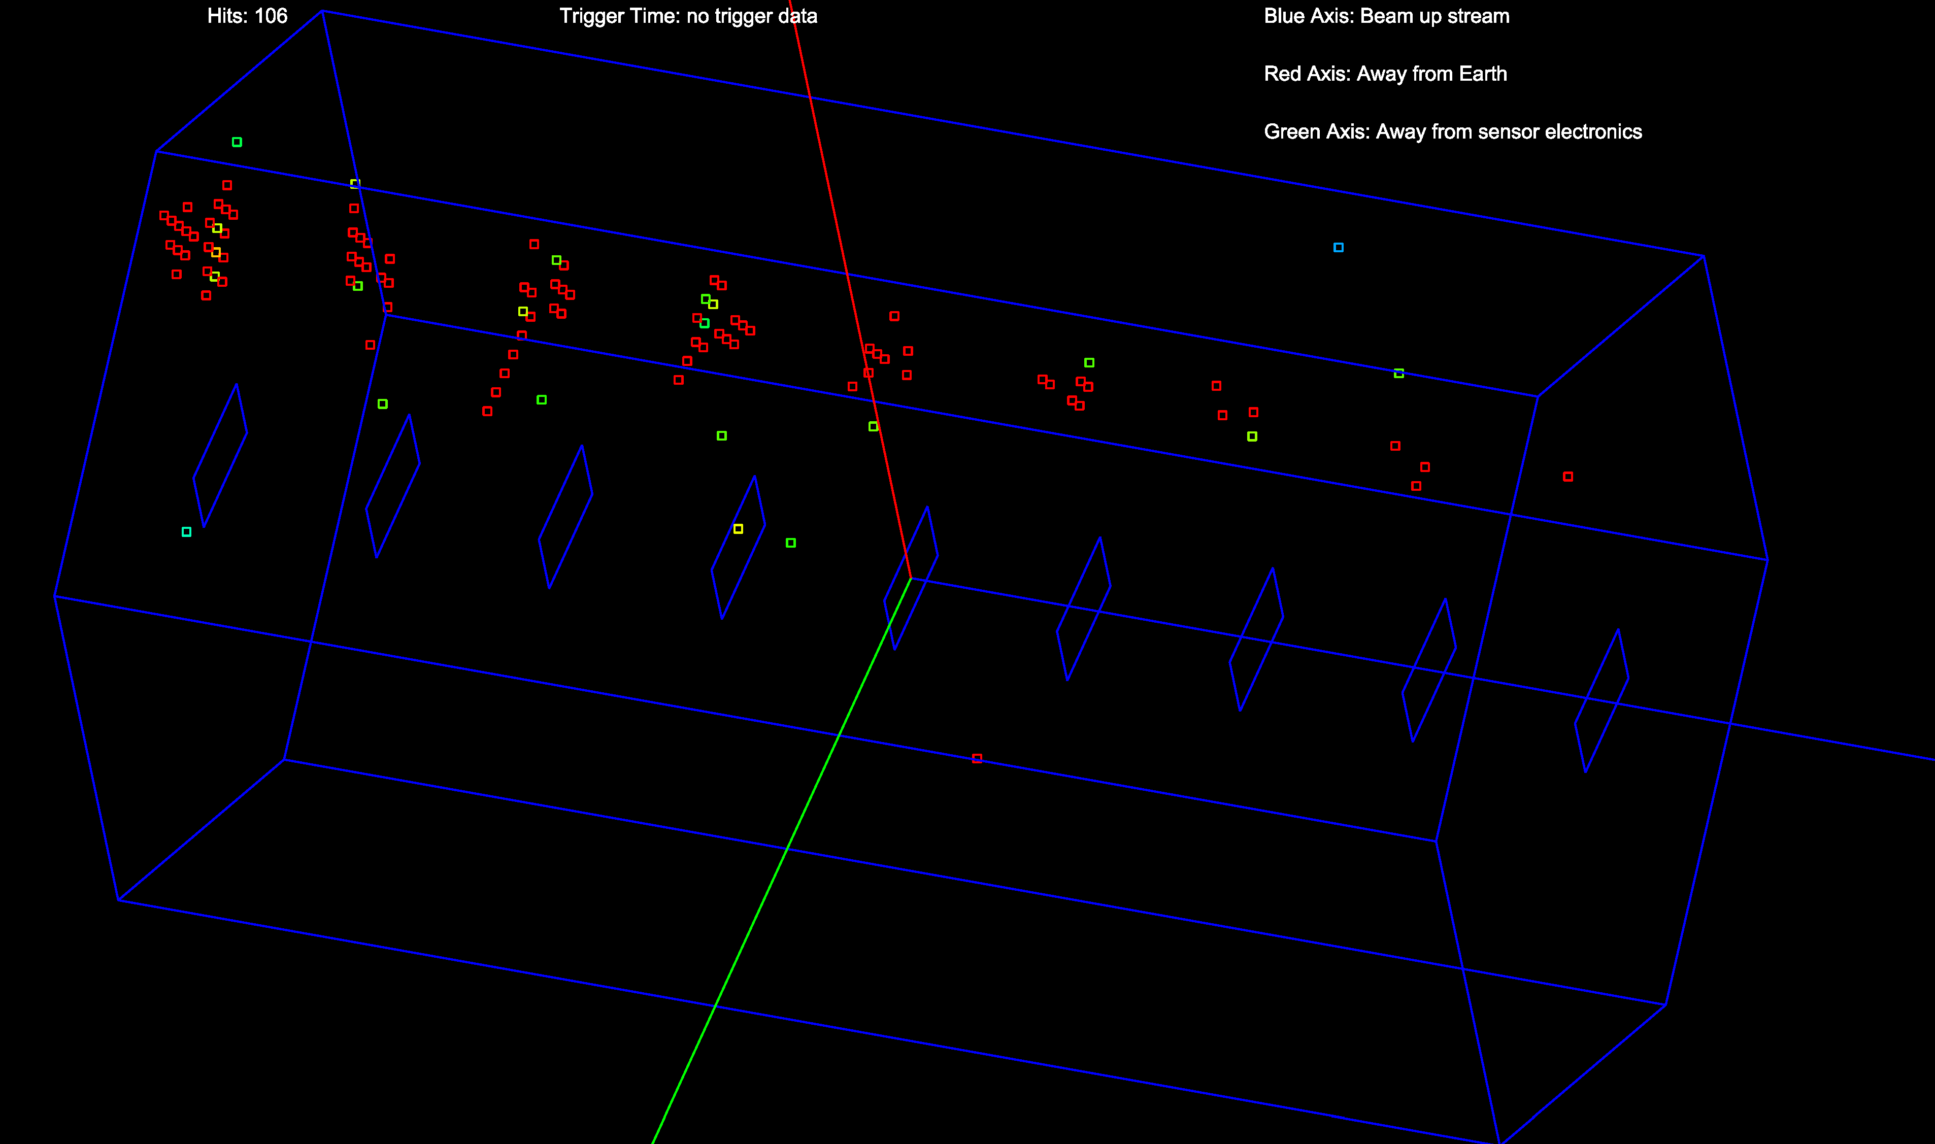
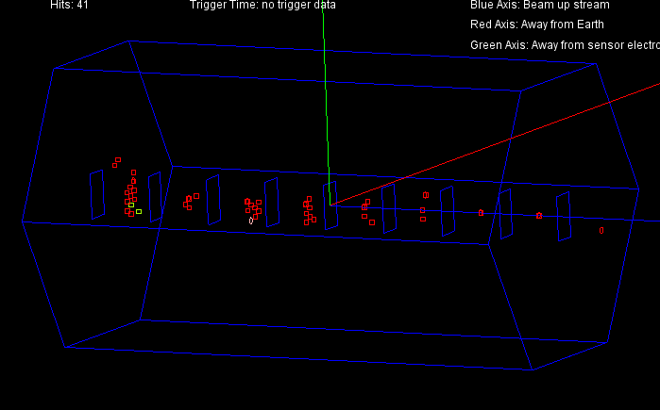
Single-electron showers

Slide 15
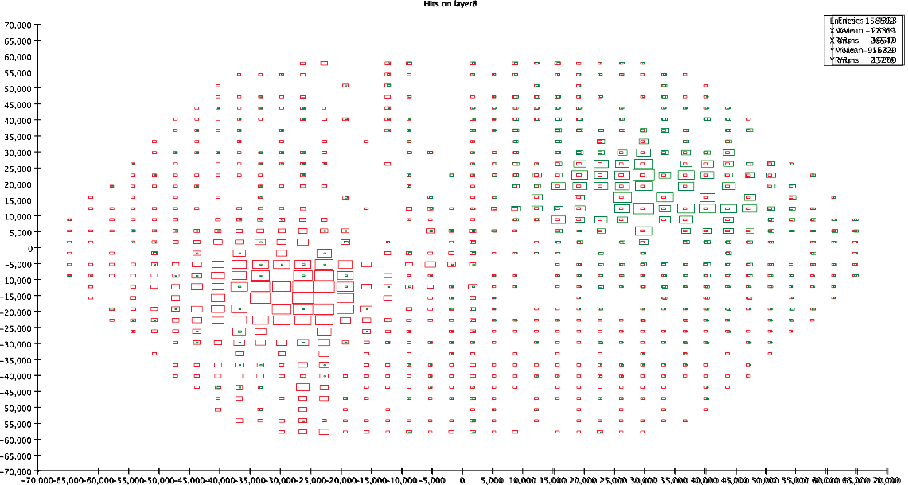
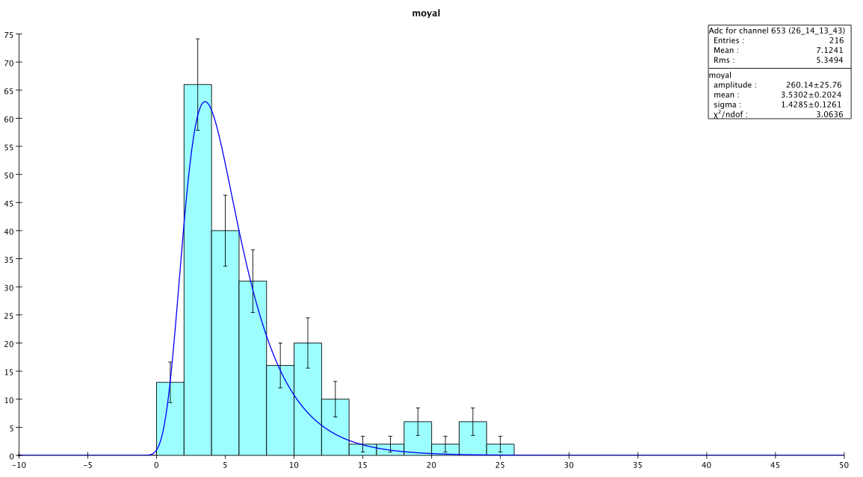
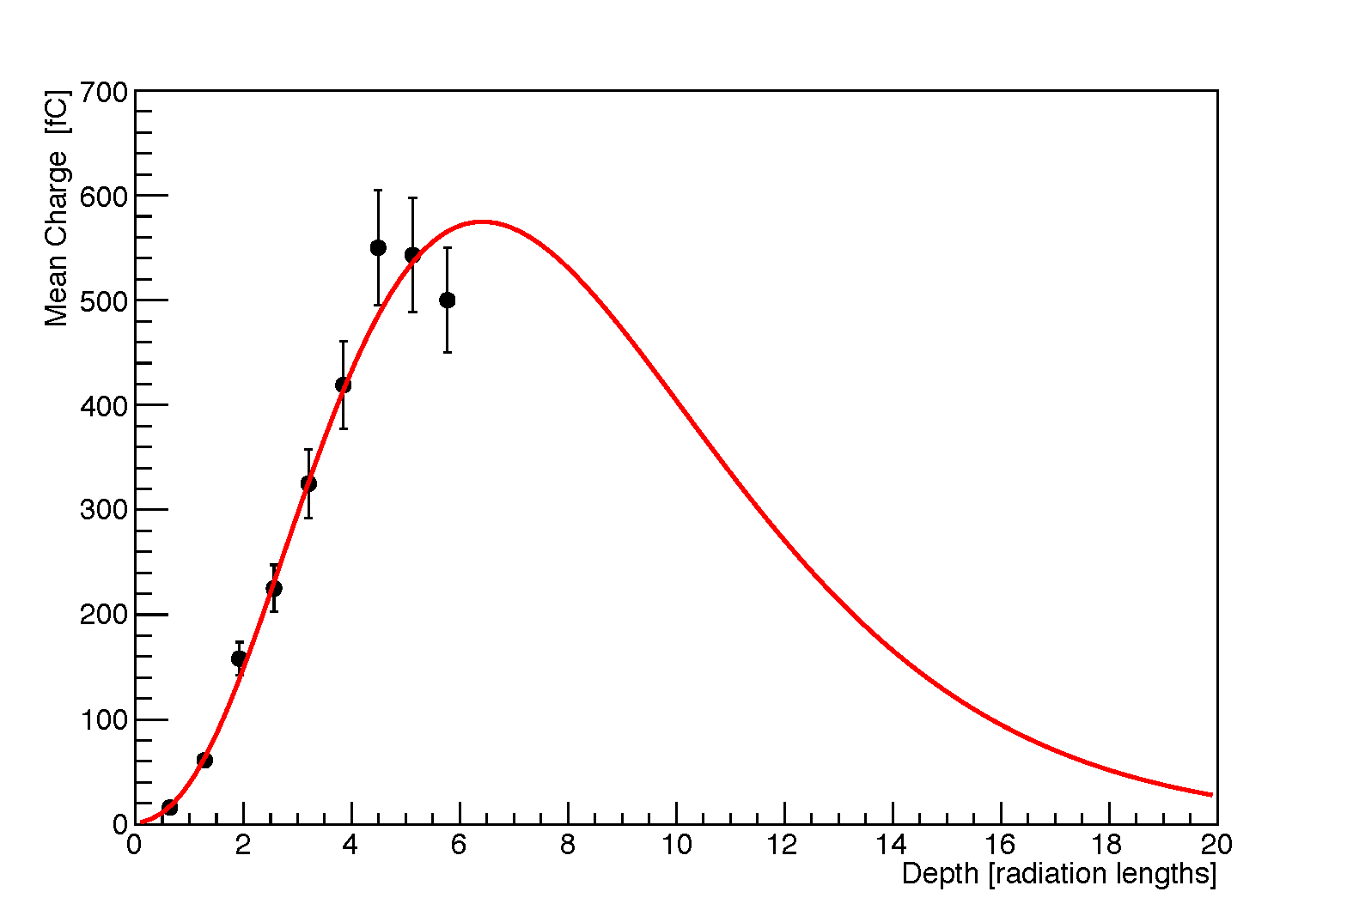
Test beam results
Upstream layer
Two overlaid runs
Upstream layer
- MIPs
beam size
profile
in depth

Slide 16
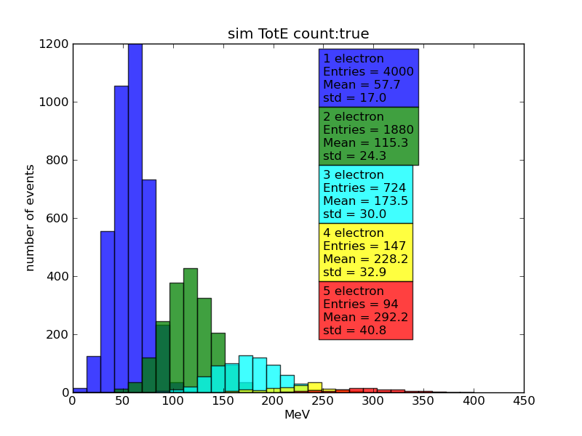
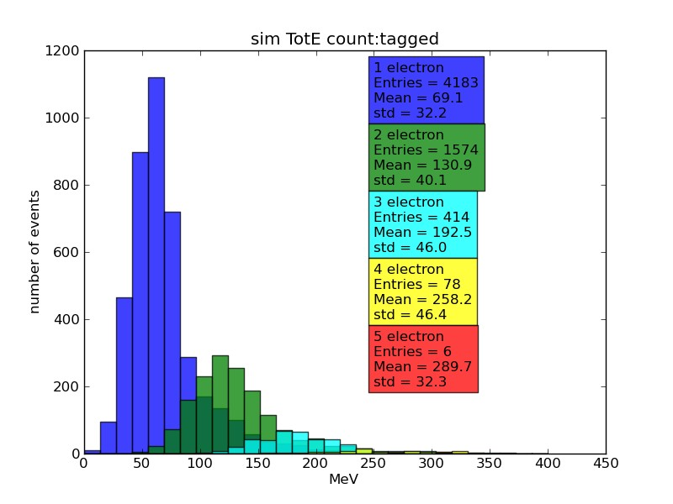
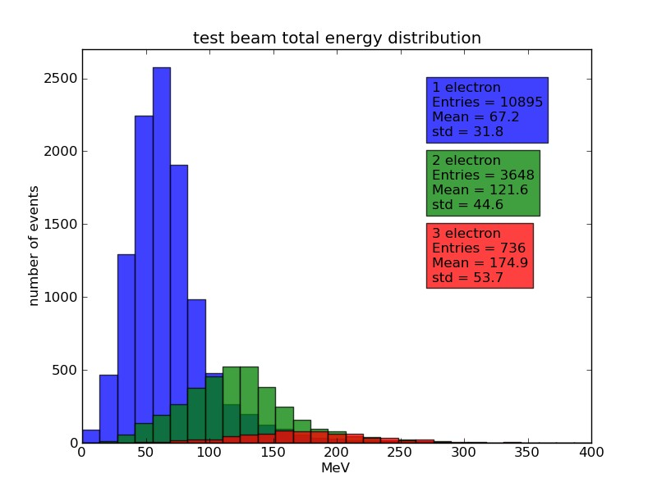
Counting test beam electrons simulation
Sim
Truth
Sim
Tagged
Beam
Test
Tagged

Slide 17
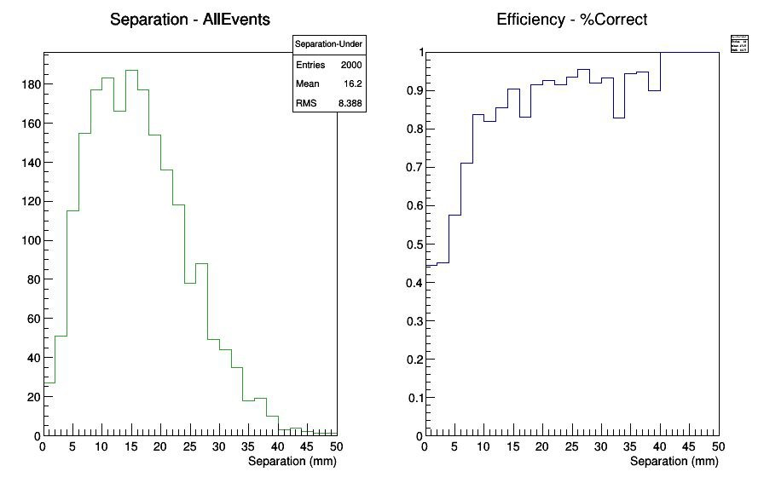
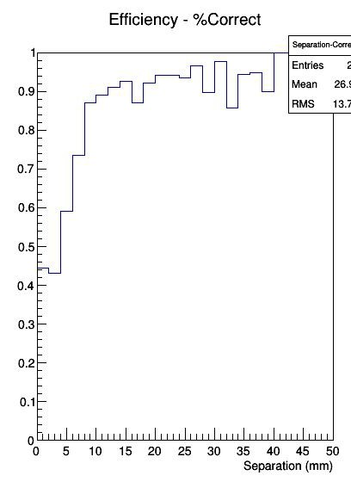
Correct counting efficiency
Two electron events

Slide 18
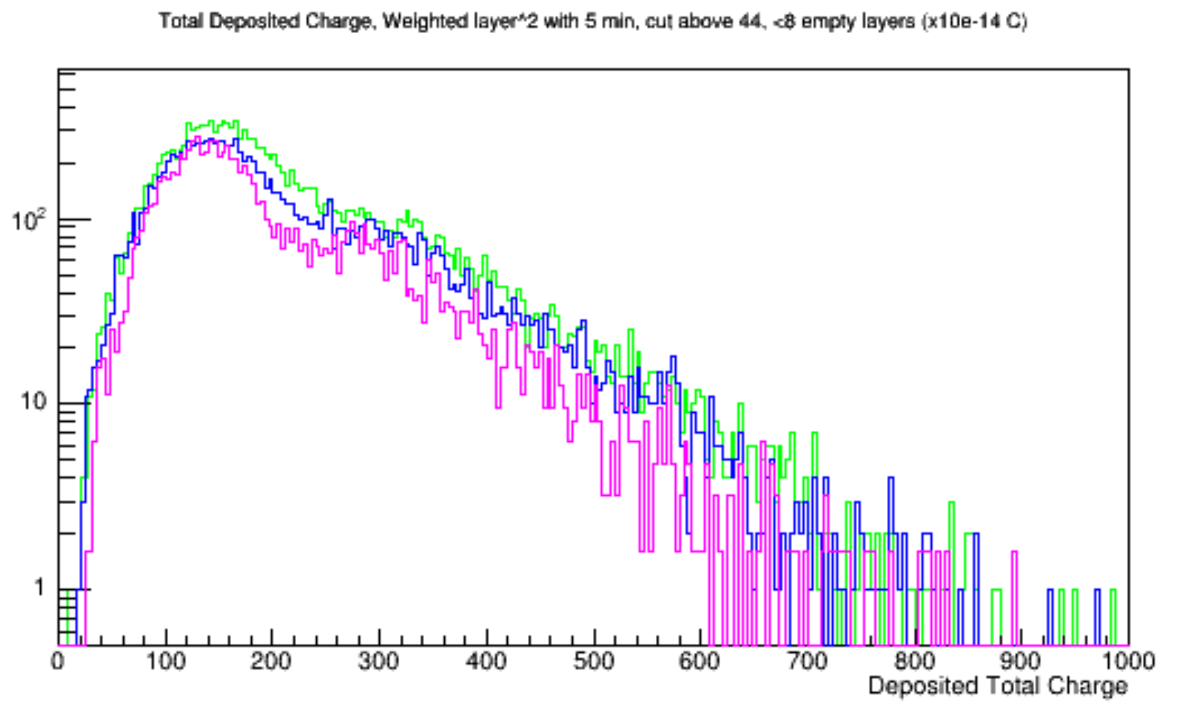
Simulation vs. data
PRELIMINARY
TOTAL SIGNAL (6X₀)
Run 43
Run 28
Simulation

Slide 19
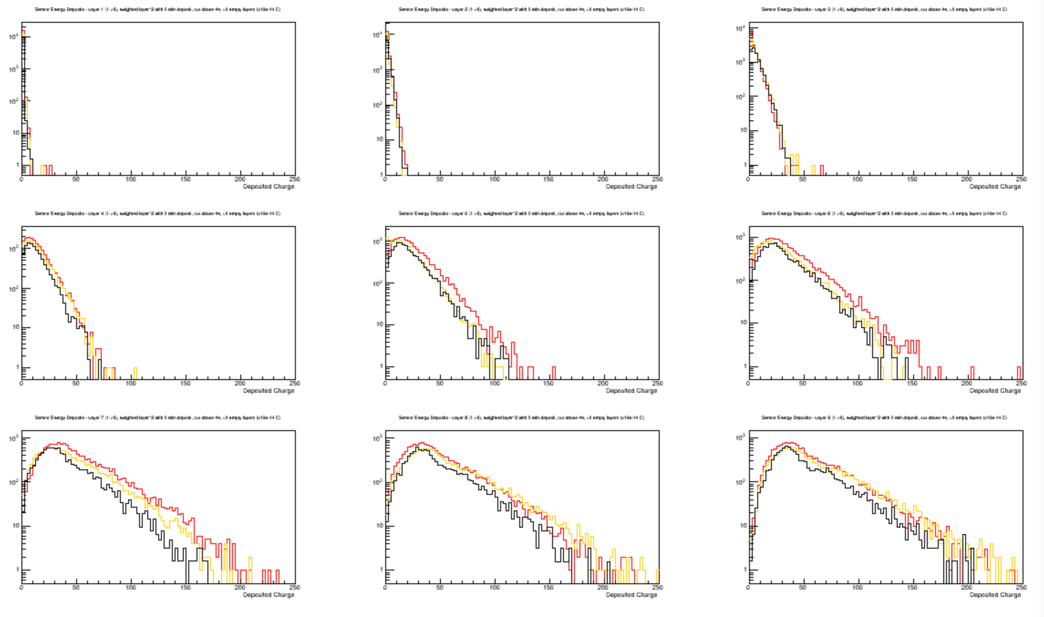
Simulation vs. data (by layer)
PRELIMINARY
SIGNAL/LAYER (5/7 X₀)
Run 43
Run 28
Simulation

Slide 20
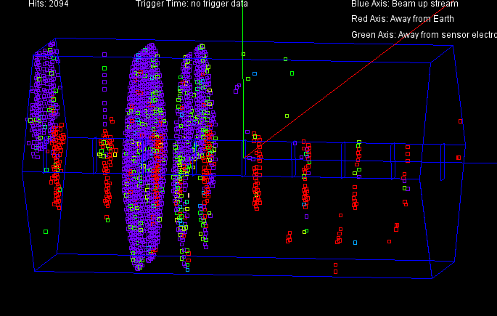
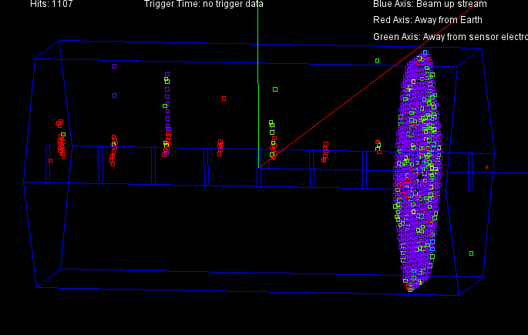
Occasional “monster events” with many negative amplitude and out of time hits

Slide 21
Major Lessons (so far)
Bump bonding to sensors with Al pads can be very difficult…
  Consider sensor foundry build final pad stack.
  Don’t dice the sensors until bonding issues are fully controlled.
EMCal can have huge number of pixels hit simultaneously, causing synchronous disturbances as pixels reset…Problem understood, small changes in KPiX design.
Sensors with ROC’s can have issues with parasitic couplings…
Notes:
Move after EMCal

Slide 22
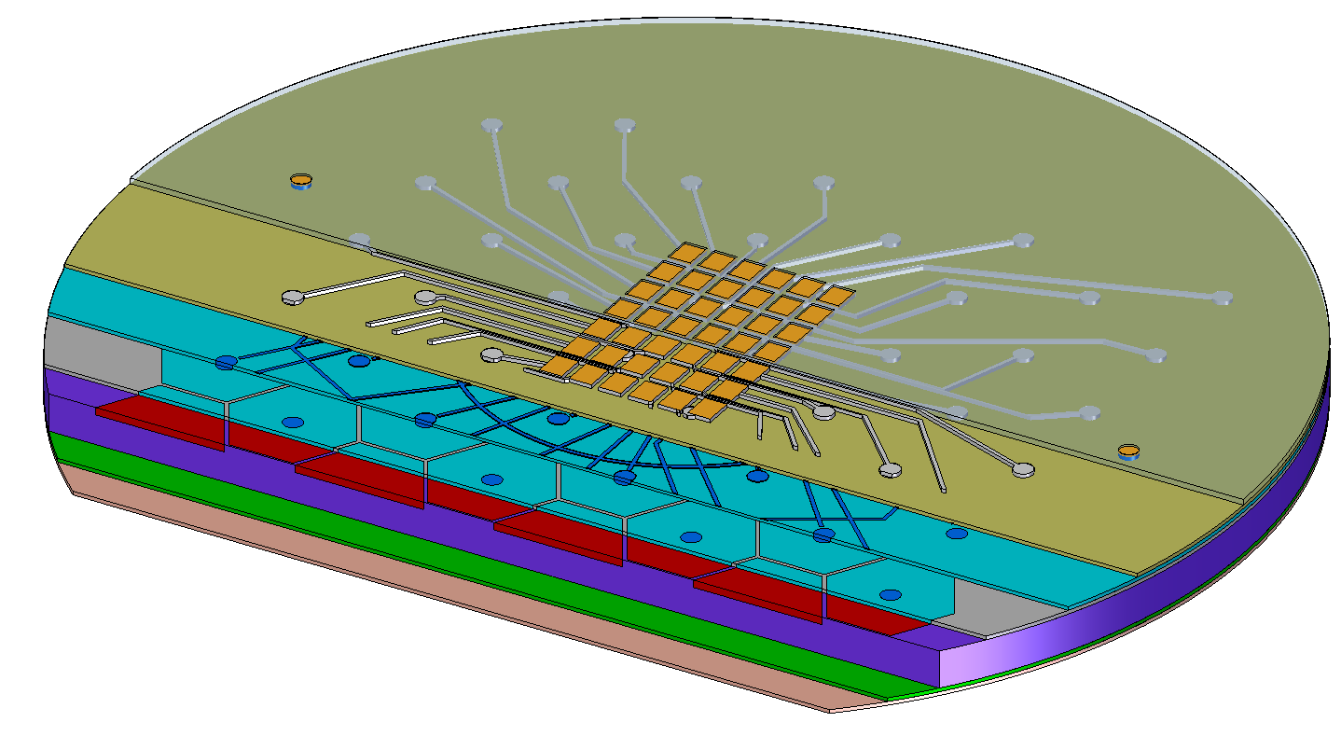
Sensor Traces
In present design, metal 2 traces from pixels to pad array run over other pixels: parasitic capacitances cause crosstalk.
New scheme has “same” metal 2 traces, but a fixed potential metal 1 trace shields the signal traces from the pixels.

Slide 23
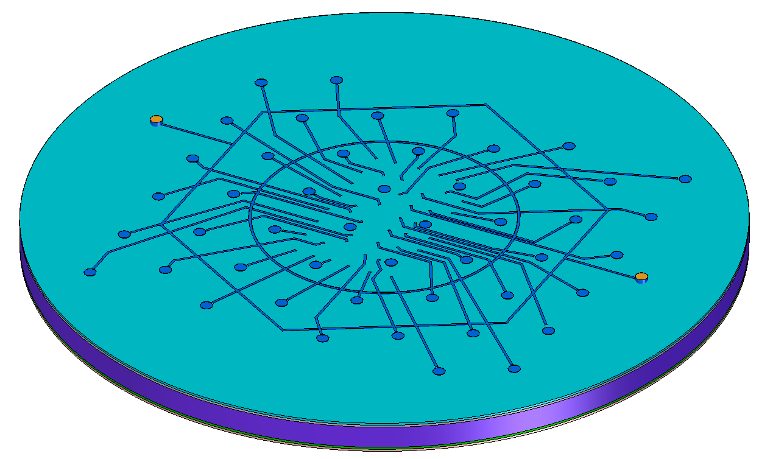

Metal 1
All shield traces are tied together, and brought to a metal 2 pad.
Shield trace running under Metal 2 signal trace.
connection of implant to metal 2 trace to pad.
To be tested in next sensor prototype.

Slide 24
New Hamamatsu Sensors
The original Hamamatsu sensors have Aluminum pads, which are extremely difficult (and expensive) to bump bond. Hamamatsu agreed to provide suitable Under Bump Metallization in the future.
We have received a new set of sensors with gold pads and the new shield structure.
Now beginning to test the new sensors.

Slide 25
Multiplicity
There have been indications that forward multiplicity might be more than 4 buffer KPiX could handle.
  Long known that BeamCal required BEAN chip, which digitizes every pulse.
Recent optimization studies indicate that 6 buffers will be adequate, taking into account all known processes.
Barrel
Endcap
Lumical

Slide 26
Multiplicity
Bhabhas must be added
Lumical must be studied to see if high multiplicity is only first layers, which might not need to be instrumented.
Study KPiX to see if more buffers might be added, preserving architecture.
Study somewhat different architecture – preconceptual ideas only…

Slide 27
Monolithic Active Pixels
An alternative sensor structure will be studied for the SiD EMCal with the sensor built from HV-CMOS, which would completely eliminate the bump bonding problem.
A pre-conceptual design has been developed. This approach would also be useful for the SiD tracker.
This approach would solve the multiplicity concern about KPiX by having more buffers, and eliminate the range switching by using smaller pixels than possible with KPiX.

Slide 28
Summary
There is progress towards a mechanical conceptual design of the EMCal!
The beam test demonstrated expected behavior of the prototype but showed different crosstalk issues in the sensor and KPiX.
There is a shielding concept for the next sensor now being tested.
Achieving bump bondable pads on the sensors is extremely difficult. The foundry must provide Au pads.
Monolithic Active Pixels are being studied for both the EMCal and the Tracker.

Slide 29
SiD EMCal
EXTRAS

Slide 30
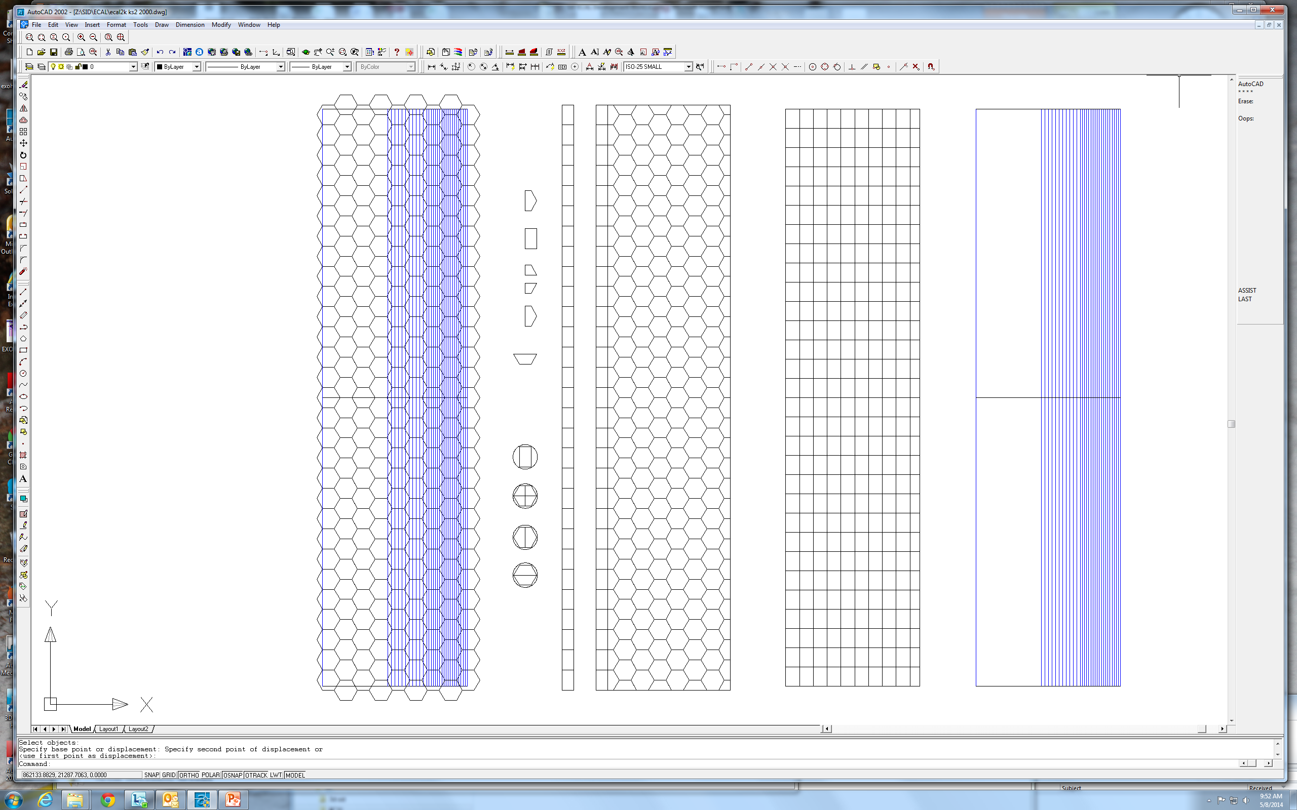
Tiling Issues
Next iteration:
Efficient tiling is possible with two different sized rectangles.
Penalty is ~30% more wafers.
Range of widths of plates makes tiling challenging!
Pre-conceptual design:
Worry about tiling later!
(Hexagons make efficient use of the wafer though…)
Top view of stack of W plates
Left edge aligned.

Slide 31
Tiling Issues
Beginning study of hybrid tiling:
Hexagons for the field, with standard elements to fill the hexagon tiling to a large rectangle.
These elements efficiently fill a wafer.
Then fill to layer edge with rectangles.

Slide 32
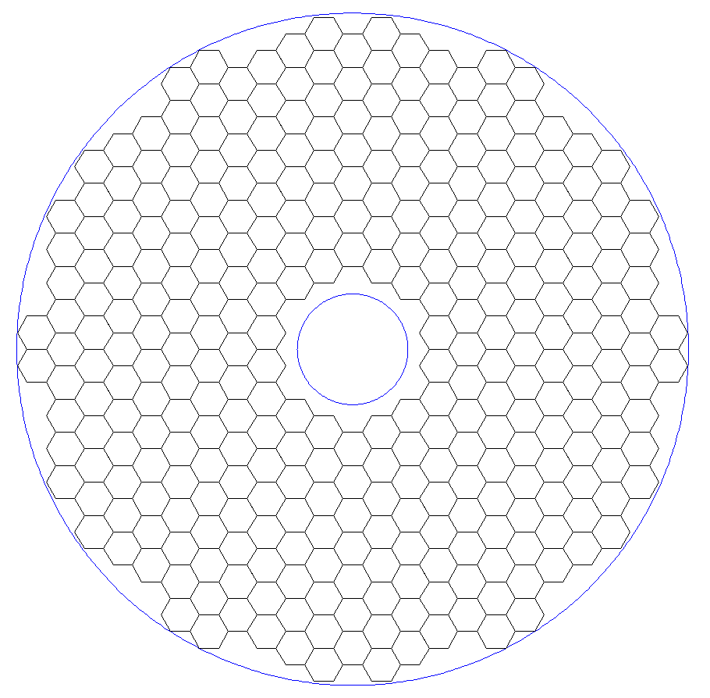
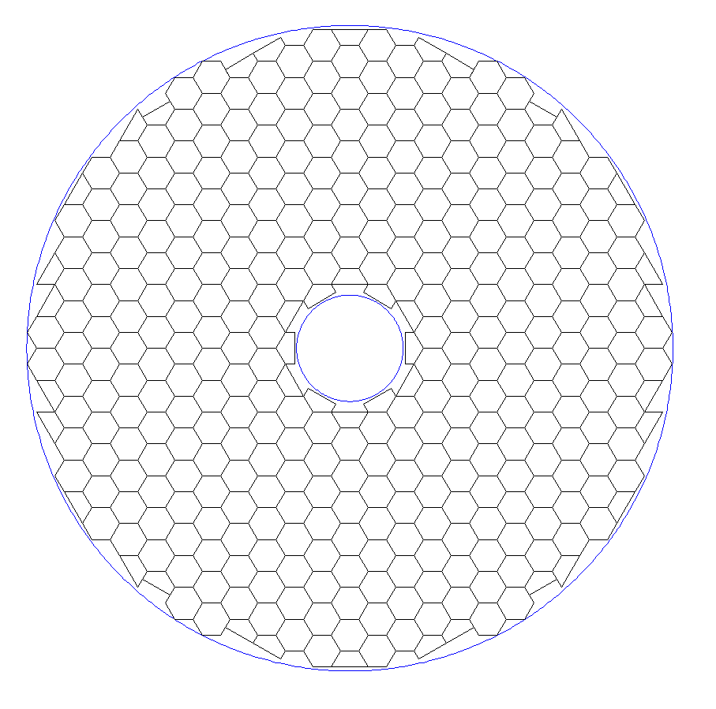
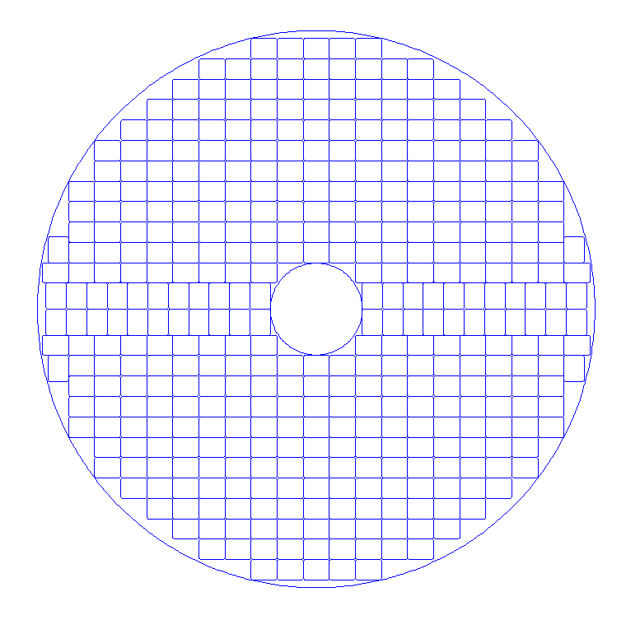
Endcap Tiling – first tries
Only hexagons
“Barrel” rectangles
Hexagons + Barrel hybrid elements

