Slide 1
The path to a new CLIC main-linac module
S. Döbert, J. Väinöla, A. Vamvakas, C. Rossi, M. Aicheler
and all related groups

Slide 2
CLIC Layout at 3 TeV
Drive Beam Generation Complex
Main Beam Generation Complex

Slide 3
Outline
CLIC module history and horizon
State of CLIC module study CDR (2012)
State of the art
Benchmarking: Cost model
PACMAN
Reevaluation of design choices

Slide 4
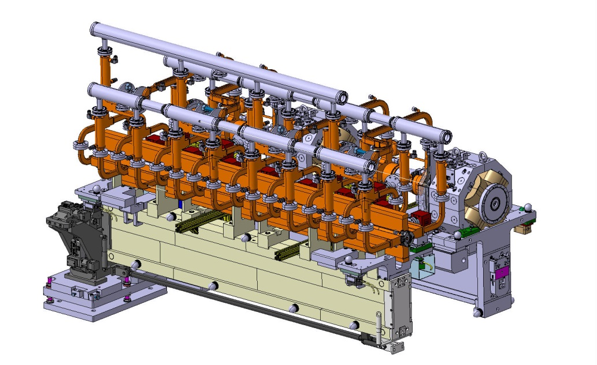
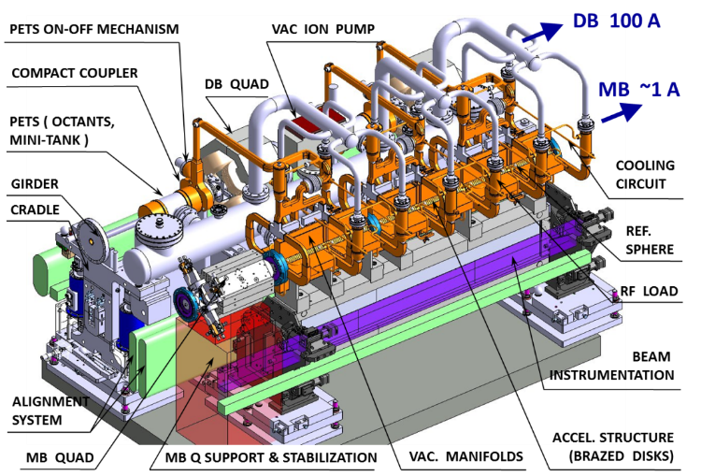
History and Horizon
Feasability demonstrated
Completed design
Mechanical prototype
Evolved design
Two additional mech. protoypes
Real RF-prototype
New 3D design ready for prototyping
2006-08
2012
2016
2019
CDR
Today
European strategy update

Slide 5

State of CLIC module study CDR (2012)
A. Samoshkin
CLIC at 500 GeV (4232 modules)
26920 Accelerating structures
13460 PETS
~ 70000 RF components
CLIC at 3 TeV (21460 modules)
142760 Accelerating structures
71380 PETS
~ 400000 RF components

Slide 6
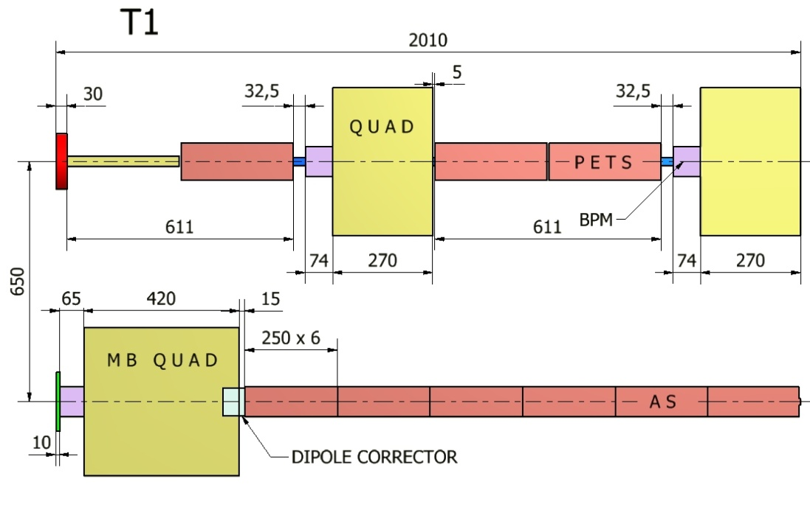
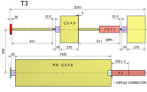
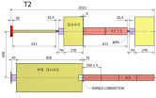
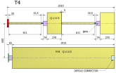
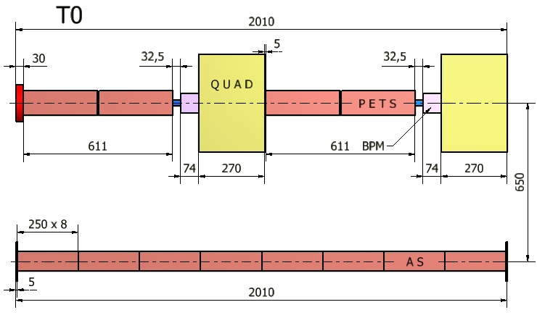
State of CLIC module study CDR (2012)
Standard Module
(L = 2010 mm)
DB (100 A)
4 PETS, 2 Quads with BPM
Each PETS feeds 2 AS
MB (1 A)
8 acc. structures
MB filling factor: 91%
CLIC Module Type 0
73 %
Module Type 1
3 %
Module Type 3
9 %
DB
Module Type 2
12 %
Module Type 4
3 %
1 to 4 pairs of AS replaced by
MB Quadrupoles
MB

Slide 7
State of CLIC module study CDR (2012)
CLIC project: alignment strategy
Beam off
Mechanical pre-alignment
~0.2 - 0.3 mm over 200 m
Active pre-alignment
14 - 17 µm over 200 m
Beam on
Beam based Alignment & Beam based feedbacks
One to one
steering
Dispersion Free
Steering
Minimization of
AS offsets
Make the beam
pass through
Optimize the position of
BPM & quads by varying
the beam energy
Using wakefield
monitors &
girders actuators
Minimization of the emittance growth

Slide 8

State of the art
Improved vacuum system cancelling all vacuum forces
5 DoF adjustable DBQ support
Individual minipumps pumping individual structures
Improved design of articlation point (fully adjustable)
Reuced crosstalk between girders

Slide 9
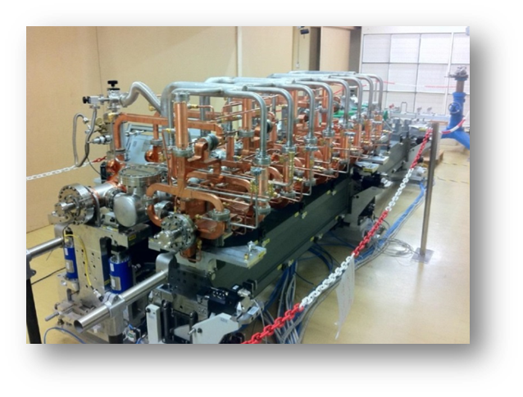
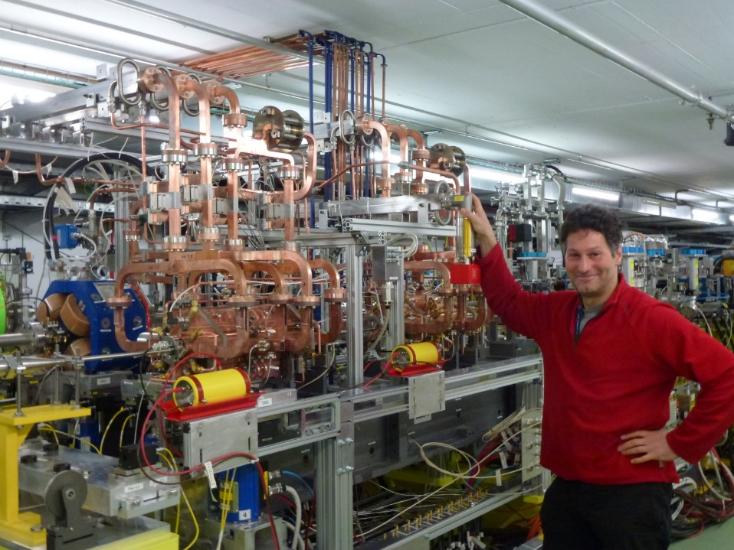
CLIC Module R&D
State of the art
CLIC mechanical test modules with mock up components in a dedicated Lab for thermo-mechanical, alignment and integration testing.
CLIC prototype Module with real RF components installed in CTF3 and tested with drive and probe beam
A
B
First module review November 2013
https://indico.cern.ch/event/281312/
CLEX Module installation review
http://indico.cern.ch/event/366835/
Second review June 2015
https://indico.cern.ch/event/393250/

Slide 10
Experimental program for the CLEX module
State of the art
Two beam acceleration, rf signal consistency, power transfer, acceleration, phasing, breakdown handling, …
Alignment studies, with and w/o beam, girder coupling, beam based alignment using WFM and BPM data, perturbation by accelerator noise, precision , reproducibility, fiducialisation, reliability
BPM studies, resolution, performance
Wake Field Monitor studies, electronics, resolution
Temperature management, control flow rates, temperatures, measure changes in beam environment
Find, understand and possibly solve shortfalls of present systems
See for example CLIC workshop January 2016 for results so far

Slide 11
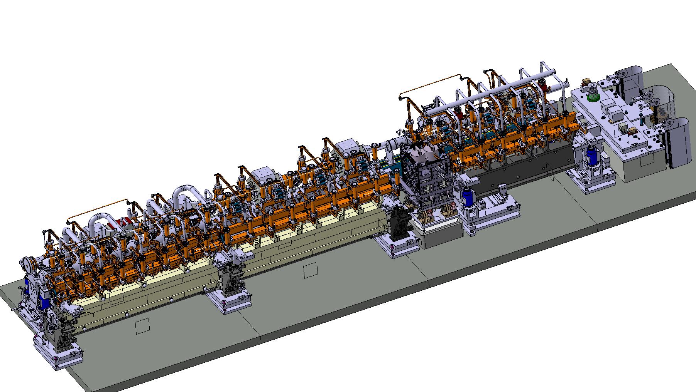
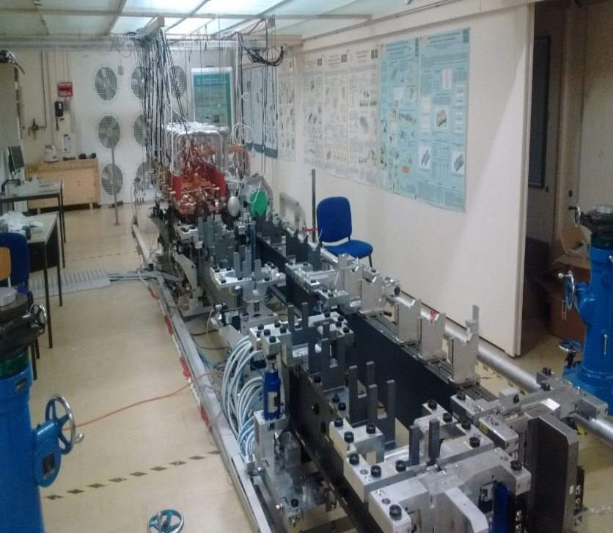
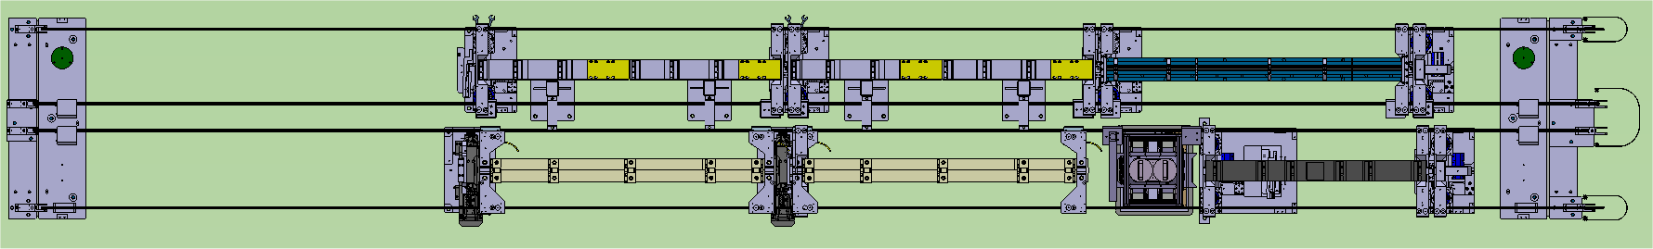
Module program in the Lab
Configuration T0-T0-T1 under assembly
State of the art
Existing T0 (not affected)
New T0
(modified)
New T1
(CLEX design)

Slide 12
Results: One point of AS
State of the art
Displacement
measurements
Time constants (min)
 | Δx | ΔΤ
Rise | 7.28 | 7.52
Fall | 7.87 | 7.33
Movement and temperature dynamics are the same
Time constants can be calculated as in the case of temperature
Valuable input for machine operations and controls

Slide 13
Experimental program for the Lab-module string
State of the art
Thermo-mechanical measurements with improved modules:
Alignment and temperature response measurements
Thermal coupling between girders and modules
Thermo-mechanical comparison of T0 and T1
Failure modes: Control of time constants through water flow
Validation of numerical simulation model
Outgassing of structures with SiC
Module interconnects T0-T0-T1
Alignment of mini module-string
Girder coupling
Cradle -girder link, alternatives
Adjustable V-supports

Slide 14
Benchmarking: «Value» model
Aim: Proper tool for evaluation and benchmarking of different design options and variants
Current «cost» model from CDR includes monetary value of individual components
Extend and document CDR cost model to include updated components cost, cost for assembly and manufacturing/assembly time
Introduce different design options and variants and evaluate their respective cost
Criteria for assessing value of each proposed design change:
Cost reduction
Machine performance (achieve luminosity requirements, etc.)
Machine robustness (aging of machine and related systems, safety margin in redundancy, etc.)
Increase in ease of operation (reduction of operational parameters, automatisation, etc.)
Most important criteria is cost. A cost increase will only be tolerated if the other criteria suggest significant improvements.
Overall optimization aim: Value increase and Cost decrease

Slide 15

PACMAN
A study on Particle Accelerator Components Metrology & Alignment to the Nanometer scale
Metrology
Survey & alignment
Beam instrumentation
Radio Frequency
Innovative Doctoral Program Network
Nano-positioning
Magnetic measurements
10 Early Stage Researchers hosted by CERN
European Commission’s FP7 Marie Curie Actions
http://pacman.web.cern.ch/

Slide 16
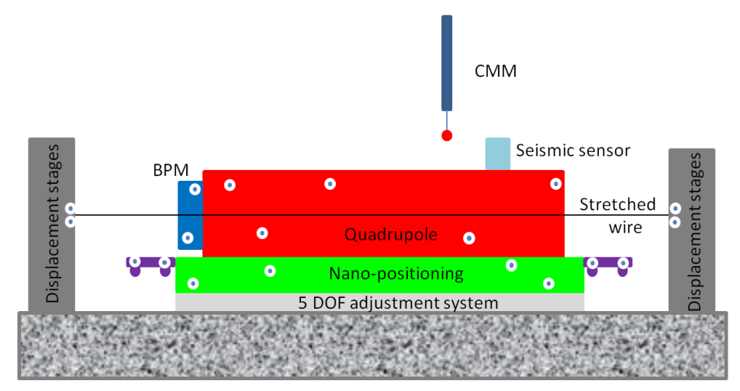
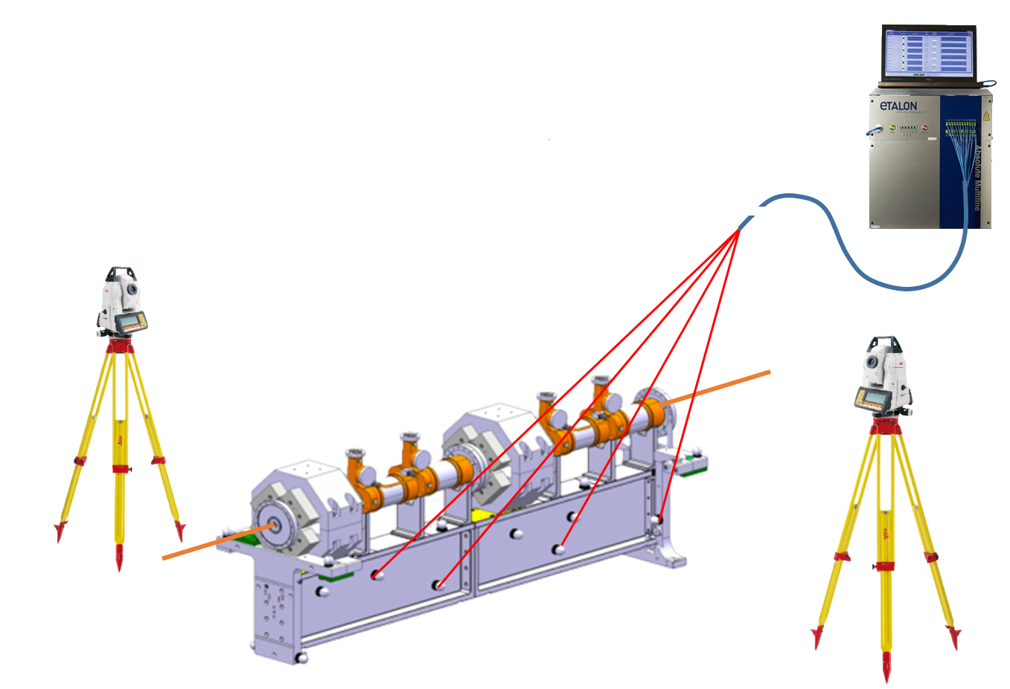
PACMAN and its possible impact on the CLIC modules
PACMAN
Combine references & methods of measurements in the same place to gain time and accuracy
Prove their feasibility on a final bench
Extrapolate the tools & methods developed to other projects
Development of a high accuracy portable solution (micro-triangulation + FSI), replacing CMM measurements:
Check in-situ fiducialisation + initial alignment of components (with stretched wire or using external alignment targets
Do in-situ fiducialisation + initial alignment in the tunnel, after transport

Slide 17
Reevaluation of design choices
Relevant components fully position adjustable
Reconsideration of relative beam positions
Unified common girder for MB&DB and reconsideration of girder crossection
Reconsideration of girder length
Reconsideration of girder material
Ultra compact and integrated components
Reconsider concept of «exotic modules» (T1-T4)

Slide 18
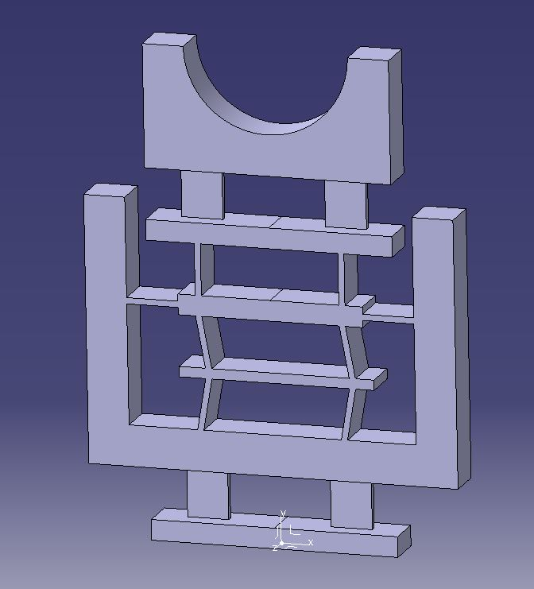
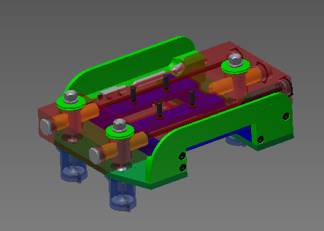
All component supports fully adjustable (SAS, PETS, DBQs)
Draft for flexure based SAS/PETS support
(X-Y plane adjustable; Z-axis flexible but adjusted seperately)
Current philosophy:
Manufacture all beam position relevant measures to extreme high tolerances -> assemble -> hope for the best
New philosophy (PACMAN):
Relaxe all beam position critical tolerances by orders of magnitude and make all supports of critical components fully adjustable -> assemble -> adjust a full module and fiducialize (potentially re-checking individual positions in tunnel again through fiducials)
Prototype for 5 axis adjustable DBQ support

Slide 19
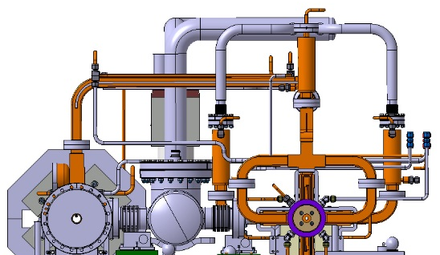


Relative beam positions
Reduce horizontal inter beam distance by e.g. 250mm to 400mm
More compact design thanks to absence of central vacuum tank
Space allocation of module in tunnel reduced (smaller footprint)
Allows for more options on supporting concept
Only limiting envelope: MBQ-DBQ
Allow for vertical offset of DB being higher up e.g. 400mm
Potential for more compact design
Easier space allocation for in/ejection of DB
Easier maintenance access to DB from tunnel
Full vertical arrangement DB on top of MB
Minimal footprint of module
Easier space allocation for in/ejection of DB
Full maintenance access to DB from tunnel

Slide 20
Common girder for DB and MB
Pros:
Half number of actuators, controlers and survey sensors
No geometrical crosstalk
Big potential for integration of cabling+cooling into girder
Much simpler and compact assembly and installation
Classical: 500mm wide
Inverse T-structure (for shielding and easier suspension of components)
Vertical girder
L-Shape girder

Slide 21
Girder length
Hypothesis: 2m module length result of design choice
DBQ positioning/correction possibilities without corrector coils
Snake (master slave) support configuration
Assuming fully adjustable supports and an alignment «PACMAN style»
in principle this 2m limit could be renegotiated
PACMAN just needs to be able to thread one common wire through all components on one girder
Difficult for 2m, potentially parabolically increasingly difficult (=> vertical module bench…)
Modules of 3m or even 4m seem viable

Slide 22
Alternative girder materials
Hypothesis: silicon carbide result of two major limitations:
Limit sag to below 10um
Limiting weight of 2m girder to approx. 250kg
Assuming fully adjustable support and an alignment «PACMAN style»; and
Assuming (no or very) high load limit on actuators
=> a significantly cheaper/more functional material can be considered
Two main contenders:
Mineral Cast (aka e.g. Epucret)
Structural Steel (aka black steel)
Alternatives:
Cast steel
Mineral concrete

Slide 23
Request and assume development of more integrated components:
super compact SAS (full length manifolds, integrated loads, optimized cooling circuit, one vacuum pumping port,…)
Super compact PETS (no tank design, one vacuum pumping port, optimized cooling,…)
MBQ magnet itself and supporting system (understanding envelope limitations)
DBQ (understanding envelope limitations)
Entire vacuum system, sensorics, piping and cabeling could be much more efficient and clean
Much easier assembly process
➔ More cost efficient!

Slide 24
Simplify module types – T2 & T4
T2 can be replaced by a ‘magnet module’
T0s continue normally afterwards
The DBQ can be independently supported or on half-length girder (only if 2 girder configuration remains)
Same principle for T4s

Slide 25
Simplify module types – T1 & T3
T1 replaced by magnet module
‘Anti-T0’ continue afterwards until next MBQ
Anti-T0 identical to T0 but inverted
10cm gap needed – 0.3% effect on filling factor (i.e. 65m of tunnel)
MBQ length can be revisited, multiple lengths easily adapted
Same principle for T3s

Slide 26

Thank you for your attention!

Slide 27
Critical issues for the module program
Cost: ~ 30% of project cost at 500 GeV
Wakefield monitor for BBA critical for Luminosity
Two beam acceleration, rf pulse shaping
ON/OFF mechanism
Full Superstructure prototype
Pre- alignment, vibrations→ emittance preservation, critical for Lumi
Module integration, alignment, rf, beam instrumentation, magnets
Development of fabrication, testing, transport and installation model and strategy
Learn about operational aspects of the CLIC machine

Slide 28
Module program 2015-2018
Finish and exploit 3 module-string and CLEX program and document results and performance shortfalls
Validate alternative concepts
Study cost drivers
and tolerances
PACMAN
Develop credible fabrication, assembly, testing and installation scheme
Transport test
Design improved and less expensive module taking into account lessons learned fulfilling all requirements and providing a base for future industrialization.

Slide 29
Module program 2015-2018 schedule
2016 | 2017 | 2018 | 2019 →
PACMAN
conclusions
Exploit 3 module string in lab and module in CLEX
Transport test results
Study and review cost drive and tolerances
Develop credible fabrication, assembly, testing and installation scheme
Validate alternative concepts
Design of new module

Slide 30
General interest beyond CLIC
High precision engineering
Ultra high precision mechanical alignment and stabilisation in um and nm scale, we are really pushing the boundaries here
Vibration compensation
PACMAN program
Beam based alignment
Fabrication of large series accelerator components
Collaborations: Finland, Pakistan, Greece, LAPP, Belgium, Spain, Netherlands, Poland

