Slide 1
BDS Muon Backgrounds and Shielding
Glen White, Lew Keller, SLAC
ECFA LC, Santander, Spain
June 1, 2016

Slide 2
Overview
BDS backgrounds from collimation system modelled with MUCARLO & GEANT4
Looking at TDR baseline machine parameters
(E_{cm}=500 GeV)
Muon production from halo in collimator absorbers
  Predominantly from coherent production from high-energy photon - nuclei interactions (Bethe-Heitler process): γ + A → A′ + μ+μ−
  Also direct annihilation of positrons on atomic electrons contributes at few-% level: e⁺+e⁻ -> μ+μ−
Turtle halo particle tracking with MUCARLO
Lucretia halo particle tracing with built-in GEANT4 model interface

Slide 3
BDS Layout with Tunnel
Electron Beamline
Air
Concrete
ε-correction
POL chicane
E-COLL
IP=0
FFS
LW Chicane
β-COLL
E chicane
Emergency extraction /
Tune-up Dump
Main Dump
Above electron beamline and tunnel implemented in GEANT4 & MUCARLO
  Geometry distribution as defined at: http://atf.kek.jp/twiki/bin/view/Main/ILCCRtunnel
Other beamlines (source, RTML) not yet included

Slide 4
BDS Layout with Tunnel
Positron Beamline
Air
Concrete
ε-correction
POL chicane
E-COLL
FFS
LW Chicane
β-COLL
E chicane
Emergency extraction /
Tune-up Dump
Main Dump
Positron tunnel layout used in simulations to represent worst case.

Slide 5
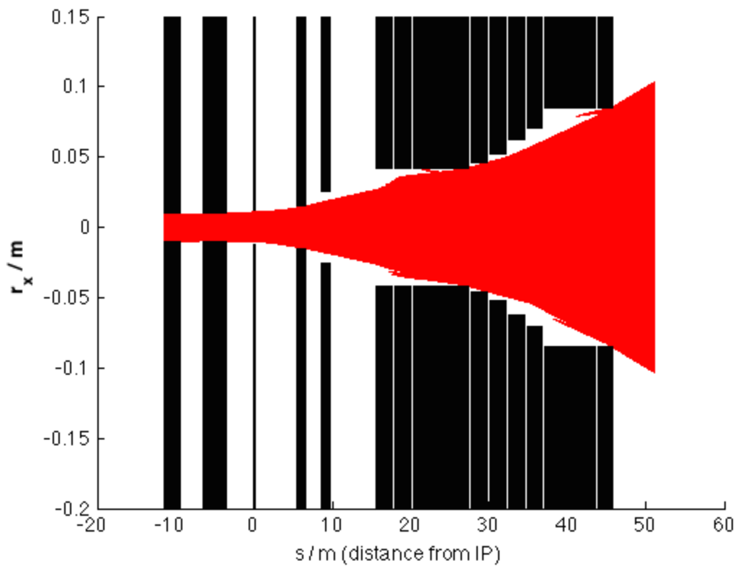
Halo Collimation Systems
Betatron COLL SP2 & SP4
Energy COLL SPEX
IR SR Fan in x-z plane
Primary spoilers & absorbers source of muons in BDS
Collimation apertures set to protect IR region from SR
  Calculated from 6d particle tracking
  Collimation types and settings recorded in BDS decks in ILC2015b

Slide 6
Muon Shielding - Wall
FERMILAB-CONF-07-276-AD
SUPPRESSION OF MUON BACKGROUNDS GENERATED
IN THE ILC BEAM DELIVERY SYSTEM ∗
A.I. Drozhdin, N.V. Mokhov, N. Nakao†, S.I. Striganov, Fermilab, Bavia, IL 60510, USA L. Keller, SLAC, Stanford, CA 94025, USA

Slide 7
Muon Shielding – Toroid Spoilers
3 muon spoilers at z locations from IP:
1143m
1227m
1408m
5m

Slide 8
Halo Distribution @ SP1
5-10 σ_{x}
45-70 σ_{y}
1/r distribution
Normalised to 0.1% of nominal beam power incident on collimation system
Weighted distribution using 10⁷ macro-particles
Energy normally distributed with cut at +/- 1% (SPEX bandwidth)

Slide 9
Interception of Primary Halo Particles
Primary beam hits only spoilers, secondary hits on absorbers and protection collimators
SP2/4 = 0.6 rl Cu
SPEX = 1 rl Ti
PC’s = 15 rl Cu
AB’s = 30 rl Cu
Halo primarily intercepted by SP2 & SP4 betatron spoilers
~150 W caught by energy spoiler (SPEX)

Slide 10
MUCARLO Tracking Results
3 Toroid Spoilers
  L = 5 m
  R = 0.7 m
Tunnel filling Wall
  L = 5 m
Spoiler locations from IP:
1408 m, 1227 m, 1143m
Green = μ⁺ Red = μ⁻

Slide 11
Distributions @ Detector
- 4-vectors provided to ILD & SiD Groups

Slide 12
MUCARLO Muon Flux Calculations - MUCARLO
(1) GEANT4 Preliminary: ~156 / bunch in 6.5m radius detector

Slide 13
Muon Wall Required?
If flux with toroid spoilers acceptable
running condition from detector groups:
  Can we remove 5m magnetized iron muon wall?
What about other backgrounds?
  Neutron flux from u/s may be an issue
    Specify simpler shielding solution
BCS requirements?
  Protection of workers in IR region against max credible accident scenario

Slide 14
BCS Issues with Tune-Up Dump Bend Failure Scenario
TDR requires worker access to IR whilst full beam power delivered to tune-up dump for Linac tuning
Max credible accident scenario: 5MW of beam incident on beam-stopper
~100 us duration if DR abort kicker fires
What is radiation dose to IR workers?
Beam-stopper(s) inserted to protect workers
in IR region
Cannot absorb full beam power: protected by
BTM & beam loss moitors

Slide 15
IR Accident Dose Rate Estimate for P=5MW (Preliminary)
From “Shield11”
Source | Wall Condition | Muons (Rem / hr) | Photons (Rem / hr) | Neutrons (Rem / hr)
ST1, z=1516m from IP | No Wall | 0.01 | 10,000 | 5
Wall, z=349m from IP | 5m steel | 15 | 0 | 0
SLAC BCS requirements for beamline occupancy:
3 stoppers required:
  2 physical beamline stoppers in betatron collimation section
    BCS electronic devices to sense beam hitting devices & immediately abort beam in DR
  Interlocked dipoles in ECOLL & FFS
Max allowable radiation levels in potentially occupied areas:
  Normal beam operation: <0.1 rem/yr (non-radiation workers) <1.5 rem/yr (radiation workers)
  Accidents: dose rate not to exceed 25 rem/hr: require beam to be switched off <14 sec to ensure whole-body dose for an individual <0.1 rem

Slide 16
Conclusions
Muon flux @ detector from collimation system estimated with MUCARLO
GEANT4 calculations started
Baseline E_{cm}=500 GeV flux @ detector= 0.5-138 muons / bunch crossing depending on shielding solution (17-9648 / 200 bunches in TPC)
Need input from detector groups to see if large steel wall required
  3.3 muons per bunch for R=6.5m detector / 273 per 200 bunches for R=2.5m TPC with toroid muon shields OK?
  If remove, maintain cavern for contingency installation of wall later
If wall removed and IR occupancy requirement remains: need some IR shielding for photons and neutrons for BCS requirements
  Need to confirm Japanese radiation physics requirements for IR occupancy
  Re-assess requirement for IR occupancy?
  Re-assess tune-up dump requirement?
Ongoing work:
  Complete GEANT4 study to cross-check muon fluxes, look at photon & neutron flux @ IP for normal running conditions
  Specify photon/neutron shielding solution if OK to remove magnetized steel muon wall

