Slide 1
High Gradient, high Q R&D program for ILC
Update on LCLS-II effort at Fermilab
Nikolay Solyak, Anna Grassellino, Sebastian Aderhold
(from behalf of SRF team of Fermilab)
ECFA LC workshop, Santander, Spain. May 30-June 5, 2016

Slide 2
ILC cavity E_{acc} & Q0: State-of-the-art and R&D goals
ILC TDR
  E_{acc} =31.5 MV/m ±20%; Q0=0.8e10 (at 35MV/m, VTS);
  Yield > 80% (90%) – see N.Walker talk
From the point view of site AC power, pushing gradient beyond 35 MV/m requires raising Q0 (cost and energy effective)
LC goal for cavity R&D (after TDR):
E_{acc} = 40-45 MV/m at Q0 ~ (1-2)E10 for 1 TeV ILC
  Path way? (R.Geng talk)
    Large-grain + new shape (LL, RE, LSF)
    Nb-Cu clad material (seamless forming)
    Coating of new material (Nb2Sn, ???)
    New ideas ?

Slide 3
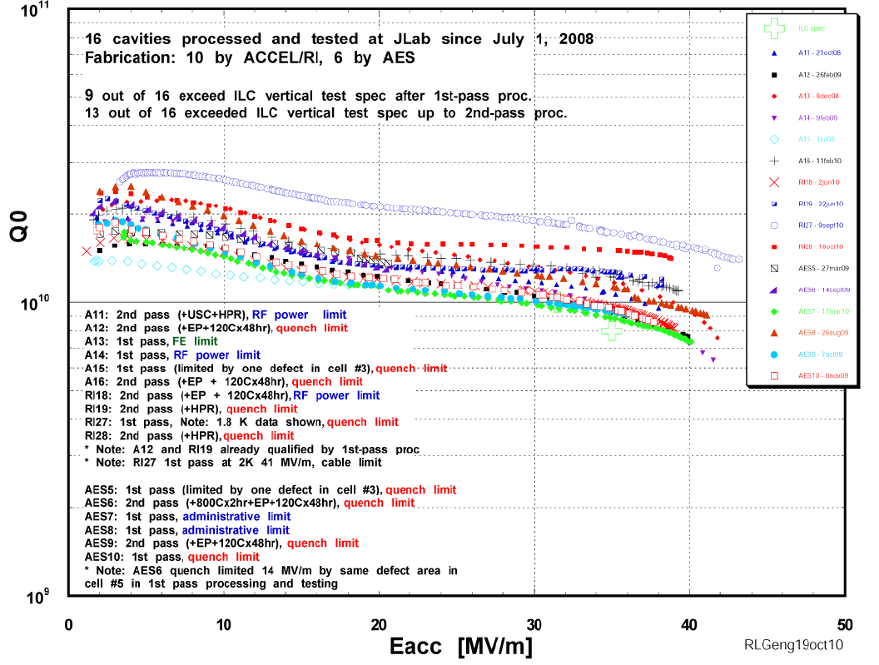
Cavity performance after “standard” treatment (more data from EXFEL production)
1.8K
2K

Slide 4
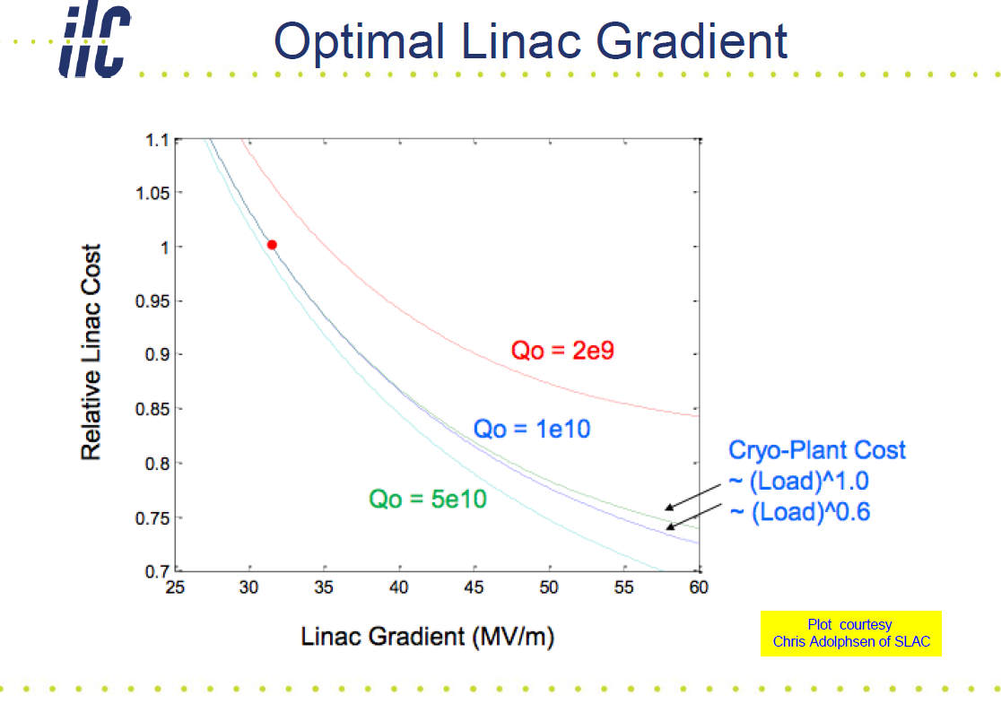

Slide 5
High gradient / high Q R&D at Fermilab
Typical EP + 120 C bake ILC treatment gives the highest achievable gradients – why?
We know it creates a “dirty” layer on top of clean bulk
Therefore, FNAL decided to study how to better “engineer” a dirty layer on top a clean bulk, using low T nitrogen treatments → aim to create few to several nanometers of nitrogen enriched layer on top of clean EP bulk
Would this yield a difference from the standard 120C bake? In gradients? In Q?
Nitrogen enriched layer to be created in the furnace post 800C treatment – so no oxide is present at the moment of injection of nitrogen at 120C → fundamental understanding of 120C bake with oxide, without oxide, and with nitrogen

Slide 6
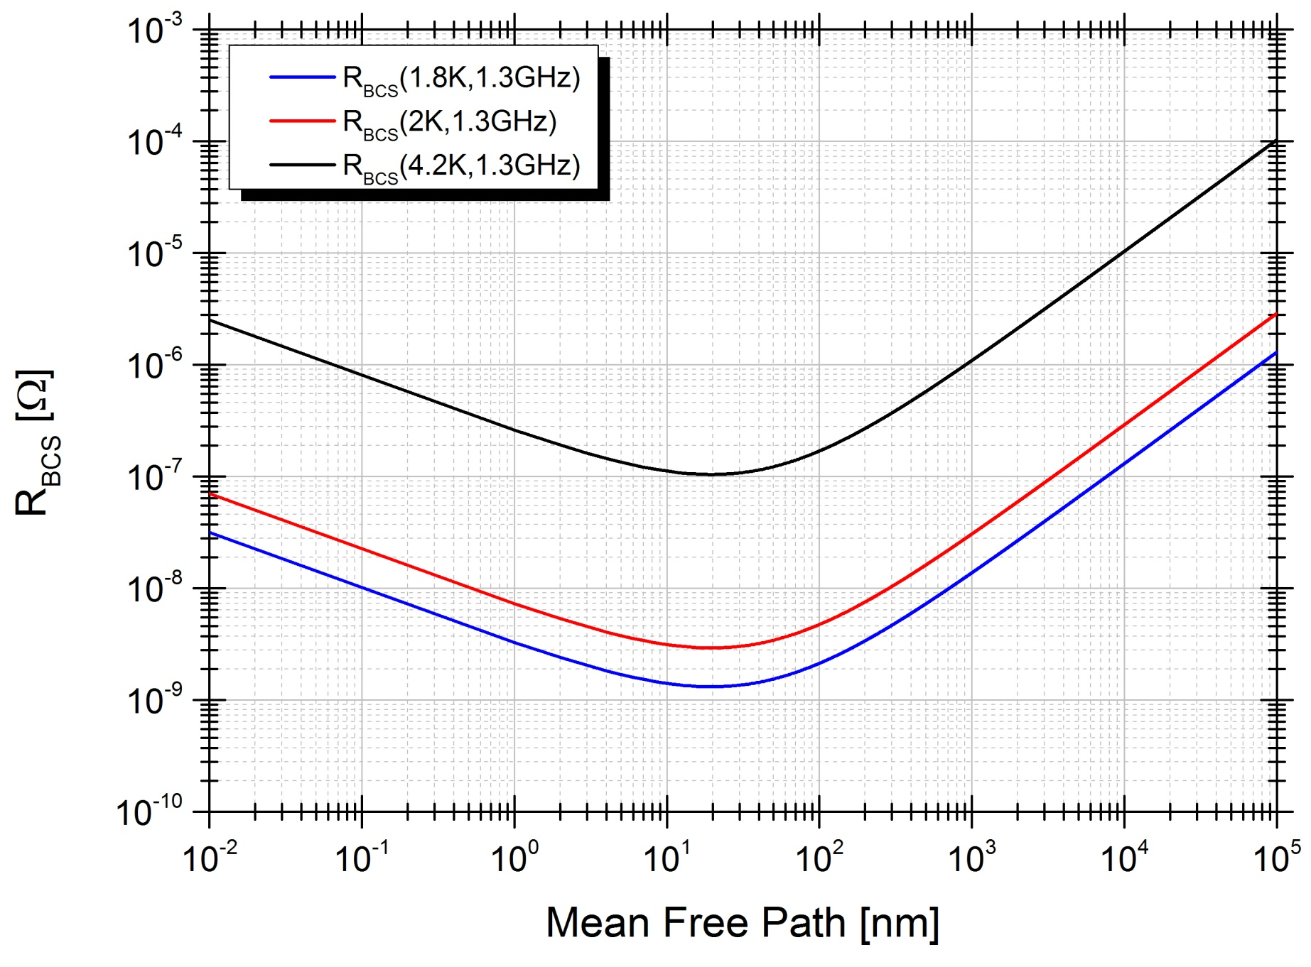
  Surface mean free path measured via LE-muSR:
  120C bake→ 2 nm mean free path in first 60 nm
BCS surface resistance as a function of mean free path
~15 nm - no screening
mfp ~ 2 nm at the surface, increasing deeper
Optimal mfp = N doping
mfp~40 nm
Dirty limit (120C bake)
Clean limit (EP, BCP)
mfp >400 nm
BCP and EP unbaked -> strong screening, clean limit
EP+120C bake-> strongly suppressed m.f.p., gradient of the m.f.p. from the surface, dirty limit
N-doped -> intermediate m.f.p., at the predicted minimum for BCS (previously unexplored)
Ba = 25 mT
Meissner screening profiles for differently treated cutouts (Ba magnetic field applied parallel to sample surface = 25 mT). Allows to directly extract surface mfp

Slide 7
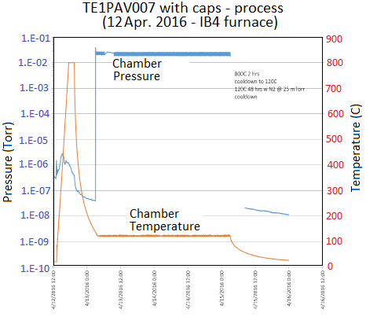
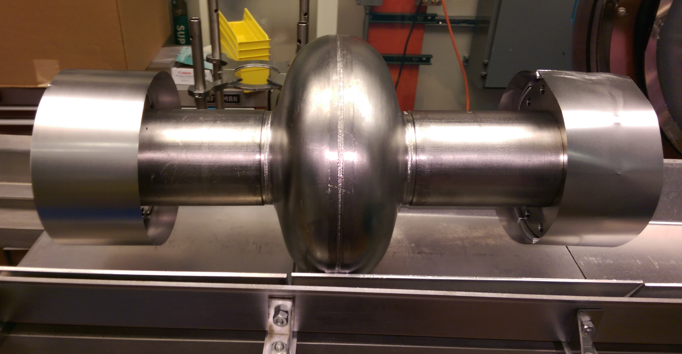
The surface processing sequence
Bulk electro-polishing
High T furnace with caps to avoid furnace contamination:
  800C 2 hours HV
  120C 48 hours with N2
NO chemistry
HPR, VT assembly
800 C -2hrs
Cooldown to 120C
120C48hrs; N2@25mTorr
Cooldown to RT

Slide 8
Results comparison
“standard” 120C bake vs “N infused” 120C bake
Achieved:
45.6 MV/m → 194 mT
With Q ~ 2e10!
Q at ~ 35 MV/m ~ 2.3e10!
ILC specs: Q=0.8e10 @ 35MV/m
Increase in Q factor of two, increase in gradient ~15%

Slide 9
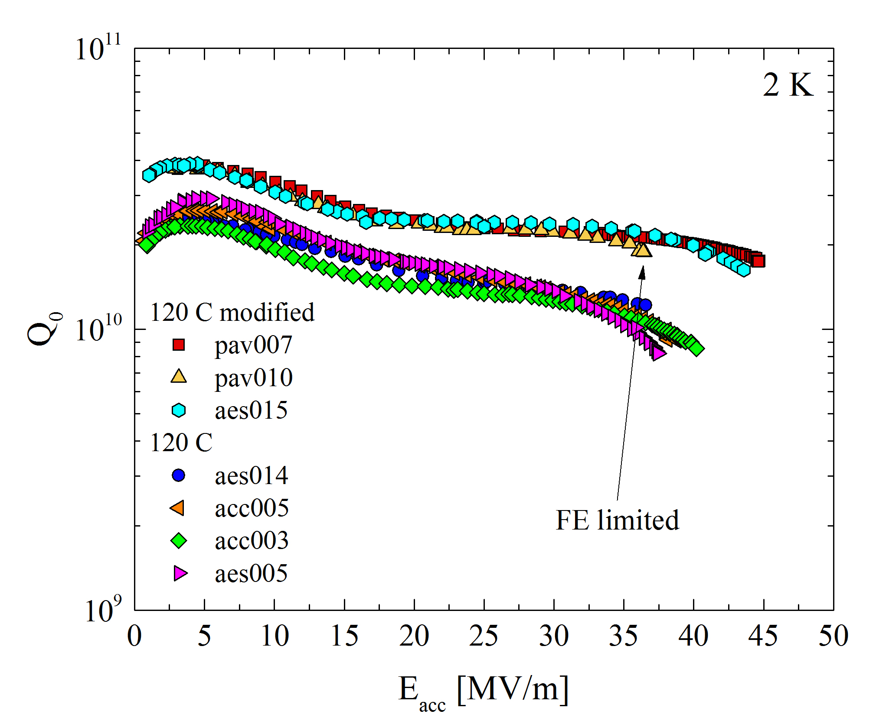
120C “modified” bake with N2 – repeatedly highest Q ever measured >2e10 at very high gradients>40 MV/m!
A. Grassellino et al, TBP

Slide 10
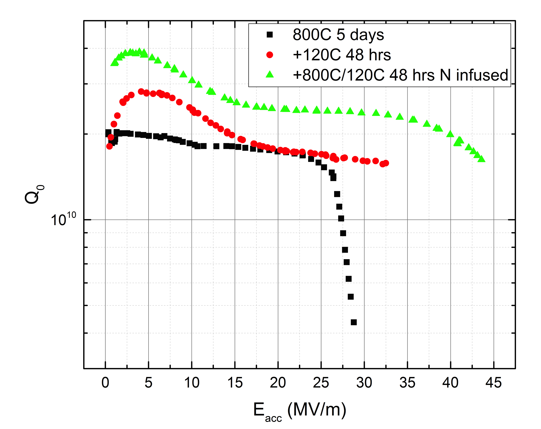
Sequence on same cavity: EP + 800C→ 120C bake→ 800C+N-infused 120C bake
A. Grassellino et al, TBP
Clear evolution trend conforming improvement in Q and quench field
Note: improvement in Q also from no EP post high T bake (see A. Grassellino et al http://arxiv.org/abs/1305.2182)

Slide 11
Conclusions/ future direction
New surface processing technique demonstrates repeatedly two times higher Q at very high gradients, and improvement in gradients (repeatedly obtained ~ 45 MV/m in different cavities)
Measured very low sensitivity to trapped magnetic flux ~ 0.3 nanoOhm/mGauss→ robustness of Q in cryomodule
Next will implement on multicell cavities and ICHIRO shape for potential > 50 MV/m
Nitrogen injection at low T playing a role in achievable high gradients – same treatment done in vacuum produces HFQS
Opens potential pathway for systematic increase in gradients – still open question: what is the ultimate achievable gradient limit in niobium SRF cavities?

Slide 12
Update on LCLS-II effort at Fermilab

Slide 13
LCLS-II Linac
Physics Requirements Document: “SCRF 3.9 GHz Cryomodule,”
LCLSII-4.1-PR-0097-R2.
Thirty-five 1.3 GHz 8-cavity cryomodules
Two 3.9 GHz 8-cavity cryomodules, connected directly to two 1.3 GHz cryomodules
Four cold segments (L0, L1, L2 and L3) which are separated by warm beamline sections.

Slide 14
Overview Fermilab Scope
    High Q0 development (FNAL led effort on N-doping)
  Transfer processing recipe to industry
  Establish average Q0 of 2.7E10 in cryomodule
Design of 1.3 GHz cryomodule (cw)
Fabricate and test pCM + sixteen 1.3 GHz CMs of 8 cavities each
Design, fabricate and test two 3.9 GHz CMs of 8 cavities each
Design verification
Acceptance testing of all cavities for above cryomodules
Design and fabrication of cryogenic distribution system
  Work closely with Jlab on interface cryoplant/distribution/CMs

Slide 15
Schedule
pCM assembly being completed - end of June
  Move to CMTS beginning of July
First 8 cavities from vendors to arrive mid July
Rest of production cavities start arriving September
1.3 GHz CM production and testing from 9/2016 to 5/2018
3.9 GHz CM production and testing from 3/2018 to 9/2018

Slide 16
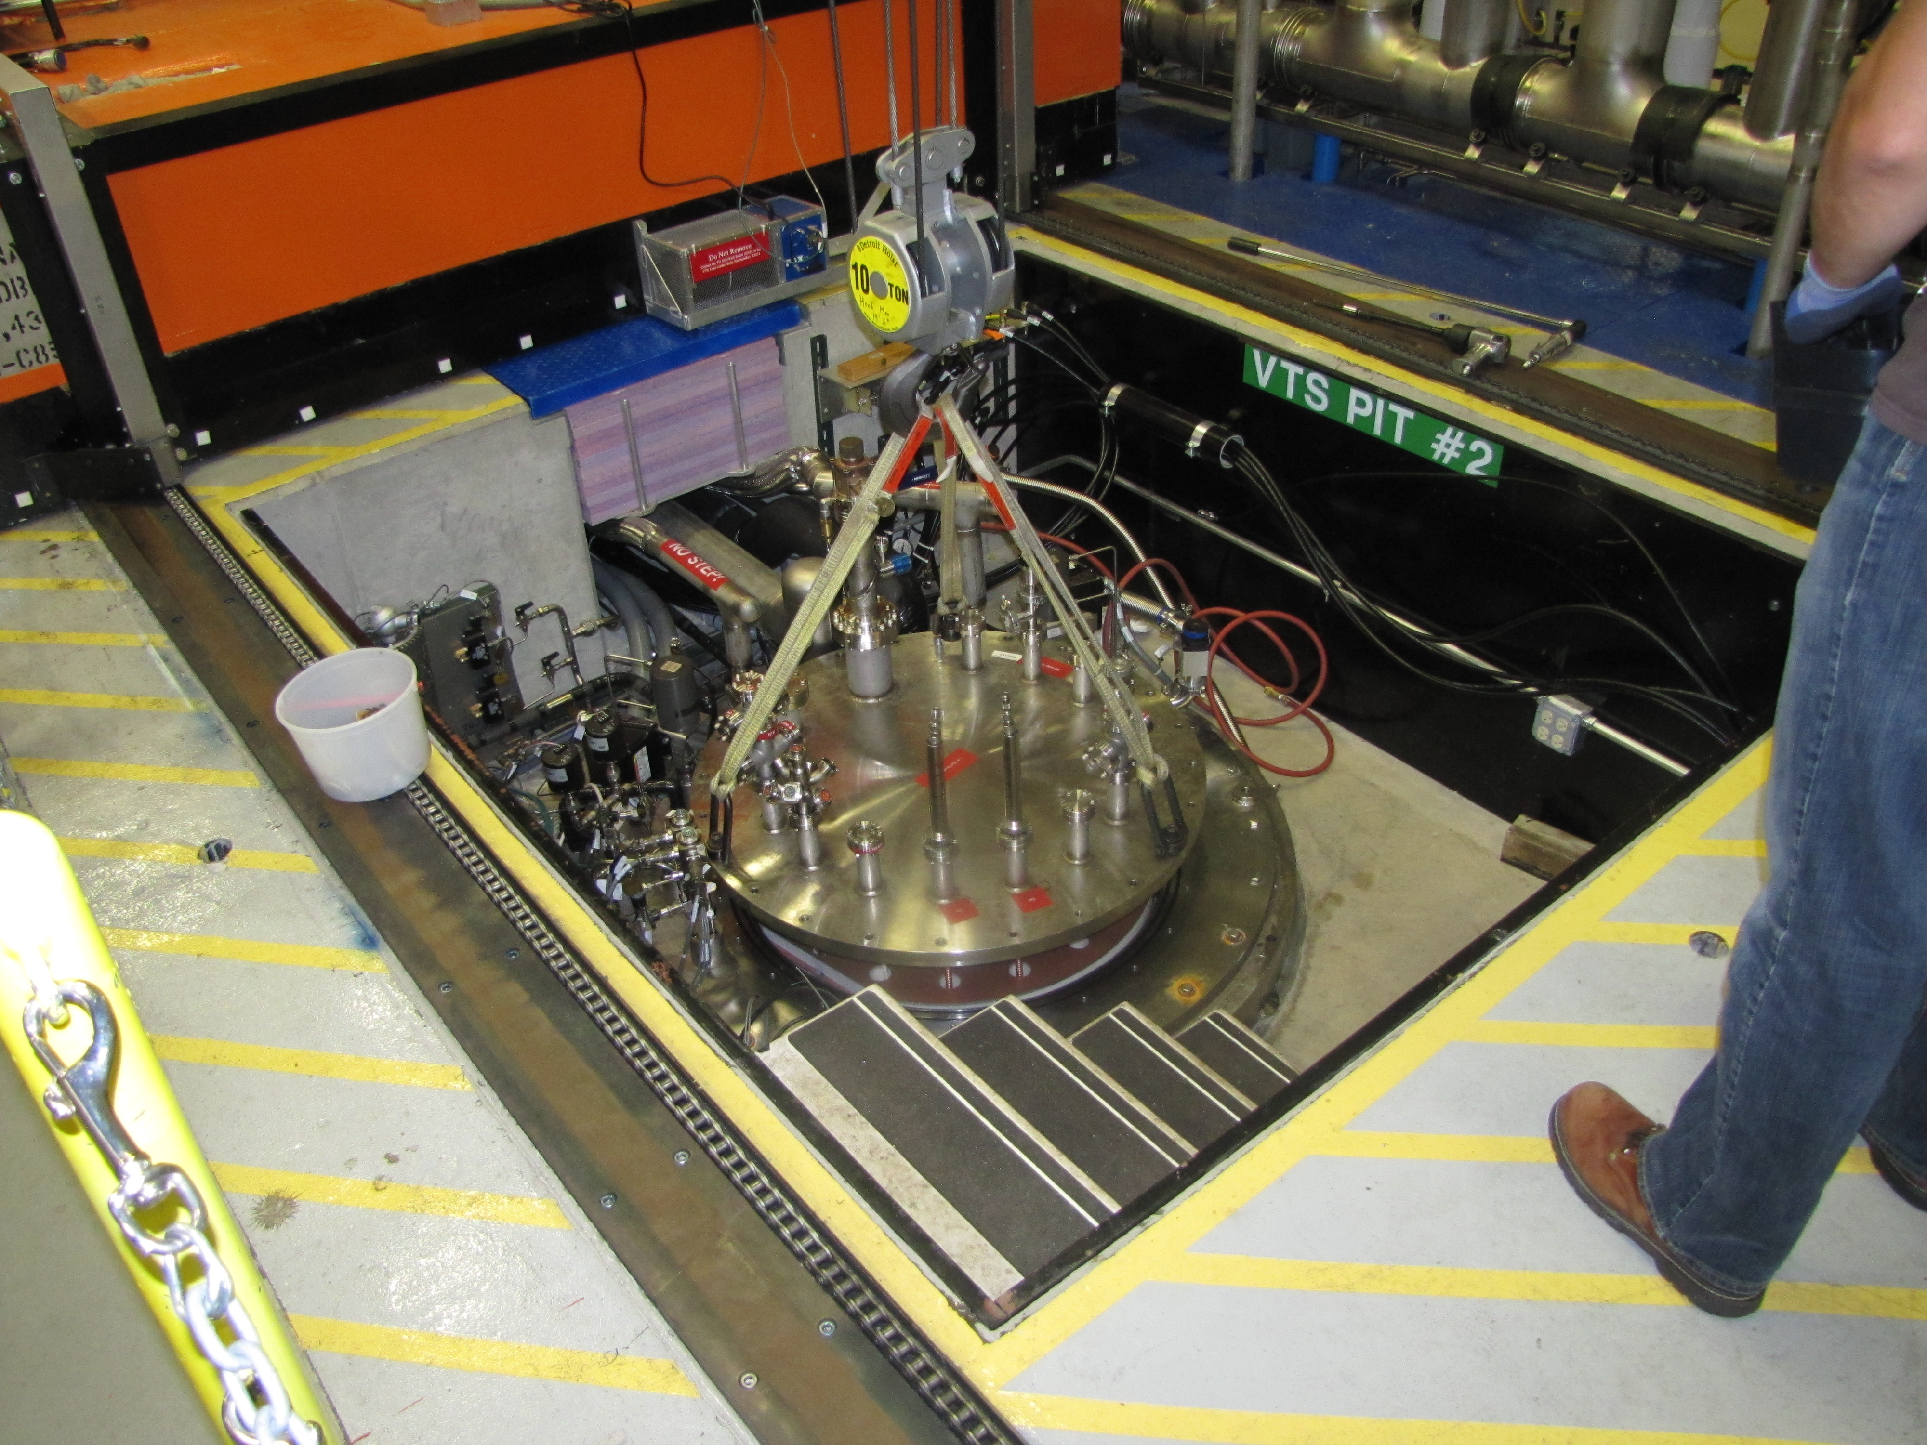
VTS
Vertical cavity test facilities getting ready for production
Adding second radiation sensor on bottom of dewars
Equipping top-plates for additional instrumentation
Magnetic shielding of VTS #2 recently improved (< 5mG)

Slide 17
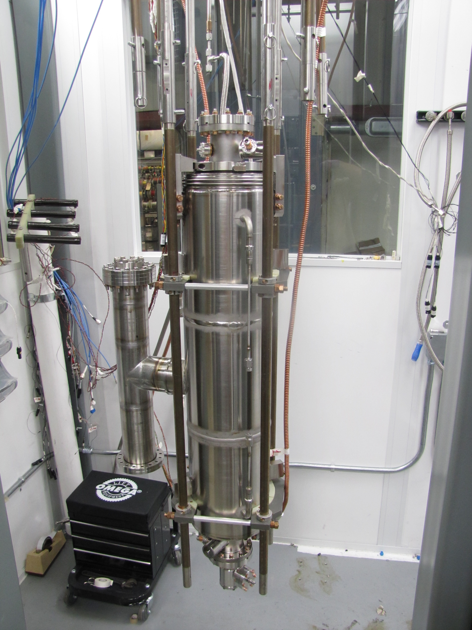
VTS
Planning three cavities per cool-down cycle / week
Fluxgate sensors and RTDs to monitor magnetic field and temperature
Acceptance criteria:
Q0 >= 2.5E10 @16 MV/m
  Lower than 2.7 E10 in CM because of SS flanges
E_{acc,max} >= 19 MV/m
VTS-1, 2 and 3 available for tests

Slide 18
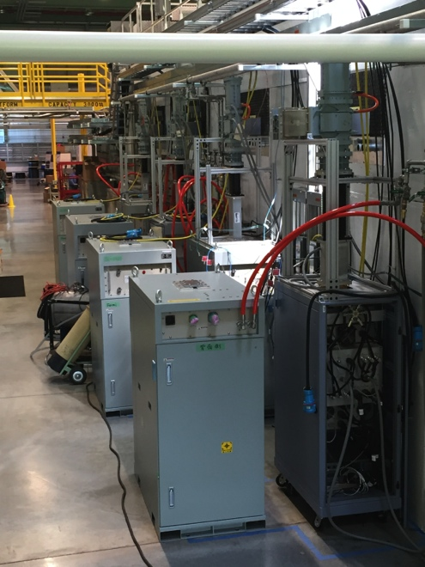
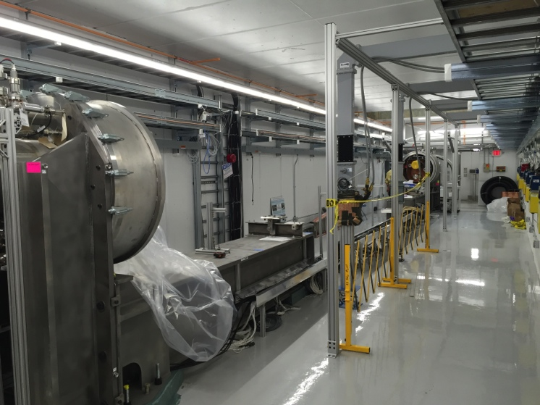
CMTS
Cable pulls completed
Operational Readiness walkthrough completed
  Permission to run RF into loads in cave
All 8 SSAs verified operational (3.8kW)
Commissioning of LLRF, Interlock and Controls systems in progress
Cryoplant operated: 4K helium delivered to test stand feedcap
pCM test to start in July

Slide 19
pCM - Prototype cryomodule
Additional instrumentation compared to production CM
  4 cavities with internal fluxgates and RTDs
Will ultimately go to accelerator as well
Currently at WS4, MLI being installed
Next: insertion into vacuum vessel
Cavity | Quench gradient [MV/m] | Q0@16 MV/m
TB9AES021 | 23.0 | 3.08E10 (latest HTS)
TB9AES019 | 19.5 | 2.82E10 (latest VTS)
TB9AES026 | 21.4 | 2.57E10 (latest VTS)
TB9AES024 | 22.4 | 2.95E10 (latest VTS)
TB9AES028 | 28.4 | 2.81E10 (latest VTS)
TB9AES022 | 21.2 | 2.77E10 (latest VTS)
TB9AES016 | 18 | 2.75E10 (latest VTS)
TB9AES027 | 22.5 | 2.75E10 (latest VTS)

Slide 20
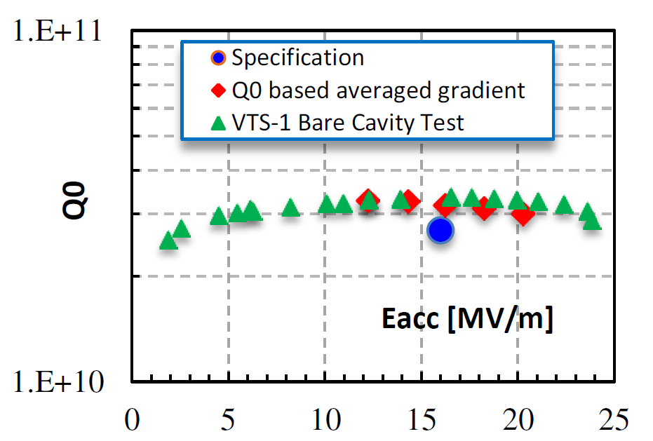
Design verification Tests (HTS)
N-doped cavity to provide Q>2.7e10
Cavity auxiliaries re-designed for handeling higher power at cw (helium vessel, magnetic shielding, power coupler, Tuner, thermal strapping, cables, feedthroughs)
All components tested at HTS.
Integrated dressed cavity test to demonstrate Q0 preservation from VTS to HTS

Slide 21
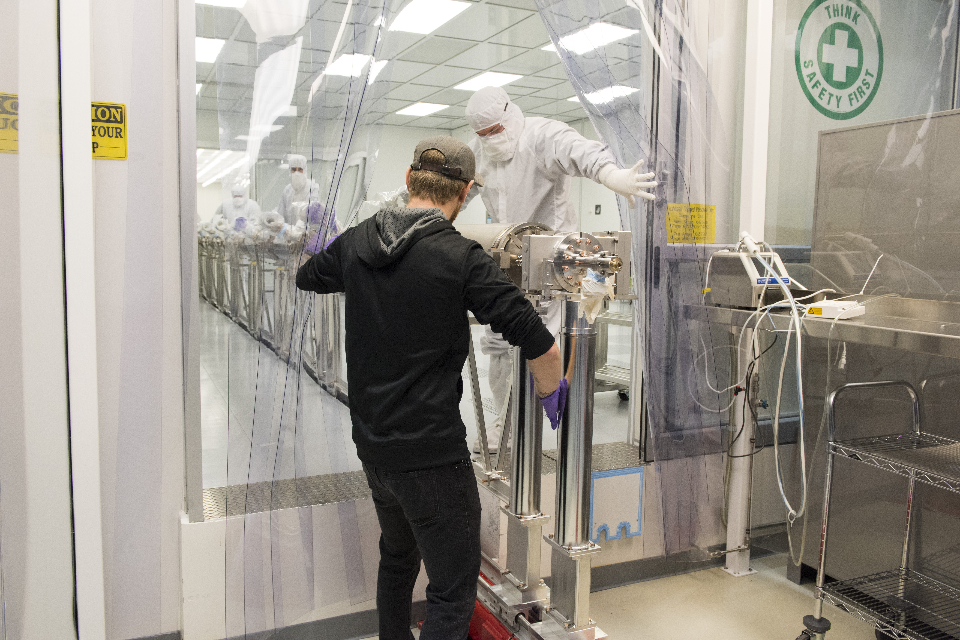
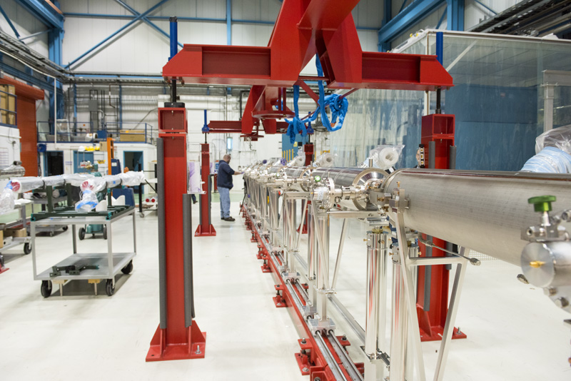
pCM

Slide 22
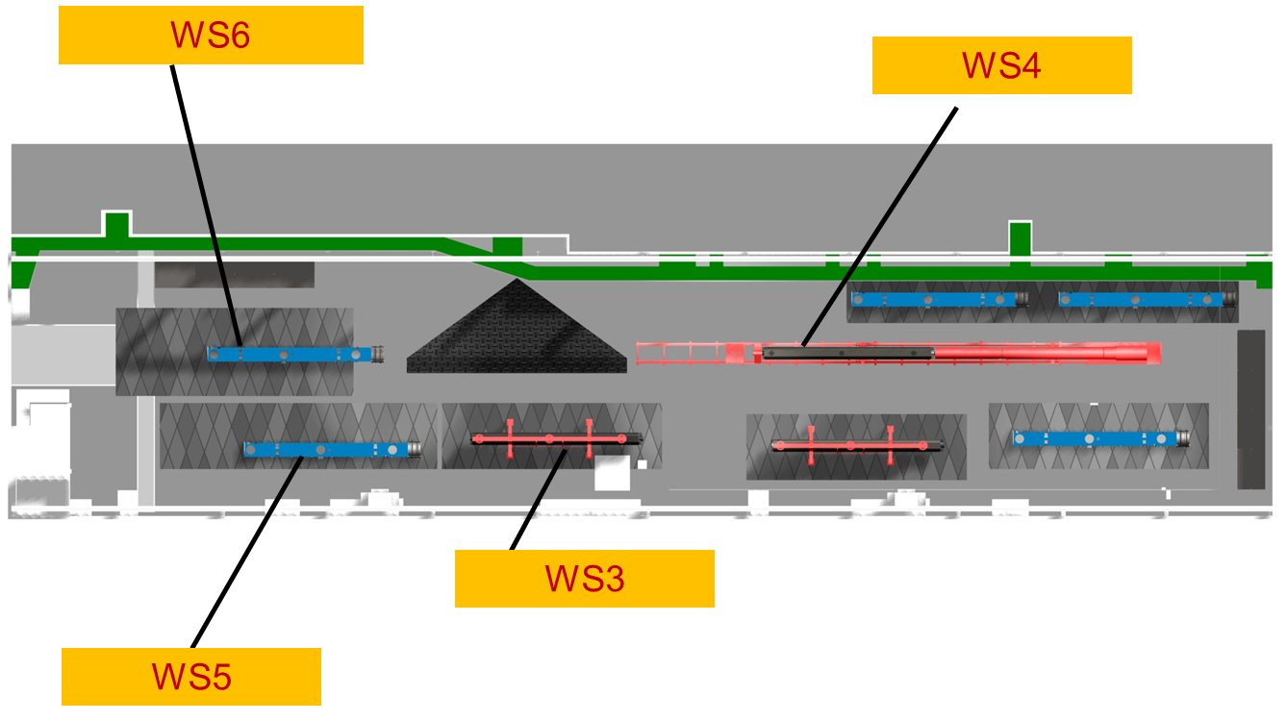
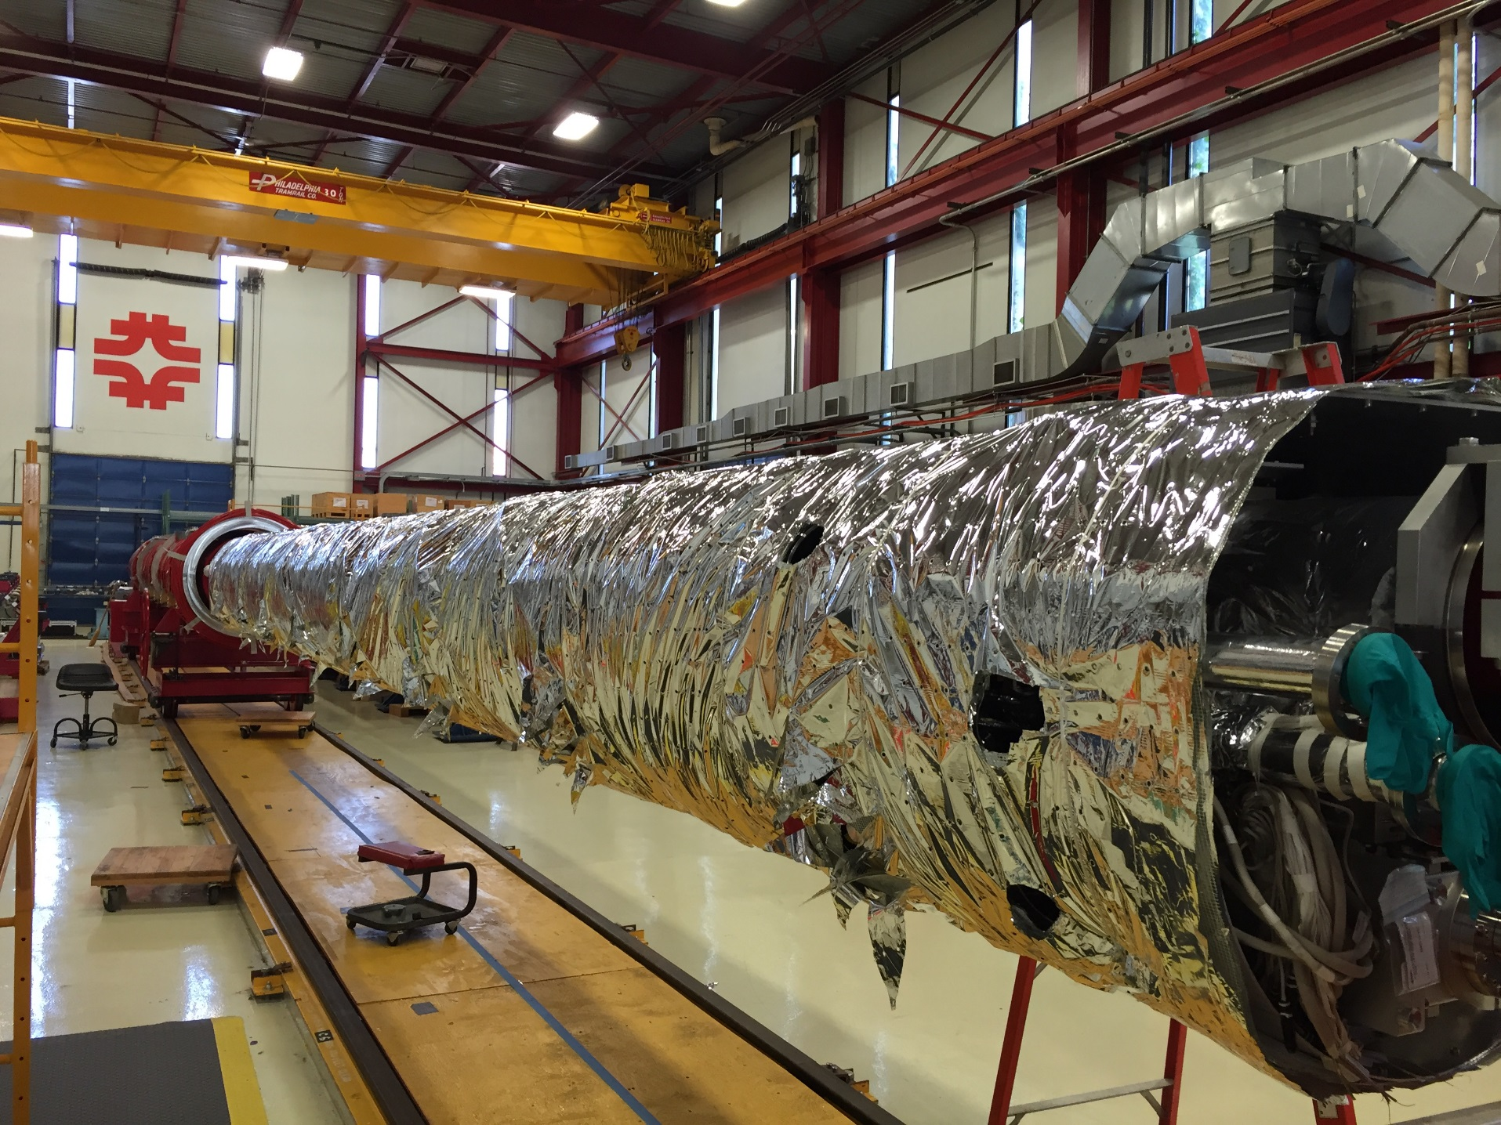
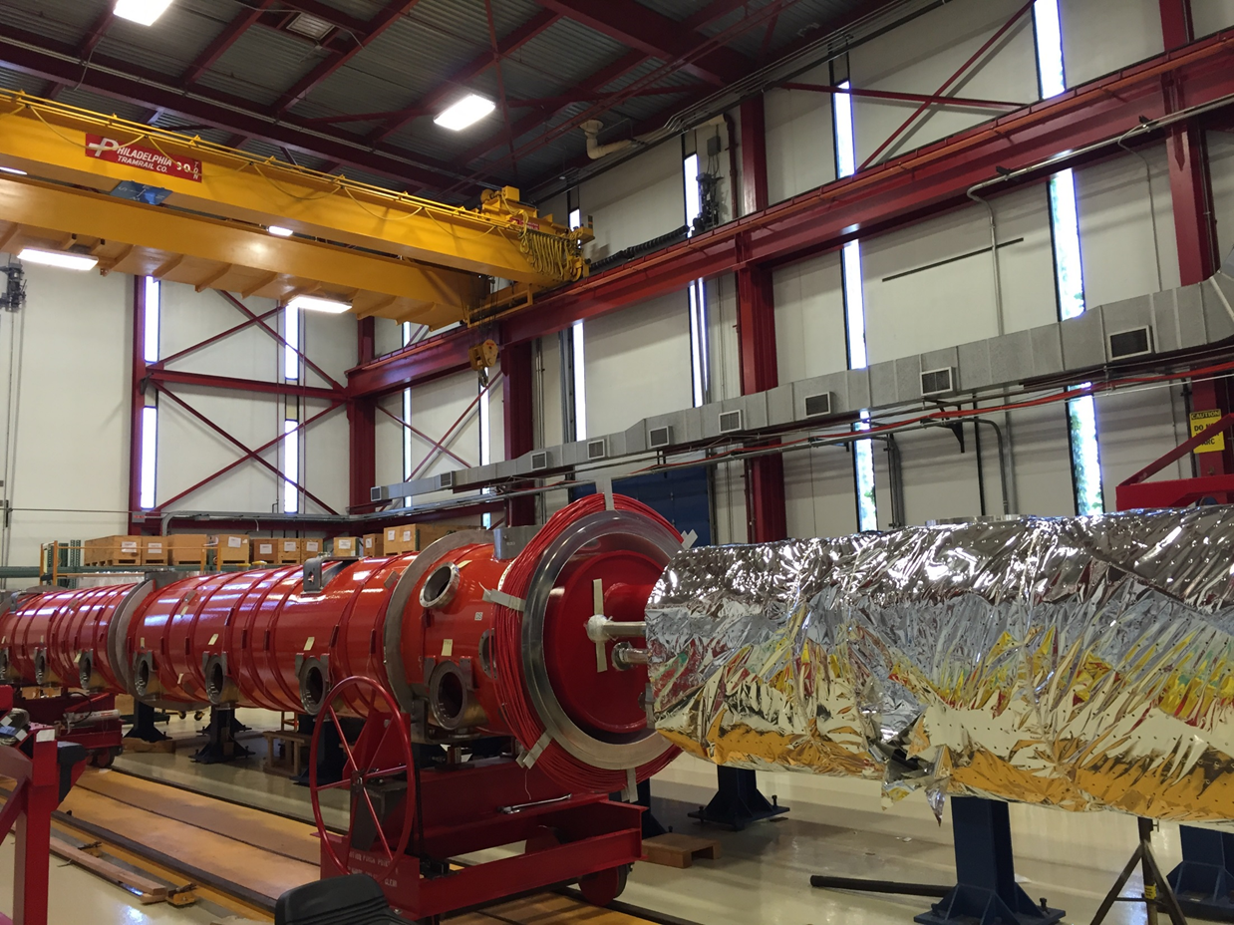
pCM

Slide 23
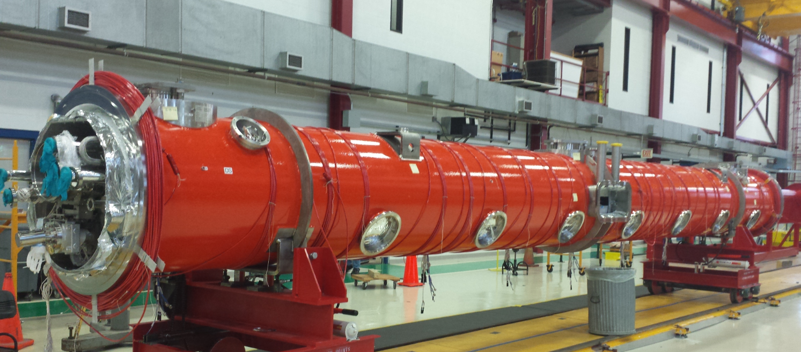
May 29, 2016

Slide 24
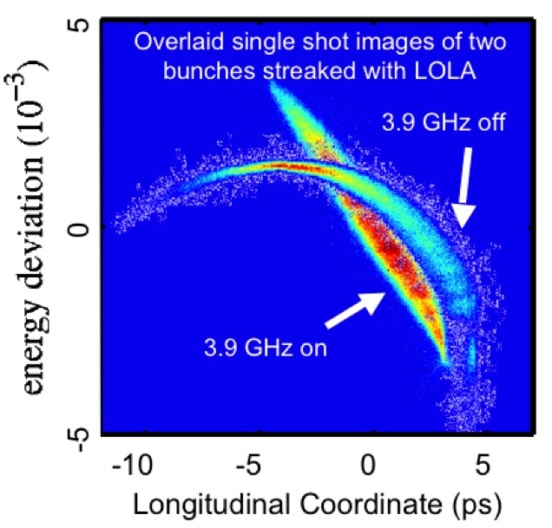
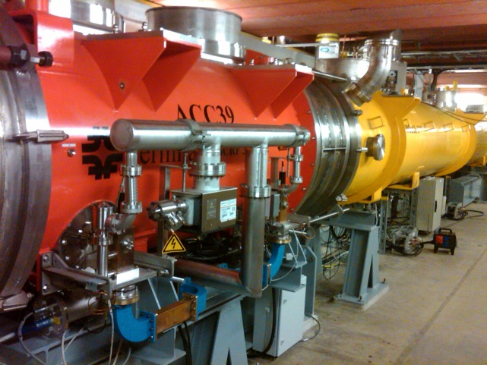
FLASH and XFEL - ACC39 performance
ACC39 routinely operates at 18.9 to 19.7 MV/m
  Capable of operation at 22 MV/m
    - Limitation set by thermal interlocks – concern about compromising HOM’s on cavities 3 & 5 (trimmed 2-post style)
Amplitude stability ≤ 2x10⁻⁵ pulse-to-pulse
Phase stability ≤ 0.003° pulse-to-pulse
24

Slide 25
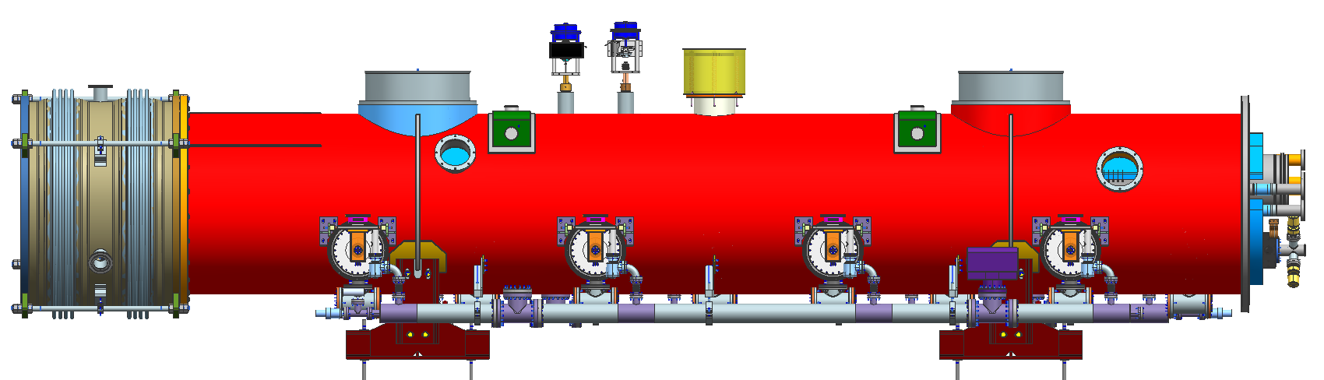
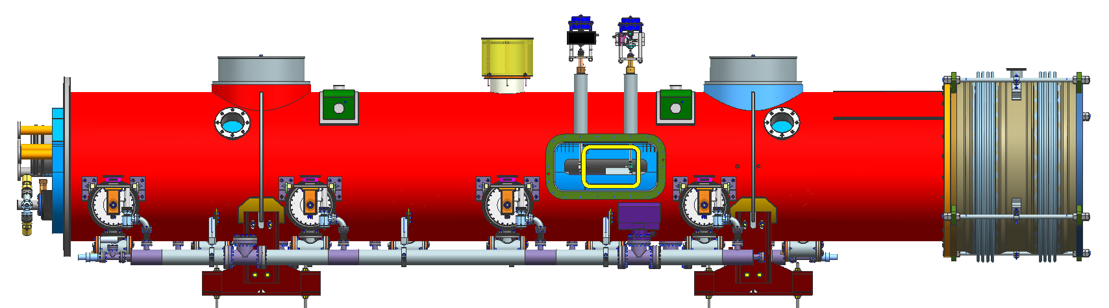
FNAL 3.9 GHz modules
8 cavities, BPM, No magnet

Slide 26
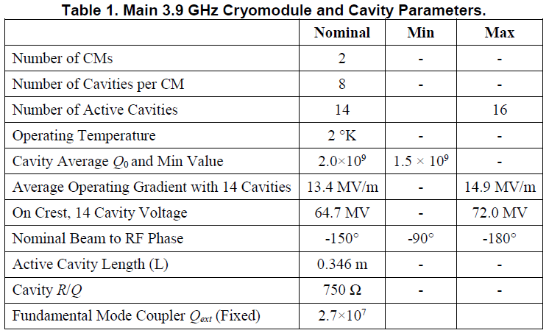
3.9 GHz modules
Cavity, main couplers, HOM re-designed to accommodate LCLS-II requirements and improve performance at cw regime

Slide 27
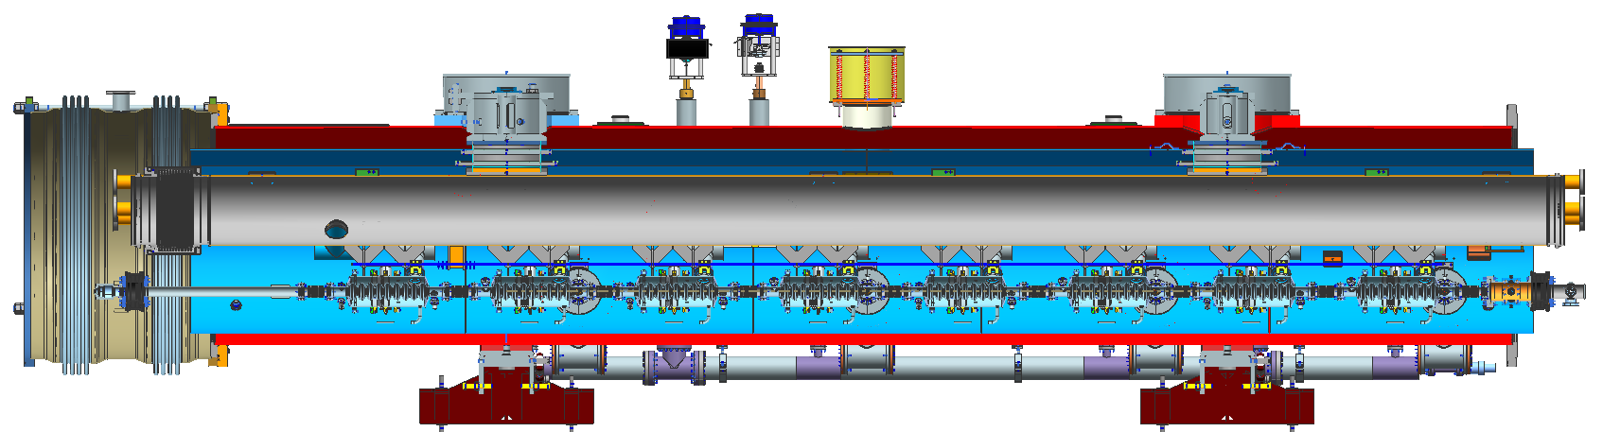
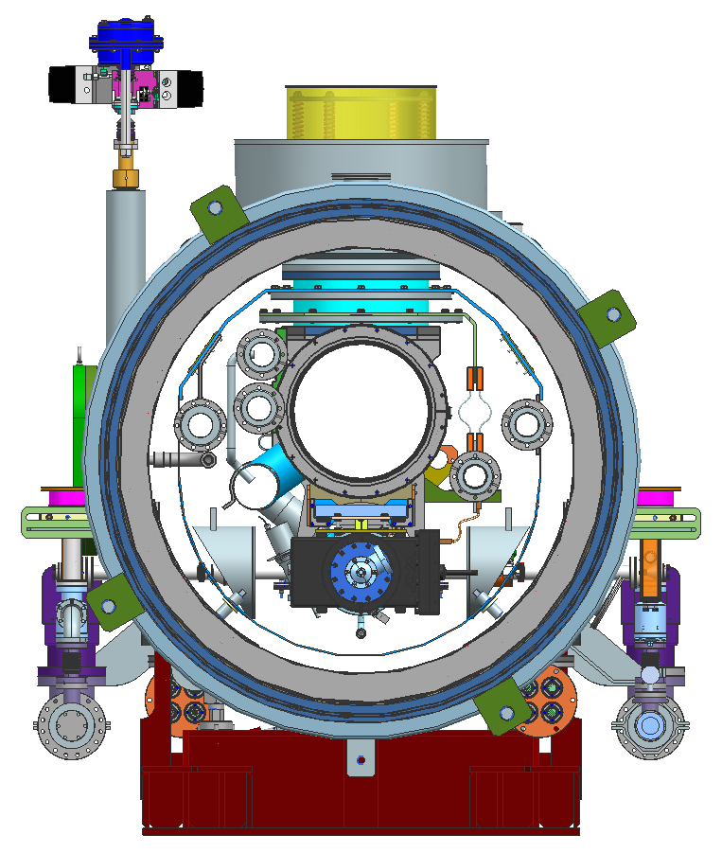
6554.5 mm (Cryomodule slot length)
Upstream end
Downstream end
BEAM
6253.0 mm (Gate Valve-to-Gate Valve faces)
Vacuum vessel
OD: 38” (965.2 mm)
Bellows interconnection
OD: 1160 mm
1820 mm
1656 mm
590 mm
3.75”
1500 mm

Slide 28
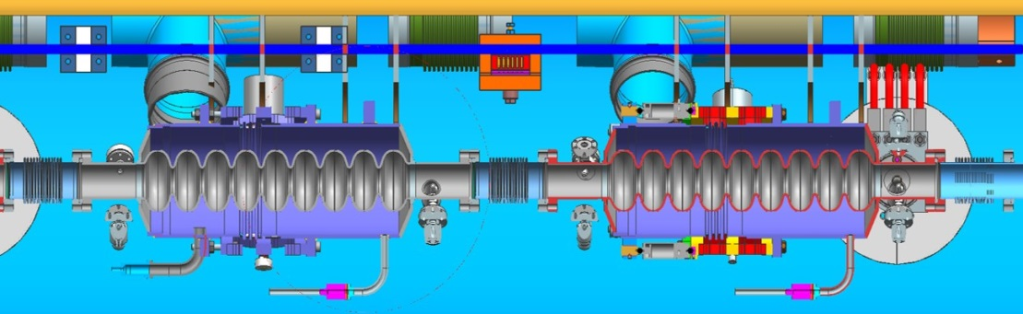
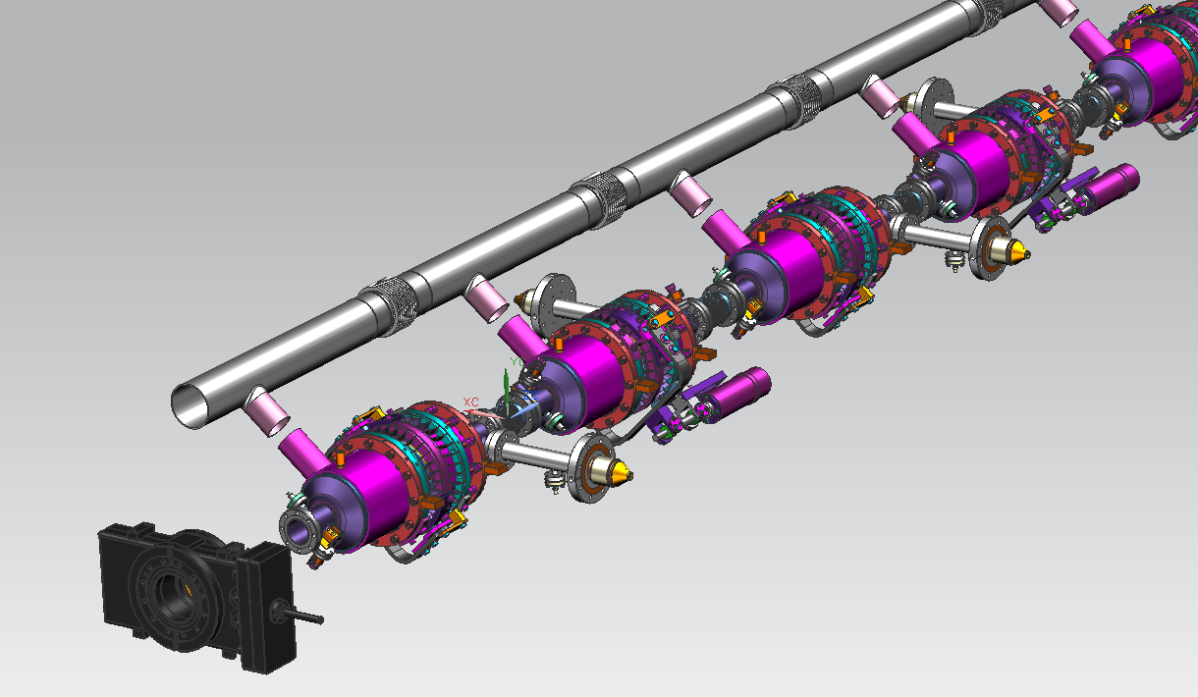
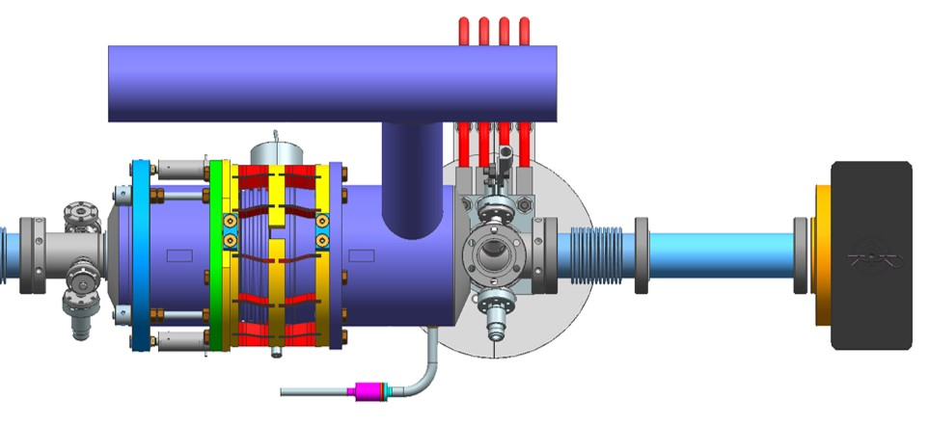
LCLS-II. 3.9GHz Cavity String (F10014812)
Blade tuner
Spool piece
Spool piece
and BPM
3.9 cavity Style-B
3.9 cavity Style-A
Gate Valve

Slide 29
Status 3.9GHz system
Design is almost completed
Prototyping
  Procurement 4 cavities awarded
  3 Coupler modification start (delivering Sept)
  Tuner ready
Design Verification program
  VTS and 120C baking study
  Coupler tests
  Dressed Cavity tests in HTS
Procurement of 3 CM’s
  LLP by the end of 2016
  2017

Slide 30
Thank you for your attention

