Slide 1
The IFIC-CLIC Collaboration:
KE2638/BE/CLIC
“Development of accelerator science and technologies associated with the CLIC accelerating structure design”
A. Faus-Golfe
A. Benot Morell
D. Esperante
C. Blanch
T. Argyropoulos
J. Giner Navarro
H. Schmickler
M. Wendt
N. Catalan Lasheras
W. Wuensch
with the support of the RF group at CERN

Slide 2
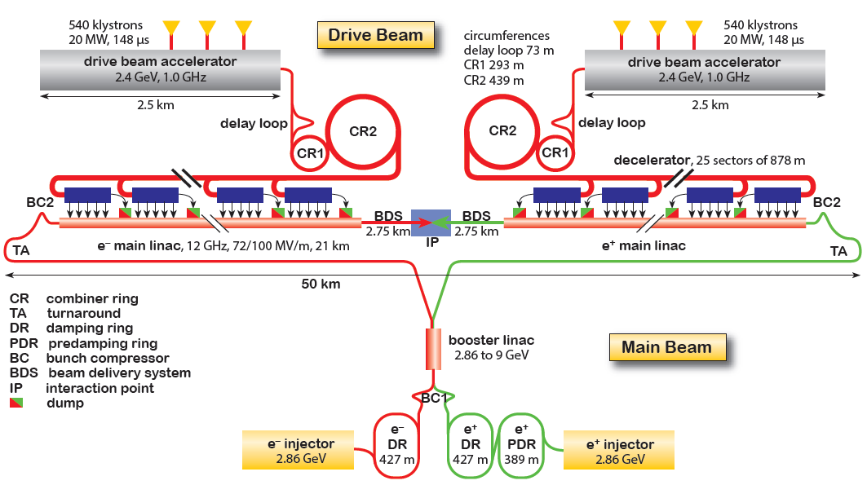
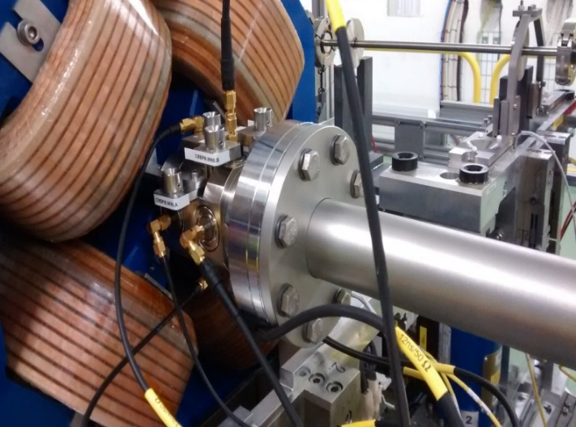
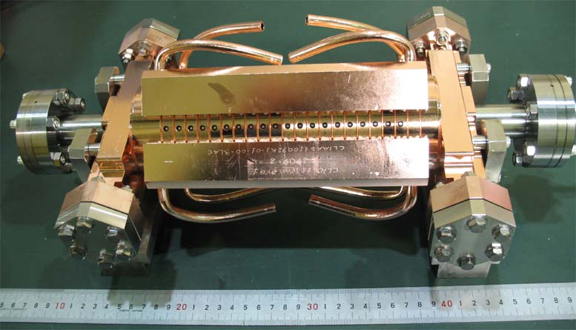
The Compact Linear Collider
Main Linac Accelerating Structures
(100 MV/m)
Drive Beam BPMs
CLIC Conceptual Design Report: A Multi-TeV Linear Collider based on CLIC technology (2012)

Slide 3
The WPs: Technical Specifications
WP1
The main objective is the installation of precision BPM into a CLIC prototype module and tests with beam at CLEX. Components of this BPM system have already been tested in the laboratory, now the entire system has to be completed and commissioned for beam tests. The beam tests shall validate the required resolution of 2um and the required accuracy of 20um under low and high power PETS operation conditions.
WP2
The primary experimental platform for testing and operating the HG X-band accelerating structures is a group of three klystron-based test stands at CERN known as XBOX-1 to XBOX-3. These test stands allow long-term conditioning and operation of accelerating structures with parameters exceeding the CLIC specifications – 65 MW input power, 170 ns pulse length and a repletion rate of 50 Hz. The test stands are also instrumented in order to develop the full operational algorithms; conditioning, breakdown recovery, pulse shaping, beam loading compensation etc. A very similar HG RF lab is being constructed at IFIC, also for high-gradient accelerating structures but with an emphasis on developing the RF system for medical therapy linacs. This installation can test RF devices with 7,5-10 MW power at 3 GHz (S-band) frequency. In WP2 the electrical setup of an XBOX and in particular the real time control system and Low Level RF (LLRF) is copied and adapted to the facilities at IFIC in Valencia. During their stay at CERN the CSIC Experts will learn the setup of an XBOX and get the necessary electrical components (hardware and software) engineered and produced at IFIC.
WP3
The primary experimental platform for testing and operating the high-gradient X-band accelerating structures is a group of three klystron-based test stands at CERN know as Xbox-1 to Xbox-3. These test stands allow long term conditioning and operation of accelerating structures with parameters exceeding the CLIC specifications – 65 MW input power, 170 ns pulse length and a repletion rate of 50 Hz. The test stands are also instrumented in order to develop the full operational algorithms; conditioning, breakdown recovery, pulse shaping, beam loading compensation etc. A very similar HG RF lab is being constructed at IFIC, also for high-gradient accelerating structures but with an emphasis on developing the RF system for medical therapy linacs. This installation can test RF devices with 7,5-10 MW power at 3 GHz (S-band) frequency. In WP3 the mechanical setup of an XBOX is copied and adapted to the facilities at IFIC in Valencia. During their stay at CERN the CSIC Experts will learn the setup of an XBOX and get the necessary mechanical components engineered and produced at IFIC.
WP4
Contribution to the laboratory tests, analysis of the results and RF analysis including relevant beam dynamics aspects, linac optimization and future developments of HG accelerator structures in the XBOX faciltiy at CERN and in the HG-RF lab at IFIC.

Slide 4
WP1: Stripline BPM Development for the CLIC Drive Beam
Aim:
  Development of Beam Position Monitors for the Drive Beam of CLIC
Specifications:
  2 μm spatial resolution
  10 ns time resolution
  Insensitive to 12 GHz PETS RF power signals
First prototype Stripline BPM
  Compact model (short-circuited electrodes)
  Installed in the Test Beam Line (TBL) at CTF3 and tested with beam
Second prototype Stripline BPM
  50-Ω terminated electrodes (8 ports)
  2 units installed in the CLIC Two-Beam Module (TBM)
  Enhanced 12 GHz suppression
  Beam tests in progress

Slide 5
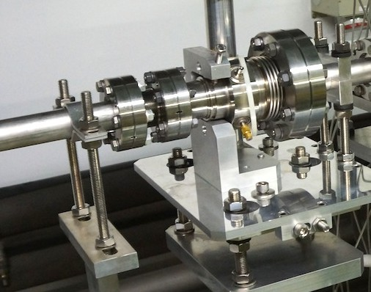


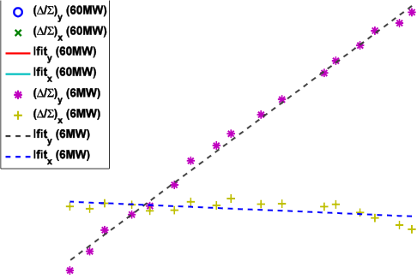



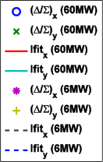
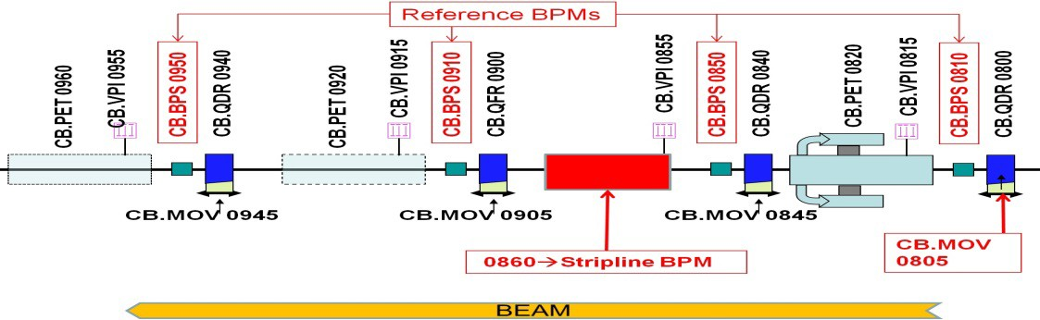
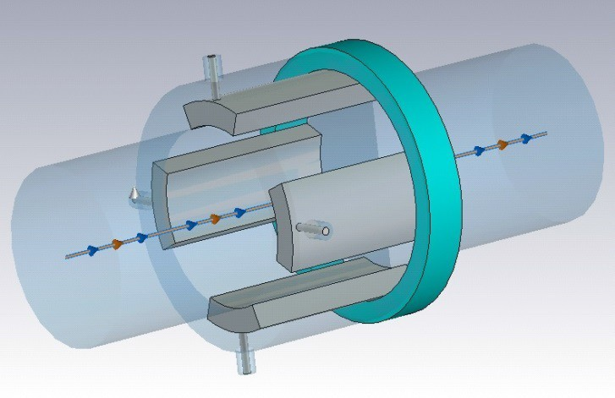

• Stripline prototype with short-­‐ circuited electrodes installed in TBL at CTF3.
• Linearity and Sensitivity parameters successfully tested with beam for 6 MW and 60 MW of extracted PETS power.
Notes:
In this slide we can see a diagram showing the test layout of the TBL line: the stripline BPM under test is at positions 0860, the values read by the neighboring BPMs at positions 0850 and 0910 are used as reference and the beam is displaced using the mover at position 0805 . The plots show the measured horizontal and vertical normalized positions (delta/sigma) read by the BPM 0860 against the reference positions (interpolated from 0850 and 0910) of the beam when being displaced on each plane. The only remarkable effect of the increase in extracted PETS power from 6 to 60 MW is a variation in the offset of the coordinate not being swept. The resolution and 12 GHz suppression requirements are not met (please see frequency response plot next slide)

Slide 6
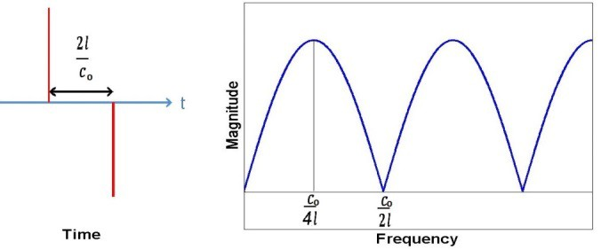
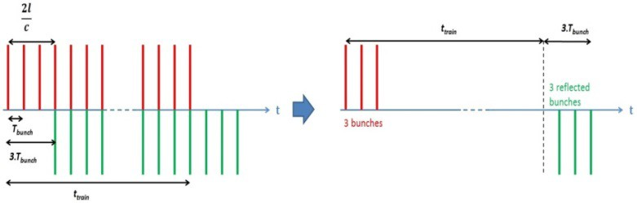
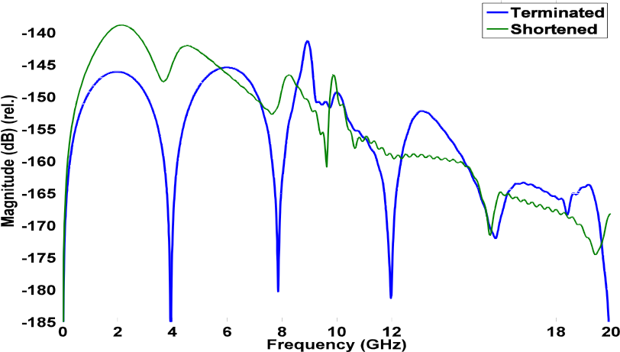
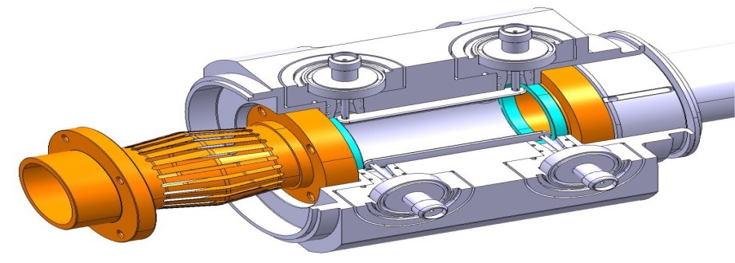
Stripline BPM Prototype for the CLIC TBM
• Enhanced PETS interference suppression at 12 GHz (*) (blue trace) compared to the first prototype (green trace).
• 2 Stripline prototypes with 50Ω­‐-terminated electrodes developed for CLIC Module.
• 8‐ -port design for increased notch tunability and loop-­‐ -through calibration.
(*)
resonance due
to TM₁₀ in the
vacuum chamber
Parameter | Shortened BPM | Terminated BPM
Stripline length | 25 mm | 37.5 mm
Angular coverage | 12.5% (45°) | 5.55% (20°)
Electrode thickness | 3.1 mm | 1 mm
Outer radius | 17 mm | 13.54 mm
Ch. Impedance | 37 Ω | 50 Ω
Duct aperture | 23 mm | 23 mm
Resolution | 2 μm | 2 μm
Accuracy | 20 μm | 20 μm
Time Resolution | 10 ns | 10 ns
A. Benot- Morell et al. “Status of the Stripline Beam Position Monitor Development for the CLIC Drive Beam”, in Proc. IBIC’13, Oxford, United Kingdom, Sept. 2013, paper TUPC12, pp. 384-387.
Notes:
In this slide we observe the frequency response of the second prototype stripline BPM (blue trace), providing an improved notch filter effect at 12 GHz compared to the first prototype (green trace)

Slide 7
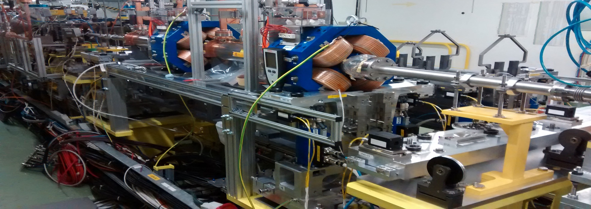
CLIC Two-Beam Module (TBM) Installation
STRIPLINE BPM DEVELOPMENT FOR THE CLIC DRIVE BEAM
STRIPLINE BPM DEVELOPMENT FOR THE CLIC DRIVE BEAM
BEAM
STRIPLINE BPMs
  Two installed units:
    CM.BPL0645
  CM.BPL0685
Beam tests in progress:
  Linearity/Sensitivity (December’15)
  Resolution (December’15)
  Sensitivity to 12 GHz PETS power increase (April’16)

Slide 8
WP1: Future work ( to be finished in June 2016 )
WP1: Summary
The first stripline BPM prototype (short-circuited electrodes) offers poor rejection of the 12 GHz PETS power signals.
The resolution of the two BPM prototypes with terminated electrodes has been estimated under realistic beam conditions and meets the requirement of 2 μm.
The position reading of the two BPM prototypes with terminated electrodes is almost insensitive to an extracted PETS power increase from 2.4 MW to 40 MW at 12 GHz via recombination.
Effect of power recirculation in PETS still needs to be studied.
Publication of obtained results:Peer reviewed journal: PRST-AB, NIM…

Slide 9
WP2, 3 and 4: High-Gradient Accelerating Structures Studies in CLIC and Application for Medical Accelerators
Two Aims:
  Contribution to the CLIC HG structures testing
  Applications to medical structures
Two aspects
  Measurements and analysis of the results (WP4)
  Hardware design and construction: electronics (WP2) and mechanics (WP3)
Two sites
  Xboxes at CERN
  HG RF lab at IFIC

Slide 10
High-Gradient technology: Motivation
Recent developments in design and production of normal-conducting RF structures raised the achievable accelerating gradient of 20-100 MV/m.
High-Gradient technology could be exploited in certain applications:
Future Linear Colliders X-band (12GHz)
  Leptonic collisions for HEP studies via linacs to avoid synchrotron radiation losses. High-Gradient offers compactness.
Free Electron Lasers (FEL) C-band (5.7GHz)
  Linac-driven FELs provide high-intensity X-rays sources, with important applications in molecular and atomic scale research. High-Gradient would allow to build smaller facilities.
Proton and Carbon ion therapy (hadron therapy) S-band(3GHz)/C-band
  Linacs offer higher flexibility for treatment than rings. High-Gradient would ease the integration of linacs in treatment facilities and hospitals

Slide 11
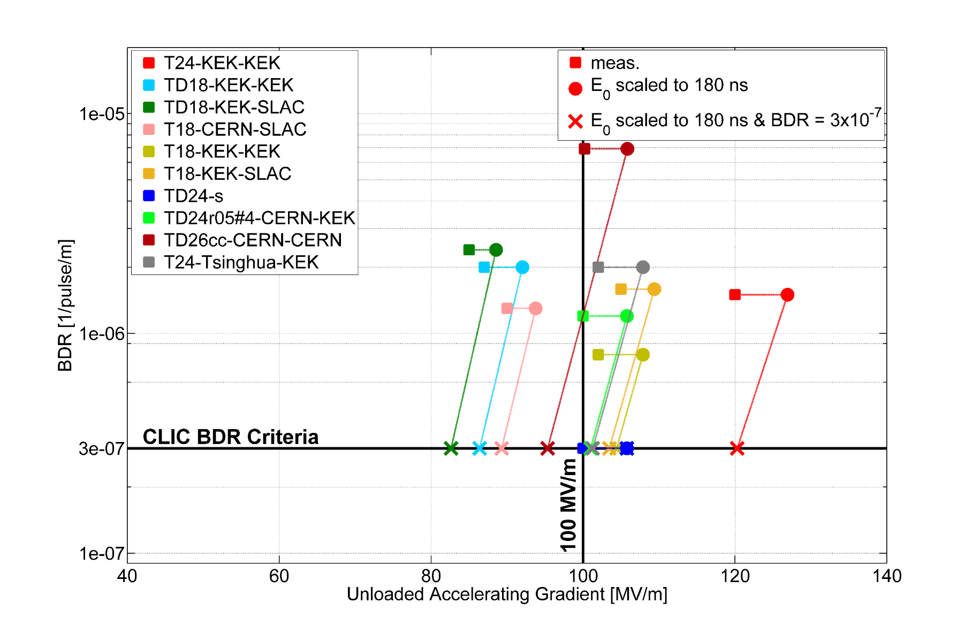

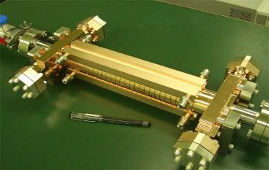
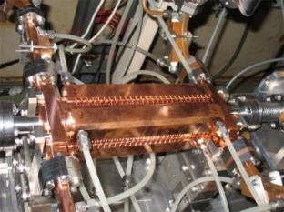
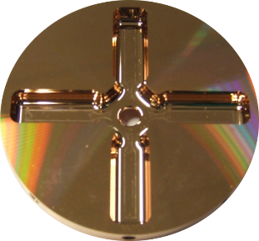
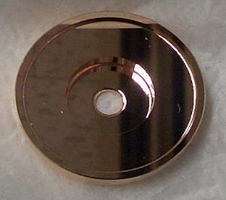
The CLIC High-Gradient testing programme
Different CLIC prototypes of accelerating structures have been tested so far at CERN, KEK (Japan) and SLAC (USA), and high gradients above 100 MV/m have been achieved at low breakdown rate.
Different prototype designs
Expected Gradient of operation at CLIC requirements
(180ns 3e-7bpp/m)
Notes:
Different CLIC designs have been constructed and tested at CERN, SLAC and KEK, and here we present a summary of their results in the framework of the CLIC High-gradient testing programme.
Squared dots are actual measurements of BDR at a fixed Unloaded Gradient (E0) and pulse length (tau)
These measurements are scaled (circles and crosses) to know the expected Gradient achieved at CLIC nominal specifications (BDR<3e-7bpp/m, pulse length 180 ns) using empirical scaling laws BDR~E0^30 tau^5.
High gradients above 100 MV/m have been achieved.

Slide 12
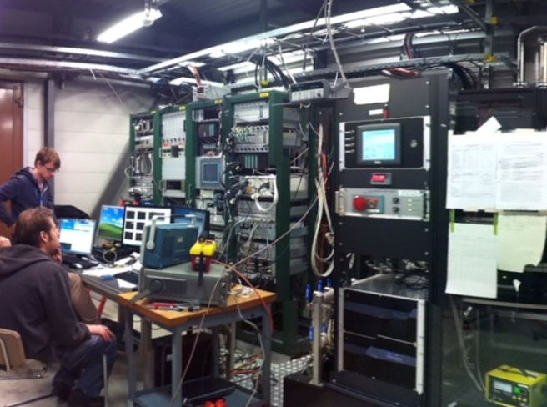
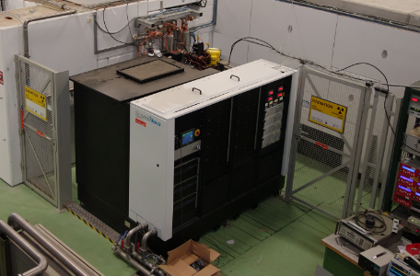
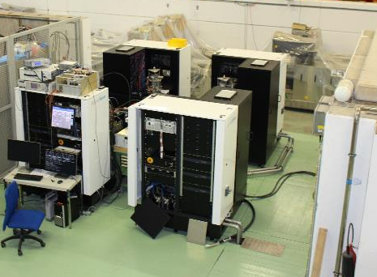
The Xboxes at CERN
The CLIC collaboration started the establishment of three X-band (12 GHz) klystron-based test stands at CERN, to support the development of high-gradient accelerating structures and high-power, 50-100 MW range, and rf components for the CLIC project.
Xbox-1
Xbox-2
Xbox-3
At CTF3
OPERATIONAL
OPERATIONAL
COMMISSIONING 2016
CPI 50MW 1.5us klystron
Scandinova Modulator
Rep Rate 50Hz
Beam test capabilities
CPI 50MW 1.5us klystron
Scandinova Modulator
Rep Rate 50Hz
4x Toshiba 6MW 5us klystron
4x Scandinova Modulators
Rep Rate 400Hz
Previous tests:
2013 TD24R05 (CTF2)
2013 TD26CC-#1 (CTF2)
2014-15 T24 (Dogleg)
Previous tests:
2014-15 CLIC Crab Cavity
Medium power tests (Xbox-3A):
2015 3D-printed Ti waveguide
2015 X-band RF valve
Ongoing test:
Aug2015- TD26CC-#1 (Dogleg)
Ongoing test:
Sep2015- T24OPEN
N. Catalan-Lasheras et al, Experience operating an X-band high-power test stand at CERN, Proceedings of IPAC14
Notes:
The CLIC collaboration started the establishment of three X-band (12 GHz) klystron-based test stands at CERN, to support the development of high-gradient accelerating structures and high-power, 50-100 MW range, and rf components for the CLIC project.
The Xboxes are the RF power source and control/acquisition system to perform the High-Gradient test of CLIC prototypes.
Xbox-1 is installed in the CLIC Test Facility CTF3 (next slide), and Xbox-2 and 3 are constructed in an independent building.

Slide 13
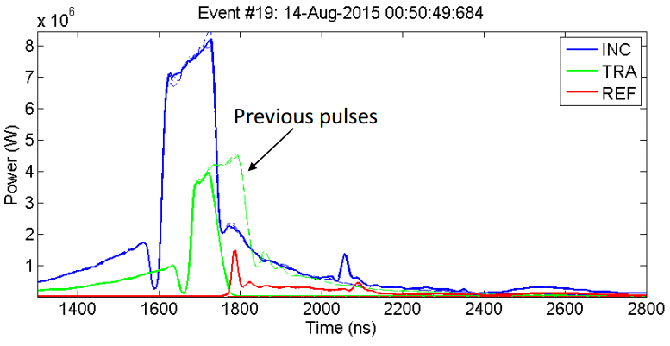
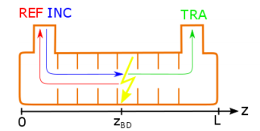


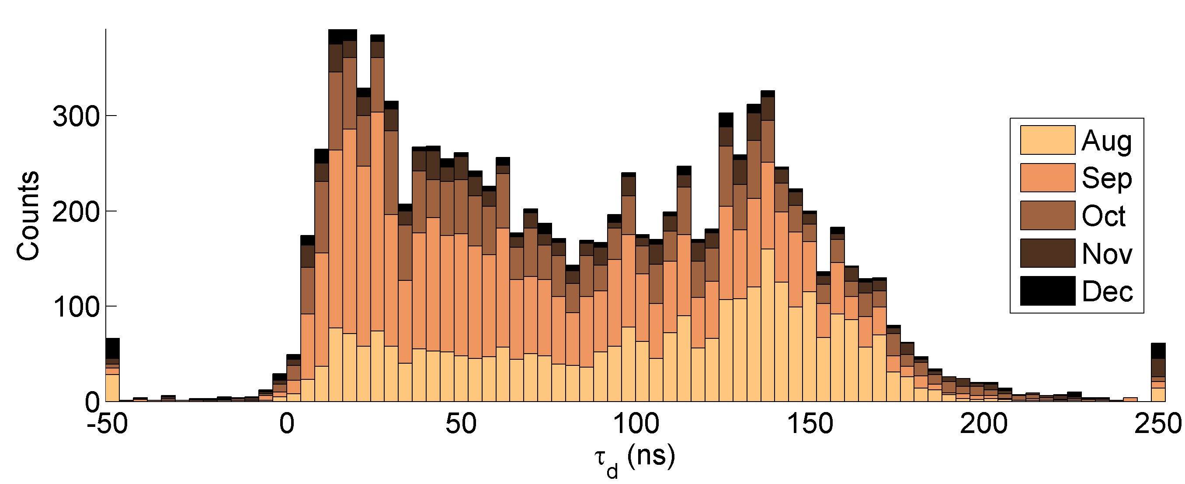

High-Gradient studies
Breakdown positioning in tested structures
Diagnostics of where the breakdown is triggered inside the structure during the testing can be done by analysing the RF signals.
When breakdown occurs:
Transmitted power drops
Reflected power rises
Trip time delays, combined with RF group velocity v_{g}, gives the onset position of the breakdown.
In the structure
Breakdown counts
Breakdown position t_{TRA}-t_{REF} (ns)

Slide 14
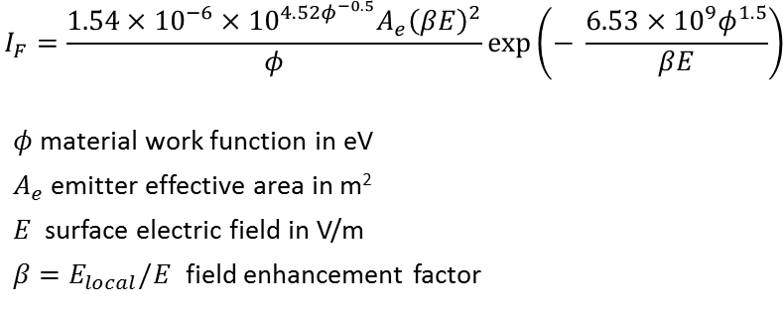
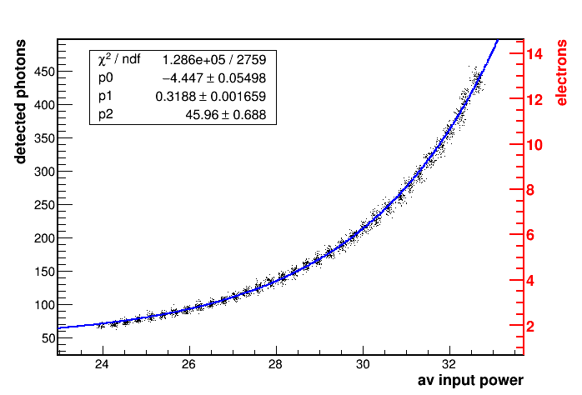
High-Gradient studies
Field emission radiation
The existence of micro-protrusions on the surface produces local electric field enhancement that generate field-emitted electrons.
Field emitted current in Amperes
E
E_{local}
J.W. Wang and G.A. Loew, PUB7684, SLAC (1997)
Field emitter
Meas. Xbox-2 with BLM (March 2016)
Emitted electrons (Dark Current) is measured by:
Faraday Cups
Beam Loss Monitors (BLM)
Radiation Monitors
Field-emitted electrons
Notes:
Important study since the Electron field emission creates so-called “dark current" which parasitically absorbs RF energy, causes radiation, backgrounds, and possibly wakefields.
Also it seems to be the precursor of RF breakdown, possibly in combination with local outgassing and plasma formation.

Slide 15
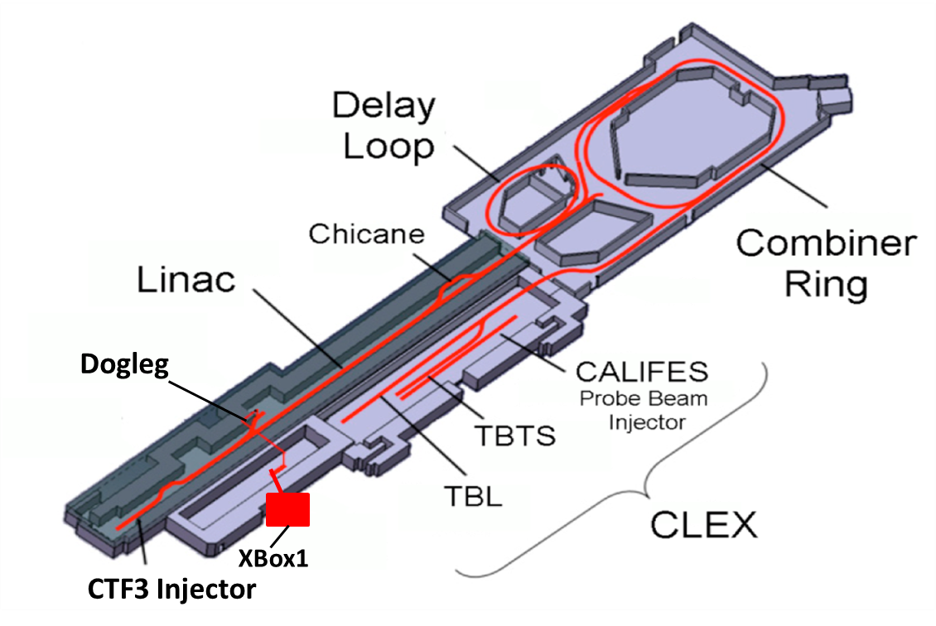
Xbox-1 Dogleg Beam-loading experiment
The CLIC Test Facility CTF3 was built at CERN by the international collaboration to demonstrate the key feasibility issues of the two-beam acceleration technology and test the Main Linac accelerating structures at nominal gradient.
Xbox-1 is integrated in the CTF3 and has been connected to the Dogleg Beam line to perform beam-loading high-gradient tests.

Slide 16
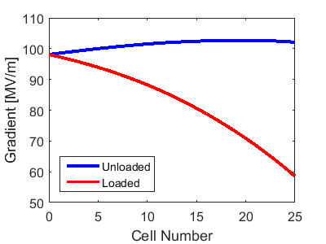
Xbox-1 Dogleg Beam-loading experiment
All the high-gradient tests performed so far where made without the presence of beam, achieving unloaded gradients of 100 MV/m.
The beam traversing the structure alters the field distribution.
What is the effect on the Breakdown Rate?
Analytical calculations of the accelerating gradient inside the TD26CC structure without beam (unloaded) and with beam (loaded)
The Dogleg Beam-loading experiment aims to study for the first time the effect of the presence of beam on breakdown rate performance in a CLIC high-gradient prototype.

Slide 17
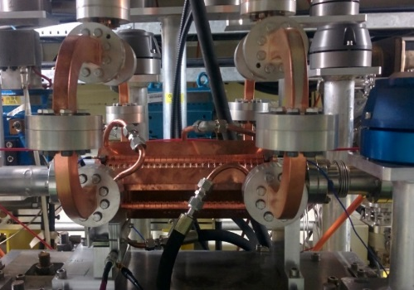
Xbox-1 Dogleg Beam-loading experiment
RF+Beam Test facility
Xbox-1 provides the high-power RF source (12GHz, 43 MW input of the structure)
CTF3 Linac provides the beam through the structure (1.6 A, 3 GHz, 125 MeV)
XBOX1
12 GHz RF
90 MW
50 Hz rep rate
TD26CC structure under test
35 m low loss waveguide
MKS02
3 GHz RF
High Gradient Accelerating Structure
MKS03
MKS05
MKS06
MKS07
Gun

Slide 18
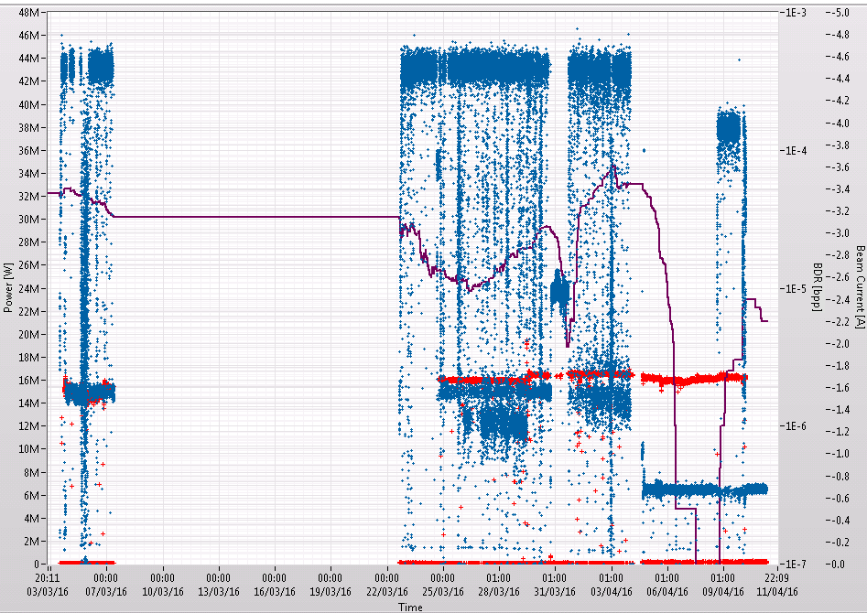
Xbox-1 Dogleg Beam-loading experiment
Beam-loading measurements March-April 2016
First measurements of breakdown rate with beam in a CLIC-G TD26CC structure:
Unloaded (no beam)
Loaded (accelerated)
Anti-loaded (decelerated)
Input Power [W]
Beam Current [A]
Breakdown Rate [bpp]
04-March-2016
10-April-2016 … ongoing
Date time
Notes:
First measurements of BDR with beam (loaded/accelerated (red boxes) and antiloaded/decelerated (green box)) have been made, in order to be compared to the Unloaded (without beam, blue boxes) measurements.
The beam current was around 1.6 A. Each block of measurements can last from 1 to 5 days. Usually the runs with beam (loaded or anti-loaded) are done during the weekends.
These measurements started at the beginning of March and further measurements are ongoing to accumulate more statistics.

Slide 19
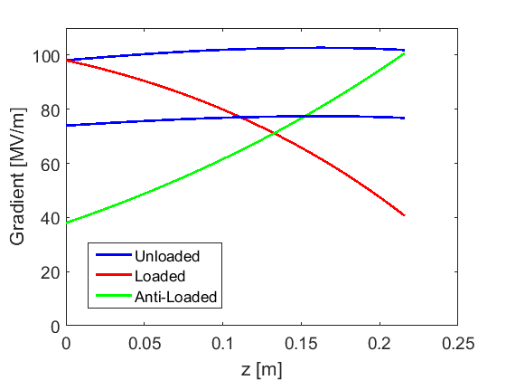
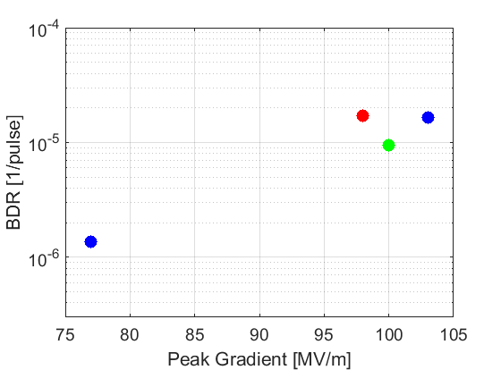
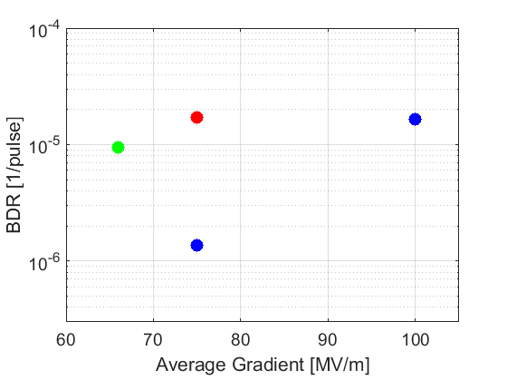
Xbox-1 Dogleg Beam-loading experiment
Beam-loading results and conclusions
Acc. Gradient inside structure at chosen measurements
Similar Breakdown Rates are obtained for those field-distributions with same peak gradient, despite the average gradient is much different.
Breakdown Rate is dominated by the peak Gradient inside the structure
Unloaded
(flat)
Loaded
(first cells)
Anti-Loaded
(end cells)
Notes:
Four sets of measurements are presented here.
1. The unloaded case with 100 MV/m (maximum input power 43 MW for which the structure and also the waveguide network/Pulse compressor has been conditioned, not easy to go higher). Top blue line in the top right figure.
Note that due to losses in the long waveguide network the power there needs to be much higher than 43 MW.
2. The loaded case with the same input power (43 MW). Red line in the top right figure. As you can see in the figure the peak gradient is around 100 MV/m as before but the average gradient is much lower (~75 MV/m).
3. In order to have also the same average gradient between the loaded and unloaded cases we also did measurements of unloaded with lower input power (24 MW) which gives an average gradient of 75 MV/m. Bottom blue line in the top right figure.
4. Finally the anti-loaded case (green line) was also studied for an input power that gives a peak gradient of 100 MV/m.
The results of the breakdown rate for all the cases with respect to peak gradient (left bottom figure) and the average gradient (right bottom figure) show that the Breakdown rate is dominated by the peak gradient inside the structure

Slide 20
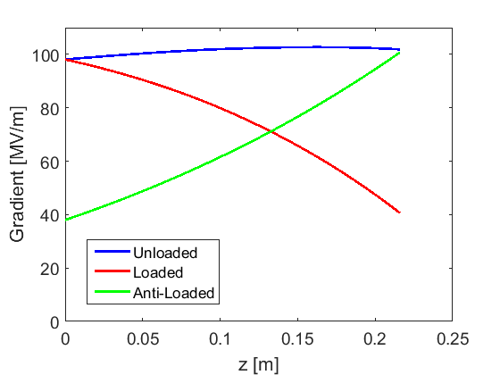
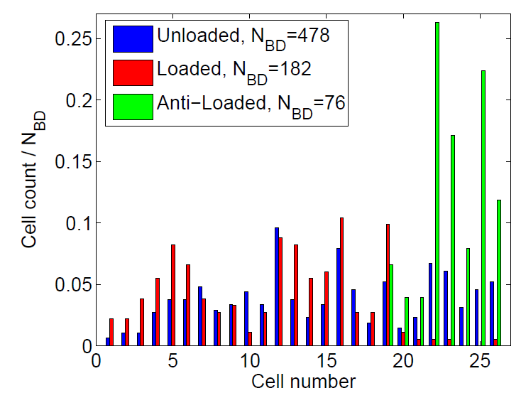
Xbox-1 Dogleg Beam-loading experiment
Beam-loading results and conclusions
Same conclusions are extracted from the localization of breakdowns inside the structure: breakdowns are accumulated in the regions of higher fields
Unloaded: Uniform probability of breakdowns
Loaded: Breakdowns at the first half
Anti-Loaded: Breakdowns at the second half
Loaded
(peak at first cells)
Unloaded (flat fields)
Anti-Loaded
(peak at end cells)
Acc. Gradient inside structure at chosen measurements

Slide 21
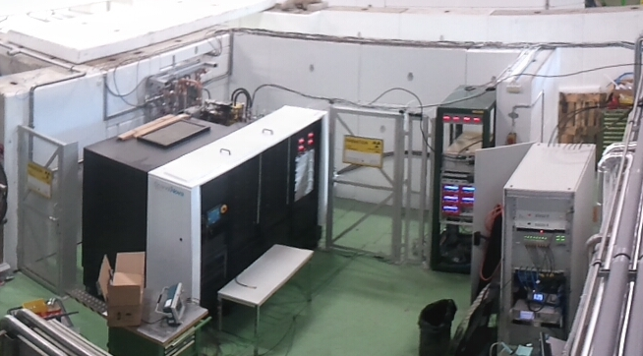
Xbox-2 test stand
The Xbox-2 is the second generation of CLIC high-power klystron-based test stands at CERN.
Same infrastructure design as Xbox-1.
Independent from the CTF3 facility.
Close access to the bunker where the accelerating structure is tested.
RF Power capabilities: up to 150 MW 200 ns
BUNKER:
Acc. Structure under test
Pulse compressor
Klystron
TWT
LLRF
Modulator

Slide 22
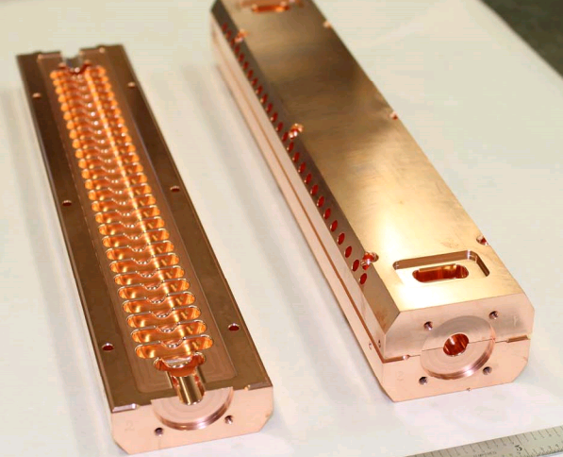
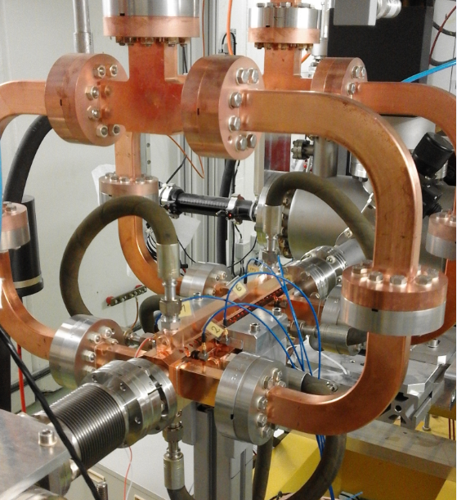
Xbox-2 test stand
The structure under test: T24-OPEN
A new prototype design, named CLIC-G “OPEN”, was designed and built by CERN and SLAC.
The structure is manufactured (SLAC) in two halves, which are later brazed together. This gives a number of advantages compared to traditional structures in which individual cells are brazed together:
Reduction of the number of pieces per structure to only two and a significantly decrease in surface area to be machined.
Free choice of joining because there are no RF currents between halves: brazing, welding…
Overall reduction of the total fabrication cost of the structure.
T24-OPEN installed at Xbox-2
A. Grudiev, H. Zha, V. Dolgashev

Slide 23
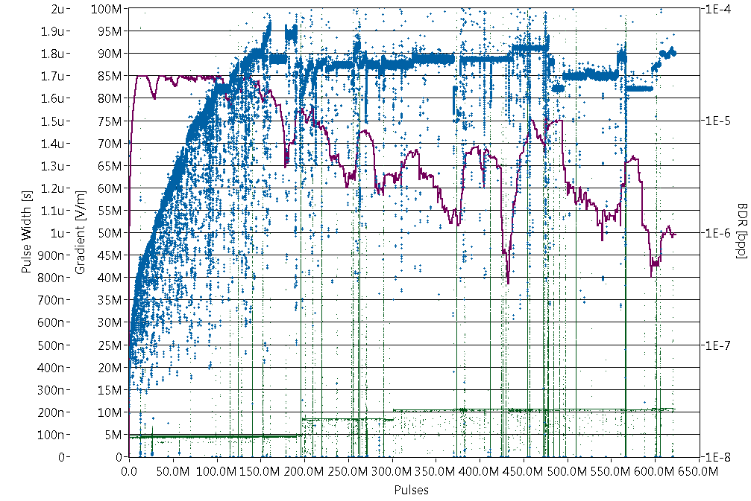
Xbox-2 test stand
Full history: T24-OPEN
100 MV/m
Gradient
BDR
Structure being well conditioned towards 100 MV/m at BDR below 1x10⁻⁶ BD/pulse
Operation is restricted by radiation in the test area
75 ns
155 ns
200 ns
Pulse width
4-Sep-2015
Cumulative Number of Pulses
24-May-2016 …
Notes:
The history of the test of the T24-OPEN structure from September 2015, and still ongoing.
Structure was initially conditioned at a short pulse length (75 ns), which was increased later to 155 ns and 200 ns.
The structure has being conditioned very well close to 100 MV/m, with a BDR below 1e-6 BD/pulse.
Power couldn’t be increased further because of restrictions of radiation shielding in the test area. Extra shielding on the bunker roof to be installed in the upcoming weeks will allow to achieve higher gradients.

Slide 24
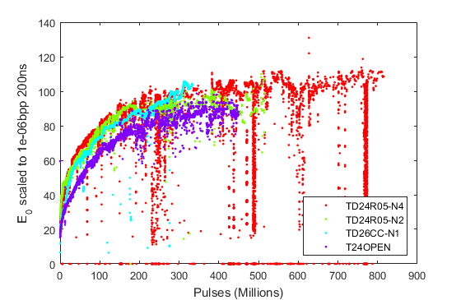
Xbox-2 test stand
High-gradient studies: Conditioning process
Comparative studies of conditioning of different prototypes allows a general characterization of the conditioning process in high-gradient structures.
The T24-OPEN structure follows the same conditioning trend as previously tested structures with different design.
Previously tested
T24OPEN
Xbox-2
Notes:
Here is a plot comparing the scaled Gradient for different structures.
(In case they ask): For the T24-OPEN the gradient is lower but the modified Poynting vector (S_{c}, used in design as a constraint for breakdowns) as well as the surface electric field for the this structure is 20% higher with respect to the others.
The S_{c} fits better with conditioning curves of previous tests in other disk-based structures.

Slide 25
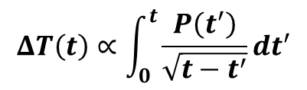
Xbox-2 test stand
High-gradient studies: Pulse shape dependence
The shape of the high-power pulse that feeds the accelerating structure could be relevant for its performance.
We want to find whether there is a Pulse shape dependence on the Breakdown Rate or not.
Two pulse shape configurations are used:
Power
P(t)
Using directly Klystron Output power
Using Pulse Compressor
Time t
Time t
Temperature Rise of the copper is different for each pulse:
The difference in temperature can alter the effective surface fields which will impact on the breakdown rate.
Notes:
The study is still ongoing for collecting more data (more breakdowns) to increase the statistics and better understand the effect.

Slide 26
WP4: Summary XBOXes
Xbox-1/Dogleg Beam-loading experiment at CTF3: study for the first time the effect of beam on breakdown rate in a CLIC high-gradient prototype.
  Breakdown Rate is correlated by the peak Gradient inside the structure
Xbox-2: conditioning of the new prototype design T24OPEN.
  Same conditioning trend as previously tested structures with different design.
HG studies in both test-stands:
  Conditioning process optimization
  Breakdown positioning in tested structures
  Field emission radiation
  Pulse shape dependence of the Breakdown rate
  …

Slide 27
The XBOX3
Aim:
  High-gradient research topics at X-Band 11.994 GHz
Technical specifications:
  X-Band (2.9985 GHz)
  Pulsed High Power RF (HPRF):
    4x Toshiba 6 MW 5us klystron
    4x Scandinova Modulators
    High power waveguide RF network that allows power combining: enables to test 4 structures at a time at up to 12 MW, 400 Hz repetition rate
  Low level RF (LLRF): RF generation (up-mixers and dow-mixers), log-detectors, trigger-interlock crates, real-time control and acquisition system with fast system interlock based on Ni-PXI (National Instruments)
  Running on Ultra-High vacuum (10⁻⁹ mbar)
Notes:
Low level RF (LLRF):
RF generation:
PLL (Phase Locked Loop) RF synthesizer: It generates the needed RF carriers to generate the RF and up-mix to the Klystrons (9.6 GHz and 2.4 GHz) and also generates the RF carriers to down-mix the RF signals from the system that will be analyzed (11.6 GHz)
Up-mixer and Down-mixers: Up-mix the RF to the Klystrons (move the modulated signal from 2.4 GHz to 12 GHz) and down-mix the RF signals from the system that will be analyzed (from 12 GHz to 400 MHz)
Log-detectors: is needed for break-down detection and RF power disable. Reflected signals are continuously being monitored using a logaritmic dectector. The logaritmic detector translates de measured power into logaritmic scale in order to measure a larger dinamic range (~45 dB).
Trigger-interlock crates: In adapts the input and output voltage signal levels from the NI-PXI to the rest of the setup
Real-time control and acquisition system with fast system interlock based on Ni-PXI (National Instruments)

Slide 28
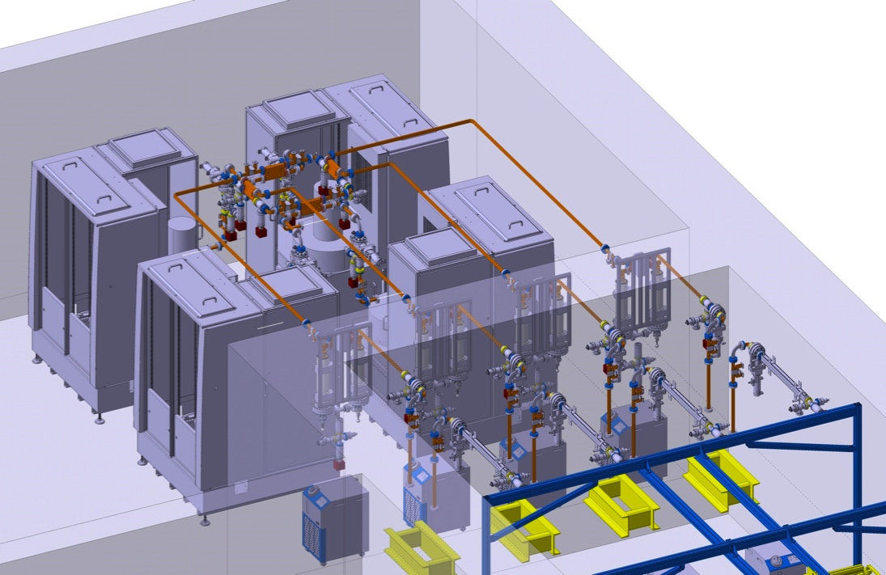
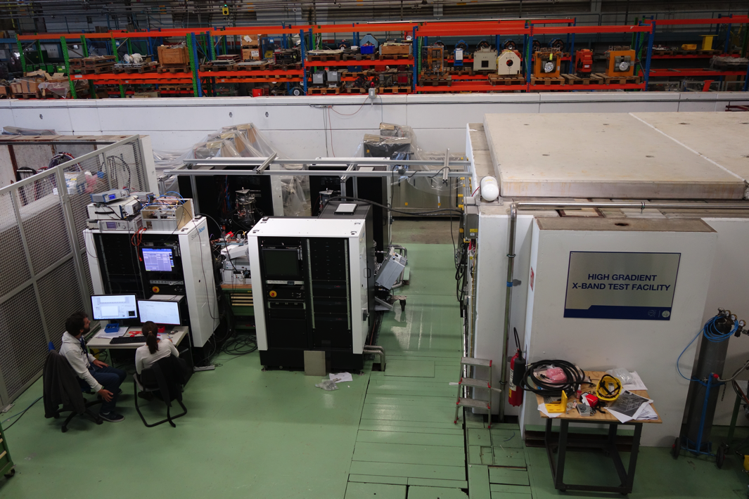
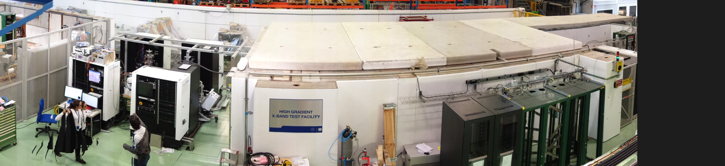
The XBOX3 inspiration
XBOX3 is a ‘clever’ way to convert the high rep. rate into the bigger number of testing slots with high peak power.
Klystron + modulator
Klystrons + modulators
Bunker, DUTs inside
Pulse comp.
DUTs
Klystrons + modulators
XBOX2
Bunker, DUTs inside
Racks for LLRF

Slide 29
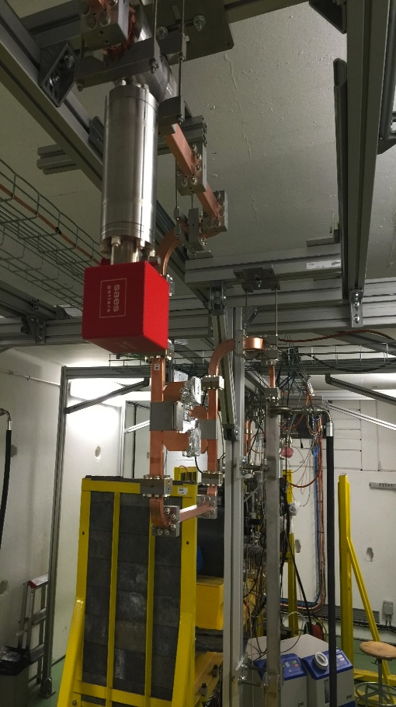
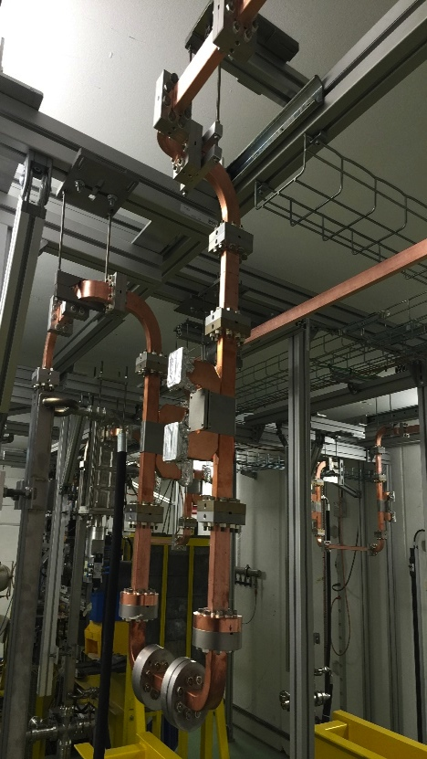
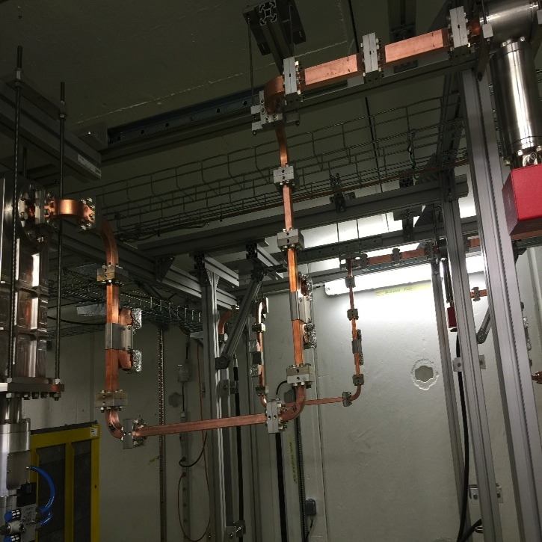
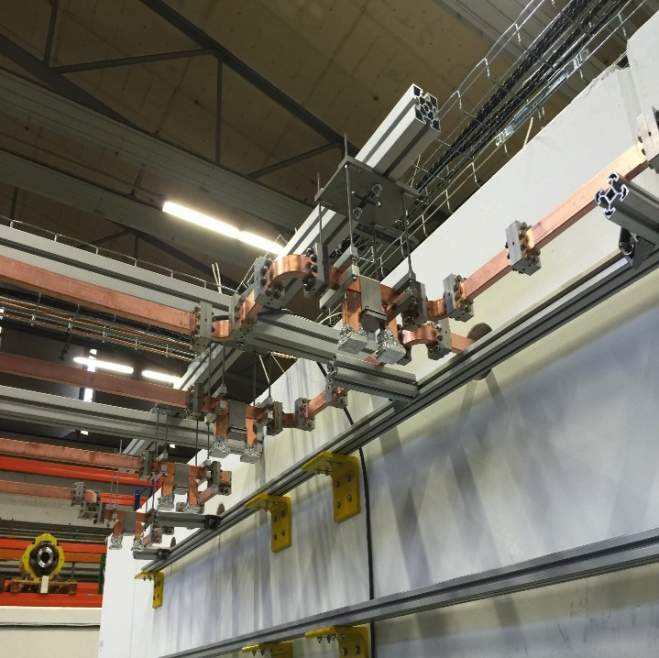
Xbox3 RF network installed and under vacuum
WP2: Working in the construction of the LLRF and commissioning

Slide 30
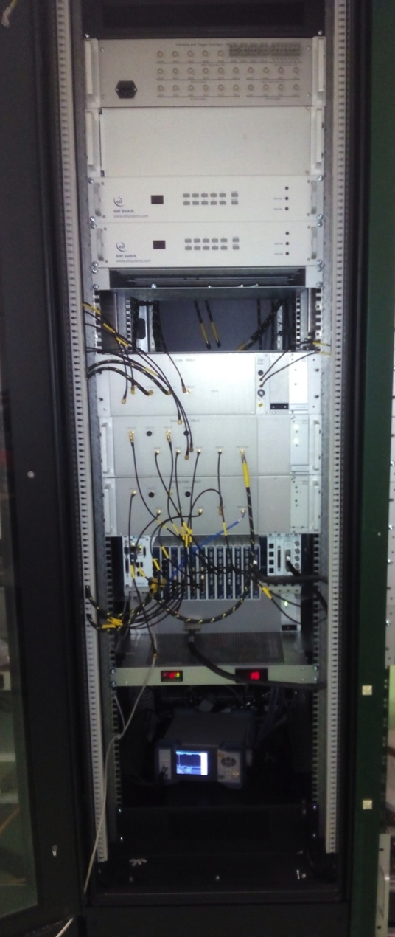
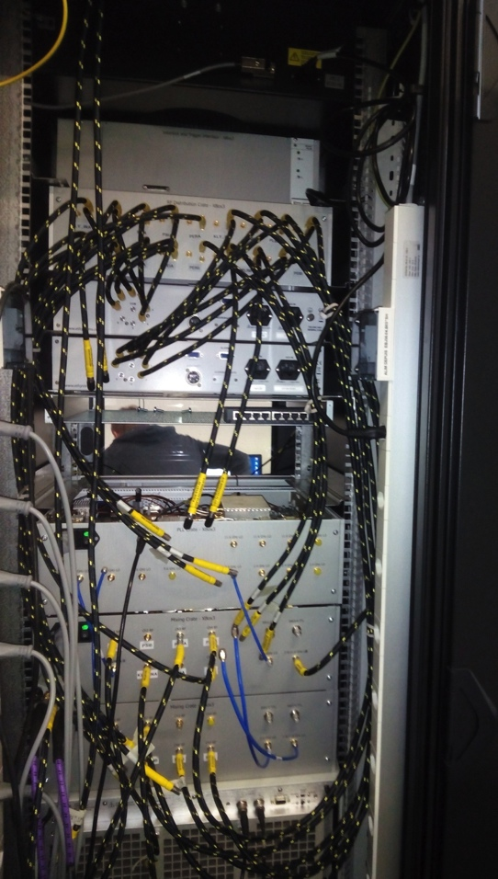
LLRF Electronics responsibilities
Equipment built and/or fixed for the XBOX3:
  12 GHz multichannel Log-Detectors
  PLL clock synthesizers
  Up and down-mixing stages
  RF distributor
Help in the commissioning and installation
Currently working in the S-Band KT structure LLRF
LLRF rack back
LLRF rack frontal
Notes:
In red is shown the custom RF electronics that has been built: the PLL RF synthesizer crates, Up and down-mixing stages, the log-detectors, RF distributor

Slide 31


Log detectors
3x Log-detector crates:
  8 ch each. 8-34 GHz detection bandwidth.
  It consists of 3 different elements
    An 8 channel Log-detector PCB (inside a shielded box)
    An 8 channel amplifier and signal conditioning PCB
    Power supplies
  Outputs analog power levels and digital interlocks for Klystron protection
Design already existing, but with some flaws:
  Log detector PCB channel to channel isolation improved (new internal RF shielding)
  Amplifier and conditioning stage electronics partially redesigned and fixed
  New PCBs assembled, tested and commissioned
Notes:
The log-detector is needed for break-down detection and RF power disable. Reflected signals are continuously being monitored using a logaritmic dectector. The logaritmic detector translates de measured power into logaritmic scale in order to measure a larger dinamic range (~45 dB).

Slide 32

PLL synthesizers
One PLL RF synthesizer crate box built.
It generates the needed RF carriers to generate the RF and up-mix to the Klystrons (x4 9.6 GHz, x8 2.4 GHz)
It generates the RF carriers to down-mix the RF signals from the system that will be analyzed (x4 11.6 GHz)
Notes:
PLL (Phase Locked Loop) RF synthesizer: It generates the needed RF carriers to generate the RF and up-mix to the Klystrons (9.6 GHz and 2.4 GHz) and also generates the RF carriers to down-mix the RF signals from the system that will be analyzed (11.6 GHz)

Slide 33


Up and down-mixers
4 up-mixer and down-mixer crates built:
  Up-mix the RF to the Klystrons
  It down-mixes the RF signals from the system that will be analyzed (x8)
Bottom shelf
Complete crate
Notes:
Up-mixer and Down-mixers: Up-mix the RF to the Klystrons (move the modulated signal from 2.4 GHz to 12 GHz) and down-mix the RF signals from the system that will be analyzed (from 12 GHz to 400 MHz)

Slide 34



Trigger-interlock box and RF distributor
Trigger-interlock box:
RF distributor:
3 built. Small redesigns in the PCB
In adapts the input and output voltage signal levels from the NI-PXI to the rest of the setup
2 built
It distributes the RF signals coming from the system to the different stages: dowm-mixers, log-detector, power calibrations

Slide 35


Commissioning in lab of LLRF
Commissioning in the lab and XBOX3 of the LLRF signal generation and down-mixing:
  PLL synthesizers tested together with up and down-mixers
  Log-detectors tested
  Trigger-interlock cards tested

Slide 36







Commissioning of the XBOX3
  XBOX3 commissioning on-going. To be operational in June. Team:
    B. Woolley, D. Esperante, G. Mcmonagle, N. Catalán, X. Stragier
  XBOX team:
    T. Argyropoulos, H. Damerau, D. Esperante, J. Giner Navarro, G. Mcmonagle, S. Rey,
    I. Syratchev, B. Woolley, N. Catalán Lasheras, X. Stragier, E. Senes

Slide 37
WP2: Summary XBOX3
Xbox-3 LLRF is progressing:
  Log detectors
  PLL synthesizers
  Up and down-mixers
  Trigger-interlock box and RF distributor
  …
Xbox-3 Commissioning: on going to be operational in June 2016

Slide 38

High-Gradient in hadrontherapy accelerators
Motivation in hadron therapy
Hadron therapy is a form of external radiotherapy using energetic beams of hadrons. Charged particles deposit their energy via ionization in the surroundings of its path. Energy loss reaches a maximum (Bragg peak) towards the end of its range.
Proton and carbon ion beams allow precise dose distribution into tumours and minimizing radiating effects in healthy tissues.
Hadron therapy accelerator facilities require High-Gradient developments in order to significantly reduce the complexity and cost of the gantries and moveable heads, which are required to irradiate the patient from different angles, by directly mounting the linacs on them and building a ‘single room facility’.

Slide 39
High-Gradient in hadrontherapy accelerators
The Framework
The work is developed within the framework of a Knowledge and Transfer (KT) project thanks to a collaboration agreement between IFIC and CERN:
KT “High-Gradient accelerating structures for proton therapy”
KT “High-power testing of a medical high-gradient accelerating structure for proton therapy”
KE2638/BE/CLIC “Development of accelerator science and technolgies associated with the CLIC accelerating structure design”
The scope of this project is the design, construction and high-power test of two high-gradient prototype 3 GHz accelerating structures at 76 MeV which corresponds to the lowest energy of a proton linac destined for the TULIP (Turning Linac for Proton therapy) project.
The new IFIC-IFIMED RF laboratory is on construction under a FEDER-funded collaboration agreement between the Universitat de Valencia and Spanish General Administration (MINECO) for the building integration and scientific equipment.
FEDER “Instalacion de Investigacion en Fisica Medica (IFIMED)”
The lab will host the high-power test of medical accelerating structures at 3 GHz operating frequency (S-band), as well as complementary studies for high-gradient developments.

Slide 40



High-Gradient in hadrontherapy accelerators
The Knowledge Transfer project
CERN-CLIC has led the design and construction of a high-gradient (50 MV/m) structure for medical applications under the framework of the KT project.
The proposal of the TUrning LInac for Proton therapy (TULIP) in the framework of the KT project consists of a single room facility for tumours irradiation by proton beam, with fast-controlled energy and beam current variations for “spot-scanning” and “multi-painting” techniques.
S. Verdu Andres, PhD thesis, Universitat de Valencia (2013)
A. Degiovanni, PhD thesis, EPFL (2014)

Slide 41



High-Gradient in hadrontherapy accelerators
S-band proton linac structure: design
A new design of a backward travelling wave (bwTW) structure has been developed for a proton linac in the framework of the TULIP project, in collaboration with CLIC and funded by Knowledge Transfer (KT).
The main requirements are compactness ($E_{0}T=50$MV/m) and low breakdown rate (below 1x10⁻⁶ BDs/pulse/m)
The design is based on the same rf constraints as CLIC prototypes (based on Sc), and the new prototype has followed exactly the same CLIC production procedure.
For 76 MeV protons (beta=0.38)

Slide 42

High-Gradient in hadrontherapy accelerators
S-band proton linac structure: construction and high-power test
The fabrication of the first prototype was finished in 2015.
Structure was successfully tuned at 2.998 GHz and tested at the lab.
Vector Network Analyzer
Accelerating structure (vertical position)
A high-power test is foreseen to take place in CTF2 in 2016: klystron power up to 22 MW and pulse length up to 4.5us, by a collaboration between CERN and IFIC.
The test will be resumed in the IFIC-IFIMED RF laboratory in Valencia.

Slide 43
IFIC-IFIMED HG RF laboratory
Foreseen developments and studies
The capabilities of the facility will open the possibility of several High-Gradient RF studies:
High-Power performance of different prototype designs to determine the right direction towards higher gradients at acceptable breakdown rates
Breakdown rate dependencies with gradient and pulse length, to test the experimental power laws and develop physical models
Breakdown localization techniques to monitor the performance of the structure and better understand the BD formation process and precursors
Surface field emission current measurements
Development of alternative diagnostics and analysis techniques to follow further breakdown studies and high-power phenomena

Slide 44

IFIC-IFIMED HG RF labs
Located in the Scientific Park of the UV
RF and Instrumentation labs
29 April 2015
HG-RF Valencia

Slide 45


IFIC-IFIMED HG RF laboratory
The test facility will be a scale in frequency of the present Xboxes running at CERN, from 12 GHz (X-band) to 3 GHz (S-band).
The RF design is inspired by the X-box 3, as well as control/acquisition electronics suitable for 3 GHz operating frequency, diagnostics and further equipment.
RF lab building integration
Devices under test inside the bunker
Accelerating structures
Modulator+ 7.5 MW Klystron units
Bunker
3dB hybrid
Accelerating structures

Slide 46


IFIC-IFIMED HG RF laboratory
Performances of the RF laboratory
The combination of two low power klystrons (7.5 MW) means cost optimization in terms of power and repetition rate. The system will provide peak power up to 15 MW, 4-5us pulse length, at 200 Hz rep rate.
  The facility will be capable of high-power testing 2 different accelerating structures at the same time. The lab foresees to perform the test of the first (76 MeV) and last (213 MeV) structures of the medical proton linac under construction at CERN in the framework of the KT project.
  Phase difference control between both klystrons (low-level rf) will allow either to manipulate the amount of power sent to each branch, or to alternate pulse-to-pulse the structure which will receive full power. This gives flexibility when testing different structures.
Scheme of RF power transmission in the 3dB hybrid with opposite klystron phase difference configuration

Slide 47

The System layout
WP3
WP2
Notes:
This the system domains block diagram. Cooling and vacuum correspond to WP3 and High power RF and LLRF to WP2.

Slide 48
IFIC-IFIMED HG RF laboratory
Technical concept
BUNKER
7.5 MW x 4µs x 400 Hz
RF/vacuum pumping port
15 MW x 4µs x 200 Hz
Directional coupler
3 dB hybrid combiner
DUT
with Faraday cups and Pumping ports
RF load
Preamp
Klystron + modulator
Klystronceramic window
Notes:
This is the technical design concept for the RF-Lab:
We have 2 klystrons+modulator on the left-hand side. The are driven by solid-state amplifiers
Each of he klystrons can provide an output power of up to 7.5 MW, with a pulse width of 4µs at maximum rate of 400 Hz
After this comes the RF waveguide network. The waveguide network enables power combining thanks to a 3 dB hybrid combiner, and incident and reflected power monitoring thanks to directional coupler.
The 3 dB hybrid combiner permits combining power from both klystrons based on the phase of the input RF coming from klystrons. The phase is controlled thanks to the LLRF control system.
This combining permits having power levels at the RF structure of up to 15 MW.
After the structure, an RF load is needed to absorb de transmitter power.
The structures are tested inside a bunker area, just in case.
Pumping ports in the RF waveguide network are used to make the vacuum

Slide 49






The HPRF subsystem: 3D design
WR284 waveguides
RF/vacuum pumping port
DUT
with Faraday cups and Pumping ports
3 dB hybrid combiner
Directional coupler
Klystron output
RF load
Notes:
This is the 3D design for the High power RF side of the technical concept shown earlier

Slide 50

The HPRF subsystem: lab integration

Slide 51

The HPRF subsystem: lab integration

Slide 52


The bunker: The real lab
2
3
7
1
4
8
5
Inside the bunker:
Supporting structure (7)
Chiller for the DUT (8)
6
Outside the bunker:
The bunker (1), the crane (2) and the supporting structure (3)
Rack for LLRF (4)
Rack for vacuum components (5)
Rack for Solid State Amplifier (6)

Slide 53




The HPRF subsystem: status
Klystron VKS8262G1:
  Provider: CPI
  Output port flange for UHV
  Peak power: 7.6 MW @145 kV & 105 A
  Tp = 5 us, 400 Hz
  Status: RF tests in CPI. Now in JEMA facility (integrated into the modulator)
SSPA (Solid-state Power Amplifier):
  To drive the Klystron
  Solid-state: MicrowaveAmplifiers:
    AM10 S-Band 400W Power Amplifier.
  Acceptance tests done
  Status: tested at IFIMED, and one to be used at CERN soon

Slide 54



The HPRF subsystem: status
Solid-state switching modulator. Specs:
  Provider: JEMA (Lasarte-Oria)
  Vpeak, typical: 145 kV
  Ipeak, typical: 105 A
  Tp = 5 us, 400 Hz
  Voltage flatness: <=+/-0.25%
  Stability, pulse to pulse: <= 0.1%
  Risetime (10->90%): <=2us
  Falltime (90->10%): <=2us
  Adjustable voltage: (45kV - 150kV)
  Status: finalizing tests (interlocks with passive load and next will be with the real klystron)

Slide 55
LLRF subsystem
High Power RF:
Solid state amplifier
Klistron+modulator
RF network
Device under test
RF generation
LLRF
Calibration power meter
National Instrumens
PXI real-time system:
RF generation
RF signals acquisition
Signal processing
External systems control, environmental monitoring and interlock
Log detector
RF diagnosis
Down-mixer
Environmental monitoring
Enviromental signals
Ext. systems:
Cooling
Vacuum
Access
Modulator interlocks
Control, monitoring and interlocks
Notes:
The LLRF system has to take care of RF generation and diagnosis together with some slow control, monitoring and interlock tasks.
A National Instruments PXI real-time system will take care of the RF generation and triggering, RF signals acquisition for diagnosis and further processing. In addition It will take care of the control and monitoring of the cooling system, vacuum system, enviromental monitoring (temperature probes and flowmeters) and access control. It will also take care of the safety system interlocking.
For the RF diagnosis three tasks need to accomplish:
The RF signals need to be periodically be power calibrated with a power meter in order to run de system at the desired power.
A log-detector is needed for break-down detection and RF power disable. Reflected signals are continuously being monitored using a logaritmic dectector. The logaritmic detector translates de measured power into logaritmic scale in order to measure a larger dinamic range (~45 dB).
The dowm-mixer moves de frequency carrier signals from 2.9985 GHz to 62.5 Mhz in order to further process it digitally in the PXI system. The processing implies both amplitude and phase analysis.

Slide 56
WP2: Summary IFIC-IFIMED HG RF lab
Lab building construction is ready
Lab design concept mostly performed
Commercial equipment reception and acceptance done.
Redesign of some of the elements advanced
Control software to be readapted

Slide 57


Vacuum
Ultra-high vacuum system:
  10⁻⁷ mbar max pressure, 5*10⁻⁸ mbar expected
  Followed Gerry’s rule: 1 pump per 4 m of waveguide
  Simulations to back-up performed
System based on Nextorr compact UHV pumps 100 l/s:
  A primary turbo pump is need to perform first vacuum
  UHV achived by Nextorr pumps (ion-pump + NEG)
  No segmentation of the system
  3 Nextorr pumps per line: 1 next to the structure and load, 1 attached to the structure and one close to the klystron
  According to the simulations performed, we have an effective pumping speed of 38 l/s at the pumping port. Improvements to this can be easily implemented (see next slides)
Notes:
With the primary turbo pump the system goes from atmospheric pressure to high vacuum (̴10-6 mbar). Then Nextorr pumps are used to reach 10-8 mbar. The Nextorr pumps are UHV pumps very compact and with high pumping speed thanks to the combination of an Ion pump with a NEG cartridge.
No segmentation means that there is not any valve dividing the vacuum system in sectors, this means all the components make only one vacuum volume. So if you vent, you vent all the system, but you reduce the cost of the valves.
The effective pumping speed is reduced from 100 l/s to 36 l/s due to the conductance of the pumping port.

Slide 58



Vacuum simulations:
Seff: 38 l/s , 3 pumps
Pumps locations
Monte-Carlo simulations performed with software Molflow
Effective pumping speed 38 l/s (calculated aswell by Molflow simulations) at each pumping port
Pressure profile obtained
Max. pressure: 4e⁻⁷ mbar
Min. pressure: 5e⁻⁸ mbar
Notes:
The peaks showed in the pressure profile graph (top-left image) are due to the shape of the faces. They are not rectangles and the shoftware plots those peaks in the graph, but they are not real.
The scales of colours goes from 4e-7 (violet) mbar to 5e-8 mbar (dark red)
The effective pumping speed was calculated by simulation aswell (see next slide)

Slide 59




Vacuum simulations: pumping speed
Simulations of effective vacuum pumping speed for H₂(dominant gas) at molecular flow
Pumping assembly cross-section
Nextorr
DN35 diameter cross
DN63 diameter cross
Valve
Gauge
Cross
Improved region
Notes:
We are able to improve (if need) the effective pumping speed by only changing the cross where the pumps are plugged. By changing the diameter of this cross (DN35, DN63, DN100) we can see the change in the effective pumping speed from 38 to 84 l/s as showed in the graph.

Slide 60

Cooling
Demineralized water cooling system installation in progress on the building.
  162KW max. cooling power
Needed for:
  Modulator (2 * 32 l/min)
  Klystron (2 * 58 l/min)
  RF water loads
There is a demineralizer already installed, not able to reach the conductivity need by the klystrons (0,5 µS/cm) directly from the network water.
  Recirculate the water and make it pass twice through the demineralizer
  Upgrade the equipment with a pre/post water treatment
Cooling machine
DEMINERALIZER
KLYSTRON
TANK
HEAT EXCHANGER
Primary circuit
Secondary circuit (demineralized water)
Notes:
Planned to finish the installation by the end of June’16.
The cooling system is composed by :
a cooling machine (162 KW cooling power) installed in the flat roof of the building
2 water circuits. A primary circuit with normal water, and a secondary circuit with demineralized water. 2 circuits because the demineralized water is aggressive for the components of the cooling machine
A heat exchanger to exchange the heat between the 2 water circuits
A demineralizer system to reach the water conductivity required by the klystron
The current demineralizer reach min conductivity 10 microSiemens/cm. Klystrons need between 0,1 to 1 microSiemens/cm
2 Solutions :
recirculate through the demineralizer untill it reach the conductivity that we want.
To upgrade the equipment with a pre or post water treatment (osmosis for instance)

Slide 61
WP3: Summary IFIC-IFIMED HG RF lab
  Vacuum system designed (10⁻⁷ mbar max pressure, 5*10⁻⁸ mbar expected)
  Vacuum components ready to install
Cooling system installation ongoing, planned to be finished by the end of June
Too high conductivity found in the water provided by the current demineralizer, possible solutions under study.

Slide 62
Conclusions
  WP1 is close to be finished (June 2016)
  WP2 constructions is progressing well in the two locations
  WP3 construction is progressing well the problems with the cooling and water are being solved
  WP4 studies are progressing well in the XBOXes
Next Step
  The next step will be start the commissioning for the IFIC-IFIMED RF labs.

Slide 63
THANKS FOR YOUR ATTENTION

Slide 64
EXTRA SLIDES WP1

Slide 65



Linearity/Sensitivity Tests
STRIPLINE BPM DEVELOPMENT FOR THE CLIC DRIVE BEAM
CTBM, pos. 0645 and 0685
Evaluate the influence of 12 GHz PETS interference (130 MW in CLIC) in the linearity of the device.
Beam steered by corrector 0510.
Reference BPMs: Inductive BPMs 0520 and 0750
Three test scenarios: 2.4 MW, 40 MW and 60 MW PETS power interference at 12 GHz
TBL Beam sweep in horizontal and vertical planes
Notes:
In this slide we can see a diagram showing the test layout of the TBM Drive Beam line: the stripline BPMs under test are at positions 0645 and 0685, the values read by the neighboring BPMs at positions 0520 and 0750 are used as reference and the beam is moved using the corrector at position 0510 . The plots show the measured horizontal and vertical normalized positions (delta/sigma) read by the BPM 0685 against the reference positions (interpolated from 0520 and 0750) of the beam when being displaced on each plane. For 60 MW of PETS power a lower vertical sensitivity was measured. One of the horizontal electrodes was damaged before the 60 MW test and has been repaired for the present CTF3 run.

Slide 66


Resolution Tests
STRIPLINE BPM DEVELOPMENT FOR THE CLIC DRIVE BEAM
Singular Value Decomposition (SVD) analysis used to separate highly-correlated, systematic beam effects from uncorrelated BPM noise floor.
Analysis performed for 1000 shots acquired from a centered 22 A beam.
Position data are recorded for all 9 BPMs in the Drive Beam line of TBM and decomposed.
Eigenvalues corresponding to high correlation region (first 5 in this case) are set to zero and the position data matrix is recomputed.
The standard deviation of the recomputed matrix columns gives the measured resolution for our prototypes:
  BPM0645 (#5): 1.4 µm (H) , 0.5 µm (V)
  BPM0685 (#6): 2.4 µm (H) , 2.5 µm (V)
Notes:
Top plot shows the eigenvalues of the SVD decomposition. The transition between the high correlation region and the flat low-correlation region occurs at mode n° 5. Eigenvalues from 1 to 5 are set to zero and the position data matrix recomputed. The standard deviation of the recomputed matrix columns gives the measured resolution for our prototypes (BPMs n° 5 and 6 in the bottom plot). Considering a 3/1 ratio between the H and V beta values at location of BPM #5 and the imperfections of the method, it is still safe to announce a resolution < 2.5 um, meeting the specified requirement for the CLIC Drive Beam.

Slide 67



Sensitivity to PETS RF power at 12 GHz
STRIPLINE BPM DEVELOPMENT FOR THE CLIC DRIVE BEAM
Electrode signals with expected shape and levels.
Influence of a PETS power increase from 2.4 MW to 40 MW via recombination studied for centered beams.
The stripline BPM prototypes (#5 and #6) have a minimum trajectory variation in H-plane and perform well in V-plane.
Effect of power recirculation in PETS still needs to be studied.
A. Benot- Morell et al. “Beam Tests of a Prototype Stripline Beam Position Monitoring System for the Drive Beam of the CLIC Two-Beam Module at CTF3”, in Proc. IPAC’16, Busan, Korea, May 2016, paper MOPMR019.
Notes:
Top plot shows the waveforms for a centered beam and 40 MW PETS power. Middle and bottom plots show that the trajectory deviation in BPMs #5 and #6 is minimum in the H-plane and within good performance limits on the V-plane when the PETS power is increased from 2.4 MW to 40 MW

Slide 68
EXTRA SLIDES WP4 XBOXES

Slide 69

Compact Linear Collider
CLIC-G prototype (TD26CC), Travelling-Wave at 11.994 GHz
CLIC main requirements:
100 MV/m gradient
at around 180 ns pulse length
RF power IN
RF power OUT
Beam OUT
Beam IN
RF power IN
RF power OUT
Tens of MW are needed to obtain accelerating gradients of 100 MV/m. At such high power, presence of non-linear effects causes the formation of vacuum breakdowns, which affects negatively to beam transmission and, therefore, collision luminosity.
The High-Gradient performance needs to be tested in advance at high-power test stands.

Slide 70


Vacuum breakdown phenomena
Vacuum arcs are spontaneously formed by high power RF pulses at the high surface field regions, and produce an abrupt current emission which can damage the surface and induce instabilities into the beam.
The existence of microscopic features, dislocations and external contaminants on the surface are potential causes of breakdowns.
SEM microscopy
Disk of a CLIC accelerating structure
Breakdown Crater

Slide 71
EXTRA SLIDES WP2 XBOXES

Slide 72

XBOX3 is a ‘clever’ way to convert the high rep. rate into the bigger number of testing slots with high peak power.
3D layout/integration of XBOX3

Slide 73
High Power RF network
Klystron/modulator
Directional coupler
RF/vacuum pumping port
RF pulse compressor
RF load
RF /vacuum gate valve
WR90 waveguide network
3 dB hybrid
24 MW x 4µs x 100 Hz
80 MW x 300 ns x 100 Hz
6 MW x 4µs x 400 Hz
Igor Syratchev

Slide 74
Log Detector crate
X 8 ch outputs
Amplifier and conditioning stage
Interlock threshold
Interlock reset
X 8 ch
X 8 ch
Interlock output signal
Log detector
8-34 GHz
Log power output

Slide 75


Slide 76
PLL Crate XBOX-3
15 dBm (need 11-14dbm)
23 dBm
We allow up to 3dB loss in the cables
MC ZVA-183+
splitter
Amp
9.6 GHz BPF
x4 9.6 GHz
9.6 GHz BPF
Marki Microwave
FB-0955
splitter
x4 2.4 GHz
(for mix-up)
X4 freq.
MC ZX60-272LN+
18.5 dBm
16.5 dBm
4 dBm (need 0 dbm)
5.5 dBm
splitter
Amp
2.4 GHz BPF
splitter
We allow up to 3-4dB loss in the cables
2.4 GHz PLL
MC ZFBP-2400+
5.5 dBm
4 dBm (need 0 dbm)
splitter
x4 2.4 GHz
(for PXI IQ mod)
Marki Microwave
FB-1215
24 dBm
23 dBm (need 21dbm)
2.9 GHz PLL
32 dBm
We allow up to 2dB loss in the cables
Amp
11.6 GHz BPF
splitter
X4 freq.
11.6 GHz BPF
x4 11.6 GH
(for mix-down)
Marki Microwave
AQA-1933
MC
ZVE-3W-183+
X4 freq.

Slide 77



Slide 78
Up-mixing Stages XBOX-3
2.4 GHz input From PXI IQ modulator
To TWT
0 dBm
12 GHz BPF
Amp
9.6 GHz input
13 dBm
splitter
12 GHz BPF
To
Reference input
0 dBm
2.4 GHz input
Distribution of 2.4GHz and 9.6 GHz from PLL crate

Slide 79
Down-mixing Mixing Stages XBOX-3
RF Input 1
400 MHz LPF
Amp
IF output 1
RF Input 2
splitter
Amp
400 MHz LPF
IF output 2
RF Input 3
Amp
400 MHz LPF
IF output 3
RF Input 4
10 dBm
Amp
400 MHz LPF
IF output 4
17 dBm
21 dBm
splitter
5V TTL in
11.6 GHz input
RF Input 5A
400 MHz LPF
Amp
2:1 Mux
RF Input 5B
IF output 5
splitter
Amp
400 MHz LPF
RF Input 6A
Amp
400 MHz LPF
RF Input 6B
2:1 Mux
IF output 6
Amp
400 MHz LPF
Top shelf in mixing crate
5V TTL in

Slide 80
EXTRA SLIDES WP2 IFIC RF

Slide 81
The XBOX inspiration
The XBOX’s are X-band (12 GHz) setups running (XBOX1 and XBOX2) or under commisioning (XBOX3) at CERN for the very same purpose
The idea is to “copy” as much as possible from the XBOX3:
  Instead of 4 RF power sources use 2 and no pulse compressor in a first stage
  Try to keep as much as possible the same of hardware and software. This is the most cost-effective solution: optimize the development time and manpower
XBOX 3 concept
Notes:
The XBOX system, in the right, is a complex setup with 4 Klystrons that allows testing 4 structures at a time. The power output of 2 klystrons can be combined at a time to achieve 12 MW. It is the same concept we have followed for the IFIMED.

Slide 82
XBOX3 and IFIC-IFIMED HG RF lab
XBOX3
VLC-RFLab
Frequency: 12 GHz
Number of DUTs: 4
Pulse compressor: planned
Frequency: 3 GHz
Number of DUTs: 2
Pulse compressor: future upgrade
These differences entail modifications:
Running at lower frequency implies:
  Different Klystron+modulator+SSPA: more cost-effective and proven solution
  Different RF network: bigger size, this is maybe worse
  Different electronics: life is easier at lower frequency
Pulse compressor, we will leave the system ready for the upgrade

Slide 83


The LLRF system: status (1)
Controls, National Instruments PXI real-time system:
Chasis | 1 |  | NI PXIe-1085, 18 slots
Controller PXI | 1 |  | NI PXIe-8135
Trigger+interlock card | 1 |  | NI 6583 + FPGA
RF Generator (4.4 GHz) | 2 |  | NI 5793 + FPGA
8 ch 250 MSPS ADC | 5 |  | NI 5171. 4xAC(RF signals) + 1xDC (Faraday cup)
RS232, RS485 gauge det. | 2 |  | NI PXI-8432/8 (RS232) and NI PXI-8433/4 (RS485). Vacuum gauges
Slow monitoring | 1 |  | NI 6363. Voltage signals like vacuum, temperature and flowmeter
Fast acq 4 ch 2.5 GSPS | 1 |  | NI 5160. Not needed for S-band: cell bining resolution of 20 ns
NI PXI system already in Valencia
Labview SW to be partially adapted developed from the one for the XBOX3

Slide 84




The LLRF system: status (2)
Log amp: under development
New PCB for 3 GHz detector already designed
Output amplifying stage copied from CERN XBOX.
Down-mixer: under construction
Being assembled at CERN for the testing of the KT structure
Power meter: ordered to Rohde&Schwarz
Notes:
Already explained to slides before the purpose of the different devices.

Slide 85
EXTRA SLIDES WP3 IFIC RF

Slide 86

Cooling
Extra 2 chillers :
  Power: 5 KW , temperature stability: 0,1°C
  For the cooling of:
    The DUT’s and/or RF load
    The future pulse-compressor
    Eventually for the rack electronics. In the XBOXs this was shown to be a need
Notes:
These chillers will be used mainly for the cooling of the DUT. They have 5KW of cooling power , giving a temperature stability of 0,1°C

