Slide 1
Change Review Panel Report
CR 012 - REDUCTION OF THE WIDTH OF THE LINAC SHIELD WALL AND TUNNEL CROSS-SECTION
Chris Adolphsen (SLAC)
Mike Harrison (BNL)
John Osbourne (CERN)

Slide 2
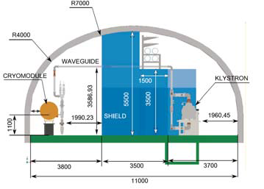
CR 012 – TDR Cross-section

Slide 3
Design Update CR 012
This CR is predicated on a design which allows RF-power-on access but not beam-on access. Being able to run the RF stations while personnel are present will allow faster and more thorough debugging of the components than would be possible if the systems could not be powered.
Since the TDR design, > 1 km of ‘free’ space has been added to the linacs, which allows for additional RF stations if needed, and more experience has been gained in the operation of ILC-like RF systems at DESY for the European XFEL. Thus, a re-evaluation of the linac energy overhead and RF system reliability seems warranted, in particular
The defining issue in determining the tunnel wall thickness is field-emission induced radiation from the cavities (dark current) when the RF power is on since it is proposed that personnel access will be permitted during these times
The panel was informed by the LCLS II experience in regard to worst-case scenarios and the US regulatory process.

Slide 4
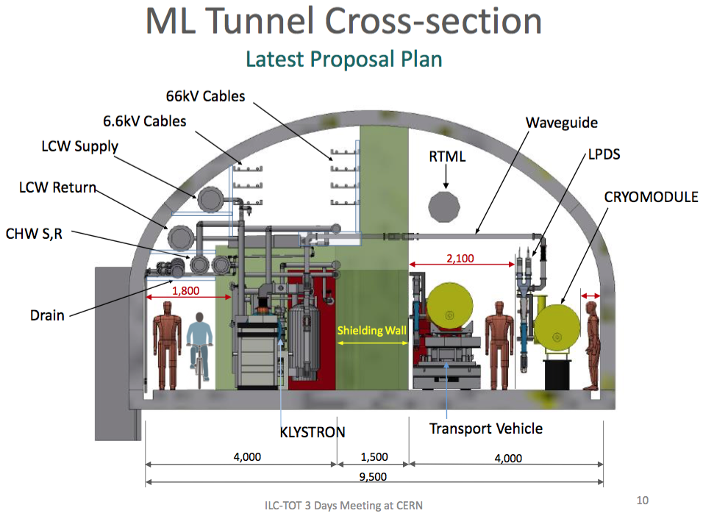
Design Update CR 012
CR-012 proposes to reduce the thickness of the concrete shield wall by 2 m, from the TDR thickness of 3.5 m to 1.5 m. However, due to further detailed integration studies since the TDR, it has been concluded that it is not possible to reduce the overall width of the tunnel accordingly, i.e. by 2 m, instead it is proposed to reduce the tunnel width from 11 m to 9.5 m. The new proposed 9.5 m wide cross section

Slide 5
Design Update CR 012 – Shield Wall
Each cavity was assumed to produce 50nA of captured dark current
Simulation of the tunnel radiation dose arising from these particles was performed using the MARS software package. MARS has been well validated over the years and the results of this simulation was cross-checked against FLUKA at SLAC as part of the LCLS-II safety analysis as well as several earlier studies during the GDE era. Both simulations produced consistent results.
Most of the particles are swept out of the cryomodule string by the magnetic fields in the quadrupoles (one every three cryomodules) and were lost in or around the location of these magnets. Loss distributions for different magnetic field settings were investigated. In all cases the loss patterns achieved an equilibrium value within a few cryomodules. The distributions were more peaked in the magnets for the highest settings corresponding to a linac energy of 125 GeV or greater.

Slide 6
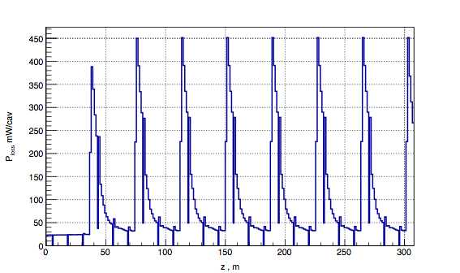
Power loss distribution: 15 GeV
quad
Losses equalize at 2nd quad, peak losses are in cavity just after quad

Slide 7
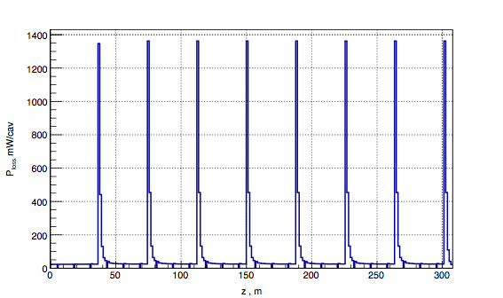
Power loss distribution: 125 GeV
quad
1st cavity
Losses equalize at 1st quad, peak losses are in quad

Slide 8
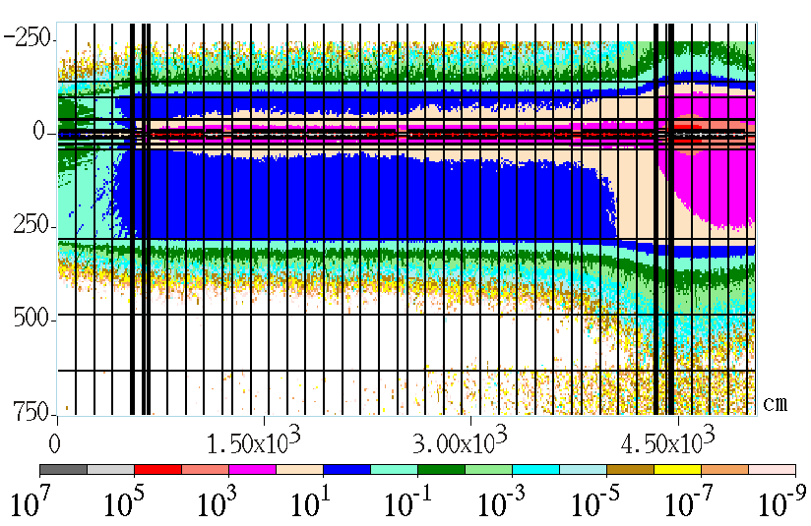
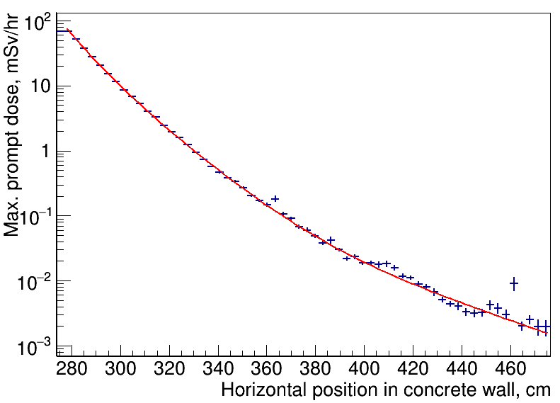
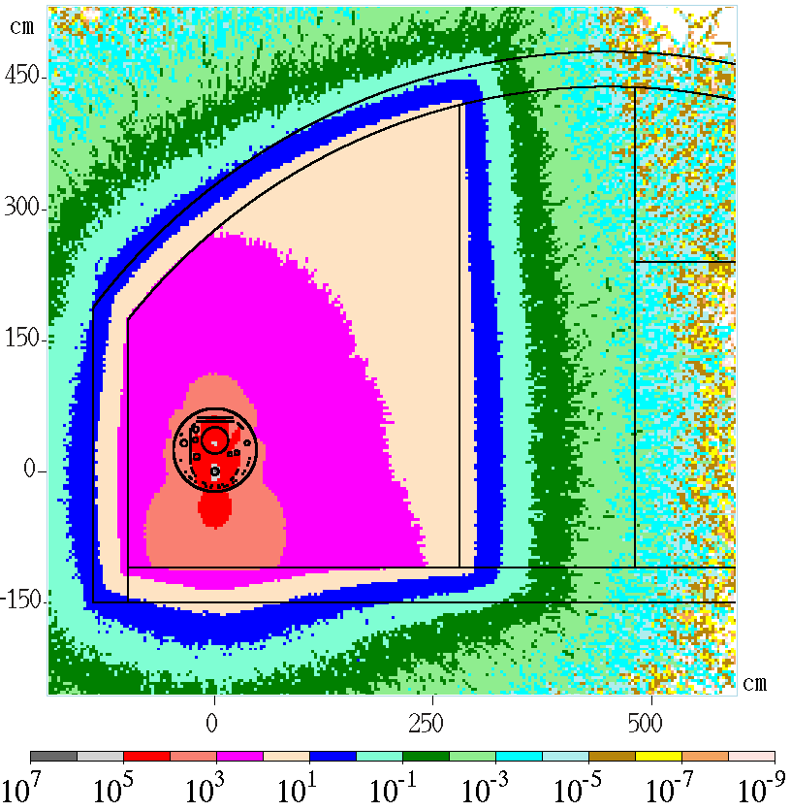
Radiation dose vs. concrete wall thickness
Magnets 250GeV, laser-straight linac
Fit for attenuation curve for prompt dose, mSv/hr
p0 = 3.42573e+00
p1 = -7.14516e-02
p2 =- 1.68580e+00
P3 = -1.27563e-01
P4 = -3.14138e+00
P5 = -2.89486e-02
25uSv/h (~1.2m)
1.5m

Slide 9
Design Update CR 012 – Shield Wall
The CR panel noted that these calculations were done using the baseline machine settings. This raised the question of whether a worst case scenario involving a pathology of operating parameters (HLRF on, magnets off, etc.) could result in higher doses than the normal parameters
Based on additional simulation results, the worst case scenario involves the quadrupoles turned off so that the dark current electrons are not swept out of the beamline by the quadrupole magnets. The steering dipoles however remain on at their nominal values. This allows a fraction of the electrons to be transported a significant distance and thus gain significant energy (> 15 GeV) before being lost

Slide 10
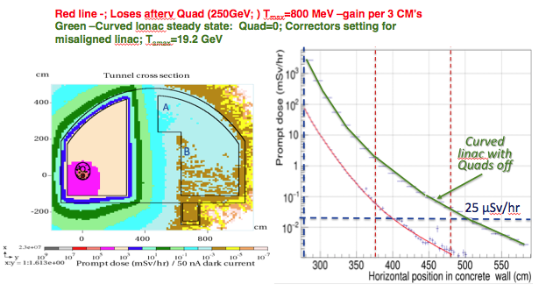
Design Update CR 012
The difference is a factor of ~20 and exceeds the Japanese regulatory level of 25 m Sv/hr. The tunnel radiation contour plot shows the maximum value in Region A, the cable tray area. The personnel zone, region B, remains significantly below the regulatory limit.

Slide 11
Design Update CR 012

Slide 12
Design Update CR 012 – Shield Wall
From this, it is not clear that 50 nA is a reasonable limit at 31.5 MV/m given that the radiation increases rapidly with gradient and most measurements have been made at lower gradients
Also, it would difficult to guarantee that a cavity would quench before exceeding any predetermined emission value. Indeed under certain pathologies, the linac can sustain very large dark currents (~ mA), but this requires thousands of space-charge limited field emission sites
With such levels of uncertainty the panel believes that purely passive protection is not practical from a regulatory standpoint and that some form of administrative and/or active protection would be necessary
Other requirements of the shield wall in regard to life safety (fire and ODH), emergency egress, and the shielding of electronics are all satisfied with < 1 m of concrete.

Slide 13
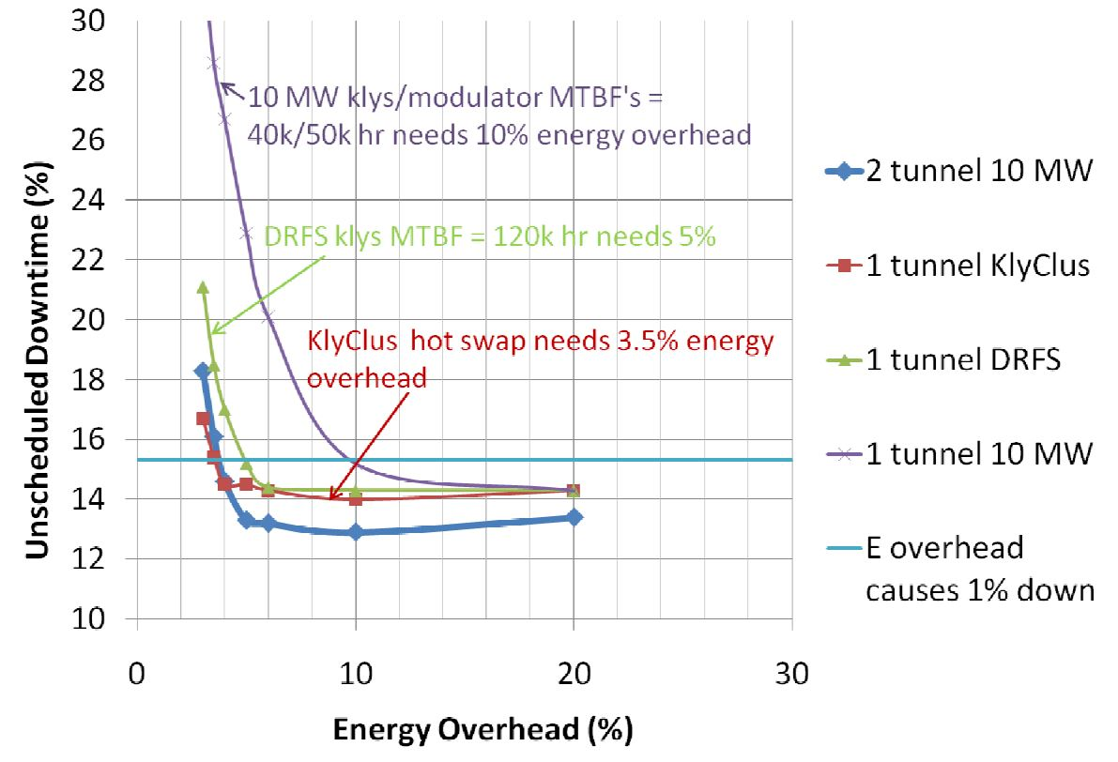
Design Update CR 012 – Reliability
With no access allowed in the tunnels during beam operation, it is assumed all repairs would be done on maintenance days, which would nominally be two weeks apart.
Two factors: (1) the reliability of the RF systems (based on the mean-time-to-failure, or MTBF, for each component) and (2) the linac energy overhead available to offset the energy loss from failed stations
The CR expected an increase of the expected MTBFs of Modulators and Klystrons from 50 khr to 100 khr, although no supporting data is provided.

Slide 14
Design Update CR 012 – Cost/Schedule/Impact
The estimated cost saving for a 2 m reduction in the concrete shield wall and 1.5 m in the tunnel width is approximately 13 B yen* for a 500 GeV CoM energy. The number of installed spare modules could affect the bottom line cost savings at the several percent level.
It is also estimated that the construction time would be reduced by 5 months*.
This is consistent with the other CFS project estimates
Beam-on personnel access to the tunnel will not be permitted. RF-power-on access to the equipment gallery will be allowed under controlled conditions. The effective tunnel size for equipment is increased by 0.5m. The tunnel cost is reduced and the construction schedule is shortened.

Slide 15
CRP recommendations
The panel believes that it is difficult to envisage a purely passive shield wall radiation protection system that would be capable of validation under a worst-case scenario associated with dark currents. An active protection system involving administrative controls and direct radiation interlocks will be necessary.
If this is deemed acceptable, the panel recommends approval of the proposal to reduce the shield wall thickness from 3.5 m to 1.5 m as described in CR-012.
The installed energy overhead will need to be re-evaluated during cryomodule production when more complete gradient data becomes available.

