Slide 1
ILD MC production
Akiya Miyamoto
KEK
1 June 2016
Topics:
1. Status of ILD production with ILDDirac
2. Monitoring network performance

Slide 2
Status of ILD MC production
with ILCDirac

Slide 3
ILCDirac for ILD: ILDDirac
ILD MC production for DBD used non-DIRAC GRID tools.
Since DBD, ILD is moving to the ILCDIRAC based system.
  LFC → Dirac File catalog, meta data, MC production
ILDDirac has been developed by C.Calancha for ILD MC Production
using ILCDirac tool.
By March 2016,
  ILD module for ILCDirac works well and processed many requests promptly and efficiently.
  Lots of efforts were made on improving and extending existing monitoring tools.
  First test using DD4hep completed successfully.

Slide 4
ILDDirac - 2
Unfortunately, Tino has left the group.
Our task to do is
  (1) Take over Tino’s product, merging his tool into ILCDirac repository.
  (2) Get familiar with ILD MC production with ILDDirac, and improve tools if necessary
  (3) Test ddsim in ILD production chain
Current status
  In the step (1), Tino’s code is committed to ILCDirac git branch by Andre,
  and AM is learning, testing, and debugging ILDDirac.

Slide 5
ILD production chain
stdhep (~500MB )
DIRAC transformation initiates a job, by checking meta information attached to files.
  Data driven processing
  Retries automatically if failed.
Meta keys for inputDataQuery.
stdhep-split
splitted ( ~ 50x10MB)
MC simulation of each splitted-file
Ex: stdhep split job
Datatype, Energy, Machine, GenProcessID,
GenProcessName, MachineParams,
SelectedFile
sim
MC reconstruction with Overlay
Same as defined for generator’s meta
information. Some key may be redundant
“SelectedFile” is added for ILDProduction
to select a file.
➔ Something equivalent to file name may
be convenient.
dst
rec
Merge dsts
merged-dst
Replication

Slide 6
Test production : 500 GeV ffH, H→μμ
Randomly pick up this process, because there was a user request.
Using DBD soft, Mokka: v01-14-01-p00, Marlin: v01-16-p05.
4 polarization combination, each 10k events of STDHEP files.
  4 STDHEP files ➔ 200 Splitted-STDHEP files.
After some learning and with a help by Andre,
  MCSimulation: all 200 gen files were simulated successfully.
  ( Several failed jobs retried automatically by DIRAC)
  MCReconstruction: Many retry happened. About 20% of sim files were
  unable to reconstruct even after O(10) retries.

Slide 7
Log info of failed jobs : I108161
Input : 40 sim files.
MCReconstuction
  203 jobs were submitted before job submission was stopped manually.
  9 sim files remained unprocessed.
  106 rec jobs had been submitted to process these files.
    Segmentation violation in 39 jobs
      Nodes: 11 cern.ch, 6, desy.de, 13 gridpp.rl.ac.uk
      ➔ Seg. violation even at major sites.
    Marlin exited with non 0 status
      4 jobs at OSG site, 63 jobs at non-OSG.
Sample error message:
[lcio::Exception: lcio::DataNotAvailableException: LCEventImpl::getCollection: collection not in event:LumiCalCollection
The LCIO file seems to have a corrupted EventHeader that doesn't list all the collections in the event properly
Further investigation is on-going.
ffH, H→μμ many not be a good example ? ( some bug in reconstruction ?)
Unable to create merged-DST yet.
  One erroneous event could be neglected, but 1 file loss can not.
  Not easy to increase gen statistics with the current scheme.

Slide 8
Other issues (wish list)
Generator samples
  “Generator file as input to sim” is preferred, except very established generator processes, because
    same input to ILD and SiD, and full sim and fast sim.
  splitted stdhep files: should be removed when finished.
    ancestor-descendants relation ?
    those written on a tape based SRM ?
Merged-DST creation
  include in ILDProductionChain
Prepare web information of produced samples.
  The automated production is preferred.
  Standard data quality monitor
  Addition of more keys in DFC may be useful
Develop a tool for DDSim and tests.

Slide 9
Monitoring
network performance

Slide 10
Grid tools and network performance
A tool to monitor a long term stability of performance has been developed
  GRID performance can vary day by day, which is not easy to follow for normal users.
In order to monitor long term stability,
  Submit 4 dirac jobs twice a day randomly
  Each job runs at KEK, PNNL, DESY, CERN Worker Nodes
  and download files from SEs at KEK, PNNL, DESY and CERN
  Daily plots at http://www-jlc.kek.jp/~miyamoto/hibi/sumplot

Slide 11
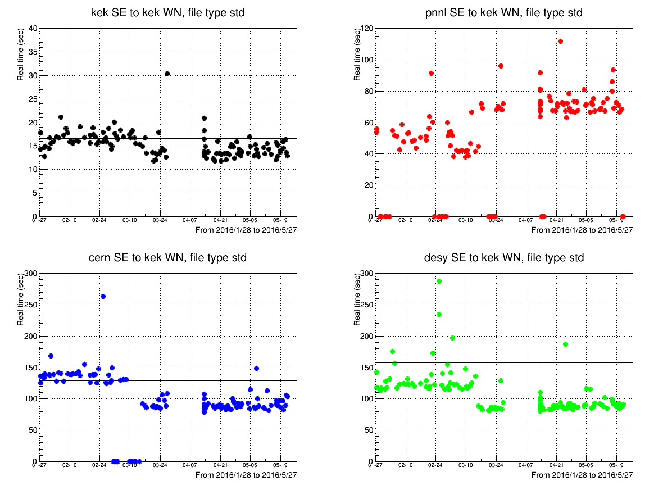
Worker Nodes at KEK downloads 500 MB from a Storage Element
KEK SE→ KEK WN
PNNL SE→ KEK WN
averaged time
File transfer time (sec)
A bug in handling job error
averaged time
Job run date
CERN SE→ KEK WN
DESY SE→ KEK WN
SINET5 service start !
●: copy failed

Slide 12
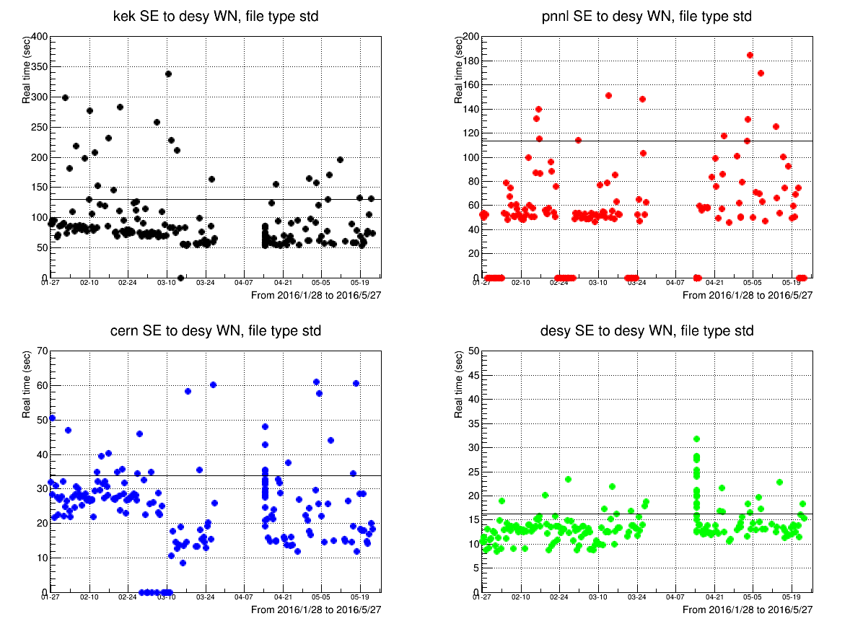
Downloading to DESY WNs
KEK SE→ DESY WN
PNNL SE→ DESY WN
CERN SE→ DESY WN
DESY SE→ DESY WN

Slide 13
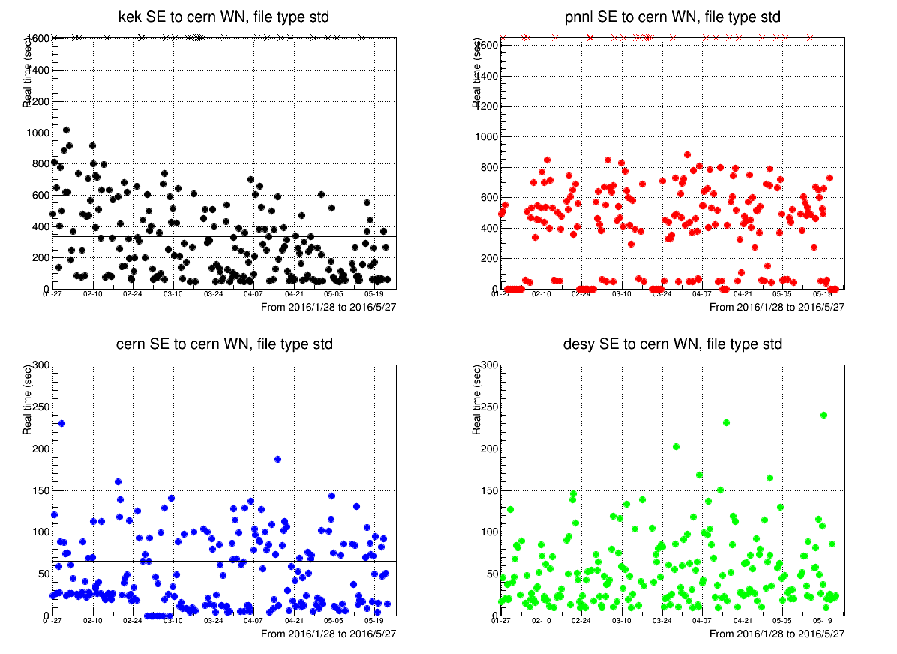
Download to CERN WNs
KEK SE→ CERN WN
PNNL SE→ CERN WN
CERN SE→ CERN WN
DESY SE→ CERN WN

Slide 14
Average file transfer speed ( unit: sec )
500MB file size
 | From(SE)
To(WN) | kek | pnnl | desy | cern
kek | 16.7 | 59.6 | 157.7 | 129.4
pnnl | 125.0 | 37.2 | 94.5 | 153.4
desy | 130.2 | 113.3 | 16.3 | 33.9
cern | 337.5 | 474.3 | 53.5 | 65.5
(2016.1.26 - 2016.5.26)
Note:
- Asymmetry:
** PNNL → KEK is faster than KEK →PNNL by a factor 2 ( improved since 2015 )
PNNL →PNNL, CERN→CERN is slower than KEK→KEK and DESY→DESY
- KEK to CERN fluctuate a lot and not as as good as CERN to KEK.
( PNNL to CERN as well. )

Slide 15
Summary
C.Calancha developed ILD MC production tool with ILCDirac and
produced ILD official samples successfully.
A new team is being formed to take over his work.
Learning, testing, and improving of ILDDirac has started.
ILDDirac will be used to produce samples for ILD physics studies and detector optimization.
Network monitoring tool has been developed to monitor day-by-day peprformance.

