Slide 1
The
International Linear Collider Project and
Industrial Implications-
Akira Yamamoto
(KEK-CERN-LCC)
Japanese-Spanish industrial Forum on
accelerator technologies and advanced detector instrumentation
ECFA LC 2016, Industrial Session,, 1 June., 2016

Slide 2
Outline
Introduction
Technical Progress
Global Collaboration and Industrial Implications
Summary
A. Yamamoto, 160208

Slide 3
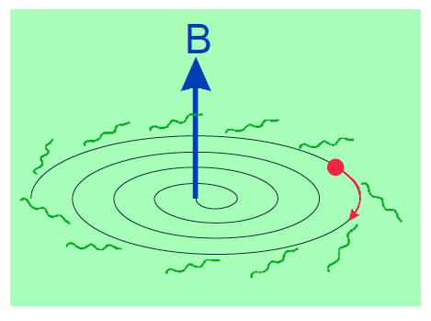
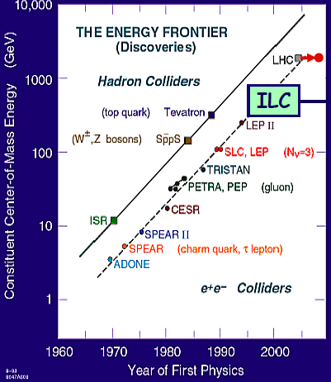
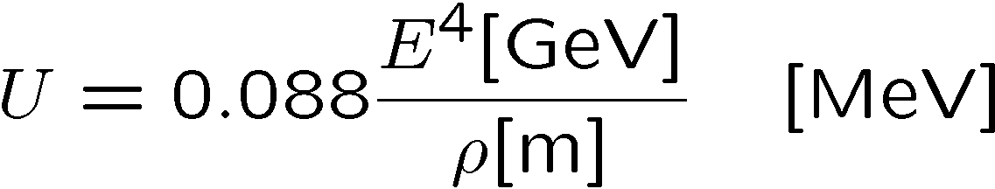
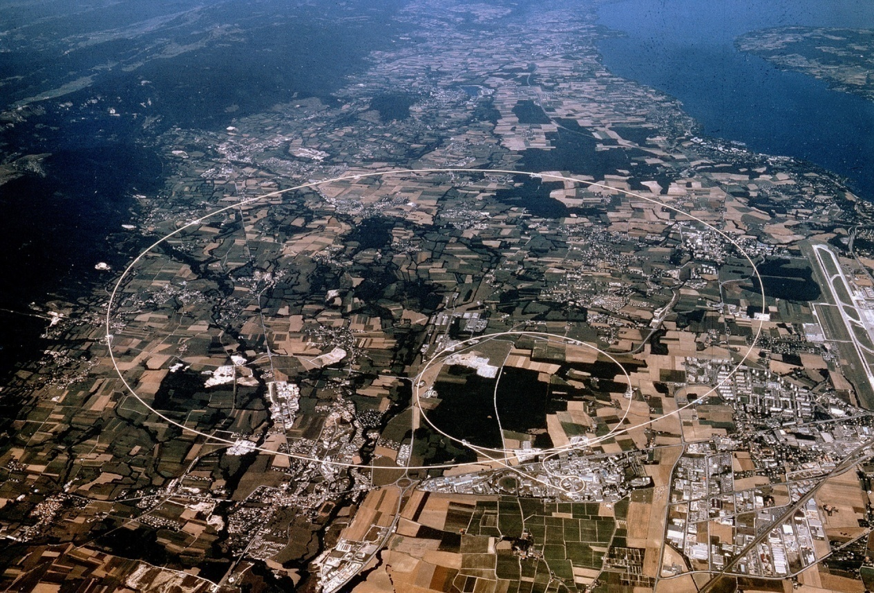
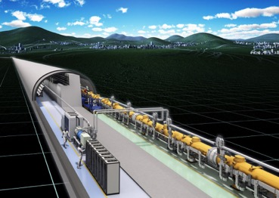
Circular to Linear e+e- Collider
Circular to Linear to mitigate synchrotron radiation energy loss ,
Energy-loss/turn
e- Linac
e+ Linac

Slide 4
Advances in Linear Collider Programs
Worldwide |  | Japan
1965: LC concept proposed by M. Tigner 1966-: Stanford Linear Accelerator | 1960’
1988-1998: SLC operation 1980’ ~ NLC design study and R&D | 1980’ | 1980’ : JLC design study and R&D stated
2004: ILC GDE started, led by B. Barish 2007: ILC Ref. Design Report (RDR) 2012: CLIC Conceptual Design (CDC) 2013: ILC Tech. Design Report (TDR) LCC to coordinate CLIC and ILC led by L. Evans 2016 : High-level discussions in preparation | 2000’ | 2013: SCJ recommended further study J-HEP community selected the primary candidate site 2014: MEXT ILC Advisory Panel , assisted by: 3 working groups on - Science, - Technology, & - Human Res. Worldwide Commissioned Survey

Slide 5


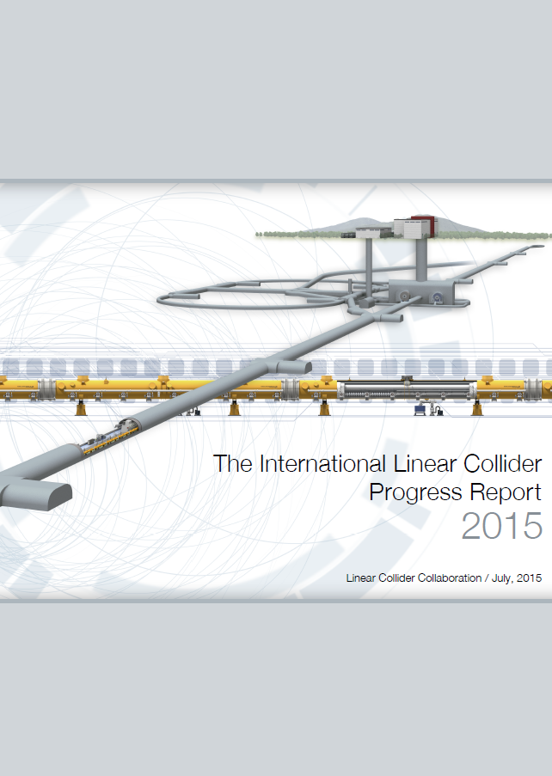
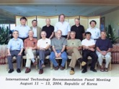
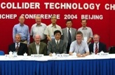
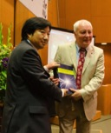
ILC GDE to LCC
1980’ ~ Basic Study
2004
2006
‘07
‘08
‘09
‘10
‘11
‘12
‘13
‘14
‘15
‘16
ILC-GDE
LCC
TDR
Technical Design Phase
Ref. Design (RDR)
TDP 2
TDR in 2013,
Prog. Rep. in 2015
LHC
126 GeV
Higgs
discovered
Selection of
SC Technology
2013.6.12

Slide 6
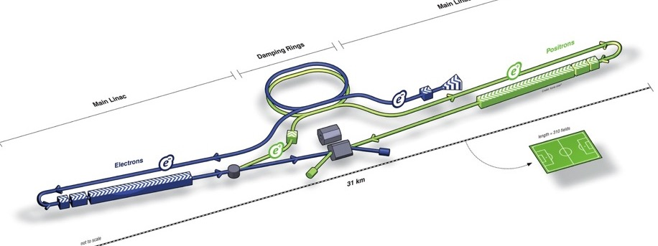
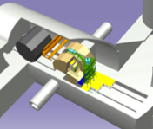
ILC Acc. Design Overview (in TDR)
Damping Ring
e- Source
e+ Main Liinac
Physics Detectors
Item | Parameters
C.M. Energy | 500 GeV
Length | 31 km
Luminosity | 1.8 x10³⁴ cm⁻²s⁻¹
Repetition | 5 Hz
Beam Pulse Period | 0.73 ms
Beam Current | 5.8 mA
Beam size (y) at FF | 5.9 nm
SRF Cavity G. Q₀ | 31.5 MV/m Q₀ = 1x10 ¹⁰
e+ Source
e- Main Linac
Key Technologies
Nano-beam Technology
SRF Accelerating Technology

Slide 7
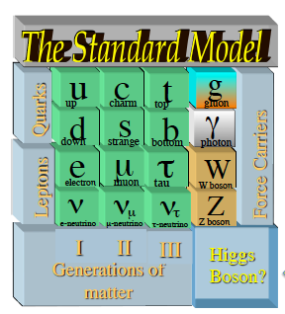




Important Energies in ILC
125 GeV Higgs discovery reinforcing the ILC importance
Integrated Luminosity (ab⁻¹)
K. Kawagoe
(modified)
2
HHZ
Physics confident:
→ Higgs and Top Quark
Learn “everything” about H (125)
Probe dynamics of EWSB
H
New Physics beyond SM:
Direct or indirect DM searches
Evidence for BSM physics
Hints of a new mass scale
1
HZ
ννH
tt
LEP
reached→
ttH
200
300
400
500
600
E _{cm} (GeV)

Slide 8
Outline
Introduction
Technical Progress
Global Collaboration and Industrial Implications
Summary

Slide 9
Progress in Technical Design Phase & after ( ~ 2016)
Nano-beam Technology：
    KEK-ATF2: FF beam size (v) of 44 →40 nm at 1.3 GeV achieved (to 37nm as a primary goal）
      Corresponding to 6.5 nm at 250 GeV (ILC) to reach 5.9 nm in the ILC design
SRF Technology ：
    SRF cavity gradient R&D: reached G-max = 37 MV/m and an Yield of 94 % at > 28 MV/m
    Beam acceleration: DESY-FLASH and KEK-STF reached 9 mA, and 1 ms
    European XFEL: Cavity production 100% (of 800) completing, with G= ~< 30 MV/m>.
      Cryomodule (CM) assembly, ~> 85% (of 100) completing
    Fermilab： CM reached the ILC gradient specification of > 31.5MV/m (av.)
    KEK: A full CM (8) + a half-CM (4) in preparation for beam acceleration
      The best 8-cavity string to be used for beam acceleration at > 31.5 MV/m (av).
ILC Accelerator Design and Integration
    LCC-ILC: Effort for further reliable and cost effective design
      Responding to advices given by the MEXT-ILC Advisory Panel and others

Slide 10
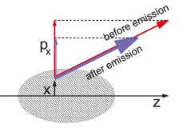
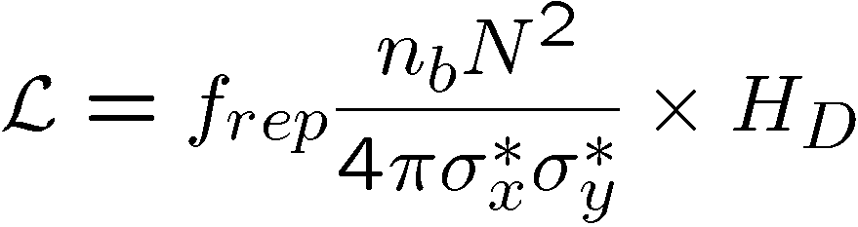
Nano-beam Technology
Electron and Positron Sources (e-, e+) :
Damping Ring (DR): → low emittance
Ring to ML beam transport (RTML）:
Main Linac (ML）：SCRF Technology
Beam Delivery System (BDS）→ small beam
Nano-beam technology progressed ATF Collaboration, hosted at KEK.
Notes:
10

Slide 11
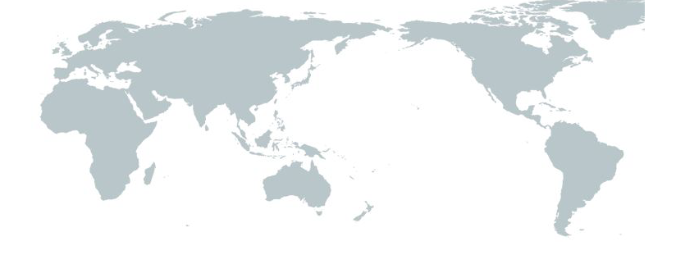

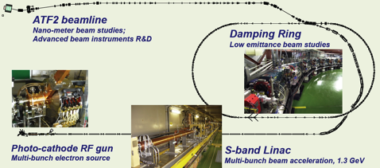
ATF: Global Collab. for Nano-beam Research
（for ILC)
CERN
DESY
IN2P3
LAL
LAPP
LLR
U. Oxford
RHU
STFC
U. Manchster
Y. Liverpool
U. C. London
INFN
IFIC
T.P.U.
KEK-ATF
Tohoku U.
Tokyo U.
Waseda U.
Nagoya U.
Kyoto U.
Hiroshima U.
IHEP
PAL
KNU
RRCAT
SLAC
LBNL
Fermilab
LLNL
BNL
Cornel
NDU
Nano-meter beam R&D
Damping Ring
  Low emittance electron beam
Final focus System Test Beamline
Intra-train beam-position feedback
Advanced Beam Instruments R&D
Cs₂Te Photocathode RF Gun

Slide 12
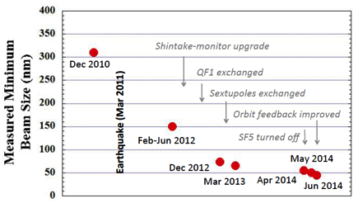
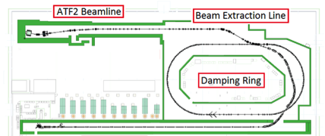
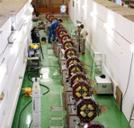
KEK-ATF: Demonstration of “Nano-beam”
ATF (Acc. Test Facility): the same FF beam optics demonstrated at ATF (1.3 GeV)
Beam-size reruied： 5.9nm at 250 GeV (ILC) → 37 nm at 1.3 GeV (ATF)
Progress： 300 nm (in 2010) → 150 nm (in 2012) → ≤ 44 nm (in 2014) → ≤40 nm (in 2016)
 | ILC | AF2
Beam Energy [GeV] | 250 | 1.3
L* (IP to FF) [m] | 4.0 | 1.0
β* [mm] | 0.48 | 0.1
Emittance (v) [pm] | 0.07 | 12
FF Beam Size [nm] | 5.9 | 37
ILC FF beam optics, demonstrated at ATF

Slide 13


SRF Technology
SRF Technology
Electron and Positron Sources (e-, e+) :
Damping Ring (DR):
Ring to ML beam transport (RTML）:
Main Linac (ML）：SCRF Technology
Beam Delivery System (BDS）
High Electric Field with low electric power consumption
Notes:
13

Slide 14
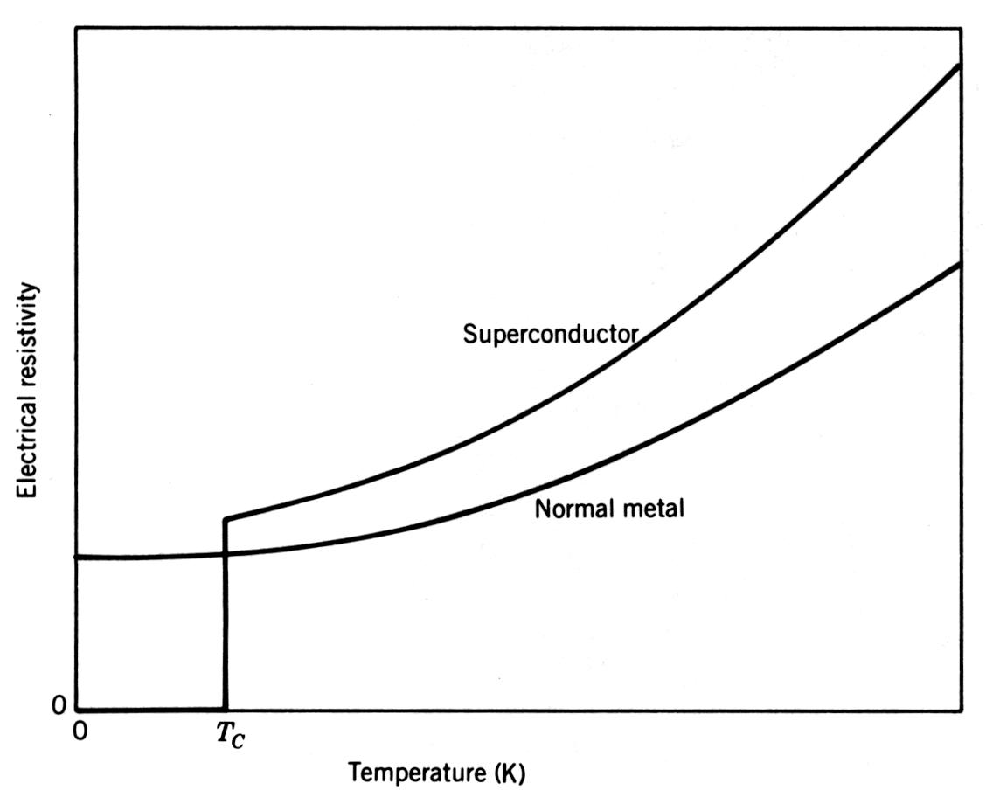
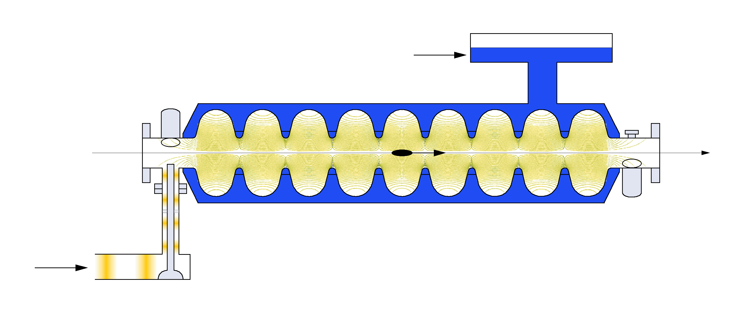
Advantage of Superconducting RF
Luminosity:
Ultra-high (Q₀ =10¹⁰):
  - small surface resistance → nearly
  zero power consumption in cavity walls
  Long beam pulses (~1 ms, at 5 Hz)
  → intra-pulse feedback
Larger aperture
→ better beam quality w/ larger aperture -
lower wake-fields
Necessary Cooling
  Cryomodule (thermal insulation)
  Cryogenics
RF efficiency
RF power / beam current
Vertical
emittance
(tiny beams)
Luminosity proportional to RF efficiency ILC
  ~160MW @ 500GeV
Efficient accelerating
high beam currents
Low impedance and preservation of
high beam quality (low emittance)

Slide 15
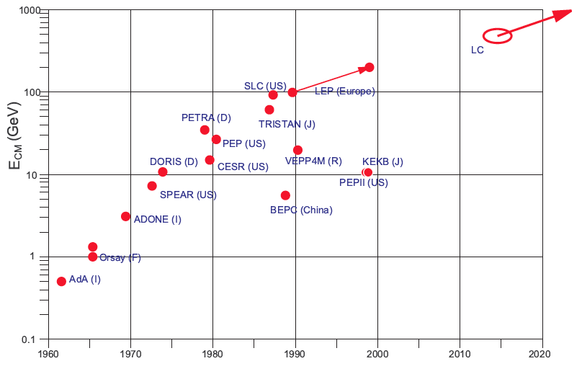


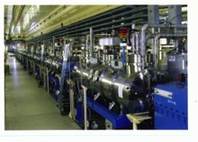
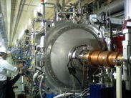

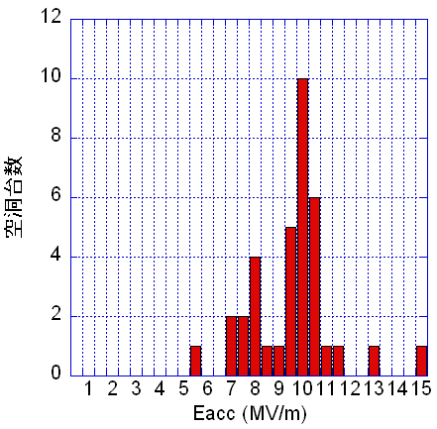
Development of e-/e+ Colliders
KEK and CERN, pioneering for SCRF beam acceleration TRISTAN→KEKB and LEP in 1980

Slide 16
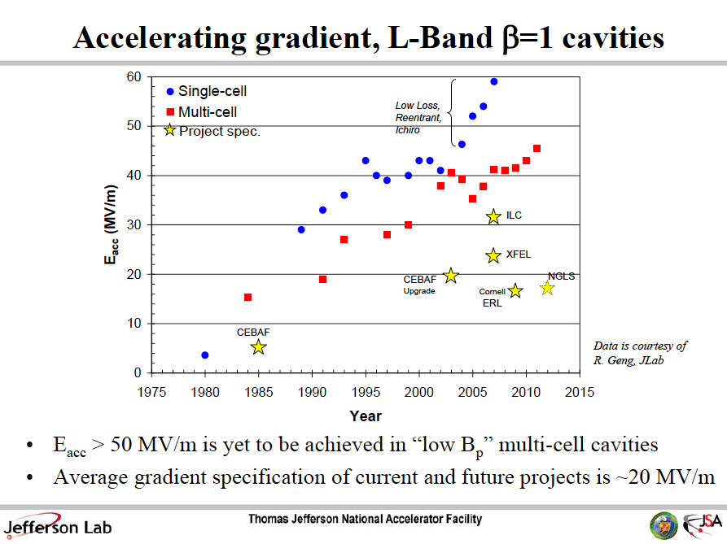
Progress in SRF Technology
Courtesy: G. Ciovati, R. Geng
G. Ciovati
IPAC’13
THYB201

Slide 17
Progress in 1.3 GHz 9-cell Cavity Production
year | Capable Lab. | Capable Industry
2006 | 1 DESY | 2 ACCEL, ZANON
2011 | 4 DESY, JLAB, FNAL, KEK | 4 RI, ZANON, AES, MHI,
2012 | 5 DESY, JLAB, FNAL, KEK, Cornell | 5 RI, ZANON, (AES), MHI, Hitachi
One Lab (2 vendor) in 2006, and
5 Lab (5 vendor) may handle it in 2012

Slide 18
Major Accelerators Under Construction
2010 ~ 2020
H. Padamsee / ILCWS2015/ILC-School
Project | Notes | # cavities | year
CEBAF-JLAB (US) | Upgrade 6.5 GeV => 12 GeV electrons | 80
XFEL-Hamburg (EU) | 18 GeV e – for Xray Free Electron Laser | 840 | ~ 2015
LCLS-II – SLAC (US) | 4 GeV electrons –CW XFEL | 300 | ~ 2019
SPIRAL-II (France) | 30 MeV, 5 mA protons -> Heavy Ion | 28
FRIB – MSU (US) | 500 kW, heavy ion beams | 340
ESS (Sweden) | 1 – 2 GeV, 5 MW n-Source ESS - pulsed | 150
PIP-II–Fnal (US) | High Intensity p-Linac for Neutrino Beams | 115
ADS- (China, India) | R&D for accelerator drive system | > 200
Global sum |  | > 2000

Slide 19

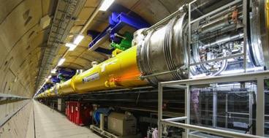
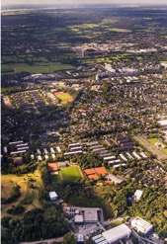

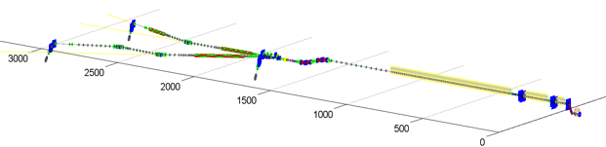
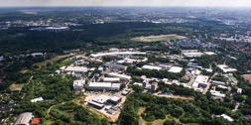

European XFEL Progressing
Media.xfel.au, Dec. 2015
Progress:
2013: Construction started
2015: SRF cav. (100%) completed
CM (70%) progressed
Further Plan:
2016: E-XFEL acc. completion
2017: XFEL beam to start
Acc. : ~ 1/10 scale to ILC-ML’s
SRF system: ~ 1/20 to ILC SRF’s
1.3 GHz / 23.6 MV/m
808 SRF acc. Cavities
101 Cryo-Modules (CM)
XFEL
DESY
1 km SRF Linac
XFEL site
DESY

Slide 20
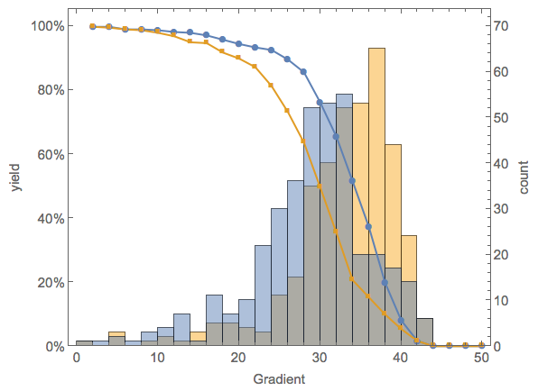
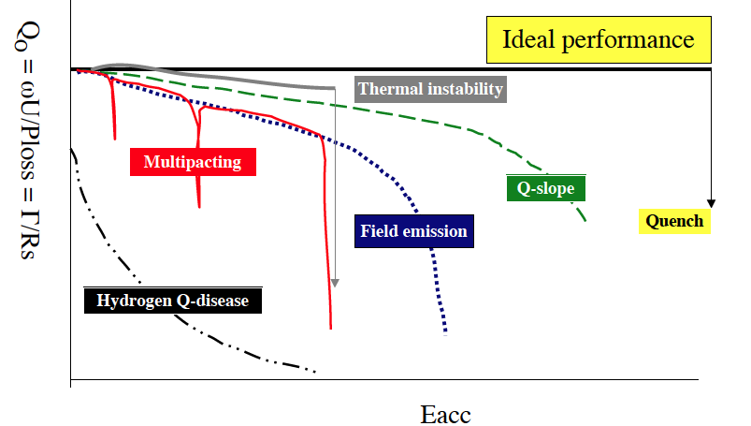
E-XFEL: SRF Cavity Performance (as received)
N. Walker, D. Reschke, SRF’15
SRF cavity production/test ；
# RI Cavities, 373 (as of Sept. 2015)
    Final process: 40 μm EP.
      The same recipe to ILC-SRF
    Tested at DESY-AMTF
Notes:：
    “Ultra-pure water rinsing as the 2nd process improving the gradient performance (~10%) for lower-performed cavities (not shown here).
G-max
G-usable
 | G-usable (Q₀> 10¹⁰ ) | G-max | (ILC) -usable
<G> MV/m | 29.4 | 33 | (35)
Yield at 28MV/m | 66% | 86% | (90%)

Slide 21
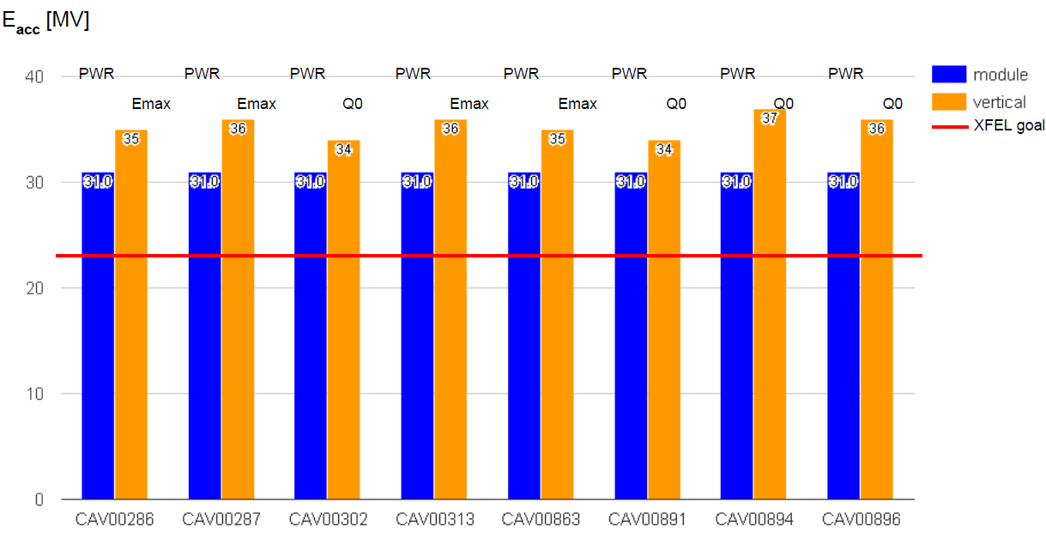
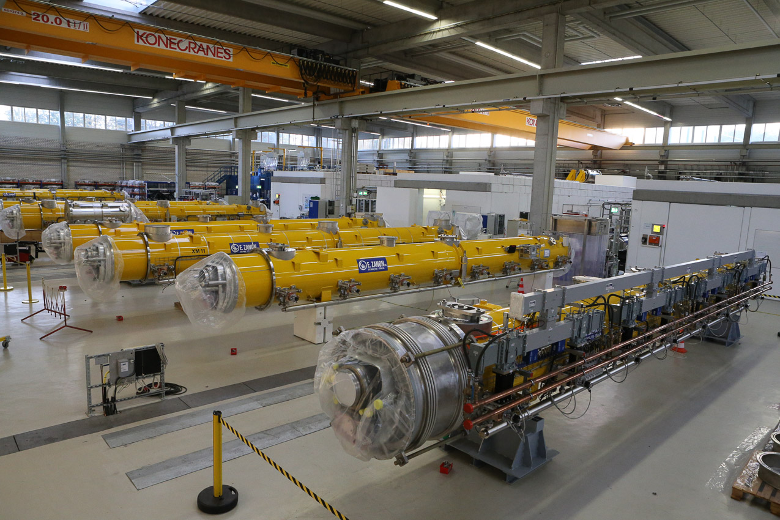
Cryomodule Performance : XM59
ILC Spec.
XFEL Spec.
⟨E_{acc}⟩ = 31 MV/m
XM59 is an excellent module, assembled after the change of CR procedure.

Slide 22
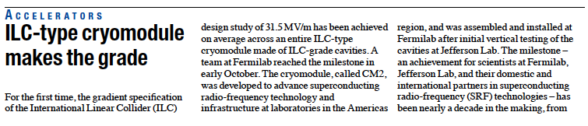

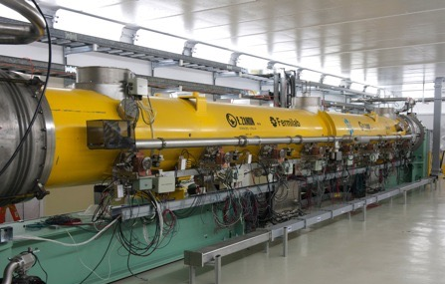
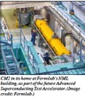
Fermilab：CM2 reached <31.5 MV/m >
Cavity | Gradient (MV/m)
1 | 31.9
2 | 30.8
3 | 31.8
4 | 31.7
5 | 31.5
6 | 31.3
7 | 31.6
8 | 31.4
Cryomodule test at Fermilab reached < 31。5 > MV/m, exceeding ILC specification

Slide 23
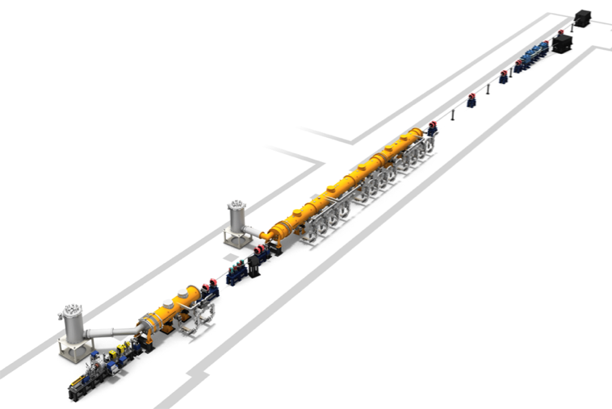
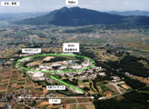
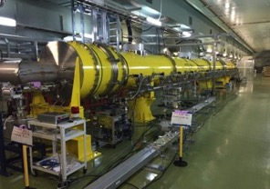
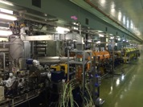
KEK-STF: Cavity Performance after CM Assembly
Beam Acceleration w/ 8 cavity string in JFY2016
SRF cavity performance before/after CM Assembly
Module | CM1a |  |  |  | CM1b |  |  |  | CM2a
Cav. # | 1 | 2 | 3 | 4 | 5 | 6 | 7 | 8 | 9 | 10 | 11 | 12
空洞単体 [MV/m] | 37 | 36 | 38 | 36 | 37 | 35 | 39 | 36 | 12 | 36 | 32 | 32
CM内 (pulse) [MV/m] | 39 | 37 | 35 | 36 | 26 | 16 | 26 | 32 | 18 | 34 | 33 | 32
 | Gradient stable |  |  |  | Degraded |  |  |  | Gradient stable
FY14: CM1+CM2a (8+4) assembly
FY15: Cavity individually tested in CM
RF power system in preparation
FY16: 8-cavity string to be RF tested
Beam Acceleration
（w/ a goal to reach > 250 MeV )
*Gradient(av) w/ 12 cavities： ~ 31 MV /m
Gradient (av) w/ best 8 cavities：~ 35 MV/m

Slide 24
Outline
Introduction
Technical Progress
Global Collaboration and Industrial Implications
Summary
A. Yamamoto, 160208

Slide 25
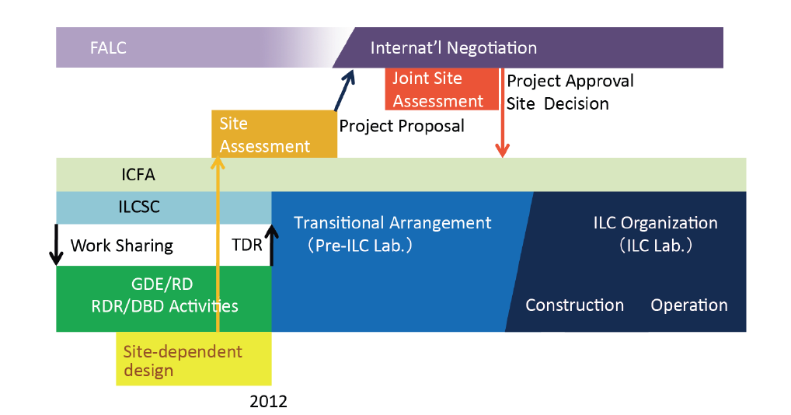
ILC Time Line: Progress and Prospect
(Pre-Preparation) and
Preparation Phase
Assuming (~2+) 4 year
(9 year)
We are here,
2016

Slide 26


ILC Accelerator Global Cooperation
TRIUMF
Oxford
STFC
◉
◉
IHEP, PKU
◉
◉
Cornell
DESY
CERN
FNAL, ANL
◉
JLAB
◉
◉
CIEMAT
LAL, CEA
◉
◉
◉
◉
INFN
KNU
KEK, Tokyo,
Hiroshima
SLAC, LLNL
◉
BARC, RRCAT,
IUAC
◉
GDE
→LCC
“Design to Realization”

Slide 27
Further Technical Issues to prepare for the ILC
The. Field | Subject | Global Cooperation
ADI | Optimize Acc. Design and Integration | LCC-ILC-ADI Global Team
SRF | Improve Gradient and Stability Establish three regional contribution Industrialization Hub-lab functioning | TTC: TESLA Tech. Collaboration: Three regional effort and experience EU：European XFEL AMs: LCLS-II AS：KEK-STF as Asian Hub.
Nano-beam | Realize ultra-low emittance (in DR), and nano-beam size and stability at FF | ATF: Acc. Test Facility Collab: - Global collaboration with KEK-centered
E+ Source | Demonstrate thermal balance with rotational target in vacuum | PosiPol Collaboration: Global collaboration
CFS | Establish a site-specific engineering Geological survey and assessment, | LCC-CFS Collaboration - Japan-centered
Management | Establish ILC Pre-Lab Prepare for the ILC Lab. | >> ICFA leading >> Inter-Government Agreement ineviable
Nano-beam
SRF

Slide 28
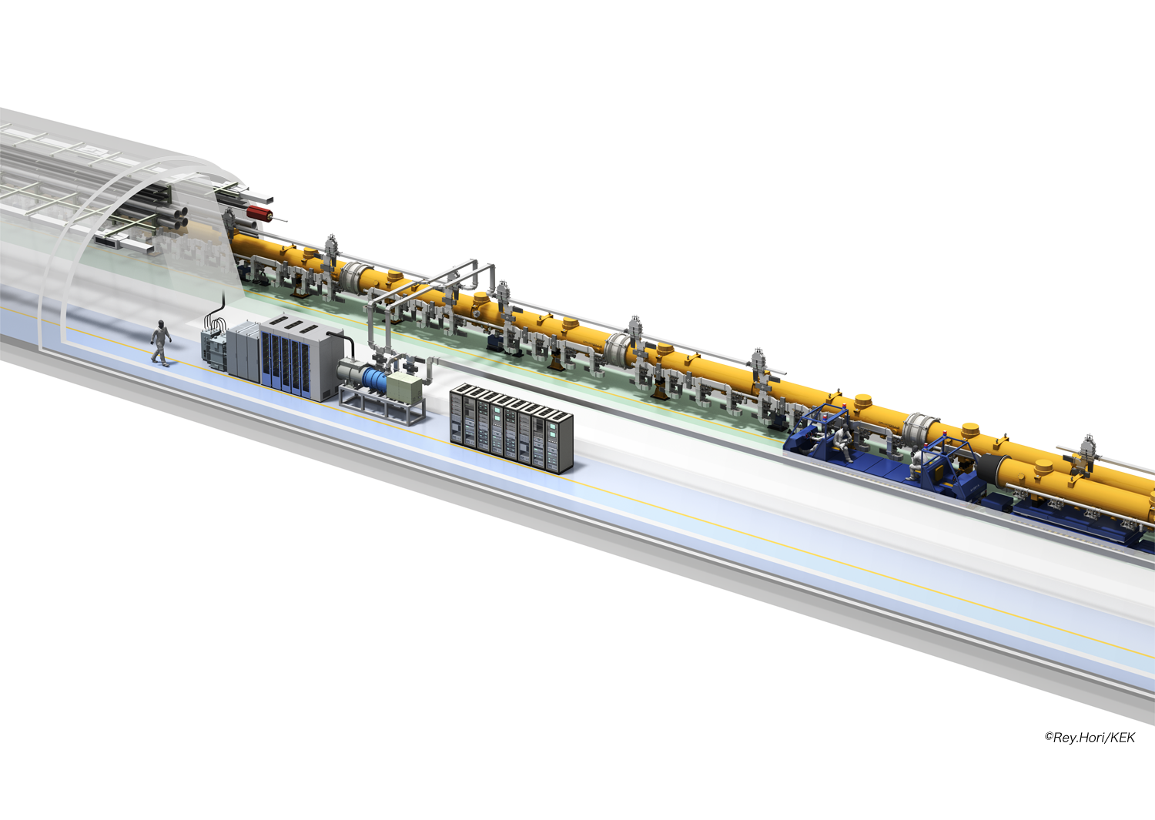
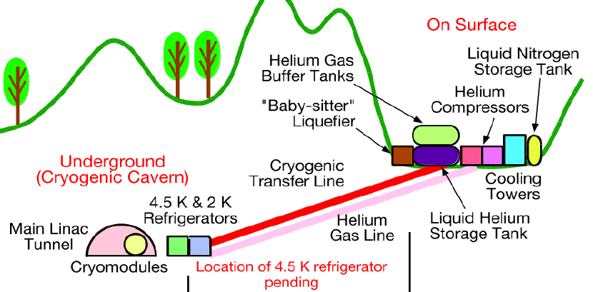
ILC ML Components
Central wall
（1.5 m ）
Cryomodule
(1855)
Cryogenics
10 x 2.3 kW at 2 K
Pulse PS
(Marx
Genegrator
: 437)
Multi-beam Klystron
(437)
Digital Control System

Slide 29
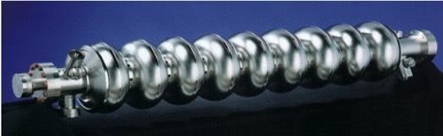
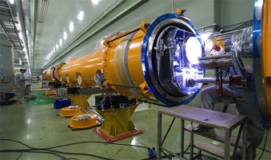
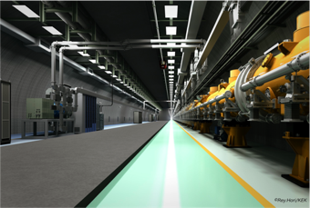
ILC SRF ML Parameters
1.3 GHz Nb 9-cellCavities | 16,024
Cryomodules | 1,855
SC quadrupole pkg | 673
10 MW MB Klystrons & modulators | 436
Approximately 20 years of R&D worldwide
→ Mature technology, overall design and cost

Slide 30

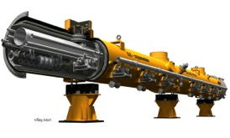
Cavity/Cryomodule Fabrication
Purchasing Material/Sub-component
Manufacturing Cavity：
Processing Surface
Assembling LHe-Tank ：
Qualifying Cavity：
Cavity String Assembly：
Cryomodule Assembly:
Qualifying CMs：

Slide 31
A Model for Cavity/CM Industrialization
Step hosted | Industry | Industry/Laboratory | Hub-laboratory | ILC Host-laboratory
Regional constraint | no | yes or no | yes | yes
Sub-comp/material - Production/Procurement | Nb, Ti, specific comp. … |  | Procurement
9-cell Cavity - Manufacturing | 9-cell-cavity, Process, He-Jacketing |  | Procurement
9-cell Cavity - Performance Test |  |  | Cold, gradient test
Cryomodule component - Manufacturing | V. vessel, cold-mass ... |  | Procurement
Cryomodule/Cavity - Assembly |  | Cav-string/ CM-assembly
SCRF Cryomodule - Perofrmance Test |  |  | Cold, gradient test
Accelerator integration, Commissioning |  |  |  | Accelerator sys. Integ.

Slide 32
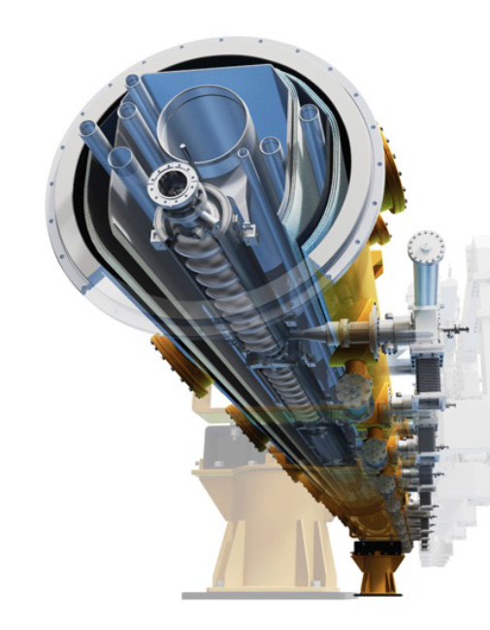
ILC SRF Global Manufacture/Integration Model
DESY, INFN
CERN
IHEP, PKU
FNAL/ANL
TRIUMF
Cornell
CEA-Saclay, LAL-Orsay
KEK
JLAB
SLAC, LCLS-II
IUAC,RRCAT
ILC
Host/Hub-Lab
Hub-lab:
regionally
hosting
integration
& Test
Hub-Lab
Hub-Lab
Industry:
manufacturing
components
w/worldwide
contracts
Industry
worldwide,
RI, EZ, MHI, Hitachi, NW, PAVAC, ROARK, …
Hub-Lab
Hub-Lab
Hub-
Lab

Slide 33
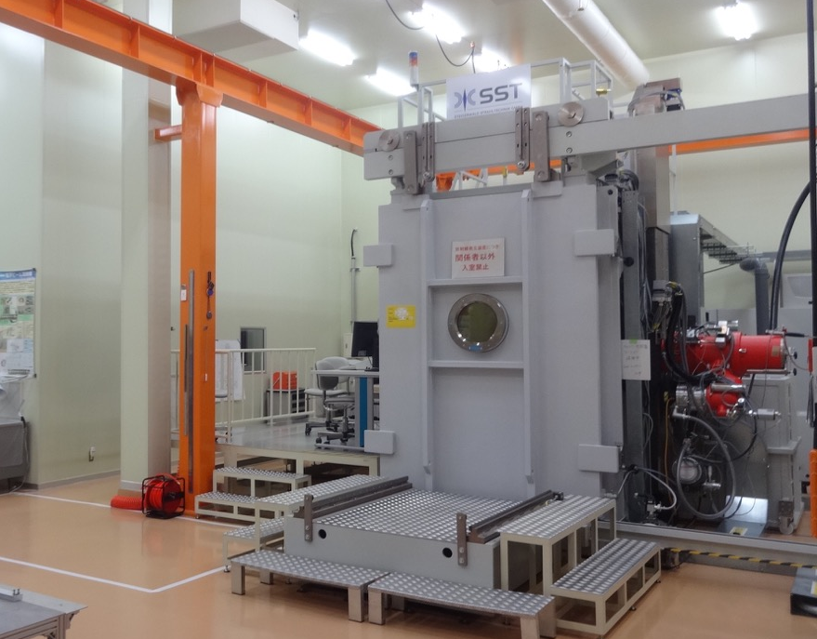




CFF at pre-preparation/main preparation phase
Chemical polishiing
Press machine
Vertical lathe
EBW
Surface inspection
Result of vertical test
⇒Qualify the ILC spec. （35 MV/m）
33
Fabricate cavities which satisfy Japan High-pressure-gas-regulation (KHK)
-> also for the “Global cryomodule” collaboration (High-pressure-gas regulation)

Slide 34




Superconducting Accelerator Development Hall
The hall is constructed by COI-budget (2012-2013) targeting future Compact SC Accelerator business development by Industry-Academic Collaboration.
As a model facility for ILC assembly & Testing
Clean-room
Cryomodule Assembly (cantilever)
EP (vertical-EP)
Cavity Testing (4-cavities-test)
He Cryogenics
( Cryomodule Test Area)

Slide 35

KEK-ILC Action Plan in Preparation Period
Hub-Laboratory Consortium

Slide 36


“Global SRF Cryomodule ” Program
-Technical Issues to be settled during the ILC Preparation Phase-
Objectives: Transportation of the cryomodule from EU (AM) to Japan
Establish system-engineering to realize Global Cryomodules (globally compatible cryomodule) including:
  Industrial technology, with optimum plug-compatibility/standardization,
  Safety regulation (such as “high-pressure-code”) with inter-regionally compatible authorization,
  Gradient performance reproducibility after inter-regional transportation.
Global Cooperation:
EU (AM) contributes a full cryomodule including manufacturing and performance test,
EU (AM), and JP work together for inter-regional transportation and safety regulations to be compatibly authorized,
JP contributes to the cryomodule performance test and to reproduce the performance,
Time-line:
The program should start soon, for its realization in the ILC main preparation period of 4 years, associated with inter-regional legal/safety process

Slide 37




Beam Handling (Sources, DR, BDS, Damp)
Damping Ring:
Vacuum
Injection/ejection Fast Pulse Kicker
SRF cavity and CM,
CW 650 MHz RF system
Wiglers
Magnets and Power Supplies
Bunch by bunch Feedback
CW 650 MHz
RF system
Bunch by bunch Feedback
Cryomodule
Sources and booster linac:
e- e+ source
Andulators, ,
NRF linac
Superconducting Final Focusing Magnet
Beam Delivery System:
Superconducting Final Focusing Magnet
Muon wall/spoiler
Beam Dump
Abort kicker

Slide 38

Damping Ring, Magnets

Slide 39



ILC Site Candidate Location in Japan: Kitakami
Preferred site selected by JHEP community,
Endorsed by LCC, in 2013
High-way
Oshu
Express-
Rail
Ofunato
Kesen-numa
Sendai
Ichinoseki
IP Region

Slide 40


Overview of Project Schedule
Design Schedule
Pre-preparation Phase
Main preparation Phase
We are here
- | - | - | 1 | 2 | 3 | 4
TD
Basic Planning
Basic Design
Detailed Design
Final Design
ED
Construction
Phase
Geological Survey
Adjustment for Bidding
Pilot S.
Basic Survey
Detailed Survey
Topographical Survey
Preliminary S.
Detailed Survey
Land
Acquisition
Environmental Assessment
Pilot S.
Pilot S.
Environmental Impact Assessment
Evaluation Certificate
Field Survey & Study

Slide 41
Summary
International Linear Collider (ILC) is an energy frontier e+e- colliding accelerator to reach a collision energy of 500 GeV extendable to 1 TeV, with the important feature complementary to the LHC.
Key technologies of SRF and Nano-Beam well demonstrated, specially by European XFEL and ATF hosted at KEK, functioning as prototype works.
LCC is extending efforts for “Design to Realization” with improving the design to be further reliable and cost-effective,
Global cooperation and industrial implementation will be inevitably important and anticipated.

Slide 42
Backup

Slide 43
ILC ML Parameters, demonstrated in TDR
Characteristics | Parameter | Unit | Demonstrated
SRF:
Average accelerating gradient | 31.5 (±20%) | MV/m | DESY, FNAL, JLab, Cornell, KEK,
Cavity Q₀ | 10¹⁰
(Cavity qualification gradient | 35 (±20%) | MV/m)
Beam current | 5.8 | mA | DESY-FLASH), KEK-STF
Number of bunches per pulse | 1312 |  | DESY
Charge per bunch | 3.2 | nC
Bunch spacing | 554 | ns
Beam pulse length | 730 | ms | DESY, KEK
RF pulse length (incl. fill time) | 1.65 | ms | DESY, KEK, FNAL
Efficiency (RF→beam) | 0.44
Pulse repetition rate | 5 | Hz | DESY, KEK
Nano-bam:
ILC-FF beam size (y) KEK-ATF-FF equiv. beam size (y) | 5.9 37 (44 reached) | nm nm | KEK-ATF

Slide 44


Progress/Prospect in SRF Cavity Gradient
for Frontier Particle Accelerators
R. Geng
Björn Wiik
vision
R&D needed
TDR by 2012
Under construction
Under construction
ITRP Recommendation
TRISTAN, LEP, KEKB

Slide 45


Progress in SRF Cavity Production Yield during ILC – Technical Design Stage
Production yield:
94 % at > 35+/-20%
Average gradient:
37.1 MV/m
> R&D goal of 35 MV/m
reached (2012)

Slide 46
SRF Cavity and Superconductor
SRF
Nb
SCM
Nb-Ti,
Nb3Sn
H
B
H_{c}1
H_{c}2

Slide 47

ILC Cryogenics System

Slide 48

Damping Ring, SRF System

Slide 49
LCC: Linear Collider Collaboration
Int. Com. for Future Acc.
ICFA
Funding Agencies for Large Colliders
FALC
Program Adv. Committee
PAC
Linear Collider Board
LCB
Regional Directors
B. Foster (EU)
H. Weerts (AMs)
A. Yamamoto (AS)
Linear Collider Collab. LCC Directorate
- Director: L. Evans
Deputy (Physics)
– H. Murayama
KEK
ILC
– M. Harrison
CLIC
– S. Stapnes
Phys./Detectors
– H. Yamamoto

