Slide 1
Pixel TPC efficiencies & resolution in the 2015 Test Beam data
Peter Kluit, Michael Lupberger, Jan Timmermans
PixelTPC meeting 10 March 2016

Slide 2
Introduction
Analysis of the pixel testbeam data
Description of the setup
  10 octoboards consisting of 2 x 4 chips
  Geometry y along radius of the TPC: x orthongonal
  z from time measurement 25 nsec clock
Start by a zero B field run: straight tracks
Run 000102_150402 offset z is 6 cm
Typically track crosses 2 x 10 Chips
Cannot align all chips in an octoboard because only 2/8 are illuminated by the beam
Use of new “rotated flipped” GEAR geometry file

Slide 3
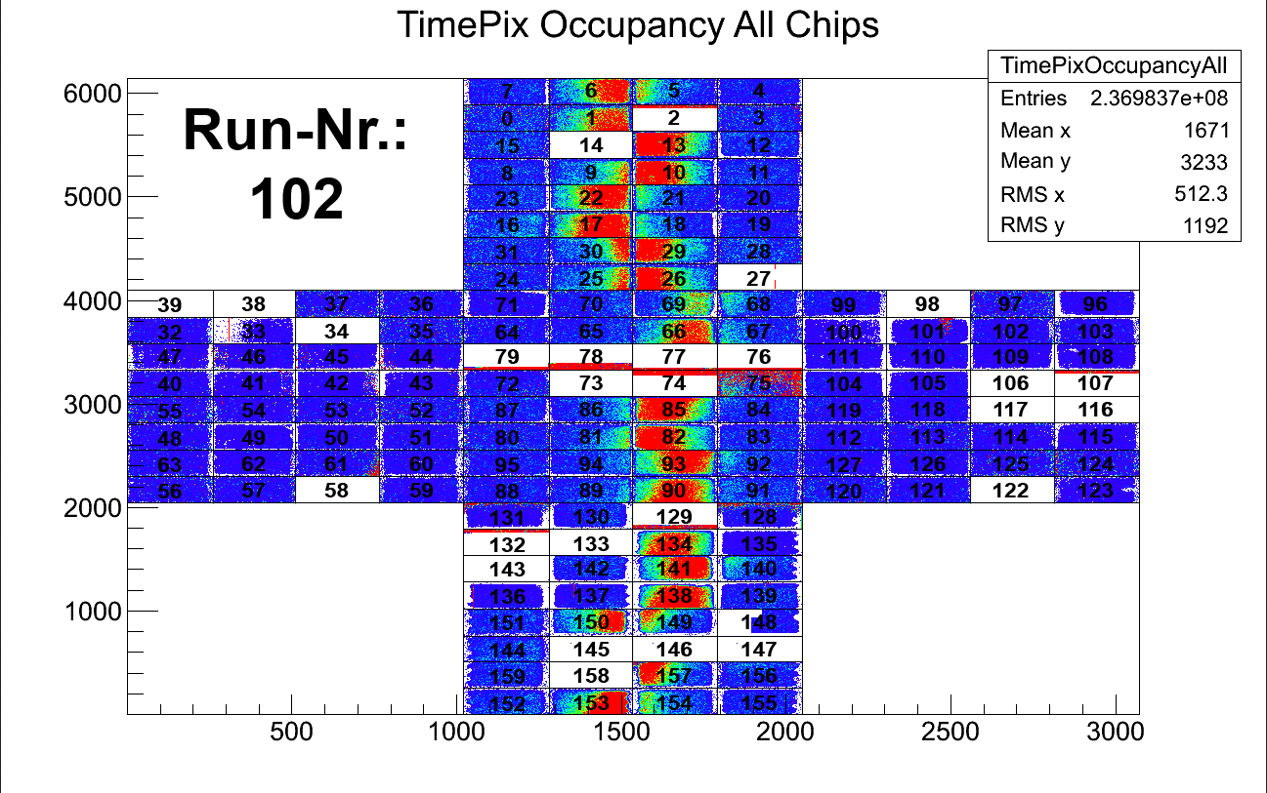
Chip layout in the test beam

Slide 4
TPC tracking and Chip edges
For a TPC it is essential that all charges are collected and the fitted to the track
If part of the beam profile (or track) covers the edge then this introduces a bias
One has to correct in the track fit (or in the track model) for the chip edges and the part of the electron cloud that is not collected on this chip
This is very different from a silicon tracker: a hit is or is not detected near the edge and is then put in the track fit without giving a bias
To calculate the bias one needs to know very precisely the track parameters say at better than 50 micron level

Slide 5
TPC tracking and Chip edges
The formula for the bias depends on the predicted position in xy, the Gaussian sigma of the diffused electron cloud and the chip edge position in xy
bias = Cσ Gaus(xy-xyEdge,σ) (one edge)
with Gaus = exp(-x²/2σ²) and C =√2/√π
here σ is 800 microns (depends on gas, field and distance)
The bias correction can be part of the track model but can only be calculated with high precision after a precise estimate of the track position
This issue has to be solved in the event data model of ILD
For the moment I just reject chips on tracks if they are closer than 3 s.d. from the (x) edge

Slide 6
TPC tracking and Chip efficiencies
There is a point that is important to minimize the bias on the fitted position: the chip efficiency
If the chip efficiency in x and y is flat and constant there is no bias on the track residuals
If however the efficiency varies e.g. linearly in x (so orthogonal to the track direction) then this will induce a shift.
Suppose the efficiency drops 20% over a chip (256 pixels). This will generate a systematic bias in the residual:
bias = σ 0.2/(256*0.055 mm) so 10 microns
This implies that: if we fit the residuals a shift or rotation can come 1) from the actual shift and rotation of the chip but also 2) from efficiency biases

Slide 7
TPC tracking and Chip efficiencies
For the detector design we therefore want to keep the efficiencies as high and flat as possible to avoid biases or deformations in the residuals
This brings me to the test beam analysis
In the analysis I observe a larger spread on the larger residuals than expected. So in stead of say a 50 micron precision per chip I see 100 microns. The pull is about 2.
This can be due to “deformations” of different origin
  One possibility is z deformations (looked into this)
  Another option are more complicated xy geometrical deformations (not a geometrical shift and rotation). Not studied yet.
  Or efficiency variations over the xy chip plane.
In the analysis we also found that it is partially due to double hits: neighboring pixels firing

Slide 8
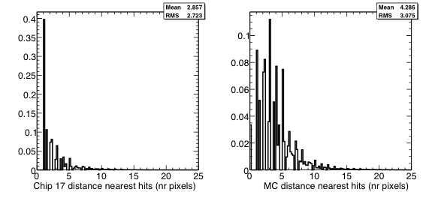
Neighbor hits in Chips
We found a quite large nr of hits per cm of 150 (Chip 17)
Study the the minimum distance between hits and wrote a simple MC generator to see what we expect for 150 hits per cm.
Needed cleanup neighbor hits
Normalized
Huge spike at 1 and 1.4
xxx
xxx
xxx

Slide 9
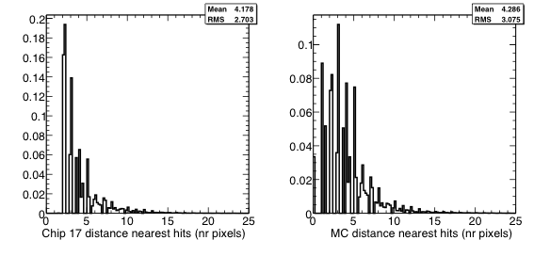
Neighbor hits in Chips
Distribution after cleanup of neighboring hits:
Choose hit with largest charge deposit = first in z to track (due to time walk)
Normalized

Slide 10
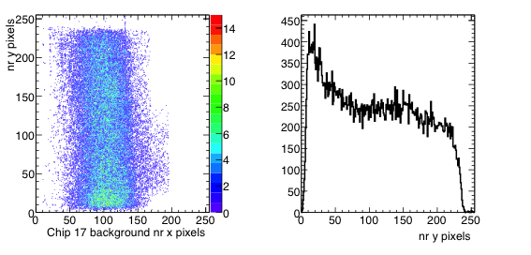
Background hits in Chip 17
Distribution of removed neighboring hits:
Clear spike at low y pixels; in 2D bkg hits x> 250

Slide 11
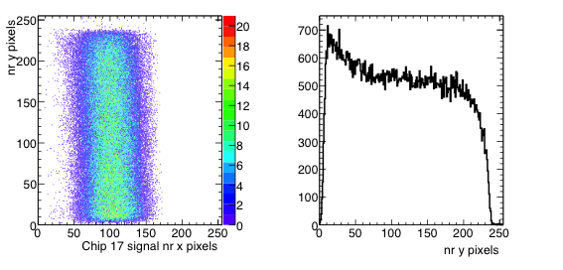
Background hits in Chip 17
Distribution of “signal” hits after removal of background:
One expects a flat distribution in y
Still some background at low y values?

Slide 12
Chip efficiencies
Method and selections (B field 0 run)
Select a track through chip 17 and 141 with more than 100 hits. The reference chips are changed because the others (10 and 153) had tracks near the edges. For these ref. chips the beam is far from the edges. NB tracks near edges give a large biases on residuals.
Reject chips tracks that cross the x edges within plus or minus 3 s.d. (0.8 mm) So keeping only chips where all the expected hits should be found.
Select only clean tracks with cuts on delta phi, z0 and d0. Reject double tracks with too many hits.
From the track parameters I calculate the expected beam profile on the chip assuming a Gaussian of 0.8 mm This gives the expected nr hits on the chip in pixel units. - The hits that are actually found are also stored - The relative efficiency is the division of the found/expected.

Slide 13
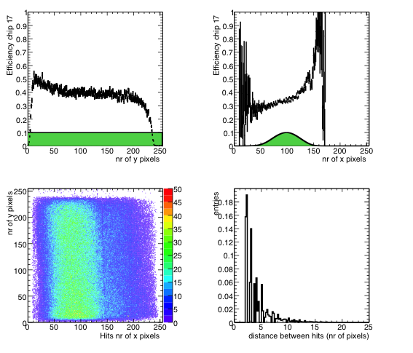
Chip 17 efficiencies
The best chip = reference 1
In green beam profile:
flat in y and multiple gaussians x
drop 220-256 pixels
drop 0 -10 pixels
Not flat in x
Raw hits
Dead zones:
Dike 6 pixels
Guard ring in y 15 pixels
Efficiency in x non-flat

Slide 14
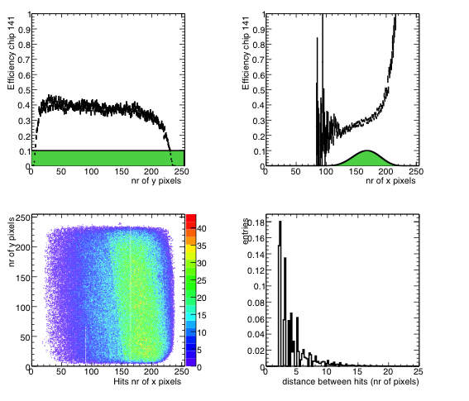
Chip 141 efficiencies
Reference chip 2
In green beam profile:
flat in y and multiple gaussians x
drop 220-256 pixels
drop 0 -10 pixels
Not flat in x
Raw hits
Right bottom round edge
Efficiency in x non-flat

Slide 15
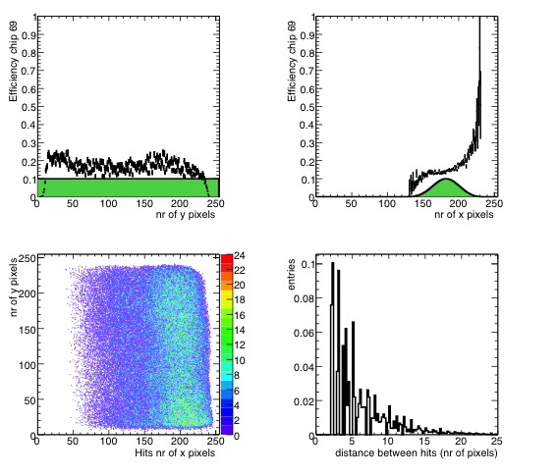
Chip 69 efficiencies
Bad low efficiency chip
In green beam profile:
flat in y and multiple gaussians x
drop 220-256 pixels
drop 0 -10 pixels
Not flat in x
Raw hits
Right bottom round edge
Efficiency in x non-flat

Slide 16
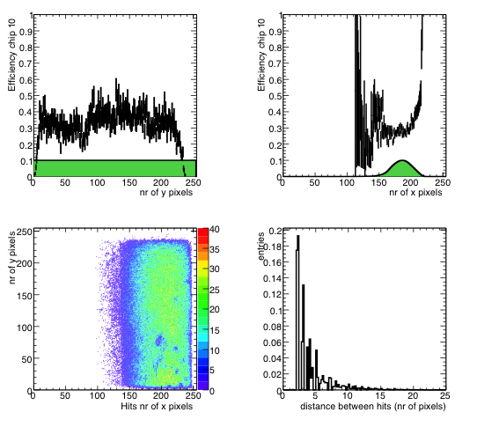
Chip 10 efficiencies
Bumpy efficiency chip
In green beam profile:
flat in y and multiple gaussians x
drop 220-256 pixels
drop 0 -10 pixels
Not flat in x
Raw hits
Right bottom round edge
Efficiency in x non-flat

Slide 17
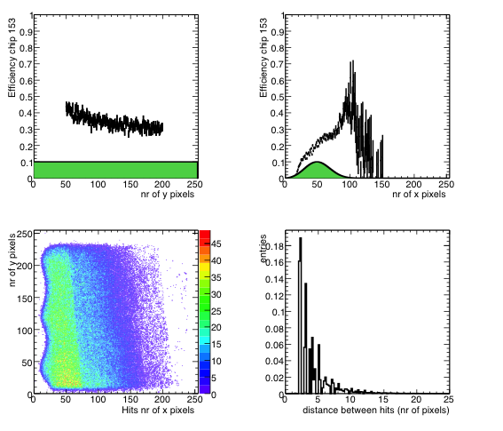
Chip 153 efficiencies
Wiggly efficiency chip
In green beam profile:
flat in y and multiple gaussians x
drop 220-256 pixels
drop 0 -10 pixels
Not flat in x
Raw hits
Left wiggly
redge
Efficiency in x non-flat

Slide 18
Summary hits per cm
chip rel. effi max rel effi Y hits trunc/cm data events
1 0.189769 0.277984 73.9338 69106
6 0.202629 0.292815 79.1688 40586
10 0.251664 0.446384 96.7501 12220
13 0.255453 0.377687 100.465 55536
17 0.294065 0.447131 113.648 119910
22 0.229647 0.306066 90.3515 86673
29 0.255055 0.452708 100.309 6896
66 0.198388 0.327687 78.1015 80896
69 0.125687 0.202122 49.6105 31555
82 0.239702 0.357666 91.9668 49731
85 0.231571 0.395135 89.9473 94299
90 0.229092 0.353952 89.5151 93416
93 0.231247 0.401479 89.8862 94295
134 0.192159 0.271147 75.3125 78250
138 0.22688 0.356937 88.3866 92389
141 0.264048 0.373338 102.99 107670
150 0.213853 0.481002 84.1619 5782
153 0.168593 0.364715 66.4043 34409
For an electron one would expect 1.4 times 100 hits/cm

Slide 19
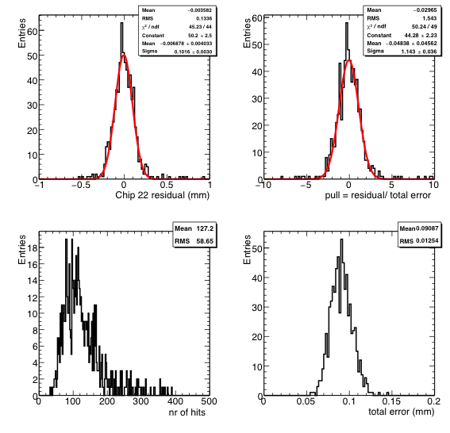
Resolution per chip
Method:
full fit through chips 17 and 141 propagate errors (assume 0.8 mm per hit)
Fit through the reference chip ONLY
Shift and rotate the chips (align)
Calculate residual of reference chip wrt full fit
Pull = residual / expected error (from full fit and chip)

Slide 20
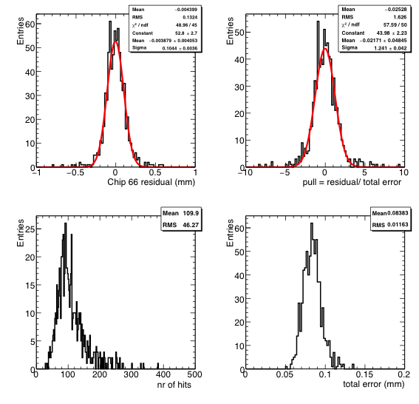
Resolution per chip 66

Slide 21
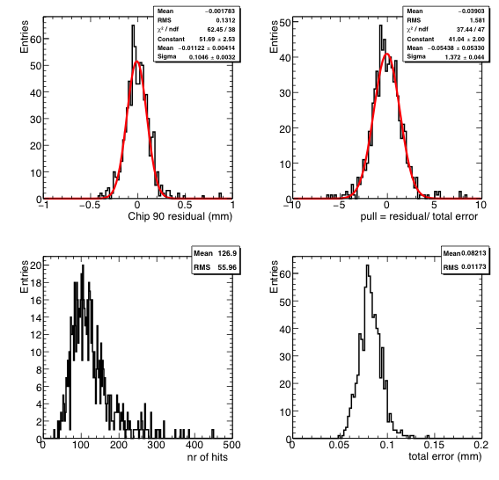
Resolution per chip 90

Slide 22
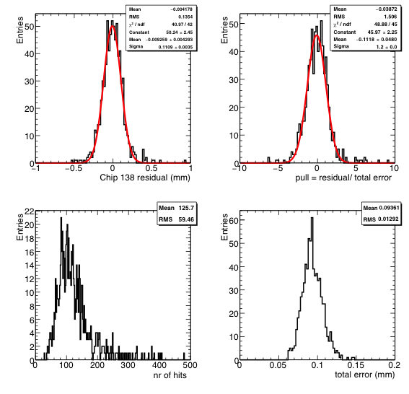
Resolution per chip 138

Slide 23
Resolution per chip
Chip resolution(mm) pull
0.125737 1.21765
0.135288 1.23106
10 0.241599 2.37582 bumpy chip
13 0.115116 1.20874
22 0.10159 1.14296
66 0.104411 1.24057
69 0.114359 1.175
82 0.10318 1.1957
85 0.108777 1.31491
90 0.104571 1.37221
93 0.109144 1.33306
134 0.116371 1.214
138 0.110914 1.19965
0.168231 1.486 wiggly chip
0.7 mm per hit

Slide 24
Resolution per chip using all good chips
Chip resolution(mm) pull
1 0.107619 1.36837
6 0.115158 1.31589
13 0.0970513 1.27545
17 0.0835968 1.27783 (was used as Ref1)
22 0.0926846 1.22985
66 0.0908516 1.24745
69 0.112894 1.1796
82 0.0877 1.21932
85 0.0936347 1.33343
90 0.0880832 1.29956
93 0.0886049 1.28664
134 0.0966038 1.22604
138 0.101433 1.3333
141 0.0986377 1.4322 (was used as Ref2)
Improved precision use all other chips to predict position and
angle in a chip

Slide 25
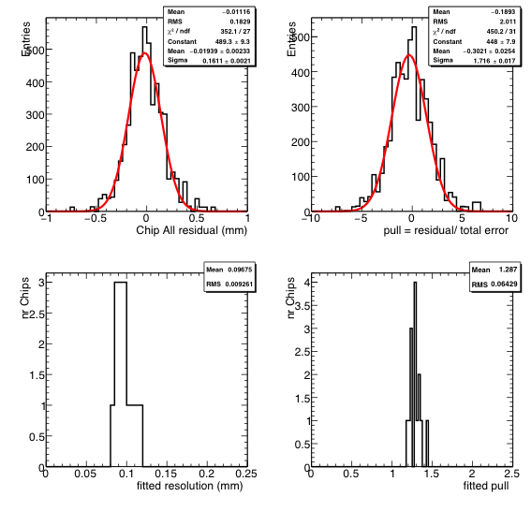
Resolution selected chips
On average the resolution per chip is 92 μm and
the average pull is 1.3. The expected precision is 70 μm.
This means that per chip we have a systematics of 60 μm .

Slide 26
Sagitta analysis
Split the tracks into three pieces according to the Modules:
Inner – Middle – Outer modules
Fit Inner + Outer -> get track parameters and errors
Fit Middle -> get track parameters and errors
The sagitta = residual at the Middle position
The sagitta shows what happens if we combine all the measurements. The pull = sagitta/ expected error tells how well we do: remaining systematical errors

Slide 27
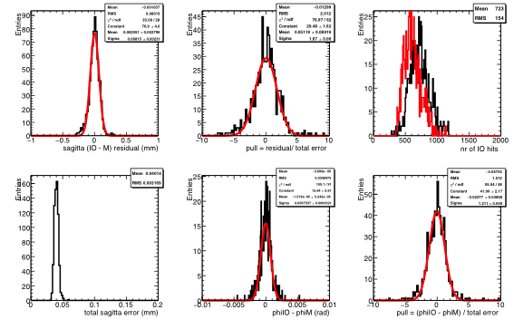
Sagitta analysis
Middle hits

Slide 28
Sagitta analysis results
The σ sagitta fitted is 67 μm; we expect 32 μm
The pull is fitted to be 1.7.
Conclude: we have additional systematics per module of 58 μm. This is quite large.
Per chip we have already 92 μm fitted resolution. At that level there was already sign of the presence of systematics of 60 μm .
The phi results per module are:
Fitted resolution 0.075 mrad expect 0.06 mrad with a fitted pull of 1.2.
Conclude: the phi systematics is rather small: only 0.04 mrad.

Slide 29
Summary
Looked into detail on the impact of chip edges
Need to be careful in the track/chip selection because they bias the track fit residuals
Investigated further the resolution per chip
Found that neighboring background hits spoiled the resolution in the previous analysis
Neighbor hits are now rejected (highest charge selected)
For the construction of next modules it is essential to have a flat efficiency over the chip plane with minimal field distortions
Clearly problematic chips have been found and removed
A low efficiency chip is found (be kept)
The 17 selected chips were aligned
After that the resolution per chip is measured
On average the resolution per chip is 92 μm expected 70 μm.
This means that per chip we have a systematics of 60 μm.
NB Resolution per hit is 0.7 mm.

Slide 30
Summary
The sagitta analysis shows that:
The σ sagitta fitted is 67 μm; we expect 32 μm.
Therefore we have a large systematics per module of 58 μm.
The fitted phi resolution is 0.075 mrad; we expect 0.06 mrad
Therefore the phi systematics is rather small: only 0.04 mrad.
For the production of a new set of modules we have to improve substantially on the systematics that affect the chips.

