Slide 1
Question to TB from CRWG on 10Hz Operation
K. Yokoya
2016.3.8 TB meeting, For CRWG

Slide 2
Letter to TB
The work of the Central Region Working Group is progressing though slowly. We need a couple of inputs in order to decide the machine configuration and the tunnel shape near the positron source region. One of them is the 10Hz operation (5Hz for positron production and 5Hz for collision, not 10Hz collision). It is briefly mentioned in Sec.2.2.2 in TDR vol.3.II. The general parameter list (Table 2.1) gives E_{CM} down to 200GeV, which reflects the design criteria (200-500GeV) on page 3. (On the other hand nothing is described, presumably, in TDR about possible operation below 200GeV, in particular at Z-pole.)
However, the design detail of 10Hz operation has not been worked out. Fig.5.2 in page 91 shows a beamline EPUNDDL in a dashed line, whose lattice structure is yet to be determined. We think the detailed lattice design is not a mission of the Central Region WG, but some guideline is necessary to go forward. On this point we would like to work on the following working hypothesis:

Slide 3
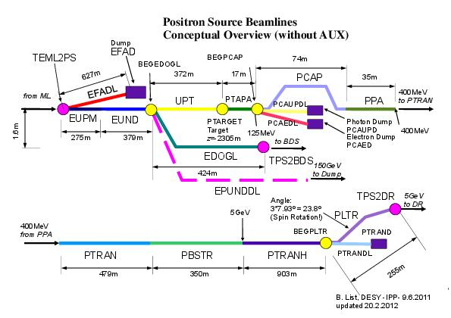
TDR v3 part2 p.91

Slide 4
Proposal from CRWG
Prepare a space to guarantee 10Hz operation down to 200GeV, though actual construction might be done later after day 1.

Slide 5
Possible Configuration
Insert a space to install later 5Hz pulsed magnets (vertical kick) just before the undulator for merging the orbits of the positron production beam and the beam for collision at the entrance of the undulator.
  Orbit difference <~10mm
  Magnet length < 5m
Insert a space to install later 5Hz pulsed magnets (horizontal kick) just after the undulator in order to separate the two beams.
  Create orbit split ~30cm
  Magnet length ~30m
  Both (v-kick and h-kick) 5Hz, 1ms flat-top
Leave a space for the transport line of the spent electron (after producing positron beam) leading to the tune-up dump (about a kilometer long).
  DC dogleg
Postron production beam
undulator
Linac end
Colliding beam
Colliding beam
Spent electron

Slide 6
Space for the red parts should be prepared
e-Linac end
undulator
Dog-leg for colliding electron
Pulsed V-bend
To BDS
Pulsed H-bend
To tune-up dump
Dog-leg for spent electron
If IP is considered to be the fixed point
Undulator must be shifted upstream by ~30m
Whether the space for linac extension (1.5km) be decreased by ~(30+5) m or not can be decided any time
Field of pulsed magnet (5Hz, 1ms flat-top)
  1Tesla seems to be OK, but may be too strong

Slide 7
Beam Dynamics for E_{CM}=200GeV
Colliding beam 100GeV (low gradient)
Positron production beam 150GeV (red) & 250GeV (black)
Injection energy 15GeV
Linac steerings tuned for 100GeV beam
Vertical offset of 150GeV beam ~1mm
Kubo
Jan.2011
& Feb.2016

Slide 8
Emittance Increase for 150GeV beam
Vertical emittance γε_{y} ~ 1μm (50 x nominal)
Still tolerable for positron production
Kubo

Slide 9
Undulator Resistive Wake for the Colliding Beam (old results by Kubo)
Assume
  150GeV beam
  200m undulator
  Align beam pipes with rms 240μm, every 20m independently
  No correction
→ Δy’ ~ 1σ_{y’} (short range wake)
(long-range wake is negligible)
Factor 1.5 larger for 100GeV beam
Alignment with beam size monitor downstream is necessary, but manageable.

Slide 10
Other Issues for E_{CM}>=200GeV
Linac hardware
  10Hz, alternating gradient

Slide 11
Z-pole Operation (in the letter to TB)
The hypothesis above does not guarantee the operation down to Z-pole, but does not exclude it either. The Parameter Group, led by Jim Brau, has been discussing about Z-pole since December last year, starting from a question from FCC-related people. The main issue is how high a luminosity is available at Z-pole (and W-pair threshold) in ILC. The necessity of detector calibration at Z-pole is also being discussed. It will take some time to come to a conclusion. There will be a discussion session at Santander workshop. The luminosity run at Z-pole is a complex issue and, we understand it is beyond the scope of CRWG. The calibration issue might be taken into our work, if their conclusion comes out early enough, but we would like to put it on the shelf for a while. (In my personal feeling a luminosity ~100 times lower than nominal may be obtained by the scheme stated above.) If they conclude Z-pole calibration is necessary, the above stated configuration should be ready from day 1.

Slide 12
Z-pole Operation
The propsal does not guarantee Z-pole operation
  Kick angle for orbit difference compensation is enough but
Beam dynamics issues
  45GeV beam in the linac
    wake at low energy
    Large relative energy spread
  Also 150 (or 125) GeV beam (large offset, HOM)
  45GeV beam in the undulator (resistive wake)
If (c) is the only problem, think of a beamline to bypass the undulator
  The space for the bypass is not too wide
If (a)(b) are serious, the only solution may be Nick’s configuration
  Too big a change to be discussed in CRWG

Slide 13
Beam Dynamics for E_{CM}=90GeV
Colliding beam 45GeV (low gradient)
Positron production beam 125GeV (black), 130GeV (red) & 250GeV (blue)
Injection energy 15GeV
Kubo

Slide 14
Orbit Deviation for the Combination 100GeV & 150GeV
Orbit deviation vs. final energy
E0=45GeV
Orbit difference too large ~18mm
Should choose 125GeV for positron production
Then, the orbit deviation is ~10mm

Slide 15
Detector Calibration at Z-pole
Z-pole calibration necessary?
Answer from detector groups still unknown
  SiD says not necessary
  Final answer at Santander?
Auxiliary positron source is too weak
  Luminosity 4-5 orders of magnitude lower than nominal
10Hz mode help?
  Presumably yes (my private answer) if luminosity ~2 oeders of magnitude lower is acceptable
  If necessary, necessary from day one.

