Slide 1
Dark current in ILC
A.Sukhanov, N.Solyak,

Slide 2
Dark Current Models
Tracking through linac section of 40 RF periods (each ~40m period consists of 26 cavities, and quad/steering magnet)
Focusing quads turned OFF
Consider 4 scenarios:
  Straight linac w/ steering/correcting magnets turned OFF
  Curved linac (follows Earth curvature) w/ steering/correcting magnets turned OFF
  Curved linac w/ steering magnets ON but NO corrections for misalignment
  Curved linac w/ steering magnets ON and corrections for misalignment

Slide 3
Dark current from single cavity
Propagation of DC from single cavity (50 nA) through 40 RF periods (~120 CMs) for 4 different models

Slide 4
Power loss along Linac (worst scenario)
Curved linac w/ steering magnets ON
NO corrections for misalignment
Curved linac w/ steering magnets ON
and corrections for 1 seed of misaligned linac
Every cavity emits 50 nA of Dark Current
Power loss at the linac elements (saturated after ~700m)

Slide 5
Summary
As expected, largest losses from DC are in the curved linac with steering magnets and corrections for misalignment ON
With every cavity emitting DC, losses levels after 20 periods (800m)
Losses are largest in the 1st cavity after magnet and may reach 2.4 W/cavity (10Hz operation)
Next Step (April): Modeling of Radiation in tunnel and required shielding (wall thickness)

Slide 6
ILC Main Linac Lattice check
Arun Saini
Nikolay Solyak
Fermi National Accelerator Laboratory

Slide 7
Initial Remarks
Lattice files ILC2015a is released and provided by G. White and M. Woodley
Tracking is performed using Lucretia through
  Main Linac
  Bunch compressor and Main linac
There are switches in ilc007.ML.xsif file that allows to include/exclude earth curvature and then their compensation.
  CURVE := 0 !switch earth's curvature following on (1) or off (0)
  STEER := 0) !switch earth's curvature steering on (1) or off (0)
  BUMPS:= 0 !switch earth's curvature steering on (1) or off (0)

Slide 8
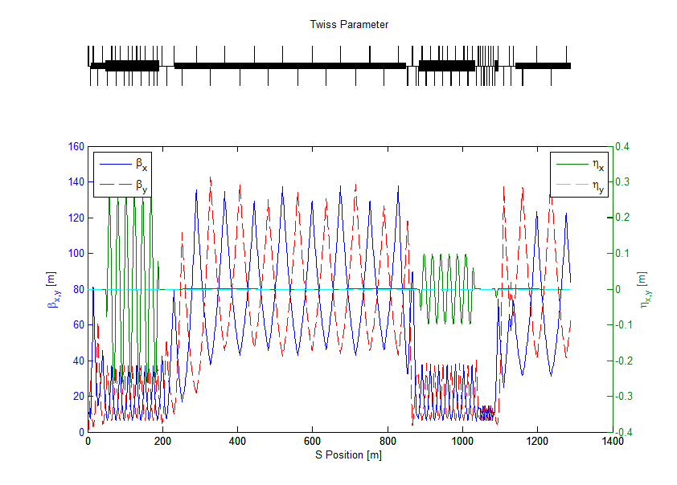
Twiss parameters in Bunch Compressors

Slide 9
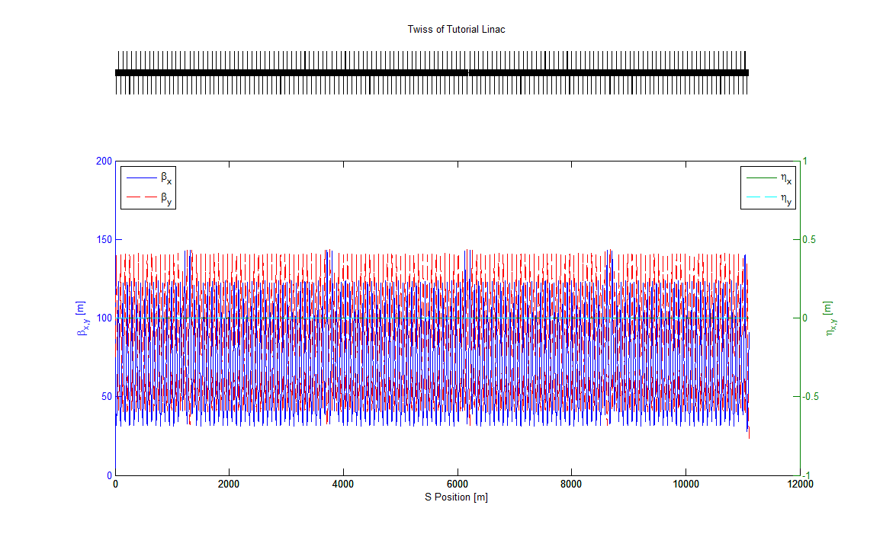
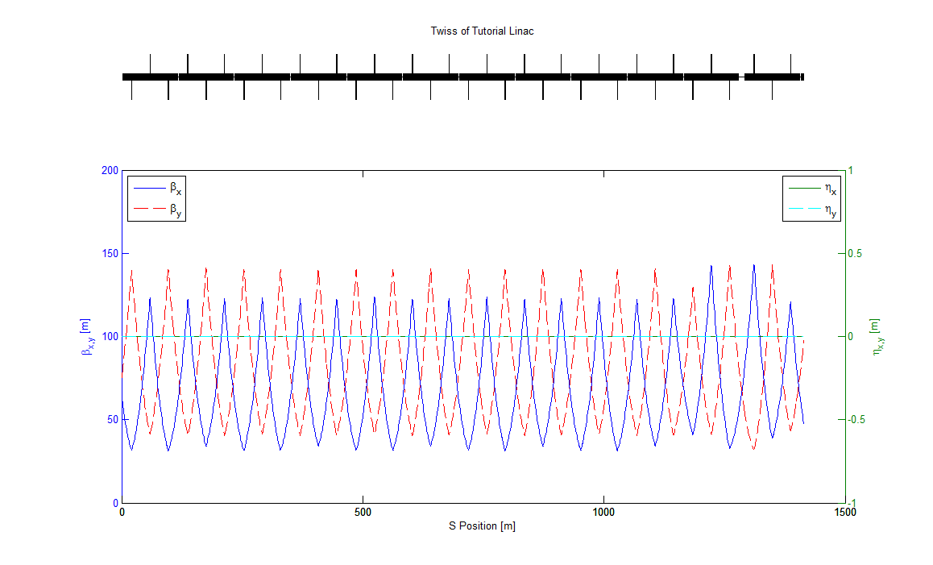
Twiss Parameters in Main Linac
Matched Twiss parameters along straight main linac.
Dispersion in x,y planes are zero.
Zoomed View

Slide 10
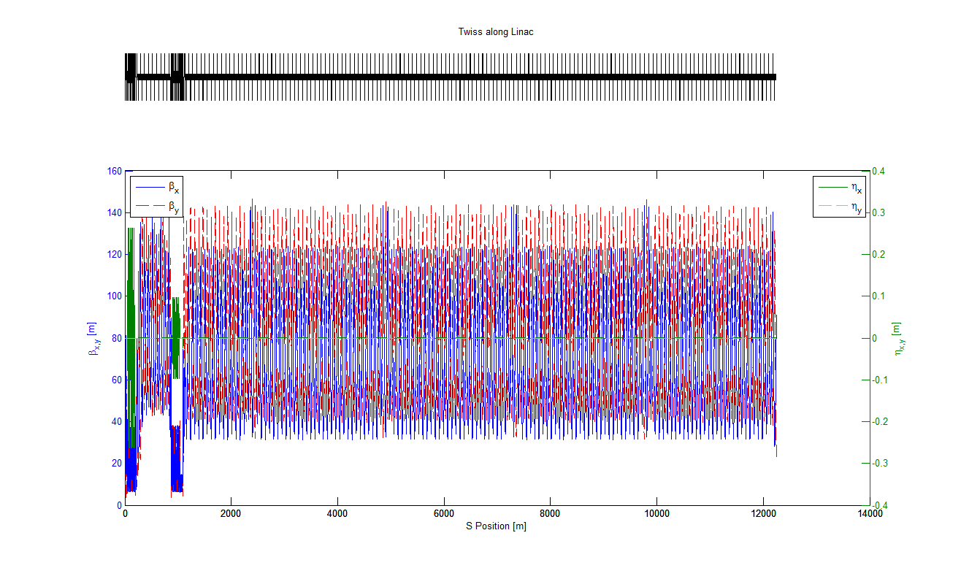
Twiss Parameters in Bunch Compressor and Main linac (no earth curvature)
Sections are well-matched.
No residual dispersion in main linac section.

Slide 11
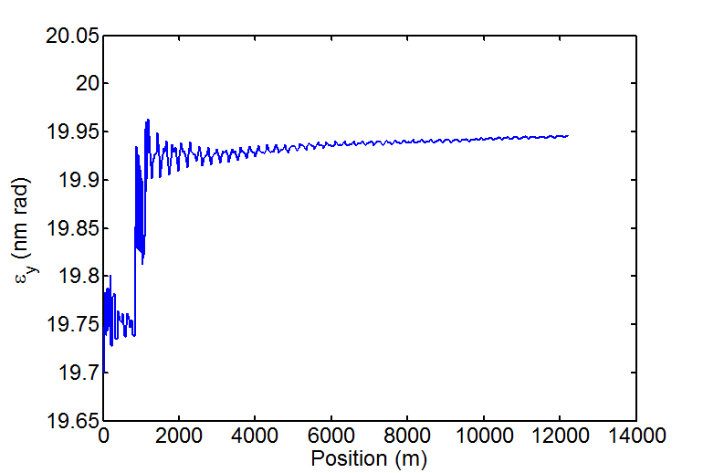
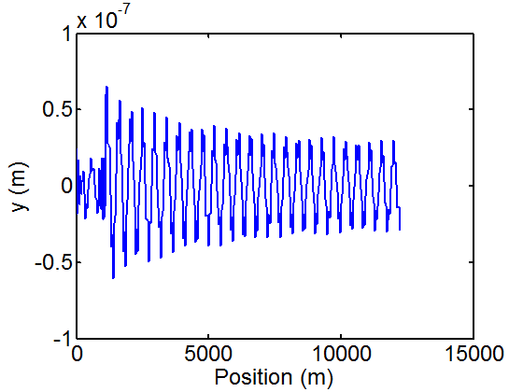
Emittance growth in Bunch compressor and straight Main Linac
No significant emittance growth along linac for nominal operation.
Longitudinal and transverse wakes are included in tracking.
No misalignment along linac.
Vertical Trajectory
OK

Slide 12
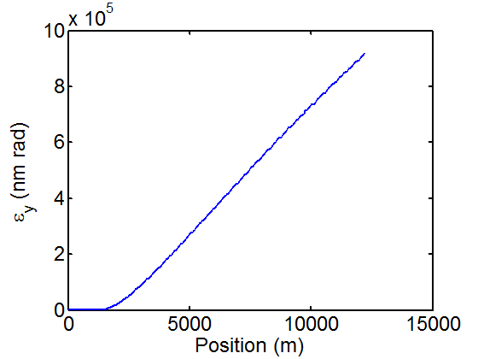
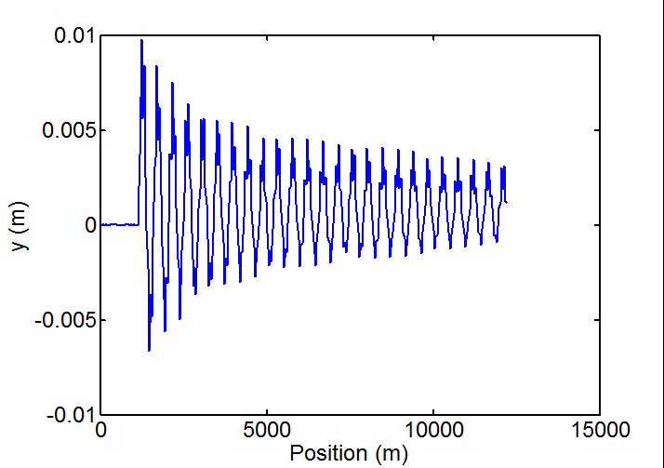
BC + Curved Linac
Settings Parameters
CURVE := 1
STEER := 0
BUMPS := 0
Emittance Growth
Vertical Trajectory

Slide 13
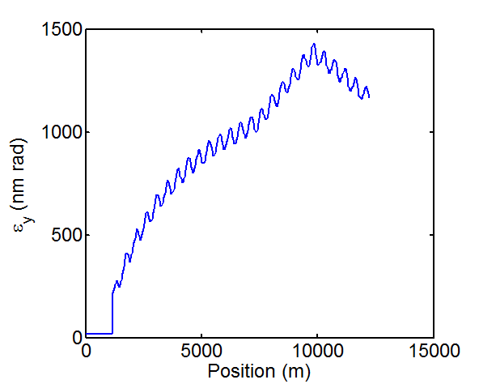
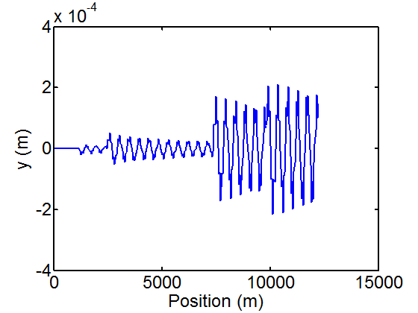
BC + Curved Linac
Settings Parameters
CURVE := 1
STEER := 1
BUMPS := 0 / 1
Emittance Growth
Vertical Trajectory
Mismatch in curved linac results in huge emittance growth.

Slide 14
Conclusion
There is discrepancy in setting of matching parameters for curved linac.
Issues has been communicated with M. Woodley. He does not check curvature/dispersion match.
Need to invest some more time to figured out source of discrepancy and to find correct setting

