Slide 1
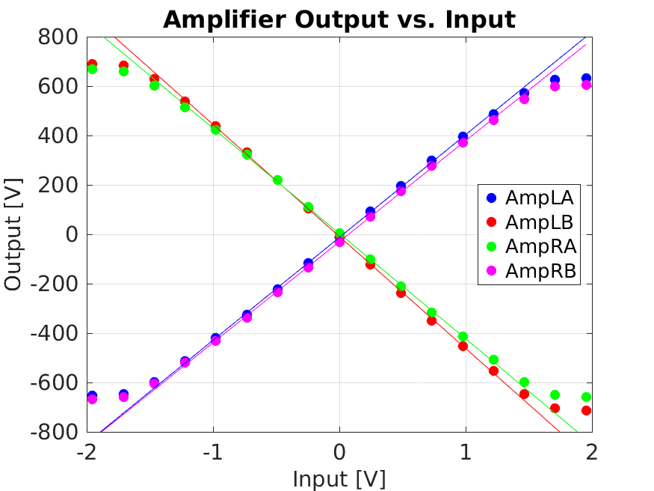
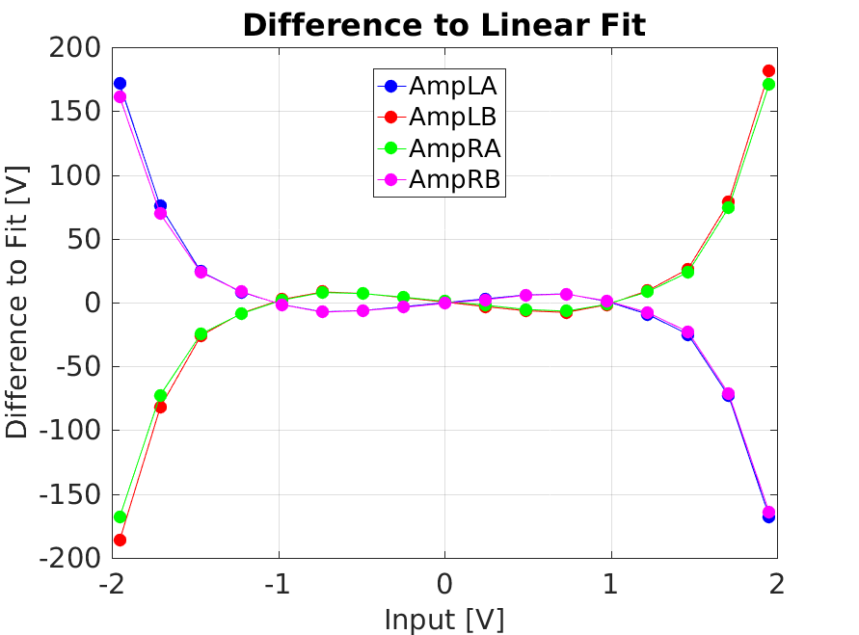
Amplifier Side | Output at +1V (L)/-1V (R) Input
LA | +416 ± 3 V
LB | -453 ± 3 V
RA | -426 ± 3 V
RB | +409 ± 3 V
Using output = 115*monitoring output

