Slide 1

  Beam dump issues
  Benno List, DESY
  Central Region Working Group Meeting
  KEK
  19.4.2016

Slide 2
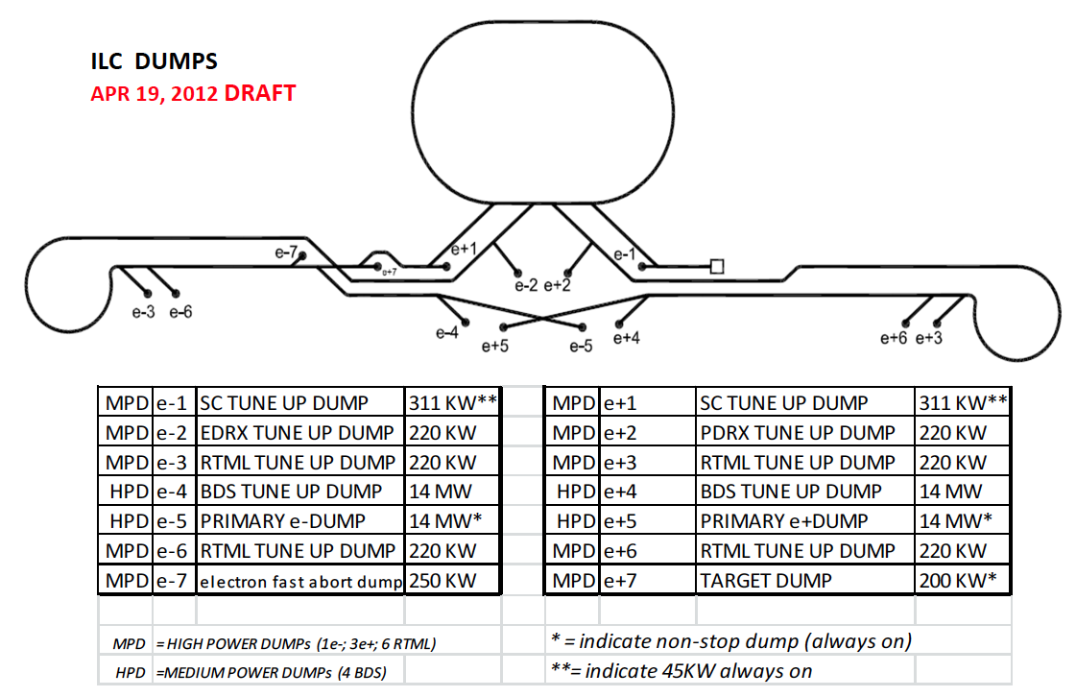
Dump locations
CFS Dump Criteria:
D00000000974845

Slide 3
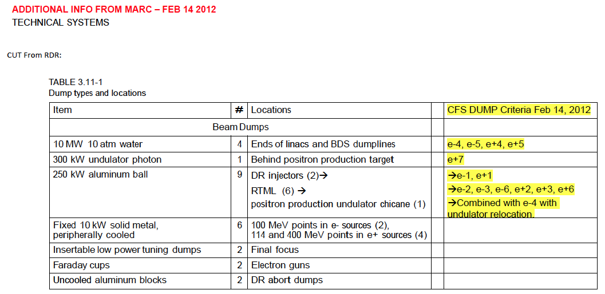
Dump types
D00000000974845

Slide 4
Industrial Study: Framatome
Industrial Study by Framatome company
for TESLA
Discusses in detail radiological safety
Concludes that in Germany beam dump without exhaust to surface (chimney, 100m high!) would probably not be permissible
Main problem: Tritium inventory (9TBq per year), needs containment and reduced air pressure
Recommendation: Keep tritium in for whole lifetime
But radionuclides from air need to be vented
This study is confidential, cannot be stored in EDMS

Slide 5
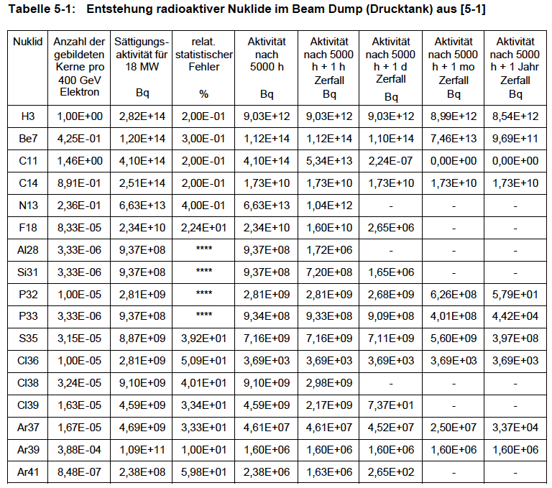
Radioactive Nuclides in Tank

Slide 6
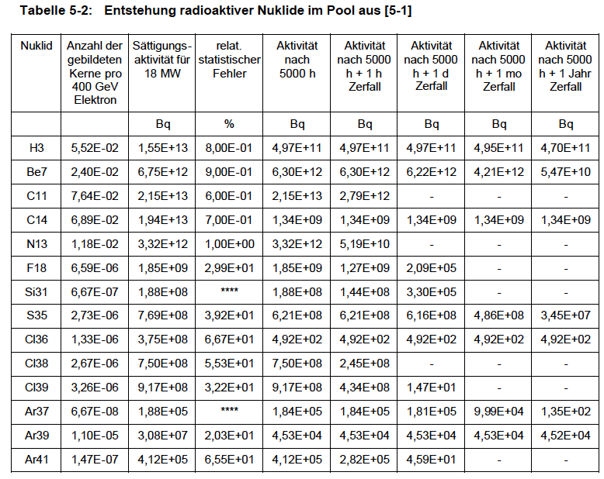
Nuclides in Pool Water

Slide 7
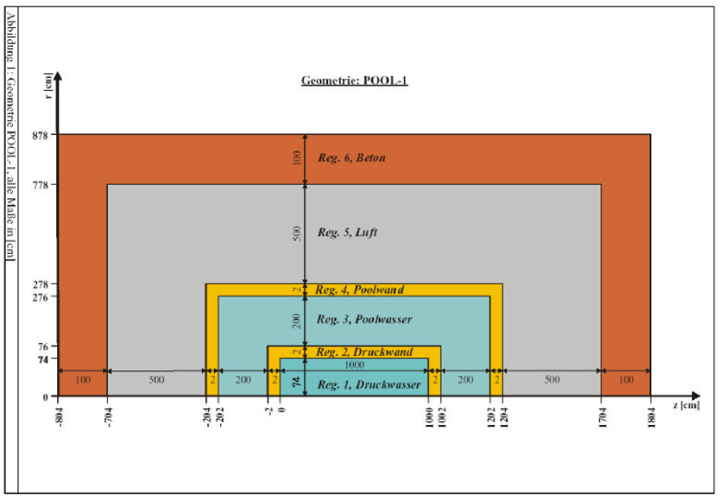
Assumed Geometry: Water Pool

Slide 8
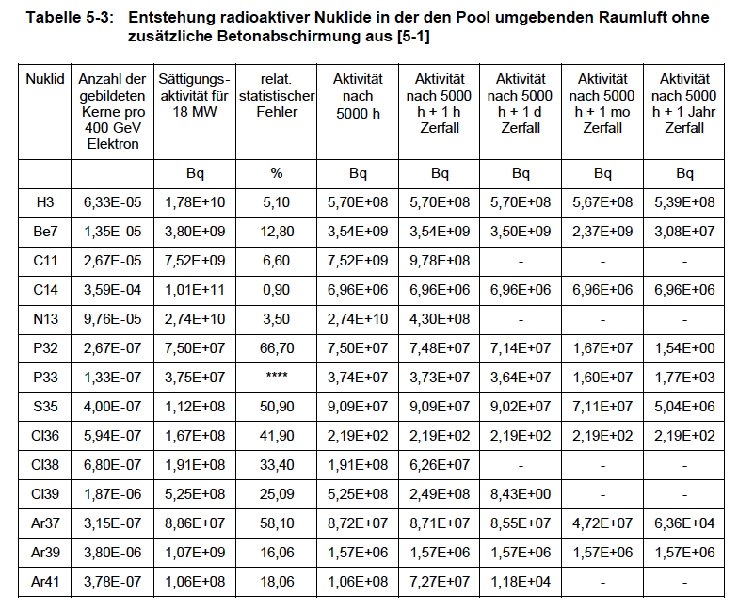
Radio Nuclides in Air around Dump

Slide 9
Industrial study: Fichtner
Industrial Study by Fichtner company
for TESLA
Very detailed investigation of heat deposition in water
Lot of information on Tritium handling
Also concludes that underpressure containment is necessary
This study is confidential, cannot be stored in EDMS

Slide 10
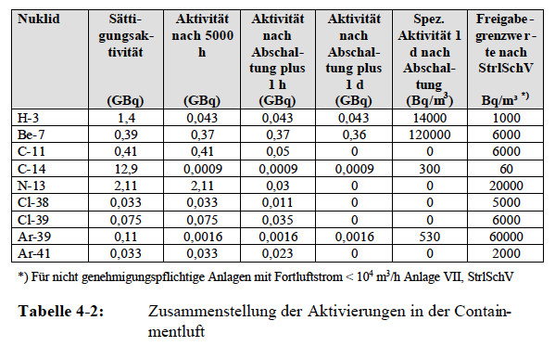
Radioactivity in Air
Fichtner concludes:
Air must be contiously vented, otherwise people cannot go into dump containment area

Slide 11
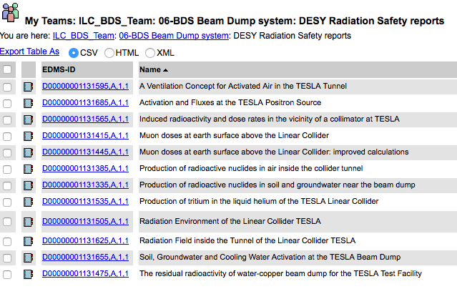
DESY Radiation Studies for TESLA

Slide 12
Requirements on CFS
Water dump needs shielded cavern
Cooling: Need 18MW cooling power (obviously)
Activation:
  Assume closed primary system that contains radioactivity
  Secondary cooling water not activated much
  Showers cannot be fully contained within dump water volume
  -> continuous production of radioctive isotopes in air
  -> needs ventilation to prevent accumulation
Dump cavern needs separate ventilation channel to outside
-> could be direct surface access, or ventilation duct in tunnel
Exhaust air is slightly radioactive. In Germany (very strict laws!) this would require ~100m high exhaust chimney. Then it would be OK even close to inhabited areas
Framatome calculation: 9TBq H3 production in water tank per year. Chimney would allow to exhaust complete Tritium production (even from primary water)

Slide 13
Risks: Window rupture
Biggest risk: Window breaks
-> releases 10atm radioactive water
Design includes double window
-> water would be contained (could leak into beam pipe though)
Needs emergency expansion vessel for radioactive water, but then it is probably OK
Second risk: Water boils, dump water becomes transparent
-> beam penetrates rear wall
How many bunches are needed to puncture the vessel?
Needs to be prevented by MPS: detect excess radiation behind dump and switch of machine
Can we assume that MPS takes care of this? Probably yes
Other Risks: Radioactivity escapes during maintenance (e.g. exchange of filters) -> need water and air tight seals between dump cavern and main tunnels to contain any radioactivity; dump hall needs to be underpressurized

Slide 14
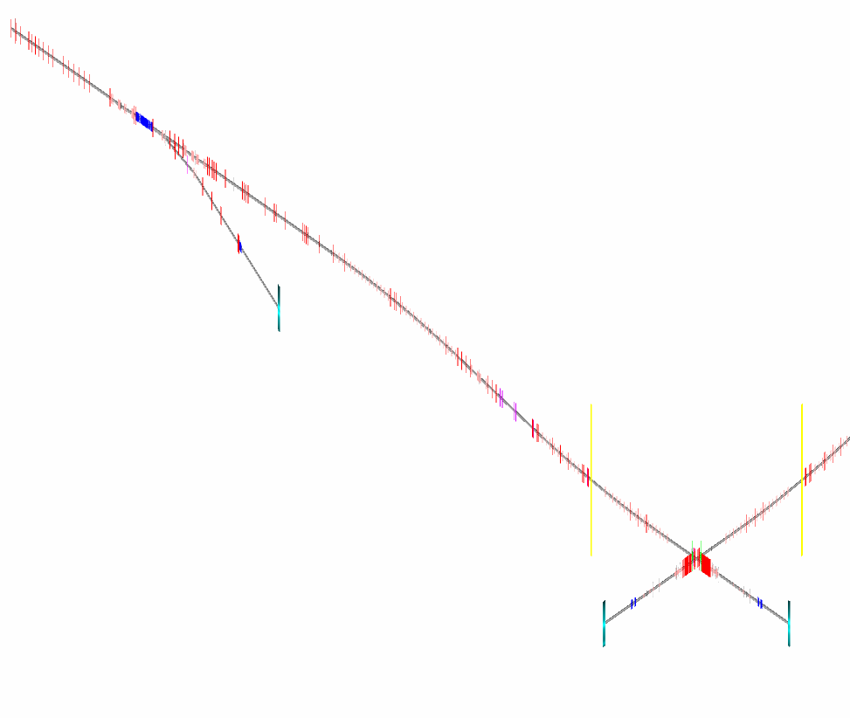
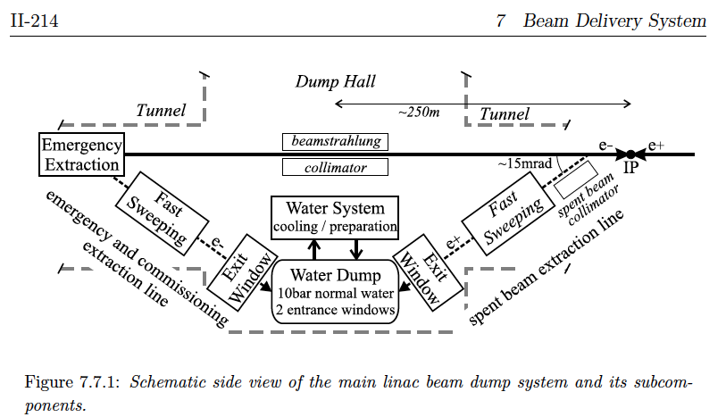
2 Dumps instead of 4?
Old idea from TESLA TDR: use the same dump as main dump and tune-up dump -> would save 2 dump caverns and 2 surface penetrations
Would need wider tunnel over
~1130m -> maybe10M$
Would increase separation between
dump and beam line -> more space
ILC BDS
Distorted scale: x:z = 100:1
Tight!
~1130m
Tune-up dump
~7m
New single dump
Main dump
TESLA TDR, vol. 2, p. 214

Slide 15
Backup Material

Slide 16
Overview
New files received from Norbert Collomb, CCLRC Daresbury Lab
These files by B. Smith (notes and drawings) describe the TDR design of the water main dump
References given in these papers were also traced, lead to papers from DESY and SLAC
Latest work: SLAC-BARC dump collaboration, published NIM paper in 2012, could trace some talks at CLIC08, LCWS08 LCWA09 workshops
See also: CFS Dump Criteria

Slide 17
Dump Design 1
B. Smith, CCLRC:
0-TB-0067-210-00-A
D00000001131215

Slide 18
Dump Design 2
B. Smith, CCLRC:
0-TB-0067-300-00-A
D00000001131175

Slide 19
18MW Water Beam Dump Concept
B. Smith, CCLRC:
088-D-006-01
D00000001130605
Describes the design of the water dump vessel, including entry window

Slide 20
Beam Enlarger/Absorber
B. Smith, CCLRC:
088-D-010-01
D00000001130635
Proposes a series of graphite discs to reduce the load on the titanium entrance window.

Slide 21
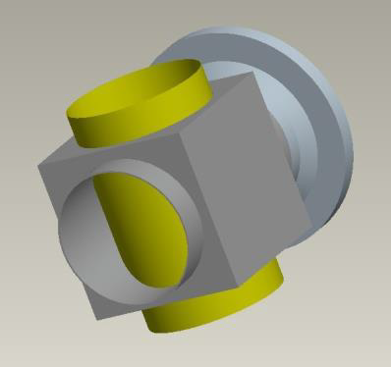
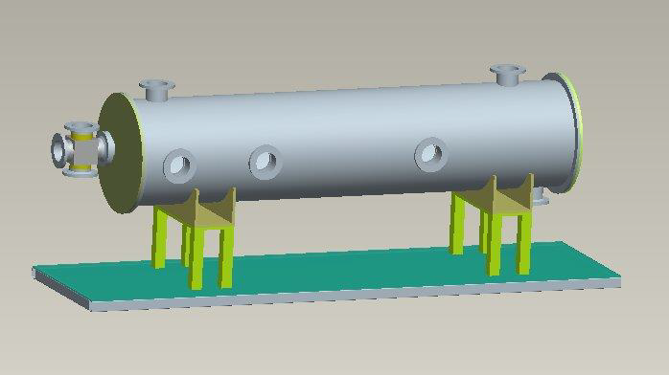
Window Design Options
B. Smith, CCLRC:
088-D-008-01
D00000001131285
Discusses different options how to design the entrance window

Slide 22
10atm water beam dump layout
B. Smith, CCLRC:
0-TB-0067-404-00-A
D00000000945405

Slide 23
Water beam dump surface site scheme
B. Smith, CCLRC:
0-TB-0067-410-00-A
D00000000945465
Shows surface facilities that service the dump, including cooling and exhaust for gases (tritium!)

Slide 24
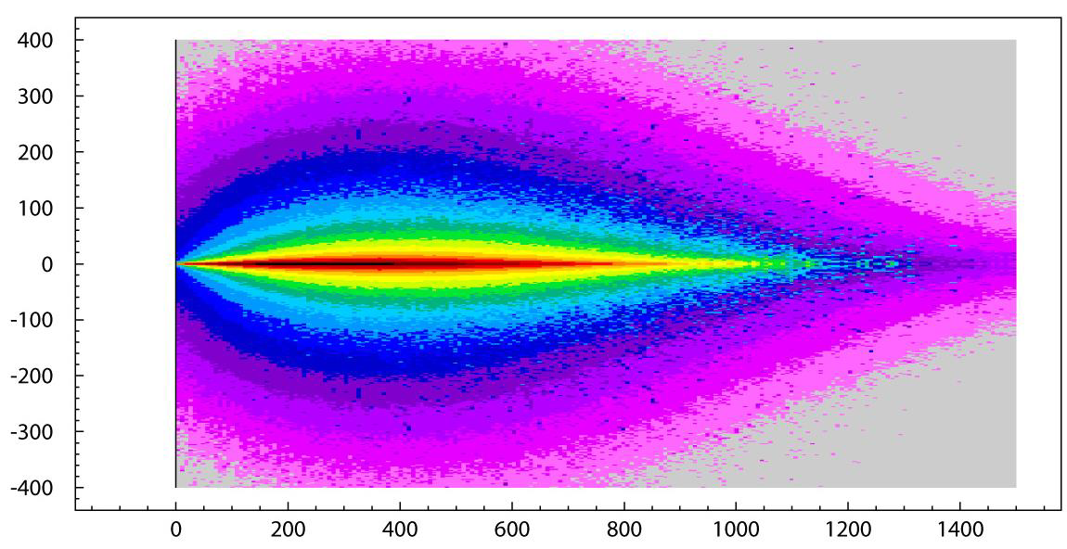
FLUKA calculations – Energy deposition in water
H. Vincke, SLAC
D00000001130725
D00000001130755
Gives detailed data on heat deposition from FLUKA calculations

Slide 25
ILC beam dump issues
R. Appleby, CCLRC Daresbury
D00000001130815
Overview over the design issues in the RDR phase

Slide 26
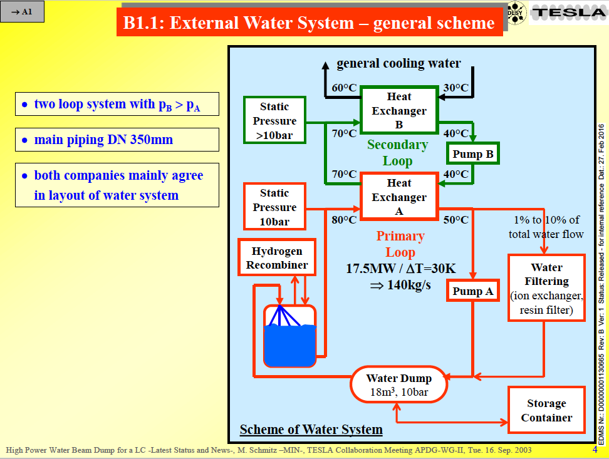
High Power Water Beam Dump for a LC
M. Schmitz, DESY
from 2003
D00000001130665
Thorough overview over water handling and radiation issues

Slide 27
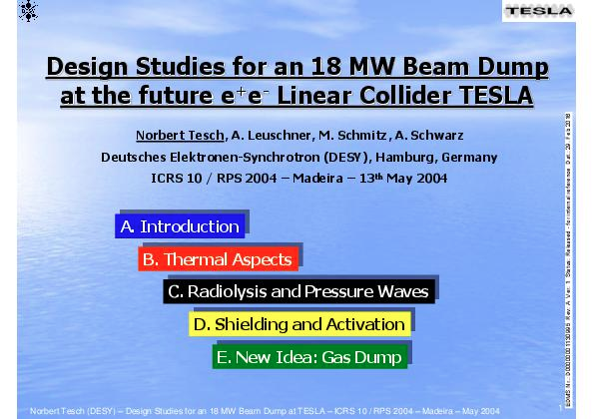
Design Studies for an 18MW Beam Dump
A. Leuschner, DESY
from 2004
D00000001130965
D00000001130965
Conference talk and writeup about the TESLA beam dump concept

Slide 28
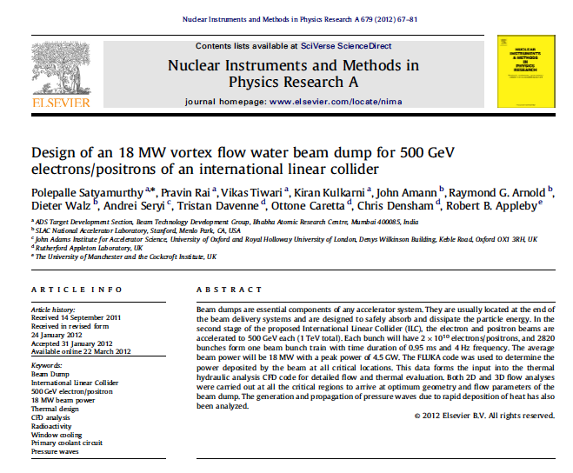
Design of a 18MW vortex flow water beam dump
Publication from SLAC-BARC dump group in 2012
NIM A679 (2012) 67-81.
See also talks by this group at CLIC08 workshop:
D00000001131785
D00000001131835
D00000001131875
D00000001132005

