Slide 1
Phase Jitter
N. Blaskovic, T. Bromwich, C. Perry, R. Ramjiawan

Slide 2
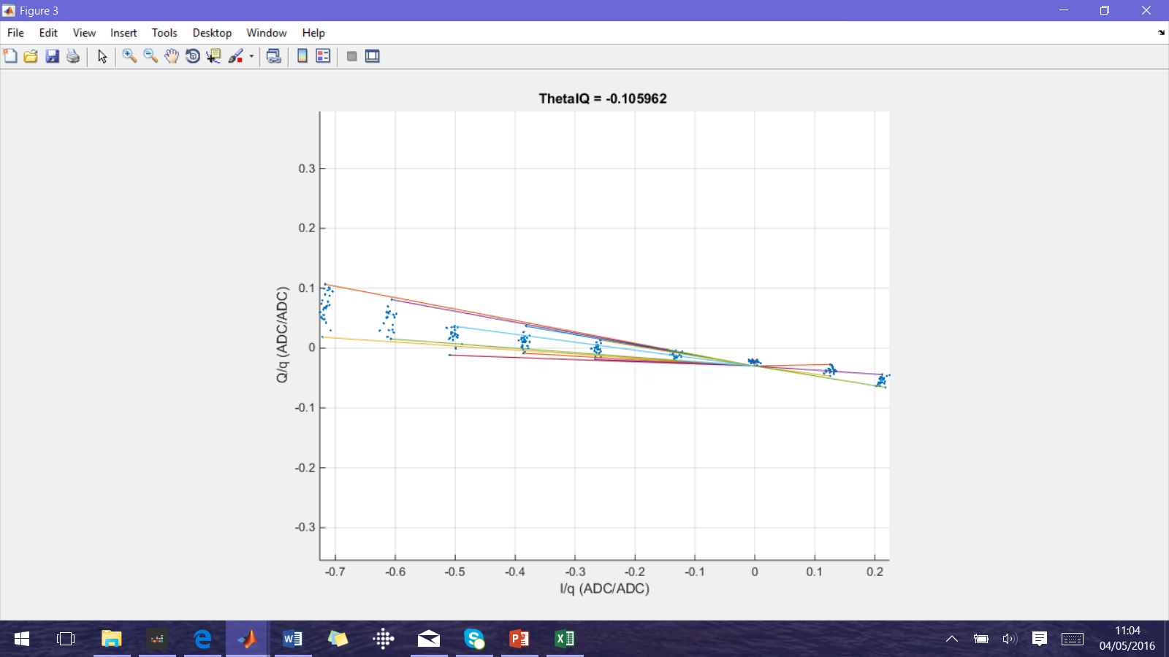
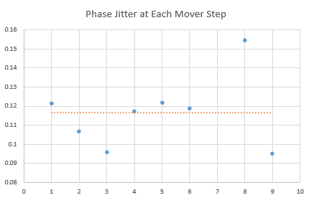
IPBPM A Phase Jitter
Reference Sample: 51,
IQ Samples: 59
Calibration File: IPAyCal1_30dB_0.7
Shift: 160315
Mean jitter: 0.1165 radians (0.159 radians)

Slide 3
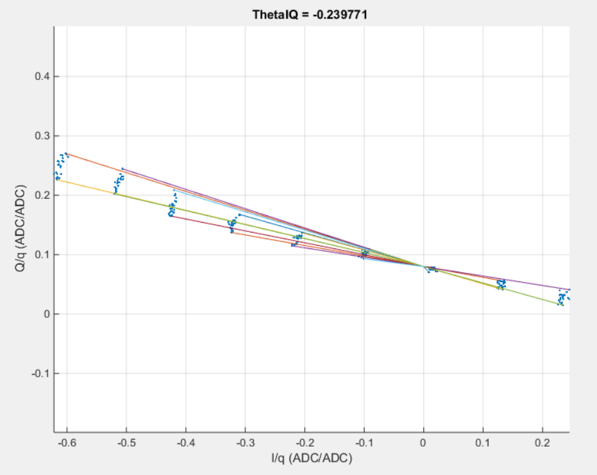
IPBPM B Phase Jitter
Reference Sample: 51,
IQ Samples: 59
Calibration File: IPByCal1_30dB_0.7
Shift: 160315
Mean jitter: 0.1059 radians (0.164 radians)

Slide 4
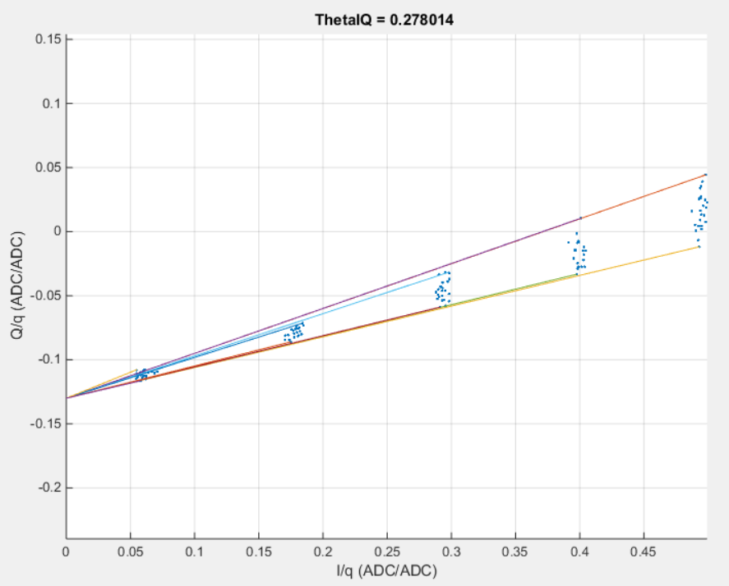
IPBPM C Phase Jitter
Reference Sample: 51,
IQ Samples: 59
Calibration File: IPCyCal1_30dB_0.7
Shift: 160315
Mean jitter: 0.0852 radians (0.104 radians)

Slide 5
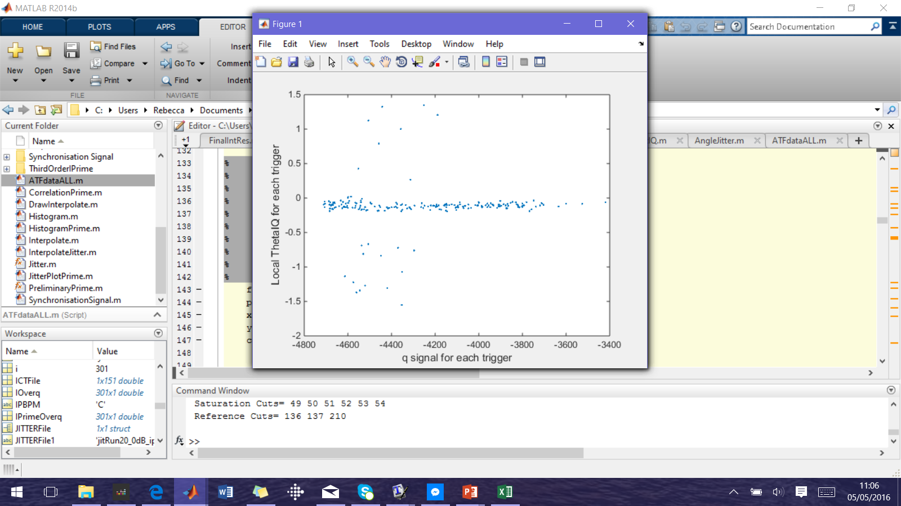
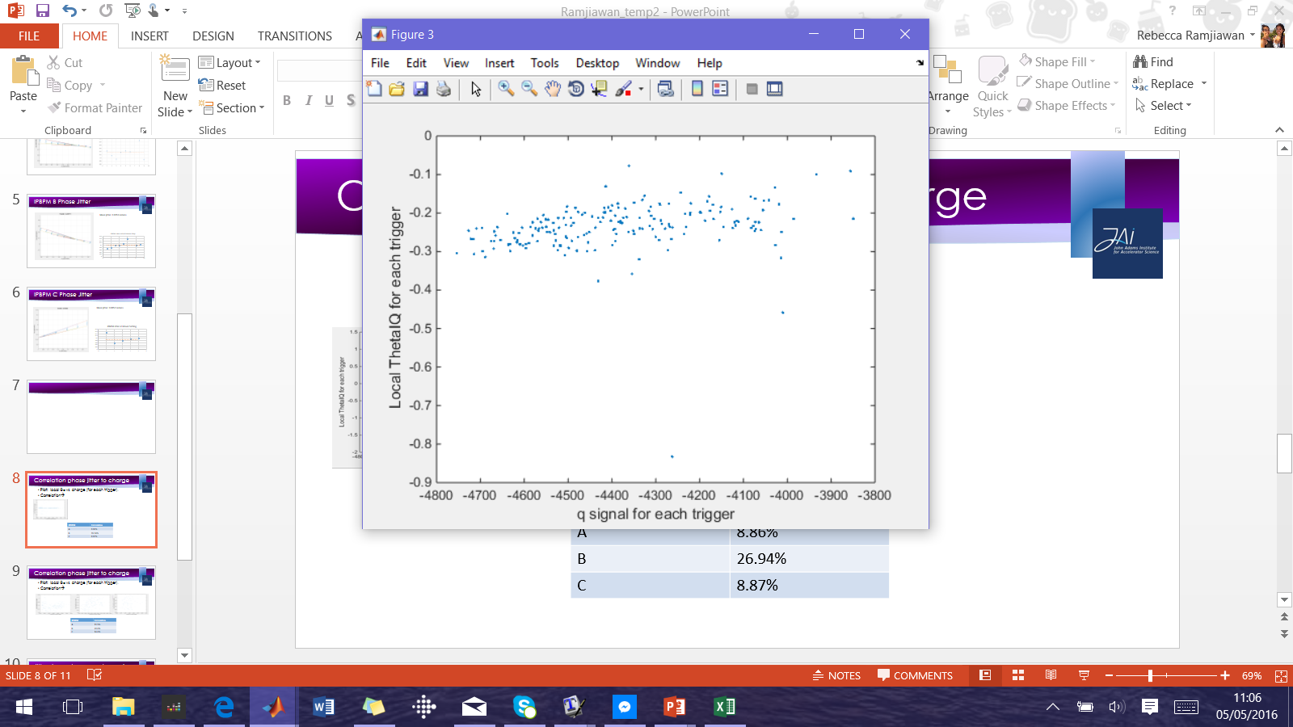

Correlation phase jitter to charge
Plot: local θ_{IQ} vs. charge (for each trigger).
Correlation→
A
B
C
IPBPM | Correlation
A | 8.86%
B | 26.94%
C | 8.87%

Slide 6
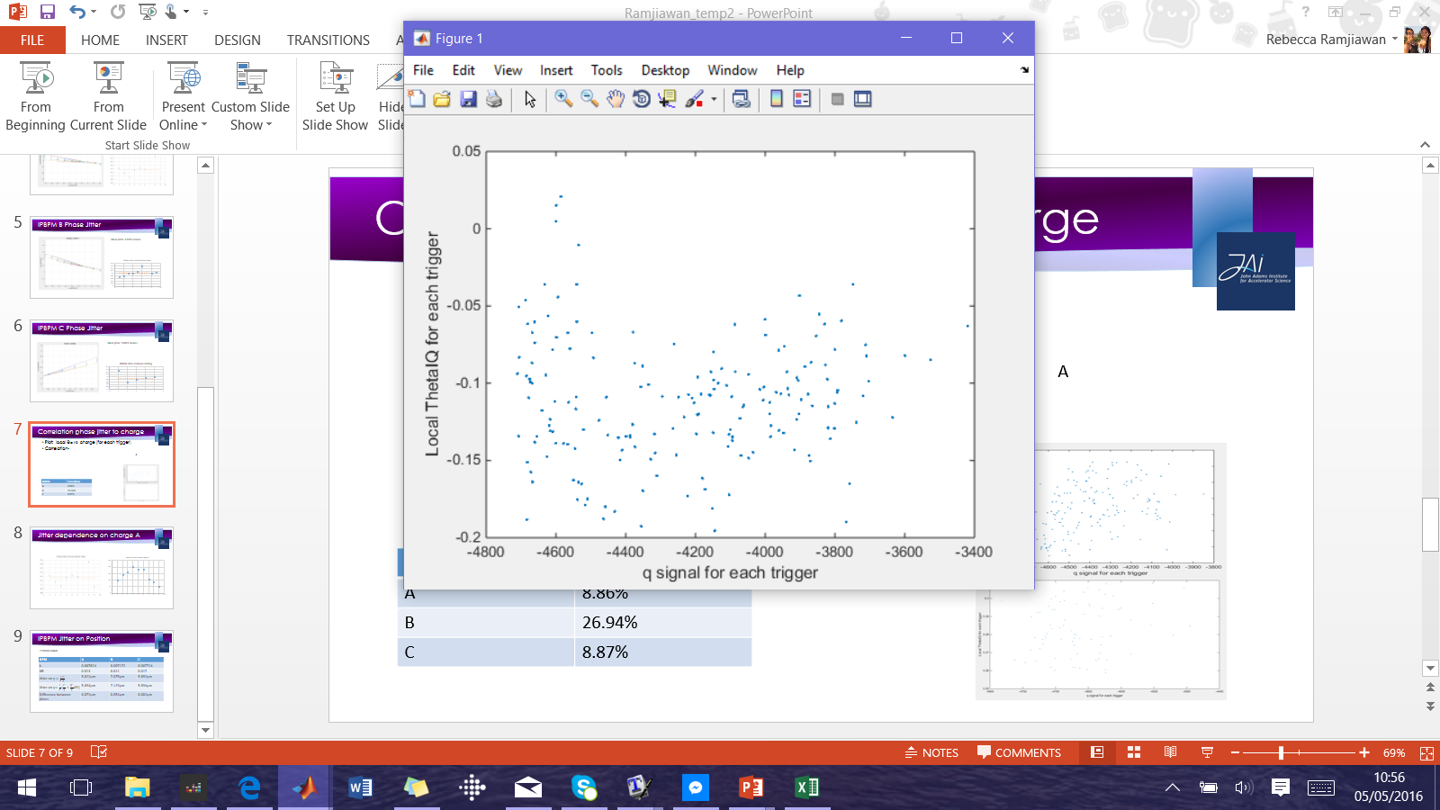
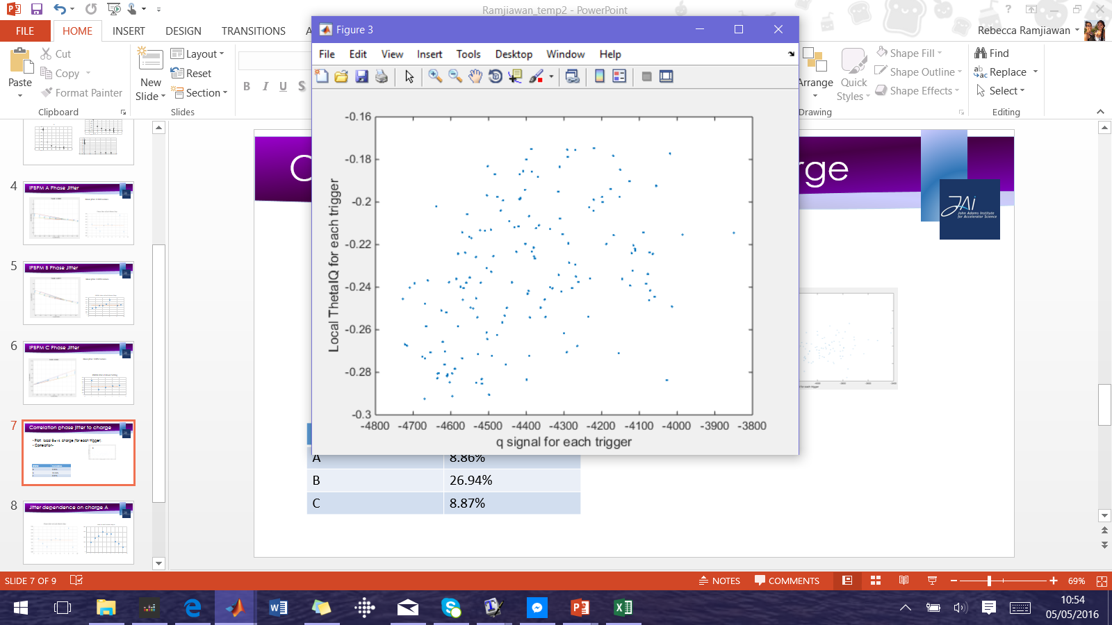
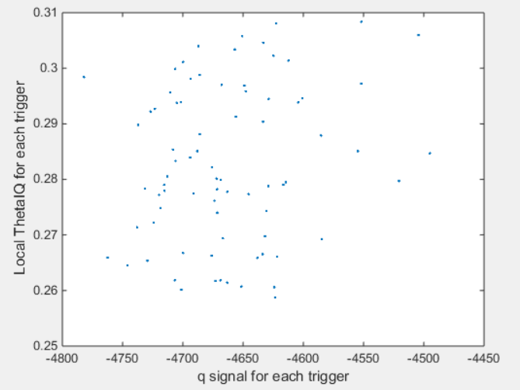
Correlation (remove outliers)
Take two 3σ cuts on local θ_{IQ}.
A
B
C
IPBPM | Correlation
A | 11.5%
B | 39.6%
C | 14.6%

Slide 7
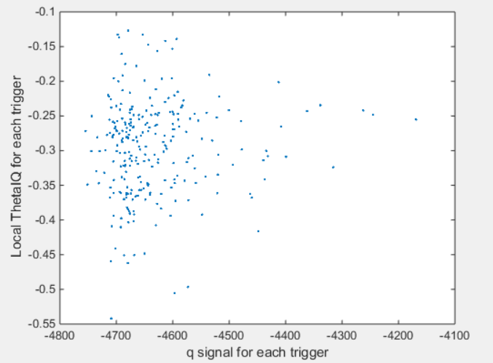

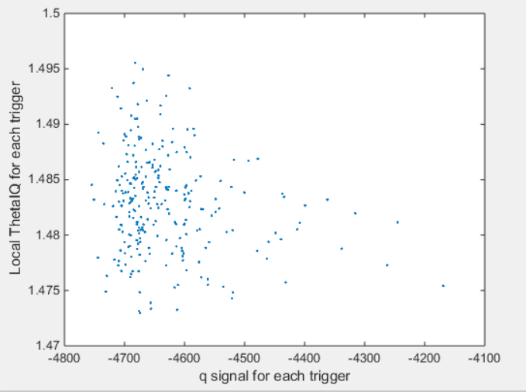
Correlation Jitter File
Reference Sample: 51,
IQ Samples: 59
Calibration File: jitRun23_30dB_0.7
Shift: 160315
A
B
C
IPBPM | Correlation
A | 7.7%
B | -1.7%
C | -22%

Slide 8
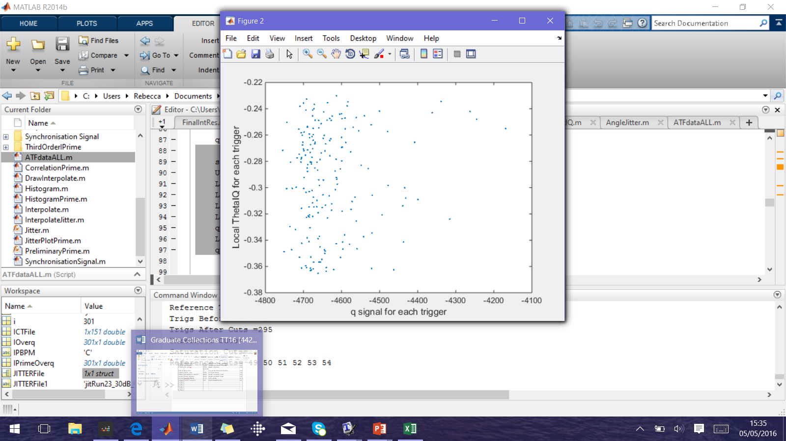
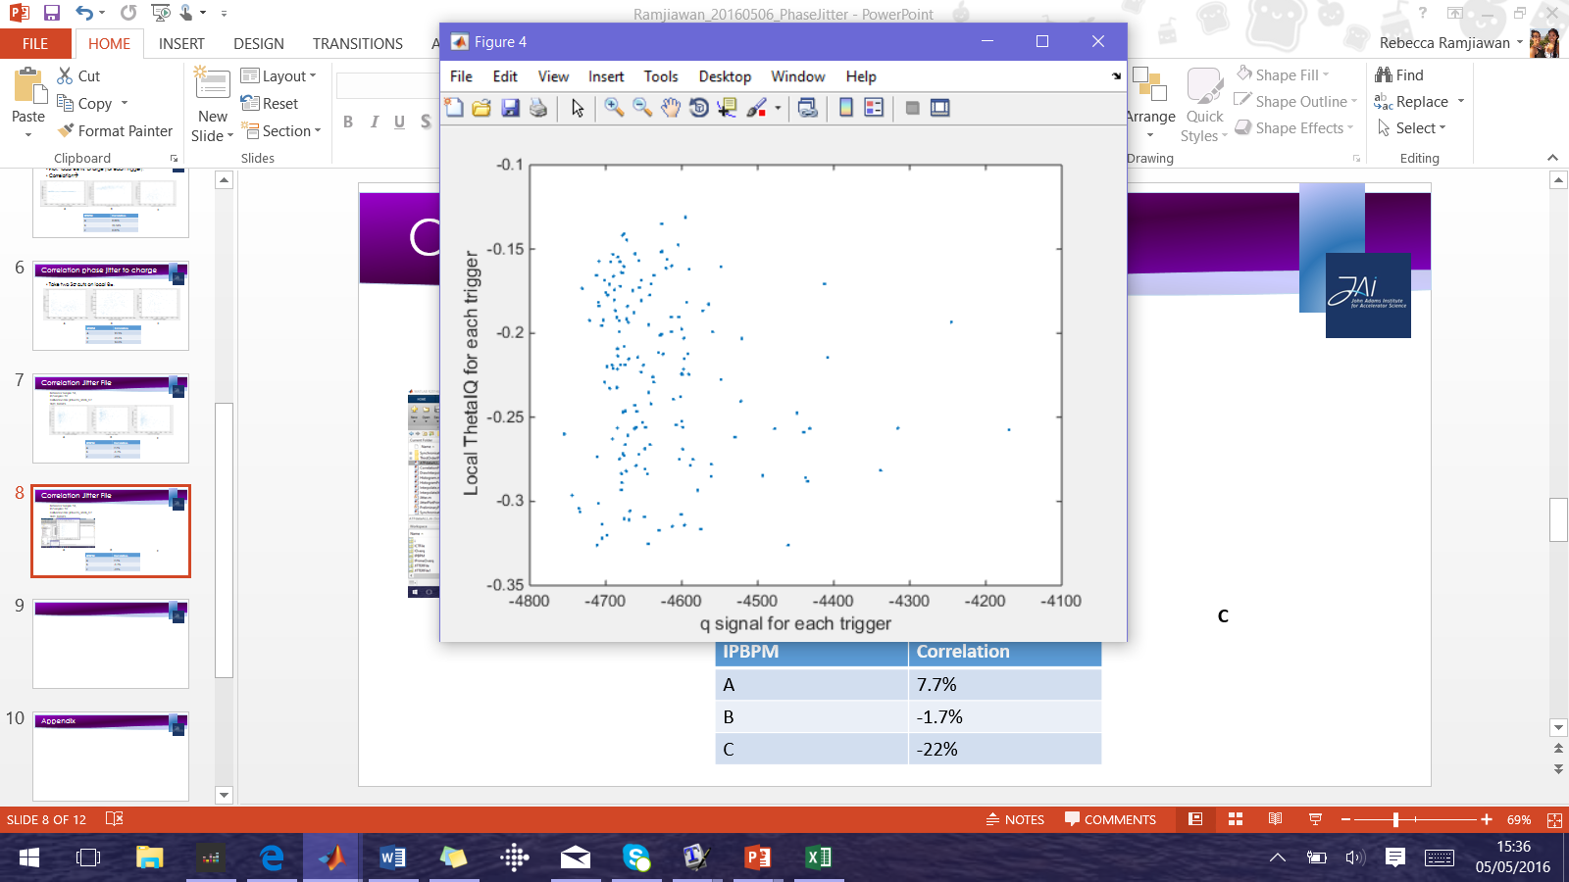

Correlation Jitter File (remove outliers)
Reference Sample: 51,
IQ Samples: 59
Calibration File: jitRun23_30dB_0.7
Shift: 160315
A
B
C
IPBPM | Correlation
A | 13.7%
B | -15%
C | -18%

