Slide 1
ILC BDS Commissioning
Glen White, SLAC
AWLC 2014, Fermilab
May 14th 2014

Slide 2
Overview
What is commissioning?
What do we expect?
  From simulations
  From experience (ATF2)
What is possible:
  Detector / no detector IR configurations
Anything missing from baseline required?

Slide 3
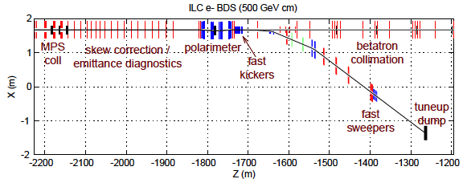
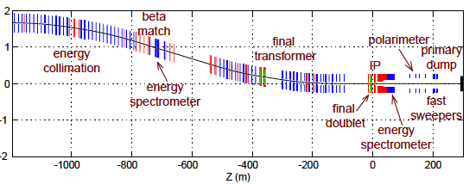
What is Commissioning?
Diagnostics commissioning
Fault-finding
Optics matching
BBA
  Quads, Sextupoles, Octupoles
Steering
Dispersion & coupling correction into FFS
2-beam alignment and collisions
Everything up to acquiring 2-beam collisions and signal on pair model (everything not using direct IP profile measurements)
  Then everything to get to nominal luminosity “tuning”
Q: Given expectations and experience, from “commissioning” steps, can we expect then to go direct to “tuning”?

Slide 4
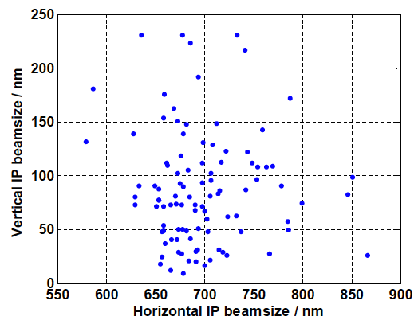
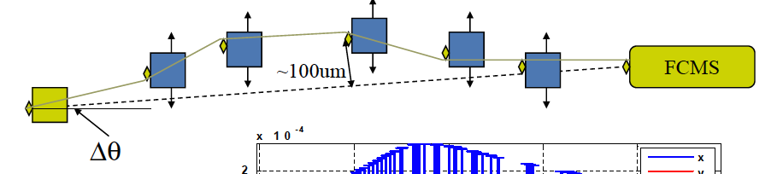
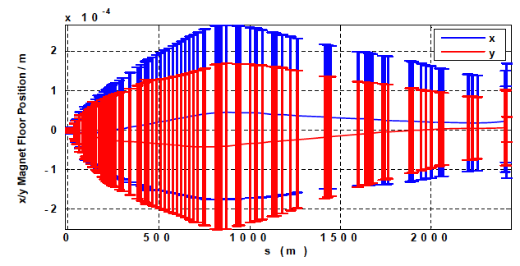
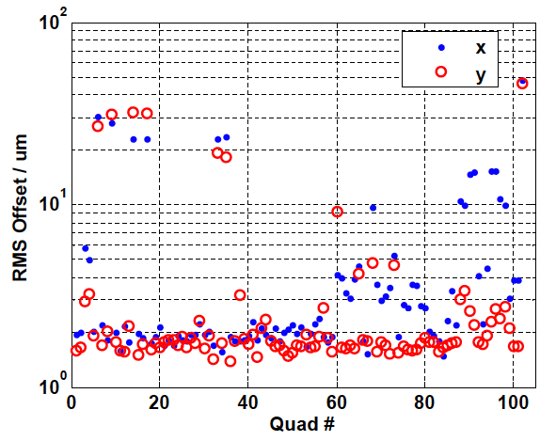
BDS Commissioning Performance from ILC S2E Simulations (RDR-era)
Apply errors to magnets/diagnostics with expected tolerances
  ~100 MC seeds
Apply commissioning all commissioning steps and observe performance.
  Forms basis for tuning simulations

Slide 5
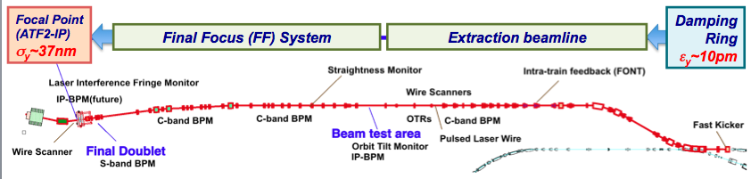
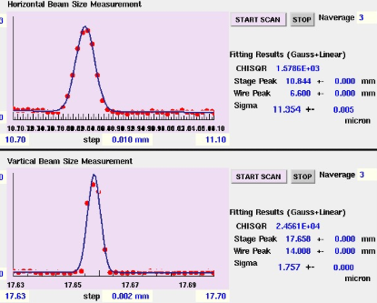
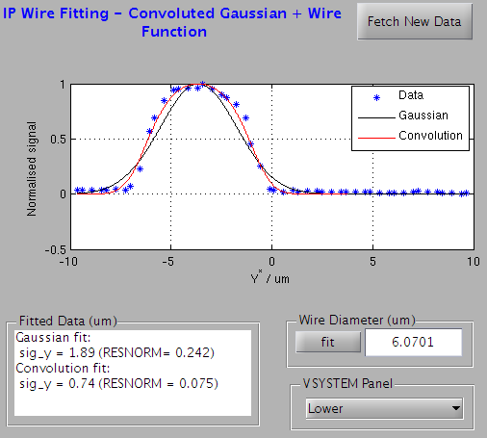
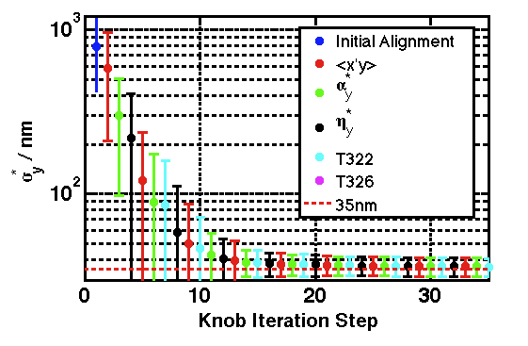
Experience from ATF2
Expect ~0.5-3 um (Y) from simulations
Experience shows ~9-15um (X) & ~<0.7-3um (Y) [design 9 um x 0.037 um]
  (recently)
  Earlier ~ <5um in Y
    (<350nm scaled to 250 GeV)

Slide 6
Commissioning Requirements
IR with no detector in place
  Commissioning items up to tune-up dump
  Require option with beam through IP?
    To do what?
      Commissioning items for collimation section – FFS end
      Co-alignment of beams for collision
      Reduction of IP beam size to within “capture range” of devices that measure beamstrahlung
    What hardware?
      Dedicated QD0’s?
      Re-match larger IR beta functions through to EXT without QD0?
      Add AUX quad upstream of QF1?
        Or, split QF1 like QD0 and have control over polarities
      IP: BPMs? Profile monitor (laserwire, Shintake Monitor,…)?

Slide 7
Commissioning Requirements
IR with detectors in place
  Is there a commissioning route for startup -> tuning capability with beamstrahlung detectors without needing to directly image IP beam profile?
    From simulation and experience at ATF2, seems ~<1um should be feasible
      Doesn’t take into account possible fault scenarios which could cause larger beam sizes and be difficult to track down without direct observations.
      Also may be desirable to directly image beam profile to diagnose any abnormalities with detector solenoid?
    What are the beam size sensitivities from beam-beam scans and/or beamstrahlung detection? (see next slides)
  What profile measurements are possible and make sense in this configuration?
    What can be integrated into detector region?
    Possibility to image beam profile at upstream location? (see later slide)

Slide 8
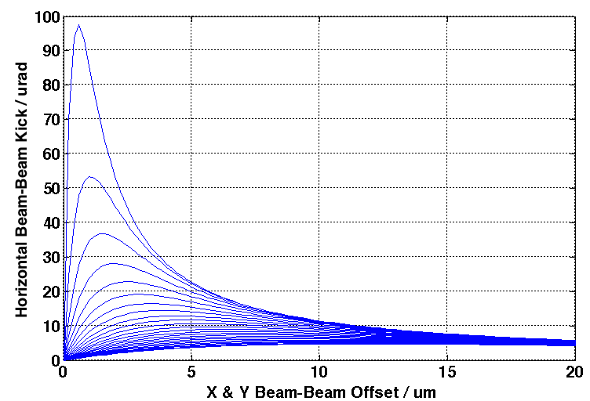
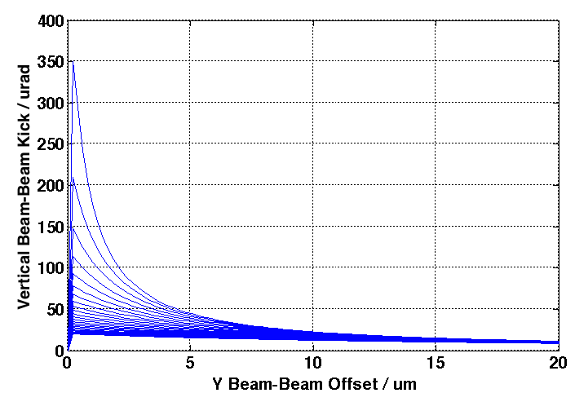
Beam-Beam Offset Scans
Δx = Δy
Δx = 0
σ = 0.5 um
σ = 10 um
Beam-beam deflection kicks for beam sizes 0.5 – 10 um rms shown (X & Y)
  Calculated using GUINEA-PIG with baseline 500 GeV TDR parameters
A detectable kick is ~>1urad
Beam-beam kick curves could enable capturing of beam-beam offsets and estimates of average beam sizes with offsets ~<5um and beam sizes ~<5um
Simulation scans performed by scaling emittances

Slide 9
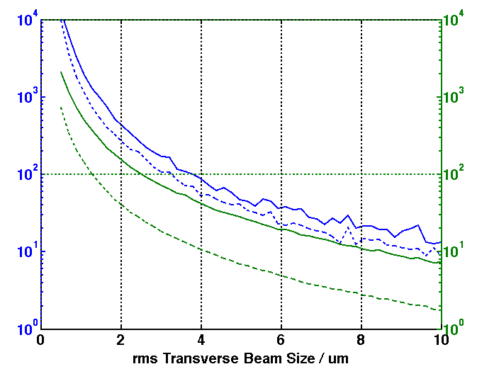
Beamstrahlung
Total pairs E in detector (GeV)
Total beamstrahlung photon E (TeV)
Beamstrahlung useable for beam sizes ~<10um ?
← σ_{x} = σ_{y}
Calculations from GUINEA-PIG (head-on collision, no waist offset)
[TDR 500 & 250 GeV cm baseline parameters]
  Total pairs energy inside pairs detector (5-30 mrad)
  Total beamstrahlung photon energy created
Photon-detector specification and design?

Slide 10
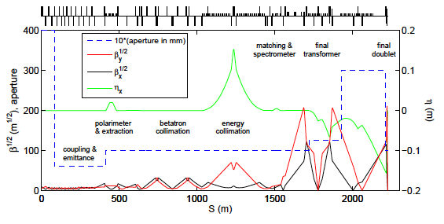
Considerations beyond TDR Baseline?
IP Image-Point in QF7
Dedicated “commissioning optics” ?
Assess performance at image point upstream of main IP using high-performance LW or SM?
  Simultaneous X & Y waist in center of QF7
  Split it?
  Waist sizes here ~ 15 x 0.5 um (500 GeV TDR paramters)
  Assess aberrations up to this point, correct matching and phase advances
Dispersion correction capability in BDS (before FFS)?
  Need dispersive beamline
    “Tweaker” quads + skew-quads in MPS/polarimeter chicane or energy collimation system?
Adequate # matching quads for beta matching + phase control in FFS?
  e.g. importance of phase advance between sext locations & feedback BPMs

Slide 11
Summary
Can rely on beam-beam scans + beamstrahlung detection alone for commissioning + tuning ?
  Seems OK for 250-500 GeV cm
    Probably need only ~<1um detection range: ~<5-10um possible
  Excludes cases where “coarse” errors exist
    e.g. @ ATF2, rolled FD quads and a bad coil pocket in a FFS SEXT caused large beam size aberrations @ IP

