Slide 1
Two-Phase CO₂ cooling for the
Micromegas-based Large Prototype TPC
Deb Sankar Bhattacharya^{1,2,3},
David Attie¹ , Paul Colas¹, Serguei Ganjour¹,
Purba Bhattacharya², Sudeb Bhattacharya², Nayana Majumdar²,
Supratik Mukhopadhyay², Sandip Sarkar²,
Alain Bellerive⁴, Madhu Dixit⁴.
Aparajita Bhattacharya³.
CEA, Saclay, France (2) SINP, Kolkata, India (3) Jadavpur University, Kolkata, India
(4) Carleton, Ottawa, Canada

Slide 2
Overview
A Micromegas Module and the Electronics
Heating of the Electronics
Possible effects on the ILD-TPC
First test of two-phase cooling
Why two-phase CO2 cooling
Numerical Study
Two-phase CO2 cooling at the LPTPC

Slide 3
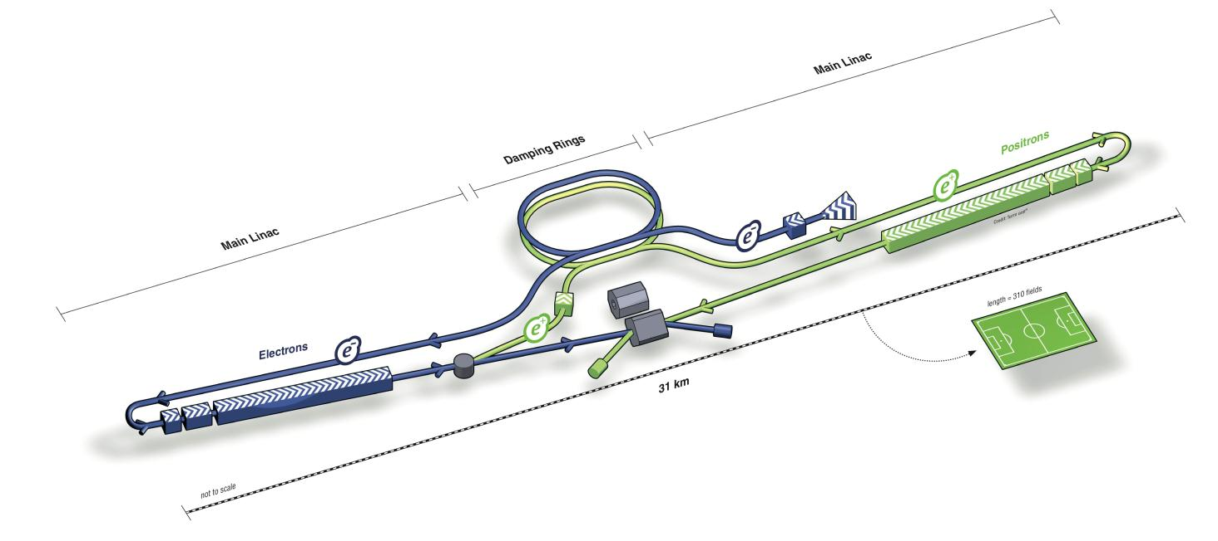
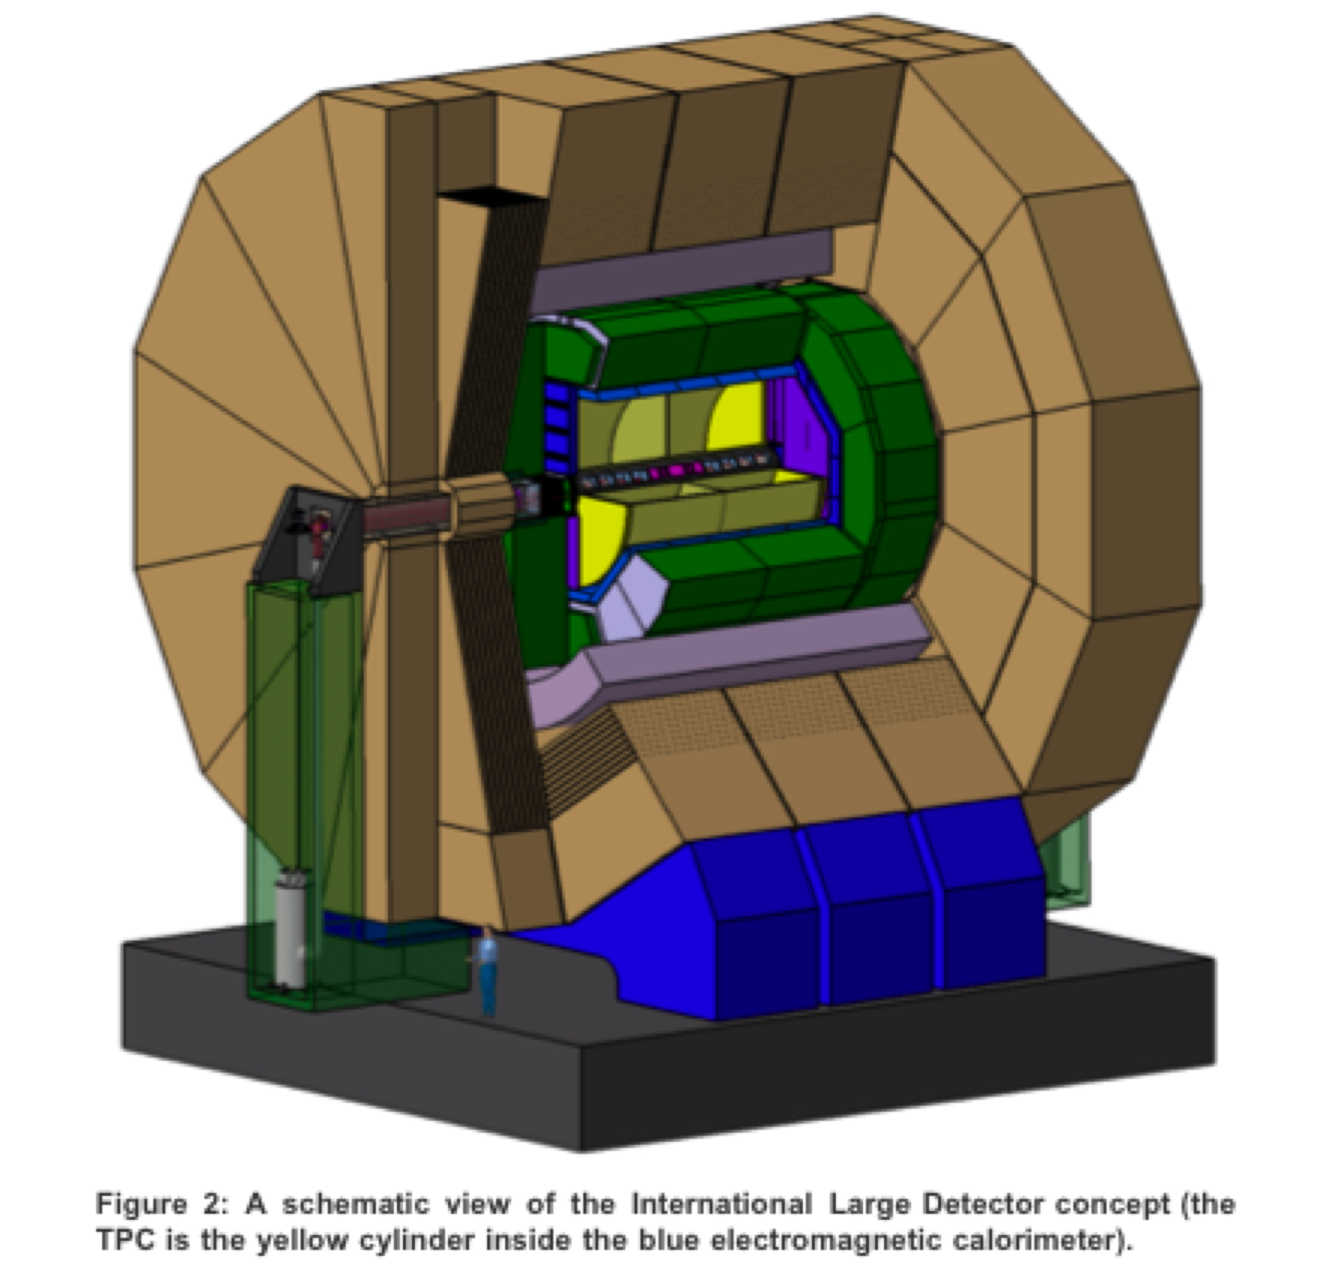
International Linear Collider : A discovery and precision measurement machine
e- e+ will collide initially in the range √s = 240 – 500 GeV
One of the two detector concepts for the ILC is the ‘International Large Detector’ (ILD).
The central tracking at the ILD will be accomplished by a Large TPC.
TPC
ILD-TPC
Length of the TPC ~ 4.6 m
Diameter of the TPC ~ 3.6 m
Magnetic field ~ 3.5 T

Slide 4
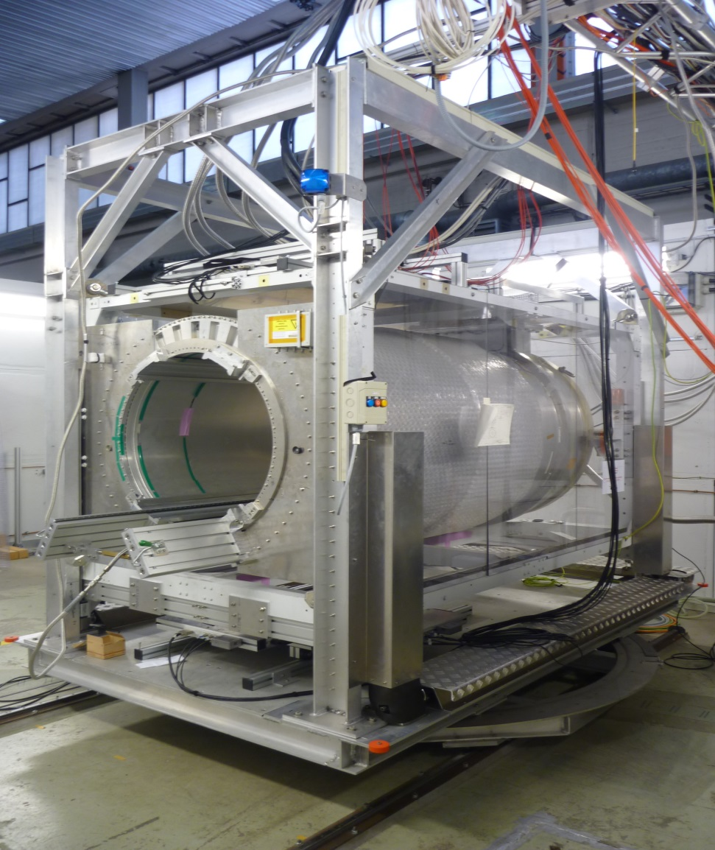
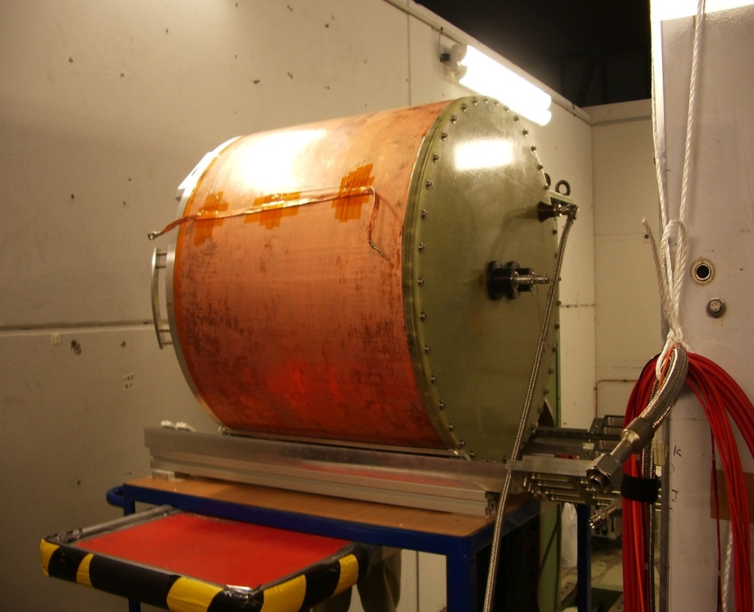


The Large prototype of the ILD-TPC at DESY
1-6 GeV
e- beam
The field cage
Drift length = 56.80 cm
Inner diameter = 72 cm
The movable stage and the PCMAG.

Slide 5
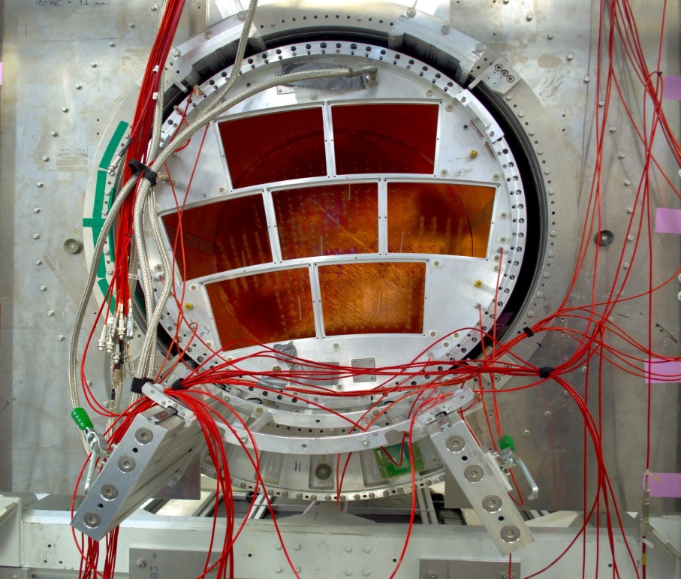
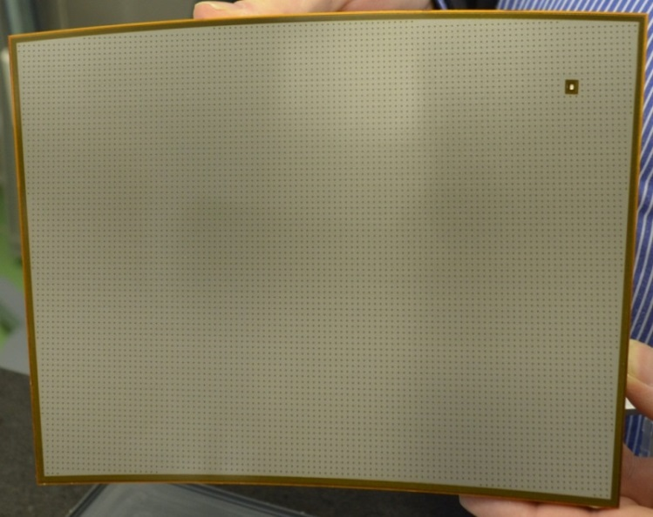
Seven Micromegas module are commissioned at the LPTPC
Micromegas module
Module size: 22 cm × 17 cm
Readout: 1728 Pads
24 rows
Pad size: ~ 3 mm × 7 mm
End-plate of the LPTPC

Slide 6
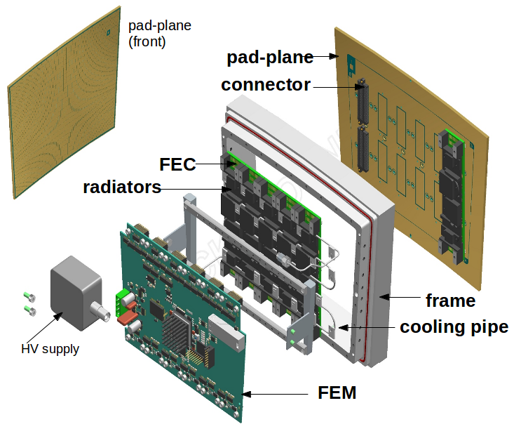
The Electronics
The electronics comprises
6 Front End Cards (FEC) and
1 Front End Mezzanine (FEM)
Each Front End Card (FEC) consists of 4 ASICs,
1 power regulator and a Heat Sensor .
The Front End Mezzanine (FEM) includes a
Field Programmable Gate Array
(FPGA).

Slide 7
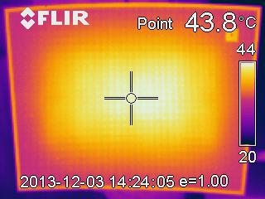
Heating of the Electronics
The electronics runs at 5 V supply.
Current from each component of the electronics has been measured.
ASICs = 12 W
6 FECs
19 W
Power regulator = 7 W
FEM
3.5 W
3.5 W
FPGA
Total
26 W
Temperature of the pad-plane is 44º C, as seen by an infrared camera.
The power dissipation by the electronics increases the temperature of the back-end as well as the pad-plane of the Micromegas module. If not removed, the heat causes potential damage to the electronics

Slide 8
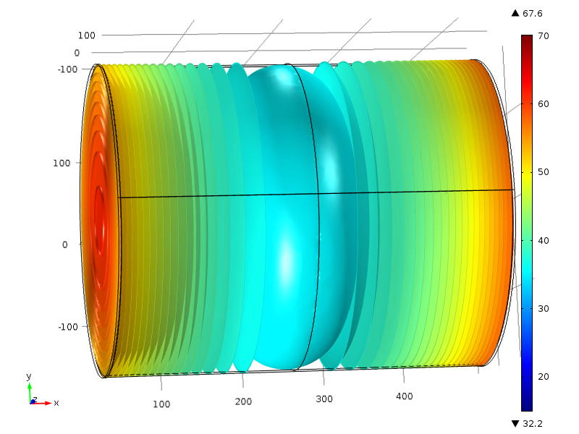
Considering the present status of the electronics, heat dissipation at the ILD-TPC
is simulated using Finite Element Method (COMSOL)
The simulated TPC is 4.6 m in length and 3.6 m in diameter.
The common cathode is at the centre and it is 0.1 mm thick.
The field cage and the end-plates are 2 cm thick.
The power dissipation on each end-plane is taken as 7.5 kW.
The gas flow is taken such that
it replaces one TPC volume in 24 hours.
Temperature along the TPC axis is found to vary from 32º C to 70º C after 7 hours of heating.

Slide 9
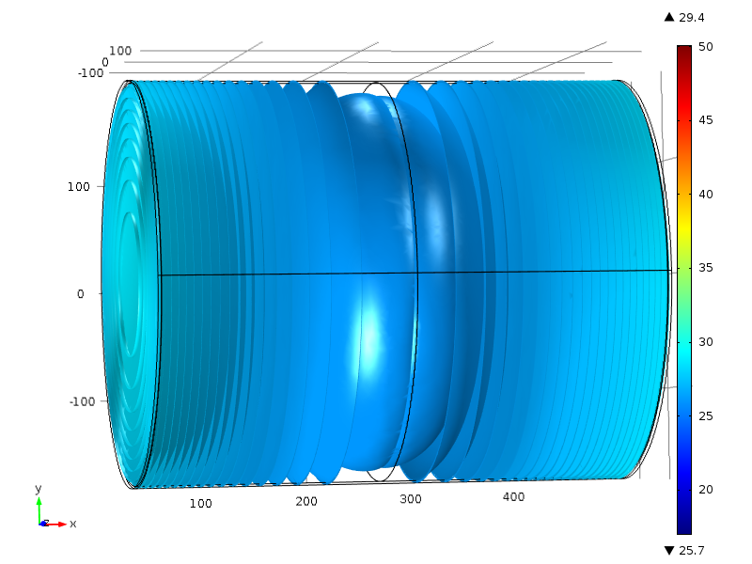
Considering the present status of the electronics, heat dissipation at the ILD-TPC
is simulated using Finite Element Method (COMSOL).
The simulated TPC is 4.6 m in length and 3.6 m in diameter.
The common cathode is 0.1 mm thick
The field cage and the end-plates are 2 cm thick.
Considering the
Power-Pulsing, the power consumption on each end-plane
is reduced by a factor of 10, e.i., to 750 W.
This limits the temperature gradient within 25º C to 30º C.

Slide 10
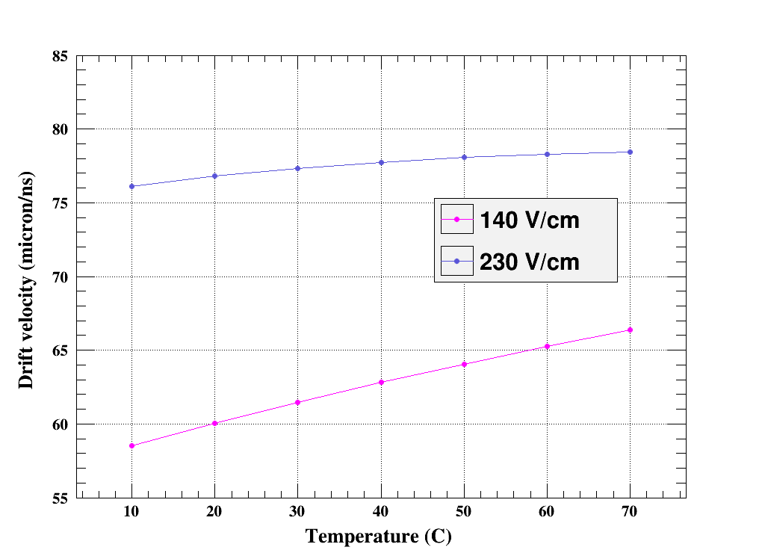
The effect of this temperature gradient along the TPC axis is investigated using Magboltz
The result shows the dependence of drift velocity on temperature for standard and low drift field.
Existence of temperature gradient along the TPC axis implies the non-uniformity of drift velocity in the TPC.
The non-uniformity of drift velocity may gives rise to inaccuracy in measurement.
Conclusion: Efficient cooling is necessary to protect the electronics as well as for accurate measurement.

Slide 11
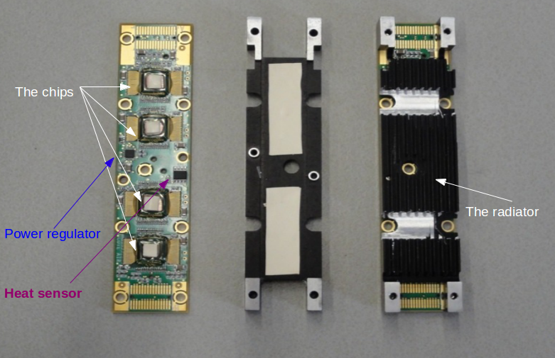
In the beginning, air cooling was implemented.
One radiator is attached with each Front End Card.

Slide 12
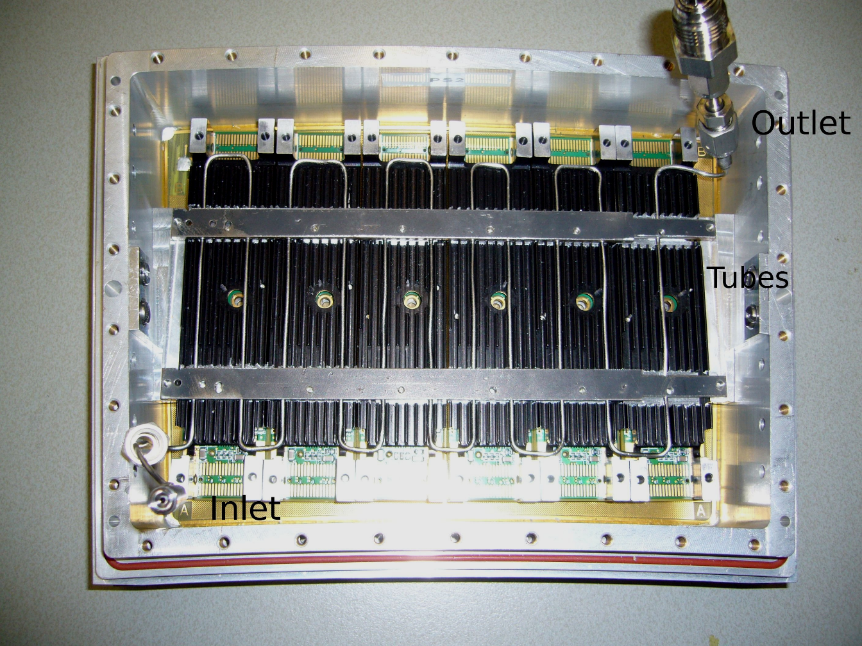
The back-end of a Micromegas module.
A stainless steel, serpent-tube is mounted along with the radiators.
The tube has the inner and outer diameters of 0.079 cm and 0.159 cm.
The coolant flows through the tube.
Two metal bars holds the structure tight for better thermal contact.

Slide 13
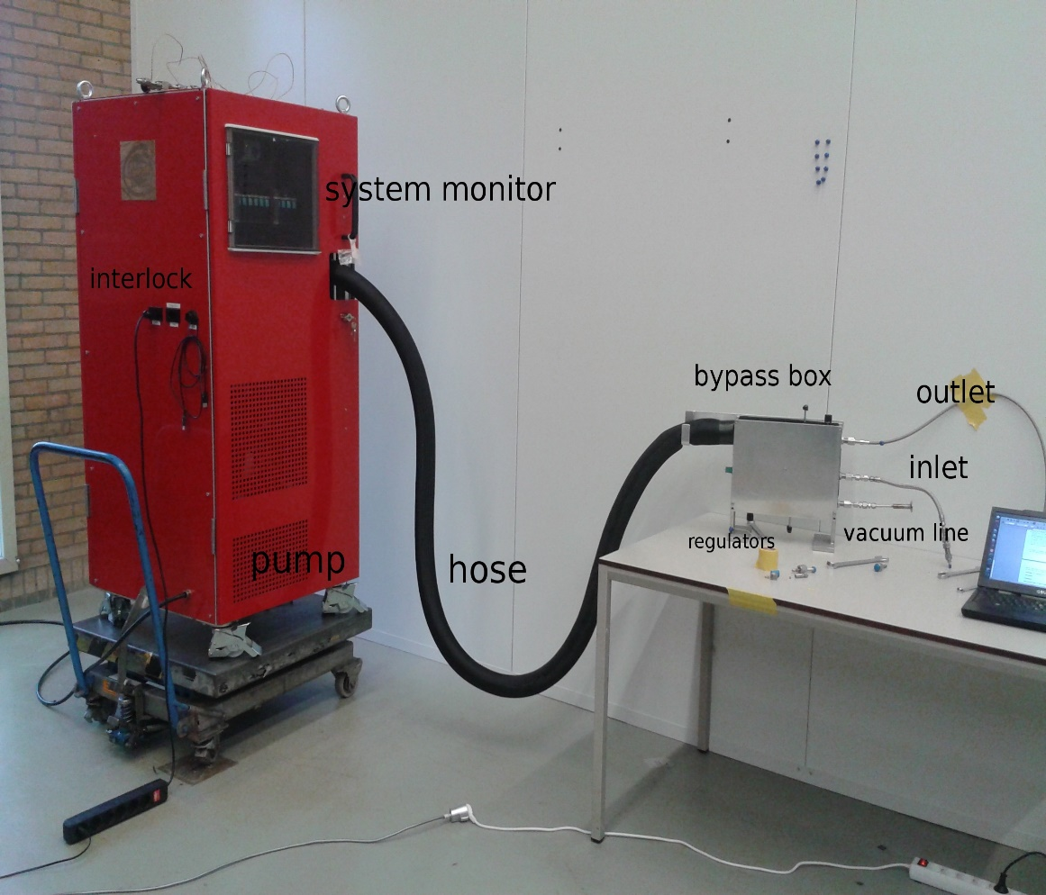
The first 2-phase CO₂ cooling was tested with one Micromegas module
in December 2013 at NIKHEF.
Liquid CO₂ is circulated in the cooling pipe of the module by a pump called the ‘TRACI’ *.
TRACI can circulate CO₂ in stable pressure difference with a large range of operation.
It circulates CO₂ in close loop with the help of a concentric hose and a distribution box.
It has 1 kg CO₂ filling.
The evaporation point of liquid CO₂ , i.e., the temperature at which cooling is done, can be varied over a long range by adjusting the inlet pressure.
The mass-flow rate and the pressure difference can be easily controlled.
Interlock switch shuts down the system in case of excess or very low pressure difference.
* B. Verlaat et al., TRACI, a multipurpose CO2 cooling system for R&D, in Proceedings of the 10th IIR Gustav Lorentzen Conference on Natural Refrigerants, Delft Netherlands (2012), Paper No. GL-208, http://www.nikhef.nl/pub/services/biblio/bib PN/GL2012 Verlaat 208.pdf.

Slide 14
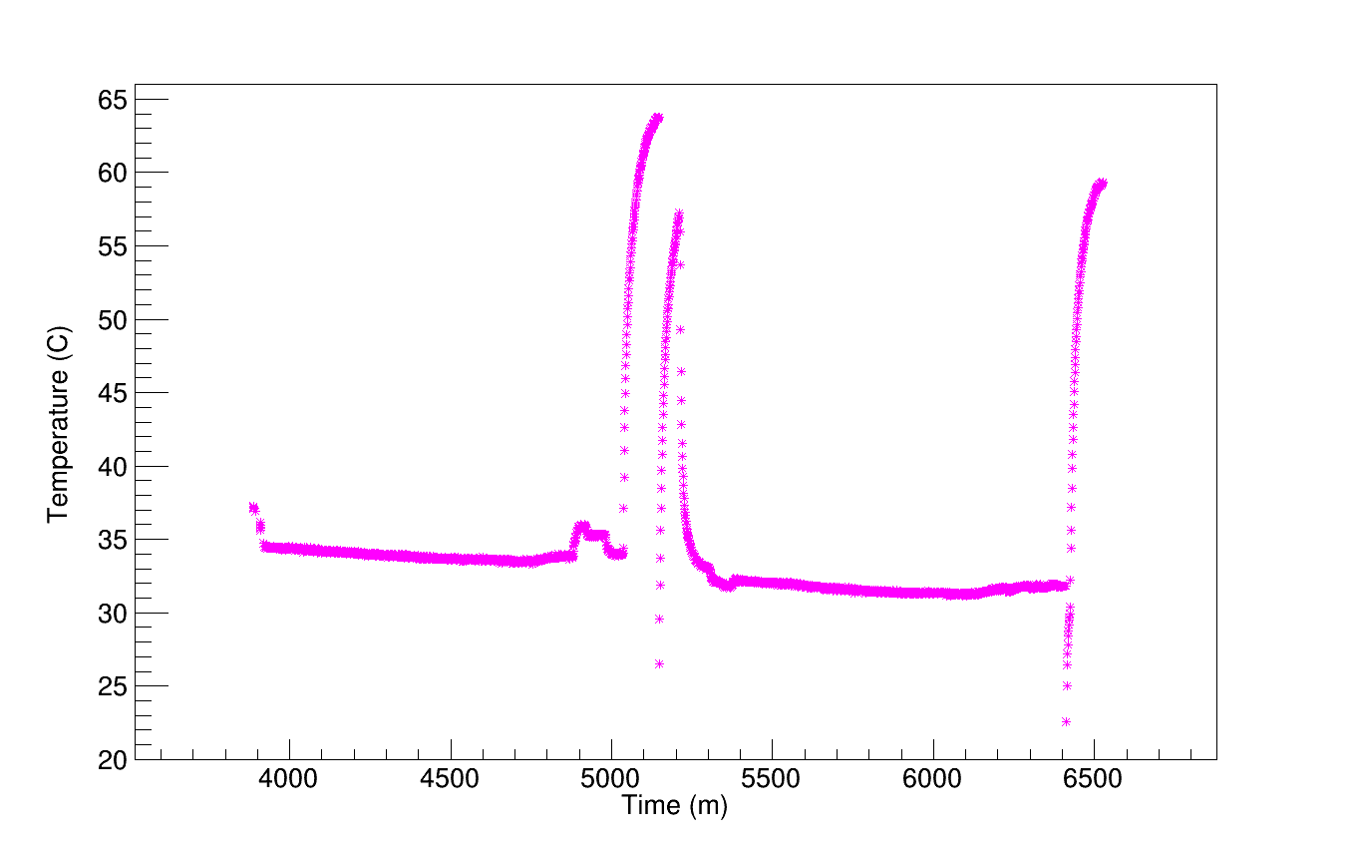
Result of 2-phase CO₂ cooling
cooling is stopped
and temperature rises
Cooling starts
Change of flow rate
Electronics is off
Electronics starts
without cooling
Temperature of one FEC is shown. It is stable around 35º C when cooling is applied.

Slide 15
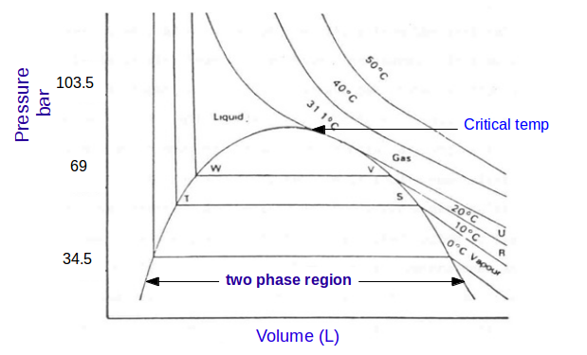
Why two-phase CO₂ cooling ?
Temperature remains constant during phase change. Hence, two-phase cooling has unique advantage of uniform cooling.
The critical temperature of CO₂ is not too low or too high( 31.1º C). Its two-phase region covers the room temperature.
Besides, CO₂ has
Large latent heat low mass flow rate.
Low viscosity uniform flow.

Slide 16
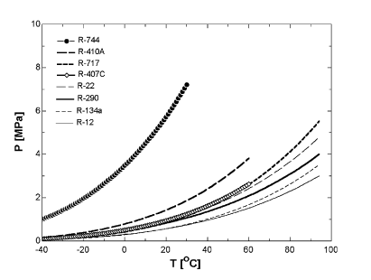
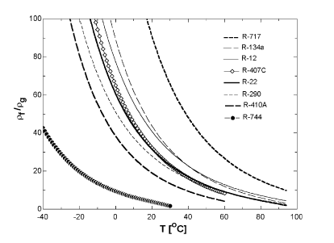
Why two-phase CO₂ cooling ?
Curve-1*
As shown in Curve-1, CO₂ has,
Steeper slope of the vapour pressure curve helps to change the temperature in smaller steps.
This also implies smaller temperature variation for pressure fluctuations.
CO₂
Curve-2*
As shown in curve-2, CO₂ has,
Low ratio of liquid to gas densities more homogeneous two-phase flow.
It also implies good heat transfer coefficient.
CO₂

Slide 17
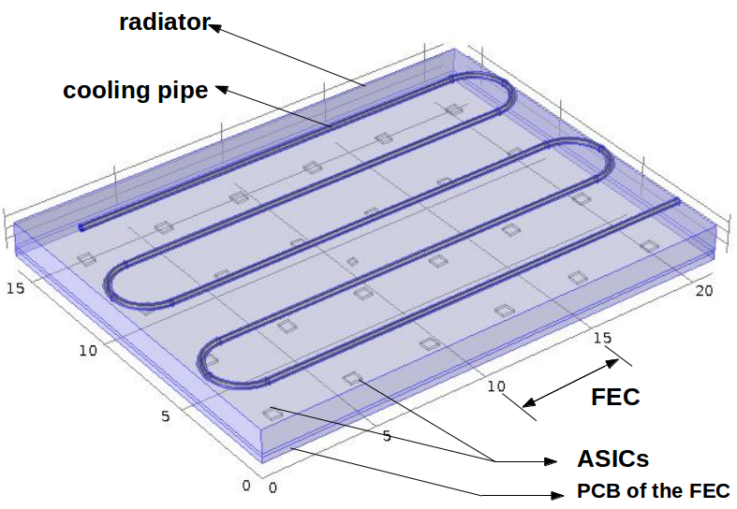
The heating and cooling is numerically studied
The simulated geometry of the PCB, the radiator, the ASICs and the cooling pipe.
The gaps within the model are filled with air.
The thermal properties of the materials are given as they are in the experiment.
Conduction, convection, and radiation of heat have been considered.
The tube has the inner and outer diameters of 0.079 cm and 0.159 cm.
The scale is in cm

Slide 18
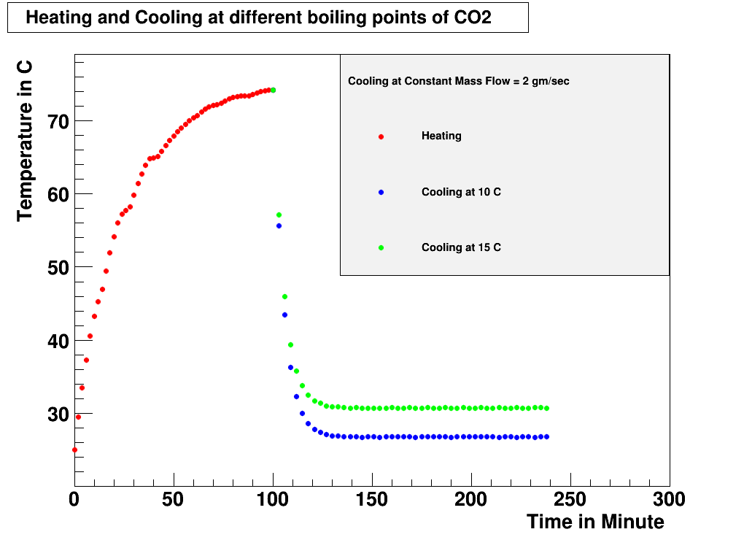
The heating and cooling is numerically studied
The ASICs are used as the power sources. The total power is distributed among them.
Instead of two-phase flow, a mixed flow of liquid and gaseous CO₂ is considered.
Different mass-flow rates and CO₂ at different temperature have been considered.
The CO₂ flow is started after first 100 minutes of heating.
The cooling is done at a constant
mass flow rate = 2 gm/sec
The temperature of CO₂ that is flowing through the pipe is varied for 10º C and 15º C.
The stable temperature of the module decreases as the CO₂ temperature is decreased.

Slide 19
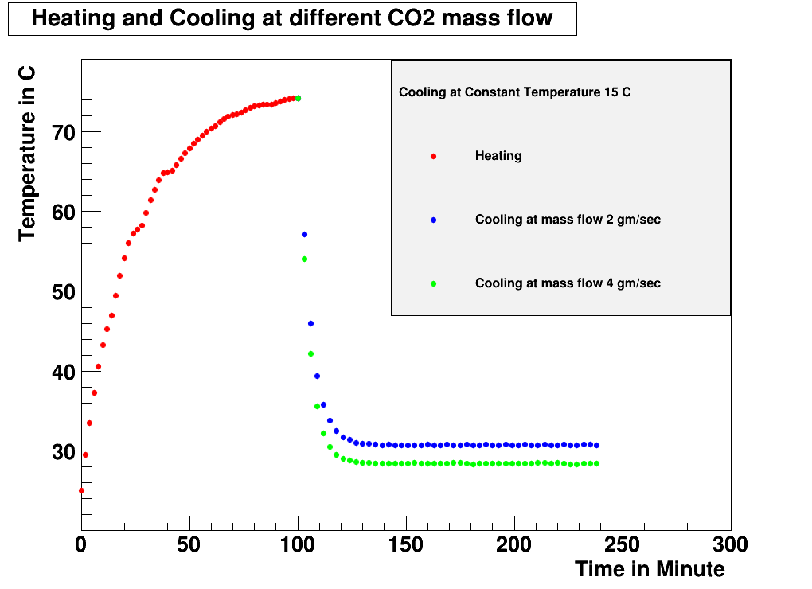
The heating and cooling is numerically studied
The ASICs are used as the power sources. The total power is distributed among them.
Instead of two-phase flow, a mixed flow of liquid and gaseous CO₂ is considered.
Different mass-flow rates and CO₂ at different temperature have been considered.
The CO₂ flow is started after first 100 minutes of heating.
The cooling is done at a constant
Temperature = 15º C.
The mass flow rate of CO₂ that is flowing through the pipe is varied for 2 gm/sec and 4 gm/sec.
The stable temperature of the module decreases as flow rate increases.

Slide 20
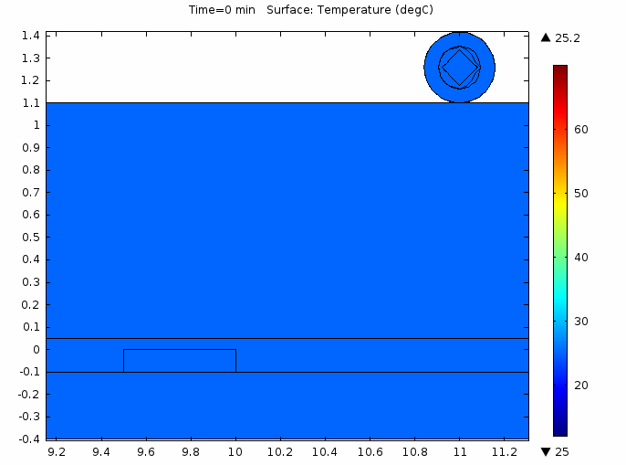
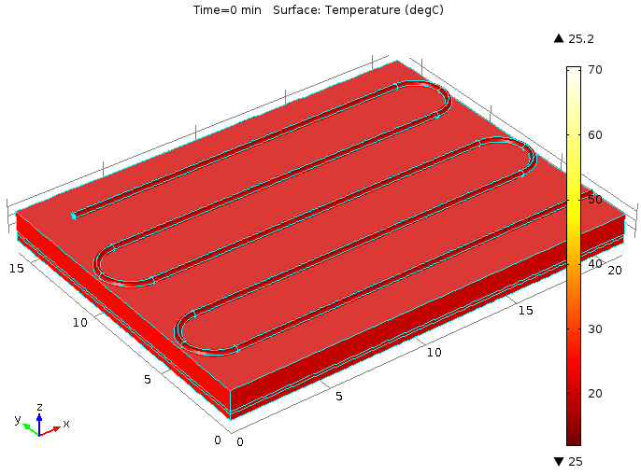
The heating and cooling is numerically studied
Change of temperature with time in a part of the model
Change of temperature with time for the entire model

Slide 21
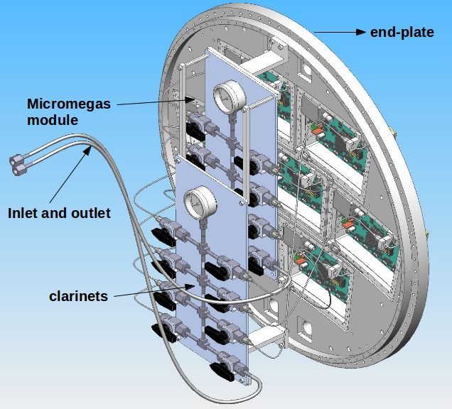
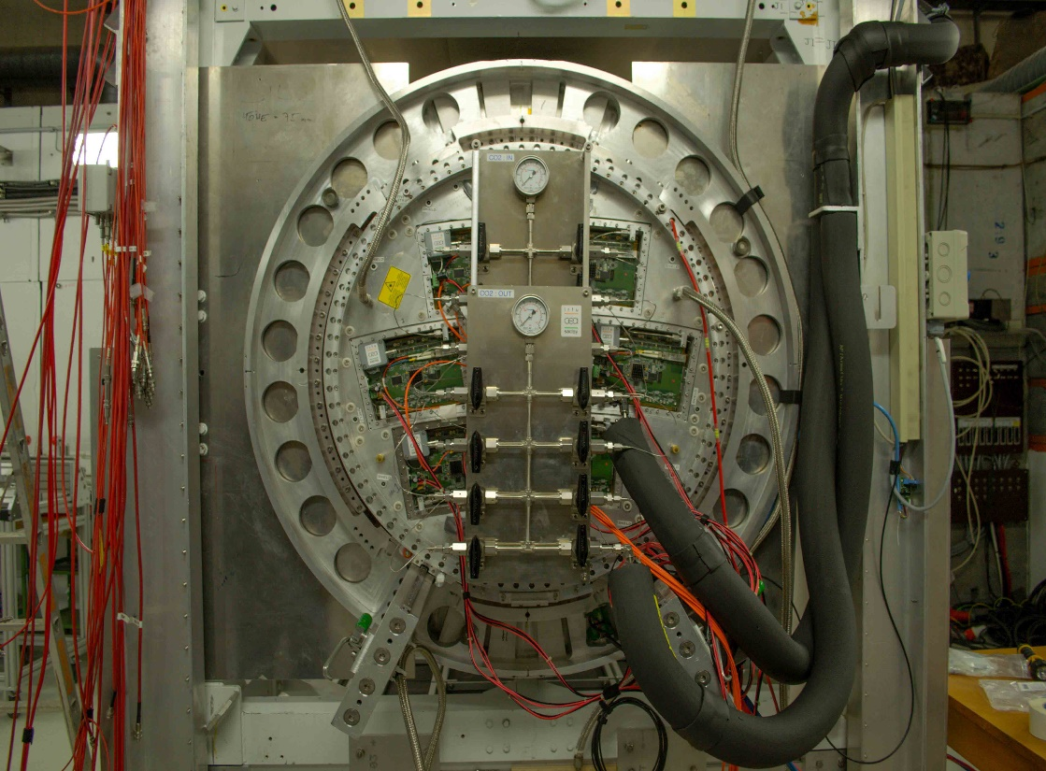
Two-phase CO₂ cooling is applied to all the seven
Micromegas modules during the beam test at DESY.
The clarinet is mounted with the end-plate of the LPTPC.
The clarinet distribute CO₂ among the 7 modules in parallel.

Slide 22
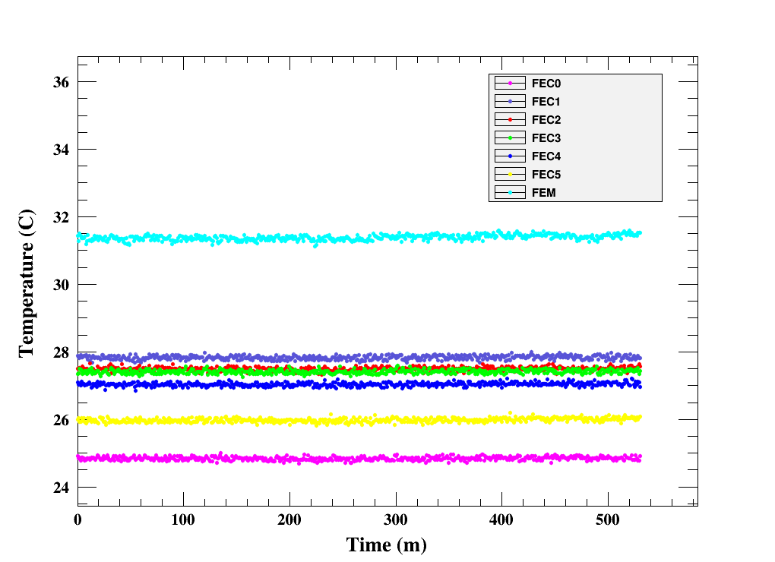
Two-phase CO₂ cooling is applied to all the seven
Micromegas module during the beam test at DESY.
The temperature of all the FECs and the FEM of a Micromegas module are shown during the beam test.
The temperatures of the FECs are vary within 25º C to 28º C and they are stable within 0.2º C.
The FEM is at relatively high temperature as it is further away from the radiator.
The 2-phase CO₂ continuously worked for more than 80 hours.

Slide 23
Conclusion and Future plan
The power dissipated by the electronics of a Micromegas module increases its temperature upto 65º C.
If the heat is not removed within reasonable time, it can damage the electronics as well as affect precise measurement.
Two-phase CO₂ cooling is successfully applied to all the seven Micromegas modules during the beam test at DESY, Hamburg for more than 80 hours.
The temperature of the FECs vary within 25º C to 28º C and they are stable within 0.2º C.
Detailed numerical study has been accomplished to understand the process of heating and two-phase CO₂ cooling.
Further improvement regarding better thermal contact and uniform cooling is under consideration.

Slide 24
Acknowledgement
I sincerely thank my supervisors and my colleagues.
I am very thankful to the members of LCTPC collaboration and the RD 51 collaboration.
I cordially thank Prof Satyajit Saha (HOD, ANPD, SINP, Kolkata) and
the technical assistants of SINP, Kolkata, India and CEA, Saclay, France.
I thank Mr. Abhik Jash and Mr. Prasanta Rout (fellows of ANPD, SINP, Kolkata).
I sincerely acknowledge IFCPAR / CEFIPRA (Project 4304-1) for funding.

Slide 25
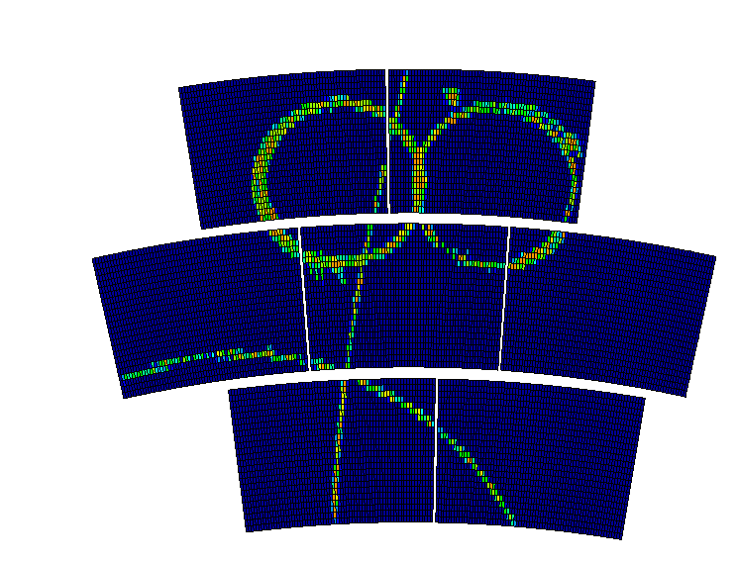
THANK You

Slide 26
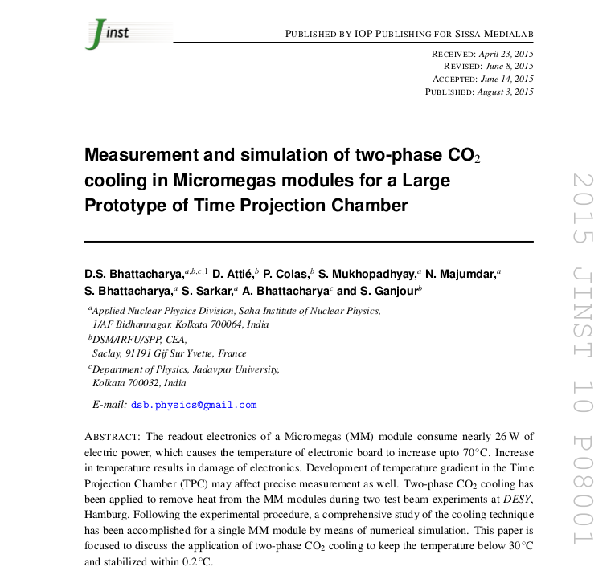
BACK UP

Slide 27
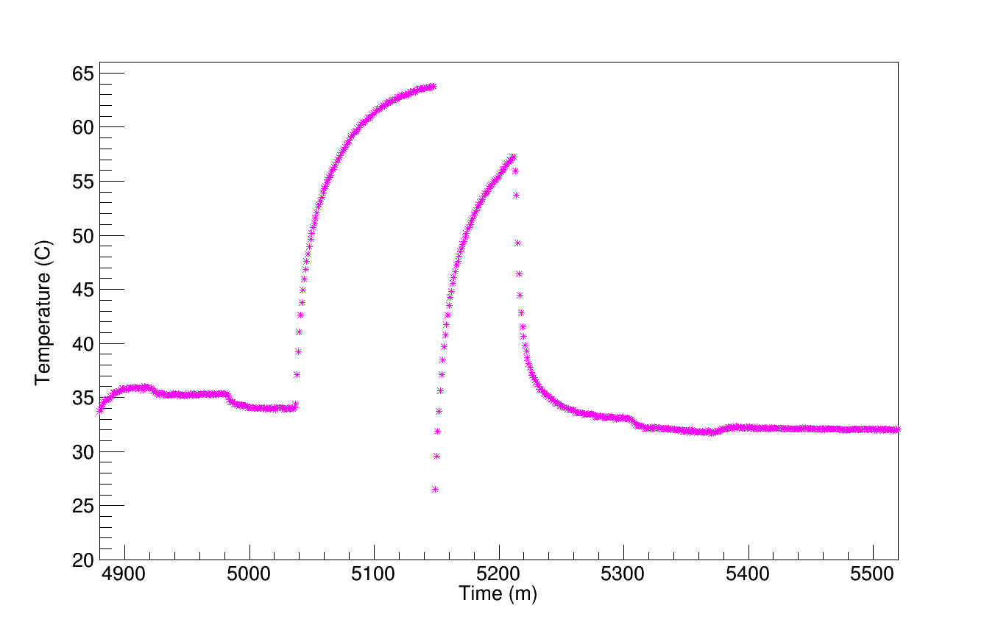
BACK UP

