Slide 1
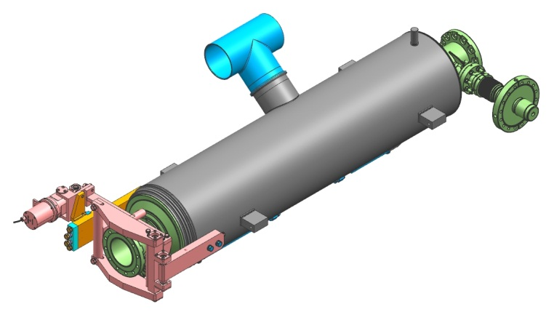
US Technology: Cryomodule production
There has been no direct ILC SRF R&D in the US since the GDE program. The US is relying on cryomodule production for the LCLS II project to develop production capacity. As such the LCLS II Project is the largest US ILC activity.
LCLS II is a mini-XFEL. An FEL based light source underway at SLAC. It is based on 1.3 GHz technology modified for CW operation. Total cryomodule production is 35 (33 + 2) units. Production split equally between Fermilab and JLAB. Production rate one/month each facility.
Dressed cavities from RI.
Prototype cryomodules this year.

Slide 2
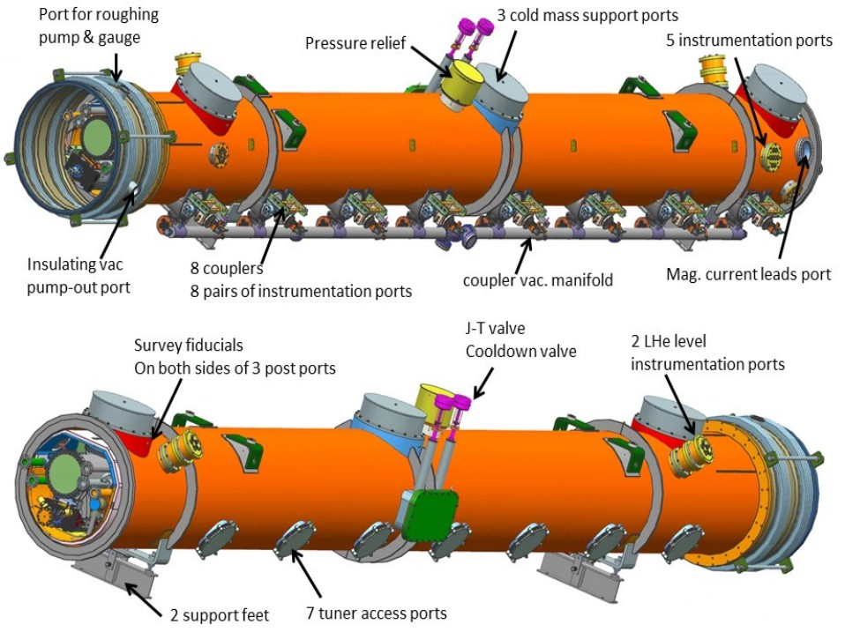
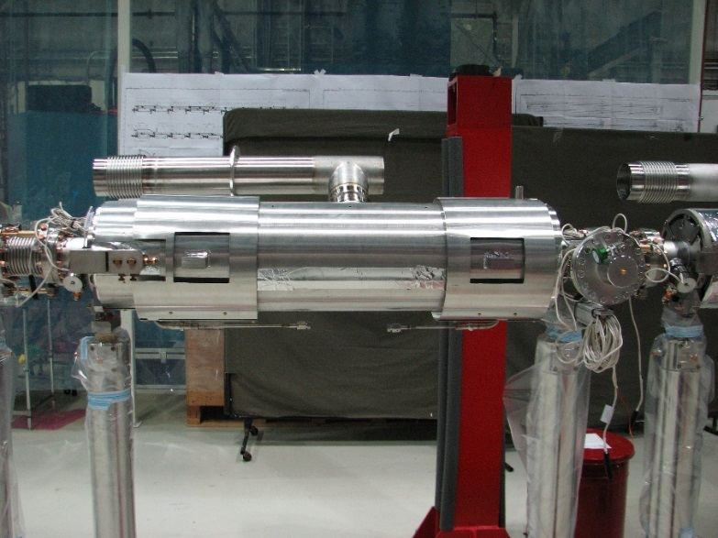
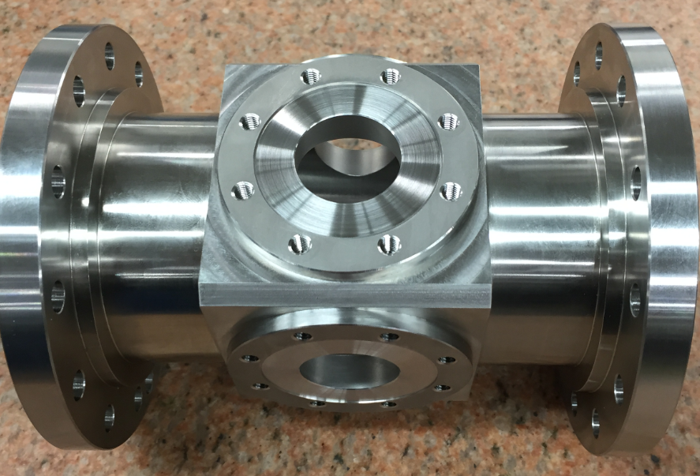
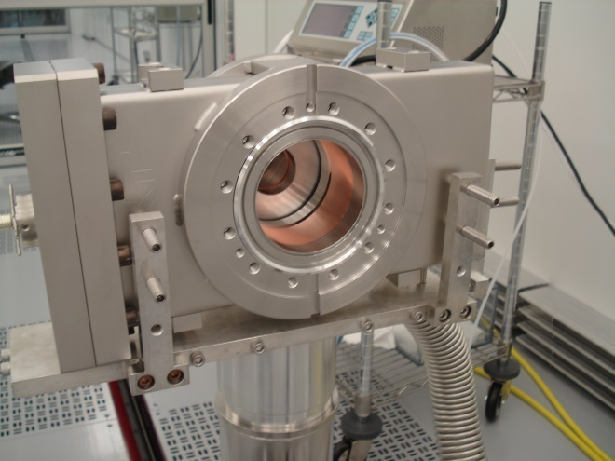
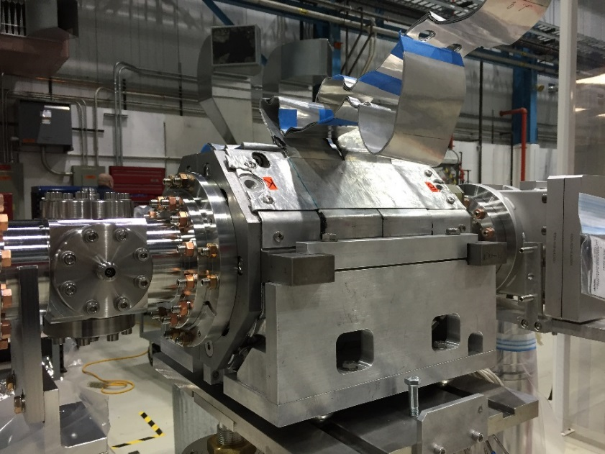
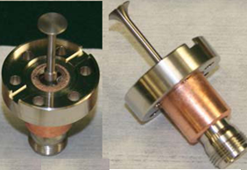
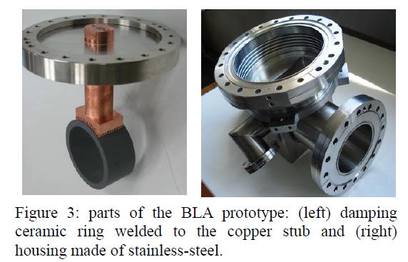
Fermilab Cryomodule production
Magnetic shielding (body) is installed except the second layer center section
Split Magnet

Slide 3
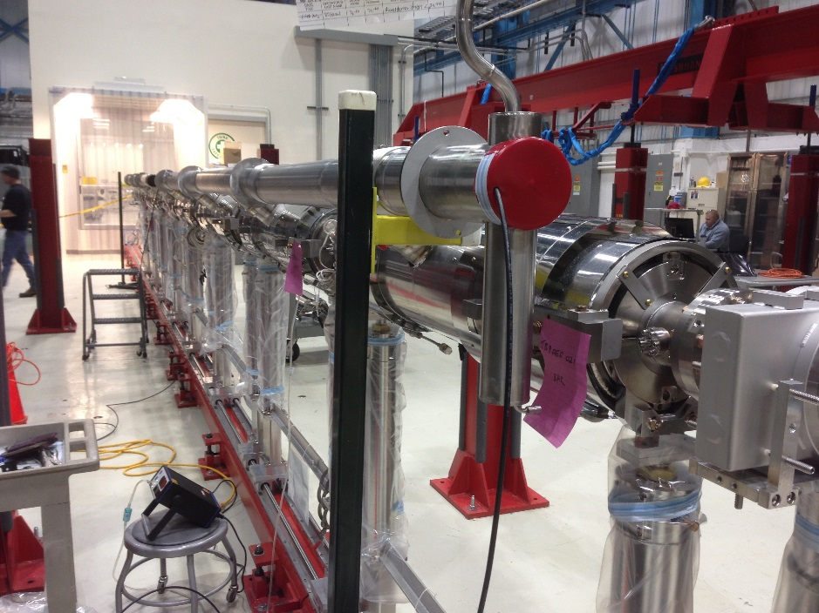
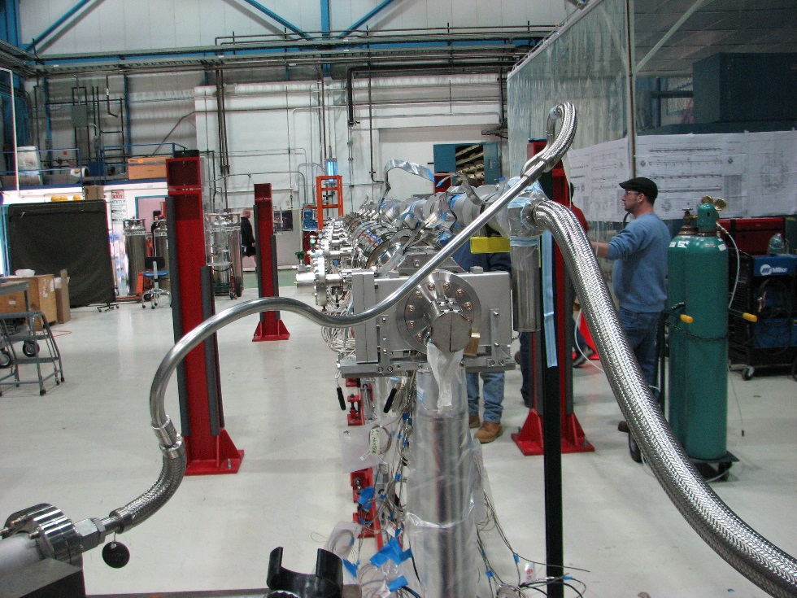
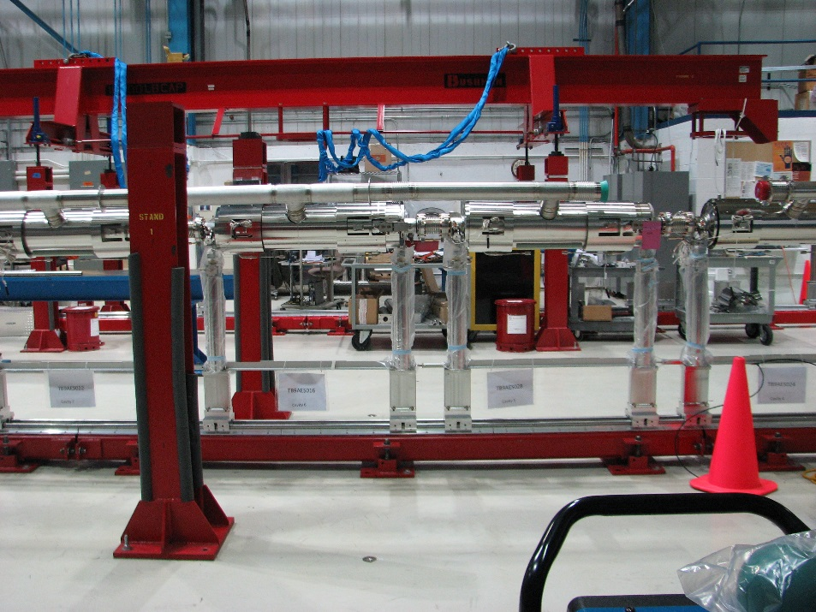
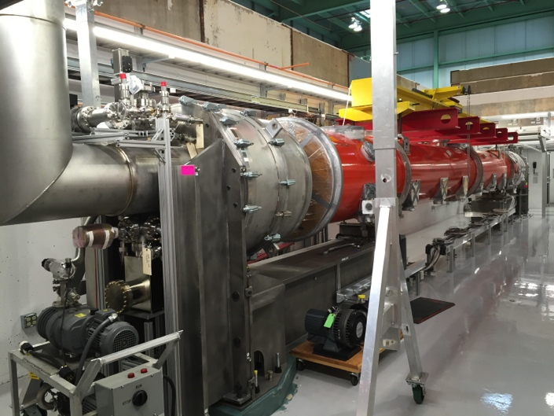
Fermilab Cryomodule production

Slide 4
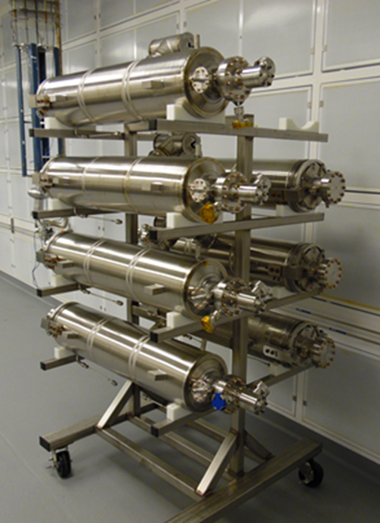
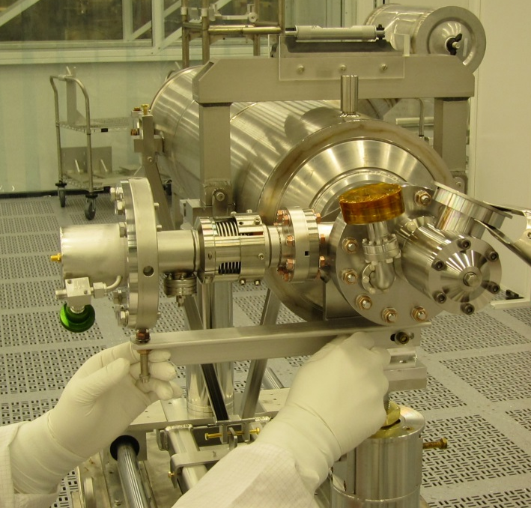
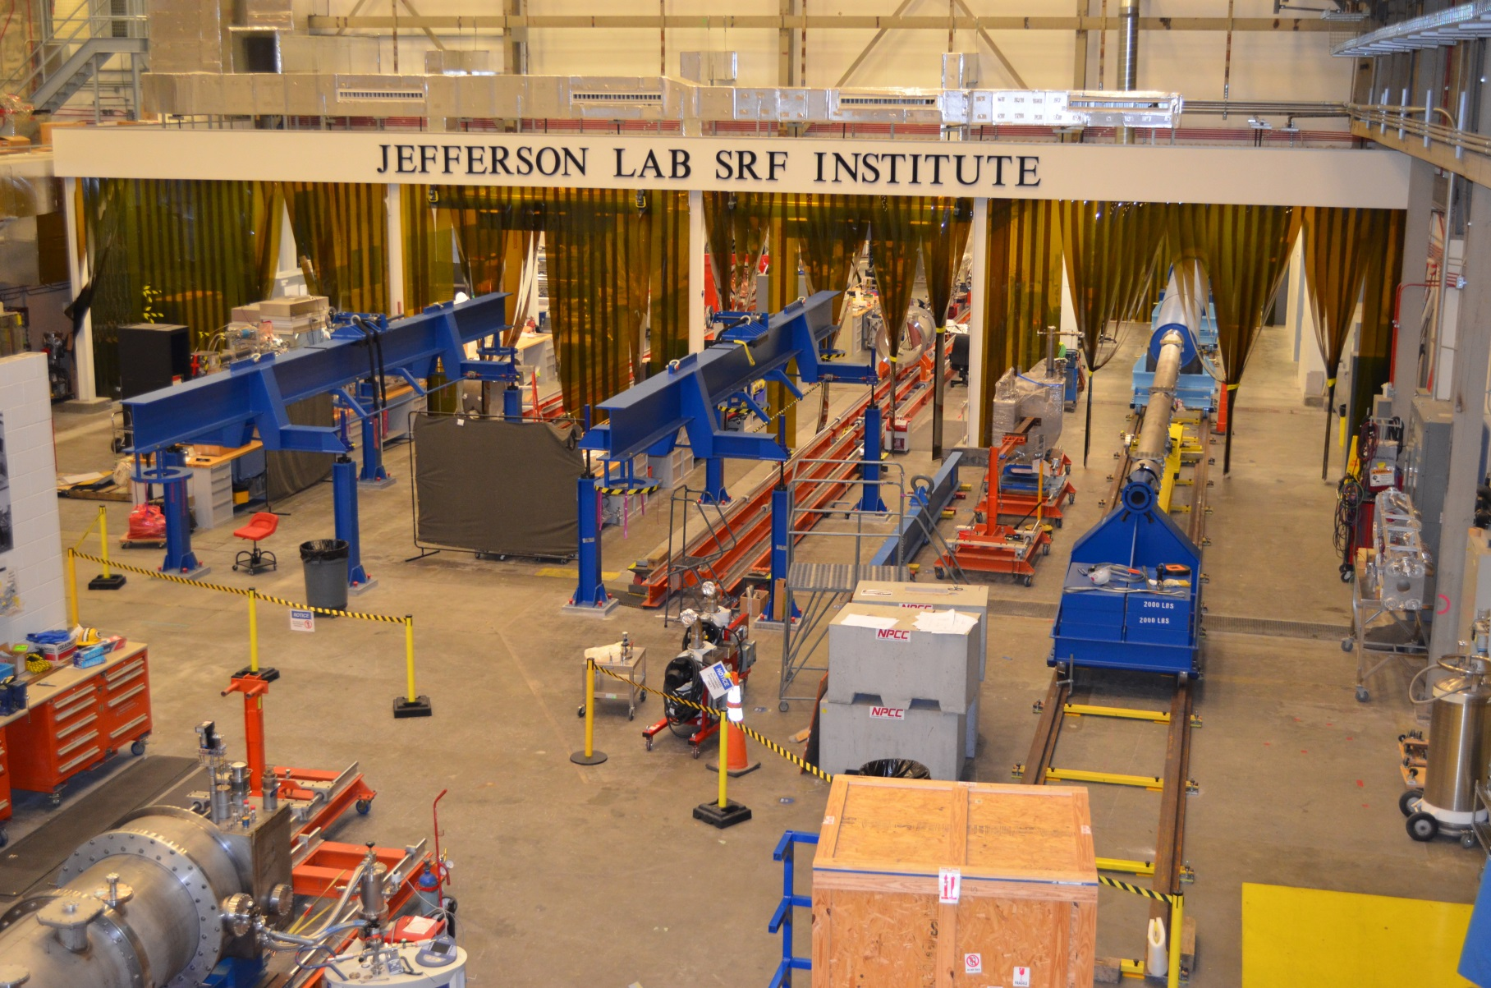
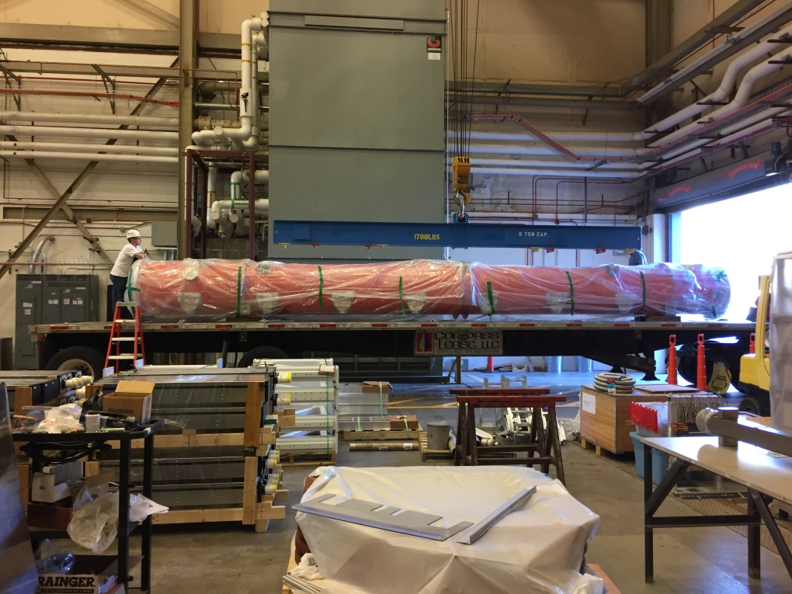
JLAB Cryomodule production

Slide 5
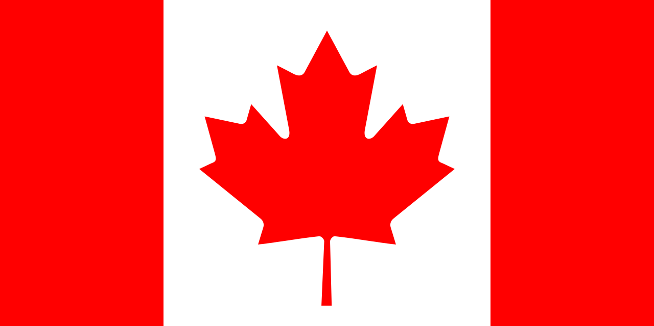
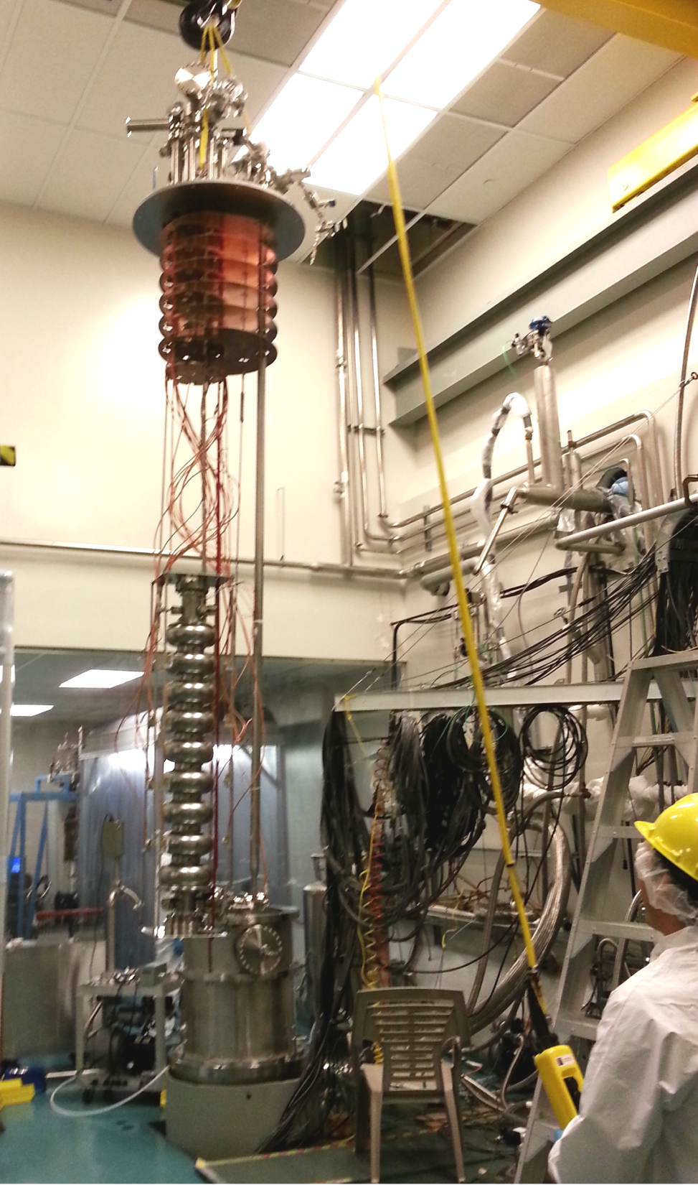
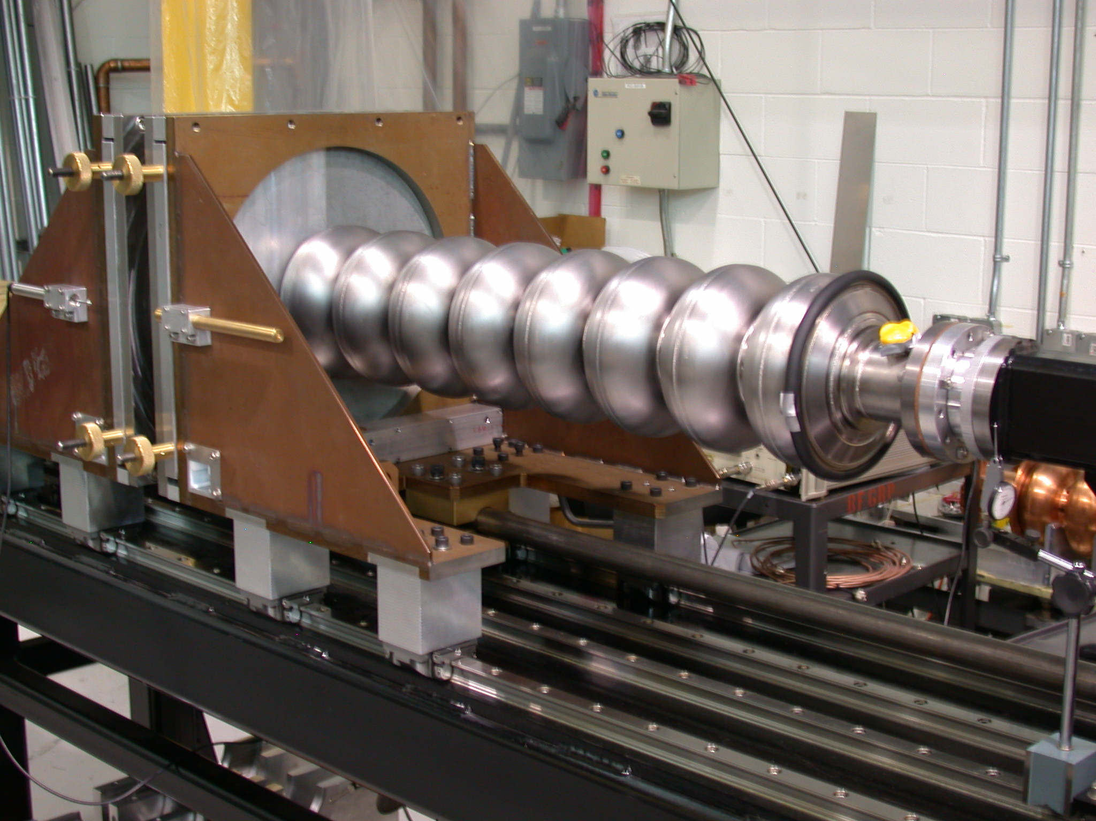
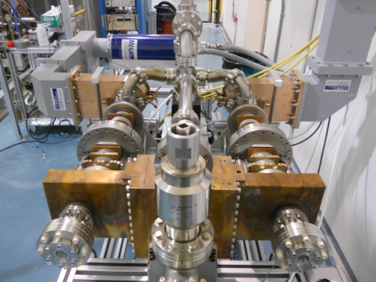
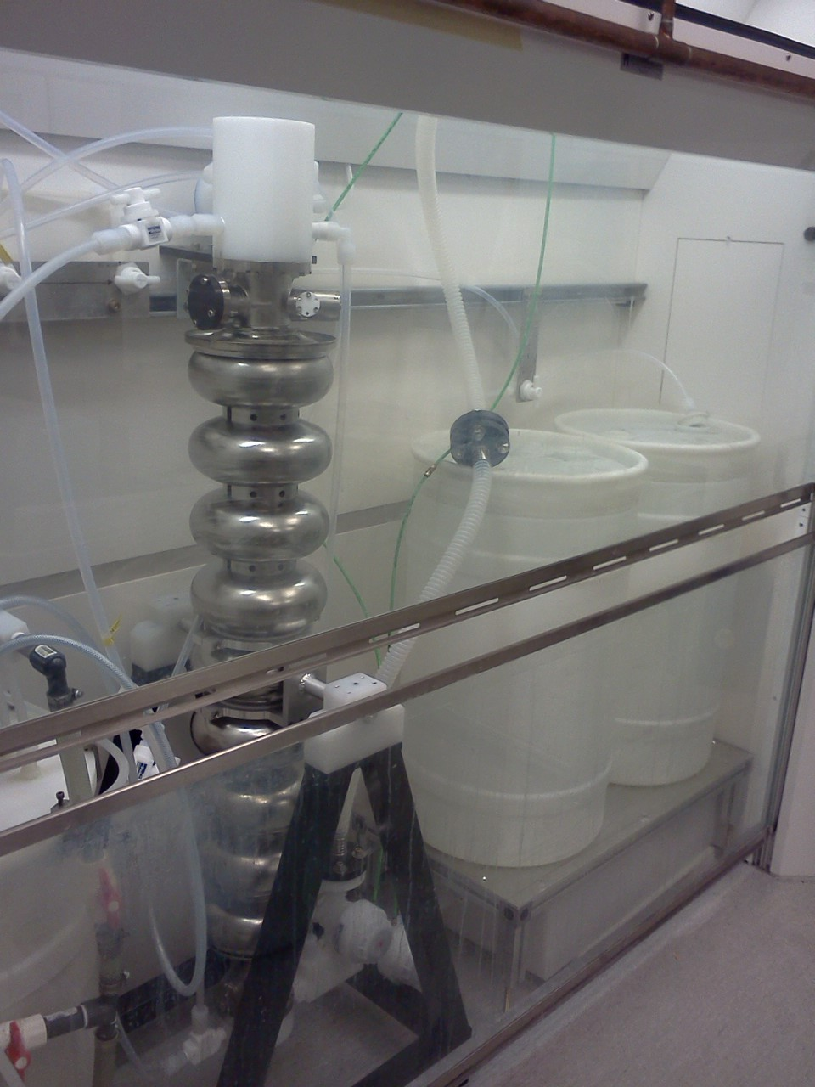
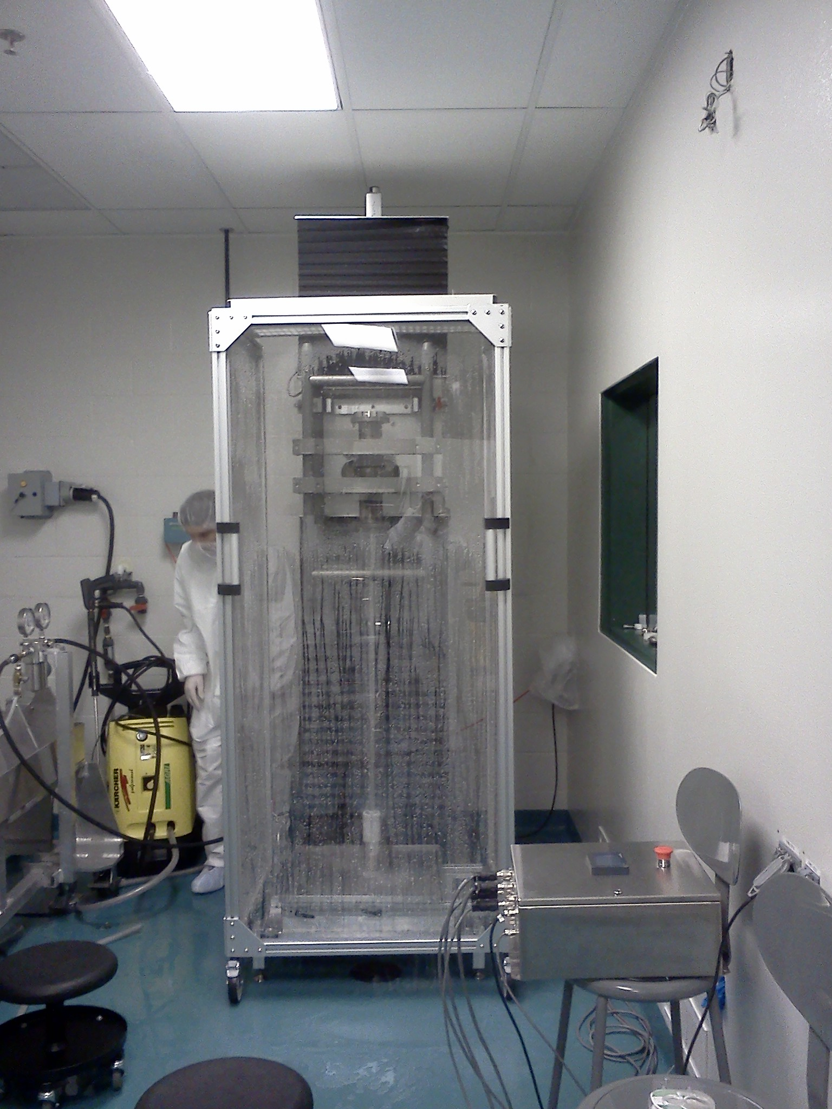
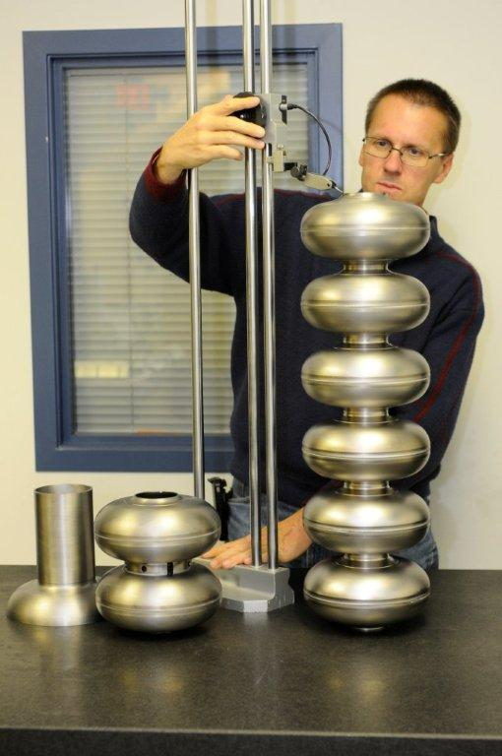
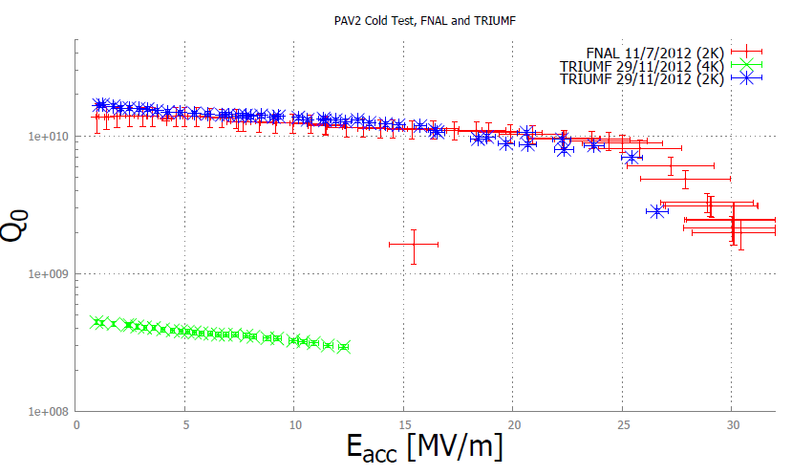
TRIUMF 1.3 GHz Infrastructure
Infrastructure established to process and test 1.3GHz single cell and multi-cell cavities and support 1.3GHz cryomodule production
Cavity tuning stand
Power coupler conditioning station
Single cell cryostat
Multi-cell cryostat
BCP chemical etching
High pressure water rinse
PAVAC
TR-PAV2 cavity test

Slide 6
US Activities in the ILC R&D Program
Positron Production and Target development – Argonne
Funding limited
Damping Ring design maintenance – Cornell – in progress
Main Linac design – Fermilab – radiation simulations in progress
Beam delivery system design, ATF2 support (nanobeams), and accelerator lattice maintenance – SLAC – in progress
Final Focus magnet development – Brookhaven - stopped
Conventional Facilities layout – Fermilab - restricted

Slide 7
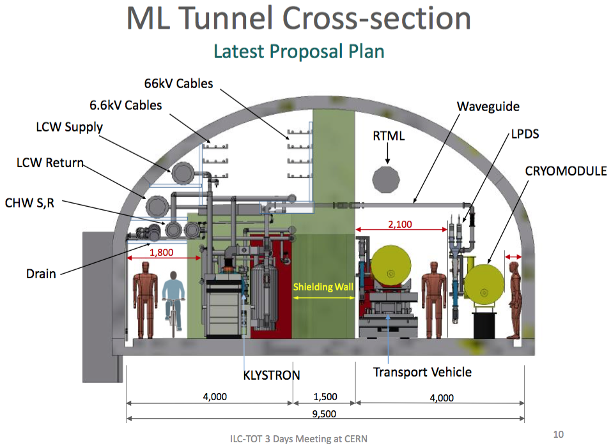
Design Update CR 012

Slide 8
So …...
The DOE seems unlikely to make any significant change to the ~$2M/year of direct ILC support without some form of formal declaration from Japan in regard to an ILC construction project (2019?). Will support continue until then ? FY17 under discussion with DOE. There is however much indirect contact between the two governments so the US is well aware of developments in Japan.
LCLS II cryomodule production will teach the US how to build cryomodules but will not say much about high rate industrial volumes.
Canada will continue with the SRF technology development and detector R&D until the ILC picture is clarified

