Slide 1
ILC R&D at KEK
FY2016 plan
Shin MICHIZONO
(KEK, Accelerator Lab.)

Slide 2
Reformation of ILC R&D and project promotion at KEK
KEK DG
April 2016 -
LC project steering committee
(LC Project Promotion)
Executive board
（LC R&D）
Chaired by KEK DG
Planning Office for the ILC
Institute of
Particle and
Nuclear Studies
Accelerator
Laboratory
Applied
Research
Laboratory
Director
(KEK DG)
Deputy Director
R&D group
R&D group
R&D group
Coordination Unit
LC R&D meeting
(External relations to organizations outside of KEK are not shown)

Slide 3
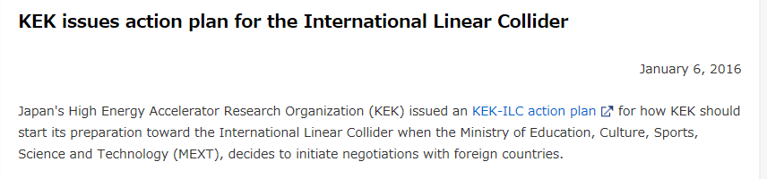
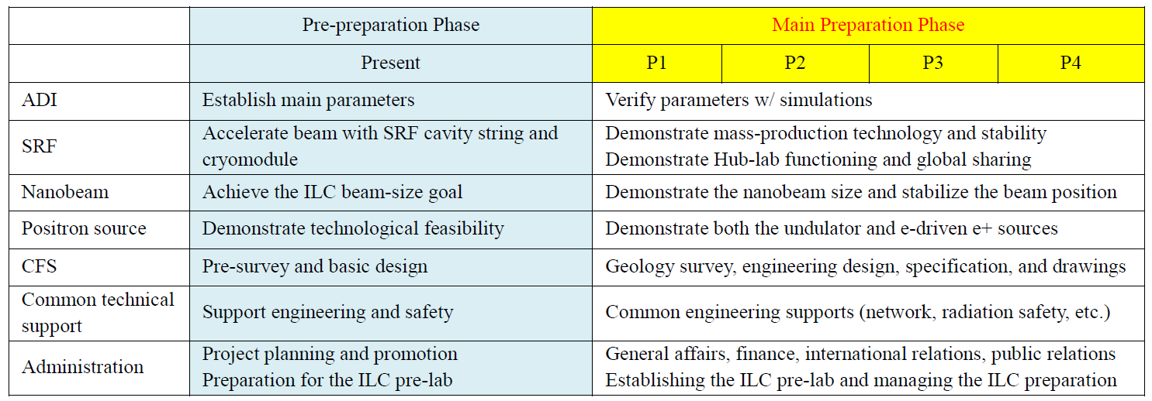
KEK action plan
https://www.kek.jp/en/NewsRoom/Release/20160106140000/

Slide 4
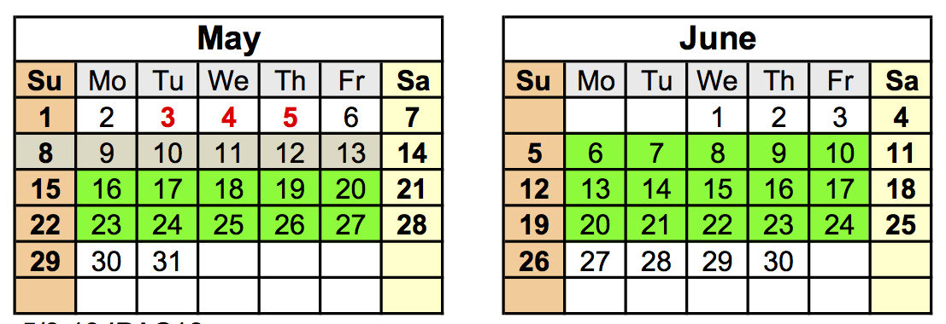
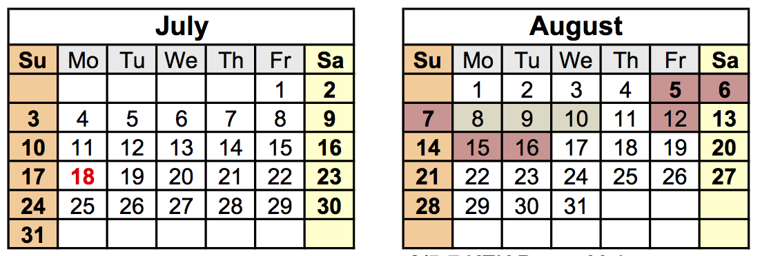
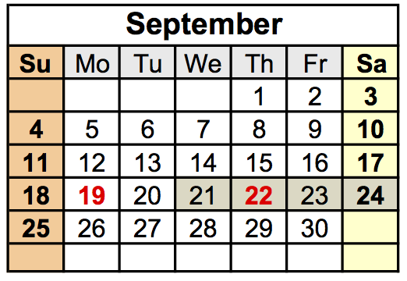
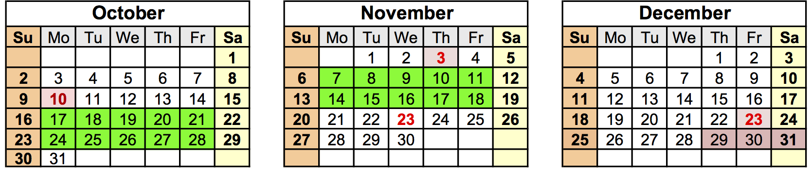
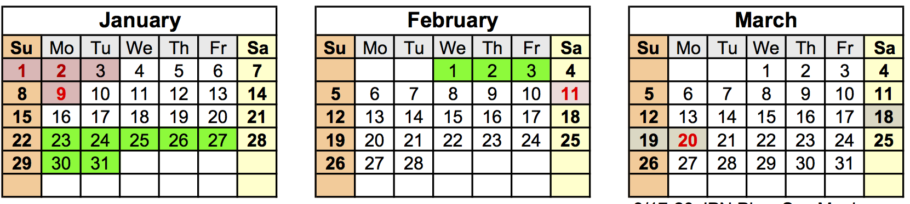
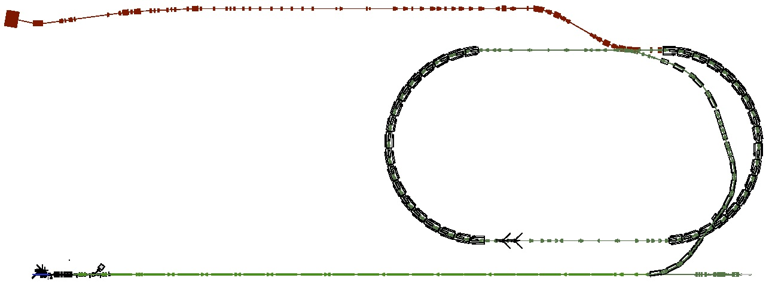
ATF/ATF2: Accelerator Test Facility
Total 12 weeks operation
ATF2: Final Focus Test Beamline
Goal-1: Small Beam R&D
ATF2 Goal : 37 nm (-> ILC 6 nm) Achieved 44 nm (2014)
Establish the tuning method to 37 nm.
Study impact of wakefield for ATF and ILC
Damping Ring (~140m)
Low emittance electron beam
Goal-2: nanometer beam position stabilization
  latency 133 nsec achieved (target: < 300 nsec)
  positon jitter at IP 410 nm → 67 nm (2015)
  nanometer stabilization by improving BPM resolution
1.3 GeV S-band Electron LINAC (~70m)

Slide 5
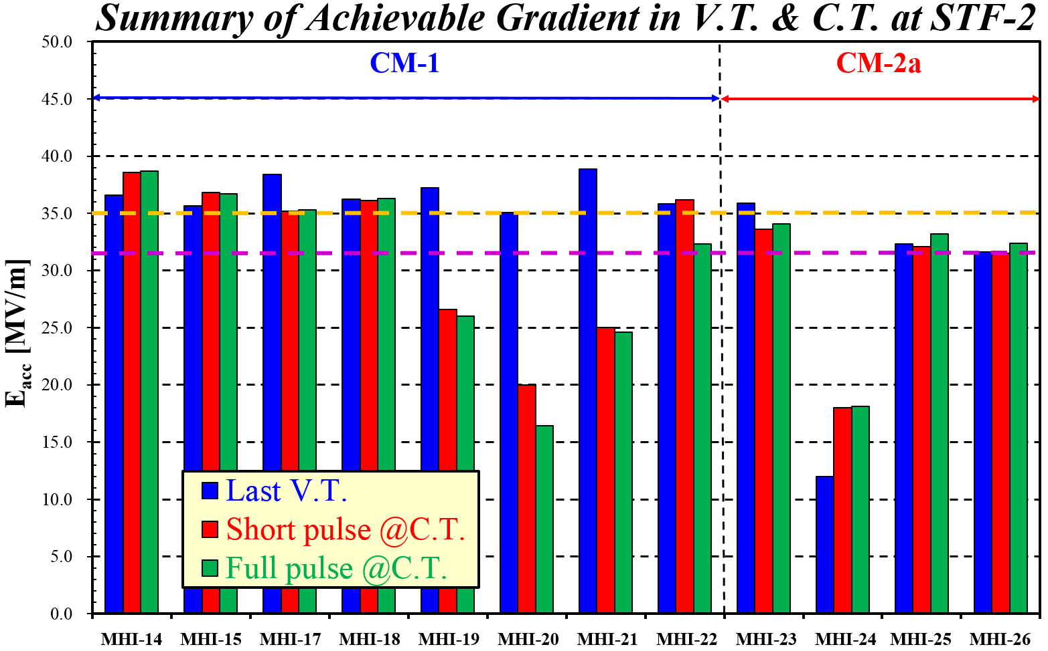
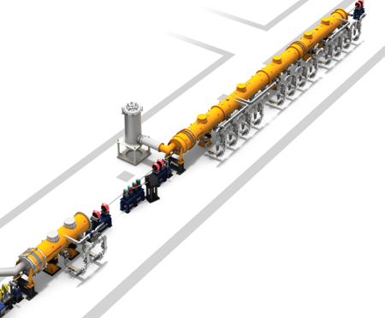
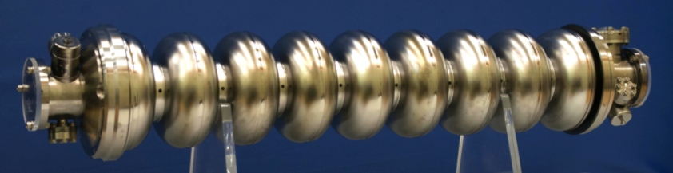
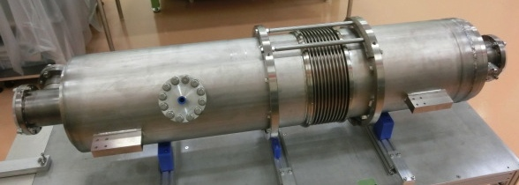
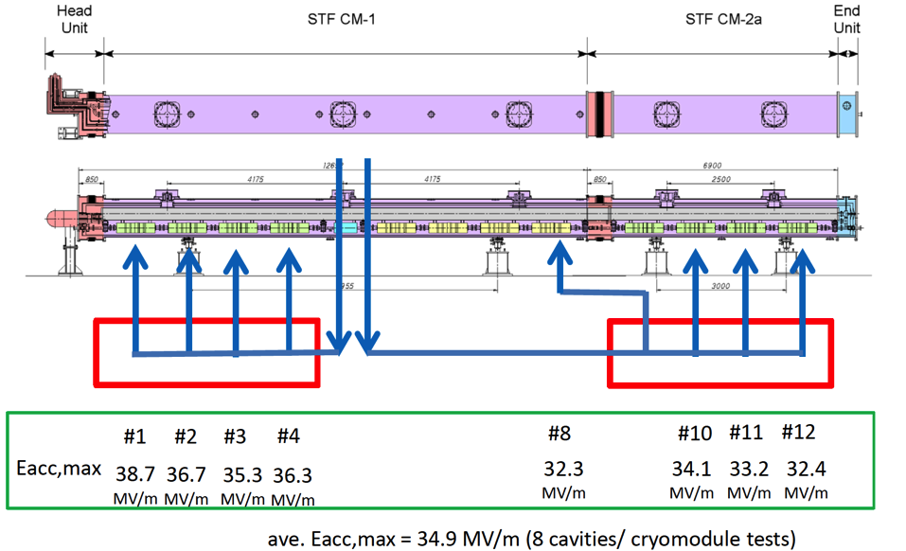
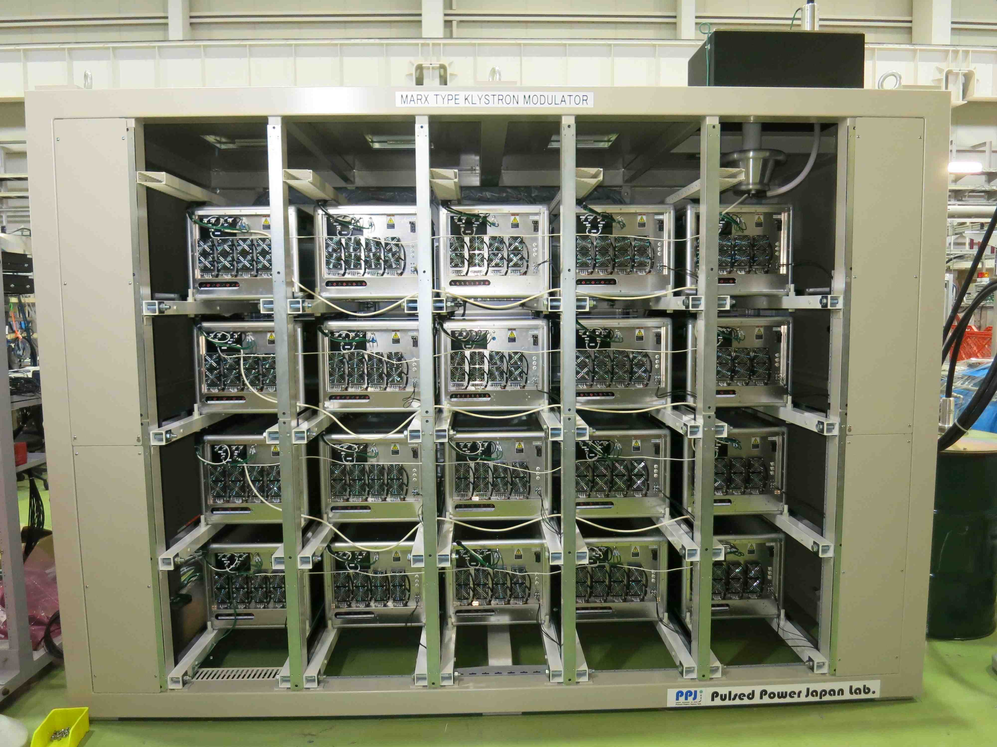
FY2016 plan at STF & CFF
Cavity fabrication at CFF
(satisfies Japan High-pressure-gas-regulation (KHK))
CM-2a
(4 cavities)
CM-1
(8 cavities)
8 cavities vector sum control operation
(Oct. and Nov. 2016)
MARX modulator (for 10MW MBK)
System evaluation at STF
Size 1.6 m(W) x 3.3 m(D) x 2.3m(H)

