Slide 1
AIDA 2020
Tel Aviv group

Slide 2
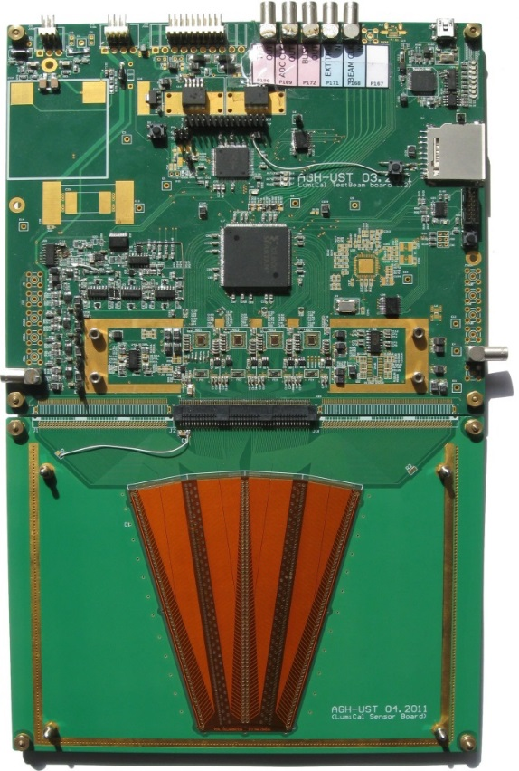
introduction
The aim for 2015/2016 was to build a thin detector for the FCAL
The silicon detector is 320 μm. need HV and read out system. Need also mechanical support.
In 2014 test beam has been done with 3.5mm complete system : the detector was glued on a PCB.

Slide 3
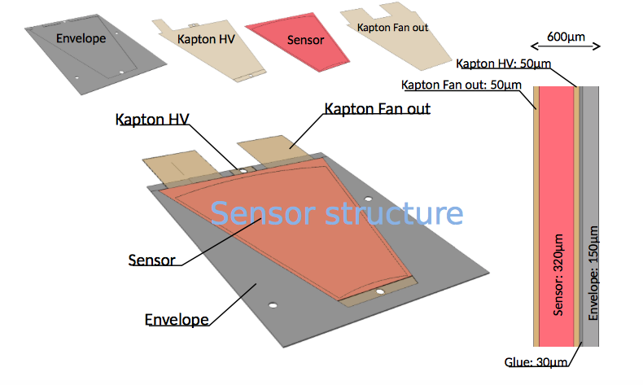
The idea

Slide 4
Envelope
In collaboration with the CERN mechanics group, we considered two options to produce the envelop :
  3D printing
  carbon fiber
The 3D printing was not rigid and flat enough so we opted for the carbon fiber solution

Slide 5
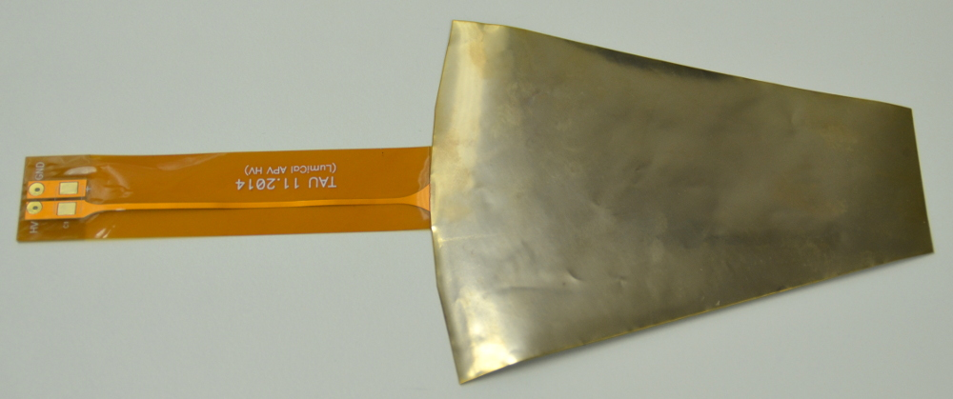
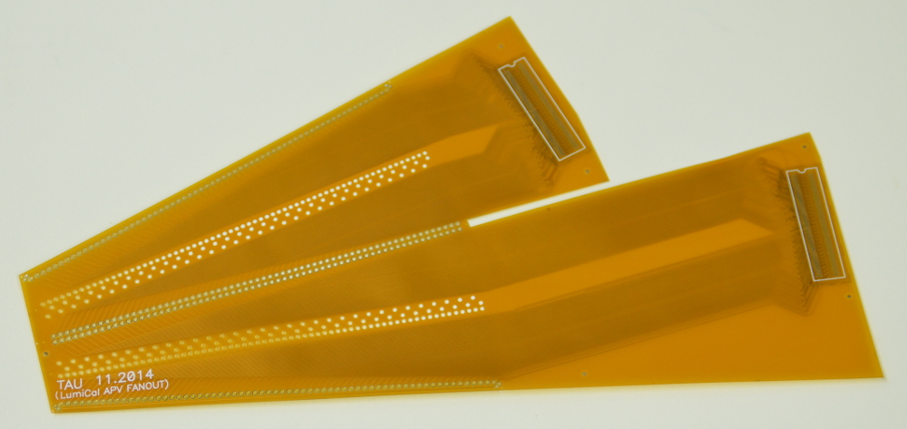
HV and Fan-out kapton
The thickness of the HV kapton is 90 μm.
90
Thickness, μm
connectors
Thickness of fan-out varies in different areas from
129 μm to 158 μm
It includes connectors for the front end boards
141
138
139
136
129
158
144

Slide 6
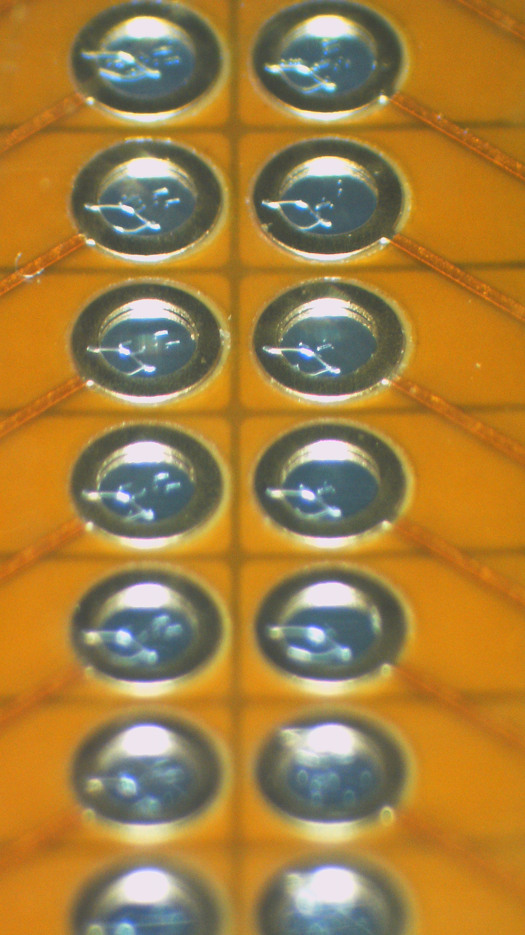
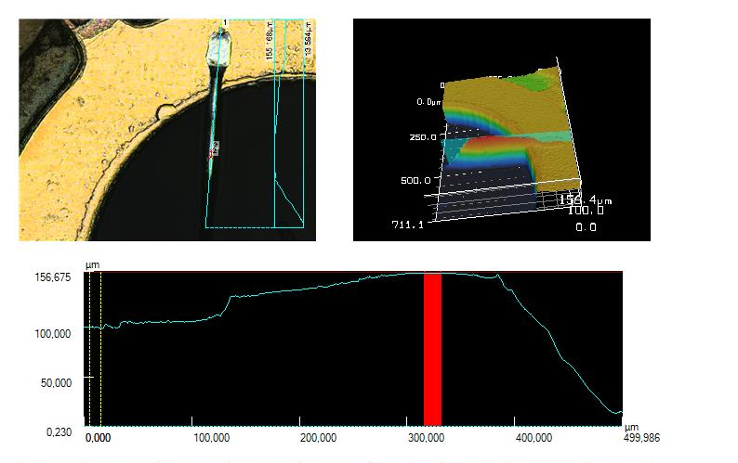
Gluing and bonding expertise
Expertise in glue deposition to have really thin and homogenous glue layer
In order to stay as thin as possible, necessary to have very small bonding loop
Produced TAB bonding fan out. Will be test soon

Slide 7
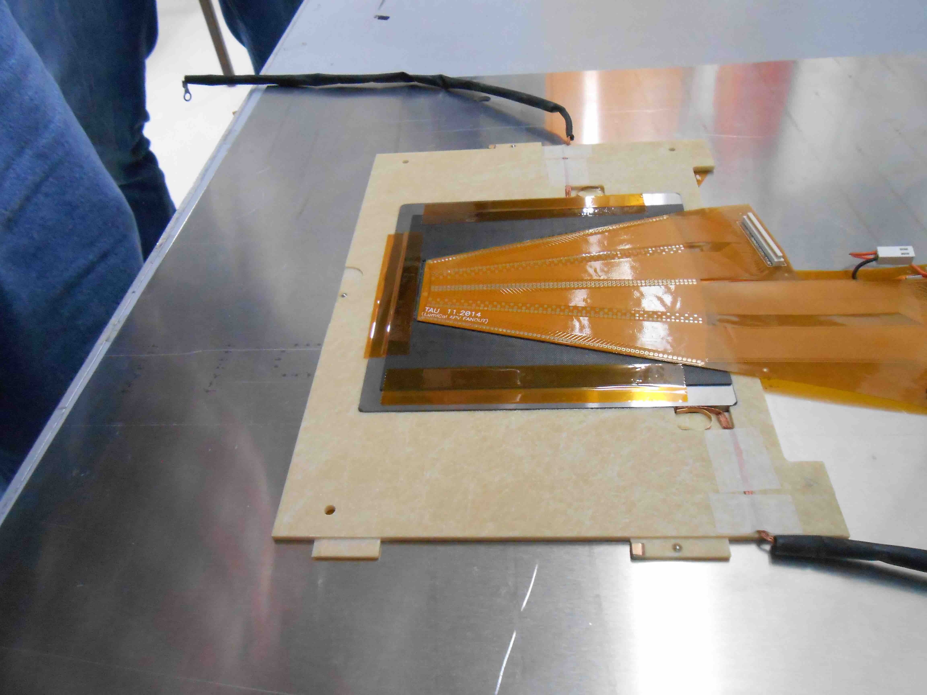
results
We succeeded to build a sub mm sensor fully equipped (~800μm)
Four complete planes have been tested in october 2015 test beam

Slide 8
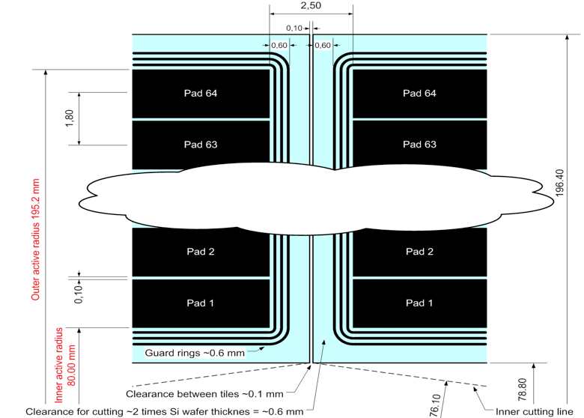
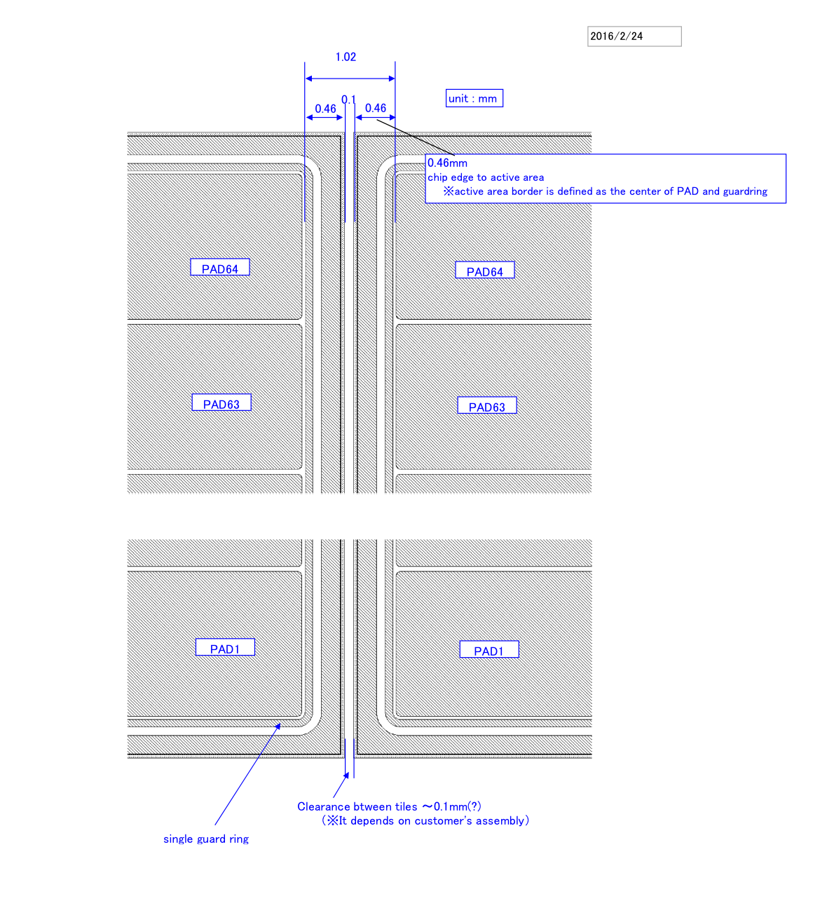
Edgeless sensor
Some study ongoing with Hamamatsu to avoid dead area at the edges
Old design
New design

