Slide 1
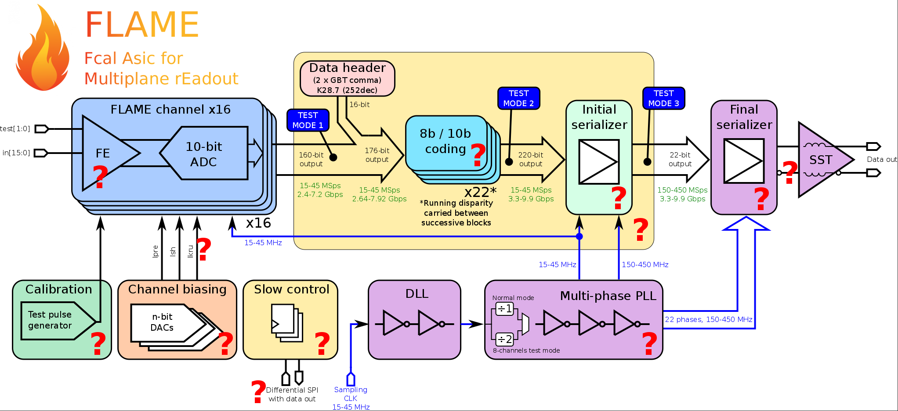
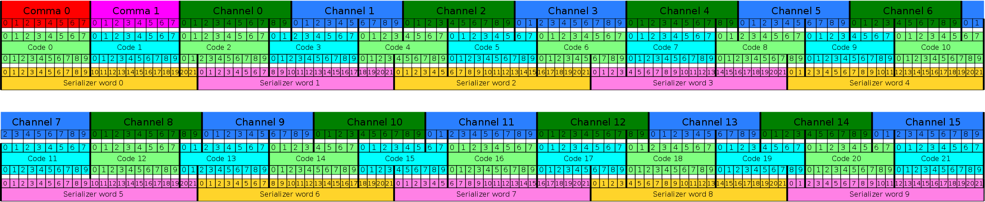
AIDA-2020 (WP14 / Task 14.3)
IFJPAN – Specialized DAQ module system
AGH-UST – the new readout board project
Data received
from many
individual ASICs
decoder
buffers
buffers
buffers
output
decoder
decoder
decoder
DAQ system is based on FPGA
Data received from FLAME ASICs readout system (AGH-UST) are decoded, added header information (board id, channel id, counter, etc), packed and sent ( by Ethernet) to storage / common DAQ system
The structure of the Asic data: 16 channels(word) 10-bit ADC system

Slide 2
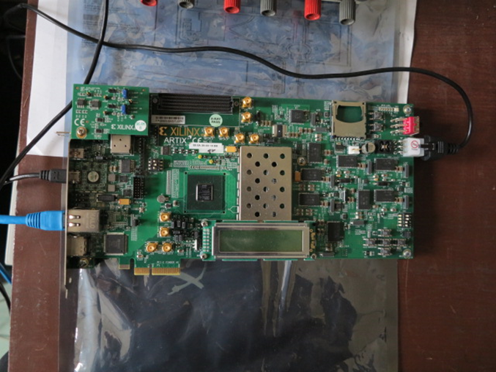
Protype board with FPGA (XILINX )
Work on a module of the DAQ system goes on using Xilinx
software Vivado and is concentrated on the basic steps:
• Test data processing with the structure input data close
to ASIC output
• Attempt to use the real data after connection to
AGH-UST ASIC board
Prototype board: containing FPGA - Artix-7 XC7A200T (XILINX)
and 8 GTP serial-type links allowing
for data transfer with the speed up to 6.6 Gb/sec
The final prototype will probably require a new board with FPGA with a higher speed serial link type:
GTX /GTH (12.5/13.1 Gb/s) to increase the maximum sampling rate from 30 MHz (with existing FPGA) to 45 MHz

