Slide 1
Stripline BPM resolution vs. charge
N. Blaskovic
N. Blaskovic

Slide 2
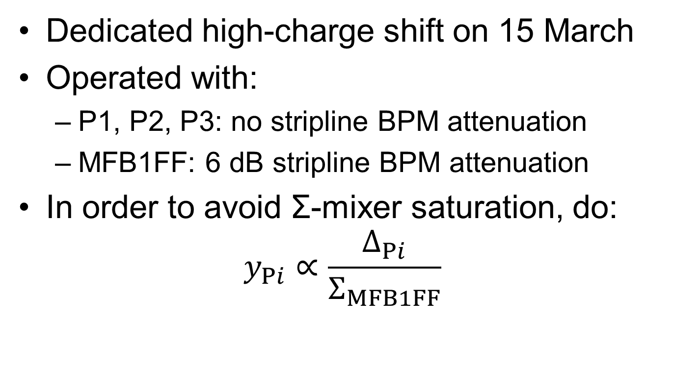
Stripline BPM setup
Dedicated high-charge shift on 15 March
Operated with:
  P1, P2, P3: no stripline BPM attenuation
  MFB1FF: 6 dB stripline BPM attenuation
In order to avoid Σ-mixer saturation, do:
$y_{Pi}∝\frac{Δ_{Pi}}{Σ_{MFB1FF}}$
N. Blaskovic

Slide 3
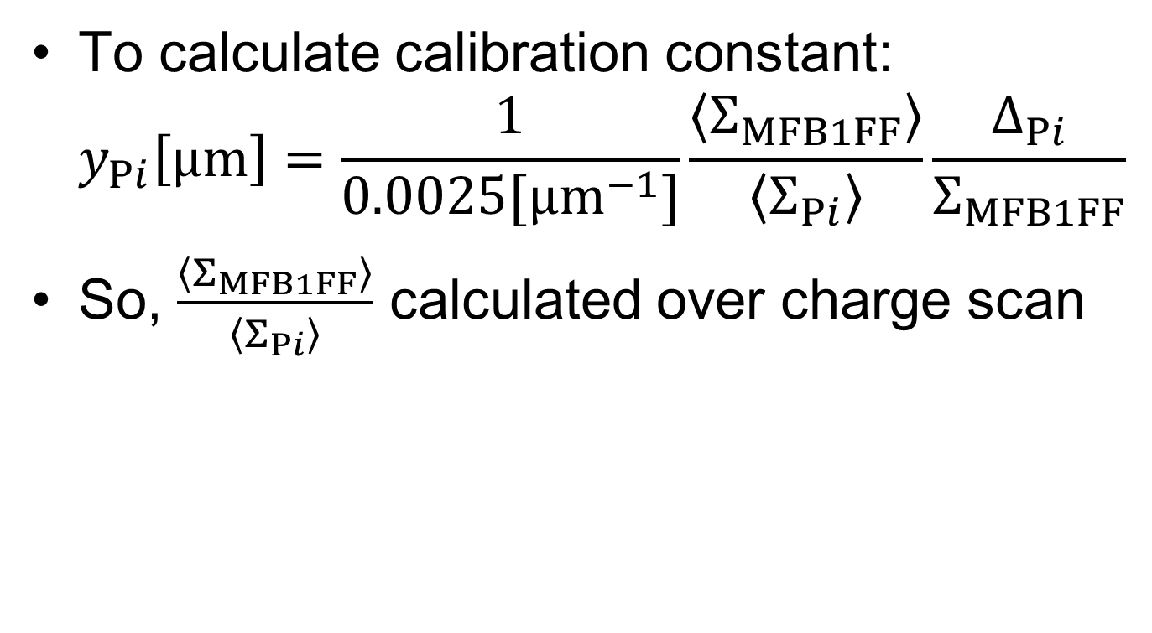
Calibration constant
To calculate calibration constant:
$y_{Pi}\left[μm\right]=\frac{1}{0.0025[μm^{−1}]}\frac{\left\langle Σ_{MFB1FF}\right\rangle }{\left\langle Σ_{Pi}\right\rangle }\frac{Δ_{Pi}}{Σ_{MFB1FF}}$
So, $\frac{\left\langle Σ_{MFB1FF}\right\rangle }{\left\langle Σ_{Pi}\right\rangle }$ calculated over charge scan
N. Blaskovic

Slide 4
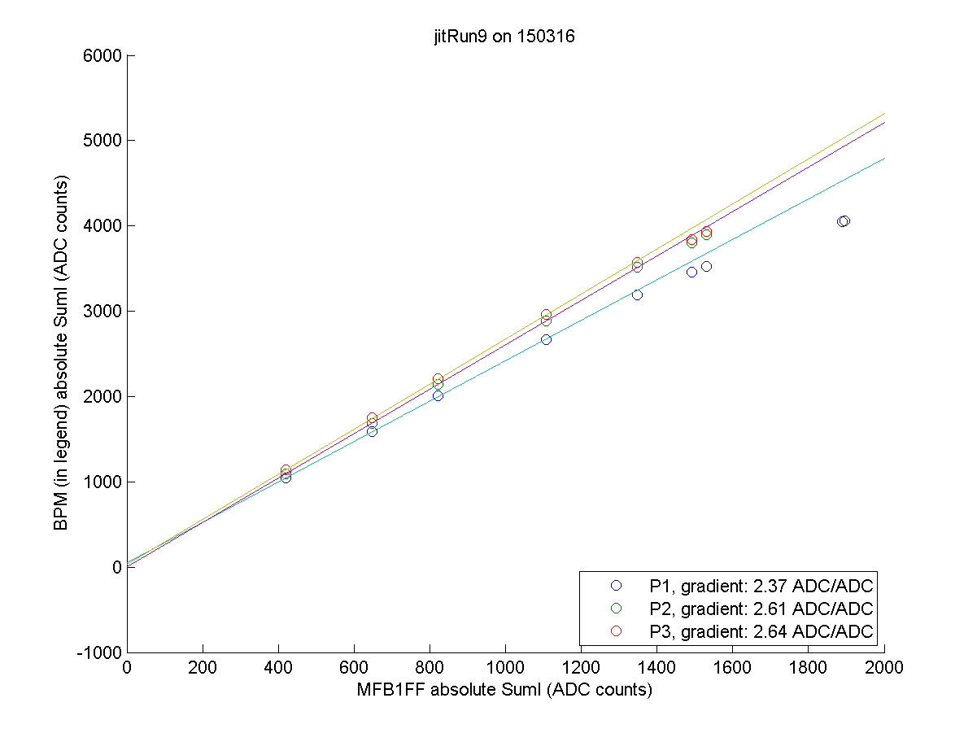
N. Blaskovic

Slide 5

Resolution
Resolution calculated using
$y_{Pi}∝\frac{Δ_{Pi}}{Σ_{MFB1FF}}$
over charge scan
N. Blaskovic

Slide 6
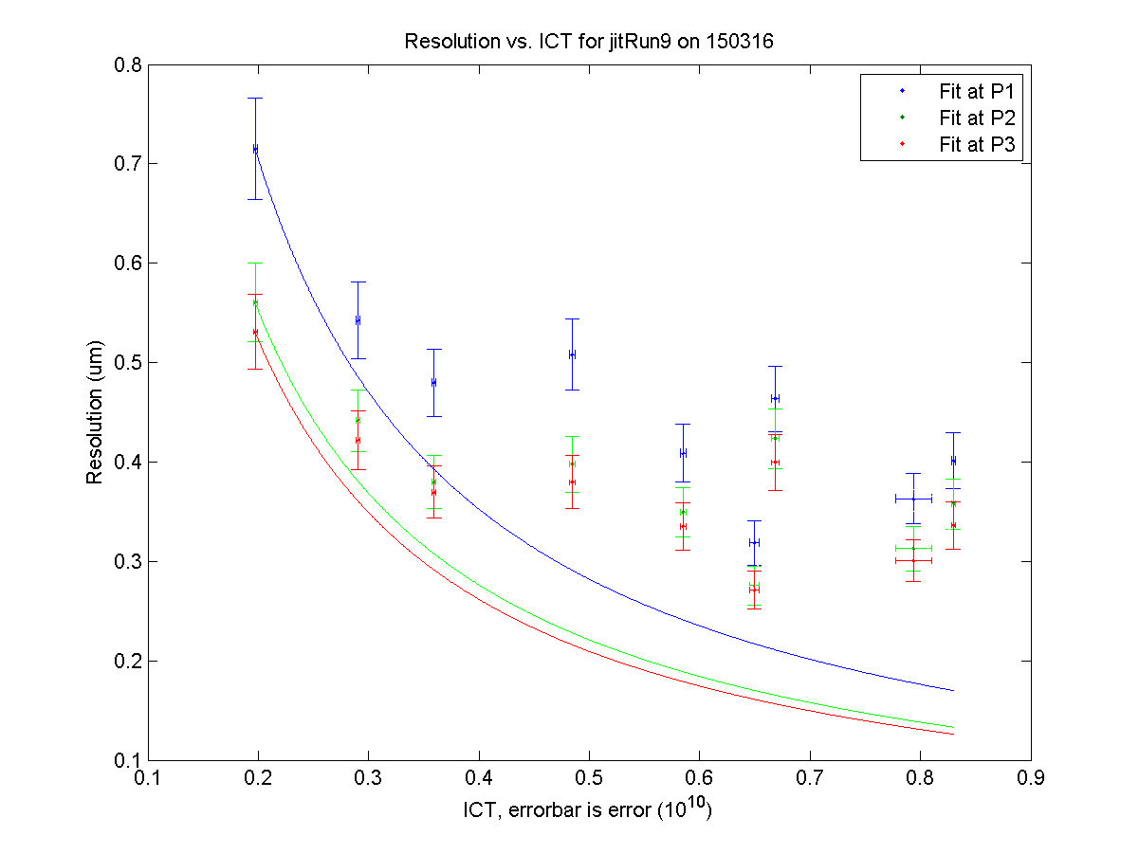
N. Blaskovic

Slide 7

Resolution
Resolution calculated using conventional
$y_{Pi}∝\frac{Δ_{Pi}}{Σ_{Pi}}$
over same charge scan
N. Blaskovic

Slide 8
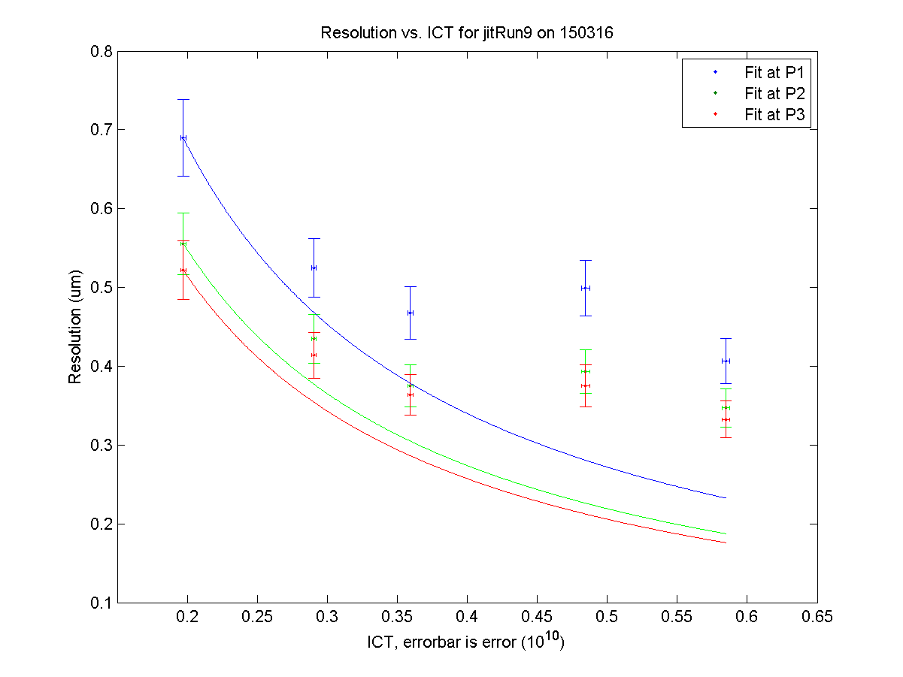
N. Blaskovic

