Slide 1
Status of the FONT feedback systems
N. Blaskovic, T. Bromwich, P. Burrows, G. Christian, C. Perry, R. Ramjiawan
FONT, John Adams Institute, Oxford University
N. Blaskovic

Slide 2
Contents
Intra-train feedback at a linear collider
ILC requirements
FONT feedback systems at ATF:
‘Upstream’ system using stripline BPMs
‘IP region’ system using cavity BPMs
N. Blaskovic

Slide 3
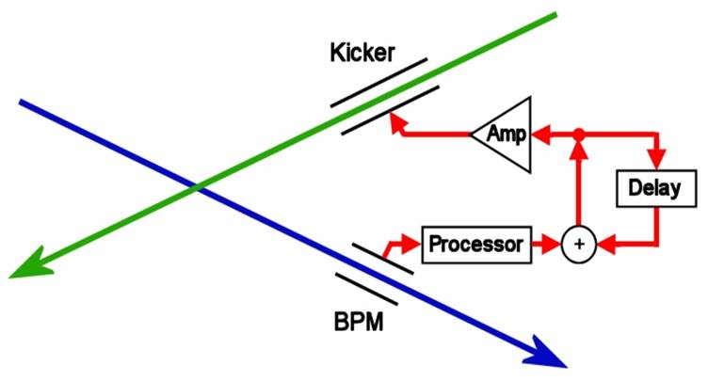
Intra-train feedback
An intra-train feedback system is required to maintain collisions at a linear collider
Misaligned beams at interaction point (IP) cause beam-beam deflection
Measure deflection on one of outgoing beams
(beam position monitor)
Correct orbit of next bunch
N. Blaskovic

Slide 4
Intra-train feedback
The FONT intra-train feedback system:
Measures the position of bunch 1
Processes on an FPGA-based FONT5 board
Corrects the position of bunch 2
ILC requirements:
Beam stability: < 1 um (at the BPM)
Latency: < 554 ns
N. Blaskovic

Slide 5
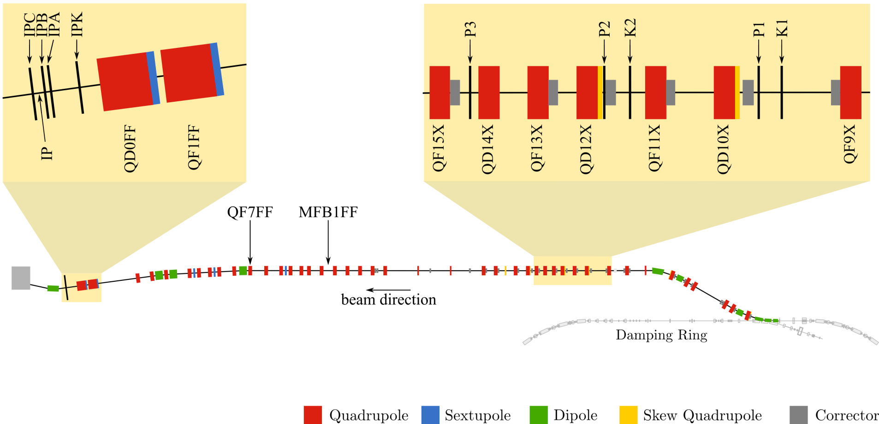
Extraction and final focus lines
‘IP region’
‘upstream’ FONT system
based on figure from G. White et al. (PRL, 2014)
N. Blaskovic

Slide 6
ATF upstream system using stripline BPMs
N. Blaskovic

Slide 7
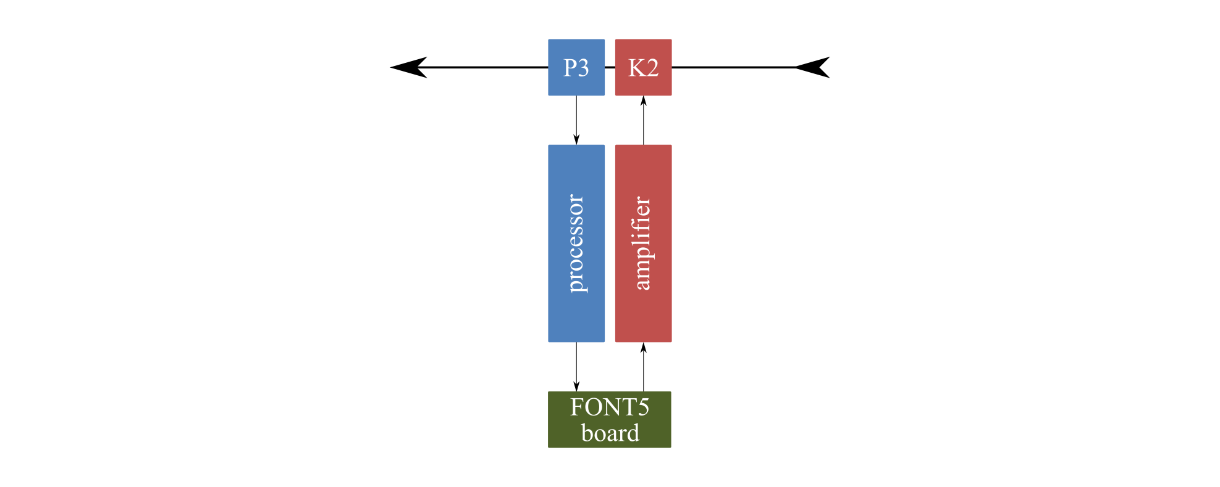
Single-loop feedback
P3 used to drive K2 in single-loop mode
Used to demonstrate ILC IP feedback
N. Blaskovic

Slide 8
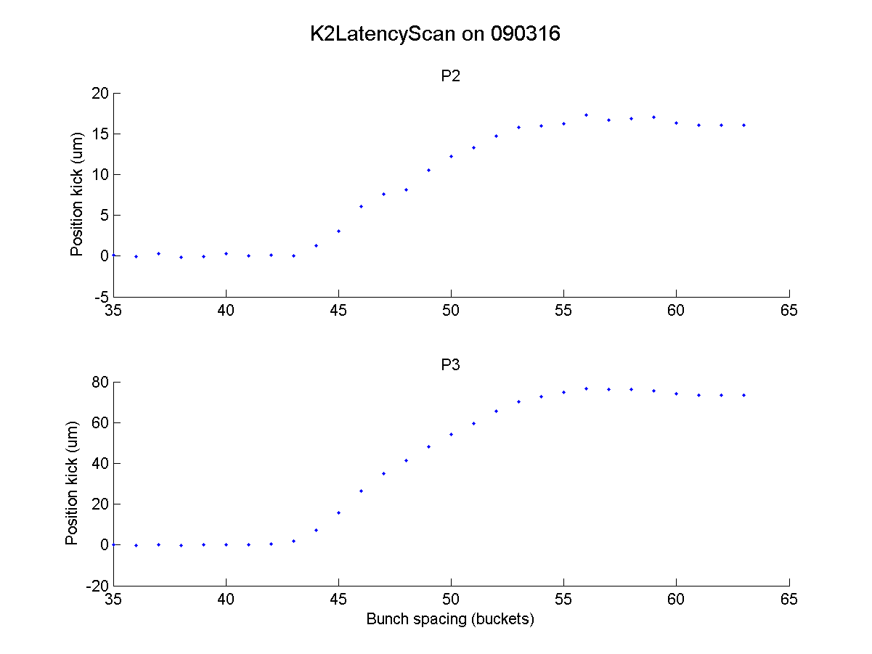
Latency
Latency: 55 buckets (154 ns)
Meets ILC requirement
N. Blaskovic

Slide 9
Single-loop feedback
3-bunch trains with 154 ns bunch spacing
Bunch charge: ~0.5 x 10¹⁰ electrons
No stripline BPM attenuation
3-BPM resolution: ~300 nm (using fitting)
Best bunch-to-bunch correlation: 98% (P3)
N. Blaskovic

Slide 10
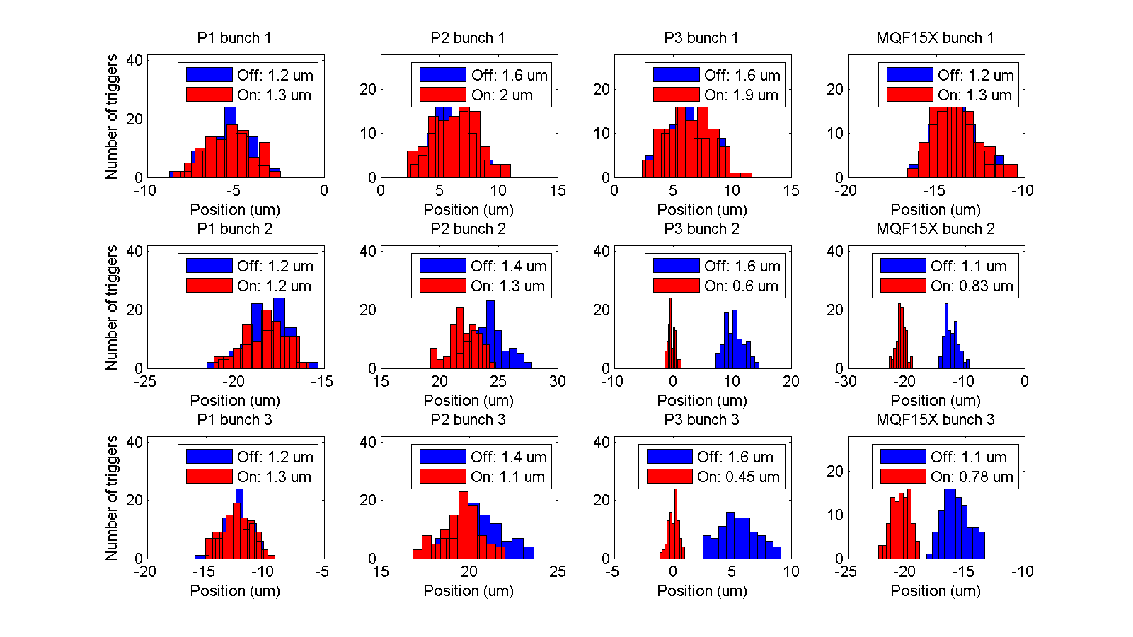
typical
Incoming bunch jitter ~ 2 um
Bunch 2 stabilised to 600 nm
Bunch 3 stabilised to 450 nm
Meets ILC requirement
N. Blaskovic

Slide 11
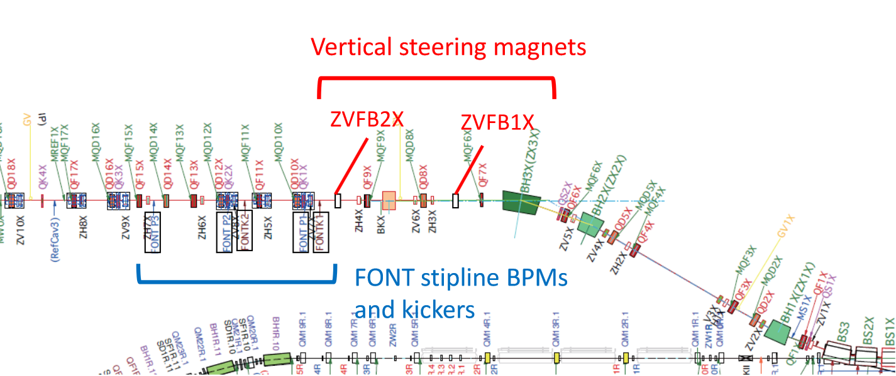
Random jitter source
Random jitter introduced pulse-to-pulse using ZVFB1X & ZVFB2X
from Y. Kano

Slide 12
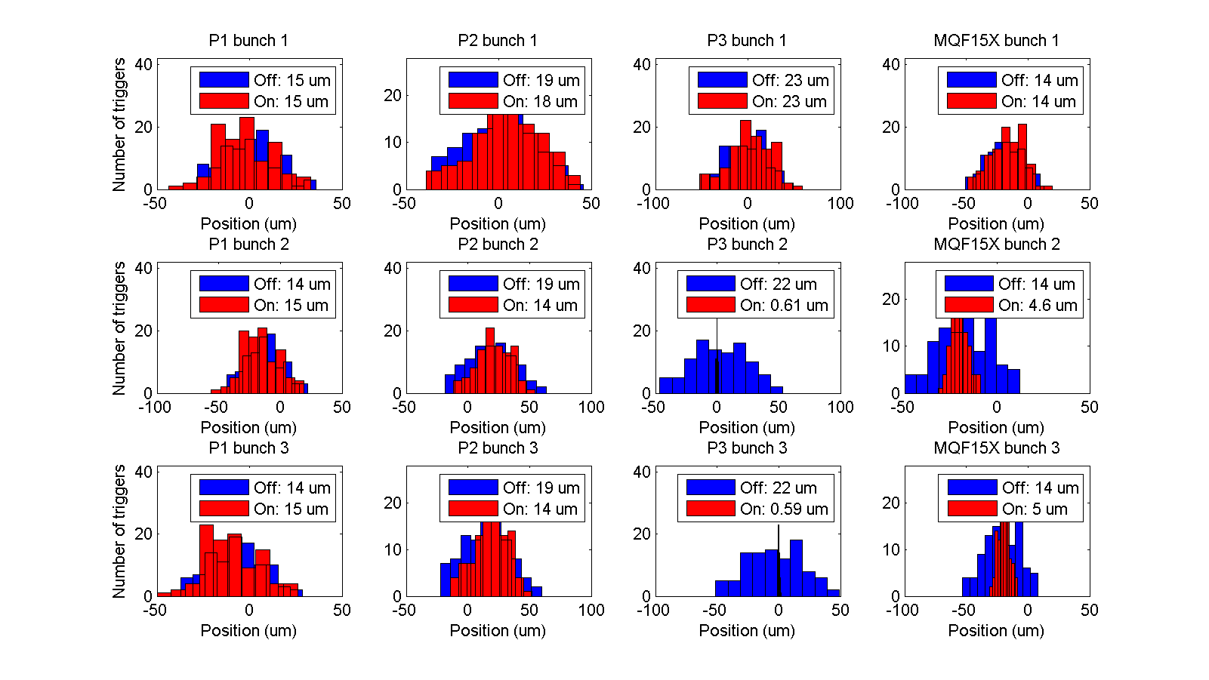
typical
+ jitter
N. Blaskovic

Slide 13
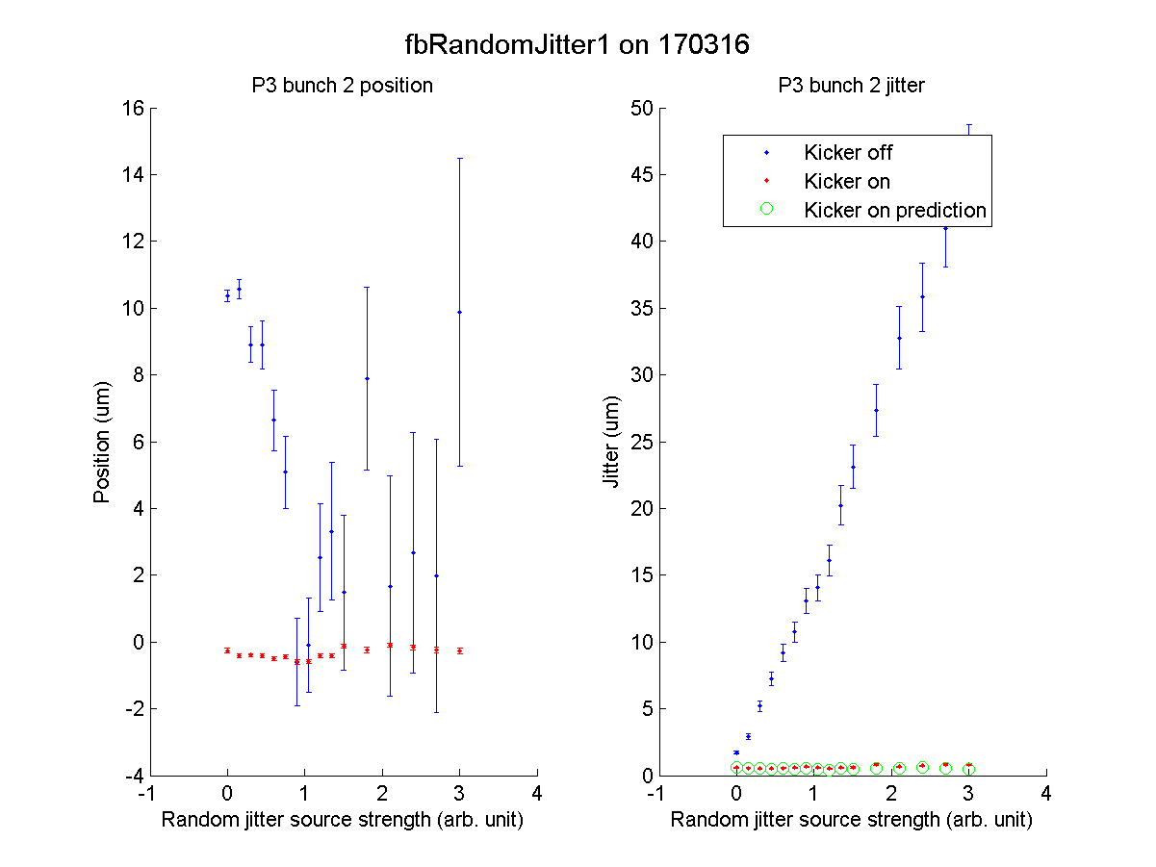
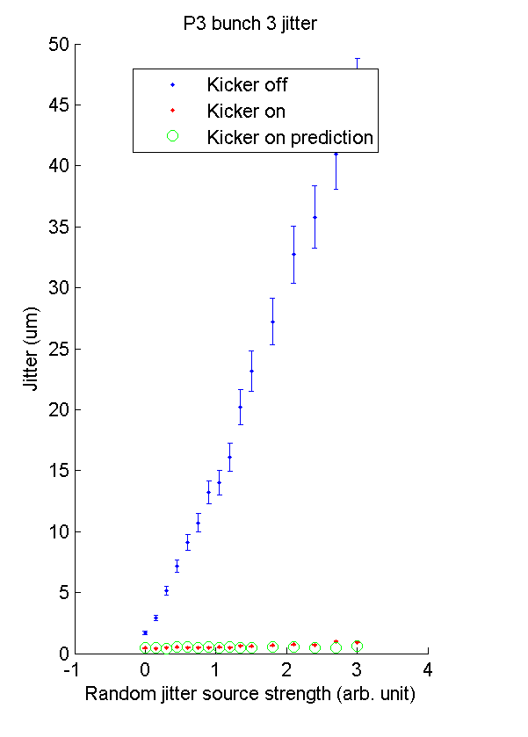
Results agree with expected performance (in green)

Slide 14
Orbit scan
Orbit scan performed using corrector ZV6X located upstream of FONT system
3-bunch feedback performance tested over a dynamic range of ±50 um
N. Blaskovic

Slide 15
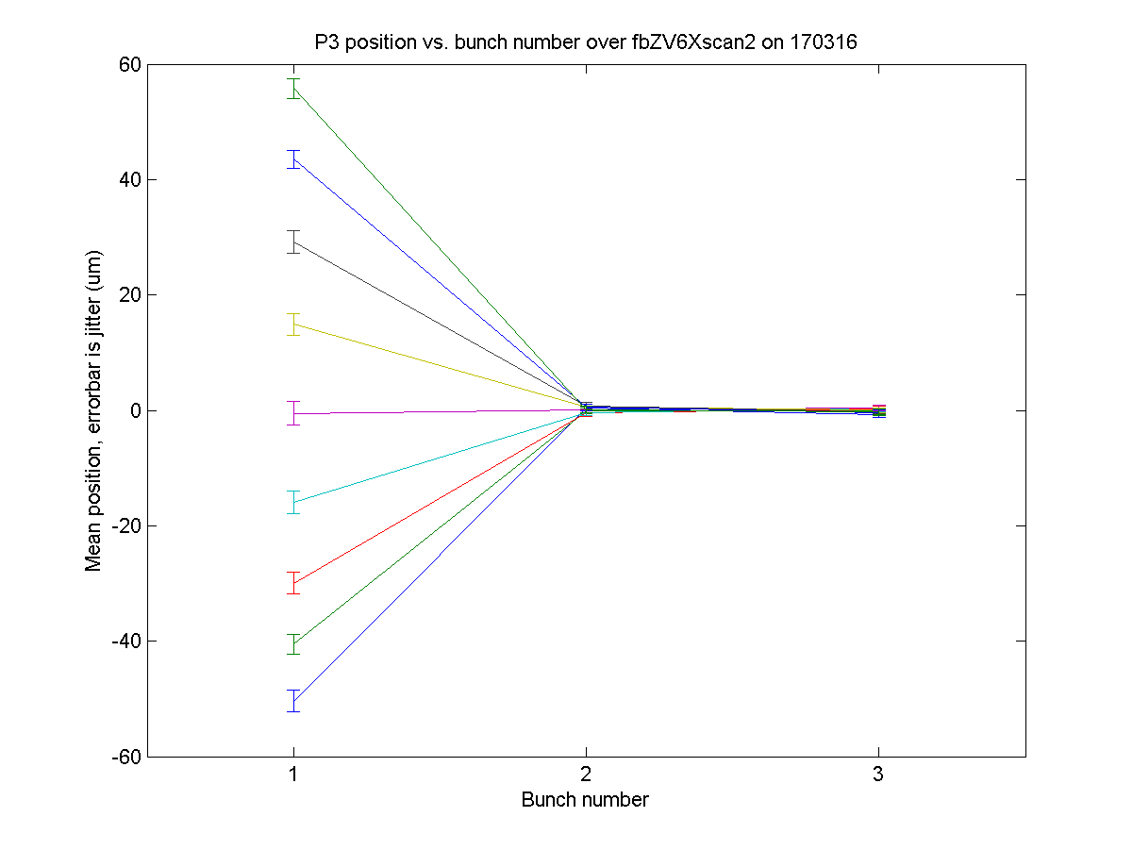
P3
N. Blaskovic

Slide 16
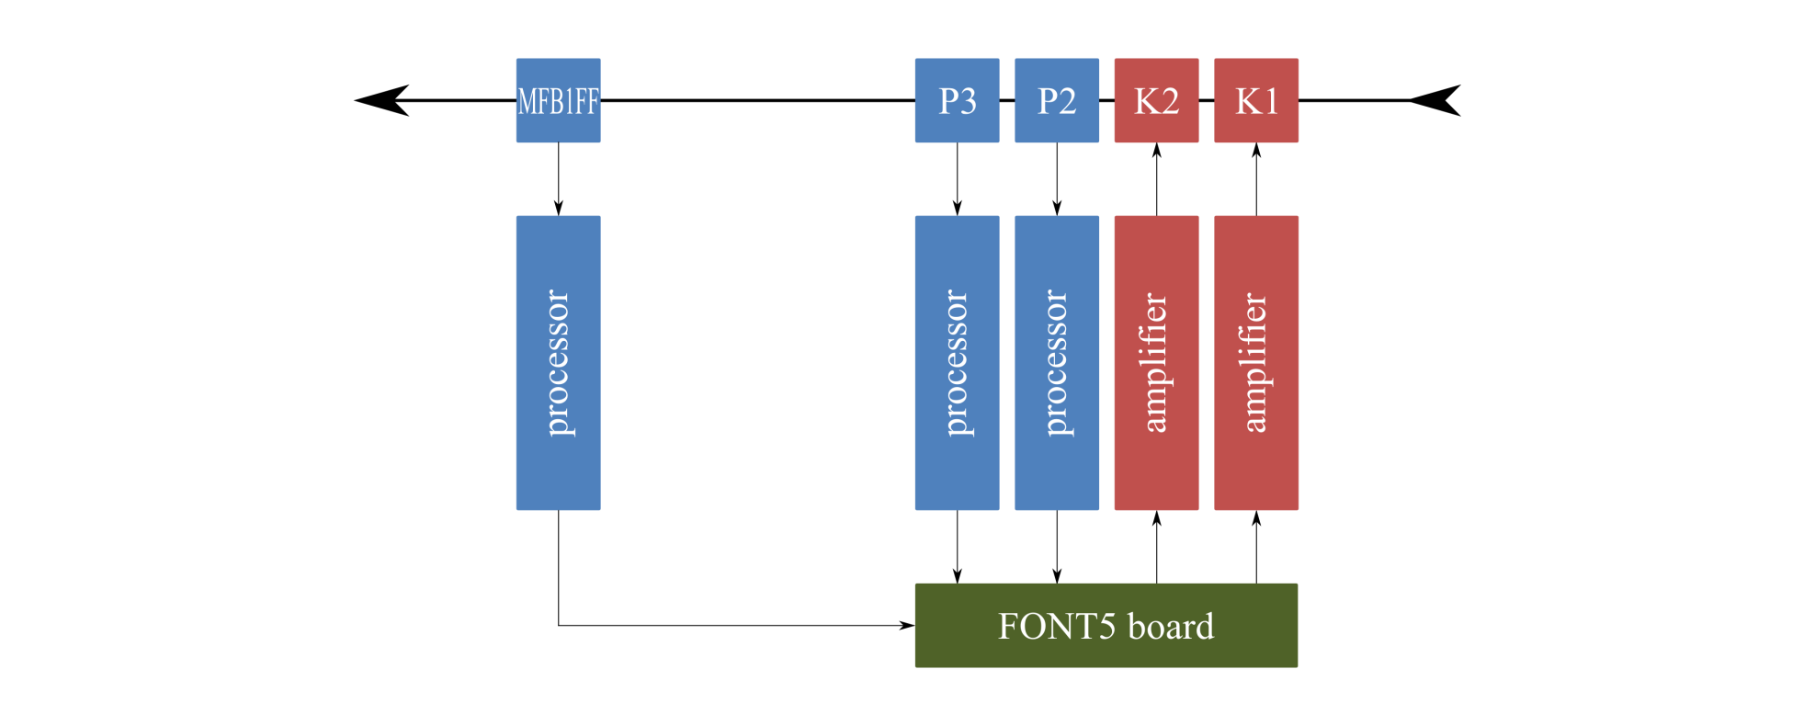
Coupled-loop feedback
P2 & P3 used to drive K1 & K2
Beam position and angle stabilisation
N. Blaskovic

Slide 17
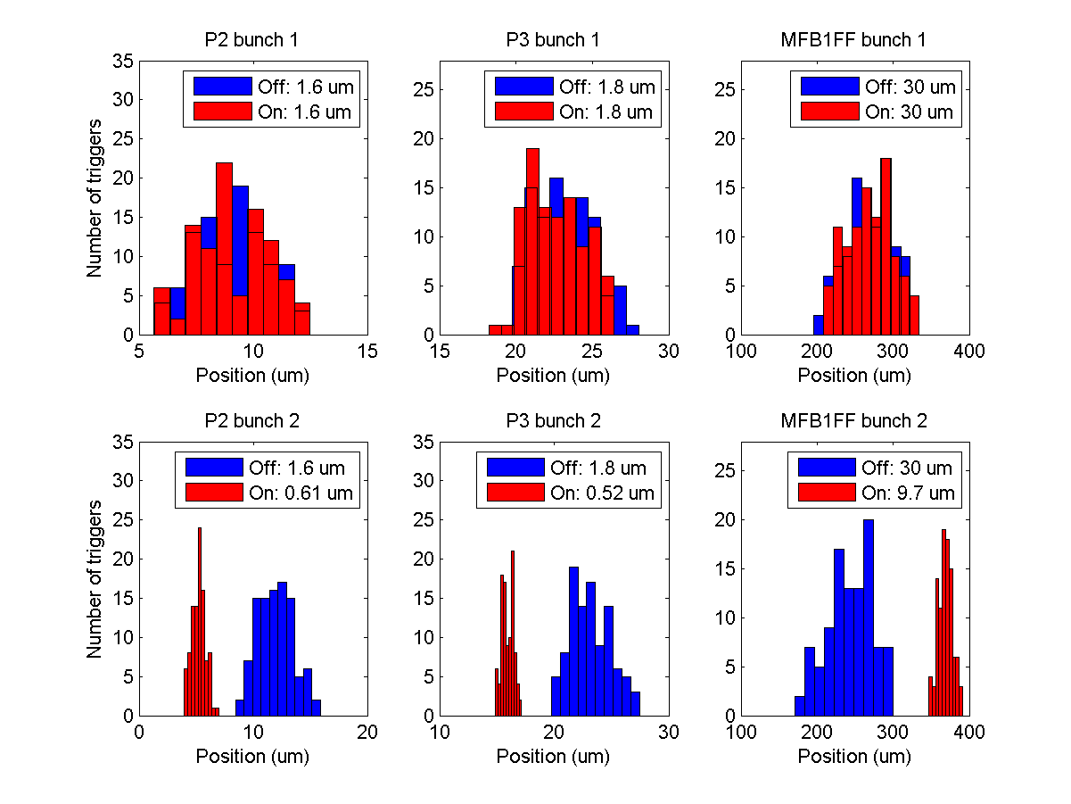
Stabilise the beam to ~600 nm at both feedback BPMs
N. Blaskovic

Slide 18
Factor 3 reduction in jitter propagates to MFB1FF
N. Blaskovic

Slide 19
ATF IP system using cavity BPMs
N. Blaskovic

Slide 20
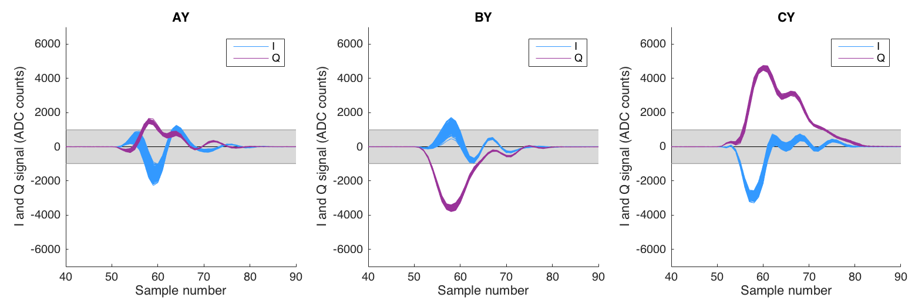
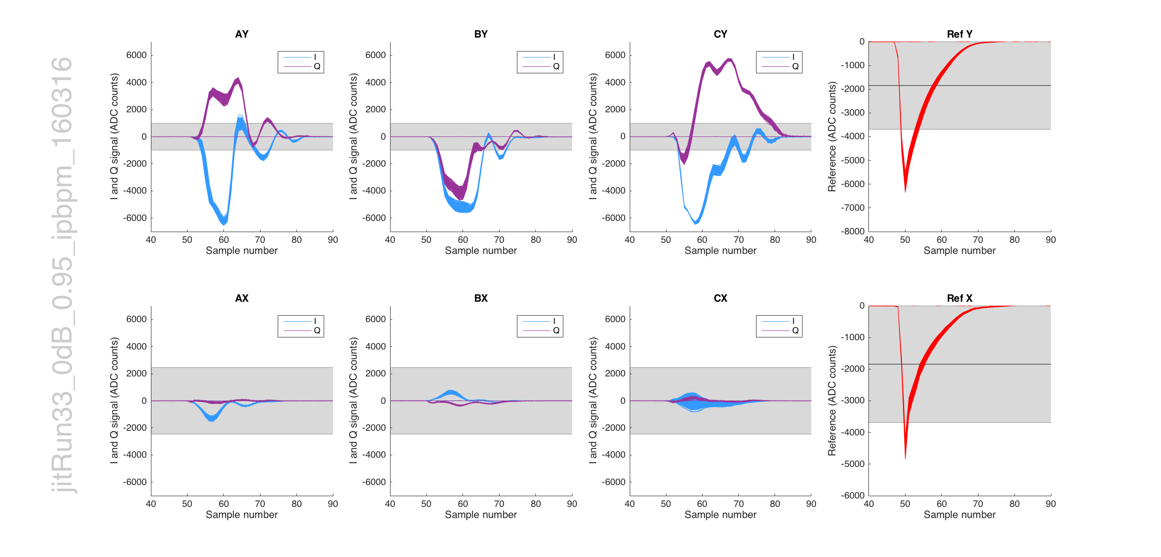
Waveforms
10 dB
Dynamic range ± 0.3 V (3 um)
0 dB
Dynamic range ± 0.3 V (3 um)
Signals exceed dynamic range!
Plots by T. Bromwich

Slide 21
3-BPM resolution
Parameter | Geometric | Fitting
Y1I’ | ✓ | ✓ | ✓ | ✓
Y2I’ | ✓ | ✓ | ✓ | ✓
Constant |  | ✓ | ✓ | ✓
Y1Q’ |  |  | ✓ | ✓
Y2Q’ |  |  | ✓ | ✓
YREF |  |  |  | ✓
Resolution (nm) at 10 dB | 161 ± 1 | 85 ± 2 | 49.3 ± 1.2 | 40.7 ± 0.6
Resolution (nm) at 0 dB | 90 ± 1 | 27 ± 1 | 13.3 ± 0.3 | 12.3 ± 0.3
Q’ is key
Analysis by T. Bromwich

Slide 22

Cavity BPM feedback
IPB used to drive IPK in single-loop mode
Working towards nanometre level stability
N. Blaskovic

Slide 23
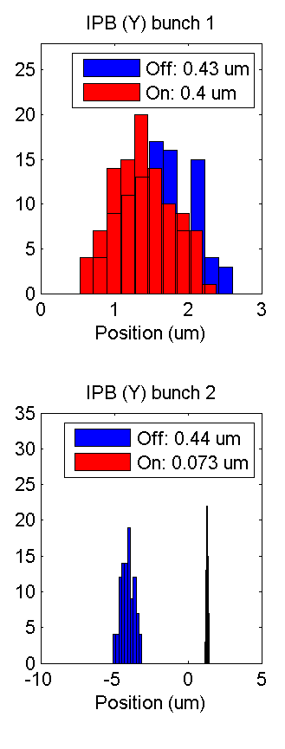
Stabilising from ~400 nm to 73 nm

Slide 24
Conclusions
Single-loop stripline BPM feedback system meets ILC stability & latency requirements
Coupled-loop stripline BPM feedback used for beam position & angle stabilisation
Cavity BPMs have resolution < 50 nm
Cavity BPM feedback system stabilises to < 75 nm
N. Blaskovic

Slide 25
Appendix
N. Blaskovic

Slide 26
Latency
Latency scan performed:
Feedback algorithm is initiated on measuring signal from first bunch
Apply a constant kick to the second bunch
Measure kick as a function of bunch spacing
K2–P3 latency ~ 55 buckets (154 ns)
Allows 3-bunch operation with 154 ns bunch spacing
N. Blaskovic

Slide 27
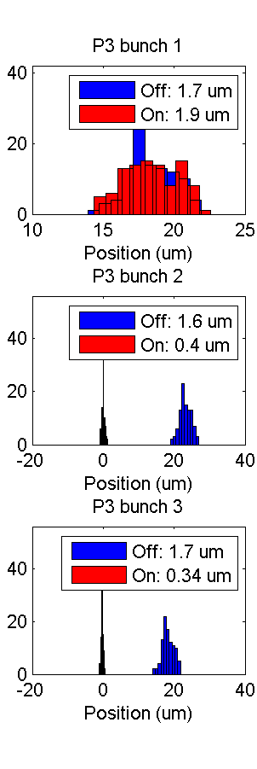
best
typical
+ jitter
N. Blaskovic

Slide 28
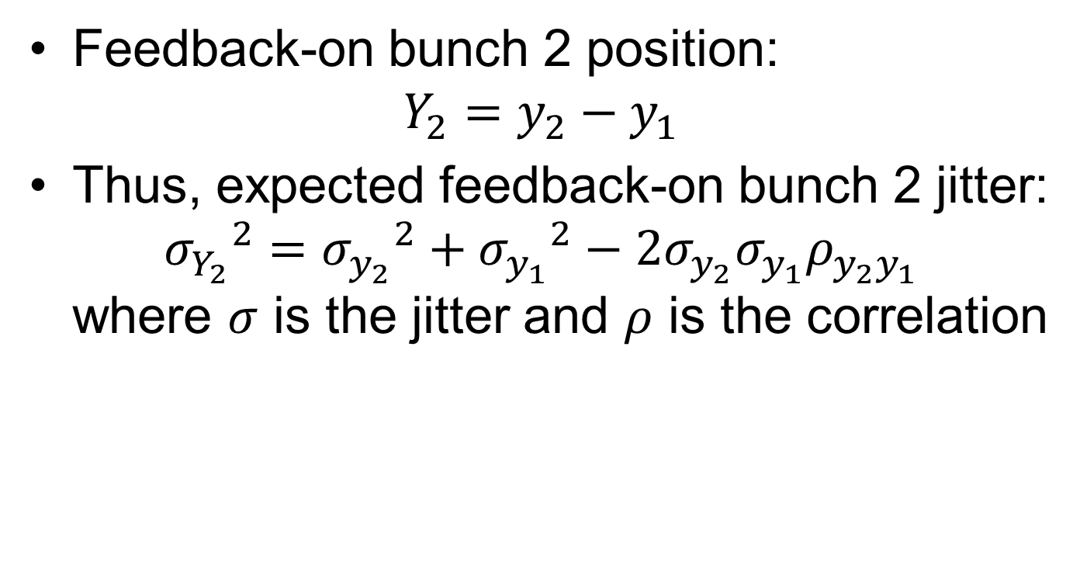
Feedback performance
Feedback-on bunch 2 position: $Y_{2}=y_{2}−y_{1}$
Thus, expected feedback-on bunch 2 jitter: ${σ_{Y_{2}}}^{2}={σ_{y_{2}}}^{2}+{σ_{y_{1}}}^{2}−2σ_{y_{2}}σ_{y_{1}}ρ_{y_{2}y_{1}}$ where $σ$ is the jitter and $ρ$ is the correlation
N. Blaskovic

Slide 29
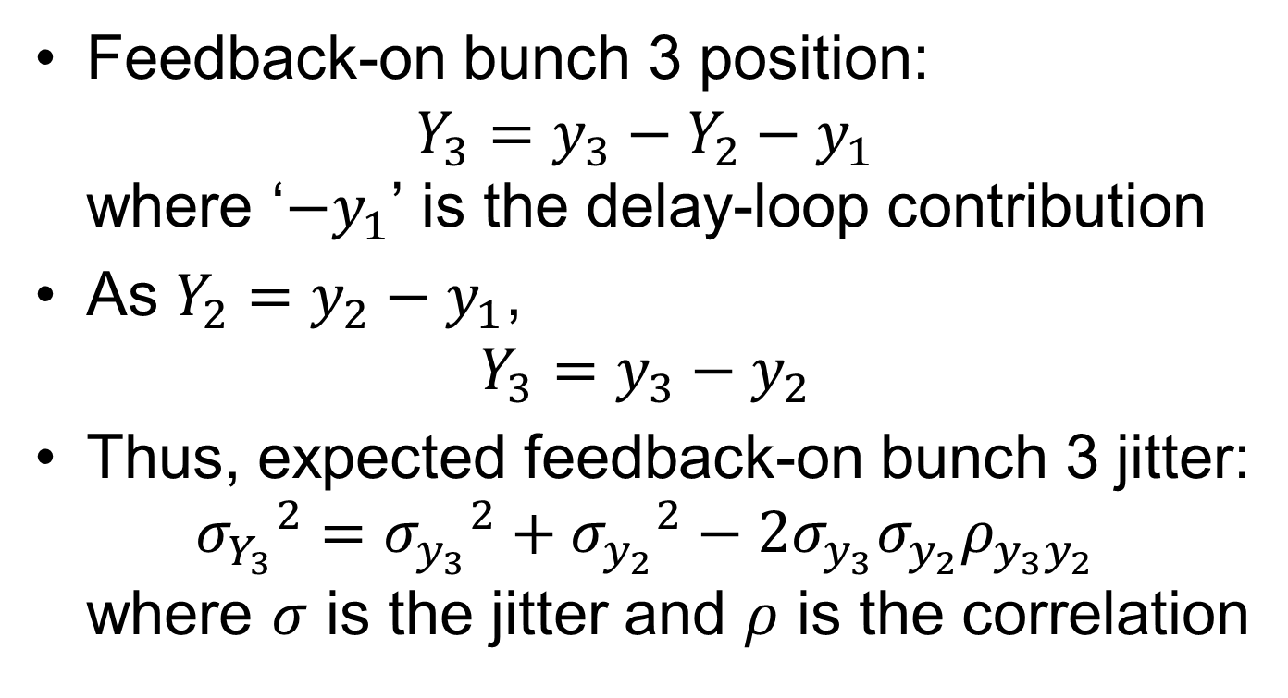
Feedback performance
Feedback-on bunch 3 position: $Y_{3}=y_{3}−Y_{2}−y_{1}$ where ‘$−y_{1}$’ is the delay-loop contribution
As $Y_{2}=y_{2}−y_{1}$, $Y_{3}=y_{3}−y_{2}$
Thus, expected feedback-on bunch 3 jitter: ${σ_{Y_{3}}}^{2}={σ_{y_{3}}}^{2}+{σ_{y_{2}}}^{2}−2σ_{y_{3}}σ_{y_{2}}ρ_{y_{3}y_{2}}$ where $σ$ is the jitter and $ρ$ is the correlation
N. Blaskovic

