Slide 1
When Beams Collide Better single and two-beam tuning with improved tuning procedures.
Ryan Bodenstein
Jochem Snuverink
ECFA Workshop 2016 – Santander
Friday, June 3, 2016

Slide 2
Before I begin…
I’d like to make clear that the development and coding of most of the work presented has been done primarily by Jochem Snuverink.
I mainly assisted this work through running simulations and analyzing data.
Jochem will be starting at PSI in July, so I plan to take over where he has left off (at least to the best of my ability).

Slide 3
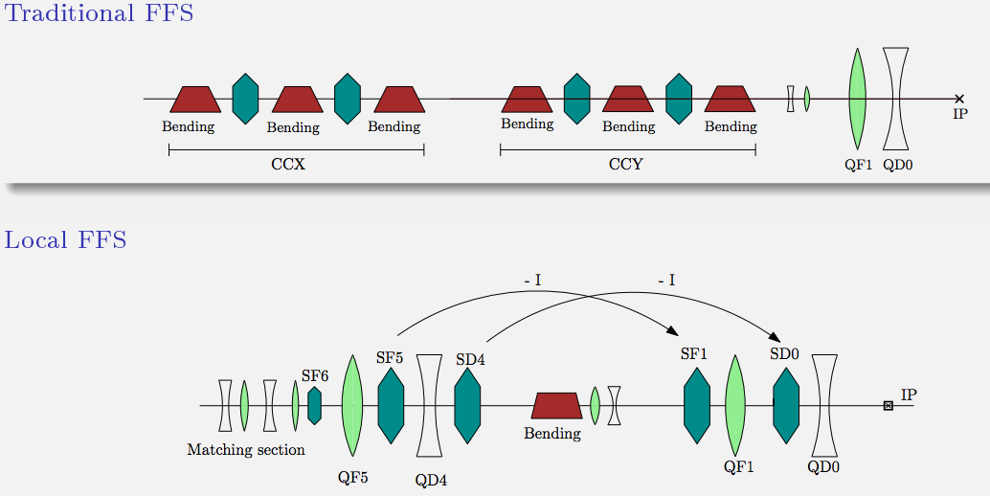
And now, some background
Two separate sections for chromaticity correction
Lattice by Hector Garcia, see e.g. his talk at CLIC WS 2014
Relatively simple system for design and analysis

Slide 4
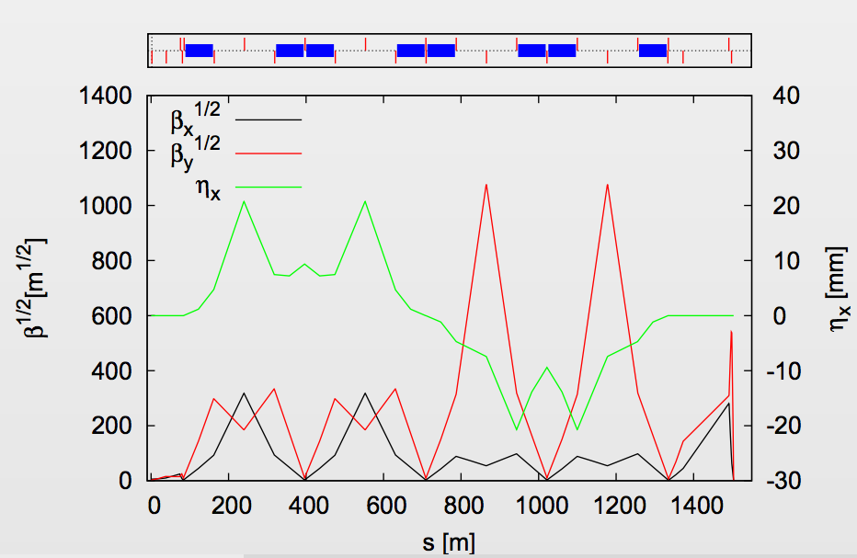
Traditional Final Focus
Parameter | Unit | Traditional “Optimized” | Local
Length | m | 1460 | 450
Total Luminosity | cm⁻²s⁻¹ | 7.5 * 10³⁴ | 7.8 * 10³⁴
Peak (1%) Luminosity | cm⁻²s⁻¹ | 2.4 * 10³⁴ | 2.4 * 10³⁴
Optimized lattice achieves similar luminosity as local scheme.

Slide 5
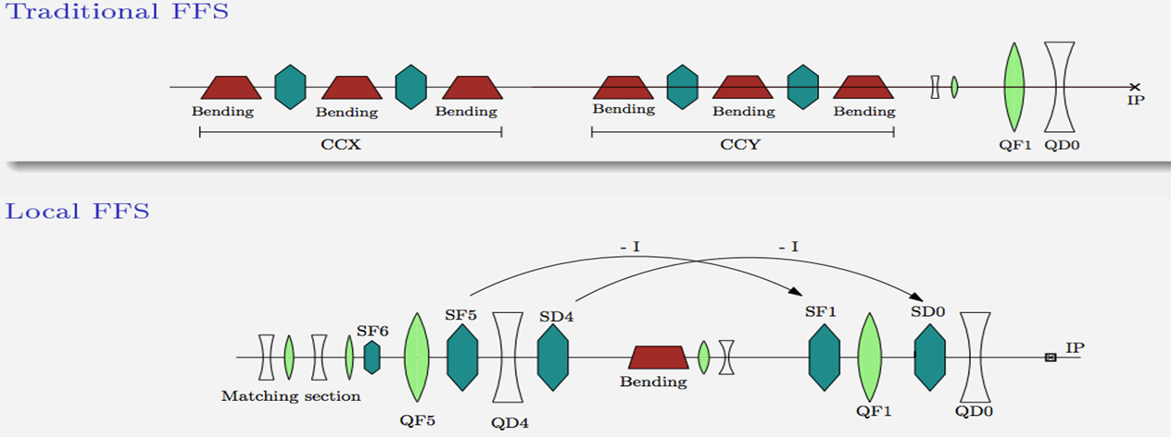
What was the tuning procedure?
Looking at the traditional final focus system, with 3 TeV collision energy.
Simulations using PLACET and GUINEA-PIG
Apply static offsets in x and y plane (10 µm RMS, 10 nm BPM resolution), then:
Dispersion Free Steering – 1
Tuning Knobs – 1
Dispersion Free Steering – 2
Tuning Knobs - 2
1-2-1 Tuning
Final shot to maximize Luminosity
Bring dispersion back toward design
Maximize Luminosity
Bring dispersion to design values
First step applied to uncorrected beam

Slide 6
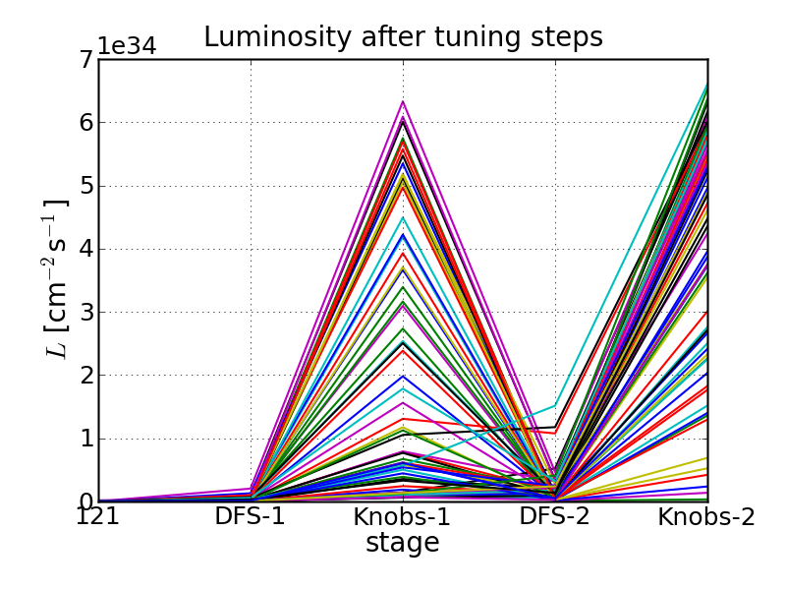
Step by step…
Apply the first corrections to the uncorrected beam
There are actually points there, but on this plot they barely show up.
Dispersion Free Steering – 1
Tuning Knobs – 1
Dispersion Free Steering – 2
Tuning Knobs - 2
1-2-1 Tuning
Final shot to maximize Luminosity
Bring dispersion back toward design
Maximize Luminosity
Bring dispersion to design values
First step applied to uncorrected beam

Slide 7
Step by step…
Apply the first corrections to the uncorrected beam
Correct the dispersion to approach design values
Dispersion Free Steering – 1
Tuning Knobs – 1
Dispersion Free Steering – 2
Tuning Knobs - 2
1-2-1 Tuning
Final shot to maximize Luminosity
Bring dispersion back toward design
Maximize Luminosity
Bring dispersion to design values
First step applied to uncorrected beam

Slide 8
Step by step…
Apply the first corrections to the uncorrected beam
Correct the dispersion to approach design values
Use the tuning knobs to maximize luminosity
Dispersion Free Steering – 1
Tuning Knobs – 1
Dispersion Free Steering – 2
Tuning Knobs - 2
1-2-1 Tuning
Final shot to maximize Luminosity
Bring dispersion back toward design
Maximize Luminosity
Bring dispersion to design values
First step applied to uncorrected beam

Slide 9
Step by step…
Apply the first corrections to the uncorrected beam
Correct the dispersion to approach design values
Use the tuning knobs to maximize luminosity
Attempt to optimize dispersion again
Dispersion Free Steering – 1
Tuning Knobs – 1
Dispersion Free Steering – 2
Tuning Knobs - 2
1-2-1 Tuning
Final shot to maximize Luminosity
Bring dispersion back toward design
Maximize Luminosity
Bring dispersion to design values
First step applied to uncorrected beam

Slide 10
Step by step…
Apply the first corrections to the uncorrected beam
Correct the dispersion to approach design values
Use the tuning knobs to maximize luminosity
Attempt to optimize dispersion again
Maximize luminosity once more
Dispersion Free Steering – 1
Tuning Knobs – 1
Dispersion Free Steering – 2
Tuning Knobs - 2
1-2-1 Tuning
Final shot to maximize Luminosity
Bring dispersion back toward design
Maximize Luminosity
Bring dispersion to design values
First step applied to uncorrected beam

Slide 11
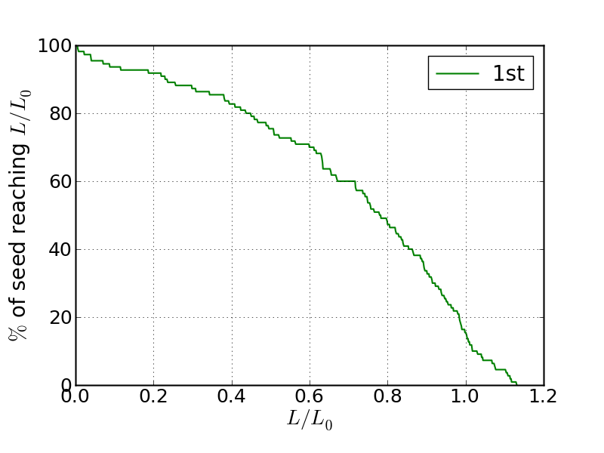
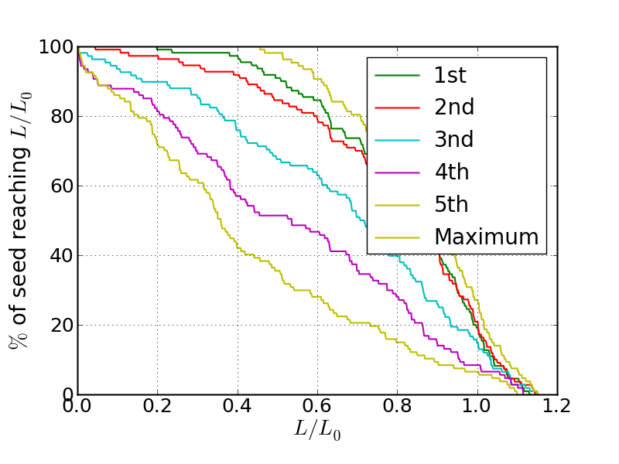
Unfortunately, this isn’t enough.
The goal is for 90% of seeds to reach 110%.
Doing multiple iterations, using the previous output as the input, surprisingly makes matters worse.

Slide 12
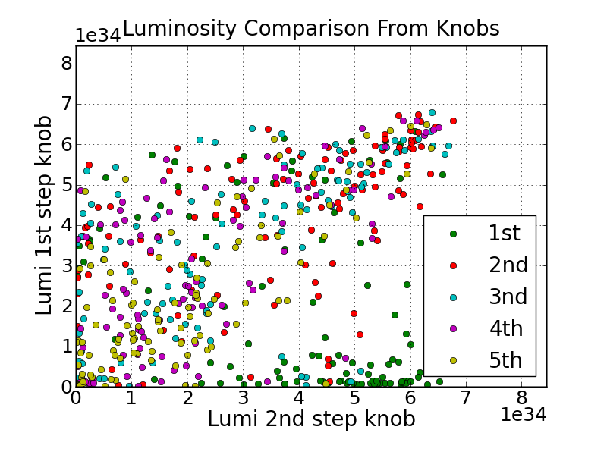
So, what’s the problem?

Slide 13
It turns out, the 2nd DFS step decreases the luminosity of many seeds.

Slide 14
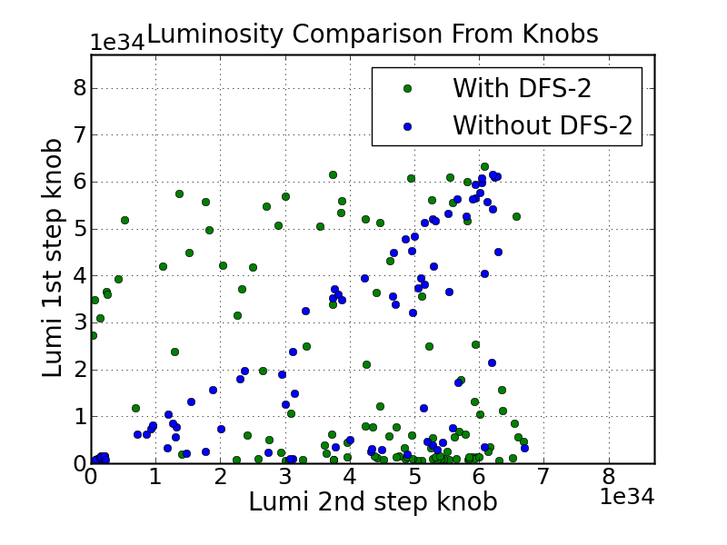
Tried simply skipping that step…

Slide 15
The Good

Slide 16
The Bad

Slide 17
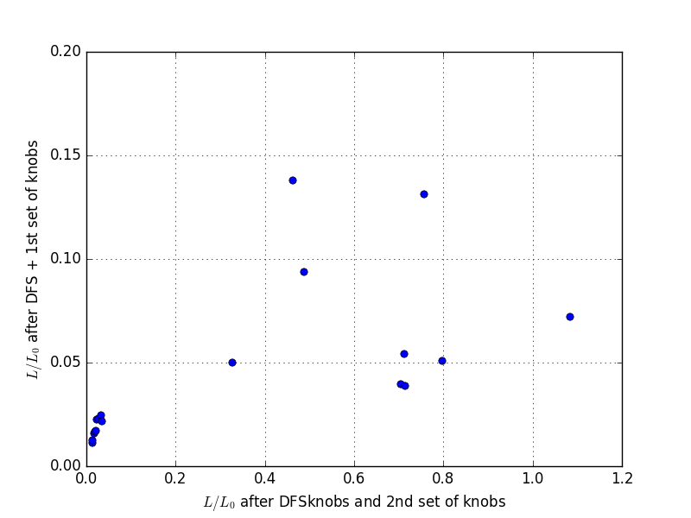
Zooming in on the low end…

Slide 18
What is to be done?
Cannot simply skip the 2nd DFS step.
Leaving it as it is will reduce the total luminosity achieved.
New DFS algorithm developed.

Slide 19
Developing new DFS knobs
2nd stage DFS is not always beneficial
Algorithm works very well without synchrotron radiation (SR)
Performance is degraded with presence of SR since system becomes non-linear
Goal: replace this step with more robust algorithm
Several ideas
Use measured response matrix and update
DFS knobs that optimize luminosity (presented here)

Slide 20
Developing new DFS knobs
Instead of matching dispersion, look for maximum luminosity signal
More robust, luminosity can only increase
Classic DFS algorithm is transformed into a few knobs (using the same dipoles)
Achieved using Singular Value Decomposition (SVD)
Only applied to 2nd stage DFS
DFS knobs change beam orbit and so won’t be orthogonal with sextupole knobs
Orthogonality not crucial, but probably best to do DFS knobs first

Slide 21
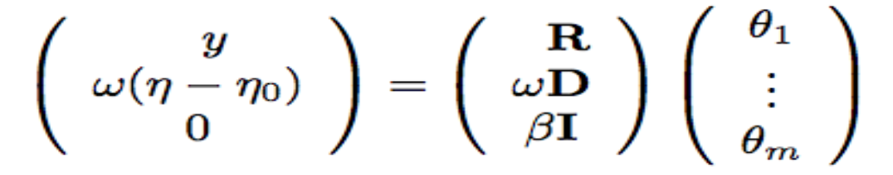
DFS Knobs Algorithm
R = Response matrix nominal beam
D = Response matrix off-energy beam
θ = Correctors
ω ₌ Weight for DFS
β = Regulation parameter
(Equivalent to cutting on singular values)
Solution:
Usual knob construction:
Take SVD and apply first few singular values
How many singular values are needed?

Slide 22
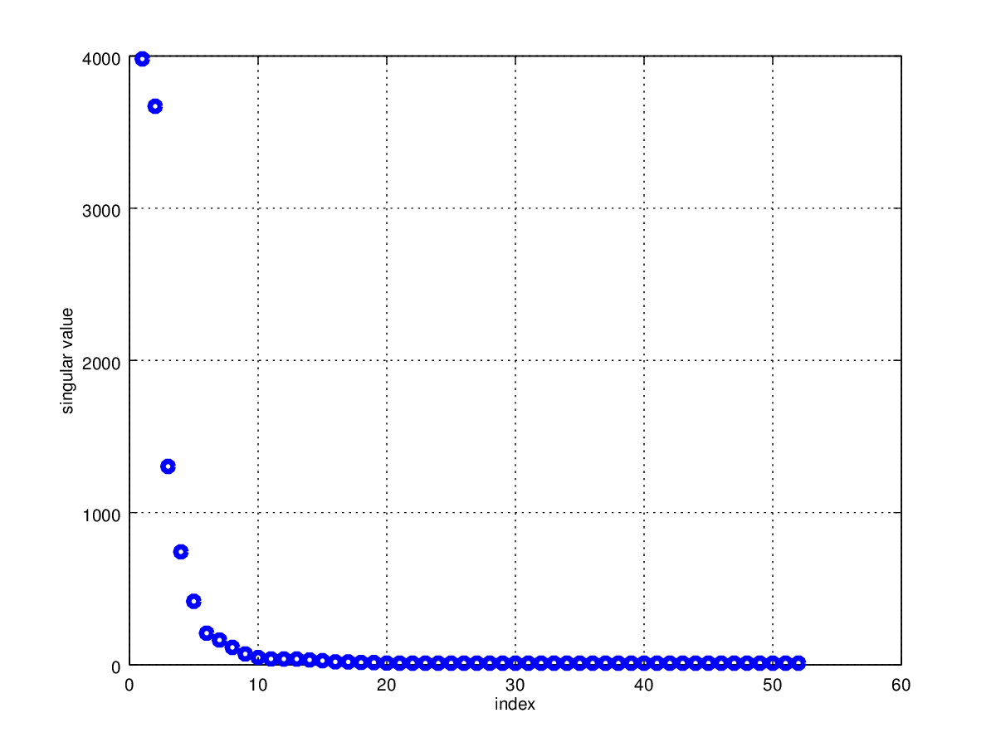
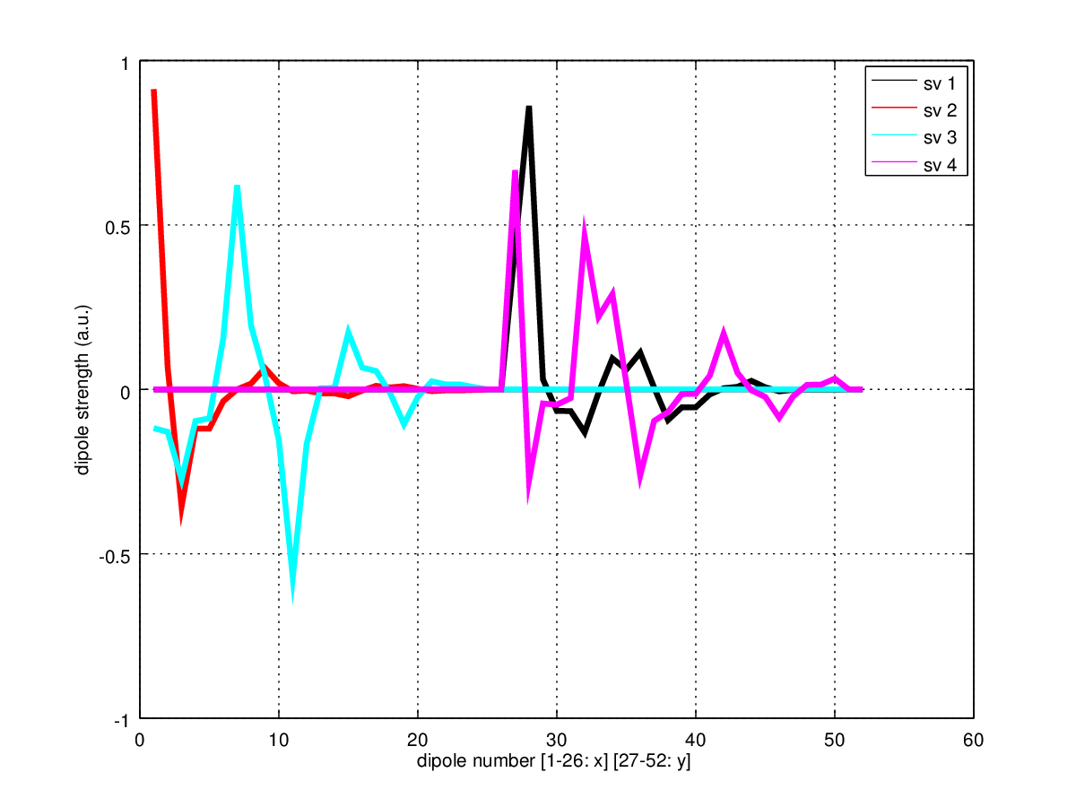
Selecting the number of singular values
Despite coupled system the actual modes are decoupled
4 singular values seems good (2 hor. and 2 vert. knobs)
x
y
Done with weights for DFS-1, but first 4 directions look very similar (expected).

Slide 23
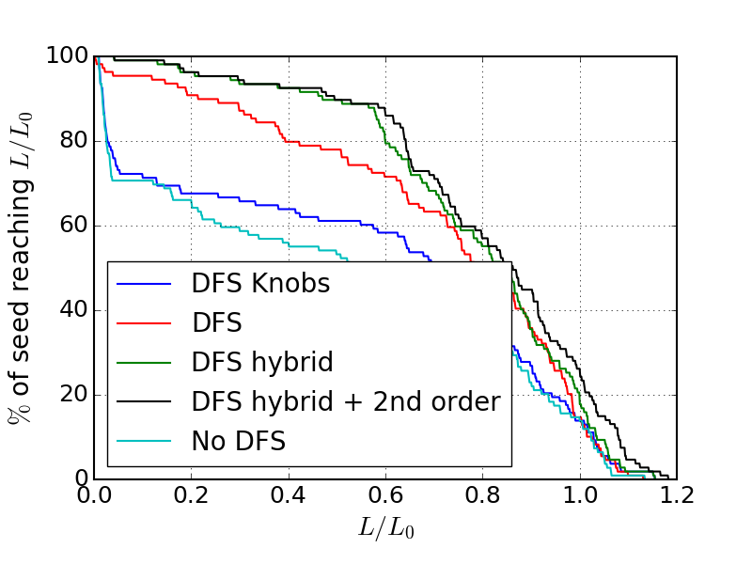
Comparing single iterations
DFS hybrid:
If relative luminosity > 3%, perform DFS knobs
Else DFS as usual
2nd order:
1 round of 8 simple 2nd order knobs (scanning tilts and strengths of sextupoles used in the knobs).
Tilt scan didn't really help.
Expected since there is no tilt misalignment

Slide 24
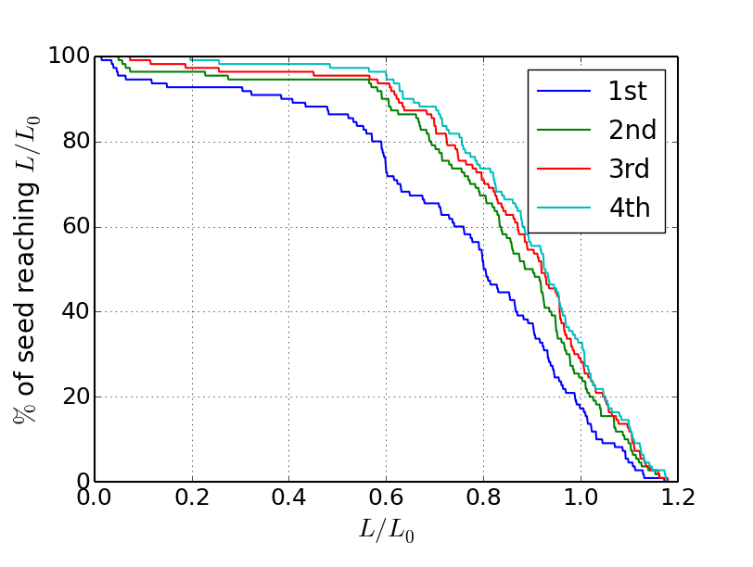
What about multiple iterations?
Good improvement for 2nd iteration.
Only small improvements with further iterations
Seeds with low luminosity improving
This only applies hybrid knobs, not 2nd order corrections.
Will likely need a new idea to reach final goal (see Edu Marin’s talk).

Slide 25
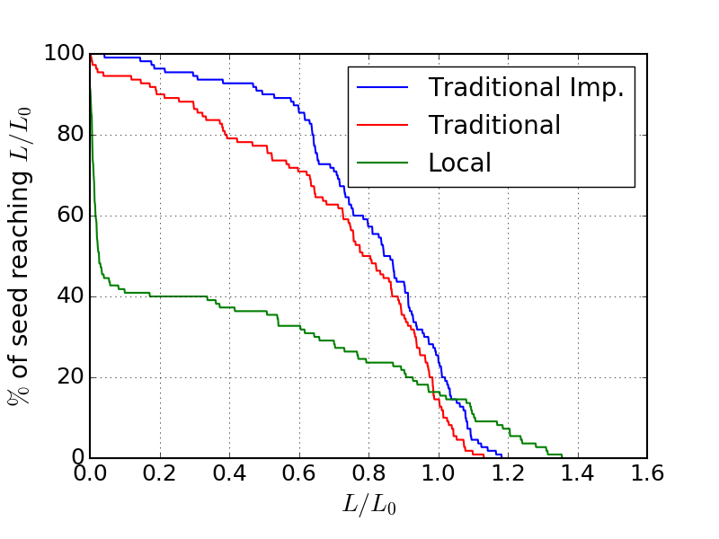
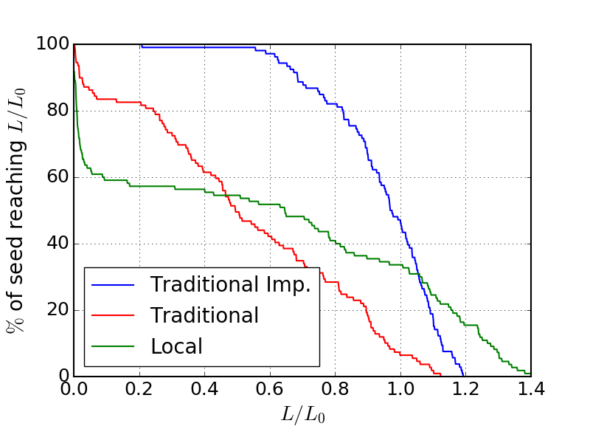
Comparing Iterations - Different Methods
Iteration 1
Iteration 4

Slide 26
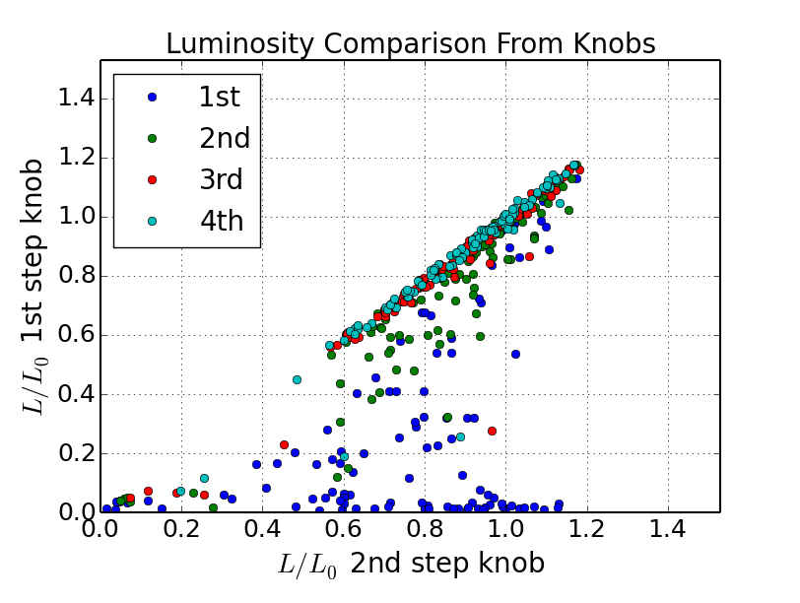
Are we still losing luminosity?

Slide 27
Two-beam Tuning
Most efforts have been on single beam tuning
Optimize one BDS beamline from static errors
Collide beam with “itself” to measure luminosity (think mirror image at the IP)
CPU-less intensive
Two-beam tuning will be at least twice as long (except for BBA)
Same basic procedure, but alternated between independent beamlines
More CPU intensive
Luminosity measurement less precise for lower luminosity
Additional luminosity loss is expected as self-collision is often optimal
Will need more iterations, as knob tuning less efficient at low luminosity

Slide 28
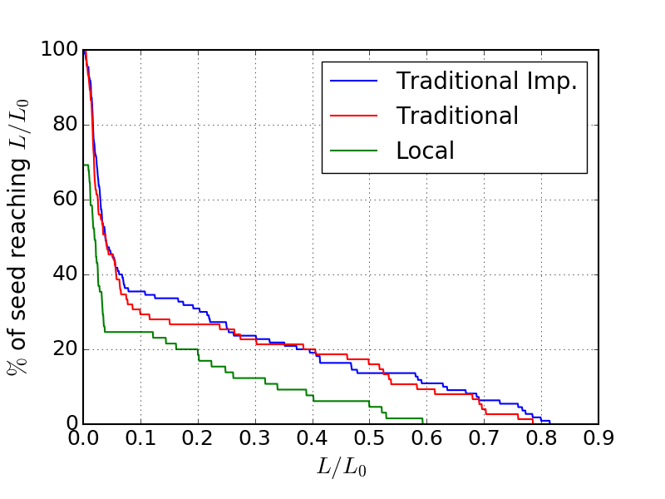
Hybrid DFS Knobs Applied to Two-Beam Tuning
First Iteration shown
Local BDS scheme shown for comparison
Traditional BDS has better results than local scheme
Applying the Hybrid DFS Knobs to the traditional scheme shows small but present improvements in the first iteration.

Slide 29
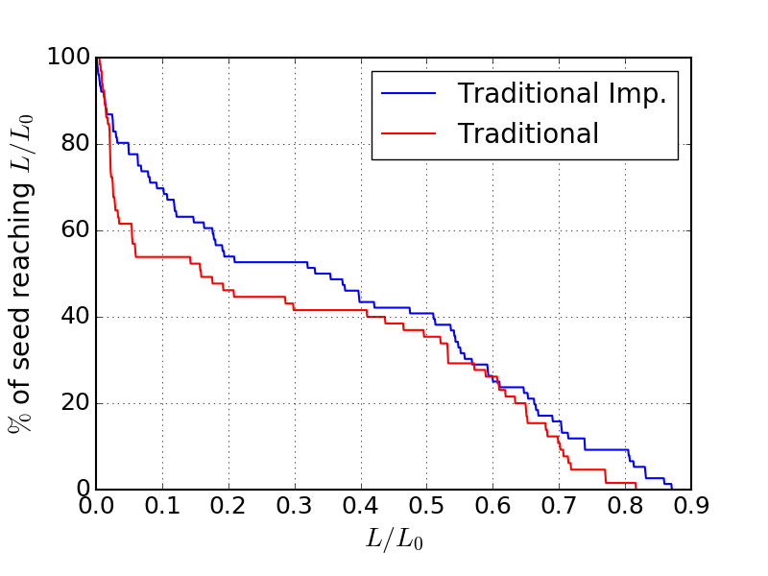
Hybrid DFS Knobs Applied to Two-Beam Tuning
Fourth Iteration shown
Local BDS scheme 4th iteration not finished, so no comparison.
Improved procedure now has clear advantage over former tuning procedure.

Slide 30
Almost 7 Iterations
Still seeing improvements through 6 iterations
7th iteration incomplete
18 out of 110 seeds did not finish (~16%)
Improvements diminishing with more iterations
Will likely need to include further methods to reach goal (see Edu Marin’s talk).

Slide 31
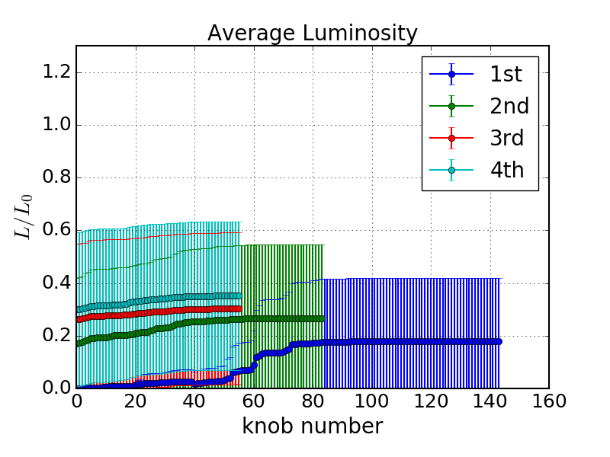
Effectiveness of knobs
Average luminosity after each knob (first 4 iterations only)
Some knobs show no improvement
Effectiveness can certainly still be improved
In 3rd and 4th iteration only 2 iterations of knobs, rather than the normal 3, were performed
Will reduce number of luminosity measurements

Slide 32
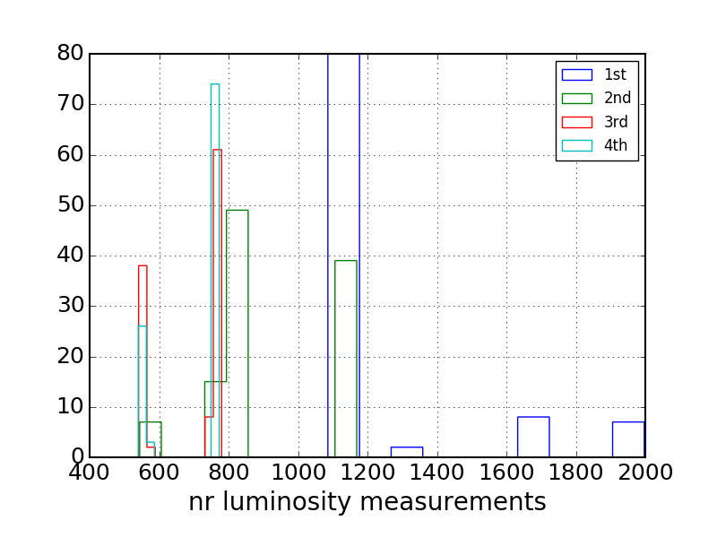
How many luminosity measurements?
1st iteration consists of 1600 luminosity measurements
2 (beams) * 2(knob rounds) * 3 (knob iterations) * 10 / 14 (sext. + DFS knobs) * ~12 (meas. per knob) = 1600 measurements
Further iterations have only 800 luminosity measurements
1 knob iteration + DFS knobs
3rd and 4th iterations only use 2 knob iterations

Slide 33
But what does it all mean?
The current procedures are very successful at increasing the achieved luminosity for both single and two-beam tuning.
Focus has been on the 3 TeV, Traditional BDS system of CLIC
The hybrid DFS knobs show a marked improvement for both single and two-beam tuning
Especially after several iterations.
Still reaching an upper limit which is significantly below the final goal.
Will need to incorporate further tuning methods and procedures to reach the goal of 90% of seeds reaching 110% of the nominal luminosity.
2nd order knobs will likely need to be used
Further techniques (discussed by Edu Marin) will be needed.
Plan to use measured response matrix to see if it improves the tuning process.

Slide 34
Questions, comments, concerns?
Since I’m currently remotely connecting, I’ll try my best to answer.
However, if you’re more comfortable with email, you can reach me at ryan.bodenstein@physics.ox.ac.uk and I’ll answer any questions in detail.
Many thanks to Jochem Snuverink, as well as the CLIC group for helping and supporting this work.
Thanks!!

