Slide 1
IP region beam jitter
G. Christian, N. Blaskovic, T. Bromwich & R. Ramjiawan
FONT, John Adams Institute, Oxford University
N. Blaskovic

Slide 2
Introduction
Data taken on 14 June with nominal optics
2 bunch mode
Charge ~ 0.25 x 10¹⁰
Used stripline BPMs (P1, P2 & P3)
Measured resolution ~ 0.7 um
Used IP BPMs (IPA, IPB & IPC)
40 dB attenuation for large dynamic range
Measured resolution ~ 4 um
N. Blaskovic

Slide 3
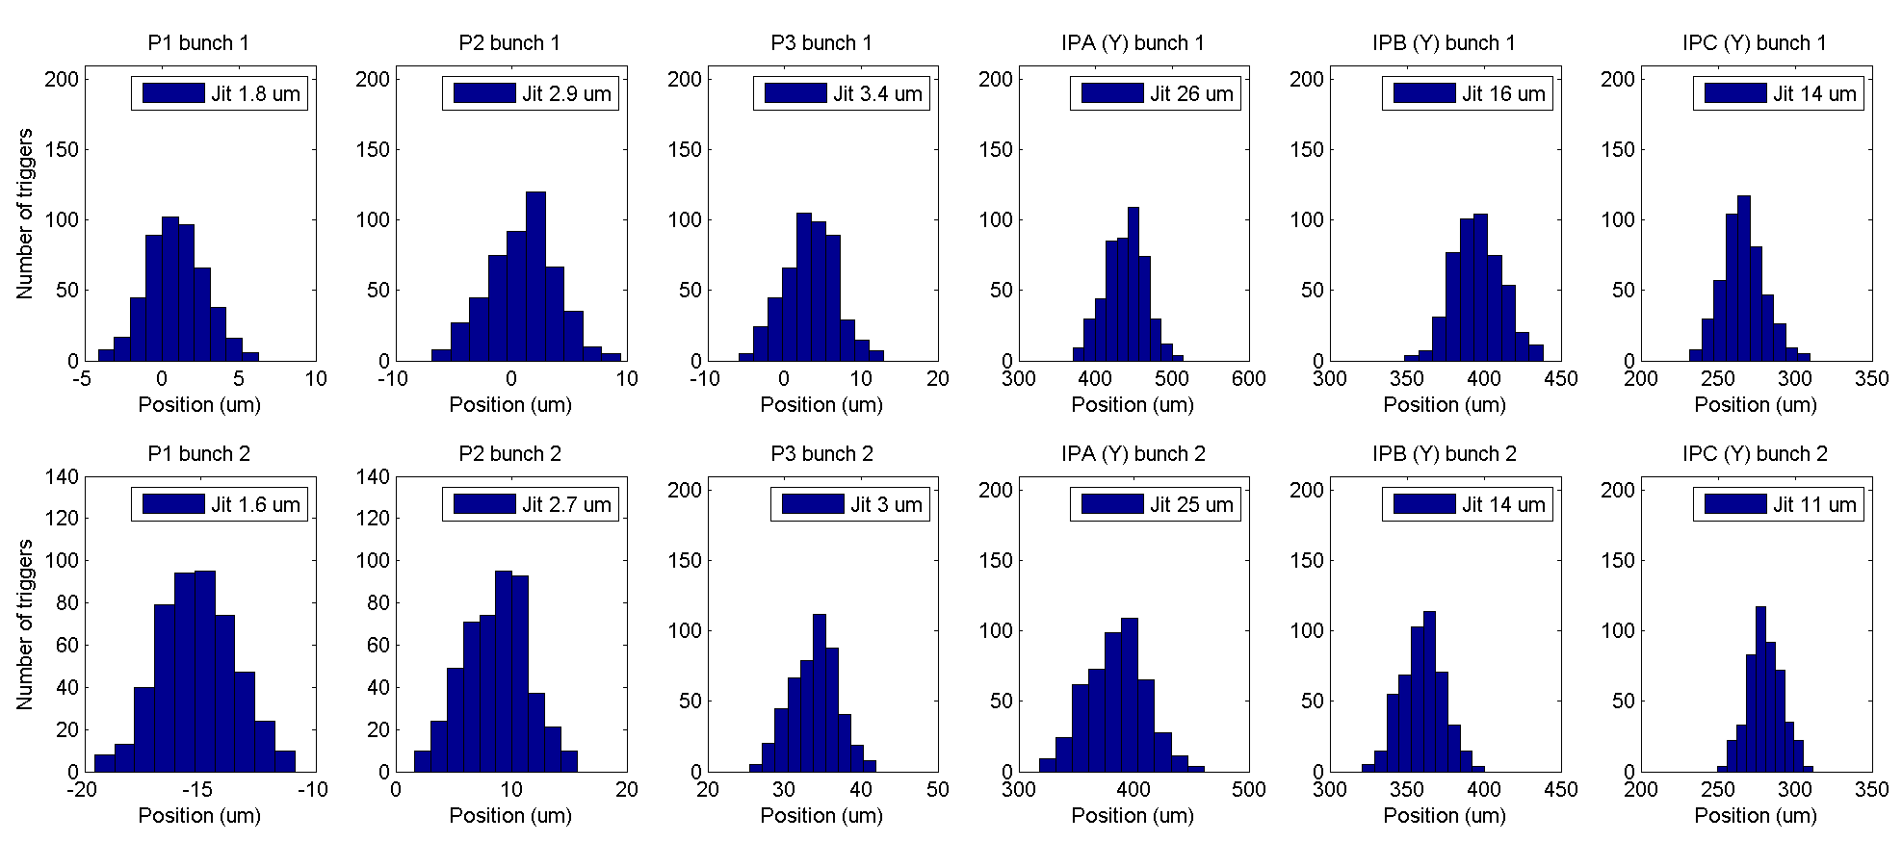
Measured jitter
~13 um jitter at IPB & IPC
N. Blaskovic

Slide 4
Propagate to IP
P2 & P3 positions propagated to IP using transfer matrices
Reproduces jitter of ~13 um at IPB & IPC
N. Blaskovic

Slide 5
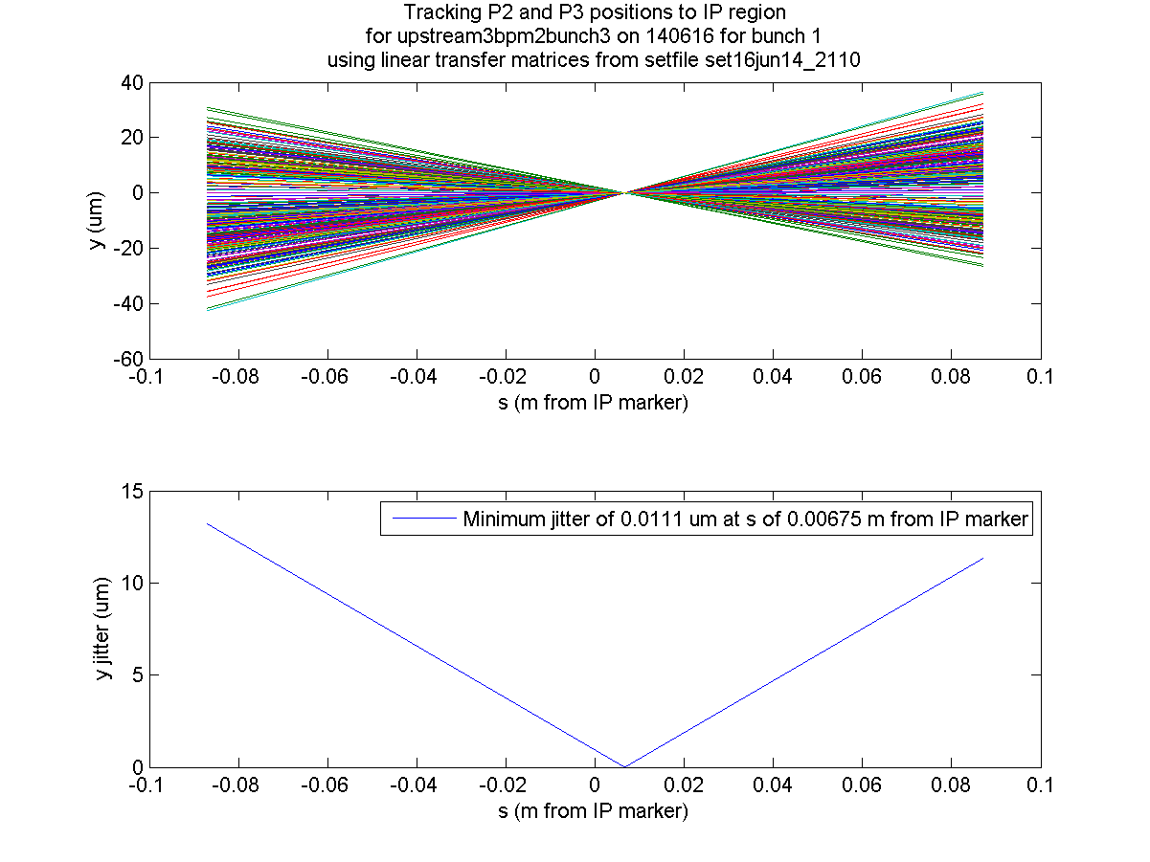
IPB
IPC
N. Blaskovic

Slide 6
Angular beam jitter
Measured jitter is ~13 um at IPB and IPC
True jitter is ~12 um if resolution is ~4 um
As IPB & IPC are each ~8 cm from IP, this corresponds to an IP y’ jitter of ~150 urad
N. Blaskovic

Slide 7
Angular beam jitter
Tauchi-san:
Vertical emittance: 9 or 15 pm
Vertical beta function: 100 um
If angular jitter is 20 % of angular divergence, expect 60 or 77 urad y’ jitter (respectively)
Kubo-san:
Fitted IP y’ jitter: 67 urad (ECFA LC 2016)
Our measurement of ~150 urad: too large?
No beam tuning before shift?
N. Blaskovic

