Slide 1
A New Beginning
Of Tuning Simulations
Some code edited from Edu Marin Lacoma
Some Code Original
Ryan Bodenstein
FONT Meeting
2016/27/6

Slide 2
It’s been a good week, despite the heat
Edu has been incredibly helpful in explaining and helping me understand the improvements he’s been making in his work.
There’s still a lot of work to be done, but progress has been made (and is continuing).
As work continues, I’ll be coming back relatively regularly.

Slide 3
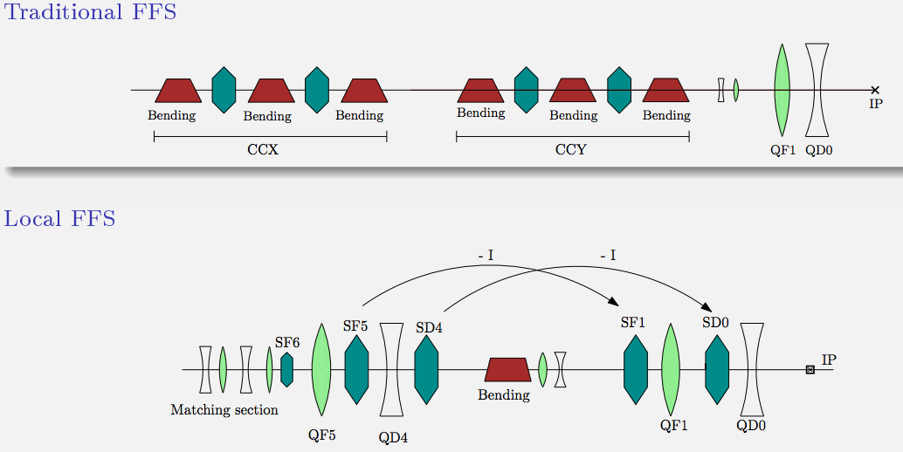
Just to be clear…focusing on the Traditional FFS
Two separate sections for chromaticity correction
Lattice by Hector Garcia, see e.g. his talk at CLIC WS 2014
Relatively simple system for design and analysis

Slide 4
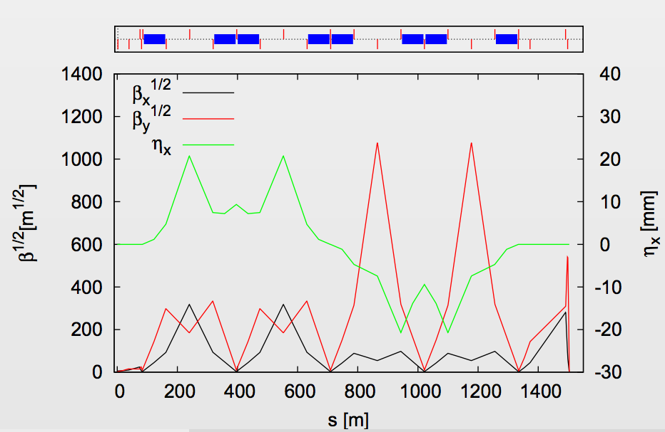
Traditional Final Focus
Parameter | Unit | Traditional “Optimized” | Local
Length | m | 1460 | 450
Total Luminosity | cm⁻²s⁻¹ | 7.5 * 10³⁴ | 7.8 * 10³⁴
Peak (1%) Luminosity | cm⁻²s⁻¹ | 2.4 * 10³⁴ | 2.4 * 10³⁴
Optimized lattice achieves similar luminosity as local scheme.

Slide 5
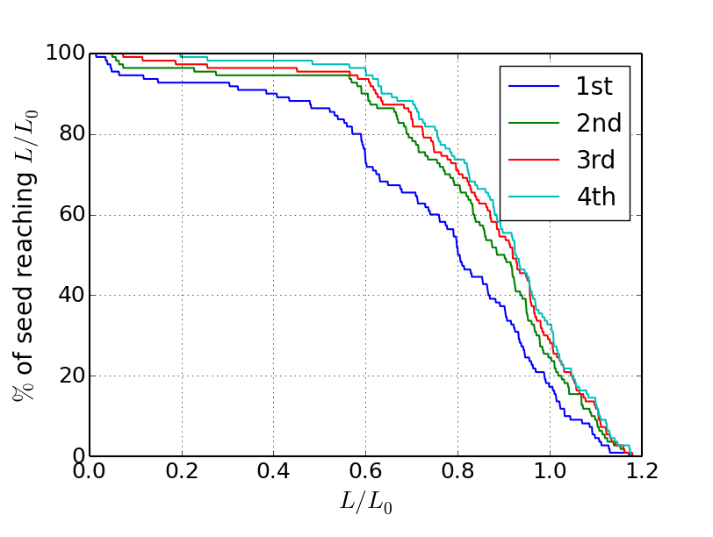
Previously achieved…
Actually finished 5, but only plotted first 4 here.
  Started getting negligible returns for further iterations.
  Seeds with low luminosity improving
  This only applies hybrid knobs, not 2nd order corrections.
  Applied some of Edu’s ideas for further improvements.

Slide 6
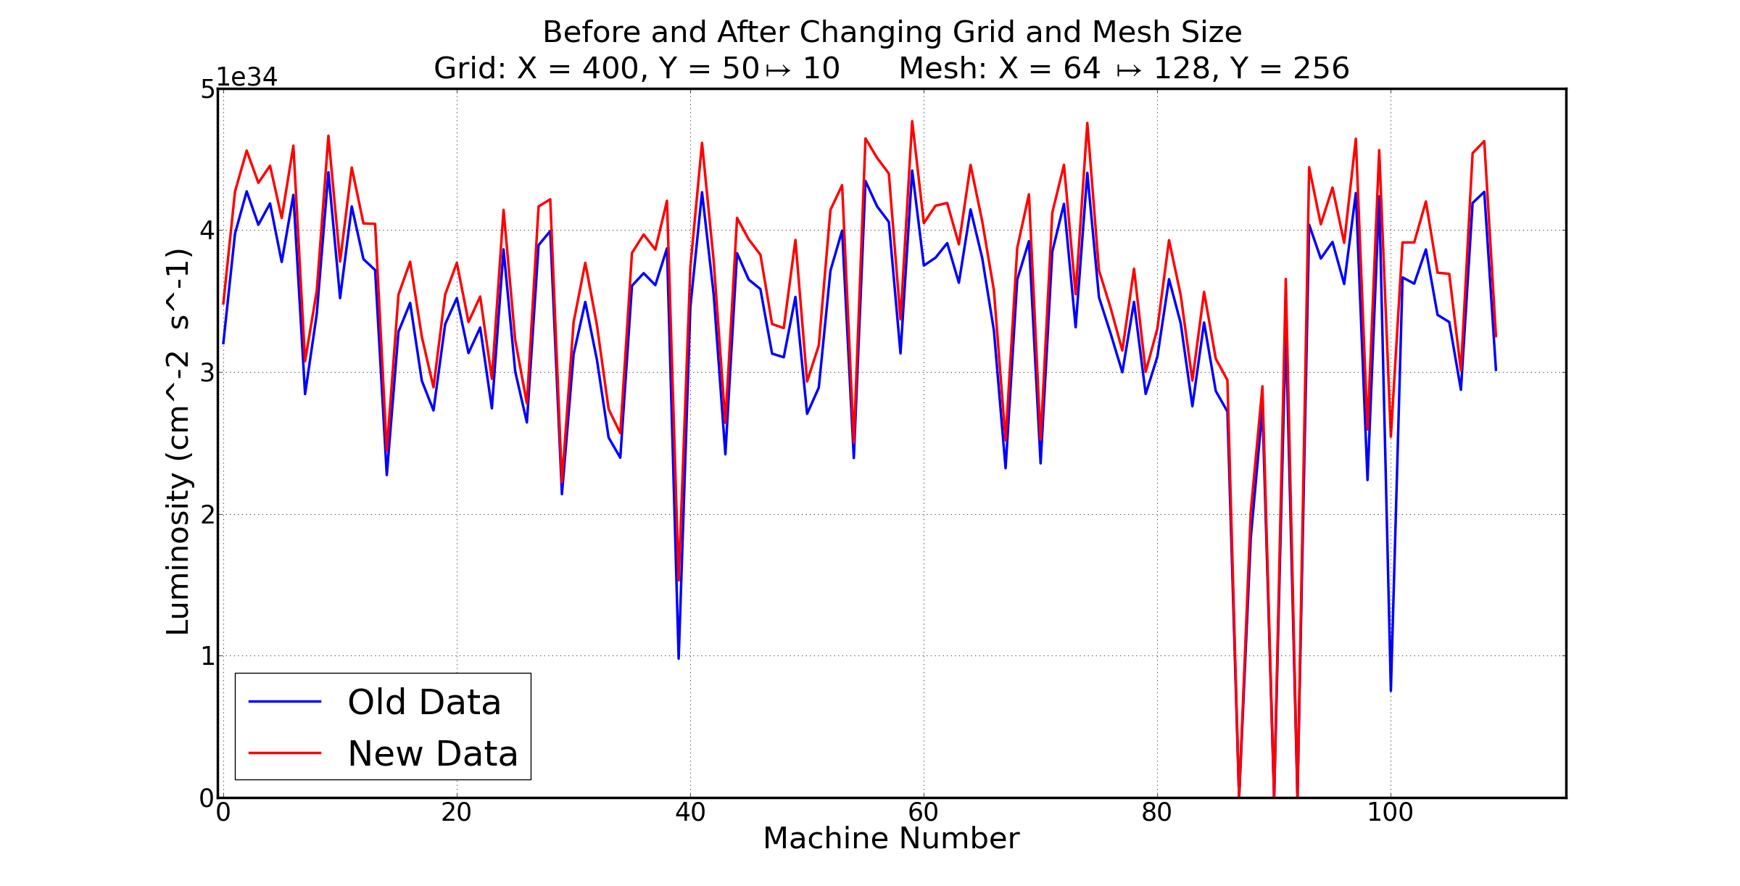
Change the Grid and Mesh Size

Slide 7
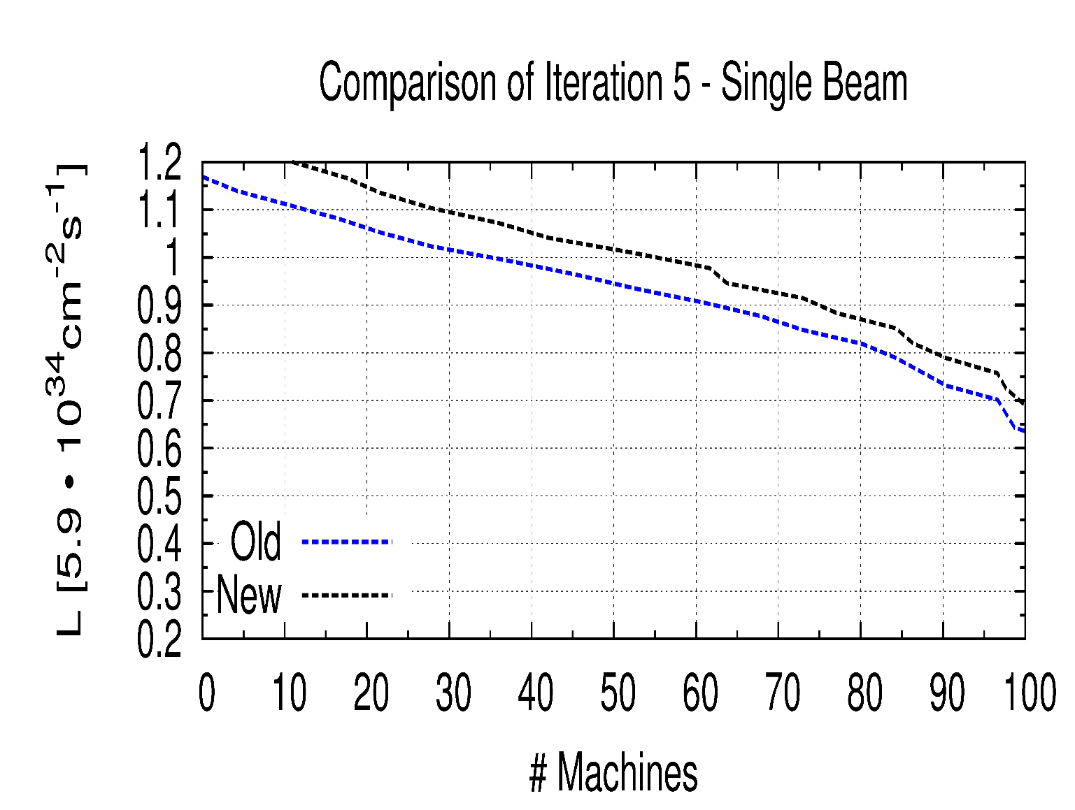
Grid and Mesh Improvements

Slide 8
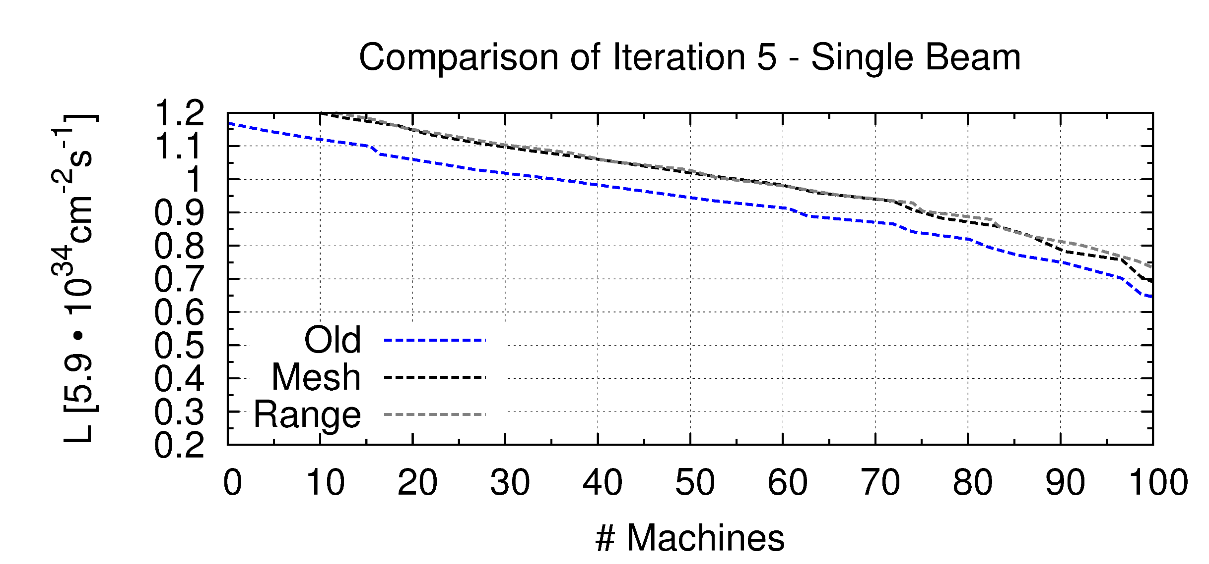
Scan the Knob Range

Slide 9
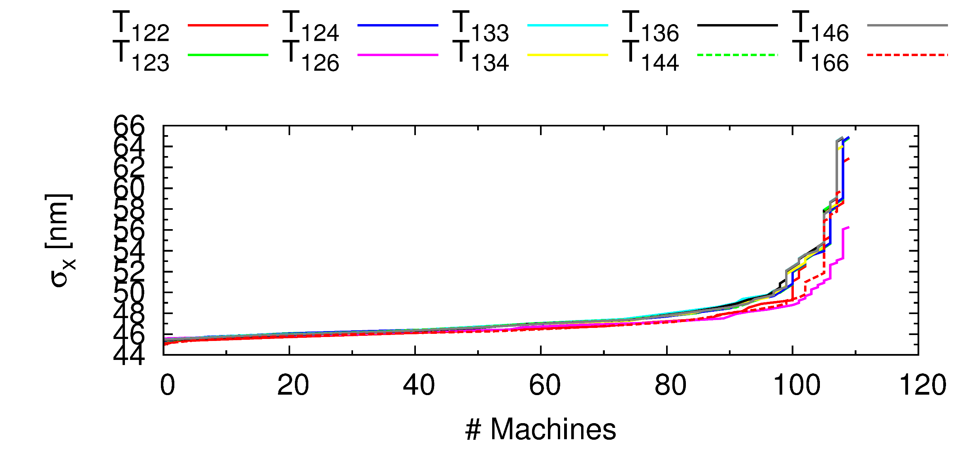
Now, applying Edu’s work…

Slide 10
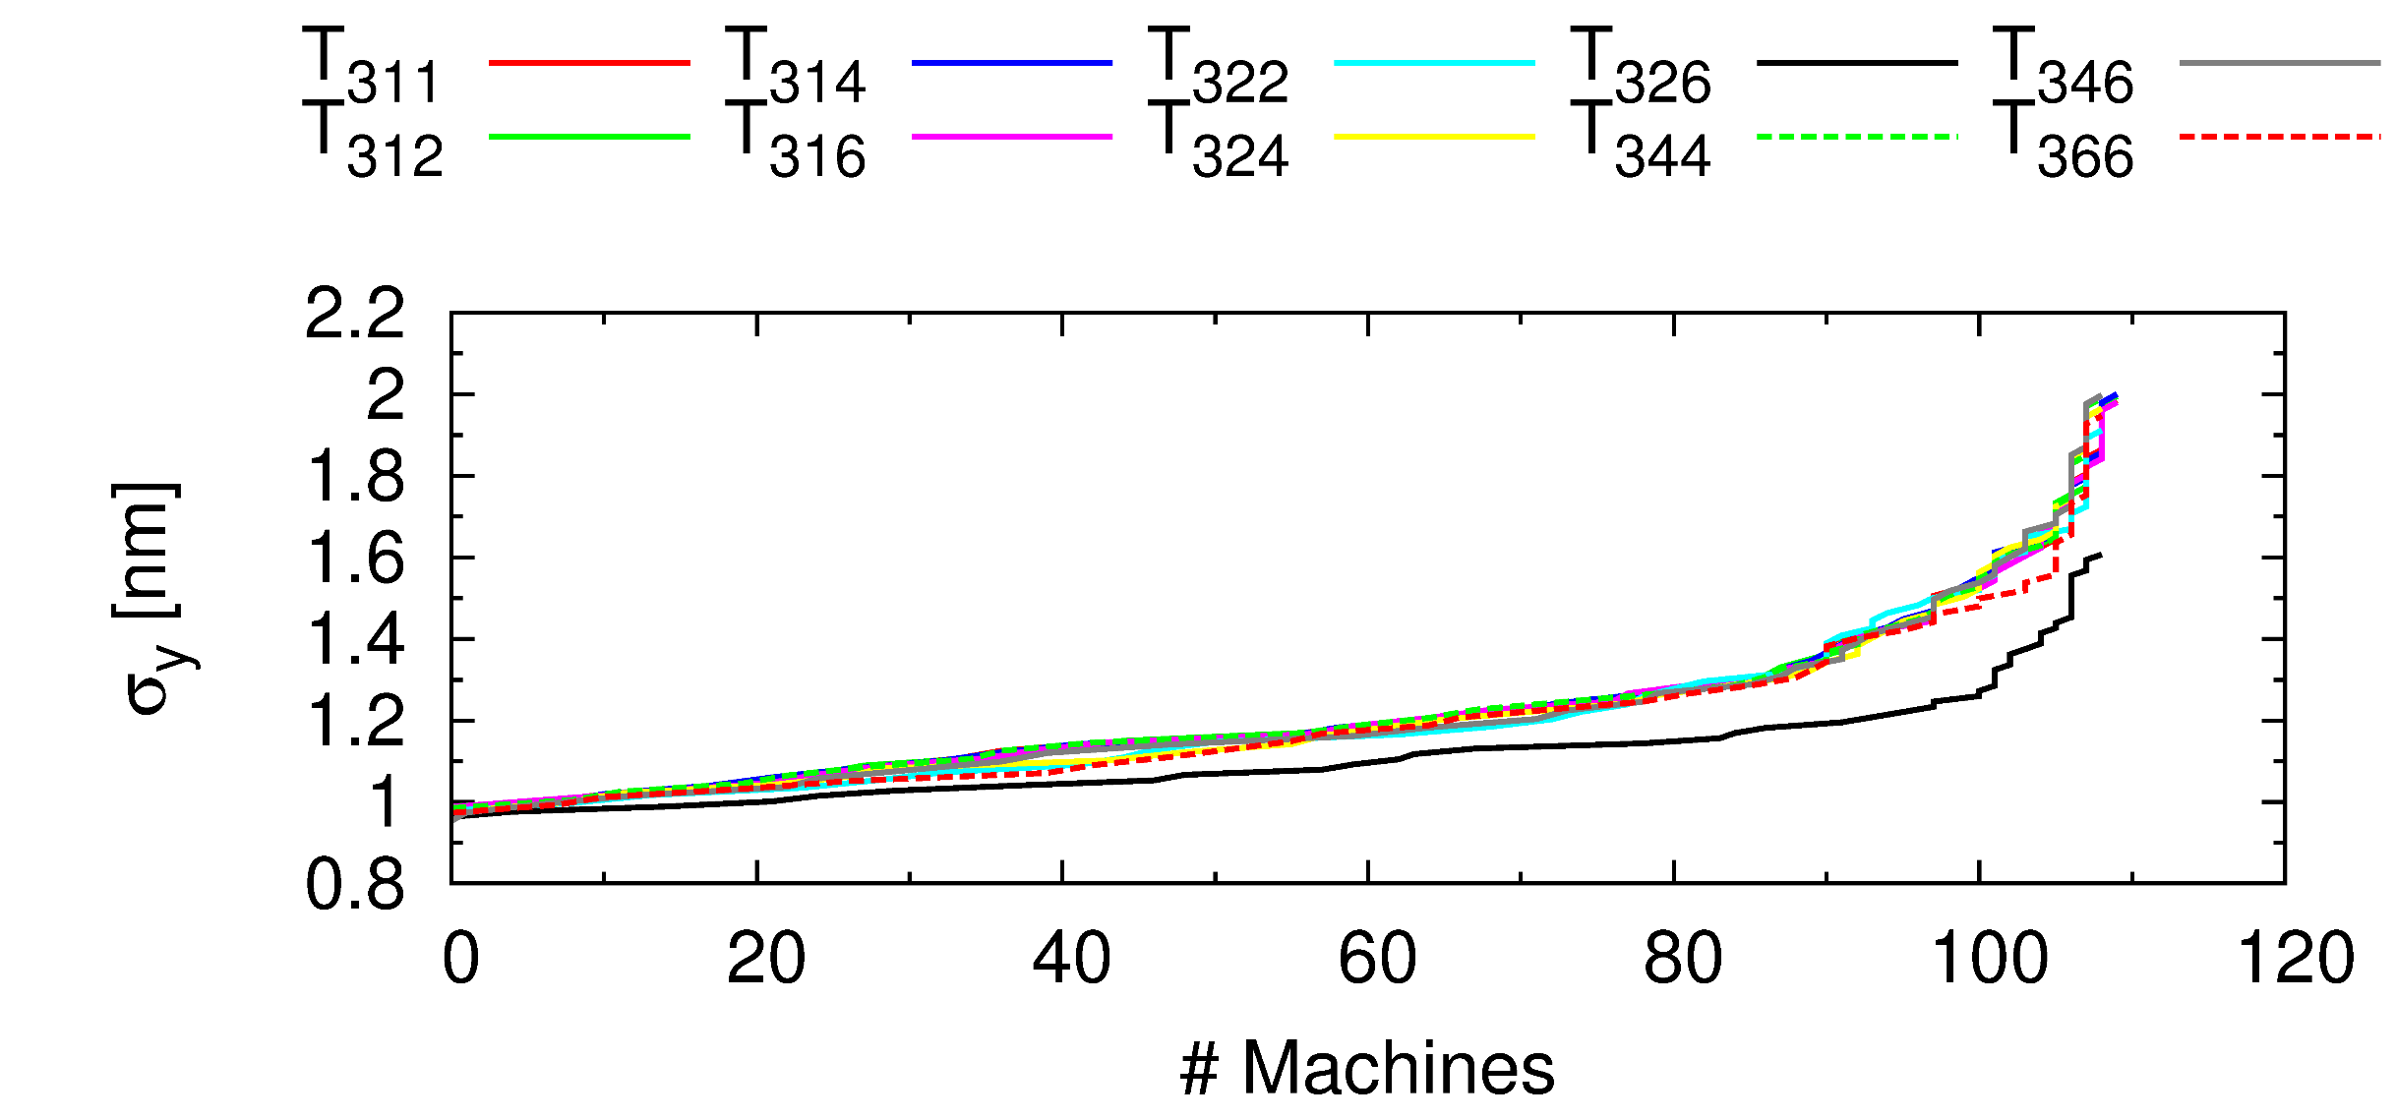
Now, applying Edu’s work…

Slide 11
But what does it all mean?
Modifying the GUINEA-PIG grid and mesh improve the luminosity.
  Roughly 10%
Scanning the Linear and DFS knobs on top of the new mesh/grid shows small improvements.
  90% of machines reach ~81% of nominal luminosity
Analysis of the IP beam distributions identifies high order aberrations which can make further improvements of the luminosity measurement.
  In the X plane, these are: T126, T166, T122
  In the Y plane, these are: T346

Slide 12
What’s next?
Investigating the inclusion of a 5th SV in the DFS Hybrid Knobs.
Design of nonlinear knobs targeting the higher order aberrations.
Eventual application to two-beam tuning, once satisfactory results are achieved in the single-beam case.
Next visit in July:
  Focus will be on knob design

