Slide 1
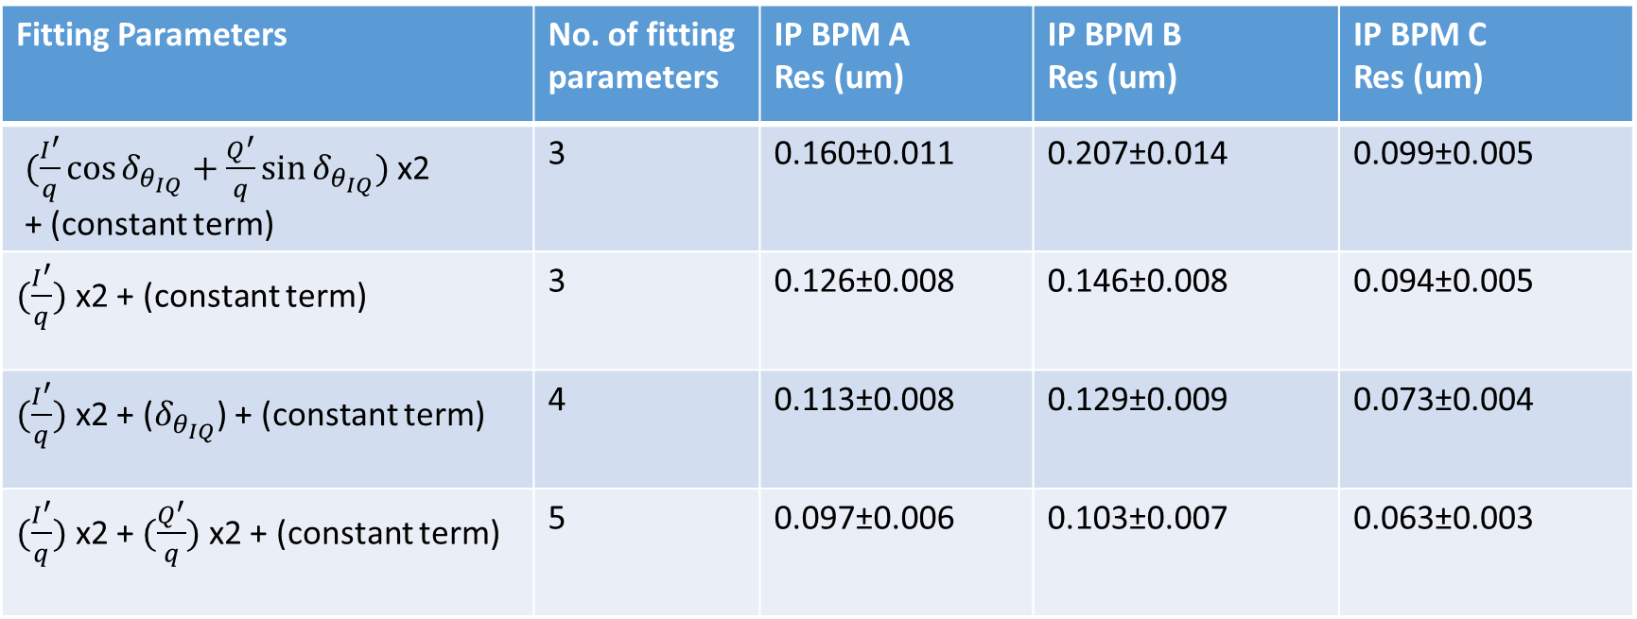
Resolution – Fitting 10dB
jitRun1_10dB
IPAyCal1_10dB
IPCyCal6_10dB (triggers 101:300)
Folder: 160617_owl
Ref. sample: 50,
IQ samples: 54:57.
Correlation: A : -0.21
B : 0.18
C : 0.65
Fitting Parameters | No. of fitting parameters | IP BPM A Res (um) | IP BPM B Res (um) | IP BPM C Res (um)
$(\frac{I^{′}}{q}\cos{δ_{θ_{IQ}}}+\frac{Q^{′}}{q}\sin{δ_{θ_{IQ}}})$ x2 + (constant term) | 3 | 0.160±0.011 | 0.207±0.014 | 0.099±0.005
$(\frac{I^{′}}{q})$ x2 + (constant term) | 3 | 0.126±0.008 | 0.146±0.008 | 0.094±0.005
$(\frac{I^{′}}{q})$ x2 + ($δ_{θ_{IQ}}$) + (constant term) | 4 | 0.113±0.008 | 0.129±0.009 | 0.073±0.004
$(\frac{I^{′}}{q})$ x2 +$(\frac{Q^{′}}{q})$ x2 + (constant term) | 5 | 0.097±0.006 | 0.103±0.007 | 0.063±0.003

Slide 2
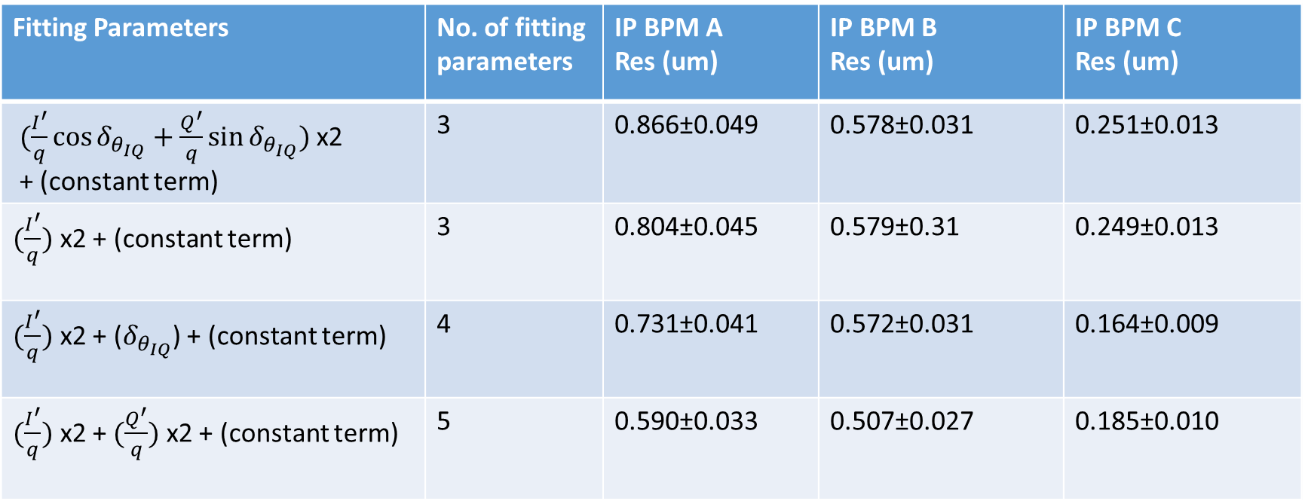
Resolution – Fitting 20dB
Folder: 160617_owl
Ref. sample: 50,
IQ samples: 54:57.
jitRun1_20dB
IPAyCal1_20dB
IPCyCal1_20dB
Correlation: A : 0.04
B : 0.13
C : 0.70
Fitting Parameters | No. of fitting parameters | IP BPM A Res (um) | IP BPM B Res (um) | IP BPM C Res (um)
$(\frac{I^{′}}{q}\cos{δ_{θ_{IQ}}}+\frac{Q^{′}}{q}\sin{δ_{θ_{IQ}}})$ x2 + (constant term) | 3 | 0.866±0.049 | 0.578±0.031 | 0.251±0.013
$(\frac{I^{′}}{q})$ x2 + (constant term) | 3 | 0.804±0.045 | 0.579±0.31 | 0.249±0.013
$(\frac{I^{′}}{q})$ x2 + ($δ_{θ_{IQ}}$) + (constant term) | 4 | 0.731±0.041 | 0.572±0.031 | 0.164±0.009
$(\frac{I^{′}}{q})$ x2 +$(\frac{Q^{′}}{q})$ x2 + (constant term) | 5 | 0.590±0.033 | 0.507±0.027 | 0.185±0.010

Slide 3
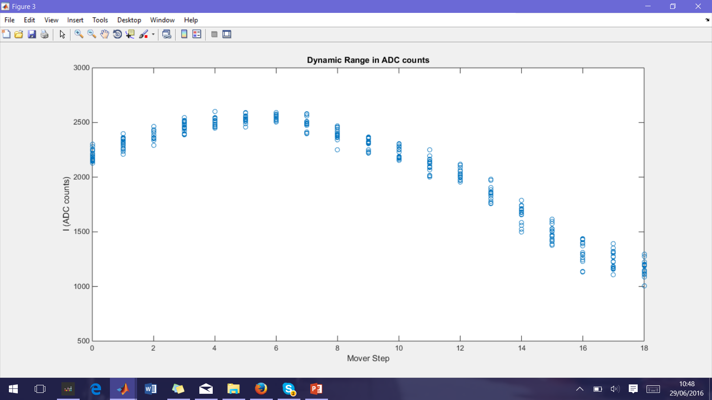
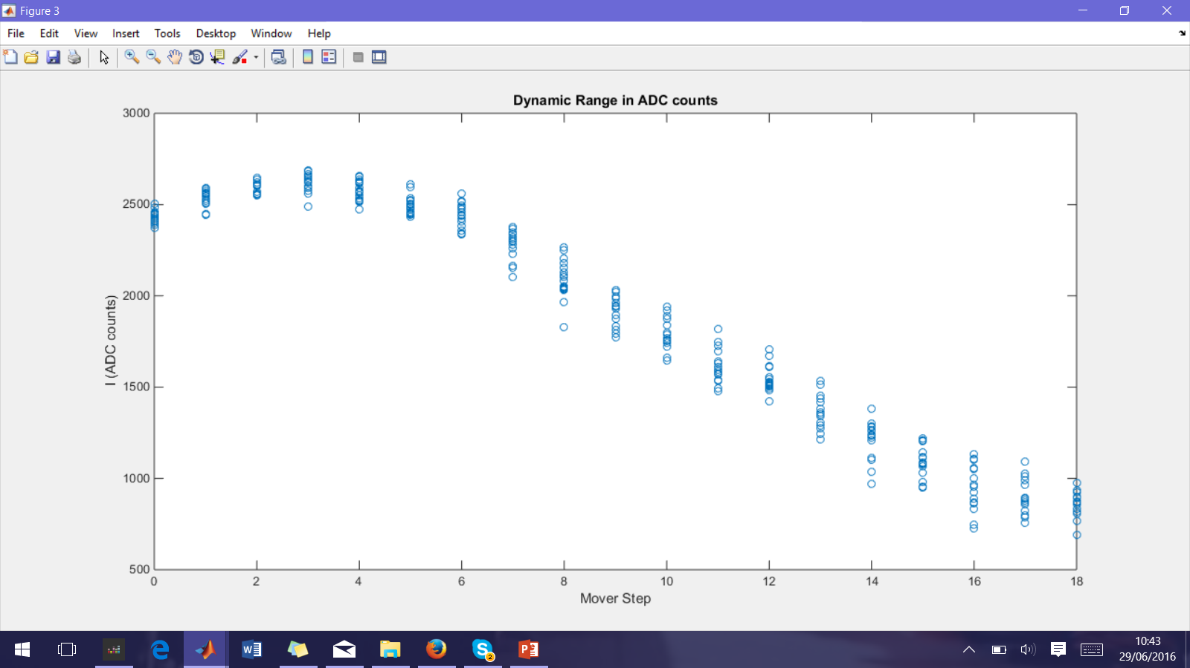
Linear Region and Saturation
Folder: 160617_owl
IPCyCal6_10dB: Samples used: 54:57.
Sample 55
Sample 56

