Slide 1
FONT5 sampling jitter investigations
G.B. Christian
C. Perry
8 July 2016

Slide 2
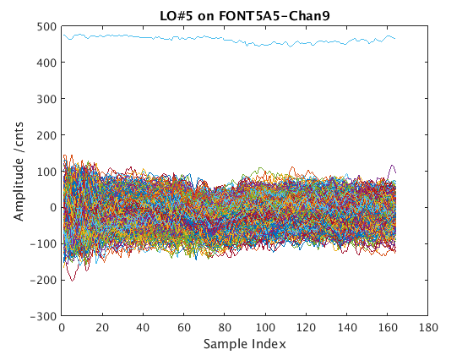
714 MHz tests at ATF
~40 counts rms jitter on 488 counts max at 714 MHz => 20 ps rms timing jitter

Slide 3
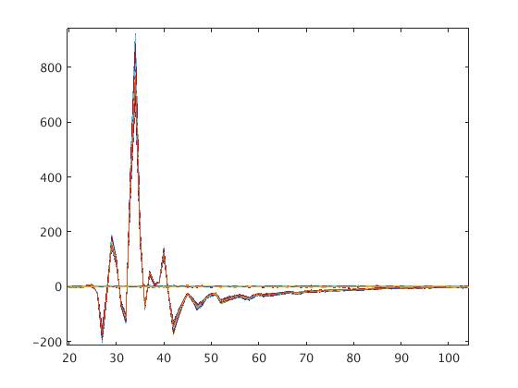
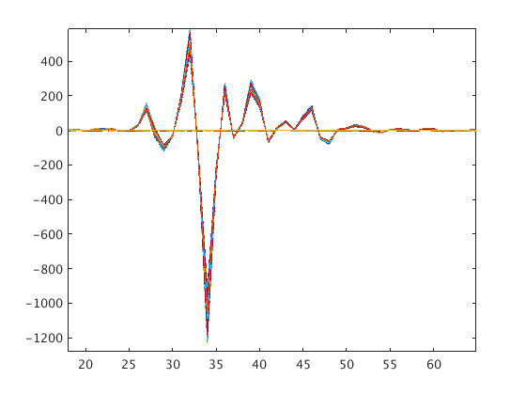
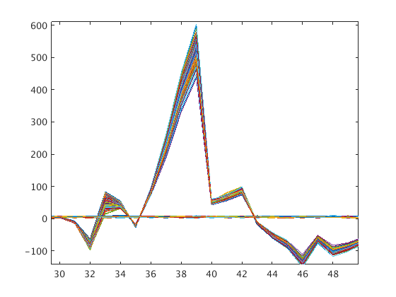
Stripline BPM difference residuals
P1
P2
P3
In the case of P1, 2.8 ns corresponds to 200 um, 20 ps => ~ 300 nm

Slide 4
ADC Baseline Noise checks (A1)
 |  | 1 | 2 | 3 | 4 | 5 | 6 | 7 | 8 | 9
SRS +7dBm | Mean | 0.63 | 0.23 | 0.40 | 0.42 | 0.01 | -0.27 | -0.14 | 0.54 | 0.17
 | Fast Noise | 1.09 +/- 0.03 | 0.89 | 1.03 | 1.05 | 1.00 | 1.07 | 0.94 | 1.08 | 1.25
 | Slow Noise | 1.08 | 0.89 | 1.02 | 1.04 | 0.99 | 1.06 | 0.94 | 1.08 | 1.24
TTi +7dBm | Mean | 0.12 | 0.62 | 0.72 | 0.66 | 0.59 | 0.47 | 0.88 | 0.71 | 1.22
 | Fast Noise | 1.08 | 0.90 | 1.04 | 1.03 | 0.98 | 1.04 | 0.92 | 1.10 | 1.24
 | Slow Noise | 1.08 | 0.90 | 1.03 | 1.03 | 0.98 | 1.04 | 0.92 | 1.09 | 1.22
TTi +1dBm | Mean | 0.24 | 0.71 | 0.73 | 0.43 | 0.39 | 0.12 | 0.56 | 0.57 | 1.35
 | Fast Noise | 1.08 | 0.90 | 1.04 | 1.05 | 0.98 | 1.05 | 0.92 | 1.09 | 1.24
 | Slow Noise | 1.07 | 0.90 | 1.03 | 1.04 | 0.98 | 1.05 | 0.92 | 1.09 | 1.22

Slide 5
357 MHz sampling tests (A1) – default
 |  | 1 | 2 | 3 | 4 | 5 | 6 | 7 | 8 | 9
ZERO XING | Mean | 22.1 +/- 0.1 | 3.4 +/- 0.1 | 6.4 +/- 0.1 | 3.7 +/- 0.1 | 1.8+/- 0.1 | 40.0 +/- 0.5 | 11.0 +/- 0.3 | 0.1 +/- 0.4 | 10.5 +/- 0.2
 | Fast Noise | 20.4 +/- 0.9 | 19.5 +/- 0.5 | 18.9 +/- 0.5 | 15.9 +/- 0.4 | 17.4 +/- 0.5 | 17.1 +/- 0.5 | 19.5 +/- 0.6 | 17.9 +/- 0.5 | 16.9 +/- 0.5
 | Slow Noise | 20.8 +/- 0.5 | 20.0 +/- 1.0 | 19.1 +/- 0.8 | 16.3 +/- 0.7 | 17.9 +/- 0.7 | 22.8 +/- 0.6 | 21.3 +/- 0.9 | 21.8 +/- 0.7 | 17.3 +/- 0.7
MAX | Mean | 1191.5 +/- 0.01 | 1086.4 +/- 0.01 | 1076.1 +/- 0.01 | 1152.2 +/- 0.01 | 1208.2 +/- 0.01 | 1139.9 +/- 0.02 | 1174.7 +/- 0.01 | 1179.2 +/- 0.01 | 1049.1 +/- 0.02
 | Fast Noise | 9.1 +/- 0.2 | 8.7 +/- 0.2 | 8.7 +- 0.2 | 8.6 +/- 0.2 | 9.1 +/- 0.2 | 8.7 +/- 0.2 | 8.6 +/- 0.2 | 8.9 +/- 0.2 | 9.1 +/- 0.2
 | Slow Noise | 9.1 +/- 0.2 | 8.7 +/- 0.2 | 8.7 +/- 0.2 | 8.6 +/- 0.2 | 9.1 +/- 0.2 | 8.7 +/- 0.2 | 9.1 +/- 0.4 | 8.9 +/- 0.2 | 9.1 +/- 0.2
TIME JITTER (ps) |  | 7.8 | 8.2 | 7.9 | 6.3 | 6.6 | 8.9 | 8.1 | 8.2 | 7.3

Slide 6
357 MHz sampling tests (A1) using PLL
Chan |  | 1 | 2 | 3 | 4 | 5 | 6 | 7 | 8 | 9
ZERO XING | Mean | 5 +/- 1 | -0.7 +/- 0.6 | 4.6 +/- 0.8 | 17.3 +/- 0.8 | 4 +/- 1 | 1.3 +/- 0.9 | 10.1 +/- 0.8 | -10.6 +/- 0.9 | 8.9 +/- 0.7
 | Fast Noise | 47 +/- 7 | 44 +/- 7 | 42 +/- 6 | 44 +/- 7 | 47 +/- 7 | 43 +/- 7 | 45 +/- 7 | 45 +/- 7 | 41 +/- 6
 | Slow Noise | 49 +/- 3 | 44 +/- 3 | 43 +/- 3 | 45 +/- 3 | 48 +/- 3 | 44 +/- 3 | 46 +/- 4 | 46 +/- 4 | 42 +/- 3
MAX | Mean | 1210 .4 | 1097.3 | 1082.1 | 1162.9 | 1218.8 | 1126.7 | 1176.2 | 1184.4 | 1058.6
 | Fast Noise | 9.2 +/- 0.2 | 9.2 +/- 0.3 | 9.0 +/- 0.3 | 8.9 +/- 0.2 | 9.0 +/- 0.2 | 9.0 +/- 0.2 | 8.8 +/- 0.2 | 8.8 +/- 0.2 | 8.2 +/- 0.2
 | Slow Noise | 9.2 +/- 0.7 | 9.2 +/- 0.7 | 9.0 +/- 0.6 | 8.9 +/- 0.6 | 9.0 +/- 0.6 | 9.0 +/- 0.6 | 8.7 +/- 0.6 | 8.8 +/-0.6 | 8.2 +/- 0.6
TIME JITTER (ps) |  | 18.1 | 17.9 | 17.7 | 17.2 | 17.6 | 17.4 | 17.5 | 17.3 | 17.7

Slide 7
357 MHz sampling tests (A2) no PLL
Chan |  | 1 | 2 | 3 | 4 | 5 | 6 | 7 | 8 | 9
ZERO XING | Mean | 1.7 +/- 0.3 | -2.8 +/- 0.5 | 1.9 +/- 0.3 | -1.8 +/- 0.2 | -9.6 +/- 0.4 | -2.6 +/- 0.4 | -10.3 +/- 0.5 | 8.8 +/- 0.6 | -4.5 +/- 0.5
 | Fast Noise | 15.7 +/- 0.4 | 17.3 +/- 0.4 | 16.3 +/- 0.4 | 15.9 +/- 0.4 | 16.6 +/- 0.4 | 16.0 +/- 0.4 | 17.3 +/- 0.4 | 16.8 +/- 0.5 | 19.3 +/- 0.6
 | Slow Noise | 16 +/- 1 | 18 +/- 1 | 16 +/- 1 | 16 +/- 1 | 17 +/- 1 | 16 +/- 1 | 18 +/- 1 | 18 +/- 1 | 20 +/- 2
MAX | Mean | 1022.1 | 1184.1 | 1064.9 | 1097.5 | 1173.9 | 1111.5 | 1127.0 | 1230.9 | 1135.6
 | Fast Noise | 8.7 +/- 0.2 | 8.8 +/- 0.2 | 8.8 +/- 0.2 | 8.5 +/- 0.2 | 8.8 +/- 0.2 | 8.5 +/- 0.2 | 8.5 +/- 0.2 | 8.8 +/- 0.2 | 8.8 +/- 0.2
 | Slow Noise | 8.7 +/- 0.6 | 8.7 +/- 0.6 | 8.8 +/- 0.6 | 8.5 +/- 0.6 | 8.8 +/- 0.6 | 8.5 +/- 0.6 | 8.5 +/- 0.6 | 8.8 +/- 0.6 | 8.8 +/- 0.6
TIME JITTER (ps) |  | 7.0 | 6.8 | 6.7 | 6.5 | 6.5 | 6.4 | 7.1 | 6.5 | 7.8

Slide 8
357 MHz sampling tests (A1) using PLL
Average spectrum

Slide 9
357 MHz sampling tests (A1) using PLL
Peaks at:
157 MHz => 200 MHz reflected
117 MHz => ??
134 MHz => ??
MHz => 40 MHz harmonic?
45 MHz??

Slide 10
357 MHz sampling tests (A1) no PLL
Average spectrum

Slide 11
To do
Check ADC clocks on spectrum analyser (both with/without PLL)
Filters on 1V rail (and 357 MHz BPFs on clocks?) – recheck sampling noise
Correlations and residuals channel-channel/bank-to-bank …

