Slide 1
Recent software WG activities
Generator
Simulation
Reconstruction
MC Production
Akiya Miyamoto
On behalf of ILD software working group
13 July 2016

Slide 2
Overview
Software WG conveners bi-weekly meeting : Last meeting held on 6-July
Core software status
  Preparing a v01-17-10 iLCSoft release in the next 2-3 weeks
    Provide the progress in reconstruction for the DBD-simulated data
  Afterwards, focus on finalizing the new DD4hep based simulation
  and reconstruction

Slide 3
Simulation
The simulation in the new framework now has been established.
The documentation wiki page has been created and now published.
  Address: http://confluence.desy.de/display/ILD/Simulation
  Used as: Communication interface, Information sharing,
  Workflow management, Available tools demonstration
The derivative radius dependence has been added into
the compact XML file
  Radius scaling to be automatic for envelopes of ecal, hcal and coil
  explicit radius are still used for outer detector Yoke
  used as reference for geometry display
  could be derivative from coil outer radius too
Preparing tools for fast & efficient validation of new simulation models

Slide 4
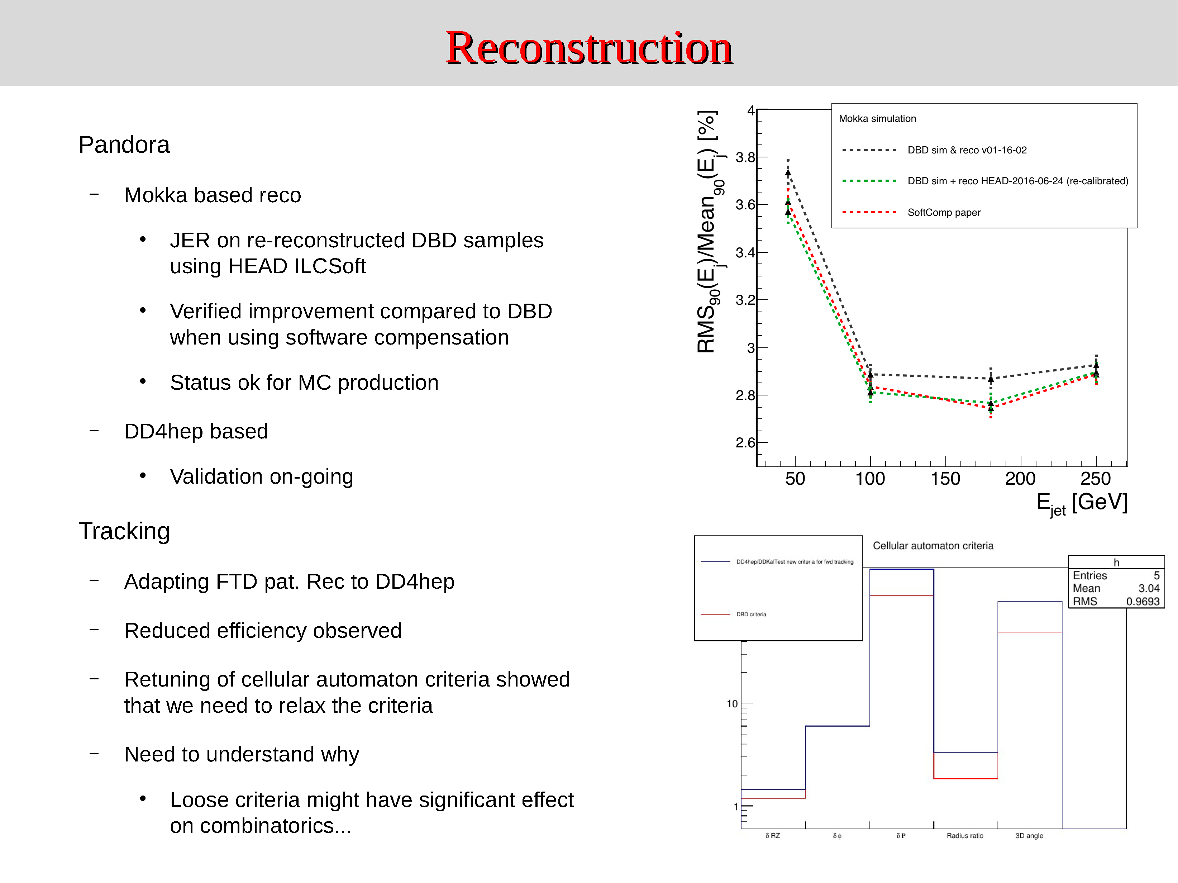
Reconstruction
new criteria
dbd criteria
δRZ
δφ
δP
Radius
ratio
3D
angle

Slide 5
MC Production
ILDDIRAC production using DBD soft (v01-16-02)
    Requested by S.Kawada:
    - 500 GeV e+e- → ffH, H→μ+μ−, 4 pol. comb.: Completed ~79.8k evts.
    Requested by Jackie:
    - 500 GeV, 4f_singleZnunu_leptonic : Completed. ~132k evts
    - 500 GeV, 4f_singleZZorWWMix_leptonic: Completed ~ 379k evts.
    - 500 GeV, 4f_singleZsingleWMix_leptonic: Completed ~ 615k evts.
    - 500 GeV, 4fsingleZee_leptonic : Running ~6.4M evts. ~1/2 of STDHEPs
    Issues: Storage, High failure rates.
    (3) No more user requests in the queue
Temporary information of newly produced samples will be found at
https://confluence.desy.de/display/ILD/Monte+Carlo+Production
Plan
  Continue productions with DBD soft, if any from user. ( Hoping not many. )
  Prepare for re-reconstruction with new reconstruction tools.
  ➔ Wish to update ILDDirac in advance, if time allows.
  Prepare for detector optimization
Important Note:
  LCG file catalog (LFC) support in ILCDirac will be terminated in new release.
  ( you need to install LFC tool by your self, if not available locally )
  LFC support by DESY is expected to continue for a while. KEK: as is support.
  DBD samples, not registered in Dirac catalog, will be registered soon.
  User files should be taken care by himself.

