Slide 1
Makin’ Knobs Tuning Beamlines
Some code edited from Edu Marin Lacoma
Some Code Original
Ryan Bodenstein
FONT Meeting
2016/22/7

Slide 2
Another hot, productive week at CERN
The goal was to design new knobs to improve the single-beam tuning
We made linear and nonlinear knobs, and they didn’t help.
Needed to introduce skew sextupoles
Creating the linear and nonlinear knobs was successful, but implementing the nonlinear knobs which include the skew sextupoles has become an ugly task.

Slide 3
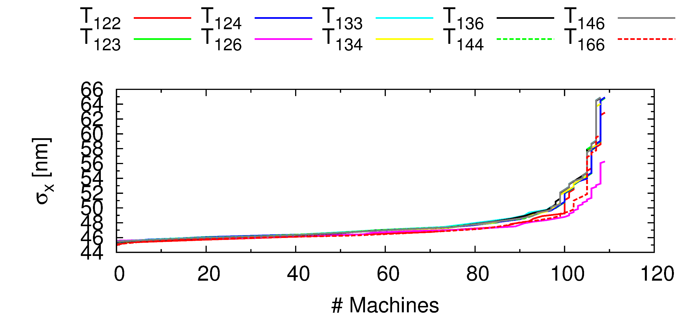
You may recall we were targeting aberrations

Slide 4
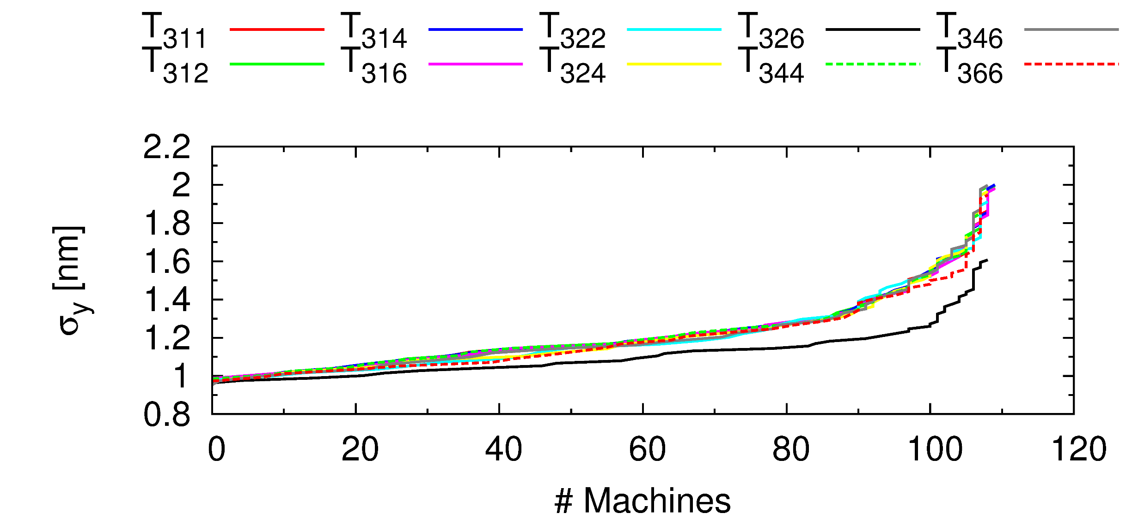
A few more aberrations…

Slide 5
How do you make a knob?
Basically, you use a bit of mathematical wizardry on the response matrix to find various vectors that are orthogonal to each other
Three methods used, primarily
Least Squares (LSQ)
Matrix Inversion (INV)
Singular Value Decomposition (SVD)
Each method ends up with different results, so all three have to be investigated and a method selected
Making the knobs is easy, implementing them in PLACET is…not (but can be)
Here come some confusing plots:

Slide 6
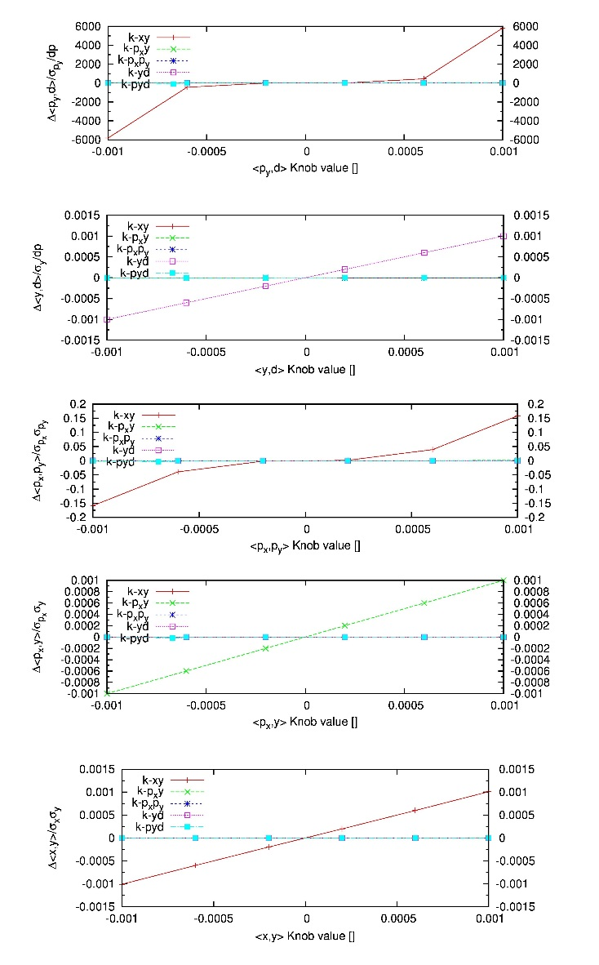
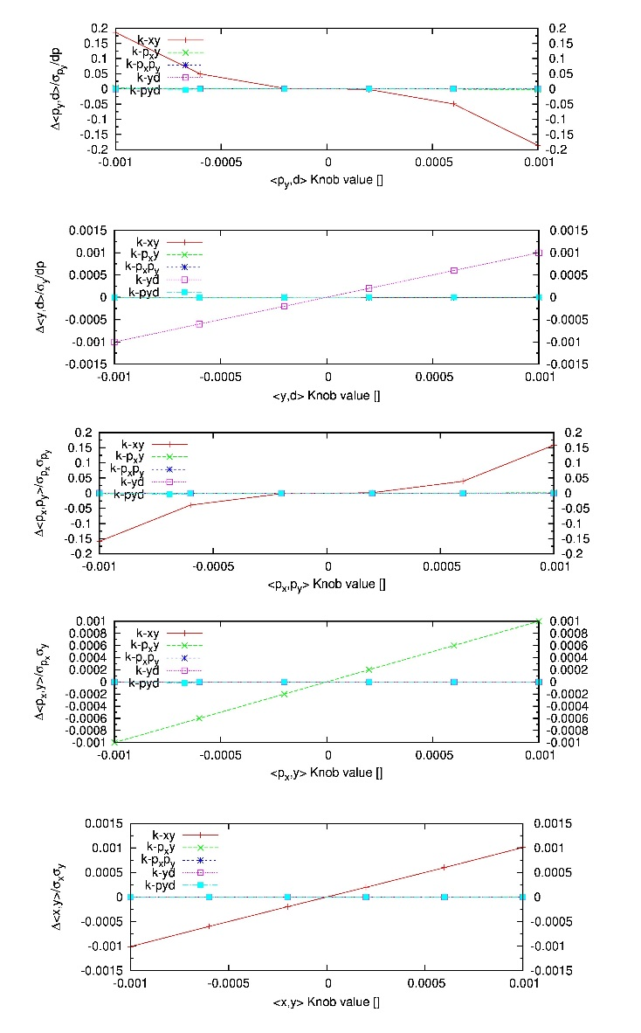
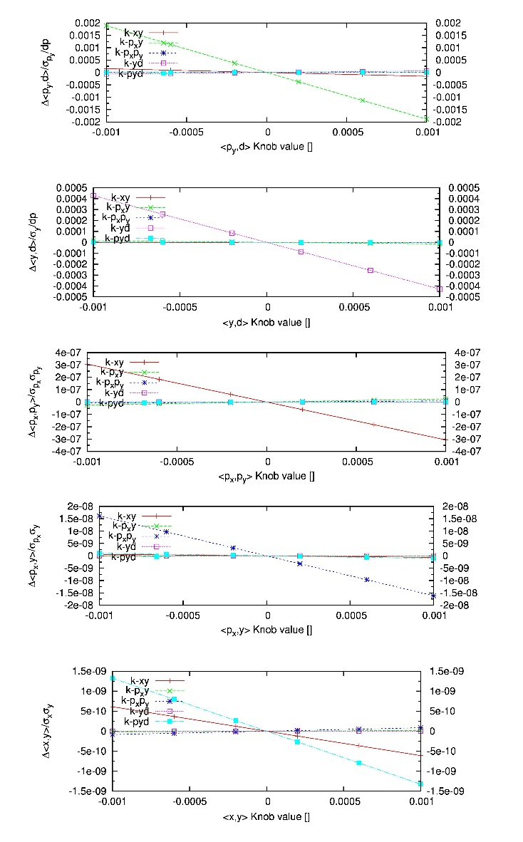
Y-Plane Linear Knobs
INV
LSQ
SVD
Singular Value 1
Singular Value 2
Singular Value 3
Singular Value 4
Singular Value 5

Slide 7
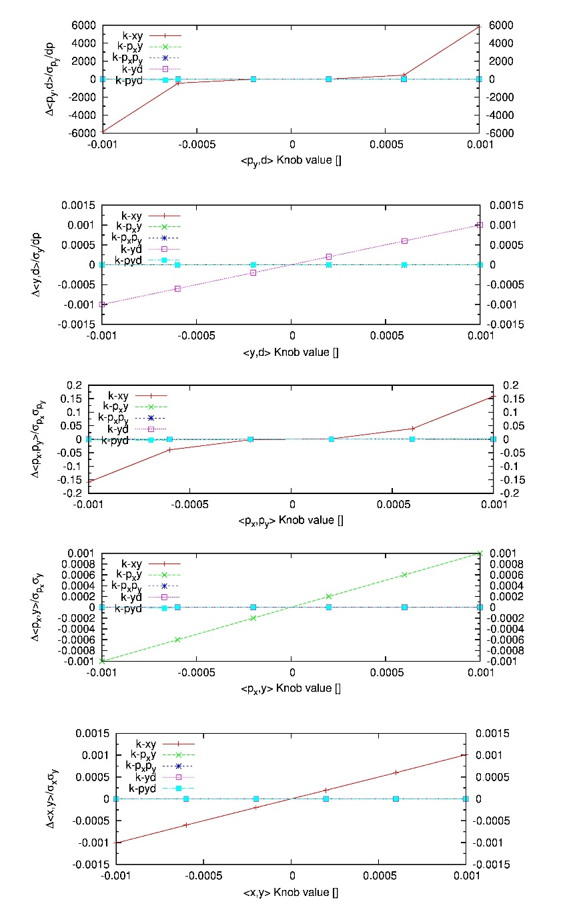
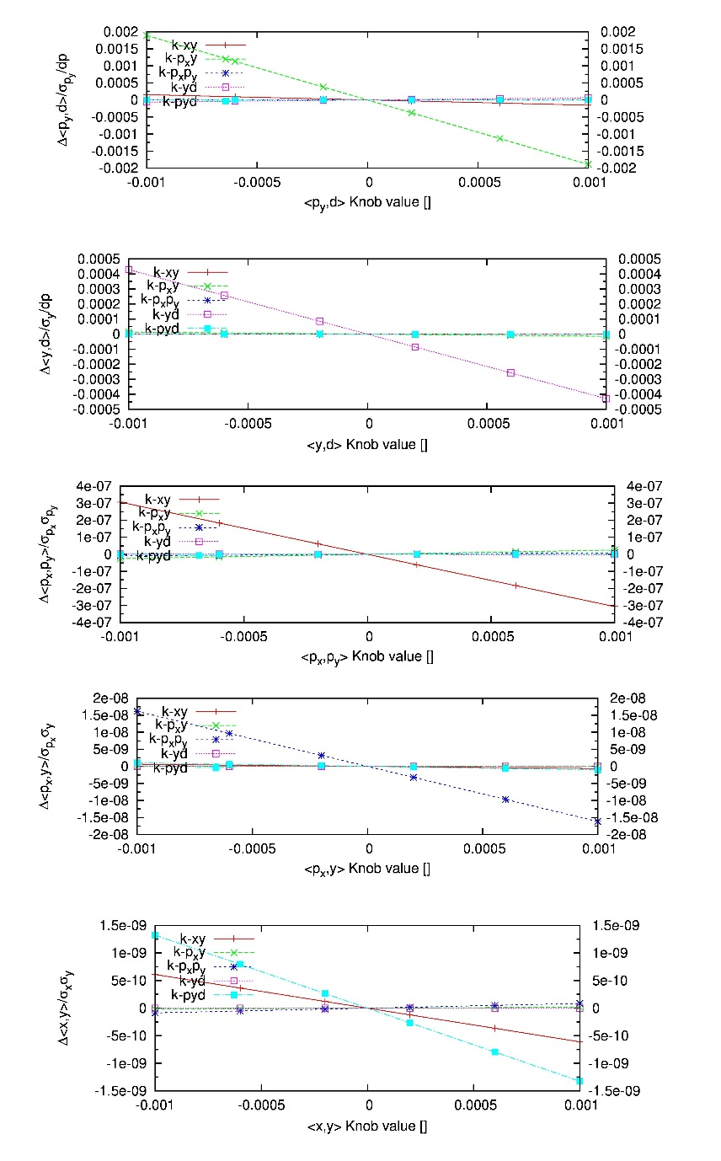
Y-Plane Linear Knobs
INV
SVD
Singular Value 1
Singular Value 2
Singular Value 3
Singular Value 4
Singular Value 5

Slide 8
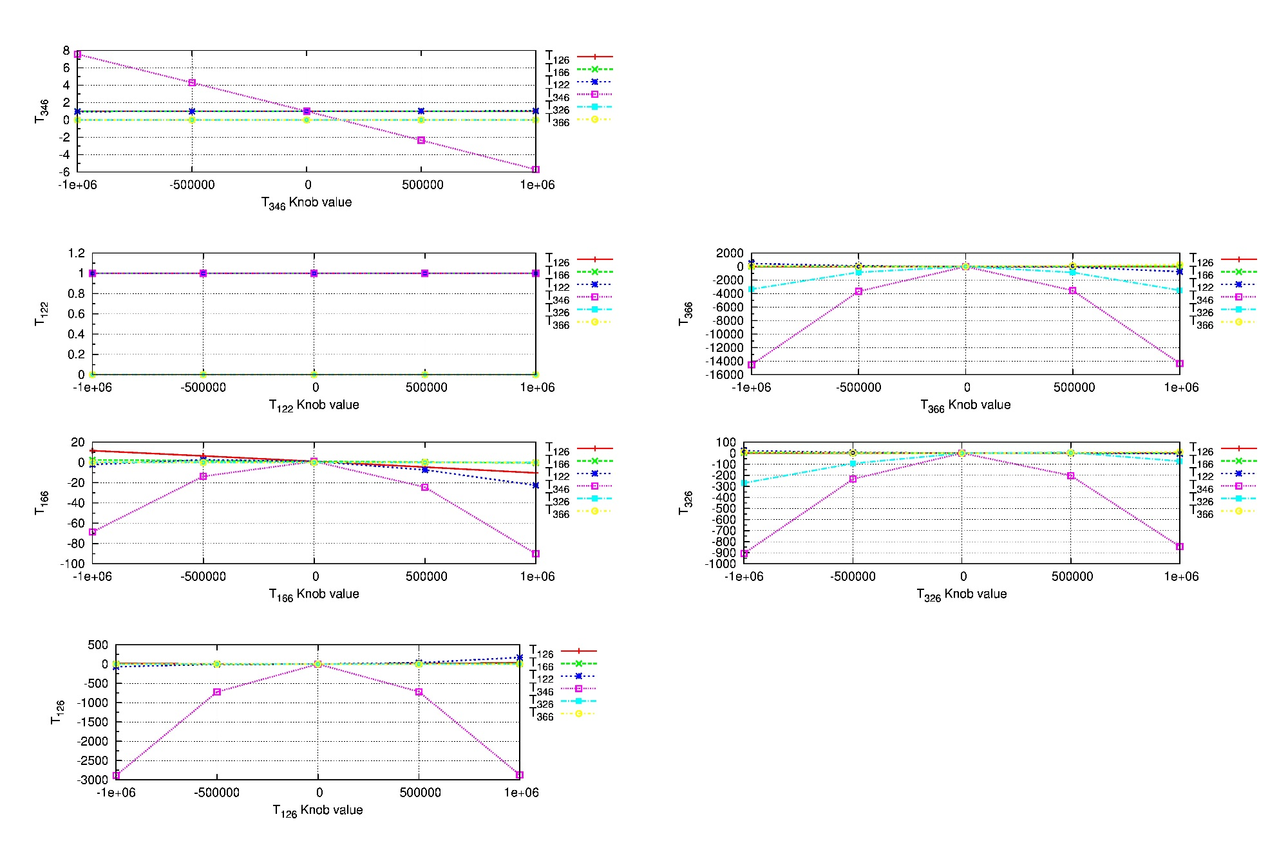
Nonlinear (2nd Order) Knobs
INV
Skew Sextupoles

Slide 9
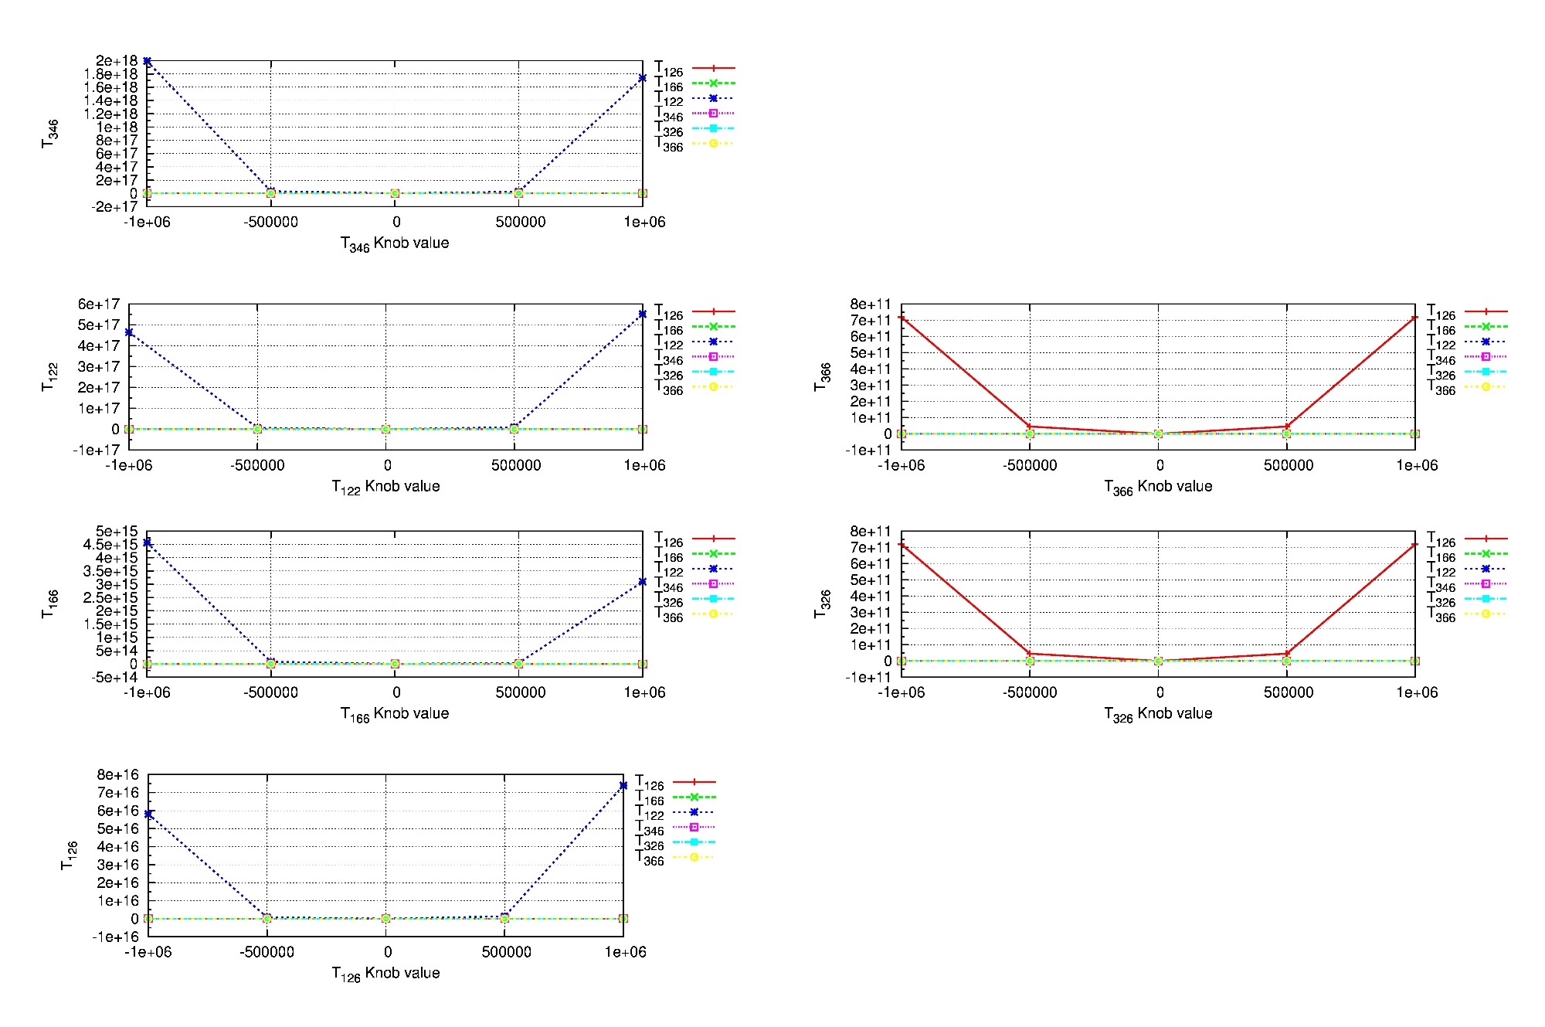
Nonlinear (2nd Order) Knobs
LSQ
Skew Sextupoles

Slide 10
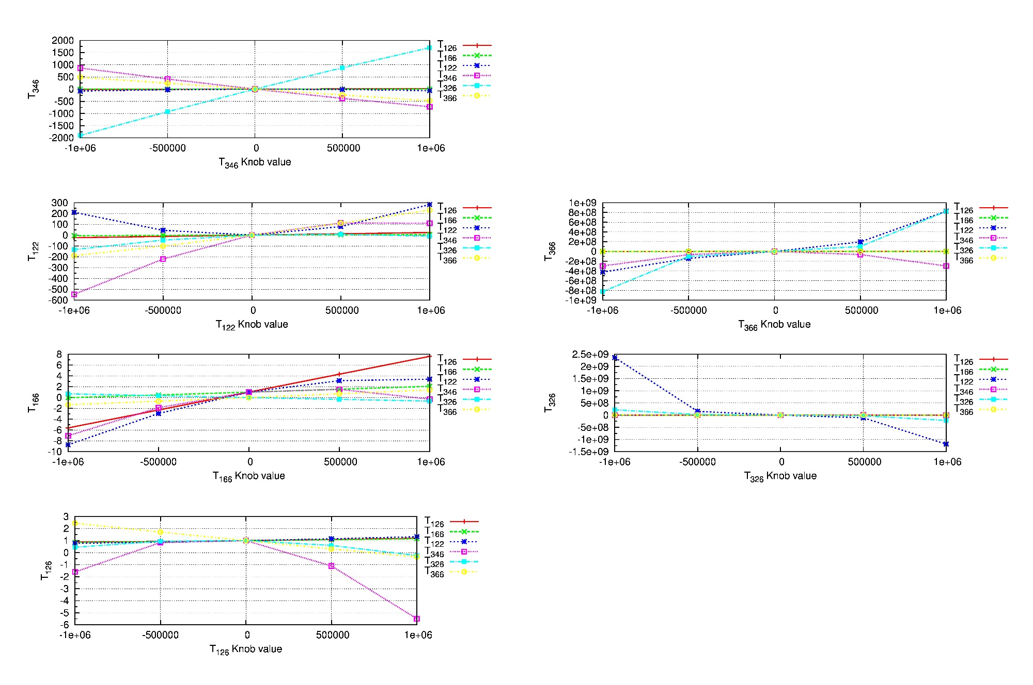
Nonlinear (2nd Order) Knobs
SVD
Skew Sextupoles

Slide 11
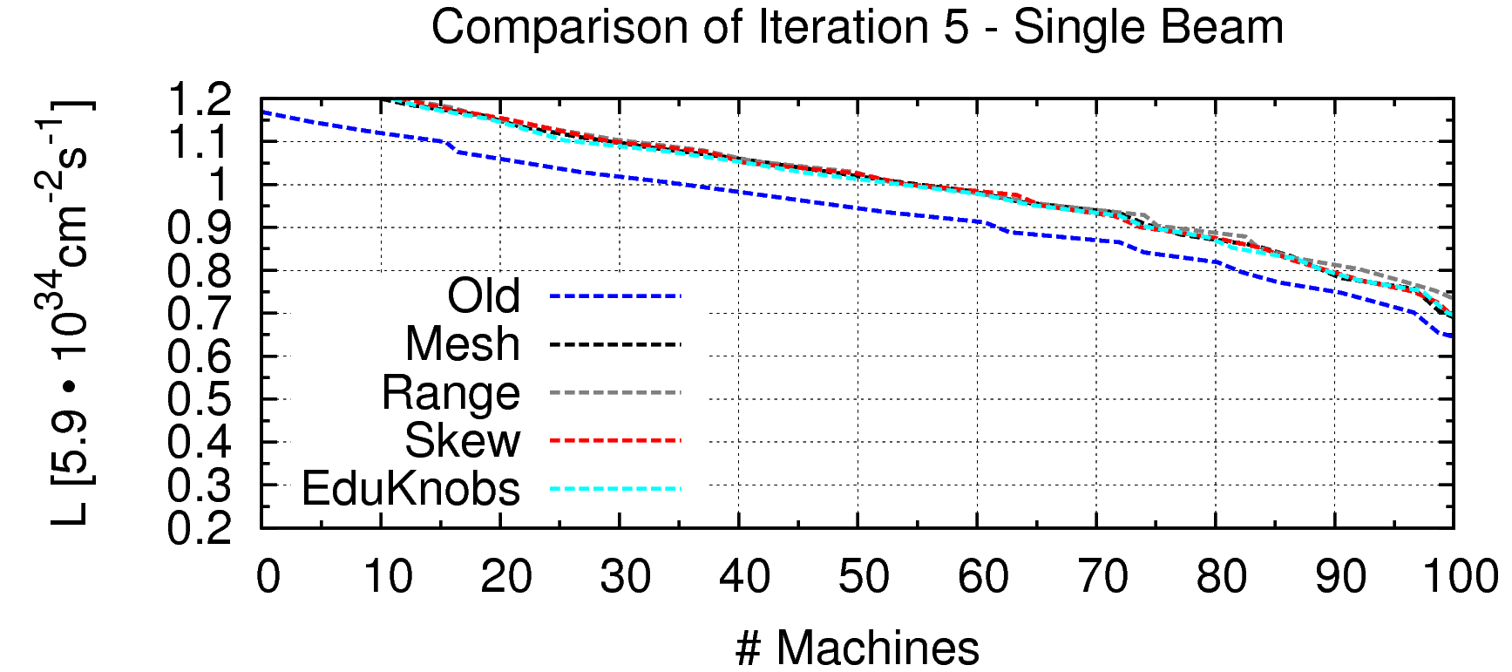
All that work, for no improvement.
This applied the nonlinear knobs and skew sextupole knobs separately
Now investigating tuning both together.

Slide 12
What’s next?
Thought I’d get the mixed tuning done in time, but implementing the new lattice and the 6 x 6 tuning lattice is a terrible job of bookkeeping
Currently getting PLACET errors when running, so I have to keep digging through the code
Edu is also looking through things. Likely, I’m missing a bracket somewhere, or forgot to change a number
Once this is figured out, I’ll present the new tuning results
Next visit in late August into September:
Will continue designing knobs
If goals are reached, may try to implement in 2-beam tuning

