Slide 1
Dynamic Range and Resolution
N. Blaskovic, T. Bromwich, R. Ramjiawan

Slide 2
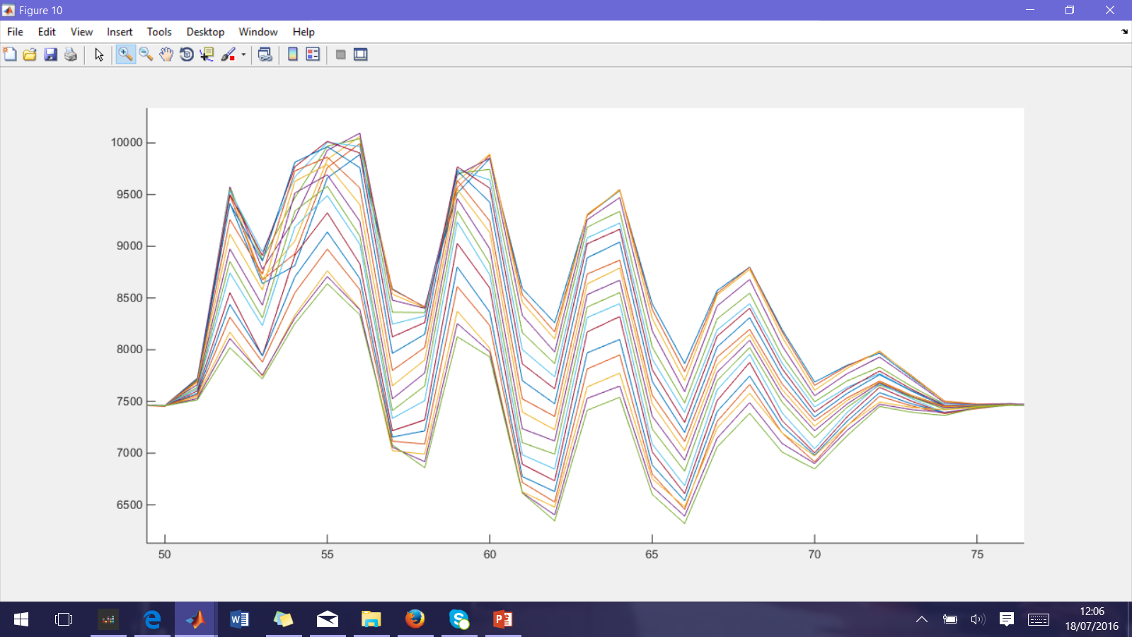
Average signal per mover setting
I signal averaged for each mover setting.
The smallest I signals correspond to mover settings close to 8.3V.
The mover setting that centralises the beam within the BPM is at the edge of the mover range for this file.
At samples 55 and 59 signals at different mover settings cross.
4.0V
IPCyCal6_10dB_ipbpm_160617.mat
I Signal
8.3V
Sample number

Slide 3
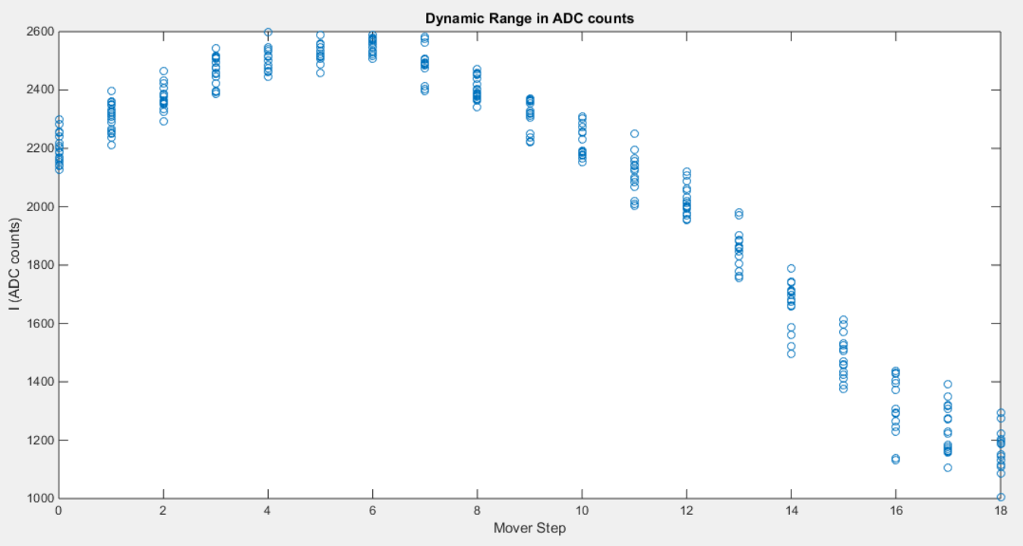
Edge of the Mover Range
IPCyCal6_10dB_ipbpm_160617.mat
I signal flattening at higher mover values.
Mover settings for these triggers are reaching the edge of range 0-8.4V.
4.0V
Larger I signals
8.3V
Smaller I signals

Slide 4
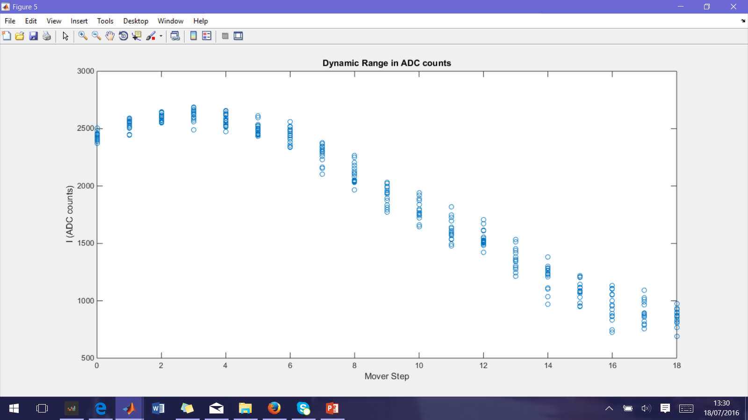

IPC mover
The linear range appears to be >2V which is twice as large as the expected dynamic range.
Expected dynamic range: 5$μ$m (10dB, ${10}^{10}$ charge, from Honda’s paper)→ 1.19V (10dB,$0.44×{10}^{10}$ charge.)
>2V
4.0V
8.3V

Slide 5
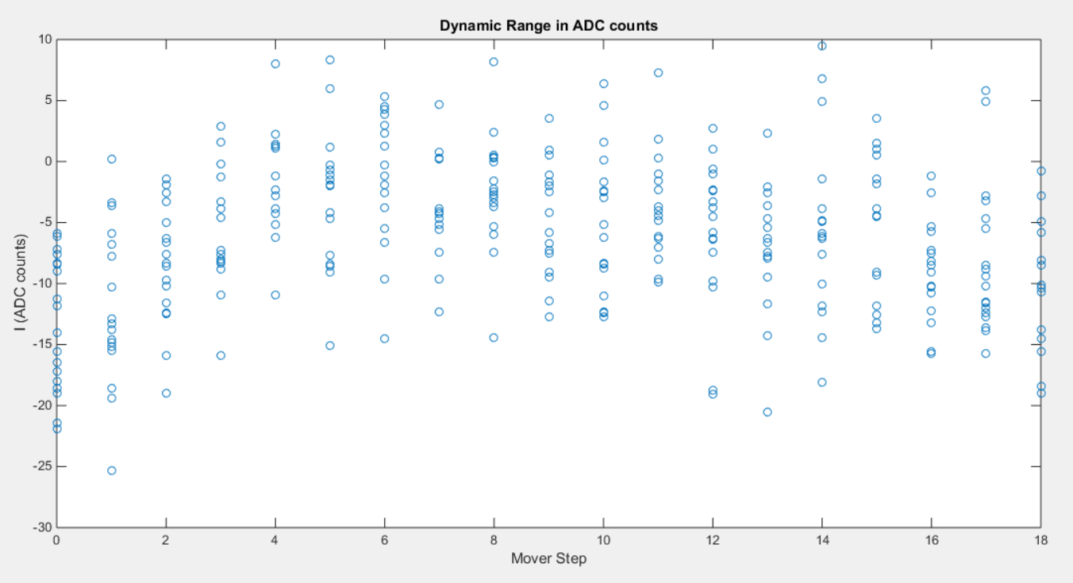
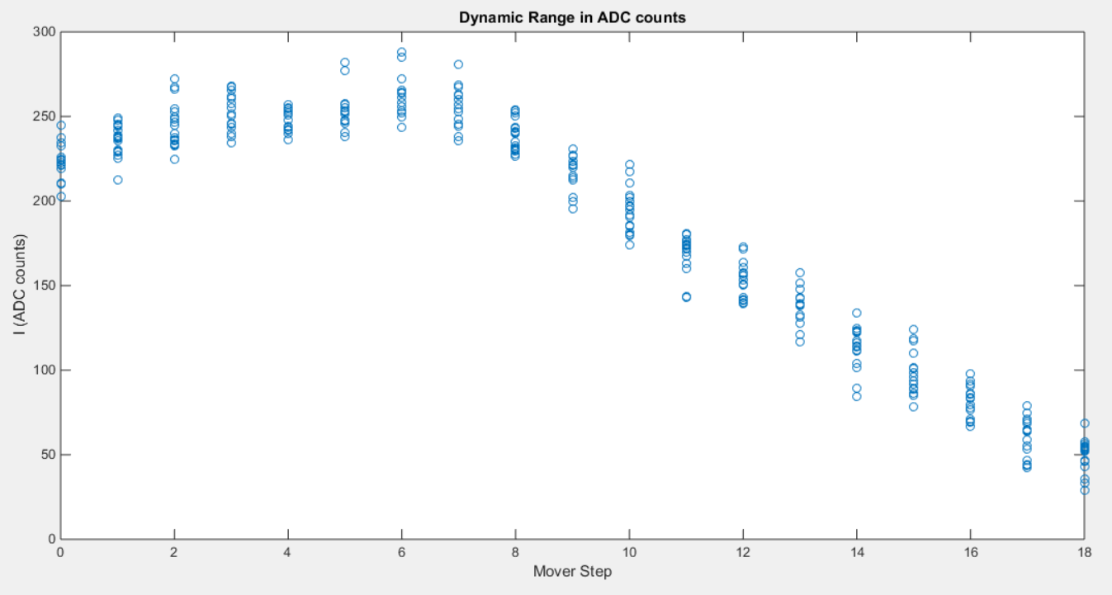
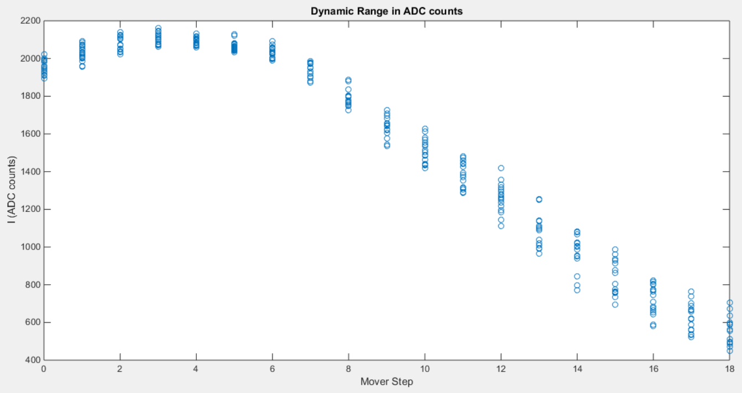
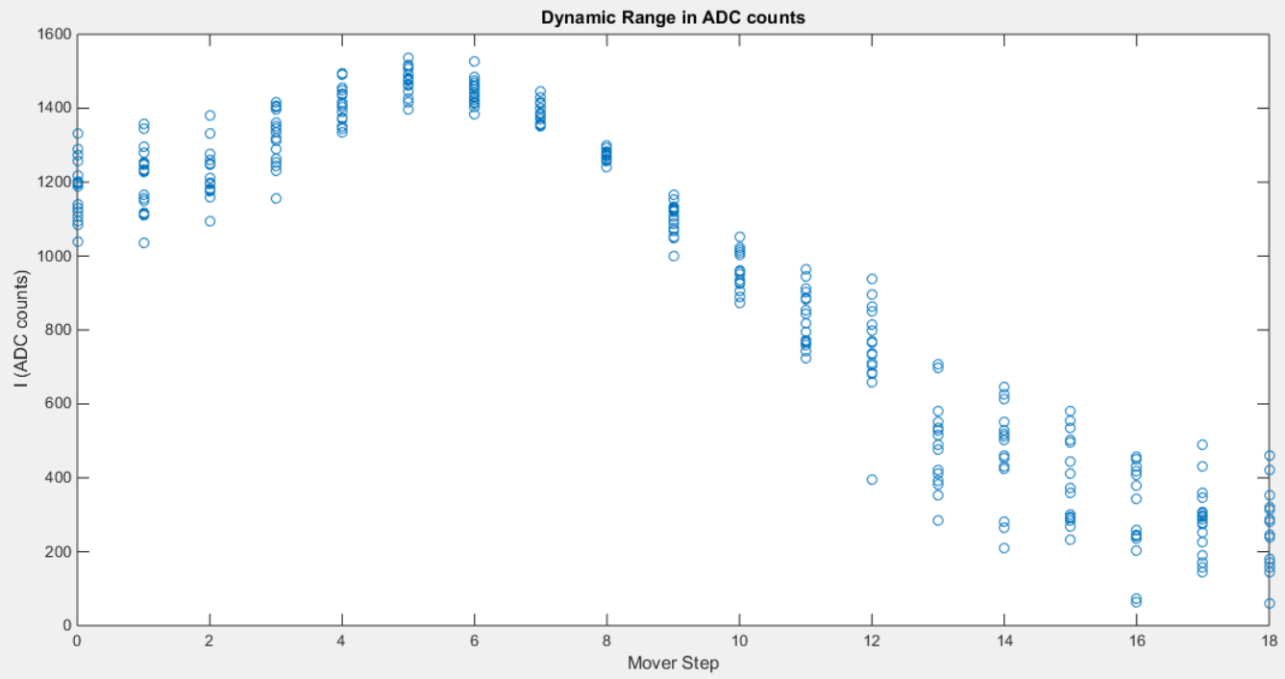
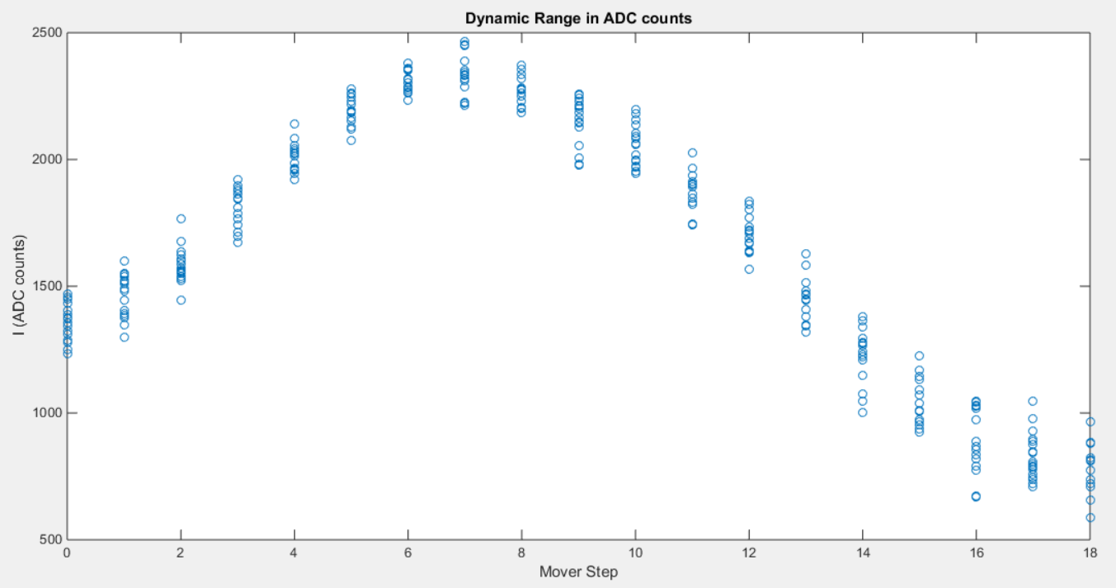
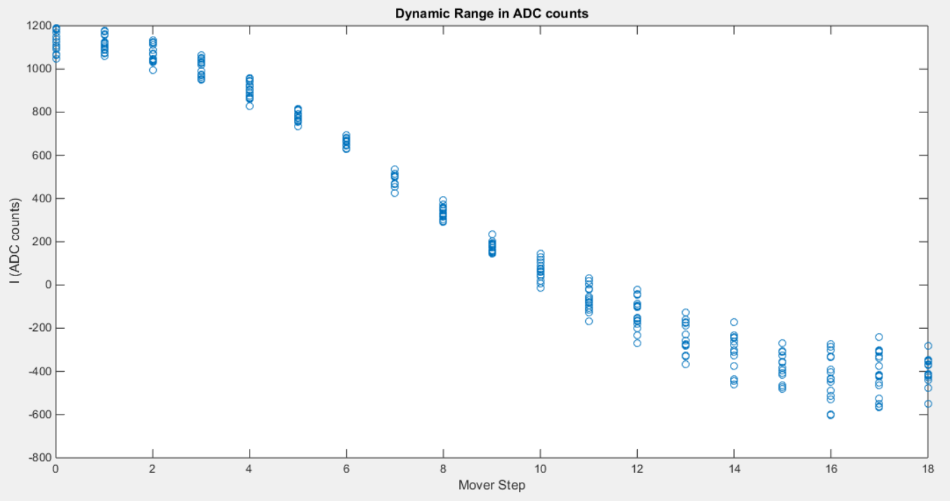
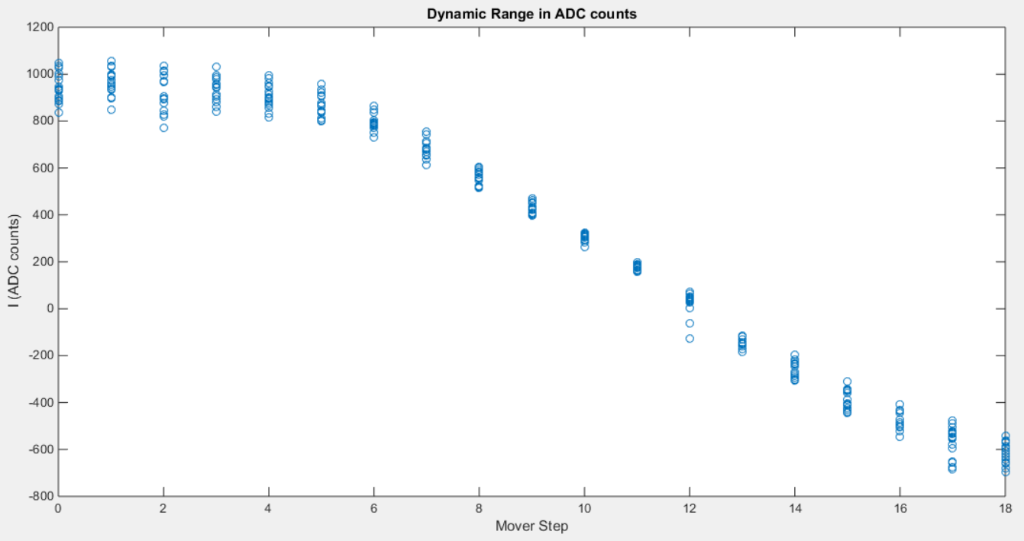
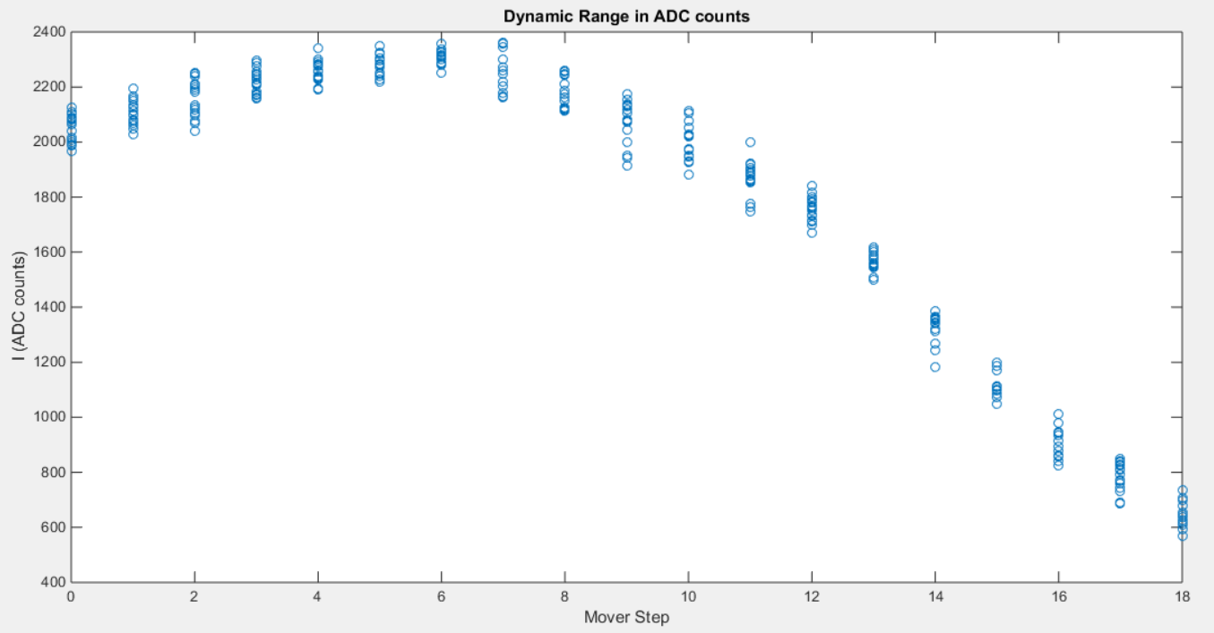
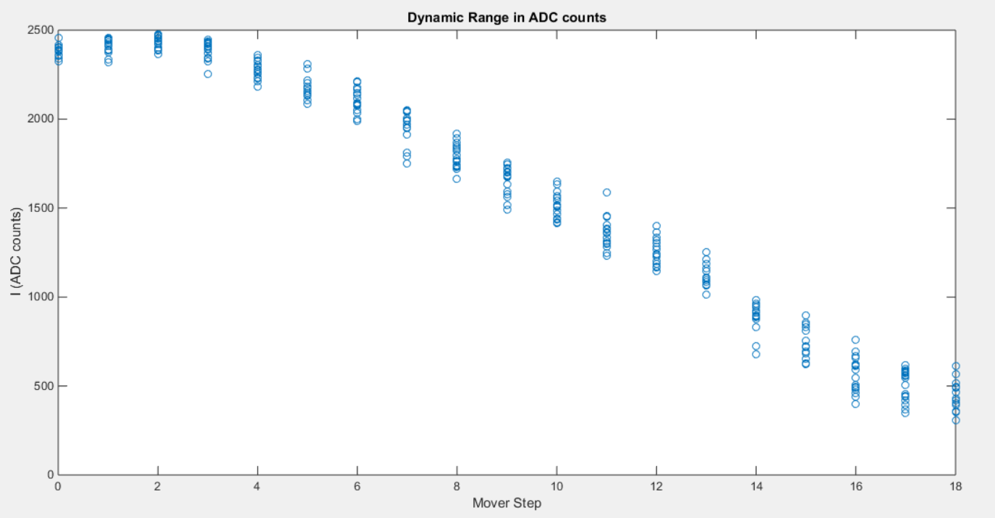
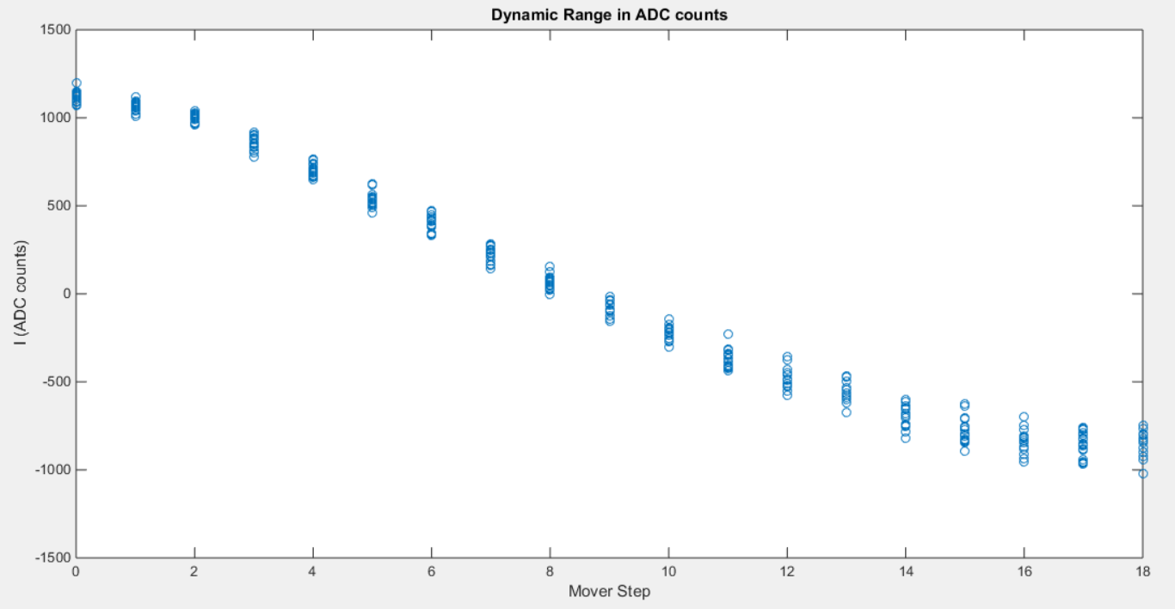
Sample 50
Sample 51
Sample 52
Sample 53
Sample 54
Sample 55
Sample 56
Sample 57
Sample 58
Sample 59
Sample 60
Sample 61

Slide 6
Saturation?
Sample 51
Sample 52
300
2200
0
400
I signal turns non-linear at mover step 6 for both sample numbers despite the I signal being two very different values.
Not saturation for sample 51 as will not be saturating at 250 ADC counts.

Slide 7
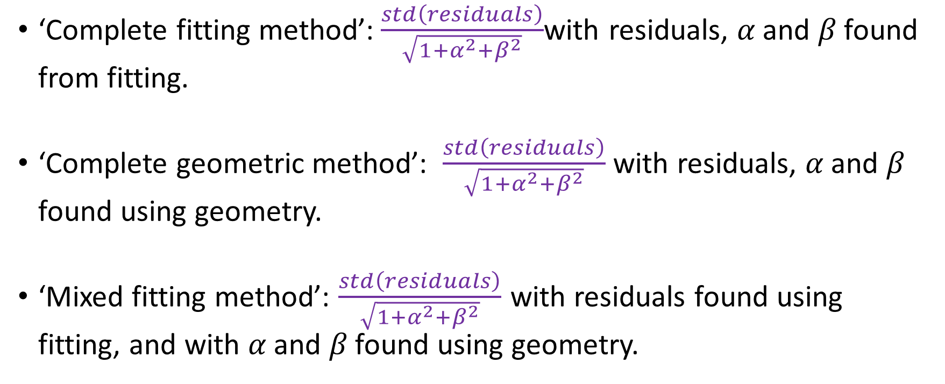
Three Resolution Methods
‘Complete fitting method’:$\frac{std\left(residuals\right)}{\sqrt{1+α^{2}+β^{2}}}$with residuals, $α$ and $β$ found from fitting.
‘Complete geometric method’: $\frac{std\left(residuals\right)}{\sqrt{1+α^{2}+β^{2}}}$ with residuals, $α$ and $β$ found using geometry.
‘Mixed fitting method’: $\frac{std\left(residuals\right)}{\sqrt{1+α^{2}+β^{2}}}$ with residuals found using fitting, and with $α$ and $β$ found using geometry.

Slide 8
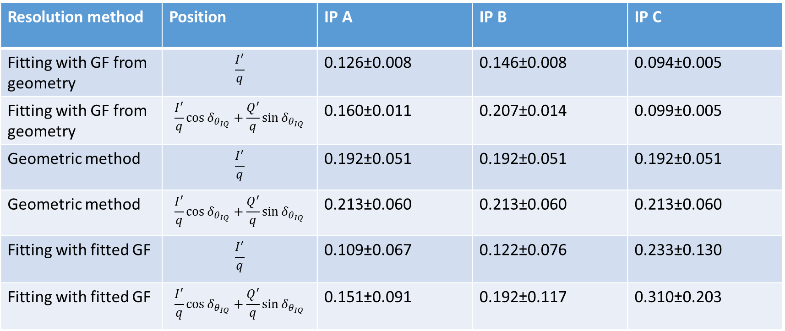
Resolution 10dB
160617_owl, samples 54-57, same files as last meeting.
Resolution method | Position | IP A | IP B | IP C
Fitting with GF from geometry | $$\frac{I^{′}}{q}$$ | 0.126±0.008 | 0.146±0.008 | 0.094±0.005
Fitting with GF from geometry | $$\frac{I^{′}}{q}\cos{δ_{θ_{IQ}}}+\frac{Q^{′}}{q}\sin{δ_{θ_{IQ}}}$$ | 0.160±0.011 | 0.207±0.014 | 0.099±0.005
Geometric method | $$\frac{I^{′}}{q}$$ | 0.192±0.051 | 0.192±0.051 | 0.192±0.051
Geometric method | $$\frac{I^{′}}{q}\cos{δ_{θ_{IQ}}}+\frac{Q^{′}}{q}\sin{δ_{θ_{IQ}}}$$ | 0.213±0.060 | 0.213±0.060 | 0.213±0.060
Fitting with fitted GF | $$\frac{I^{′}}{q}$$ | 0.109±0.067 | 0.122±0.076 | 0.233±0.130
Fitting with fitted GF | $$\frac{I^{′}}{q}\cos{δ_{θ_{IQ}}}+\frac{Q^{′}}{q}\sin{δ_{θ_{IQ}}}$$ | 0.151±0.091 | 0.192±0.117 | 0.310±0.203

Slide 9
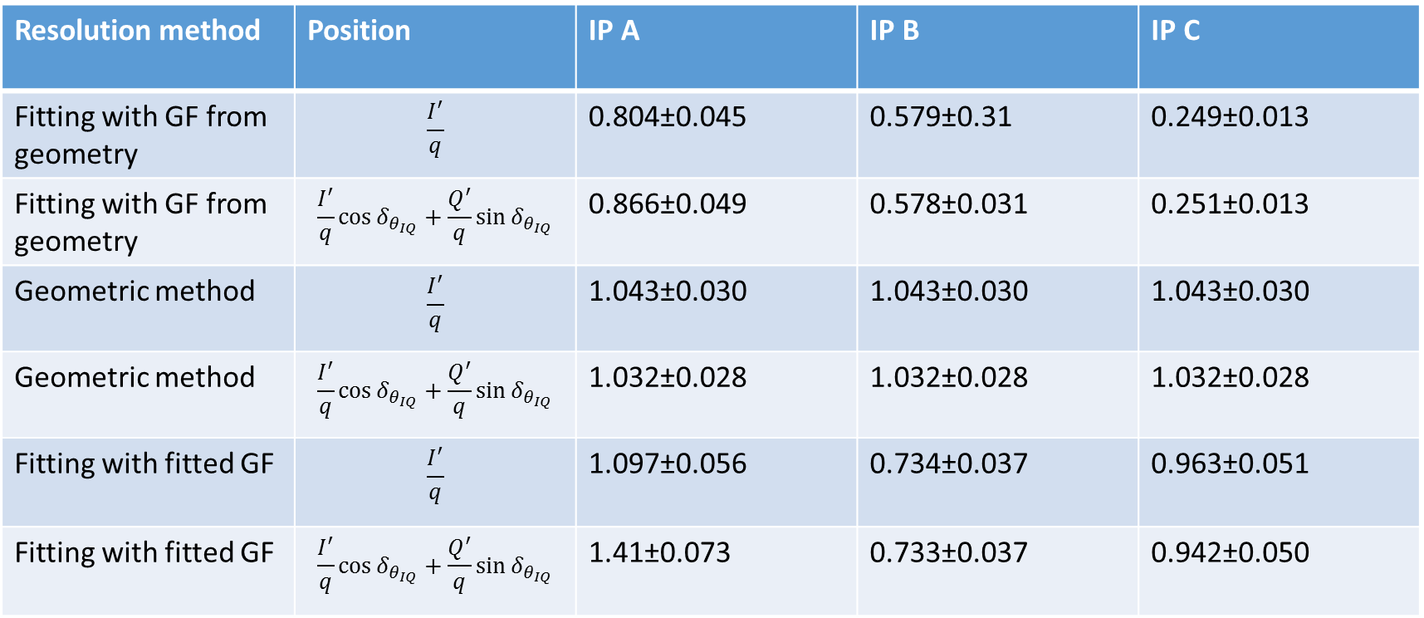
Resolution 20dB
160617_owl, samples 54-57, same files as last meeting.
Resolution method | Position | IP A | IP B | IP C
Fitting with GF from geometry | $$\frac{I^{′}}{q}$$ | 0.804±0.045 | 0.579±0.31 | 0.249±0.013
Fitting with GF from geometry | $$\frac{I^{′}}{q}\cos{δ_{θ_{IQ}}}+\frac{Q^{′}}{q}\sin{δ_{θ_{IQ}}}$$ | 0.866±0.049 | 0.578±0.031 | 0.251±0.013
Geometric method | $$\frac{I^{′}}{q}$$ | 1.043±0.030 | 1.043±0.030 | 1.043±0.030
Geometric method | $$\frac{I^{′}}{q}\cos{δ_{θ_{IQ}}}+\frac{Q^{′}}{q}\sin{δ_{θ_{IQ}}}$$ | 1.032±0.028 | 1.032±0.028 | 1.032±0.028
Fitting with fitted GF | $$\frac{I^{′}}{q}$$ | 1.097±0.056 | 0.734±0.037 | 0.963±0.051
Fitting with fitted GF | $$\frac{I^{′}}{q}\cos{δ_{θ_{IQ}}}+\frac{Q^{′}}{q}\sin{δ_{θ_{IQ}}}$$ | 1.41±0.073 | 0.733±0.037 | 0.942±0.050

