Slide 1
Histograms for upstream feedback scans
N. Blaskovic
N. Blaskovic

Slide 2
Introduction
K2-P3 single-loop feedback performed in March with Talitha & Rebecca
Stripline phase shifter set up on P3
Offline phase subtraction for MQF15X
Performed a range of scans
N. Blaskovic

Slide 3
Scans
Scans:
Orbit scan (using corrector magnet ZV6X)
Random jitter source strength scan
Feedback gain scan
Bunch charge scan
Results presented for bunches 2 & 3
Results measured at P3 & MQF15X
N. Blaskovic

Slide 4
Results at P3
Results measured at feedback BPM P3
P3 logged on FONT5A board A5
Charge cut performed on P3 only
N. Blaskovic

Slide 5
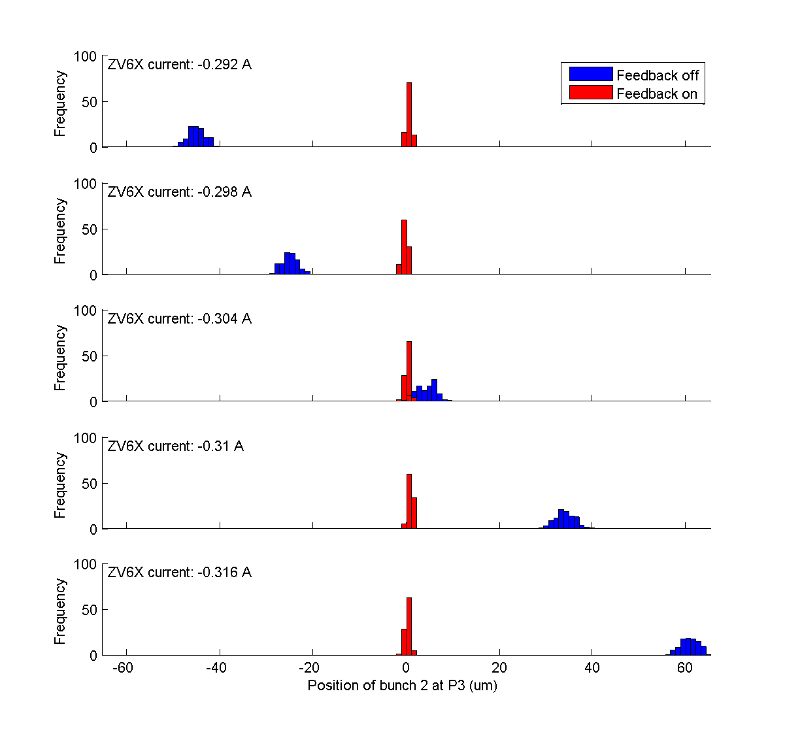
P3
bunch 2
Orbit scan
N. Blaskovic

Slide 6
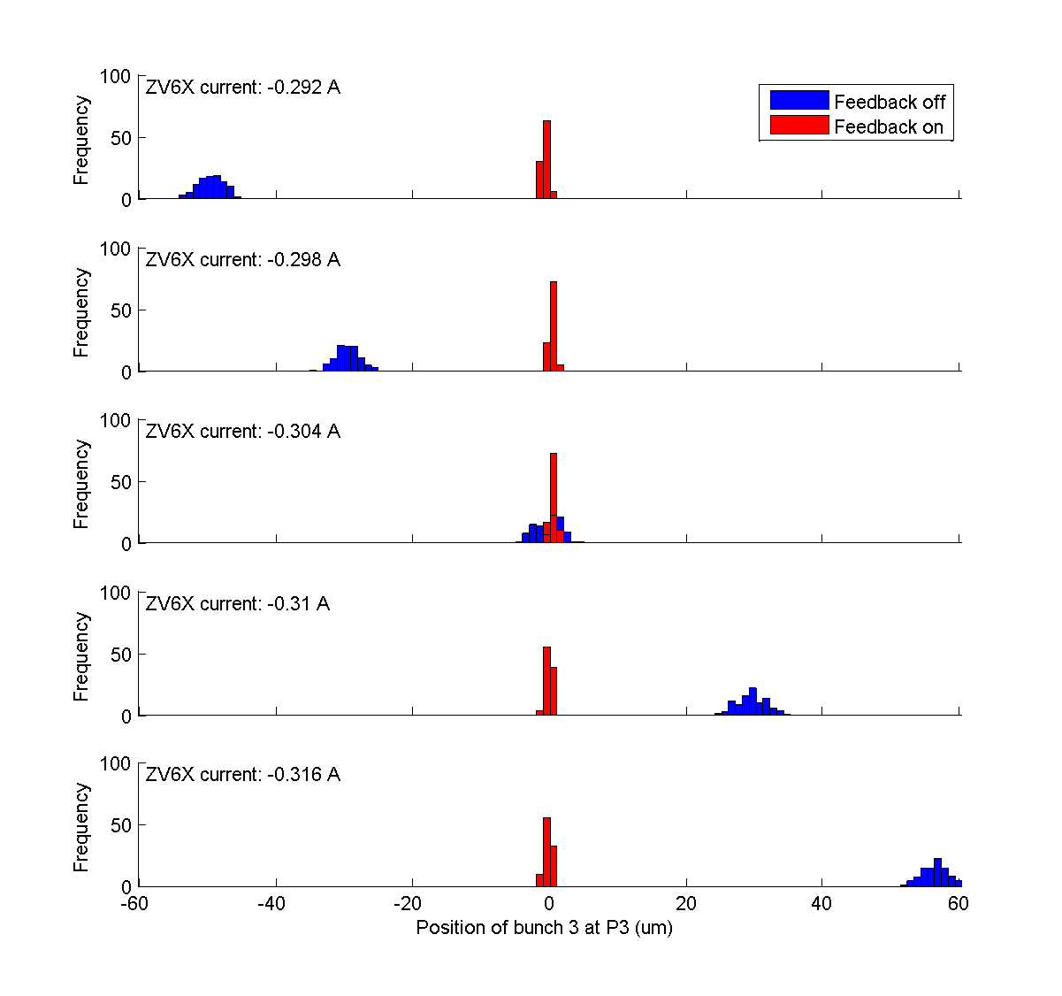
P3
bunch 3
Orbit scan
N. Blaskovic

Slide 7
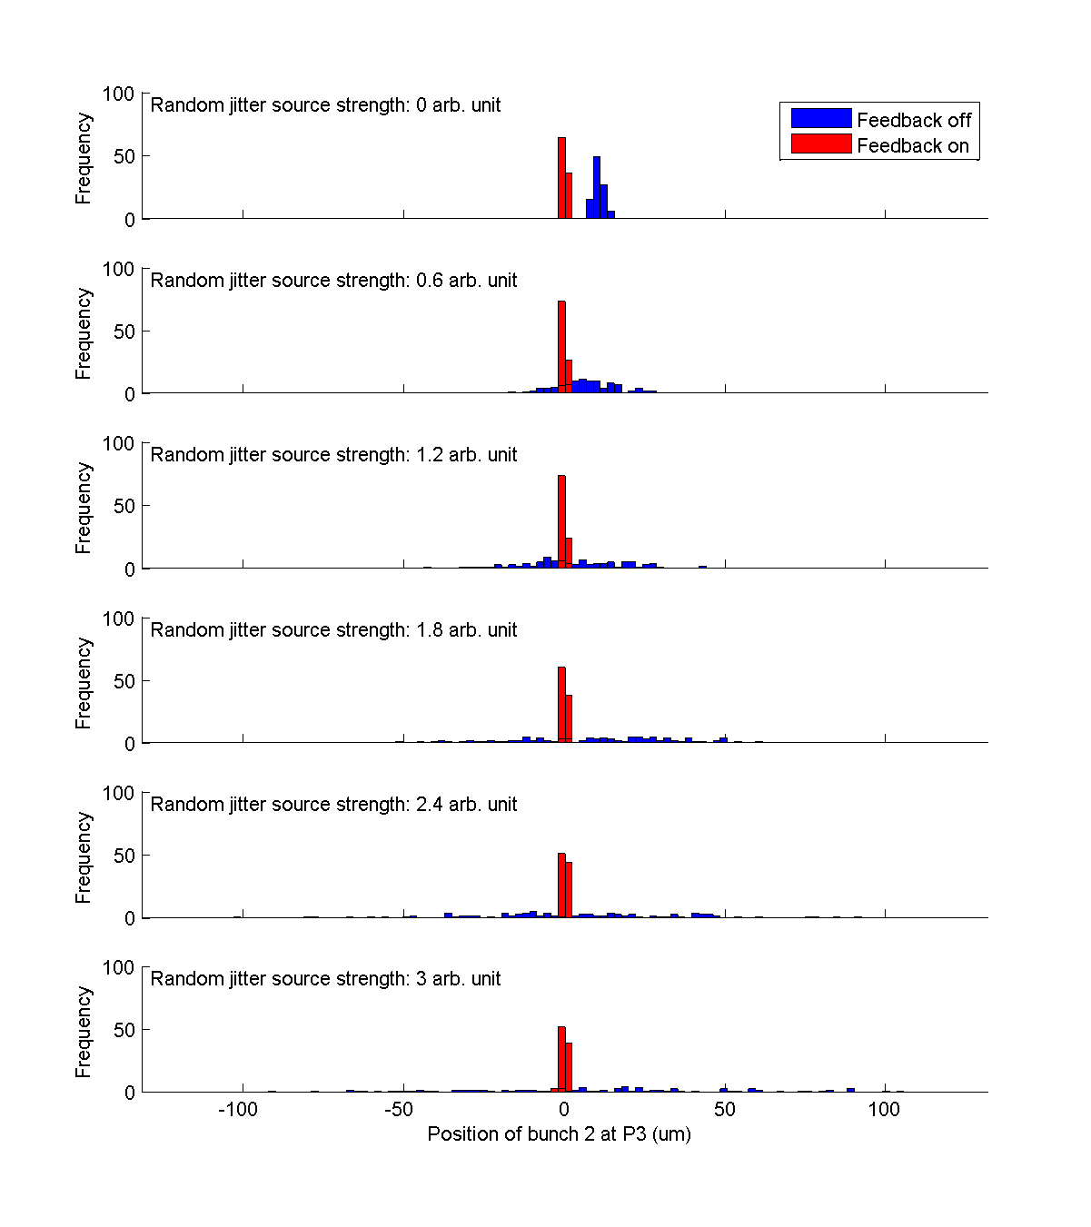
P3
bunch 2
Random jitter scan
N. Blaskovic

Slide 8
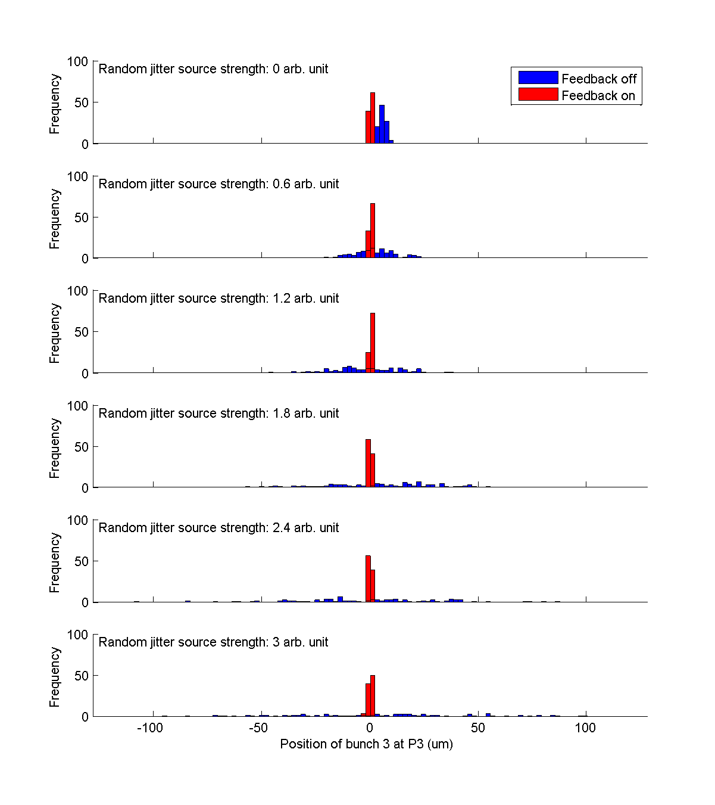
P3
bunch 3
Random jitter scan
N. Blaskovic

Slide 9
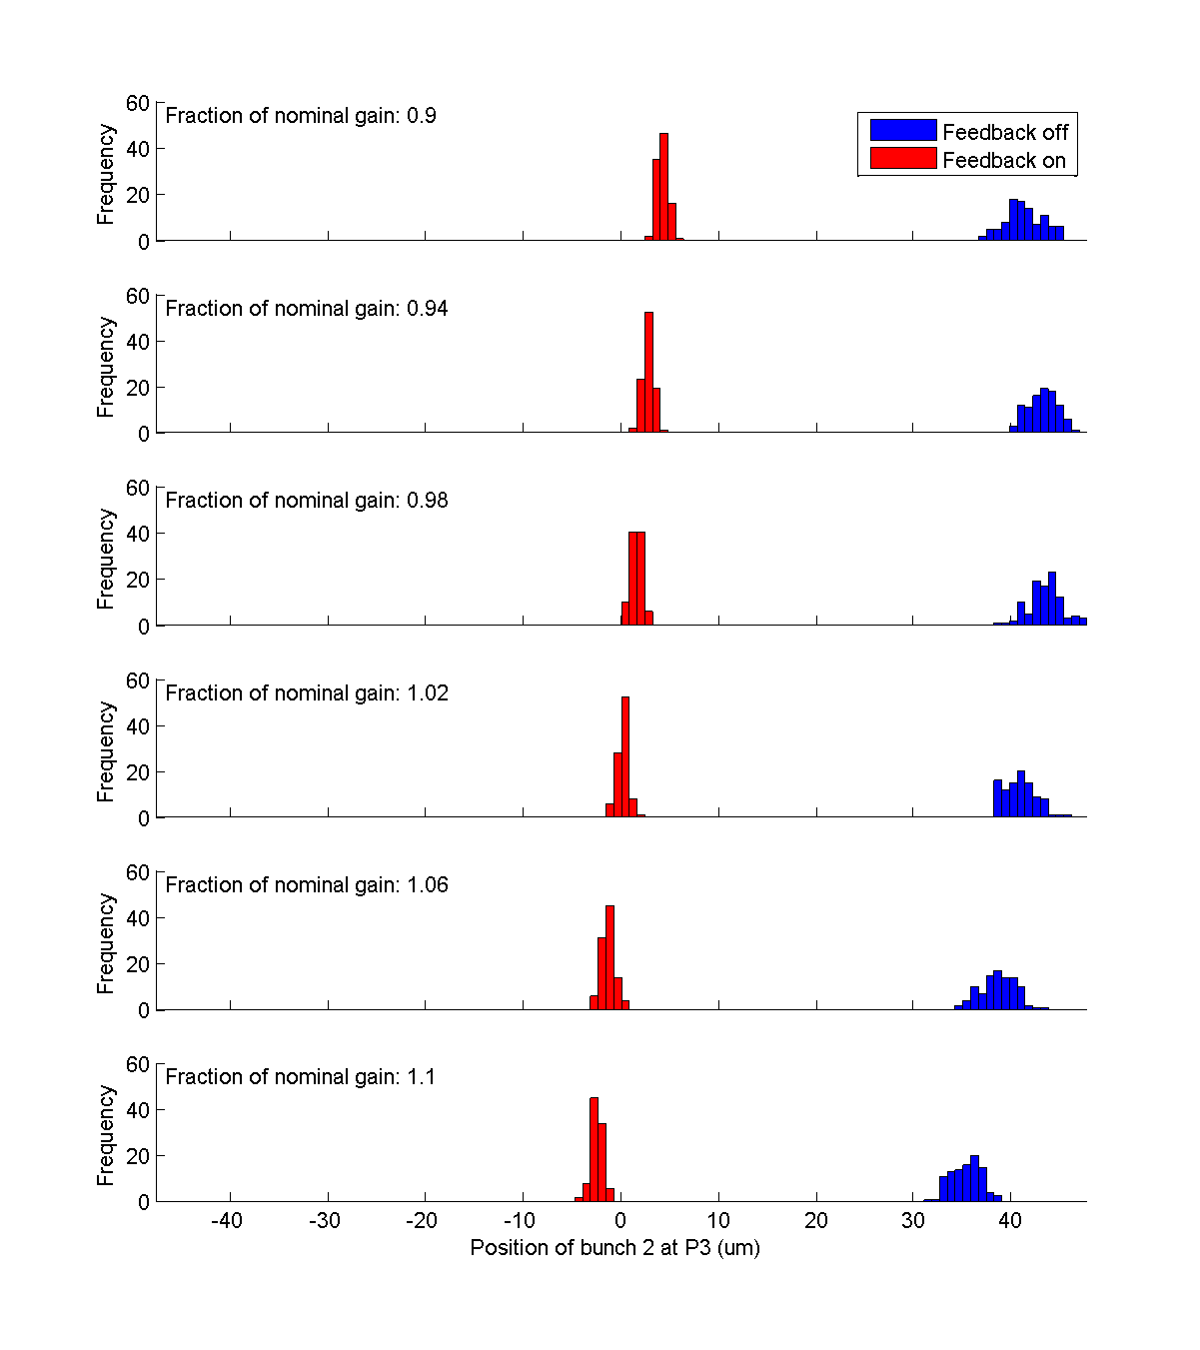
P3
bunch 2
Feedback gain scan
N. Blaskovic

Slide 10
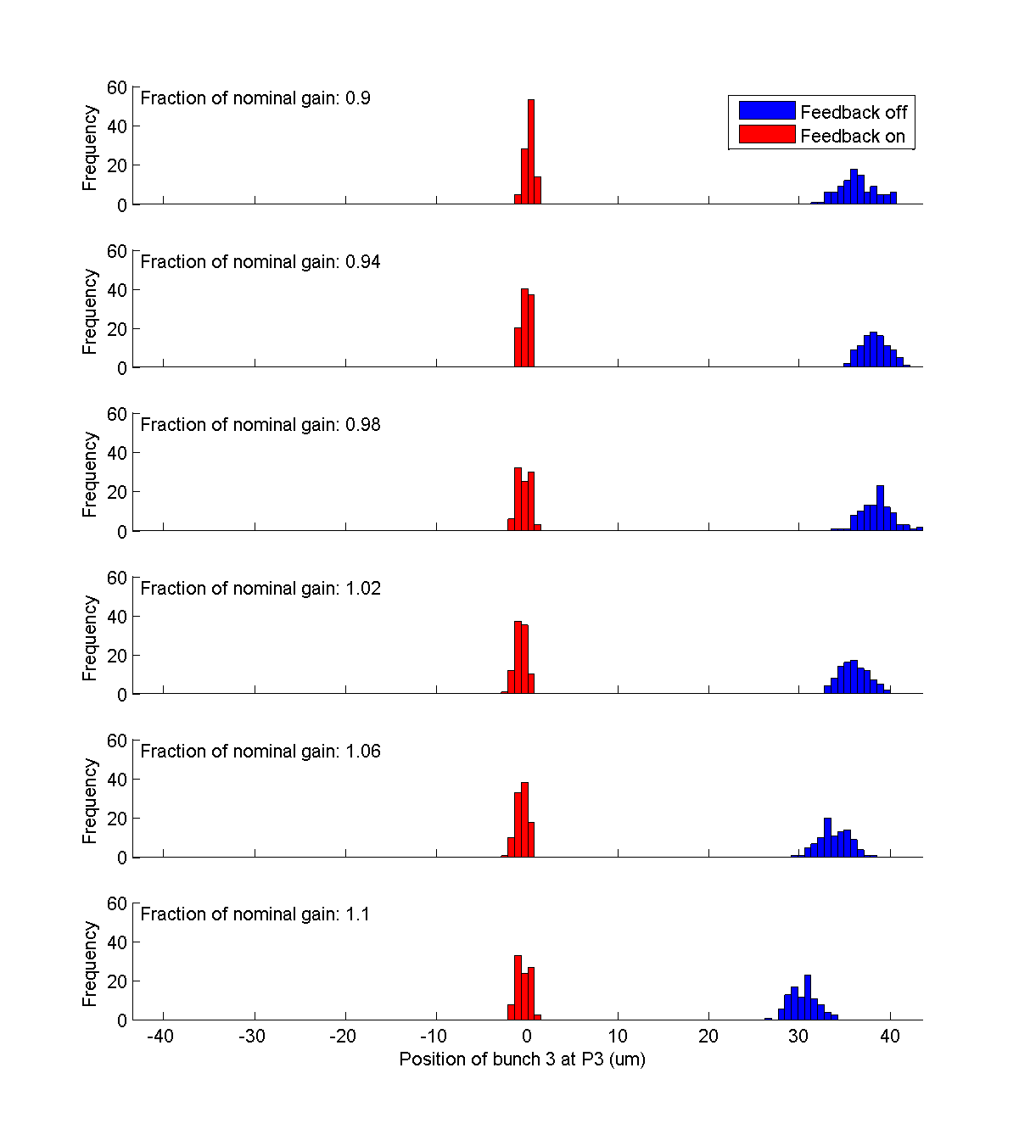
P3
bunch 3
Feedback gain scan
N. Blaskovic

Slide 11
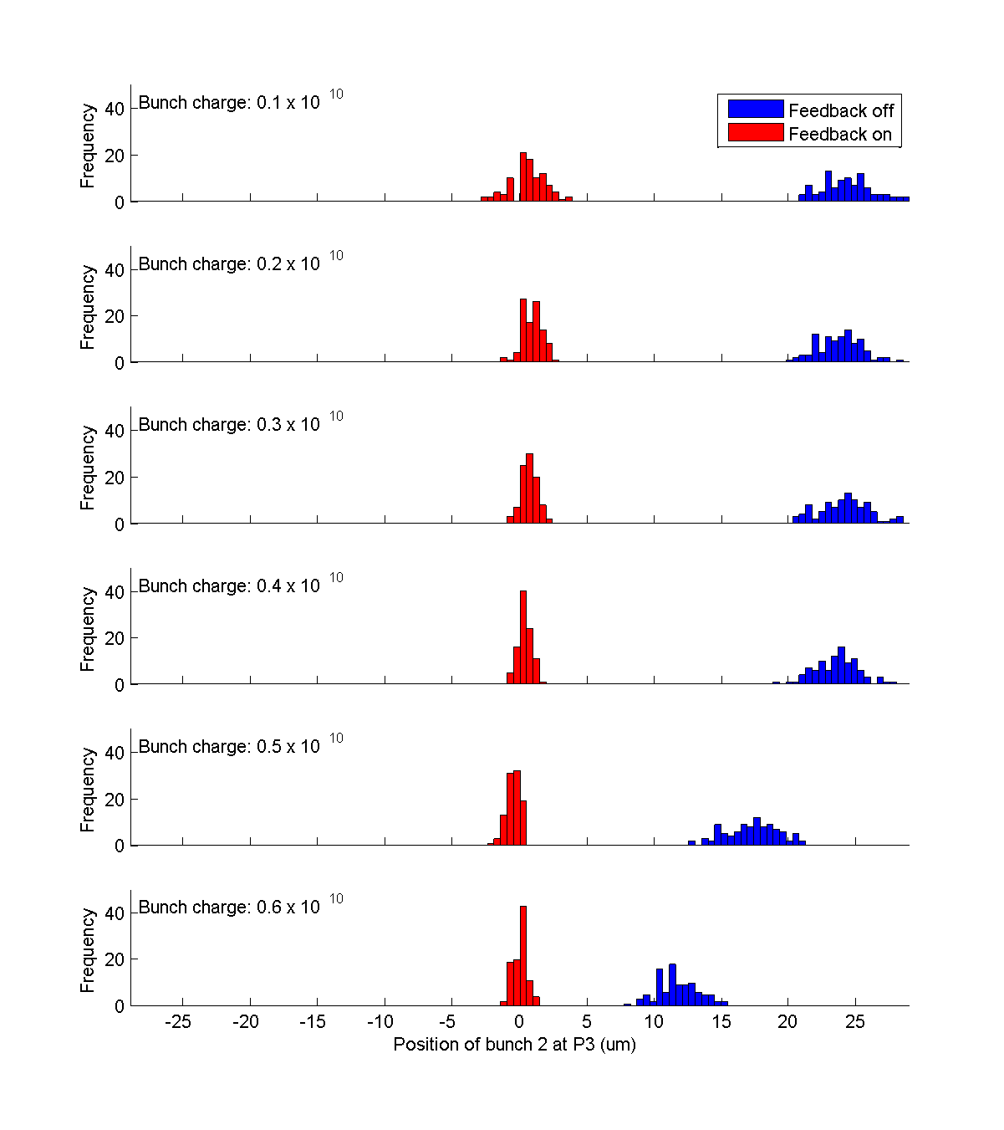
P3
bunch 2
Bunch charge scan
N. Blaskovic

Slide 12
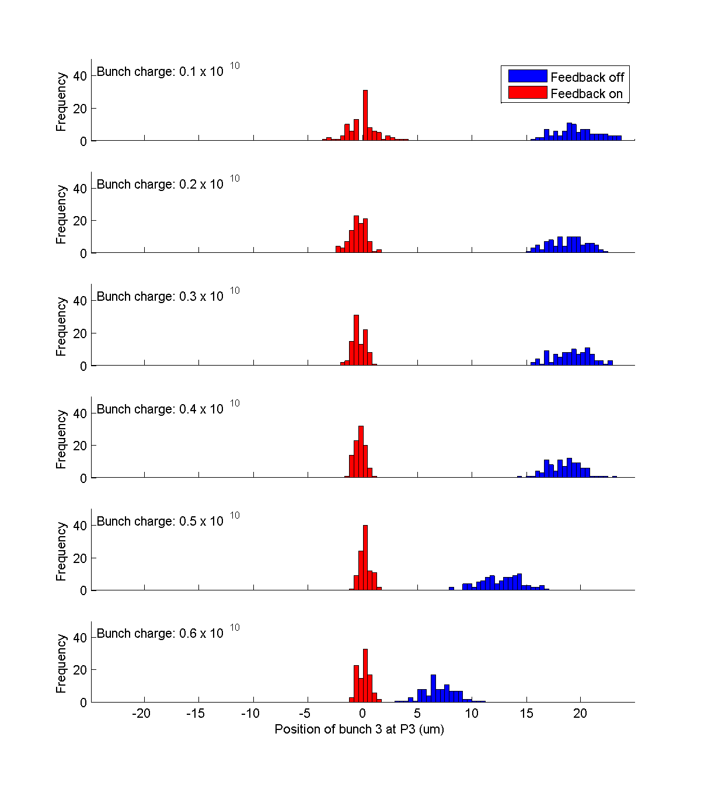
P3
bunch 3
Bunch charge scan
N. Blaskovic

Slide 13
Results at MQF15X
Results from witness BPM MQF15X
MQF15X logged on FONT5A board A4
Unless otherwise stated, charge cut on MQF15X only
For data where boards are asynchronous:
Feedback on/off discrimination from board A5
MQF15X data from board A4
So, charge cut on P3 & MQF15X to remove asynchronous triggers
N. Blaskovic

Slide 14
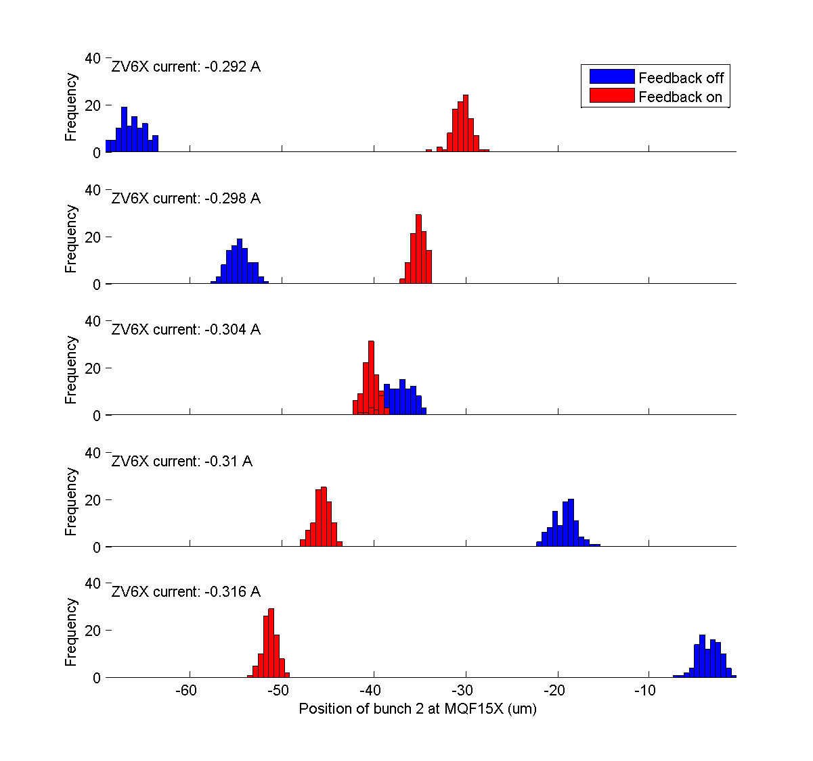
MQF15X
bunch 2
Orbit scan
N. Blaskovic

Slide 15
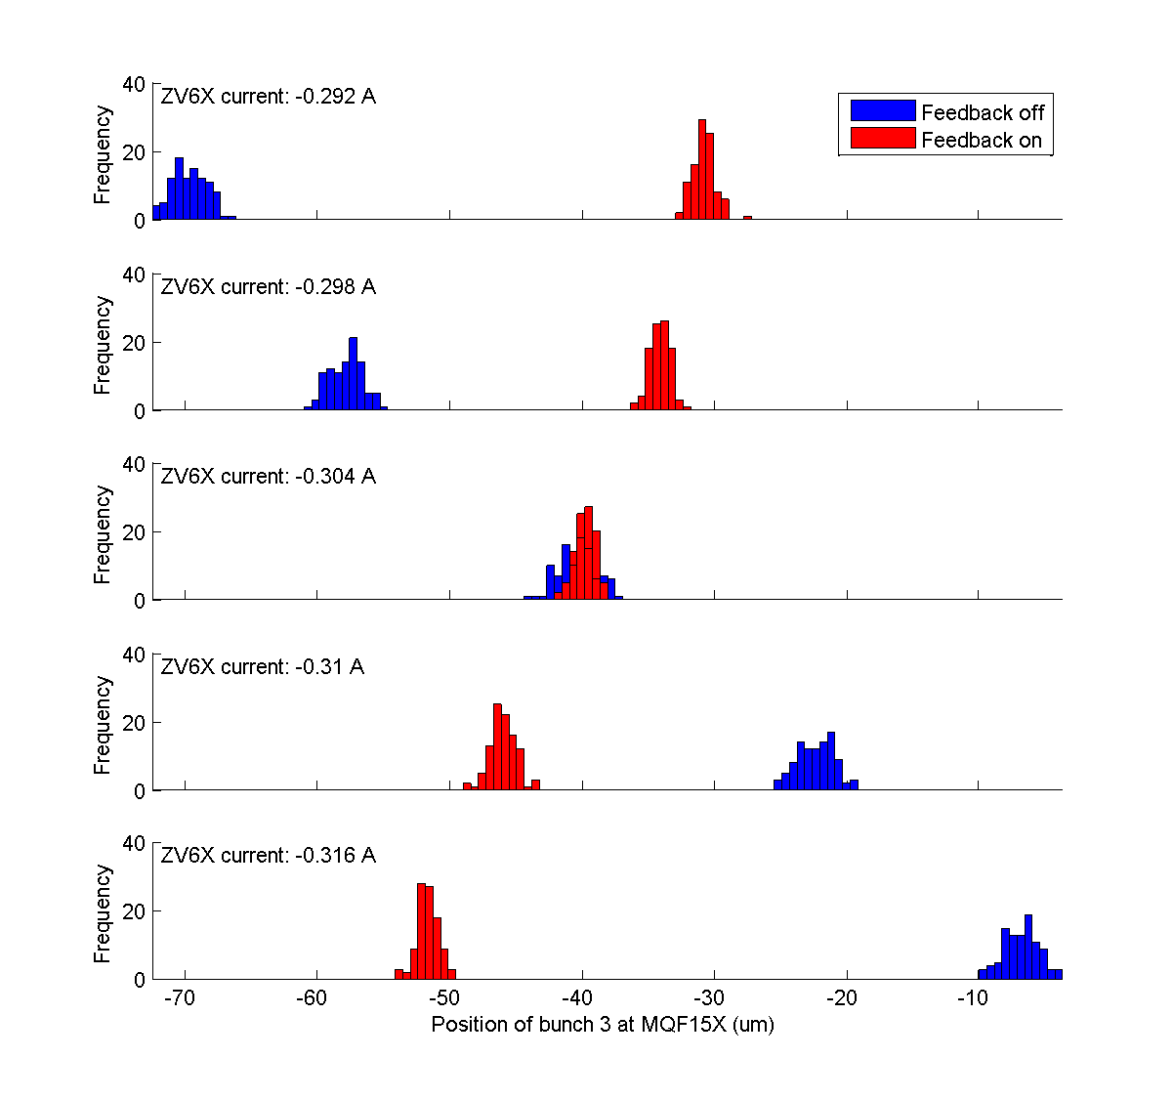
MQF15X
bunch 3
Orbit scan
N. Blaskovic

Slide 16
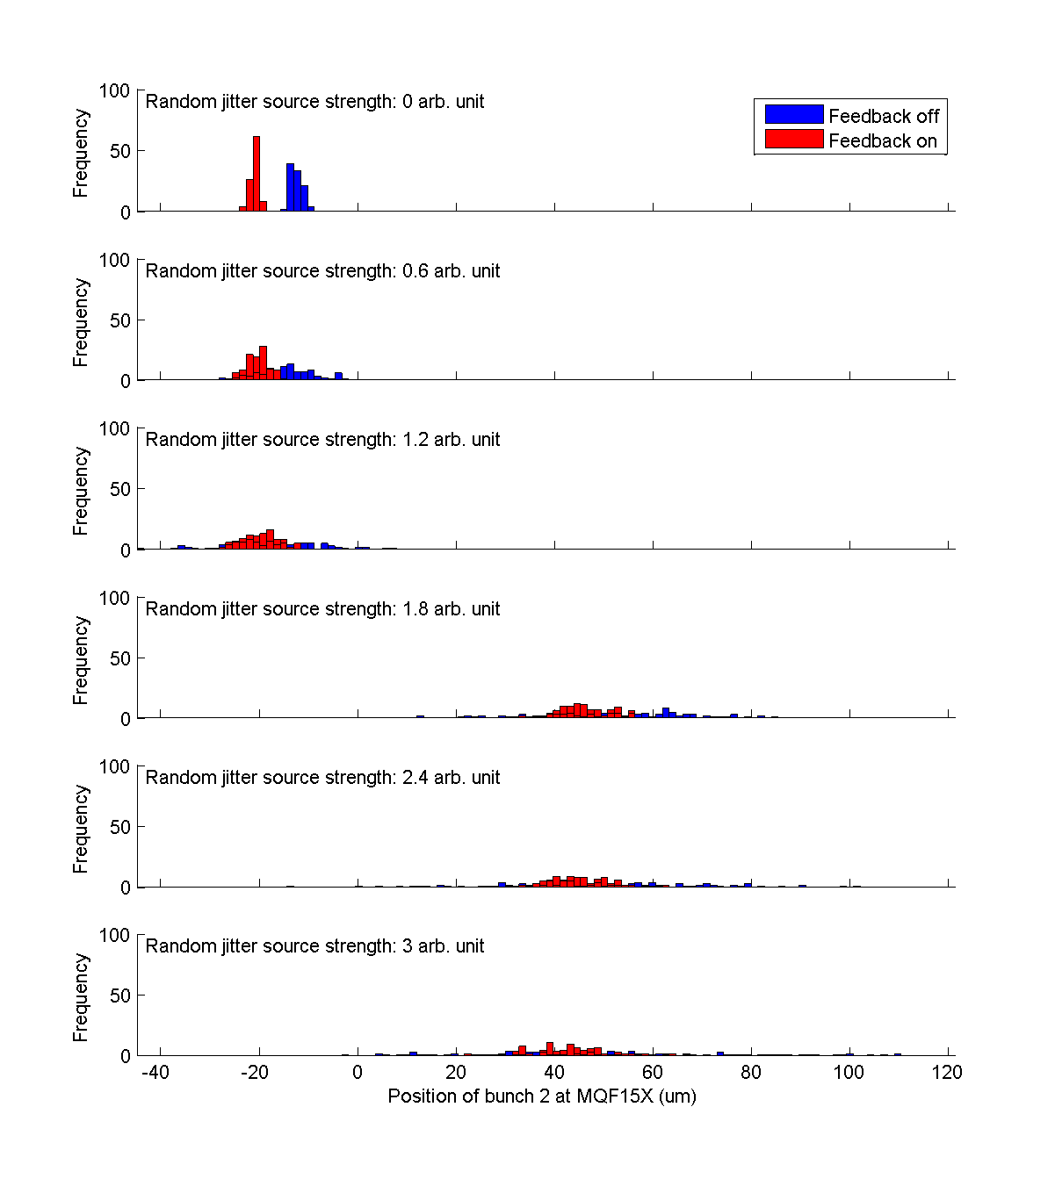
MQF15X
bunch 2
scan break
Random jitter scan
N. Blaskovic

Slide 17
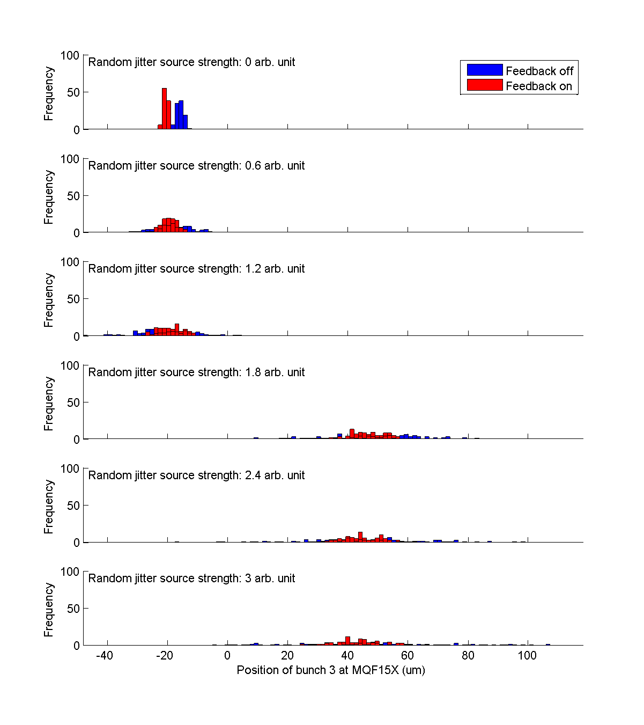
MQF15X
bunch 3
scan break
Random jitter scan
N. Blaskovic

Slide 18
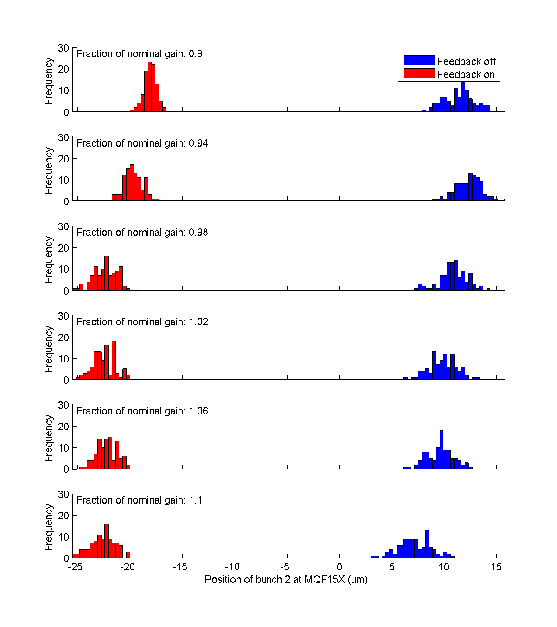
MQF15X
bunch 2
Feedback gain scan
N. Blaskovic

Slide 19
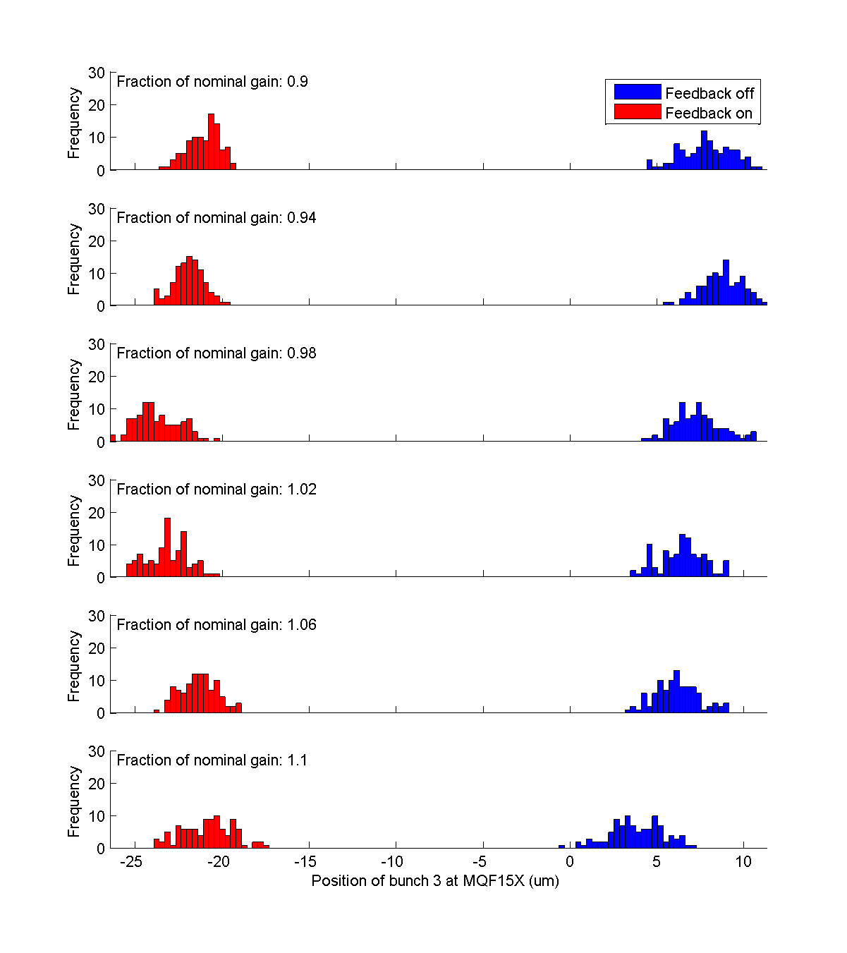
MQF15X
bunch 3
Feedback gain scan
N. Blaskovic

Slide 20
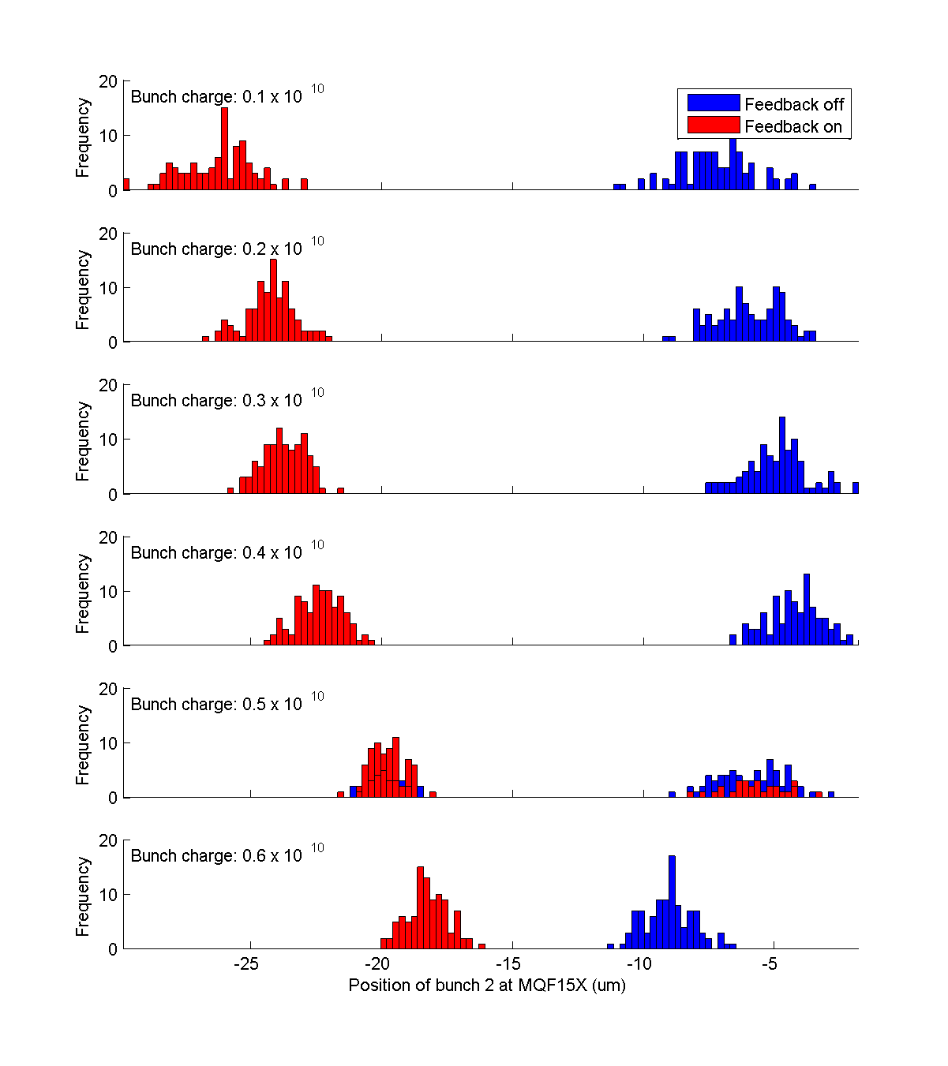
MQF15X
bunch 2
Bunch charge scan
asynchronous boards
N. Blaskovic

Slide 21
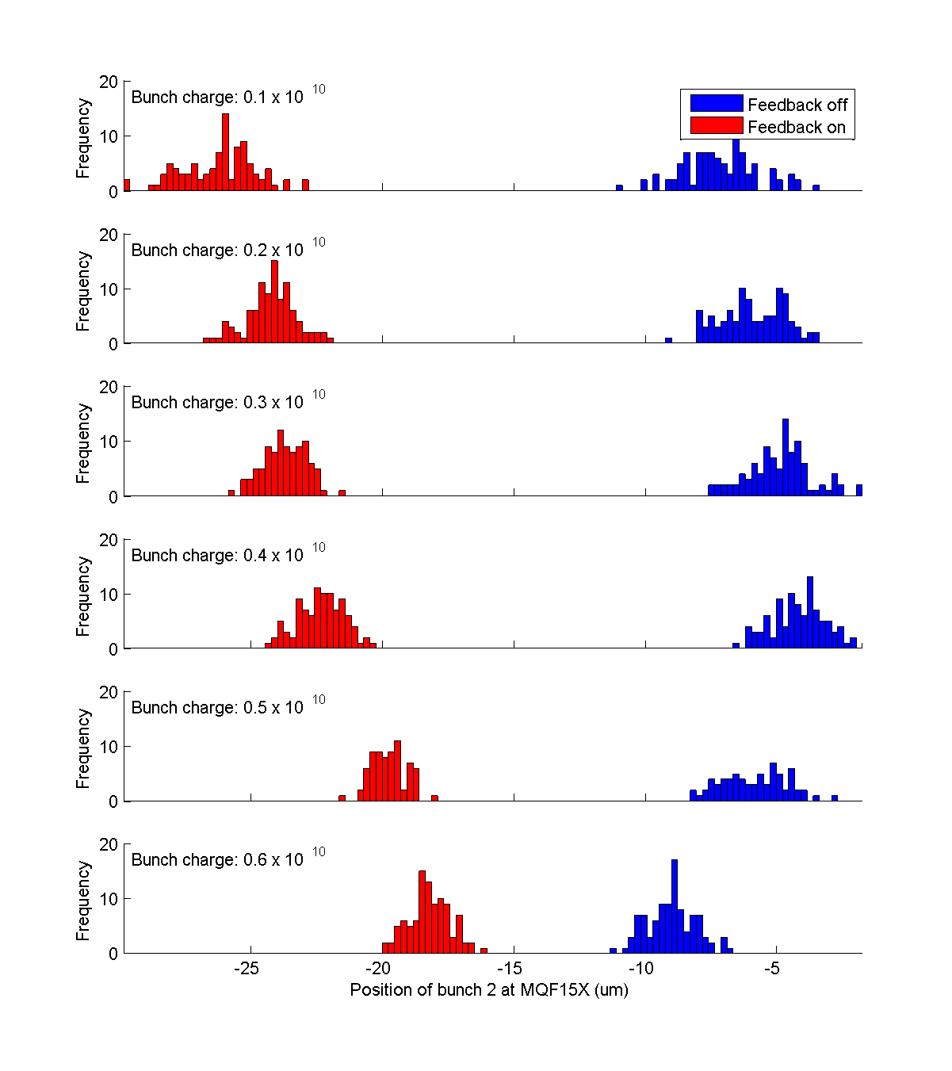
MQF15X
bunch 2
Bunch charge scan (cut on P3 & MQF15X)
N. Blaskovic

Slide 22
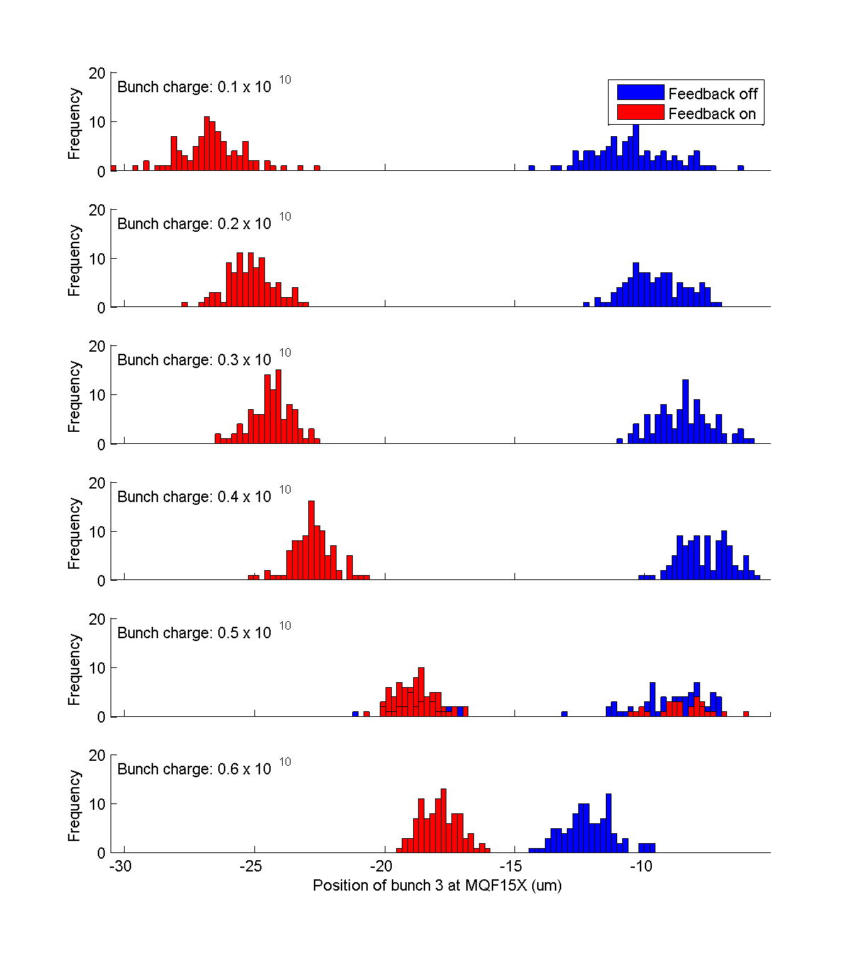
MQF15X
bunch 3
Bunch charge scan
asynchronous boards
N. Blaskovic

Slide 23
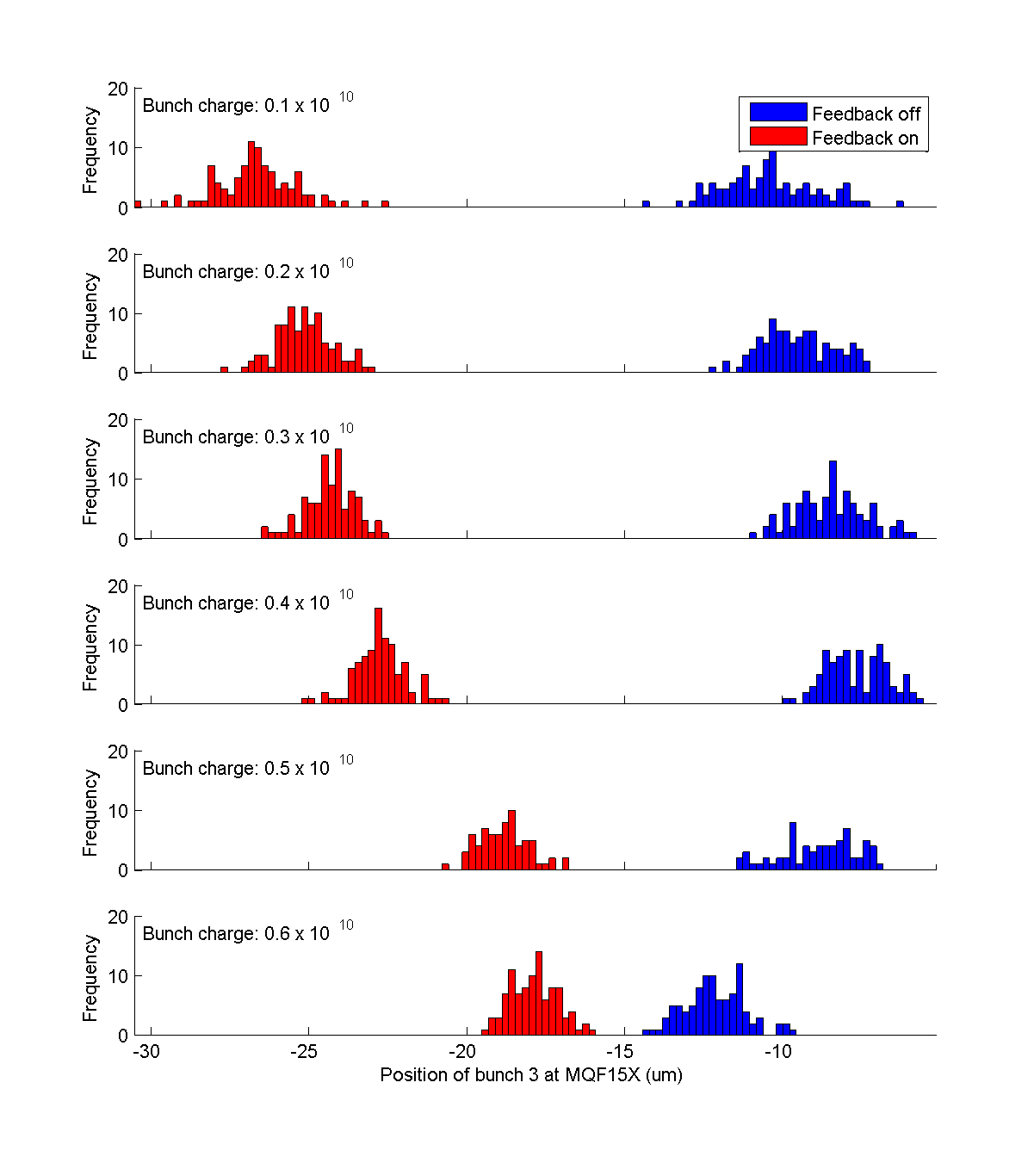
MQF15X
bunch 3
Bunch charge scan (cut on P3 & MQF15X)
N. Blaskovic

Slide 24
To do
Propagate P2 and P3 data to MQF15X to cross-check measurements at MQF15X
N. Blaskovic

