Slide 1
Propagated and measured IP y’
N. Blaskovic, T. Bromwich, P. Burrows,
G. Christian, C. Perry, R. Ramjiawan
John Adams Institute, Oxford University
N. Blaskovic

Slide 2
Introduction
IP y’ can be obtained from
  Propagating P2 & P3 positions to IP with MAD
  Measuring IPA & IPC positions in IP region
Data used from 14 June 2016
P2, P3 and IP BPM data saved by FONT5 boards (hence synchronous)
Thanks to Philip and Tauchi for suggestion
N. Blaskovic

Slide 3
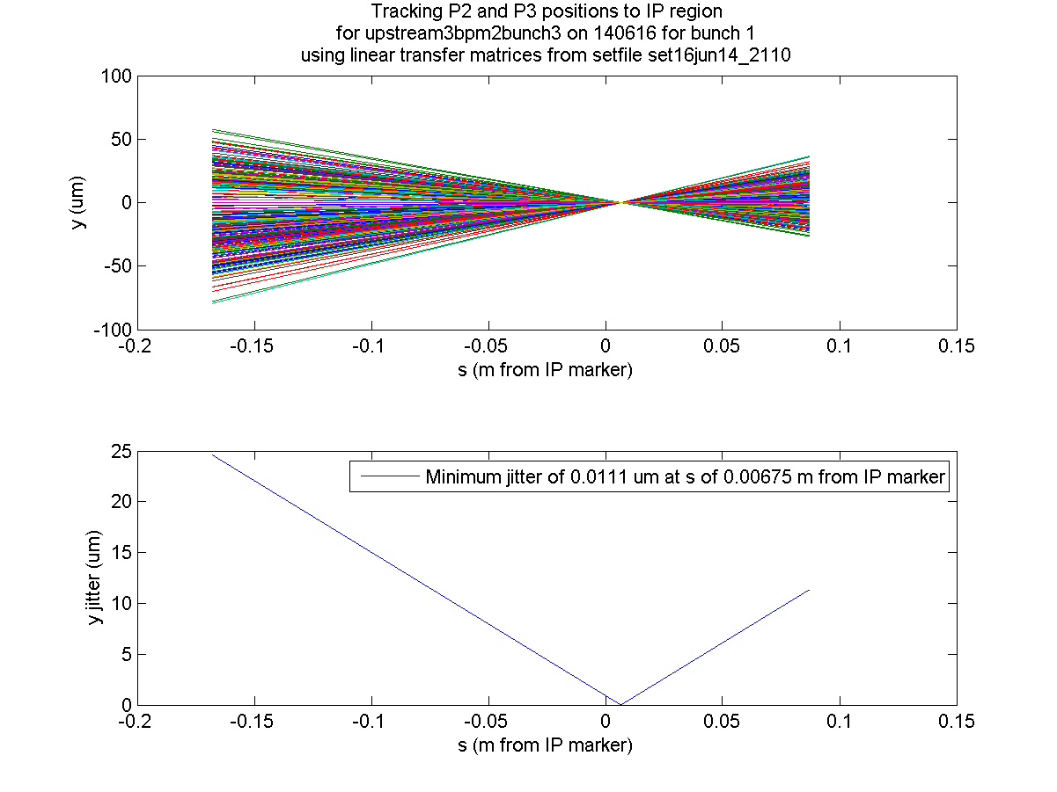
propagated
11 nm propagated
y jitter at IP
N. Blaskovic

Slide 4
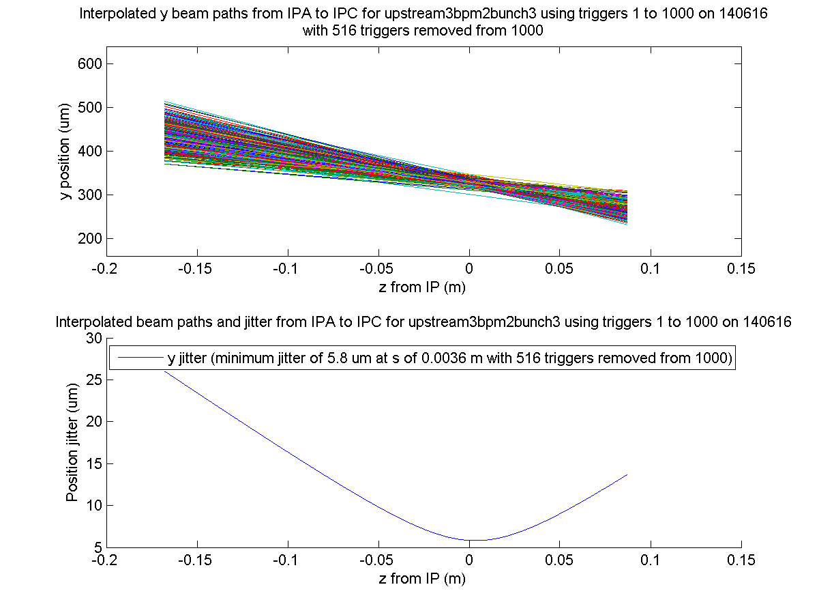
measured
Interpolated y jitter limited
by IP BPM resolution
N. Blaskovic

Slide 5
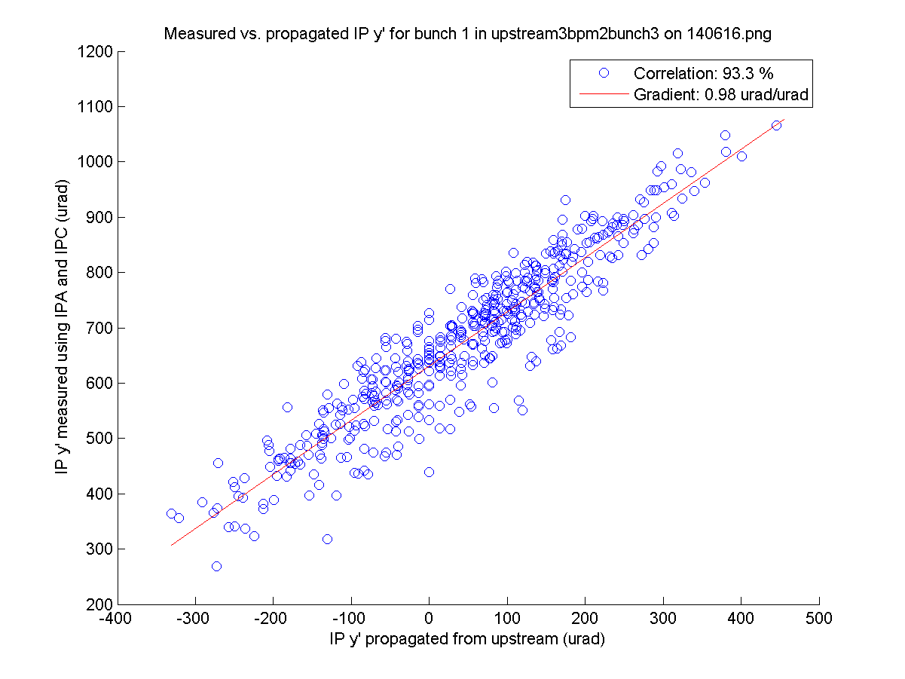
measured vs. propagated
Scale of measured
and propagated
IP y’ agree
N. Blaskovic

Slide 6
Conclusion
IP y jitter interpolation is limited by IP BPM resolution
IP y’ reconstruction is accurate and agrees with propagated results from upstream
N. Blaskovic

Slide 7
Appendix
N. Blaskovic

Slide 8
Notes on data
Data: upstream3bpm2bunch3
Calibration: AQD0FFyScan2_40dB
Date: 14 June 2016
Analysed bunch 1
  Sample 9 for IPA, IPB, IPC
  Sample 14 for Ref
N. Blaskovic

Slide 9
Resolution
Charge ~ 0.25 x 10¹⁰
Upstream BPMs:
  6 dB attenuation before Σ mixer
  no attenuation before Δ mixer
  3-BPM resolution ~ 700 nm (fitting)
IP BPMs:
  40 dB attenuation after dipole cavities
  3-BPM resolution ~ 4 um (fitting)
N. Blaskovic

